Slide 1
Application Delivery Fundamentals :
Power Plant

Slide 2
Goals
Power Plant Microservices

Slide 3
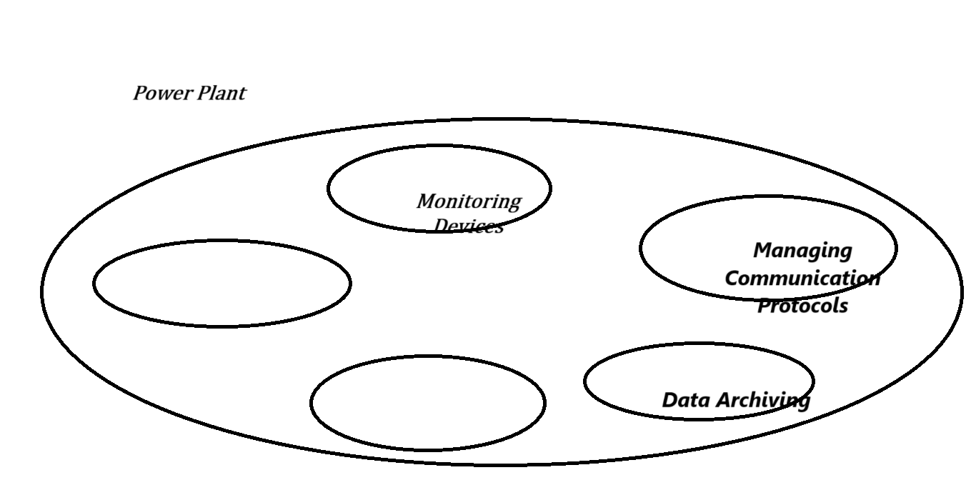
DDD ( Decomposition By Business)

Slide 4
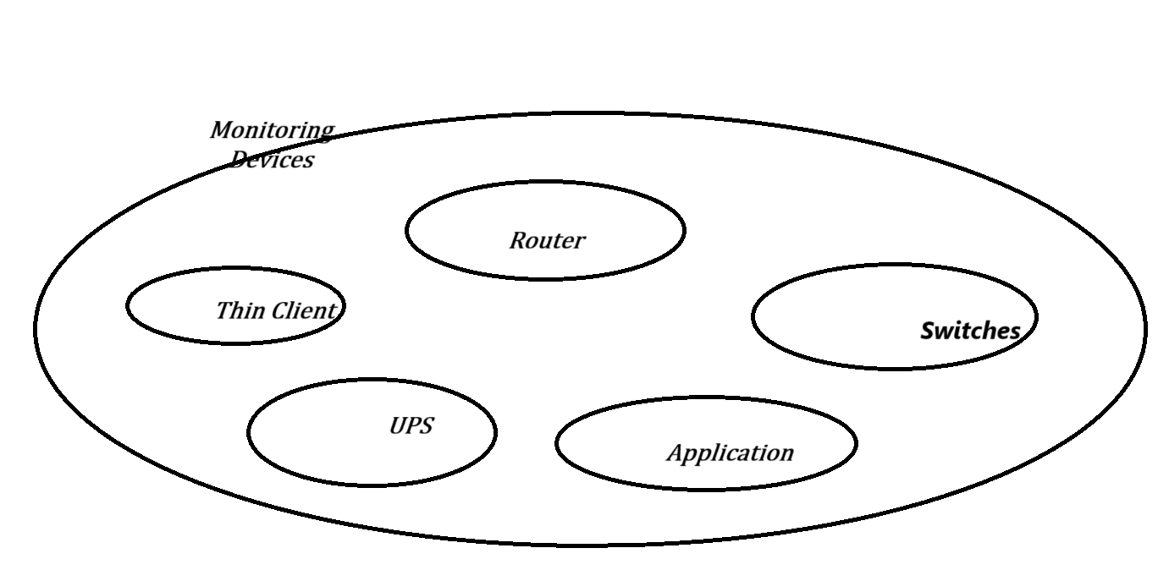
DDD ( Decomposition By Sub Domain)

Slide 5
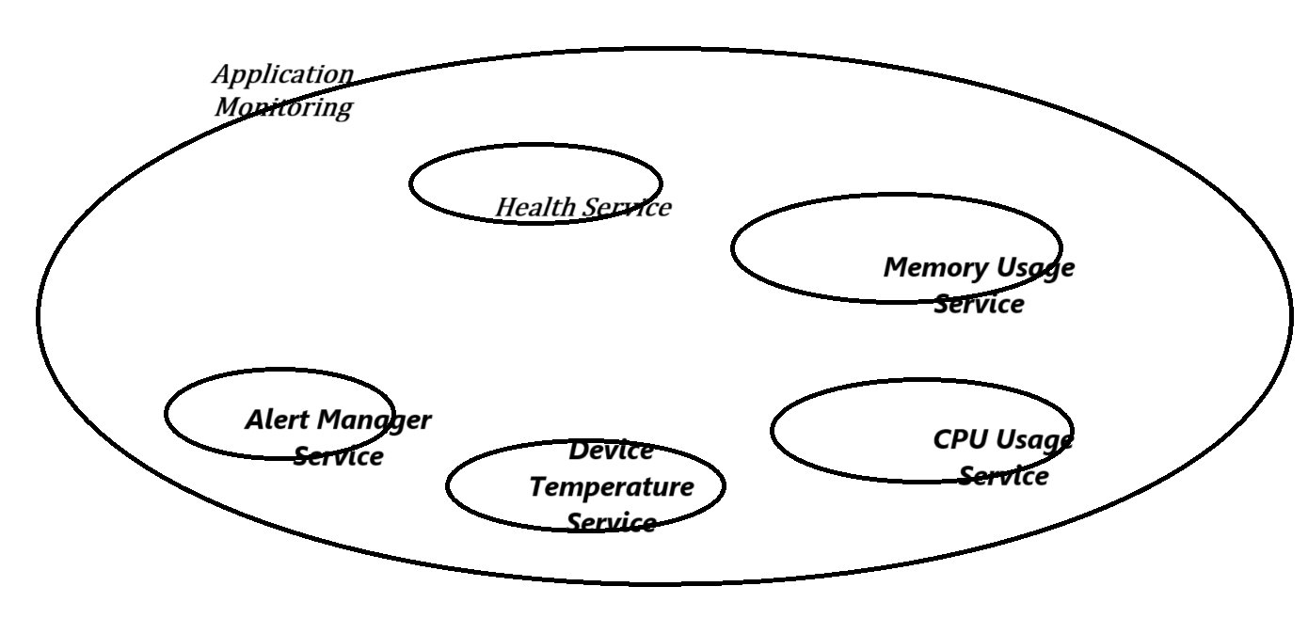
DDD ( Decomposition By Transaction)

Slide 6
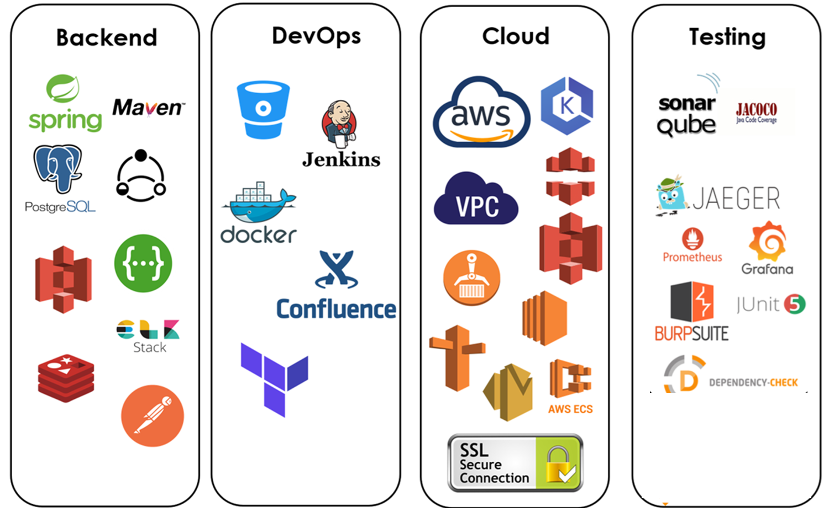
Tech Stack

Slide 7
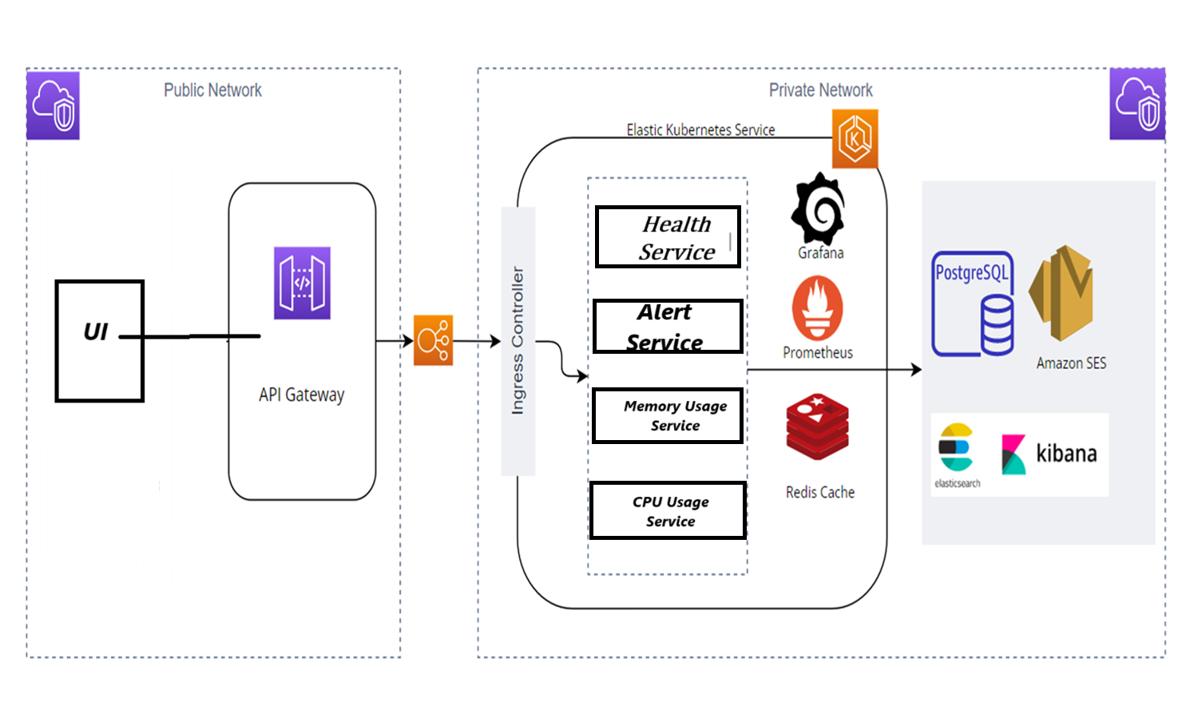
Cloud Deployment Architecture

Slide 8
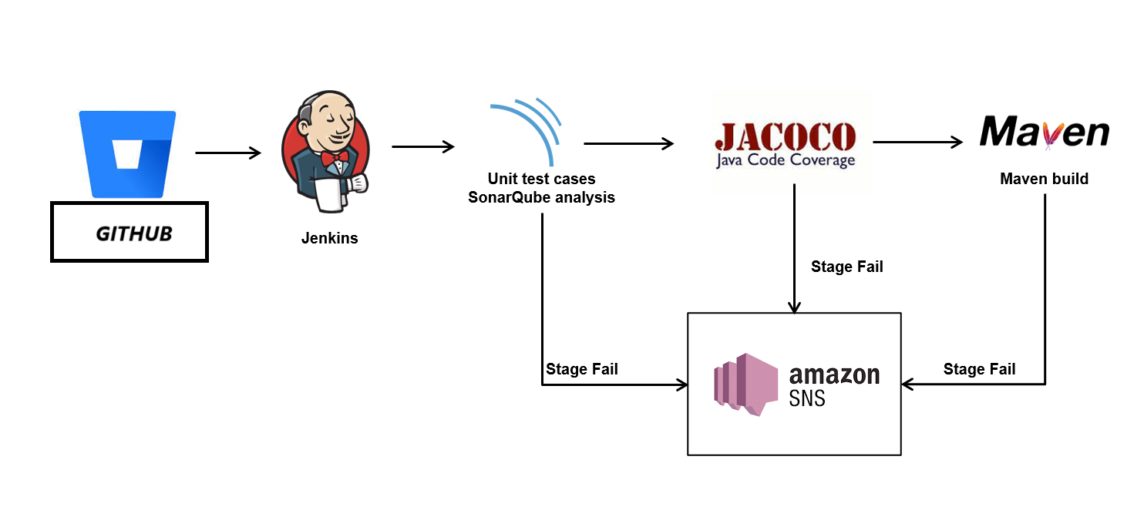
CI/CD Deployment

Slide 9
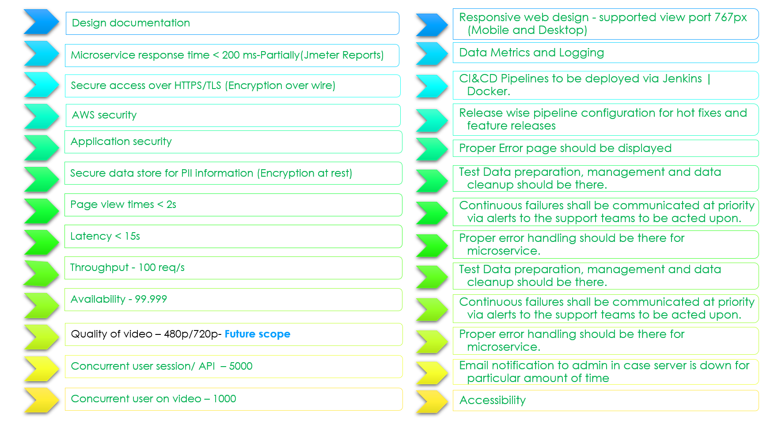
NFR and SLAs

Slide 10
Questions

Slide 11
Module Summary
DDD
Tech Stack
CI/CD Deployment
NFRS and SLAs

