Slide 1
Design Patterns

Slide 2
Origins….
Christopher Alexander, an architect, studied ways to improve the process of designing buildings and urban areas
"Each pattern is a three part rule, which expresses a relation between a certain context, a problem, and a solution.“
Christoper Alexander , The Timeless Way of Building
Reusing solutions that have worked leads to more productivity and offers other advantages of re-use such as flexibility, efficiency etc
Object oriented systems that have been well designed have been seen to have recurring patterns of classes and objects

Slide 3
Pattern and Types of patterns
A pattern is a solution to a problem in a given context. As it becomes reliable it can be followed over and over.
Conceptual Pattern
“A conceptual pattern is a pattern whose form is described by means of the terms and concepts from an application domain.”
Design Pattern
“A design pattern is a pattern whose form is described by means of software design constructs, for example objects, classes inheritance, aggregation and use-relationship.”
Programming Pattern (Programming Idiom)
“A programming pattern is a pattern whose form is described by means of programming language constructs.”
-- Dirk Riehle and Heinz Züllighoven “Understanding and Using Patterns in Software Development”

Slide 4
“GoF” Design Patterns
Design Patterns: Elements of Reusable Object-Oriented Softwaare Software by the “Gof (Gang of Four)”
Erich Gamma
Richard Helm
Ralph Johnson
John Vlissides

Slide 5
Advantages
They are reusable in multiple projects.
They provide the solutions that help to define the system architecture.
They capture the software engineering experiences.
They provide transparency to the design of an application.
They are well-proved and testified solutions since they have been built upon the knowledge and experience of expert software developers.
Design patterns don’t guarantee an absolute solution to a problem. They provide clarity to the system architecture and the possibility of building a better system.

Slide 6
When should we use the design patterns?
We must use the design patterns during the analysis and requirement phase of SDLC(Software Development Life Cycle).
Design patterns ease the analysis and requirement phase of SDLC by providing information based on prior hands-on experiences.
Categorization of design patterns:
Basically, design patterns are categorized into two parts:
Core Java (or JSE) Design Patterns.
JEE Design Patterns.

Slide 7
Core Java Design Patterns
Creational Patterns
Patterns relating to the creation of objects
Example: Singleton
Structural Patterns
Patterns relating to the structural relationship between objects
Example: Façade
Behavioral Patterns
Patterns relating to communication between objects
Example: Observer

Slide 8
Classification
Creational Patterns
Factory Pattern
Abstract Factory Pattern
Singleton Pattern
Prototype Pattern
Builder Pattern

Slide 9
Classification
Structural Design Pattern
Adapter Pattern
Bridge Pattern
Composite Pattern
Decorator Pattern
Facade Pattern
Flyweight Pattern
Proxy Pattern

Slide 10
Classification
Behavioural Design Pattern
Chain Of Responsibility Pattern
Command Pattern
Interpreter Pattern
Iterator Pattern
Mediator Pattern
Memento Pattern
Observer Pattern
State Pattern
Strategy Pattern
Template Pattern
Visitor Pattern

Slide 11
Singleton Pattern
“Ensure a class only has one instance, an provide a global point of access to it.”
According to Design Patterns: Elements of Reusable Object-Oriented Softwaare Software by the “Gof (Gang of Four)”
In other words there should be only one instance of a class accessible by multiple users or multiple parts of application
When this class is subclassed, the subclasses instances should not modify the base class code and make it NOT singleton.

Slide 12
Singleton Pattern: usage
Situation where there is only one resource like print spooler or a database engine or the object with registry settings or network connection. In such case only one instance of the resource is desired.
A stateless object that has only utility methods with parameters can also be designed as singleton.
Use in JEE :
Most servlets run as Singletons in their servlet engines

Slide 13
Tell me why?
We can get Singleton-like behavior with static fields and methods as well? Then why singleton classes?
One of the advantages of creating singleton is lazy initialization that is you can initialize only when it is first used.
In case design changes then Singleton can be easily changed to allow multiple instances without affecting other parts of the code.
In case multiple instance are desired some implementations of the Singleton, allow the subclasses to override methods such that multiple instances of subclasses can be created (something not possible with static methods)

Slide 14
Tell me why?
There are two forms of singleton design pattern
Early Instantiation: creation of instance at load time.
Lazy Instantiation: creation of instance when required.

Slide 15
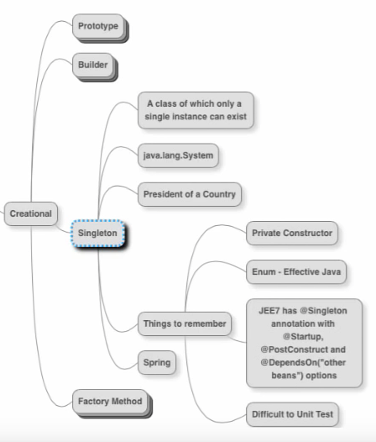
Singleton

Slide 16
Structure
Singleton
private Singleton uniqueinstance
public static Singleton getInstance
singletonOperation()

Slide 17
Code skeleton
public class Singleton {
private static uniqueinstance;
private Singleton() {
// initialize data
}
// Lazy initialization
public static synchronized Singleton getInstance() {
if (uniqueinstance ==null) {
uniqueinstance = new Singleton();
}
return uniqueinstance ;
}
// rest of the code
}
Note that this implementation does not allow Singleton to be subclassed

Slide 18
Some pitfalls of Singleton
If the singleton is allowed to be Serialized, then at some point we will end up getting 2 or more instances of singleton.
If you allow subclasses to be created then, subclasses if not coded properly may end up creating multiple instances of base class through conversion.

Slide 19
Prototype Design Pattern
Prototype Pattern says that cloning of an existing object instead of creating new one and can also be customized as per the requirement.
This pattern should be followed, if the cost of creating a new object is expensive and resource intensive.

Slide 20
Prototype Design Pattern
Advantage of Prototype Pattern
The main advantages of prototype pattern are as follows:
It reduces the need of sub-classing.
It hides complexities of creating objects.
The clients can get new objects without knowing which type of object it will be.
It lets you add or remove objects at runtime.

Slide 21
Prototype Design Pattern
Usage of Prototype Pattern
When the classes are instantiated at runtime.
When the cost of creating an object is expensive or complicated.
When you want to keep the number of classes in an application minimum.
When the client application needs to be unaware of object creation and representation.

Slide 22
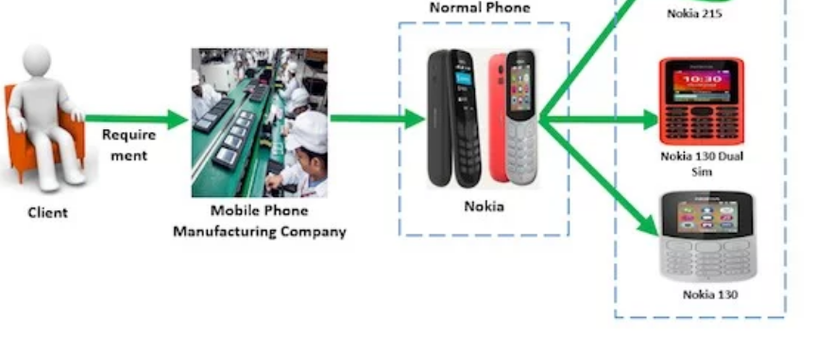
Prototype Design Pattern

Slide 23
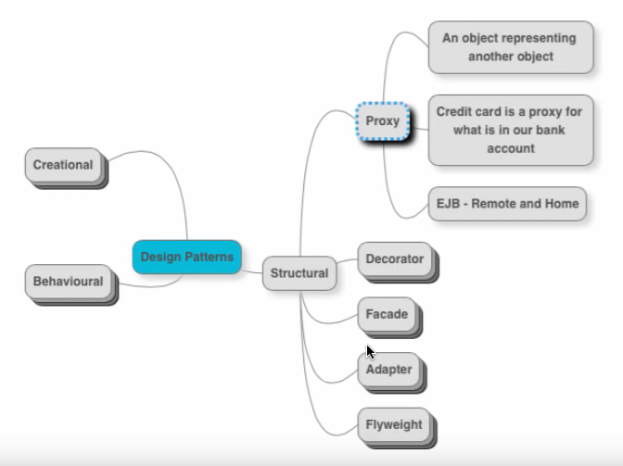
Prototype Design Pattern

Slide 24
Factory Design Pattern
A Factory Pattern or Factory Method Pattern says that just define an interface or abstract class for creating an object but let the subclasses decide which class to instantiate.
In other words, subclasses are responsible to create the instance of the class.
The Factory Method Pattern is also known as Virtual Constructor.

Slide 25
Factory Design Pattern
Advantage of Factory Design Pattern
Factory Method Pattern allows the sub-classes to choose the type of objects to create.
It promotes the loose-coupling by eliminating the need to bind application-specific classes into the code. That means the code interacts solely with the resultant interface or abstract class, so that it will work with any classes that implement that interface or that extends that abstract class.

Slide 26
Factory Design Pattern
Usage of Factory Design Pattern
When a class doesn't know what sub-classes will be required to create
When a class wants that its sub-classes specify the objects to be created.
When the parent classes choose the creation of objects to its sub-classes.

Slide 27
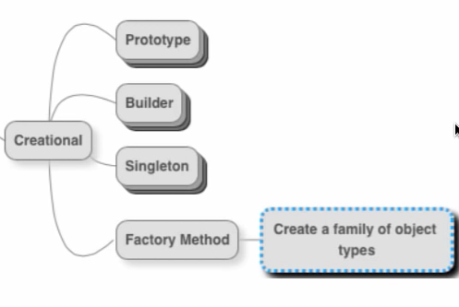
Factory Design Pattern

Slide 28
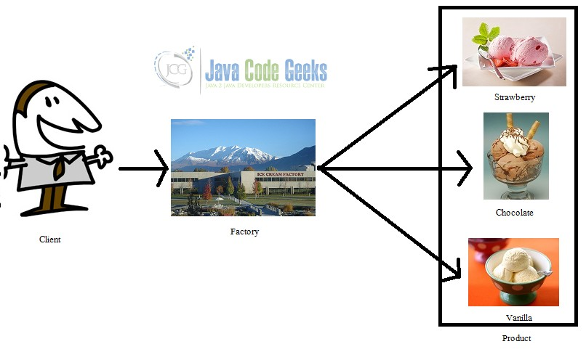
Factory Design Pattern

Slide 29
Abstract Factory Pattern
Abstract Factory Pattern says that just define an interface or abstract class for creating families of related (or dependent) objects but without specifying their concrete sub-classes.
That means Abstract Factory lets a class returns a factory of classes. So, this is the reason that Abstract Factory Pattern is one level higher than the Factory Pattern.
An Abstract Factory Pattern is also known as Kit.

Slide 30
Abstract Factory Pattern

Slide 31
Abstract Factory Pattern
Advantage of Abstract Factory Pattern
Abstract Factory Pattern isolates the client code from concrete (implementation) classes.
It eases the exchanging of object families.
It promotes consistency among objects.

Slide 32
Abstract Factory Pattern
Usage of Abstract Factory Pattern
When the system needs to be independent of how its object are created, composed, and represented.
When the family of related objects has to be used together, then this constraint needs to be enforced.
When you want to provide a library of objects that does not show implementations and only reveals interfaces.
When the system needs to be configured with one of a multiple family of objects.

Slide 33
Builder Design Pattern
Builder Pattern says that "construct a complex object from simple objects using step-by-step approach"
It is mostly used when object can't be created in single step like in the de-serialization of a complex object.
The main advantages of Builder Pattern are as follows:
It provides clear separation between the construction and representation of an object.
It provides better control over construction process.
It supports to change the internal representation of objects.

Slide 34
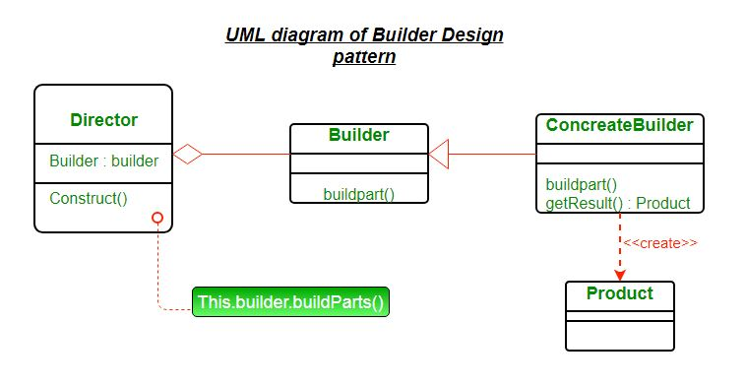
Builder Design Pattern

Slide 35
Builder Design Pattern
Product – The product class defines the type of the complex object that is to be generated by the builder pattern.
Builder – This abstract base class defines all of the steps that must be taken in order to correctly create a product.
Each step is generally abstract as the actual functionality of the builder is carried out in the concrete subclasses.
The GetProduct method is used to return the final product. The builder class is often replaced with a simple interface.

Slide 36
Builder Design Pattern
ConcreteBuilder – There may be any number of concrete builder classes inheriting from Builder. These classes contain the functionality to create a particular complex product.
Director – The director class controls the algorithm that generates the final product object. A director object is instantiated and its Construct method is called. The method includes a parameter to capture the specific concrete builder object that is to be used to generate the product.

Slide 37
Builder Design Pattern
The director then calls methods of the concrete builder in the correct order to generate the product object. On completion of the process, the GetProduct method of the builder object can be used to return the product.
Disadvantages of Builder Design Pattern
The number of lines of code increase at least to double in builder pattern, but the effort pays off in terms of design flexibility and much more readable code.
Requires creating a separate ConcreteBuilder for each different type of Product.

Slide 38
Object Pool Pattern
Mostly, performance is the key issue during the software development and the object creation, which may be a costly step.
Object Pool Pattern says that " to reuse the object that are expensive to create".
Basically, an Object pool is a container which contains a specified amount of objects. When an object is taken from the pool, it is not available in the pool until it is put back.Objects in the pool have a lifecycle: creation, validation and destroy.
A pool helps to manage available resources in a better way. There are many using examples: especially in application servers there are data source pools, thread pools etc.

Slide 39
Object Pool Pattern
Advantage of Object Pool design pattern
It boosts the performance of the application significantly.
It is most effective in a situation where the rate of initializing a class instance is high.
It manages the connections and provides a way to reuse and share them.
It can also provide the limit for the maximum number of objects that can be created.

Slide 40
Object Pool Pattern
Usage:
When an application requires objects which are expensive to create. Eg: there is a need of opening too many connections for the database then it takes too longer to create a new one and the database server will be overloaded.
When there are several clients who need the same resource at different times.

Slide 41
Bridge Pattern
The Bridge design pattern allows you to separate the abstraction from the implementation.It is a structural design pattern.
There are 2 parts in Bridge design pattern :
Abstraction
Implementation

Slide 42
Structural Pattern

Slide 43
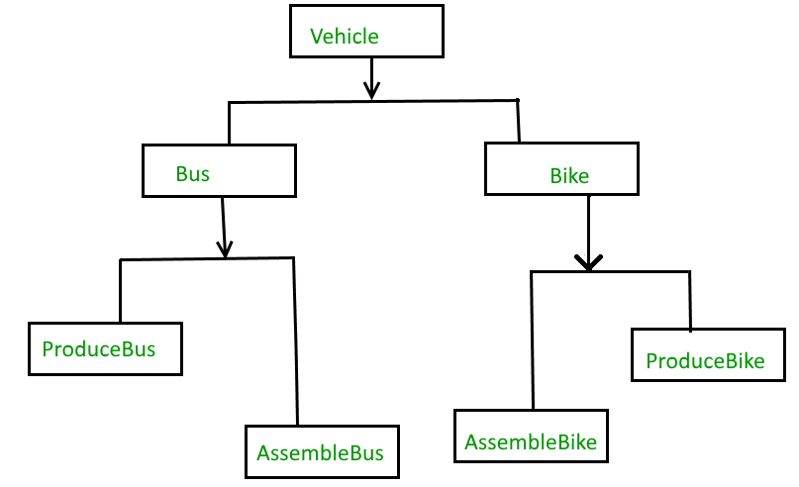
Bridge Pattern(Without Bridge)

Slide 44
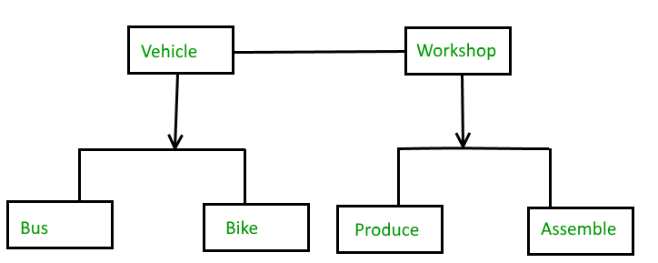
Bridge Pattern(With Bridge)

Slide 45
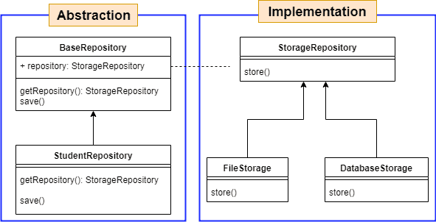
Bridge Pattern(With Bridge)

Slide 46
Bridge Pattern
Bridge pattern decouple an abstraction from its implementation so that the two can vary independently.
It is used mainly for implementing platform independence feature.
It adds one more method level redirection to achieve the objective.
Publish abstraction interface in a separate inheritance hierarchy, and put the implementation in its own inheritance hierarchy.
Use bridge pattern to run-time binding of the implementation.
Use bridge pattern to map orthogonal class hierarchies
Bridge is designed up-front to let the abstraction and the implementation vary independently.

Slide 47
Adapter Pattern
Adapter design pattern in java is a structural design pattern.
It provides solution for helping incompatible things to communicate with each other.
It works as an inter-mediator who takes output from one client and gives it to other after converting in the expected format.
Adapter pattern is also known as wrapper.

Slide 48

Adapter Pattern

Slide 49
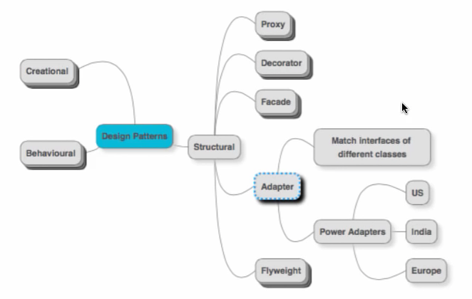
Adapter Pattern

Slide 50
Composite Design Pattern
From the name, “Composite” means the combination or made from different parts. So this pattern provides solution to operate group of objects and single object in similar way.
The two most important uses of the composite design pattern are,
Objects can be represented in a tree structure hierarchy
Composite and individual objects are treated uniformly

Slide 51
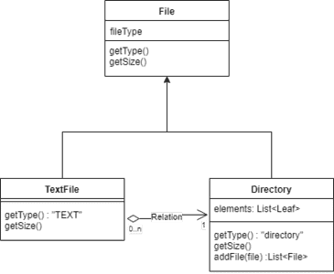
Composite Design Pattern

Slide 52
Façade Pattern
“Provide a unified interface to a set of interfaces in a subsystem. Façade defines a higher-level interface that makes the subsystem easier to use.”
Design Patterns: Elements of Reusable Object-Oriented Softwaare Software by the “Gof (Gang of Four)”
In other words, façade pattern creates a simplified view of complex sub-system system to the other sub-systems by providing an interface through which the other subsystem interact.
It helps to layer and decouple subsystems.

Slide 53
Facade Pattern: usage
Situation where a simple interface need to be provided to a complex subsystem like say Employee Management subsystem can provide an interface through which Payroll subsystem can access Employee details.
Another commonly used pattern which is a derivation of Façade pattern is Session Façade
Session Facade defines a higher-level business logic that in turn calls the lower-level business logic implemented in the business components.
Clients interact with Session Façade only and this decouples lower-level business components from one another, making designs more flexible and comprehensible
In JEE, a Session Facade is implemented as a session enterprise bean.

Slide 54
Structure
Facade
Subsystem classes

Slide 55
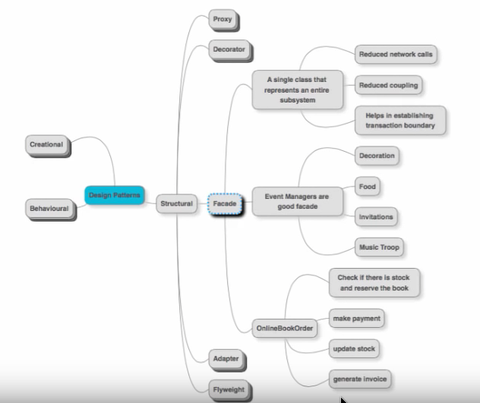
Structure

Slide 56
Code skeleton
class Payroll{
public void calculatePay(){
Employee e=getEmployee();
…
int i=e.getEmpID(); }
interface Employee { public int getEmpID();}
class IndiaEmployees implements Employee {
public int getEmpID(){ ….}
//other methods
}
class ChinaEmployees implements Employee {
public int getEmpID(){ ….}
//other methods
}

Slide 57
Observer Pattern
Define a one-to-many dependency between objects so that when one object changes state, all its dependents are notified and updated automatically.”
Design Patterns: Elements of Reusable Object-Oriented Softwaare Software by the “Gof (Gang of Four)”
Idea is for an object to notify the interested objects about the change(s) that happen in it.
Also known as Dependents / Publish-Subscribe

Slide 58
Observer Pattern: usage
When a change to one object requires changing others and we don’t know how many objects need to be changed.
When an object should be able to notify other objects without making assumptions about who these objects are. In other words, we don’t want these objects tightly coupled.
The JSE has many examples that implement this pattern
Inter-thread communication using wait(), notify() methods of Object class
AWT Event handling mechanism
SAX Parser

Slide 59
Structure
Observable
register(Observer)
unregister(Observer)
observers
Observer
notify()
for all o in observers{
o.notify()
}
subject
ConcreteObserver
notify()
state
observerState=
subject.getstate()
ConcreteObservable
getState()
setState()
state
return state

Slide 60
Explanation
The Observer is the object interested in changes that happen in Observable object.
The Observer must call register method of Observable to register itself. Observable object must maintain a list of Observer objects.
When change happens in Observer , it calls the notify() method of the Observer .
Observer then implements the required changes with respect to the change that happened in the Observable .

Slide 61
Revisiting SaxParser
import java.io.*;
import org.xml.sax.Attributes;
import javax.xml.parsers.SAXParser;
import org.xml.sax.helpers.DefaultHandler;
import javax.xml.parsers.SAXParserFactory;
public class CountSax extends DefaultHandler{
public static void main(String s[]) throws Exception{
SAXParserFactory factory=SAXParserFactory.newInstance();
SAXParser saxParser=factory.newSAXParser();
File f= new File(“persons.xml”);
if(f.exists())
saxParser.parse(f,new CountSax());
else
System.out.println("unknown file");}
Observer
Observable
register

Slide 62
static private int ele=0;
public void startDocument(){ele=0;}
public void
startElement(String uri, String localName, String qName, Attributes attrs)
{ ele++;}
public void endDocument(){
System.out.println("Number of elements :" +ele);
}
}
Many notify() type methods

Slide 63
Tell me what
Which type of design pattern does MVC belong to?
MVC does not fall into any of the 3 patterns.
Initially these 3 design patterns were introduced by GoF.
Later in another classification, architectural pattern also came up.
MVC is an architectural pattern .

Slide 64
Architectural pattern
An architectural pattern is a general, reusable solution to a commonly occurring problem in software architecture within a given context. Architectural patterns are similar to software design pattern but have a broader scope.
Layered pattern
Client-server pattern
Master-slave pattern
Pipe-filter pattern
Broker pattern
Peer-to-peer pattern
Event-bus pattern
Model-view-controller pattern
Blackboard pattern
Interpreter pattern

Slide 65
Layered Design Pattern
Presentation layer (also known as UI layer)
Application layer (also known as service layer)
Business logic layer (also known as domain layer)
Data access layer (also known as persistence layer)

Slide 66
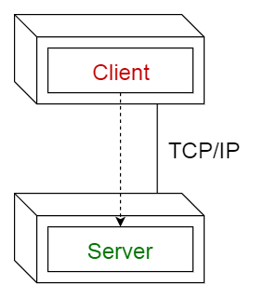
Client-server pattern
This pattern consists of two parties; a server and multiple clients. The server component will provide services to multiple client components.
Clients request services from the server and the server provides relevant services to those clients. Furthermore, the server continues to listen to client requests.

Slide 67
Master-slave pattern
This pattern consists of two parties; master and slaves.
The master component distributes the work among identical slave components, and computes a final result from the results which the slaves return.
Usage
In database replication, the master database is regarded as the authoritative source, and the slave databases are synchronized to it.
Peripherals connected to a bus in a computer system (master and slave drives).

Slide 68
Pipe-filter pattern
This pattern can be used to structure systems which produce and process a stream of data.
Each processing step is enclosed within a filter component. Data to be processed is passed through pipes.
These pipes can be used for buffering or for synchronization purposes.
Usage
Compilers. The consecutive filters perform lexical analysis, parsing, semantic analysis, and code generation.
Workflows in bioinformatics.

Slide 69
Broker pattern
This pattern is used to structure distributed systems with decoupled components. These components can interact with each other by remote service invocations.
A broker component is responsible for the coordination of communication among components.
Servers publish their capabilities (services and characteristics) to a broker. Clients request a service from the broker, and the broker then redirects the client to a suitable service from its registry.
Usage
Message broker software such as Apache ActiveMQ, Apache Kafka, RabbitMQ and JBoss Messaging.

Slide 70
Peer-to-peer pattern
In this pattern, individual components are known as peers. Peers may function both as a client, requesting services from other peers, and as a server, providing services to other peers. A peer may act as a client or as a server or as both, and it can change its role dynamically with time.
Usage
File-sharing networks such as Gnutella and G2)
Multimedia protocols such as P2PTV and PDTP.

Slide 71
Event-bus pattern
This pattern primarily deals with events and has 4 major components; event source, event listener, channel and event bus. Sources publish messages to particular channels on an event bus. Listeners subscribe to particular channels. Listeners are notified of messages that are published to a channel to which they have subscribed before.
Usage
Android development
Notification services

Slide 72
Model-view-controller pattern
This pattern, also known as MVC pattern, divides an interactive application in to 3 parts as,
model — contains the core functionality and data
view — displays the information to the user (more than one view may be defined)
controller — handles the input from the user

Slide 73
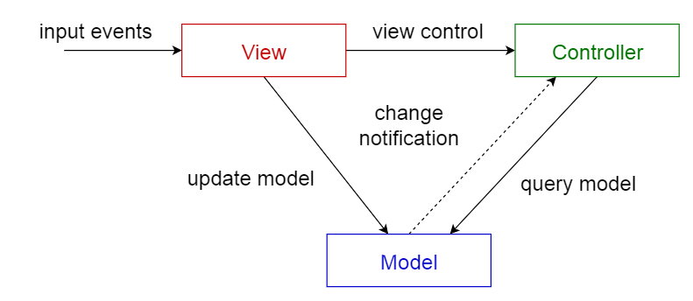
Model-view-controller pattern

Slide 74
Blackboard pattern
This pattern is useful for problems for which no deterministic solution strategies are known. The blackboard pattern consists of 3 main components.
blackboard — a structured global memory containing objects from the solution space
knowledge source — specialized modules with their own representation
control component — selects, configures and executes modules.

Slide 75
Blackboard pattern
All the components have access to the blackboard. Components may produce new data objects that are added to the blackboard. Components look for particular kinds of data on the blackboard, and may find these by pattern matching with the existing knowledge source.
Usage
Speech recognition
Vehicle identification and tracking
Protein structure identification
Sonar signals interpretation.

Slide 76
Interpreter pattern
This pattern is used for designing a component that interprets programs written in a dedicated language. It mainly specifies how to evaluate lines of programs, known as sentences or expressions written in a particular language. The basic idea is to have a class for each symbol of the language.
Usage
Database query languages such as SQL.
Languages used to describe communication protocols.

Slide 77
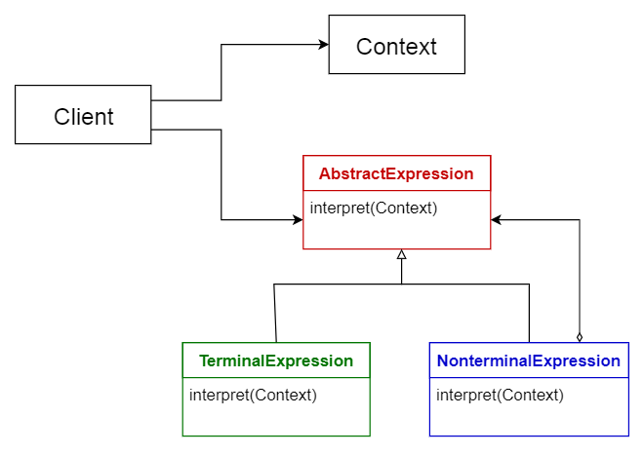
Interpreter pattern

Slide 78
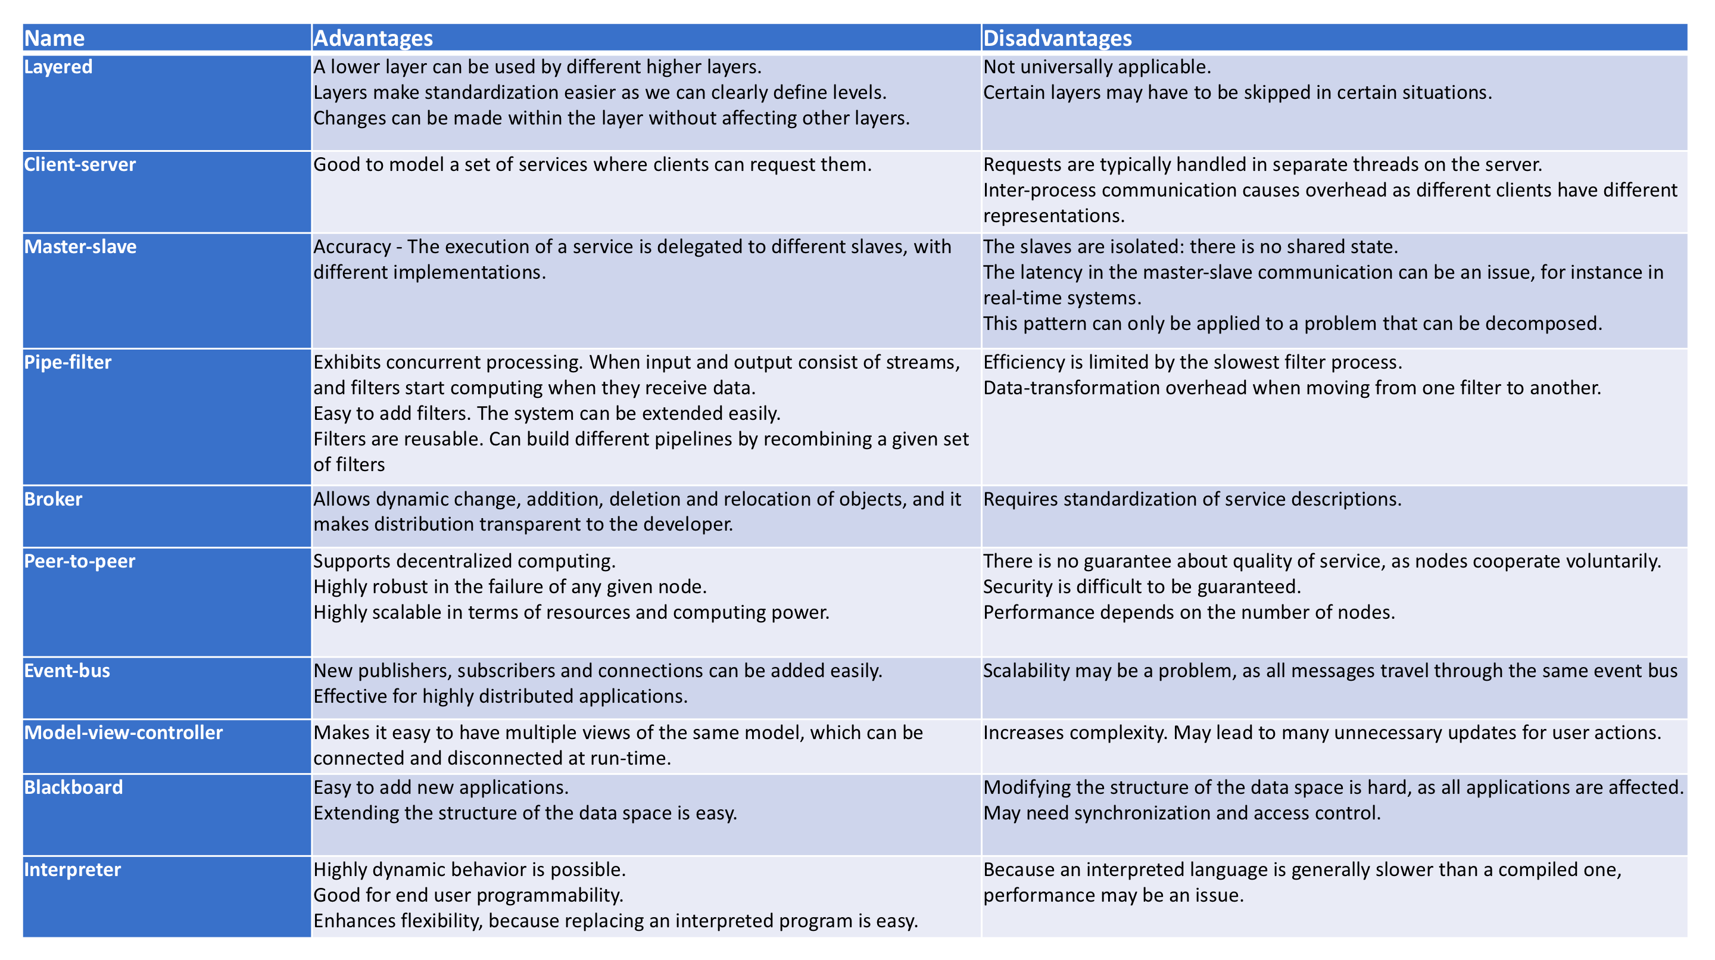
Comparison of Architectural Patterns

Slide 79
Comparison of Architectural Patterns

