Slide 1
Introduction to JEE

Slide 2
What is an enterprise application?
Software that performs business functions such as accounting, customer information management, sales and so on
Aims to improve the organization's performance
Software application for the enterprises of today…and tomorrow…
Need for rapid scalability (both in terms of volume and geographical spread)
Need to accommodate multiple types of device access
Need to integrate with diverse software applications
Need to be very change-friendly
High degree of security reliability and performance

Slide 3
Enterprise application n-tier architecture
Browser
firewall
Application Client
Services
Presentation logic
Business Logic
XML
documents
DB

Slide 4
What is a web application?
Client accesses applications using a browser.
Client typically requests for a static or dynamic resource/page from a server connected to the internet. This server is a web server.
The client typically gets back HTML page as response that can view in the browser. Further interaction with the server can happen using the HTML page.

Slide 5
Static and Dynamic resource/page
Static pages/resources are the files that are pre-created in a particular path in the web server.
Dynamic pages are created by the application on the fly.

Slide 6
Web server
Request for a static resources is met by the web server.
The web server understands HTTP protocol.
Example: Apache web server.
Notes:
Sometimes people refer to an application server as web server which is acceptable now a days.

Slide 7
Application server
Application server is an environment where applications can reside and run.
The definition extended to support web applications as well.
A web server which can run web application is an application server. In other words, web server is embedded in application server. For instance , Apache web server is embedded in most of the popular application server’s of today like Tomcat, Jboss.
JEE (Java Platform, Enterprise Edition ) application servers support Java based applications and provides API and supporting services.
Request for a dynamic resource is met by application server.
Notes:
Sometimes people refer to an application server as web server which is acceptable now a days.

Slide 8
JEE Application server
Apache Tomcat Web Server
Jboss Application server
Websphere Application Server from IBM
Oracle WebLogic Server.
We will be using Apache Tomcat Web Server 7.0 for our sessions.

Slide 9
HTTP Protocol
HTTP is an application level protocol ( generally implemented over TCP/IP) used to transfer information between the web clients and web applications.
It provides a set of rules that computers use to communicate over the internet.
Communication is done by sending packets.
The packet structure should be is defined by the protocol.
Packets are request and response packet.
HTTP 1.1 is stateless implies that after one cycle of request-response the connection between the client and the web server is lost.

Slide 10


HTTP and Statelessness
opening connection to the requested URL
Request
Response
Client
closing connection to the requested URL
Web Server

Slide 11
HTTP Methods
GET
POST
OPTIONS
HEAD
PUT
DELETE
TRACE
CONNECT
Our focus!

Slide 12
The GET request method
Used for accessing static resources such as HTML pages or images.
Example: requesting for a page www.yahoo.com
Can also be used to retrieve information that is formed dynamically ( example: page generated by the application in a response to a specific user query).
Form tag assumes GET method when method attribute is not specified.
Example: www.mySite.com/index.do?city=Bangalore
The convention has been established that the GET (and HEAD methods) SHOULD NOT have the significance of taking an action other than retrieval. These methods ought to be considered "safe".

Slide 13
A sample GET Packet
GET /mywebdir/index.do?city=Bangalore HTTP/1.1
Host:www.mySite.com
User-Agent:Mozilla/5.0…
Accept: text/xml,application/xml, text/html, image/gif
Accept-Language: en-us
Accept-Encoding: gzip, deflate
Keep-Alive: 300
Connection: keep-alive
Request Header
Request Body

Slide 14
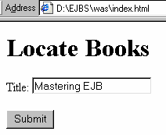
<html>
<head>
<title>Book list</title>
</head>
<body>
<h1>Locate Books</h1>
<form name=“findBook" method=“get" action="FindBook">
Title:
<input name="title" type="text"><br><br>
<input type="submit" name="Submit" value="Submit">
</form>
</body>
</html>
optional
Query String
Request goes to the application as:
http://myWeb/FindBook?title=“Mastering%20EJB”
URL: Uniform Resource Locator

Slide 15
The POST Request
This method is used to send large amount of data to the server.
It is commonly used for accessing dynamic resources.
Data is sent within the body of the request.
If data such as password is transmitted, the post method is preferred.
According to W3C, POST is designed to allow a uniform method to cover the following functions:
-Annotation of existing resources; -
Posting a message to a bulletin board, newsgroup, mailing list, or similar group of articles; -
Providing a block of data, such as the result of submitting a form, to a data-handling process; -
Extending a database through an append operation.

Slide 16
A sample POST Packet
POST /mywebdir/index.do HTTP/1.1
Host:www.mySite.com
User-Agent:Mozilla/5.0…
Accept: text/xml,application/xml, text/html, image/gif
Accept-Language: en-us
Accept-Encoding: gzip, deflate
Keep-Alive: 300
Connection: keep-alive
Request Header
city=Bangalore&state=Karnataka
Request Body

Slide 17
A sample response packet
Status code which indicates successful request acceptance
HTTP/1.1 200 OK
Set-Cookie:JSESSIONID=7277272818;Path=/xyz
Content-Type: text/html
Content-Length:230
Date: Sun, 1 Apr 2007 13:45:30 GMT
Server: Apache Server/1.1
Connection:close
Response Header
<html>
…
</html>
Response Body

Slide 18
Status codes
Status Code | Type | Description
1XX | Information | Request received, continuing to process
2XX | Success | The was successfully received and accepted
3XX | Redirection | Further action must be in order to complete the request
4XX | Client Error | Request cannot be fulfilled because of error in client side
5XX | Server Error | Request cannot be fulfilled because of error in server side

Slide 19
Status 2xx
GET Request for a resource
Response packet
HTTP/1.1 200 OK
…
<html>
…</html
header
Client
Server
body
HTTP status code 2xx indicating the requested resource is available.

Slide 20
Status 3xx
HTTP status code 3xx indicating the redirect
Server
Request for a resource
Response packet
HTTP/1.1 307 Temporary Redirect
…
Client
Request for a resource
PondServer

Slide 21
Status 4xx
GET Request for a resource
Response packet
HTTP/1.1 404 NOT FOUND
…
header
Client
Server
body
HTTP status code 4xx indicating the requested resource is not available.

Slide 22
Status 5xx
Http Method not defined!
POST Request for a resource
Response packet
HTTP/1.1 500 Internal Server Error
…
Client
Server
HTTP status code 5xx server error. In this case the request is made for the method not defined in the servlet.

Slide 23
Java Platform, Enterprise Edition
Java Platform, Enterprise Edition (Java EE) 6 is the industry standard for enterprise Java computing.
It is a powerful collection of technologies that sit on top of Java Standard Edition (JSE) environment.
It provides cross-platform compatibility for both application and application server.
The JEE architecture is managed by Sun Microsystems with the help and support of many active industry partners.
JEE technology is used to build used to build enterprise application in Java.

Slide 24
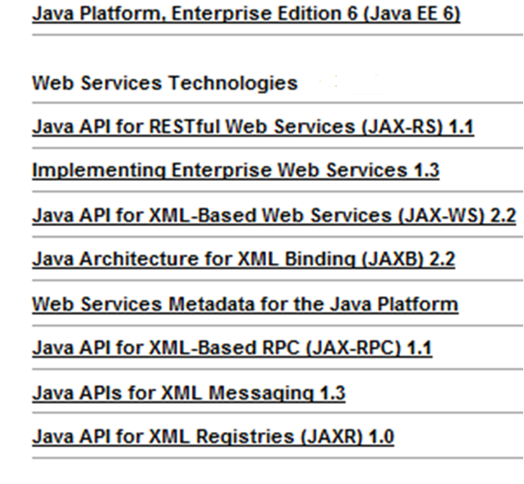
Java EE 6 Technologies
We will do this

Slide 25
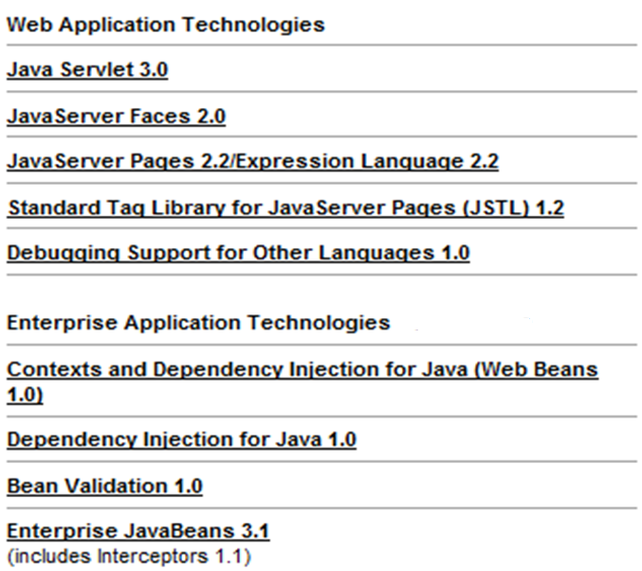
We will do these

Slide 26
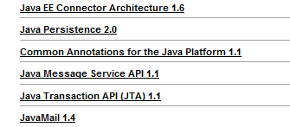

Slide 27
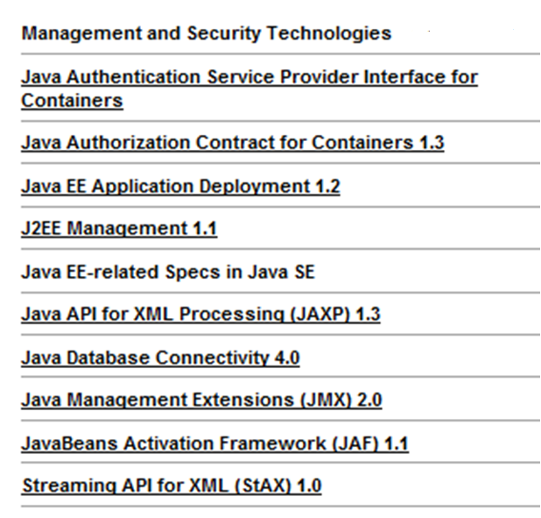
We will do these
Can you identify the technologies we already covered in this list?

Slide 28


JEE Architecture
JSE application
Client Tier
Web client
JEE Server
JSP
Web Tier
EJBs
Business Tier
Databases
EISTier
XML
Multi-tiered Applications

Slide 29
JEE Container Services
Security
Allows easy configuration of secure features for a web component or enterprise bean so that they are accessed only by authorized users.
Transaction
Transaction model lets allows to configure features for a group of methods which form a single transaction.
JNDI lookup services
common way to look up to application components and other services
Remote connectivity model
Allows clients to communicate to remote enterprise beans as if it were in the same virtual machine.

Slide 30
Java web applications
Java web applications are made up of JavaServer Pages (JSPs), Servlets and static resources such as HTML pages, images etc
The Web container is used to host these web components.
We will start with Servlets

