Slide 1
Communication

Slide 2
Redirect: Servlet- browser communication
Sometime the resource requested may be moved to another server either temporarily or permanently. In such case, we may want to send back a message to browser to redirect the page to another location.
HttpServletResponse method
void sendRedirect(java.lang.String location) throws java.io.IOException
This method sends a temporary redirect response to client with status code 3xx. Location specifies the URL page to which the redirection is going to be.
Usage: response.sendRedirect(“http://localhost:8080/direct/s?name=‘Potter’”)

Slide 3


Status 3xx
public void doGet(){
response.sendRedirect(“http://pondser/app2);
…
}
Request for servlet S1
S1
Response packet
HTTP/1.1 302
…
Server
Client
Request for http://pondser/app2
PondServer
Status code (302) indicating that the resource reside temporarily under a different URI

Slide 4
More on sendRedirect
If the response has already been committed, sendRedirect() method throws an IllegalStateException
The URL can be relative . The servlet container converts the relative URL to an absolute URL before sending the response to the client.

Slide 5
Sending Error: Servlet- browser communication
HttpServletResponse method
void sendError(int sc,String msg) throws IOException
void sendError(int sc) throws IOException
is used to send an error response to the client using the specified status code represented by int sc and and clearing the buffer
For sc static constant defined in this class that represents the HTTP response Status code is used.
The first method allows sending a descriptive message as well.
Example: response.sendError(response.SC_NOT_FOUND, "No recognized search engine specified.");
The advantage of sendError over setStatus is that, with sendError, the server automatically generates an error page showing the error message.

Slide 6
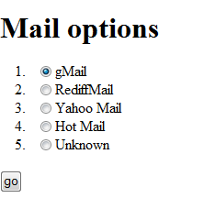
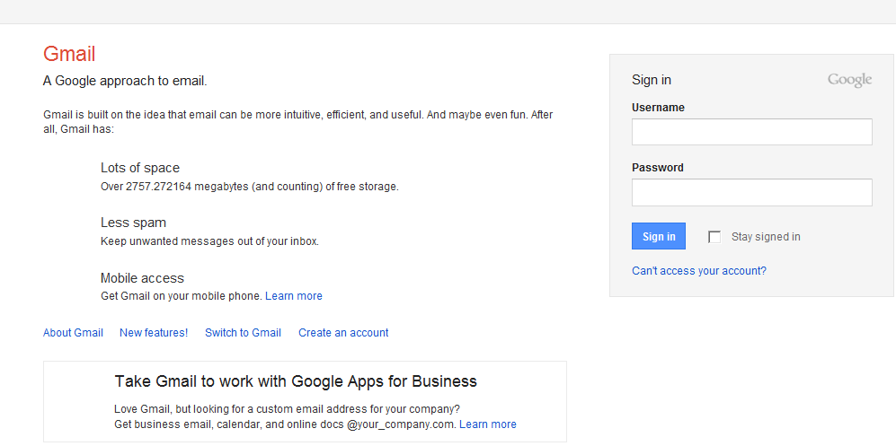
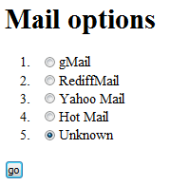
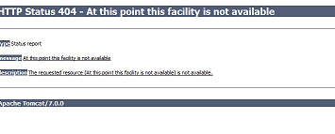
Example: sendRedirect() and sendError()
HTML page displays email options of which one is unknown
If unknown option is an 404 error page is displayed.

Slide 7
<html><head>
<title>Mail</title>
</head><body>
<h1>Mail options</h1>
<form action="GoMailServlet">
<ol>
<li><input type="radio" name="mail" value="http://www.gmail.com">gMail
<li><input type="radio" name="mail" value="http://www.rediffmail.com">RediffMail
<li><input type="radio" name="mail" value="http://www.yahoo.com">Yahoo Mail
<li><input type="radio" name="mail" value="http://www.hotmail.com">Hot Mail
<li><input type="radio" name="mail" value="unknown">Unknown
</ol>
<input type=submit value="go">
</form></body></html>
index.html

Slide 8
@WebServlet("/GoMailServlet")
public class GoMailServlet extends HttpServlet {
protected void doGet(HttpServletRequest request, HttpServletResponse response) throws ServletException, IOException {
String mail=request.getParameter("mail");
if (mail.equals("unknown") ) response.sendError(response.SC_NOT_FOUND,"At this point this facility is not available");
else response.sendRedirect(mail);
}
}

Slide 9
Inter- servlet communication
Many times it becomes useful for a servlet to partly process the request and then to pass on the request to another servlet for further processing.
Two servlets (or JSPs) can communicate with each other using a RequestDispatcher object.
The servlet container creates the RequestDispatcher object,.
This object can be obtained from ServletContext using methods:
RequestDispatcher getRequestDispatcher(java.lang.String path)
RequestDispatcher getNamedDispatcher(java.lang.String name)
The first method is provided by Servlet Request also.
These methods return a RequestDispatcher object that acts as a wrapper for the resource located at the given path (url pattern) or servlet name.

Slide 10
Different getRequestDispatcher()
RequestDispatcher getRequestDispatcher(java.lang.String path)
The path must be relative to the root of the application when this method when used using ServletContext .
Relative path with respect to the servlet can be used with when this method when used using Servlet Request .

Slide 11
Tell me what
RequestDispatcher getNamedDispatcher(java.lang.String name)
This method uses servlet name to get RequestDispatcher ? What is servlet name? Is the servlet name same as servlet class name?
Servlet name is not same as servlet class name. This name is usually used for configuration information by the server and is provided to decouple the class name from name that can be used for configuration.
Servlet name can be provided in two ways :
Through annotation:
@WebServlet(name="MySer",urlPatterns= {"/my"})
Though web.xml:
<web-app>
<servlet>
<servlet-name>Register</servlet-name>
<servlet-class>Register</servlet-class>
</servlet> …</web-app>

Slide 12
javax.servlet.RequestDispatcher
This interface receives requests from the client and sends them to any resource (such as a servlet, HTML file, or JSP file) on the server.
There are two ways in which the communicate can happen based on where the control is finally going to be.
These are the only 2 methods that this interface declares. Note that the 2 request and response objects are also passed.
forward:
controls goes to the forwarded servlet
void forward(ServletRequest request, ServletResponse response)
include:
control comes back to the original servlet
void include(ServletRequest request, ServletResponse response)

Slide 13
forward
request
response
GET Request for servlet S1
S1
forward
S2
Calls doGet() method of S2.
If the request was for POST, then
doPost() of S2 gets called.
Control finally is in S2. Response is generated by S2

Slide 14
include
request
response
GET Request for servlet S1
S1
include
S2
Calls doGet() method of S2.
If the request was for POST, then
doPost() of S2 gets called.
Control finally is in S1. Response is generated by S1

Slide 15
Test your understanding
Servlets are java classes. A java class method can call another java class method. Then why do you need to RequestDispatcher?

Slide 16
Request Attributes
Request and Response objects are shared between the servlets when they communicate. Needless to say that form parameters etc. will be accessible by both the servlets.
In addition to this, request object can be used to send additional data to the a servlet or a JSP while forwarding (or including).
HttpSessionRequest methods that allow this:
Object getAttribute(String name)
void setAttribute(String name , Object obj)
void removeAttribute(String name)

Slide 17
Example: using forward and include
Scenario:
A HTML form is displayed where user enters some data.
On submitting this form, a servlet is invoked that checks for the validity of data.
If the data is invalid, the same form is displayed with an error message → using include
Otherwise another servlet is invoked that displays a friendly message→ using forward

Slide 18
1. HTML form
<html><head><title>Register</title></head>
<body>
<h2>Register</h2>
<table border=1><tr><td>
<form method=post action=“Register">
First Name:<input type=text name=“fname”>
Last Name:<input type=text name=“lname”>
<input type=submit></form></td></tr> </table>
</body>
</html>

Slide 19
2. Register Servlet
// assume imports
public class Register extends HttpServlet {
@WebServlet("/Register")
..
protected void doPost(HttpServletRequest request, HttpServletResponse response) throws ServletException, IOException {
String fname=request.getParameter(“fname");
String lname=request.getParameter(“lname");
if( (fname!=null && fname.trim().length()!=0) && (lname!=null && lname.trim().length()!=0))
request.getRequestDispatcher(“Success").forward(request,response);

Slide 20
else{
request.setAttribute("error",“first name or last name not entered");
getServletContext().getNamedDispatcher("error").include(request,response);
request.getRequestDispatcher("index.html").include(request,response);
}
}

Slide 21
3. Success Servlet
//assume imports
@WebServlet("/Success")
public class Success extends HttpServlet {
protected void doPost(HttpServletRequest request,
HttpServletResponse response) throws
ServletException, IOException {
response.setContentType("text/html");
PrintWriter out = response.getWriter();
out.println("<html><head><title>Success</title>");
out.println("<head><body>");
out.println("Thanks <I> "+request.getParameter("fname")+"</I>" );
out.println("</body></html>");}
…}

Slide 22
4. Error Servlet
//assume imports
@WebServlet(name = "error", urlPatterns ="/Error")
public class Error extends HttpServlet {
…
protected void doPost(HttpServletRequest request, HttpServletResponse response) throws ServletException, IOException {
PrintWriter out = response.getWriter();
response.setContentType("text/html");
out.println("<html><head><title>login </title>");
out.println("<head><body><font color=red><b>");
String err=(String)request.getAttribute("error");
if(err!=null)
out.println(err);
out.println("</font><b><br></body></html>");
}
…}

Slide 23
String err=(String)request.getAttribute("error");
String login=request.getParameter("login");
if(err!=null)
out.println(err);
out.println("</font><b><br></body></html>");
}catch(Exception e){out.println(e.toString());
}
}
}

Slide 24
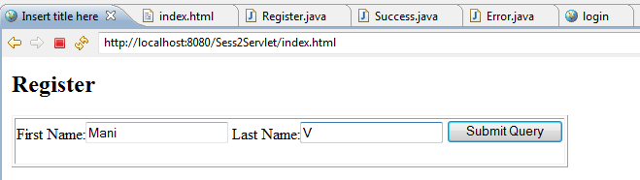
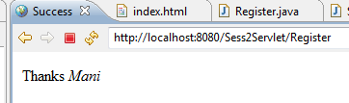
Executing: scenario 1

Slide 25
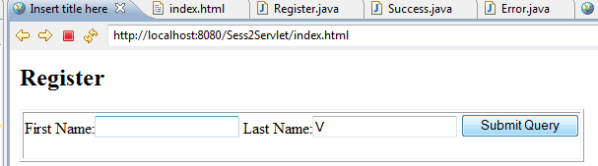
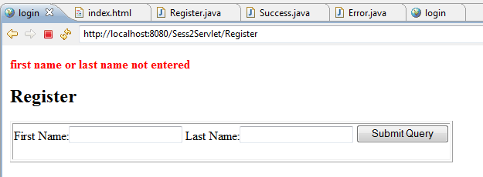
Executing: scenario 2

Slide 26
Tell me how
It would be nice if the form page retains the data already entered? How can we achieve this?
This can be easily done using by using a JSP page instead of HTML page.
We will do this in JSP session.

Slide 27
More on include method
The include() may be called at any time.
Though the request object passed to the included/target servlet can be used just in the same way as the original servlet, there are some restrictions on the usage of response object.
The included/target servlet can only write information to the ServletOutputStream or Writer of the response object and commit a response by writing content.
It cannot set headers or call any method that affects the headers of the response (except for setting session parameters, which we will see later).
Any attempt to set headers will be ignored.
If the response is committed, then setting session parameters will throw IllegalStateException.

Slide 28
More on forward method
The forward() can be called by any servlet only when no output has been committed to the client.
If the response has been committed, an IllegalStateException is thrown.
If output data exists in the response buffer that has not been committed then the content must be flushed using flushBuffer() of ServletResponse before the target servlet is called.
The path elements of the request object has target servelt’s path incase the RequestDispatcher is obtained using URL.
In case RequestDispatcher is obtained using getNamedDispatcher, then path elements of the request object has path of original request.

Slide 29
Query Strings
Query Strings can also be specified with the path that is getRequestDispatcher(java.lang.String path).
String path = “/error?code=5”;
RequestDispatcher rd = getServletContext().getRequestDispatcher(path);
rd.include(request, response);
This parameter can be obtained using
request.getParameter(“error”);

Slide 30
Tell me what
What if there is clash between names of form parameter and query strings? That is if in the previous example
String path = “/error?code=5&fname=bob”;
Parameters specified in the query string used to create the RequestDispatcher take precedence over other parameters of the same name passed to the included servlet.
Also the scope of the parameters associated with a RequestDispatcher are only for the duration of the include or forward call.

