Slide 1
fitbit
June 29 2017

Slide 2
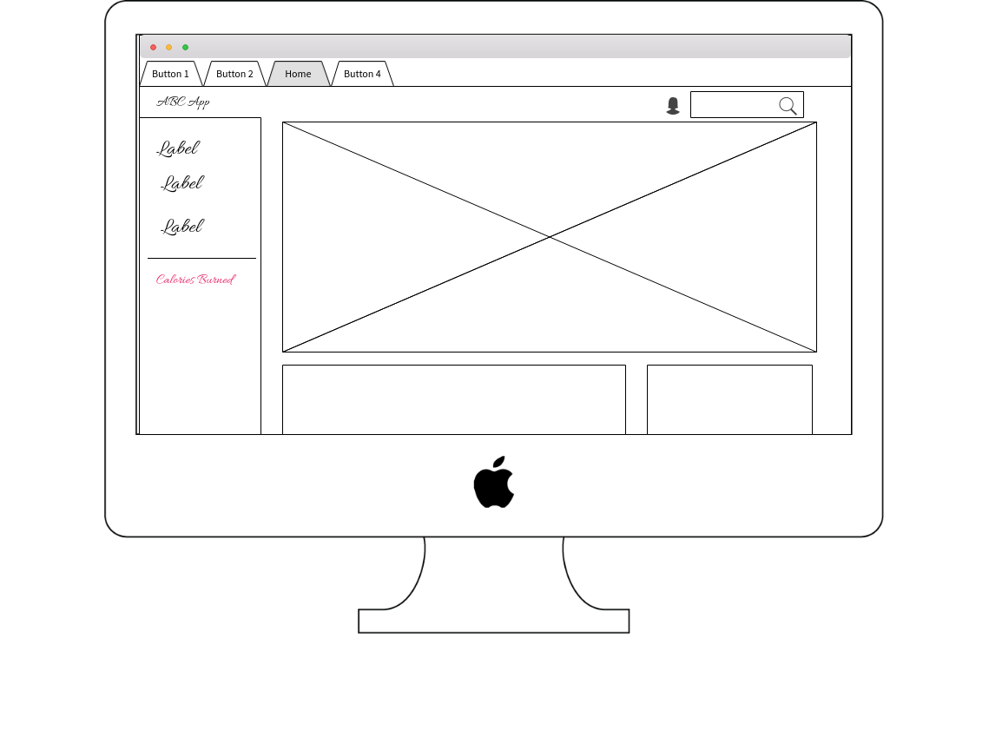

Slide 3
