Slide 1
Application Delivery Fundamentals : Java
Java 8

Slide 2
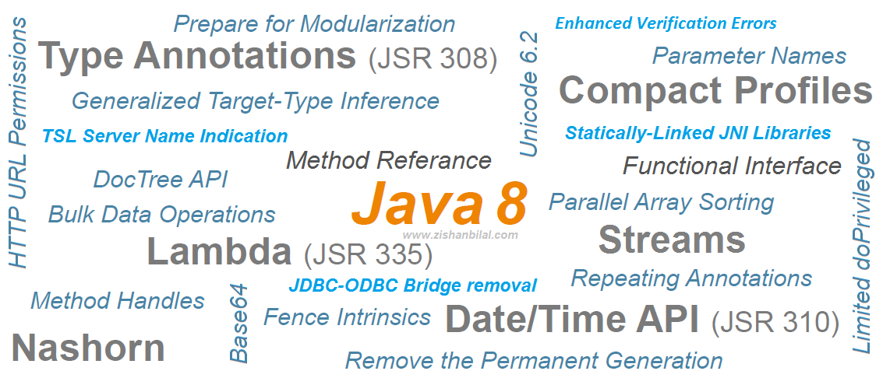
Java 8

Slide 3
Java 8 Goals
Lambda expressions
Method references
Functional interfaces
Accumulators(Double Acc, Double Adder Long Acc, Long Adder)
Stream API
Default methods
Base64 Encode Decode
Static methods in interface,
Optional class

Slide 4
Java 8 Goals
Collectors class,
ForEach() method,
Parallel array sorting,
Nashorn JavaScript Engine,
Parallel Array Sorting,
Type and Repating Annotations,
IO Enhancements,
Concurrency Enhancements,
JDBC Enhancements etc.

Slide 5
Java 8 Goals
Java 8 Security Enhancements
Javadoc Enhancements ( Doc Tree API)

Slide 6
Java Lambda Expressions
Lambda expression is a new and important feature provides a clear and concise way to represent one method interface using an expression.
It is very useful in collection library. It helps to iterate, filter and extract data from collection.
The Lambda expression is used to provide the implementation of an interface which has functional interface.
It saves a lot of code.
Java lambda expression is treated as a function.

Slide 7
Java Lambda Expressions
Lambda expressions is to treat functionality as method argument, or code as data.
Java 8 Lambda Expressions can be defined as methods without names i.e anonymous functions.
Like methods, they can have parameters, a body, a return type and possible list of exceptions that can be thrown.
But unlike methods, neither they have names nor they are associated with any particular class.

Slide 8
Lambda Syntax
(Parameters) -> Expression
OR
(Parameters) -> { Statements }
Lambda syntax consist of three parts – list of parameters, an arrow mark and a body.
The body of a lambda can be an expression or a set of statements.
If it is set of statements, they must be enclosed within curly braces { }.
Return type and possible list of exceptions that can be thrown are not explicitly mentioned in a lambda.
They are implicitly applied.

Slide 9
Where To Use Lambda Expressions?
Lambda expressions are used where an instance of functional interface is expected.
Functional interface is an interface which has only one abstract method.
Functional interfaces can have any number of default methods.
But, they must have only one abstract method. Comparator, Runnable And ActionListener are some examples of functional interfaces.

Slide 10
Functional Interface
Lambda expression provides implementation of functional interface.
An interface which has only one abstract method is called functional interface.
Java provides an annotation @FunctionalInterface, which is used to declare an interface as functional interface.

Slide 11
Functional Interface
Single Abstract Method Type
Functional Interfaces
Example
@FunctionalInterface
public interface Runnable {
public void run();
}
Runnable r = () -> System.out.println(“CITI Team!");

Slide 12
Java Lambda Expression Syntax
(argument-list) -> {body}
Java lambda expression is consisted of three components.
1) Argument-list: It can be empty or non-empty as well.
2) Arrow-token: It is used to link arguments-list and body of expression.
3) Body: It contains expressions and statements for lambda expression.

Slide 13
Java Lambda Expression Syntax

Slide 14
Java Lambda Expression Syntax

Slide 15
Java Lambda Expression Syntax

Slide 16
Java Lambda Expression Syntax
@FunctionalInterface
public interface Comparator
{
int compare(T o1, T o2); //Only one abstract method
}
@FunctionalInterface
public interface Runnable
{
public abstract void run(); //Only one abstract method
}
@FunctionalInterface
public interface ActionListener extends EventListener
{
public void actionPerformed(ActionEvent e); //Only One abstract method
}

Slide 17
Java Lambda Expression Example: No Parameter
interface Sayable{
public String say();
}
public class LambdaExpressionExample3{
public static void main(String[] args) {
Sayable s=()->{
return "I have nothing to say.";
};
System.out.println(s.say());
}
}

Slide 18
Java Lambda Expression Example: Single Parameter
interface Sayable{
public String say(String name);
}
public class LambdaExpressionExample4{
public static void main(String[] args) {
// Lambda expression with single parameter.
Sayable s1=(name)->{
return "Hello, "+name;
};
s.o.p (s1.say(“casper”);
}
}

Slide 19
Java Lambda Expression
Java Lambda Expression Example: Multiple Parameters
Java Lambda Expression Example: with or without return keyword
Java Lambda Expression Example: For each Loop
Java Lambda Expression Example: Creating Thread
Java Lambda Expression Example: Comparator
Collections.sort(list,(p1,p2)->{
return p1.name.compareTo(p2.name);
});

Slide 20
How To Use Lambda Expressions?
Lambda expressions are used to implement functional interfaces.
Before Java 8, anonymous inner classes are used to implement functional interfaces.
Before Java 8 : Implementation of Comparator interface using anonymous inner class
Comparator<Student> idComparator = new Comparator<Student>() {
@Override
public int compare(Student s1, Student s2) {
return s1.getID()-s2.getID();
}
};

Slide 21
How To Use Lambda Expressions?
After Java 8 : Implementation of Comaparator interface using lambda expressions
Comparator<Student> idComparator = (Student s1, Student s2) -> s1.getID()-s2.getID();

Slide 22
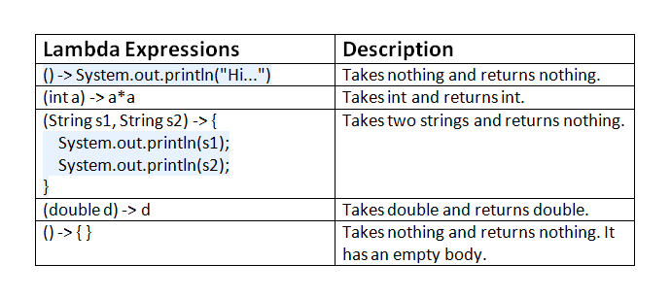
Valid Lambda Expressions With Description

Slide 23
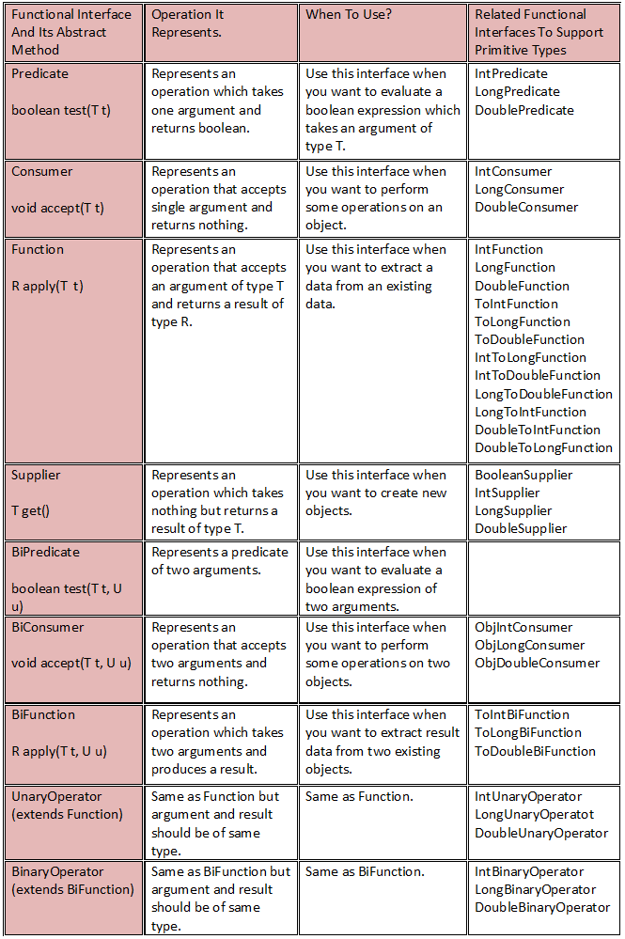
Java 8 Functional Interfaces java.util.function package

Slide 24
Java 8 Functional Interfaces java.util.function package

Slide 25
Built-in Functions
Interface Summary
Interface | Description
BiConsumer<T,U> | Represents an operation that accepts two input arguments and returns no result.
BiFunction<T,U,R> | Represents a function that accepts two arguments and produces a result.
BinaryOperator<T> | Represents an operation upon two operands of the same type, producing a result of the same type as the operands.
BiPredicate<T,U> | Represents a predicate (boolean-valued function) of two arguments.
BooleanSupplier | Represents a supplier of boolean-valued results.
Consumer<T> | Represents an operation that accepts a single input argument and returns no result.
DoubleBinaryOperator | Represents an operation upon two double-valued operands and producing a double-valued result.
DoubleConsumer | Represents an operation that accepts a single double-valued argument and returns no result.
DoubleFunction<R> | Represents a function that accepts a double-valued argument and produces a result.
DoublePredicate | Represents a predicate (boolean-valued function) of one double-valued argument.
DoubleSupplier | Represents a supplier of double-valued results.
DoubleToIntFunction | Represents a function that accepts a double-valued argument and produces an int-valued result.
DoubleToLongFunction | Represents a function that accepts a double-valued argument and produces a long-valued result.
DoubleUnaryOperator | Represents an operation on a single double-valued operand that produces a double-valued result.

Slide 26
Built-in Functions
Function<T,R> | Represents a function that accepts one argument and produces a result.
IntBinaryOperator | Represents an operation upon two int-valued operands and producing an int-valued result.
IntConsumer | Represents an operation that accepts a single int-valued argument and returns no result.
IntFunction<R> | Represents a function that accepts an int-valued argument and produces a result.
IntPredicate | Represents a predicate (boolean-valued function) of one int-valued argument.
IntSupplier | Represents a supplier of int-valued results.
IntToDoubleFunction | Represents a function that accepts an int-valued argument and produces a double-valued result.
IntToLongFunction | Represents a function that accepts an int-valued argument and produces a long-valued result.
IntUnaryOperator | Represents an operation on a single int-valued operand that produces an int-valued result.
LongBinaryOperator | Represents an operation upon two long-valued operands and producing a long-valued result.
LongConsumer | Represents an operation that accepts a single long-valued argument and returns no result.
LongFunction<R> | Represents a function that accepts a long-valued argument and produces a result.
LongPredicate | Represents a predicate (boolean-valued function) of one long-valued argument.
LongSupplier | Represents a supplier of long-valued results.

Slide 27
Built-in Functions
LongToDoubleFunction | Represents a function that accepts a long-valued argument and produces a double-valued result.
LongToIntFunction | Represents a function that accepts a long-valued argument and produces an int-valued result.
LongUnaryOperator | Represents an operation on a single long-valued operand that produces a long-valued result.
ObjDoubleConsumer<T> | Represents an operation that accepts an object-valued and a double-valued argument, and returns no result.
ObjIntConsumer<T> | Represents an operation that accepts an object-valued and a int-valued argument, and returns no result.
ObjLongConsumer<T> | Represents an operation that accepts an object-valued and a long-valued argument, and returns no result.
Predicate<T> | Represents a predicate (boolean-valued function) of one argument.
Supplier<T> | Represents a supplier of results.
ToDoubleBiFunction<T,U> | Represents a function that accepts two arguments and produces a double-valued result.
ToDoubleFunction<T> | Represents a function that produces a double-valued result.
ToIntBiFunction<T,U> | Represents a function that accepts two arguments and produces an int-valued result.
ToIntFunction<T> | Represents a function that produces an int-valued result.
ToLongBiFunction<T,U> | Represents a function that accepts two arguments and produces a long-valued result.
ToLongFunction<T> | Represents a function that produces a long-valued result.
UnaryOperator<T> | Represents an operation on a single operand that produces a result of the same type as its operand.

Slide 28
Java Method References
Method reference is used to refer method of functional interface.
It is compact and easy form of lambda expression.
Each time when you are using lambda expression to just referring a method, you can replace your lambda expression with method reference.
Java 8 method references can be defined as shortened versions of lambda expressions calling a specific method.
Method references are the easiest way to refer a method than the lambdas calling a specific method.
Method references will enhance the readability of your code.

Slide 29
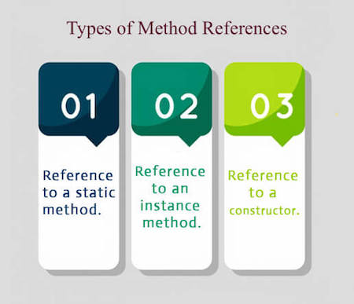
Types of Method References

Slide 30
Static Reference
interface Sayable{
void say();
}
public class MethodReference {
public static void saySomething(){
System.out.println("Hello, this is static method.");
}
public static void main(String[] args) {
// Referring static method
Sayable sayable = MethodReference::saySomething;
// Calling interface method
sayable.say();
}
}

Slide 31
Instance Method Reference
interface Sayable{
void say(); }
public class InstanceMethodReference {
public void saySomething(){
System.out.println("Hello, this is non-static method.");
}
public static void main(String[] args) {
// Creating object
InstanceMethodReference methodReference = new InstanceMethodReference();
// Referring non-static method using reference
Sayable sayable = methodReference::saySomething;
// Calling interface method
sayable.say(); } }

Slide 32
Reference to a Constructor
interface Messageable{
Message getMessage(String msg);
}
class Message{
Message(String msg){
System.out.print(msg);
}
}
public class ConstructorReference {
public static void main(String[] args) {
Messageable hello = Message::new;
hello.getMessage("Hello");
}
}

Slide 33
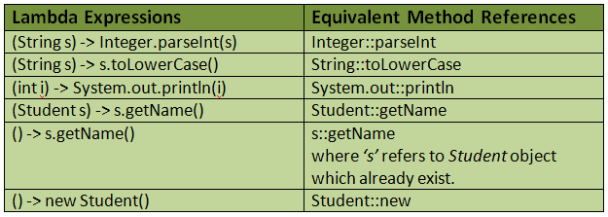
Method References

Slide 34
Java 8 Stream
Java provides a new additional package in Java 8 called java.util.stream.
This package consists of classes, interfaces and enum to allows functional-style operations on the elements.
You can use stream by importing java.util.stream package.

Slide 35
Java 8 Stream
Stream provides following features:
Stream does not store elements.
It simply conveys elements from a source such as a data structure, an array, or an I/O channel, through a pipeline of computational operations.
Stream is functional in nature.
Operations performed on a stream does not modify it's source.
For example, filtering a Stream obtained from a collection produces a new Stream without the filtered elements, rather than removing elements from the source collection.
Stream is lazy and evaluates code only when required.
The elements of a stream are only visited once during the life of a stream.
Like an Iterator, a new stream must be generated to revisit the same elements of the source.
Stream can be used to filter, collect, print, and convert from one data structure to other etc. In the following examples, we have apply various operations with the help of stream.

Slide 36
Java Stream
Methods | Description
boolean allMatch(Predicate<? super T> predicate) | It returns all elements of this stream which match the provided predicate. If the stream is empty then true is returned and the predicate is not evaluated.
boolean anyMatch(Predicate<? super T> predicate) | It returns any element of this stream that matches the provided predicate. If the stream is empty then false is returned and the predicate is not evaluated.
static <T> Stream.Builder<T> builder() | It returns a builder for a Stream.
<R,A> R collect(Collector<? super T,A,R> collector) | It performs a mutable reduction operation on the elements of this stream using a Collector. A Collector encapsulates the functions used as arguments to collect(Supplier, BiConsumer, BiConsumer), allowing for reuse of collection strategies and composition of collect operations such as multiple-level grouping or partitioning.
<R> R collect(Supplier<R> supplier, BiConsumer<R,? super T> accumulator, BiConsumer<R,R> combiner) | It performs a mutable reduction operation on the elements of this stream. A mutable reduction is one in which the reduced value is a mutable result container, such as an ArrayList, and elements are incorporated by updating the state of the result rather than by replacing the result.

Slide 37
Java Stream
static <T> Stream<T> concat(Stream<? extends T> a, Stream<? extends T> b) | It creates a lazily concatenated stream whose elements are all the elements of the first stream followed by all the elements of the second stream. The resulting stream is ordered if both of the input streams are ordered, and parallel if either of the input streams is parallel. When the resulting stream is closed, the close handlers for both input streams are invoked.
long count() | It returns the count of elements in this stream. This is a special case of a reduction.
Stream<T> distinct() | It returns a stream consisting of the distinct elements (according to Object.equals(Object)) of this stream.
static <T> Stream<T> empty() | It returns an empty sequential Stream.
Stream<T> filter(Predicate<? super T> predicate) | It returns a stream consisting of the elements of this stream that match the given predicate.
Optional<T> findAny() | It returns an Optional describing some element of the stream, or an empty Optional if the stream is empty.
Optional<T> findFirst() | It returns an Optional describing the first element of this stream, or an empty Optional if the stream is empty. If the stream has no encounter order, then any element may be returned.

Slide 38
Java Stream
<R> Stream<R> flatMap(Function<? super T,? extends Stream<? extends R>> mapper) | It returns a stream consisting of the results of replacing each element of this stream with the contents of a mapped stream produced by applying the provided mapping function to each element. Each mapped stream is closed after its contents have been placed into this stream. (If a mapped stream is null an empty stream is used, instead.)
DoubleStream flatMapToDouble(Function<? super T,? extends DoubleStream> mapper) | It returns a DoubleStream consisting of the results of replacing each element of this stream with the contents of a mapped stream produced by applying the provided mapping function to each element. Each mapped stream is closed after its contents have placed been into this stream. (If a mapped stream is null an empty stream is used, instead.)
IntStream flatMapToInt(Function<? super T,? extends IntStream> mapper) | It returns an IntStream consisting of the results of replacing each element of this stream with the contents of a mapped stream produced by applying the provided mapping function to each element. Each mapped stream is closed after its contents have been placed into this stream. (If a mapped stream is null an empty stream is used, instead.)

Slide 39
Java Stream
DoubleStream flatMapToDouble(Function<? super T,? extends DoubleStream> mapper) | It returns a DoubleStream consisting of the results of replacing each element of this stream with the contents of a mapped stream produced by applying the provided mapping function to each element. Each mapped stream is closed after its contents have placed been into this stream. (If a mapped stream is null an empty stream is used, instead.)
IntStream flatMapToInt(Function<? super T,? extends IntStream> mapper) | It returns an IntStream consisting of the results of replacing each element of this stream with the contents of a mapped stream produced by applying the provided mapping function to each element. Each mapped stream is closed after its contents have been placed into this stream. (If a mapped stream is null an empty stream is used, instead.)
LongStream flatMapToLong(Function<? super T,? extends LongStream> mapper) | It returns a LongStream consisting of the results of replacing each element of this stream with the contents of a mapped stream produced by applying the provided mapping function to each element. Each mapped stream is closed after its contents have been placed into this stream. (If a mapped stream is null an empty stream is used, instead.)
void forEach(Consumer<? super T> action) | It performs an action for each element of this stream.
void forEachOrdered(Consumer<? super T> action) | It performs an action for each element of this stream, in the encounter order of the stream if the stream has a defined encounter order.
static <T> Stream<T> generate(Supplier<T> s) | It returns an infinite sequential unordered stream where each element is generated by the provided Supplier. This is suitable for generating constant streams, streams of random elements, etc.

Slide 40
Java Stream
static <T> Stream<T> iterate(T seed,UnaryOperator<T> f) | It returns an infinite sequential ordered Stream produced by iterative application of a function f to an initial element seed, producing a Stream consisting of seed, f(seed), f(f(seed)), etc.
Stream<T> limit(long maxSize) | It returns a stream consisting of the elements of this stream, truncated to be no longer than maxSize in length.
<R> Stream<R> map(Function<? super T,? extends R> mapper) | It returns a stream consisting of the results of applying the given function to the elements of this stream.
DoubleStream mapToDouble(ToDoubleFunction<? super T> mapper) | It returns a DoubleStream consisting of the results of applying the given function to the elements of this stream.
IntStream mapToInt(ToIntFunction<? super T> mapper) | It returns an IntStream consisting of the results of applying the given function to the elements of this stream.
LongStream mapToLong(ToLongFunction<? super T> mapper) | It returns a LongStream consisting of the results of applying the given function to the elements of this stream.
Optional<T> max(Comparator<? super T> comparator) | It returns the maximum element of this stream according to the provided Comparator. This is a special case of a reduction.
Optional<T> min(Comparator<? super T> comparator) | It returns the minimum element of this stream according to the provided Comparator. This is a special case of a reduction.

Slide 41
Java Stream
boolean noneMatch(Predicate<? super T> predicate) | It returns elements of this stream match the provided predicate. If the stream is empty then true is returned and the predicate is not evaluated.
@SafeVarargs static <T> Stream<T> of(T... values) | It returns a sequential ordered stream whose elements are the specified values.
static <T> Stream<T> of(T t) | It returns a sequential Stream containing a single element.
Stream<T> peek(Consumer<? super T> action) | It returns a stream consisting of the elements of this stream, additionally performing the provided action on each element as elements are consumed from the resulting stream.
Optional<T> reduce(BinaryOperator<T> accumulator) | It performs a reduction on the elements of this stream, using an associative accumulation function, and returns an Optional describing the reduced value, if any.
T reduce(T identity, BinaryOperator<T> accumulator) | It performs a reduction on the elements of this stream, using the provided identity value and an associative accumulation function, and returns the reduced value.
<U> U reduce(U identity, BiFunction<U,? super T,U> accumulator, BinaryOperator<U> combiner) | It performs a reduction on the elements of this stream, using the provided identity, accumulation and combining functions.
Stream<T> skip(long n) | It returns a stream consisting of the remaining elements of this stream after discarding the first n elements of the stream. If this stream contains fewer than n elements then an empty stream will be returned.

Slide 42
Java Stream
Stream<T> sorted() | It returns a stream consisting of the elements of this stream, sorted according to natural order. If the elements of this stream are not Comparable, a java.lang.ClassCastException may be thrown when the terminal operation is executed.
Stream<T> sorted(Comparator<? super T> comparator) | It returns a stream consisting of the elements of this stream, sorted according to the provided Comparator.
Object[] toArray() | It returns an array containing the elements of this stream.
<A> A[] toArray(IntFunction<A[]> generator) | It returns an array containing the elements of this stream, using the provided generator function to allocate the returned array, as well as any additional arrays that might be required for a partitioned execution or for resizing.

Slide 43
Java 8 Stream
List<Float> productPriceList2 =productsList.stream()
.filter(p -> p.price > 30000)// filtering data
.map(p->p.price) // fetching price
.collect(Collectors.toList()); // collecting as list
Stream.iterate(1, element->element+1)
.filter(element->element%5==0)
.limit(5)
.forEach(System.out::println);
}
productsList.stream()
.filter(product -> product.price == 30000)
.forEach(product -> System.out.println(product.name));

Slide 44
Java 8 Stream
// This is more compact approach for filtering data
Float totalPrice = productsList.stream()
.map(product->product.price)
.reduce(0.0f,(sum, price)->sum+price); // accumulating price
System.out.println(totalPrice);
// More precise code
float totalPrice2 = productsList.stream()
.map(product->product.price)
.reduce(0.0f,Float::sum); // accumulating price, by referring method of Float class

Slide 45
Java 8 Stream
// // max() method to get max Product price
Product productA = productsList.stream()
.max((product1, product2)->
product1.price > product2.price ? 1: -1).get();
System.out.println(productA.price);
// min() method to get min Product price
Product productB = productsList.stream()
.max((product1, product2)->
product1.price < product2.price ? 1: -1).get();

Slide 46
Java 8 Stream
// count number of products based on the filter
long count = productsList.stream()
.filter(product->product.price<30000)
.count();
// Converting Product List into a Map
Map<Integer,String> productPriceMap =
productsList.stream()
.collect(Collectors.toMap(p->p.id, p->p.name));
List<Float> productPriceList =
productsList.stream()
.filter(p -> p.price > 30000) // filtering data
.map(Product::getPrice) // fetching price by referring getPrice method
.collect(Collectors.toList()); // collecting as list

Slide 47
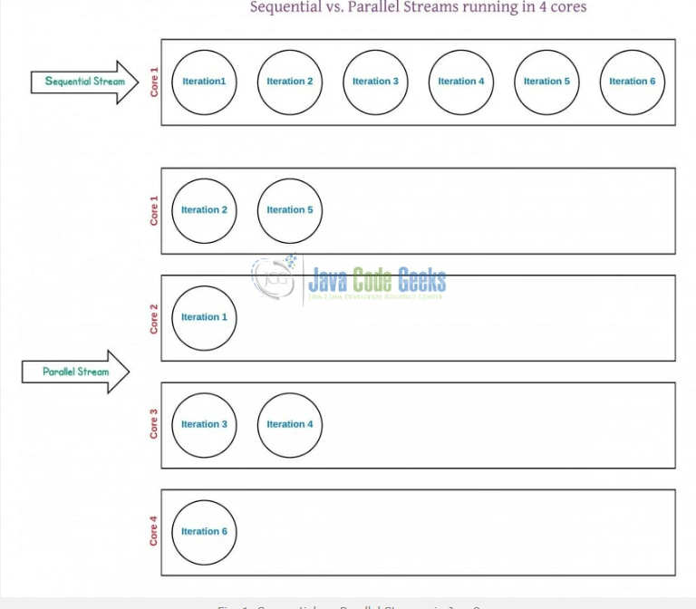
Streams

Slide 48
What streams are good for
They allow functional programming style using bindings.
They allow for better performance by removing iteration. Iteration occurs with evaluation. With streams, we can bind dozens of functions without iterating.
They allow easy parallelization for task including long waits.
Streams may be infinite (since they are lazy). Functions may be bound to infinite streams without problem. Upon evaluation, there must be some way to make them finite. This is often done through a short circuiting operation.

Slide 49
When to use Parallel Streams?
They should be used when the output of the operation is not needed to be dependent on the order of elements present in source collection (i.e. on which the stream is created)
Parallel Streams can be used in case of aggregate functions
Parallel Streams quickly iterate over the large-sized collections
Parallel Streams can be used if developers have performance implications with the Sequential Streams
If the environment is not multi-threaded, then Parallel Stream creates thread and can affect the new requests coming in

Slide 50
What streams are not good for
Streams should be used with high caution when processing intensive computation tasks.
In particular, by default, all parallel streams will use the same ForkJoinPool, configured to use as many threads as there are cores in the computer on which the program is running.
If evaluation of one parallel stream results in a very long running task, this may be split into as many long running sub-tasks that will be distributed to each thread in the pool.
From there, no other parallel stream can be processed because all threads will be occupied.

Slide 51
What streams are not good for
A parallel stream has a much higher overhead compared to a sequential one.
Coordinating the threads takes a significant amount of time. Use sequential streams by default and only consider parallel ones if you have a massive amount of items to process (or the processing of each item takes time and is parallelizable)
parallelism also often exposes nondeterminism in the computation that is often hidden by sequential implementations;

Slide 52
What streams are not good for
In reality, sometimes parallelism will speed up your computation, sometimes it will not, and sometimes it will even slow it down.
It is best to develop first using sequential execution and then apply parallelism where (A) you know that there's actually benefit to increased performance and (B) that it will actually deliver increased performance.
(A) is a business problem, not a technical one. If you are a performance expert, you'll usually be able to look at the code and determine (B), but the smart path is to measure.

Slide 53
Java Base64 Encode and Decode
Java provides a class Base64 to deal with encryption.
You can encrypt and decrypt your data by using provided methods.
You need to import java.util.Base64 in your source file to use its methods.
This class provides three different encoders and decoders to encrypt information at each level.

Slide 54
Java Base64 Encode and Decode
Basic Encoding and Decoding
It uses the Base64 alphabet specified by Java in RFC 4648 and RFC 2045 for encoding and decoding operations.
The encoder does not add any line separator character. The decoder rejects data that contains characters outside the base64 alphabet.

Slide 55
Java Base64 Encode and Decode
URL and Filename Encoding and Decoding
It uses the Base64 alphabet specified by Java in RFC 4648 for encoding and decoding operations. The encoder does not add any line separator character. The decoder rejects data that contains characters outside the base64 alphabet.

Slide 56
Java Base64 Encode and Decode
Class | Description
Base64.Decoder | This class implements a decoder for decoding byte data using the Base64 encoding scheme as specified in RFC 4648 and RFC 2045.
Base64.Encoder | This class implements an encoder for encoding byte data using the Base64 encoding scheme as specified in RFC 4648 and RFC 2045.

Slide 57
Java Base64 Encode and Decode
Base64 Methods
Methods | Description
public static Base64.Decoder getDecoder() | It returns a Base64.Decoder that decodes using the Basic type base64 encoding scheme.
public static Base64.Encoder getEncoder() | It returns a Base64.Encoder that encodes using the Basic type base64 encoding scheme.
public static Base64.Decoder getUrlDecoder() | It returns a Base64.Decoder that decodes using the URL and Filename safe type base64 encoding scheme.
public static Base64.Decoder getMimeDecoder() | It returns a Base64.Decoder that decodes using the MIME type base64 decoding scheme.
public static Base64.Encoder getMimeEncoder() | It Returns a Base64.Encoder that encodes using the MIME type base64 encoding scheme.
public static Base64.Encoder getMimeEncoder(int lineLength, byte[] lineSeparator) | It returns a Base64.Encoder that encodes using the MIME type base64 encoding scheme with specified line length and line separators.
public static Base64.Encoder getUrlEncoder() | It returns a Base64.Encoder that encodes using the URL and Filename safe type base64 encoding scheme.

Slide 58
Java Base64 Encode and Decode
Base64 Methods
Methods | Description
public static Base64.Decoder getDecoder() | It returns a Base64.Decoder that decodes using the Basic type base64 encoding scheme.
public static Base64.Encoder getEncoder() | It returns a Base64.Encoder that encodes using the Basic type base64 encoding scheme.
public static Base64.Decoder getUrlDecoder() | It returns a Base64.Decoder that decodes using the URL and Filename safe type base64 encoding scheme.
public static Base64.Decoder getMimeDecoder() | It returns a Base64.Decoder that decodes using the MIME type base64 decoding scheme.
public static Base64.Encoder getMimeEncoder() | It Returns a Base64.Encoder that encodes using the MIME type base64 encoding scheme.
public static Base64.Encoder getMimeEncoder(int lineLength, byte[] lineSeparator) | It returns a Base64.Encoder that encodes using the MIME type base64 encoding scheme with specified line length and line separators.
public static Base64.Encoder getUrlEncoder() | It returns a Base64.Encoder that encodes using the URL and Filename safe type base64 encoding scheme.

Slide 59
Java Default Methods
Java provides a facility to create default methods inside the interface.
Methods which are defined inside the interface and tagged with default are known as default methods. These methods are non-abstract methods.

Slide 60
Java Stream forEachOrdered() Method
Along with forEach() method, Java provides one more method forEachOrdered().
It is used to iterate elements in the order specified by the stream.
Signature:
void forEachOrdered(Consumer<? super T> action)
gamesList.stream().forEachOrdered(System.out::println);

Slide 61
Java Optional Class
java introduced a new class Optional in jdk8.
It is a public final class and used to deal with Null PointerException in Java application.
You must import java.util package to use this class.
It provides methods which are used to check the presence of value for particular variable.

Slide 62
Java Optional Class
Methods | Description
public static <T> Optional<T> empty() | It returns an empty Optional object. No value is present for this Optional.
public static <T> Optional<T> of(T value) | It returns an Optional with the specified present non-null value.
public static <T> Optional<T> ofNullable(T value) | It returns an Optional describing the specified value, if non-null, otherwise returns an empty Optional.
public T get() | If a value is present in this Optional, returns the value, otherwise throws NoSuchElementException.
public boolean isPresent() | It returns true if there is a value present, otherwise false.
public void ifPresent(Consumer<? super T> consumer) | If a value is present, invoke the specified consumer with the value, otherwise do nothing.
public Optional<T> filter(Predicate<? super T> predicate) | If a value is present, and the value matches the given predicate, return an Optional describing the value, otherwise return an empty Optional.

Slide 63
Java Optional Class
public <U> Optional<U> map(Function<? super T,? extends U> mapper) | If a value is present, apply the provided mapping function to it, and if the result is non-null, return an Optional describing the result. Otherwise return an empty Optional.
public <U> Optional<U> flatMap(Function<? super T,Optional<U> mapper) | If a value is present, apply the provided Optional-bearing mapping function to it, return that result, otherwise return an empty Optional.
public T orElse(T other) | It returns the value if present, otherwise returns other.
public T orElseGet(Supplier<? extends T> other) | It returns the value if present, otherwise invoke other and return the result of that invocation.
public <X extends Throwable> T orElseThrow(Supplier<? extends X> exceptionSupplier) throws X extends Throwable | It returns the contained value, if present, otherwise throw an exception to be created by the provided supplier.
public boolean equals(Object obj) | Indicates whether some other object is "equal to" this Optional or not. The other object is considered equal if:It is also an Optional and; Both instances have no value present or; the present values are "equal to" each other via equals().

Slide 64
Java Optional Class
public int hashCode() | It returns the hash code value of the present value, if any, or returns 0 (zero) if no value is present.
public String toString() | It returns a non-empty string representation of this Optional suitable for debugging. The exact presentation format is unspecified and may vary between implementations and versions.

Slide 65
Java Nashorn
Nashorn is a JavaScript engine. It is used to execute JavaScript code dynamically at JVM (Java Virtual Machine). Java provides a command-line tool jjs which is used to execute JavaScript code.
You can execute JavaScript code by using jjs command-line tool and by embedding into Java source code.

Slide 66
Java Nashorn
Nashorn is a JavaScript engine. It is used to execute JavaScript code dynamically at JVM (Java Virtual Machine). Java provides a command-line tool jjs which is used to execute JavaScript code.
You can execute JavaScript code by using jjs command-line tool and by embedding into Java source code.

Slide 67
Java Parallel Array Sorting
Java provides a new additional feature in Array class which is used to sort array elements parallel.
New methods has added to java.util.Arrays package that use the JSR 166 Fork/Join parallelism common pool to provide sorting of arrays in parallel.
The methods are called parallelSort() and are overloaded for all the primitive data types and Comparable objects.

Slide 68
Java Parallel Array Sorting
Methods | Description
public static void parallelSort(byte[] a) | It sorts the specified array into ascending numerical order.
public static void parallelSort(byte[] a, int fromIndex, int toIndex) | It sorts the specified range of the array into ascending numerical order. The range to be sorted extends from the index fromIndex, inclusive, to the index toIndex, exclusive. If fromIndex == toIndex, the range to be sorted is empty.
public static void parallelSort(char[] a) | It sorts the specified array into ascending numerical order.
public static void parallelSort(char[] a, int fromIndex, int toIndex) | It sorts the specified range of the array into ascending numerical order. The range to be sorted extends from the index fromIndex, inclusive, to the index toIndex, exclusive. If fromIndex == toIndex, the range to be sorted is empty.
public static void parallelSort(double[] a) | It sorts the specified array into ascending numerical order.

Slide 69
Java Parallel Array Sorting
public static void parallelSort(double[] a, int fromIndex, int toIndex) | It sorts the specified range of the array into ascending numerical order. The range to be sorted extends from the index fromIndex, inclusive, to the index toIndex, exclusive. If fromIndex == toIndex, the range to be sorted is empty.
public static void parallelSort(float[] a) | It sorts the specified array into ascending numerical order.
public static void parallelSort(float[] a, int fromIndex, int toIndex) | It sorts the specified range of the array into ascending numerical order. The range to be sorted extends from the index fromIndex, inclusive, to the index toIndex, exclusive. If fromIndex == toIndex, the range to be sorted is empty.
public static void parallelSort(int[] a) | It sorts the specified array into ascending numerical order.
public static void parallelSort(int[] a,int fromIndex, int toIndex) | It sorts the specified range of the array into ascending numerical order. The range to be sorted extends from the index fromIndex, inclusive, to the index toIndex, exclusive. If fromIndex == toIndex, the range to be sorted is empty.

Slide 70
Java Parallel Array Sorting
public static void parallelSort(long[] a) | It sorts the specified array into ascending numerical order.
public static void parallelSort(long[] a, int fromIndex, int toIndex) | It sorts the specified range of the array into ascending numerical order. The range to be sorted extends from the index fromIndex, inclusive, to the index toIndex, exclusive. If fromIndex == toIndex, the range to be sorted is empty.
public static void parallelSort(short[] a) | It sorts the specified array into ascending numerical order.
public static void parallelSort(short[] a,int fromIndex,int toIndex) | It sorts the specified range of the array into ascending numerical order. The range to be sorted extends from the index fromIndex, inclusive, to the index toIndex, exclusive. If fromIndex == toIndex, the range to be sorted is empty.
public static <T extends Comparable<? super T>> void parallelSort(T[] a) | Sorts the specified array of objects into ascending order, according to the natural ordering of its elements. All elements in the array must implement the Comparable interface. Furthermore, all elements in the array must be mutually comparable (that is, e1.compareTo(e2) must not throw a ClassCastException for any elements e1 and e2 in the array).

Slide 71
Java Parallel Array Sorting
public static <T7gt; void parallelSort(T[] a,Comparator<? super T> cmp) | It sorts the specified array of objects according to the order induced by the specified comparator. All elements in the array must be mutually comparable by the specified comparator (that is, c.compare(e1, e2) must not throw a ClassCastException for any elements e1 and e2 in the array).
public static <T extends Comparable<? super T>> void parallelSort(T[] a,int fromIndex, int toIndex) | It sorts the specified range of the specified array of objects into ascending order, according to the natural ordering of its elements. The range to be sorted extends from index fromIndex, inclusive, to index toIndex, exclusive. (If fromIndex==toIndex, the range to be sorted is empty.) All elements in this range must implement the Comparable interface. Furthermore, all elements in this range must be mutually comparable (that is, e1.compareTo(e2) must not throw a ClassCastException for any elements e1 and e2 in the array).
public static <T> void parallelSort(T[] a, int fromIndex, int toIndex, Comparator<? super T> cmp) | It sorts the specified range of the specified array of objects according to the order induced by the specified comparator. The range to be sorted extends from index fromIndex, inclusive, to index toIndex, exclusive. (If fromIndex==toIndex, the range to be sorted is empty.) All elements in the range must be mutually comparable by the specified comparator (that is, c.compare(e1, e2) must not throw a ClassCastException for any elements e1 and e2 in the range).

Slide 72
Method Parameter Reflection
Java provides a new feature in which you can get the names of formal parameters of any method or constructor.
The java.lang.reflect package contains all the required classes like Method and Parameter to work with parameter reflection.

Slide 73
Method Parameter Reflection
Method | Description
public boolean equals(Object obj) | It compares this Method against the specified object. It returns true if the objects are the same. Two Methods are the same if they were declared by the same class and have the same name and formal parameter types and return type.
public AnnotatedType getAnnotatedReturnType() | It returns an AnnotatedType object that represents the use of a type to specify the return type of the method/constructor.
public <T extends Annotation> T getAnnotation(Class<T> annotationClass) | It returns this element's annotation for the specified type if such an annotation is present otherwise returns null. NullPointerException - if the given annotation class is null
public Annotation[] getDeclaredAnnotations() | It returns annotations that are directly present on this element. This method ignores inherited annotations. If there are no annotations directly present on this element, the return value is an array of length 0. The caller of this method is free to modify the returned array. it will have no effect on the arrays returned to other callers.

Slide 74
Method Parameter Reflection
public Class<?> getDeclaringClass() | It returns the Class object representing the class or interface that declares the executable represented by this object.
public Object getDefaultValue() | It returns the default value for the annotation member represented by this Method instance.
public Class<?>[] getExceptionTypes() | It returns an array of Class objects that represent the types of exceptions declared to be thrown by the underlying executable represented by this object.
public Type[] getGenericExceptionTypes() | It returns an array of Type objects that represent the exceptions declared to be thrown by this executable object. It returns an array of length 0 if the underlying executable declares no exceptions in its throws clause. It throws following exceptions: GenericSignatureFormatError - if the generic method signature does not conform to the format specified in The Java Virtual Machine Specification. TypeNotPresentException - if the underlying executable's throws clause refers to a non-existent type declaration. MalformedParameterizedTypeException - if the underlying executable's throws clause refers to a parameterized type that cannot be instantiated for any reason.

Slide 75
Method Parameter Reflection
public Type[] getGenericParameterTypes() | It returns an array of Type objects that represent the formal parameter types. It throws following exceptions:GenericSignatureFormatError - if the generic method signature does not conform to the format specified in The Java Virtual Machine Specification. TypeNotPresentException - if any of the parameter types of the underlying executable refers to a non-existent type declaration. MalformedParameterizedTypeException - if any of the underlying executable's parameter types refer to a parameterized type that cannot be instantiated for any reason.
public int getModifiers() | It returns the Java language modifiers for the executable represented by this object.
public String getName() | It returns the name of the method represented by this Method object as a String.
public Annotation[][] getParameterAnnotations() | It returns an array of arrays that represent the annotations on the formal and implicit parameters, in declaration order, of the executable represented by this object.
public int getParameterCount() | It returns the number of formal parameters for the executable represented by this object.
public Class<?>[] getParameterTypes() | It returns an array of Class objects that represent the formal parameter types. in declaration order, of the executable represented by this object. It returns an array of length 0 if the underlying executable takes no parameters.

Slide 76
Method Parameter Reflection
public Class<?> getReturnType() | It returns a Class object that represents the formal return type of the method represented by this Method object.
public TypeVariable<Method>[] getTypeParameters() | It returns an array of TypeVariable objects that represent the type variables declared by the generic declaration represented by this GenericDeclaration object, in declaration order. It throws GenericSignatureFormatError, if the generic signature of this generic declaration does not conform to the format specified in The Java Virtual Machine Specification
public int hashCode() | It returns a hashcode for this Method. The hashcode is computed as the exclusive-or of the hashcodes for the underlying method's declaring class name and the method's name.

Slide 77
Method Parameter Reflection
public Object invoke(Object obj, Object... args) throws IllegalAccessException, IllegalArgumentException, InvocationTargetException | It invokes the underlying method represented by this Method object, on the specified object with the specified parameters. If the underlying method is static, the specified obj argument is ignored. It may be null. If the number of formal parameters required by the underlying method is 0, the supplied args array may be of length 0 or null. If the underlying method is an instance method, it is invoked using dynamic method lookup as documented in The Java Language Specification. If the underlying method is static, the class that declared the method is initialized if it has not already been initialized. If the method completes normally, the value it returns is returned to the caller of invoke.
public boolean isBridge() | It returns true if this method is a bridge method. otherwise returns false.

Slide 78
Method Parameter Reflection
public boolean isDefault() | It returns true if this method is a default method otherwise returns false. A default method is a public non-abstract instance method, that is, a non-static method with a body, declared in an interface type.
public boolean isSynthetic() | It returns true if this executable is a synthetic construct; returns false otherwise.
public boolean isVarArgs() | It returns true if this executable was declared to take a variable number of arguments; returns false otherwise.
public String toGenericString() | It returns a string describing this Method, including type parameters.
public String toString() | It returns a string.

Slide 79
Method Parameter Reflection
Methods | Description
public boolean equals(Object obj) | It compares based on the executable and the index.
public AnnotatedType getAnnotatedType() | It returns an AnnotatedType object that represents the use of a type to specify the type of the formal parameter represented by this Parameter.
public <T extends Annotation> T getAnnotation(Class<T> annotationClass) | It returns this element's annotation for the specified type if such an annotation is present, else null. It throws NullPointerException, if the given annotation class is null.
public Annotation[] getAnnotations() | It returns annotations that are present on this element. If there are no annotations present on this element, the return value is an array of length 0.
public <T extends Annotation> T[] getAnnotationsByType(Class<T> annotationClass) | It returns annotations that are associated with this element. If there are no annotations associated with this element, the return value is an array of length 0. The difference between this method and AnnotatedElement.getAnnotation(Class) is that this method detects if its argument is a repeatable annotation type (JLS 9.6), and if so, attempts to find one or more annotations of that type by "looking through" a container annotation. It throws NullPointerException, if the given annotation class is null.

Slide 80
Method Parameter Reflection
public <T extends Annotation> T getDeclaredAnnotation(Class<T> annotationClass) | It returns this element's annotation for the specified type if such an annotation is directly present, else null. This method ignores inherited annotations. It throws NullPointerException, if the given annotation class is null.
public Annotation[] getDeclaredAnnotations() | It returns annotations that are directly present on this element. This method ignores inherited annotations. If there are no annotations directly present on this element, the return value is an array of length 0.
public <T extends Annotation> T[] getDeclaredAnnotationsByType(Class<T> annotationClass) | It returns this element's annotations for the specified type if such annotations are either directly present or indirectly present. This method ignores inherited annotations. If there are no specified annotations directly or indirectly present on this element, the return value is an array of length 0. The difference between this method and AnnotatedElement.getDeclaredAnnotation(Class) is that this method detects if its argument is a repeatable annotation type (JLS 9.6), and if so, attempts to find one or more annotations of that type by "looking through" a container annotation if one is present. The caller of this method is free to modify the returned array; it will have no effect on the arrays returned to other callers. It throws NullPointerException, if the given annotation class is null

Slide 81
Method Parameter Reflection
public Executable getDeclaringExecutable() | It returns the Executable which declares this parameter.
public int getModifiers() | It returns the modifier flags for the parameter represented by this Parameter object.
public String getName() | It returns the name of the parameter. If the parameter's name is present, this method returns the name provided by the class file. Otherwise, this method synthesizes a name of the form argN, where N is the index of the parameter in the descriptor of the method which declares the parameter.
public Type getParameterizedType() | It returns a Type object that identifies the parameterized type for the parameter represented by this Parameter object.
public Class<?> getType() | It returns a Class object that identifies the declared type for the parameter represented by this Parameter object.
public int hashCode()mul int arg0 int arg1 add int arg0 int arg1 | It returns a hash code based on the executable's hash code and the index.
public boolean isImplicit() | It returns true if this parameter is implicitly declared in source code. Otherwise, returns false.

Slide 82
Java Type and Repeating Annotations
Java Type Annotations
@NonNull String str;
@NonNull List<String>
List<@NonNull String> str
Arrays<@NonNegative Integer> sort
@Encrypted File file
@Open Connection connection

Slide 83
New Date-Time API in Java 8
New date-time API is introduced in Java 8 to overcome the following drawbacks of old date-time API :
Not thread safe : Unlike old java.util.Date which is not thread safe the new date-time API is immutable and doesn’t have setter methods.
Less operations : In old API there are only few date operations but the new API provides us with many date operations.

Slide 84
New Date-Time API in Java 8
Java 8 under the package java.time introduced a new date-time API, most important classes among them are :
Local : Simplified date-time API with no complexity of timezone handling.
Zoned : Specialized date-time API to deal with various timezones.

Slide 85
Java 8 JDBC Improvements
The JDBC-ODBC Bridge has been removed.
Oracle does not support the JDBC-ODBC Bridge. Oracle recommends that you use JDBC drivers provided by the vendor of your database instead of the JDBC-ODBC Bridge.

Slide 86
Java 8 JDBC Improvements
Added some new features in JDBC 4.2.
Java JDBC 4.2 introduces the following features:
Addition of REF_CURSOR support.
Addition of java.sql.DriverAction Interface
Addition of security check on deregisterDriver Method in DriverManager Class
Addition of the java.sql.SQLType Interface
Addition of the java.sql.JDBCType Enum
Add Support for large update counts
Changes to the existing interfaces
Rowset 1.2: Lists the enhancements for JDBC RowSet.

Slide 87
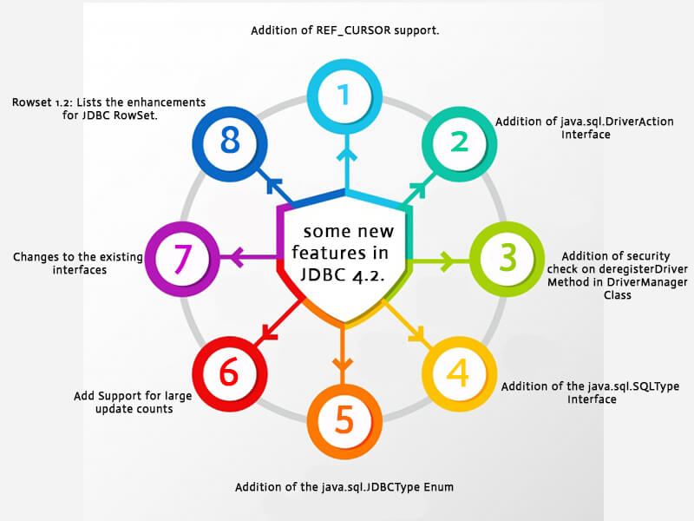
Java 8 JDBC Improvements

Slide 88
Questions

Slide 89
Module Summary
Lambdas
Stream API
Base 64
Nashorn
Reflection
Date Time API
Repeated Annotations
JDBC Improvements

