Slide 1
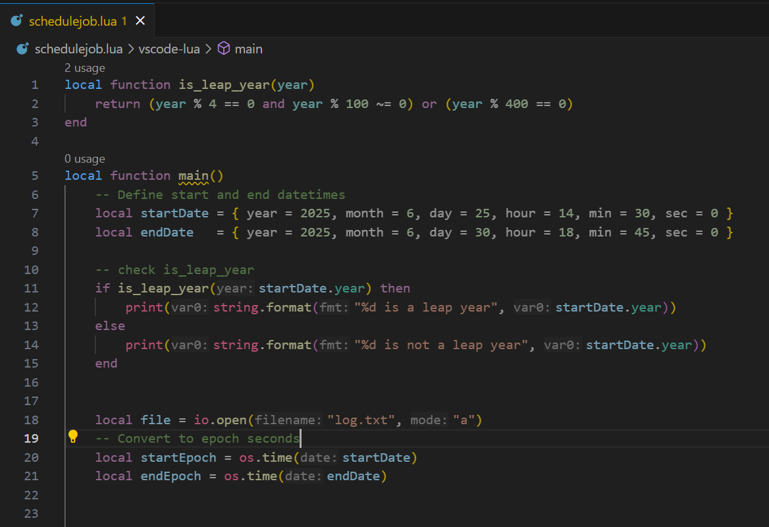
Scheduled Job

Slide 2
Summary
Task | Function
Get current time | os.date() / os.time()
Format date string | os.date("%Y-%m-%d")
Parse date → timestamp | os.time{year=..., month=...}
Timestamp → date | os.date(nil, ts)
Difference in seconds | os.difftime(t1, t2)
Add/subtract time | os.time() ± seconds

Slide 3
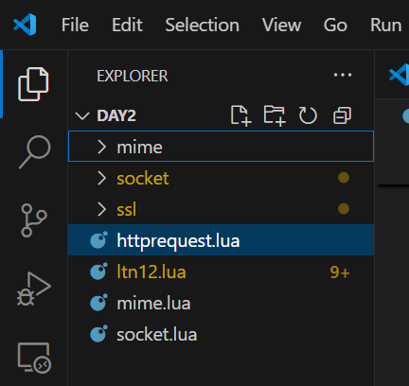
Lua Socket
Download Luasocket from Luarocks
https://github.com/alain-riedinger/luasocket/releases
Create socket folder and keep socet c, header and lua
Create mime folder to keep lib

Slide 4
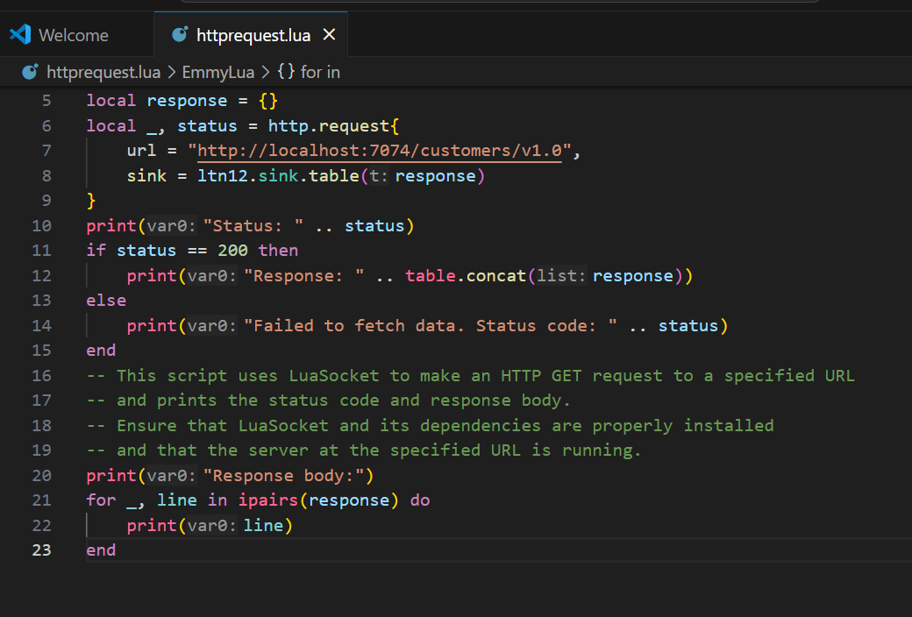
Lua Socket

Slide 5
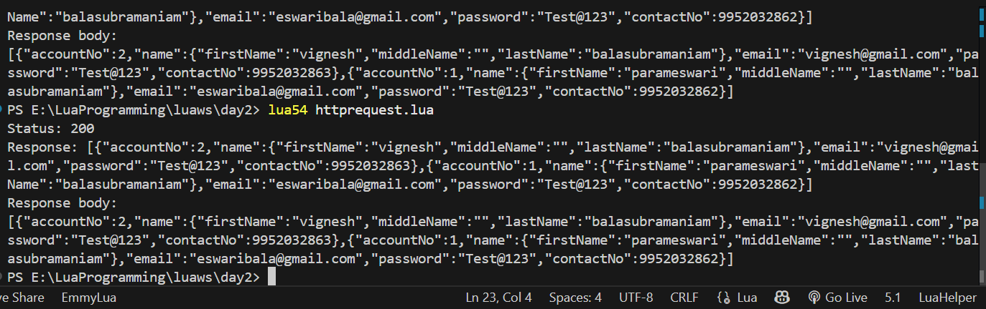
Lua Socket

Slide 6
Luasec for ssl
sudo apt update
sudo apt install openssl libssl-dev
sudo apt install libssl-dev
openssl version
dpkg -L libssl-dev | grep include
sudo apt update
sudo apt install libssl-dev
ls /usr/include/openssl/ssl.h

Slide 7
Luasec for ssl
sudo luarocks install luasec OPENSSL_INCDIR=/usr/include OPENSSL_LIBDIR=/usr/lib/x86_64-linux-gnu

Slide 8
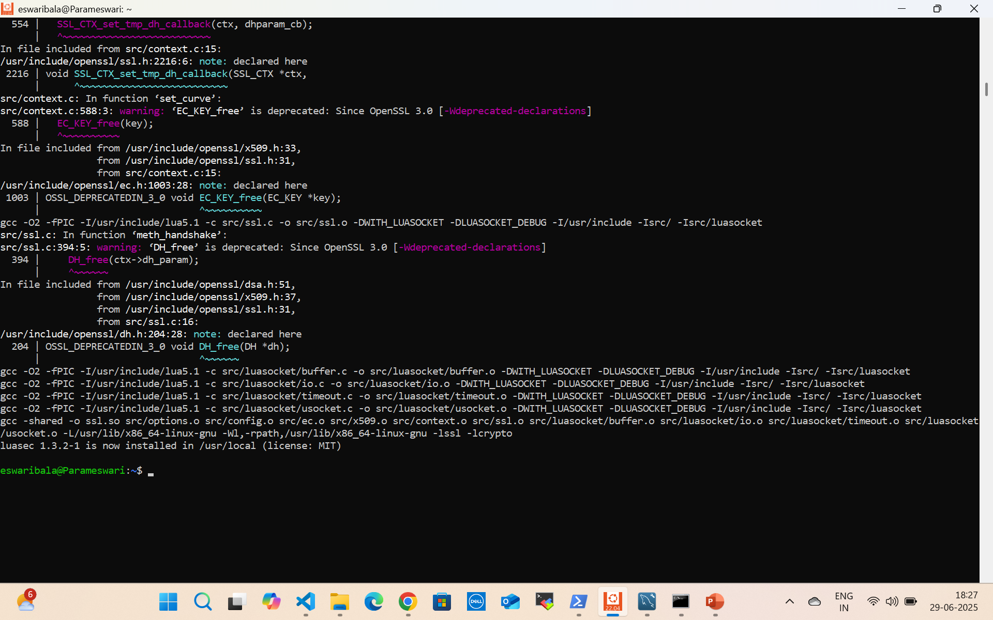
Luasec for ssl

Slide 9
Common Lua Database Connections
Database | Lua Library | LuaRocks Package | Notes
SQLite | lsqlite3 | luarocks install lsqlite3 | Easiest, no server needed
MySQL | luasql.mysql | luarocks install luasql-mysql | Needs MySQL client installed
PostgreSQL | luasql.postgres | luarocks install luasql-postgres | Needs PostgreSQL client installed
MongoDB | luamongo (C++) or REST | Manual build or REST | Complex to build, or use via HTTP
Via Python/REST | Any DB via bridge | Use os.execute or io.popen | Practical and lightweight

Slide 10
Mysql Connection
Now, to install MySQL 8, simply type:
sudo apt install mysql-server
sudo nano /etc/mysql/mysql.conf.d/mysqld.cnf(change port)
sudo service mysql start
sudo mysql_secure_installation
#login as admin
sudo mysql

Slide 11
Mysql Connection
#after that set password
ALTER USER 'root'@'localhost' IDENTIFIED WITH mysql_native_password BY 'newpassword';
mysql -u root -p
create database ecommercedb;
use ecommercedb;
create table Product(ProductId int primary key, Name varchar(50), Cost int);
Notes:
`

Slide 12
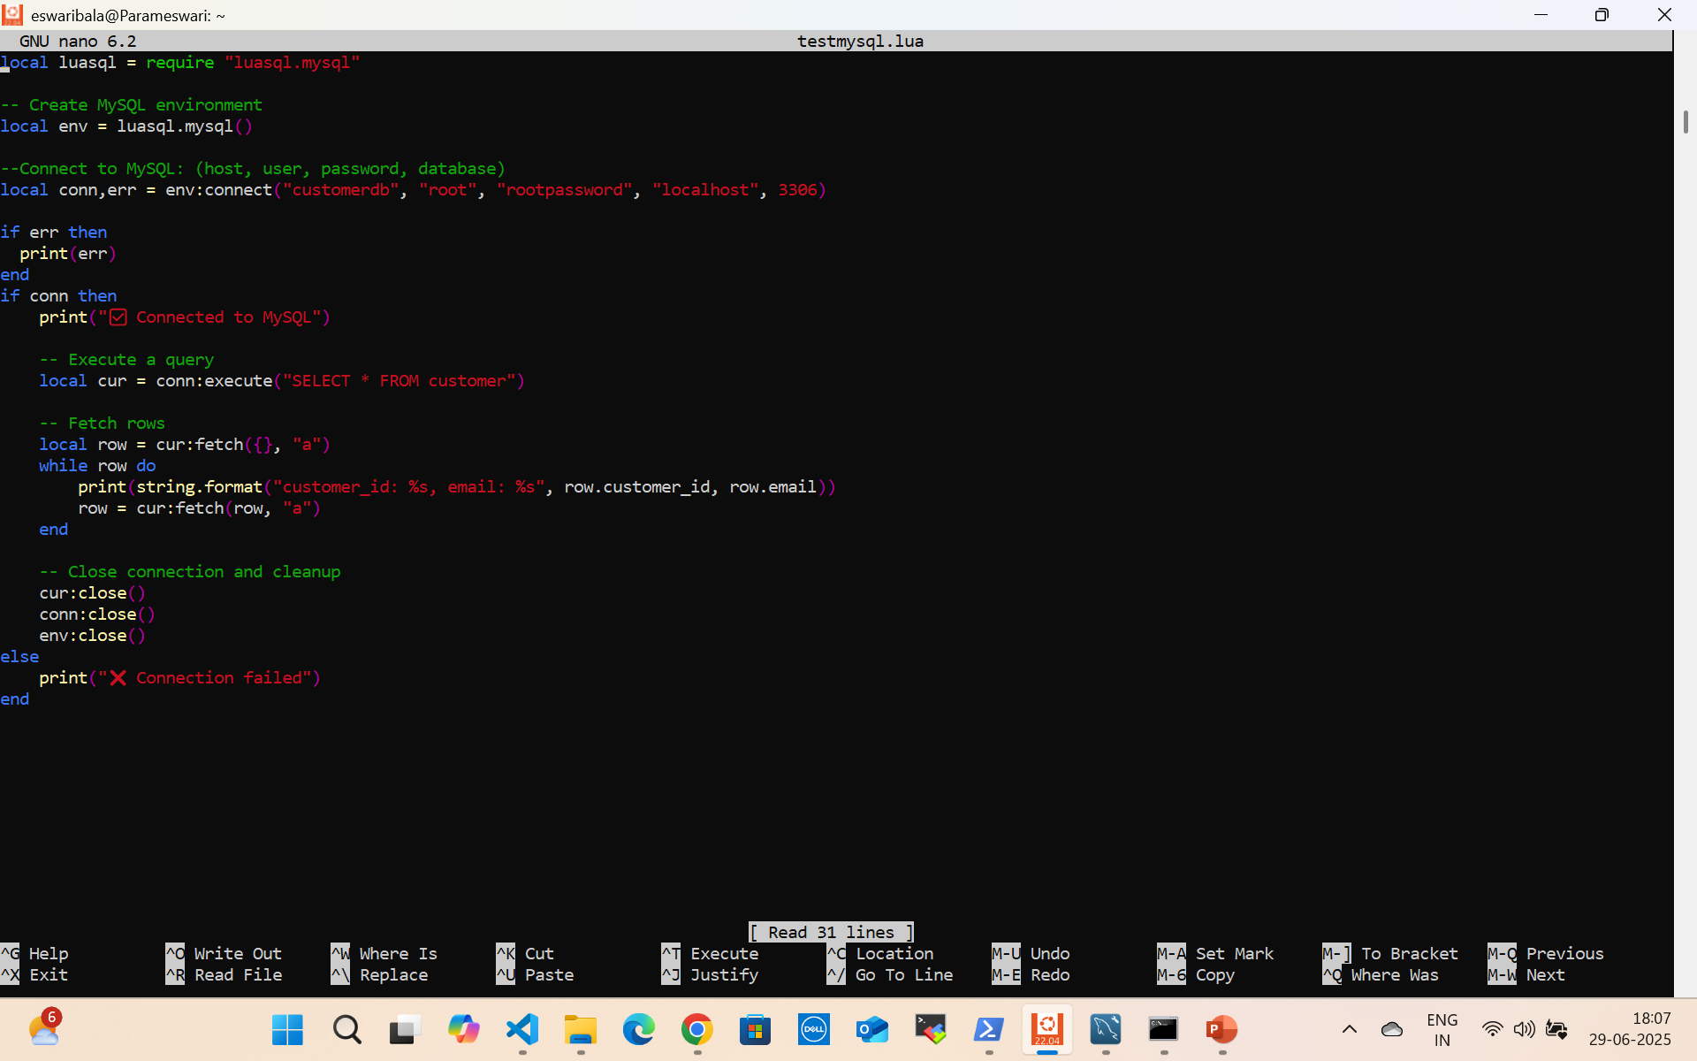
Lua mysql
sudo apt-get install lua-sql-mysql

Slide 13
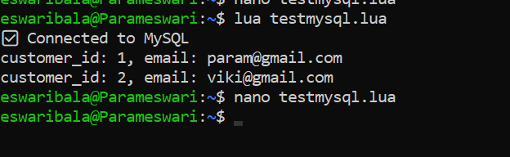
Lua mysql
Lua testmysql.lua

Slide 14
Lua Mongodb
sudo apt update
sudo apt install libbson-dev libmongoc-dev
ls /usr/include/libbson-1.0/bson/bson.h
sudo apt install cmake build-essential pkg-config libssl-dev
git clone https://github.com/mongodb/mongo-c-driver.git
cd mongo-c-driver
git checkout 1.24.4 # Use a stable version
mkdir cmake-build
cd cmake-build
cmake -DENABLE_AUTOMATIC_INIT_AND_CLEANUP=OFF ..
make -j$(nproc)
sudo make install

Slide 15
Lua Mongodb
sudo luarocks install lua-mongo \
LIBBSON_INCDIR=/usr/local/include/libbson-1.0 \
LIBMONGOC_INCDIR=/usr/local/include/libmongoc-1.0 \
LIBBSON_LIBDIR=/usr/local/lib \
LIBMONGOC_LIBDIR=/usr/local/lib

Slide 16
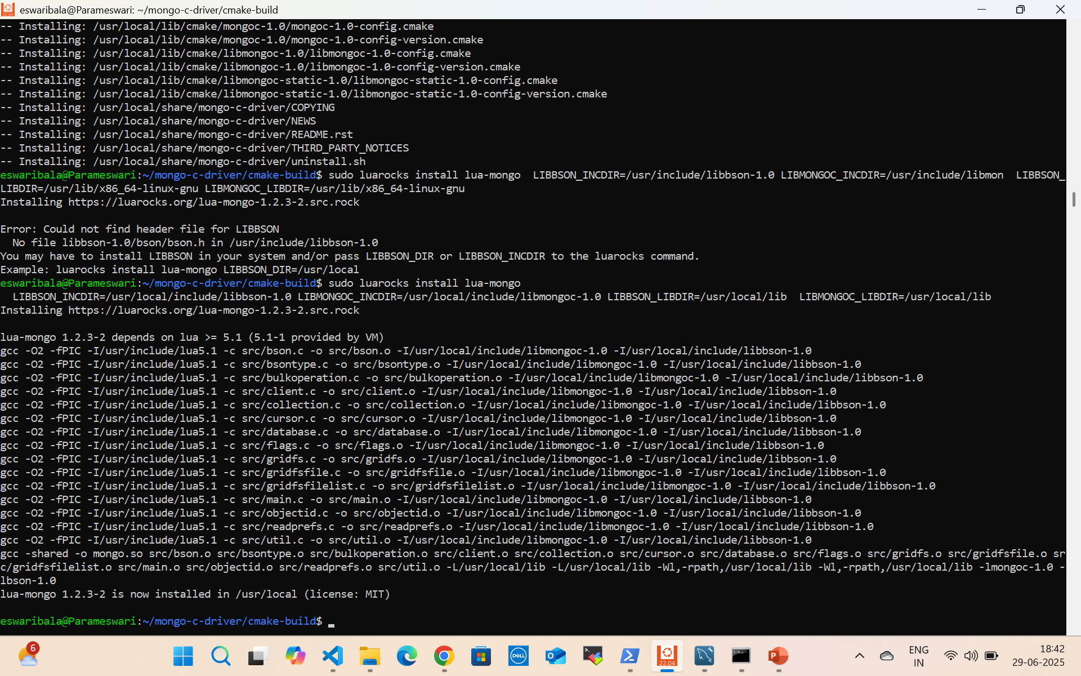
Lua Mongodb

Slide 17
Install mongodb
# Import MongoDB GPG key
curl -fsSL https://pgp.mongodb.com/server-7.0.asc | \
sudo gpg -o /usr/share/keyrings/mongodb-server-7.0.gpg --dearmor
# Add MongoDB repository (for Ubuntu 20.04/22.04/24.04)
echo "deb [ signed-by=/usr/share/keyrings/mongodb-server-7.0.gpg ] https://repo.mongodb.org/apt/ubuntu $(lsb_release -sc)/mongodb-org/7.0 multiverse" | \
sudo tee /etc/apt/sources.list.d/mongodb-org-7.0.list
# Update package list
sudo apt update
# Install MongoDB server, shell, tools
sudo apt install -y mongodb-org

Slide 18
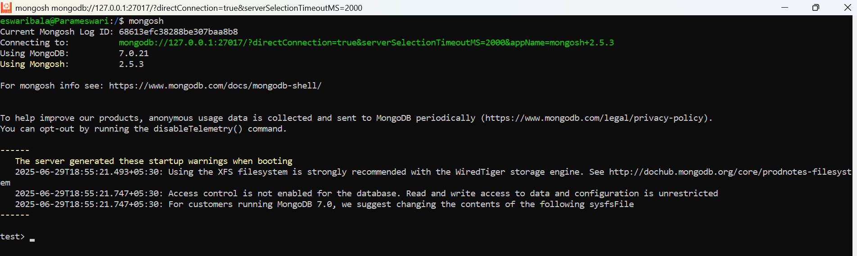
Install mongodb
sudo systemctl start mongod
sudo systemctl status mongod
Mongosh

Slide 19
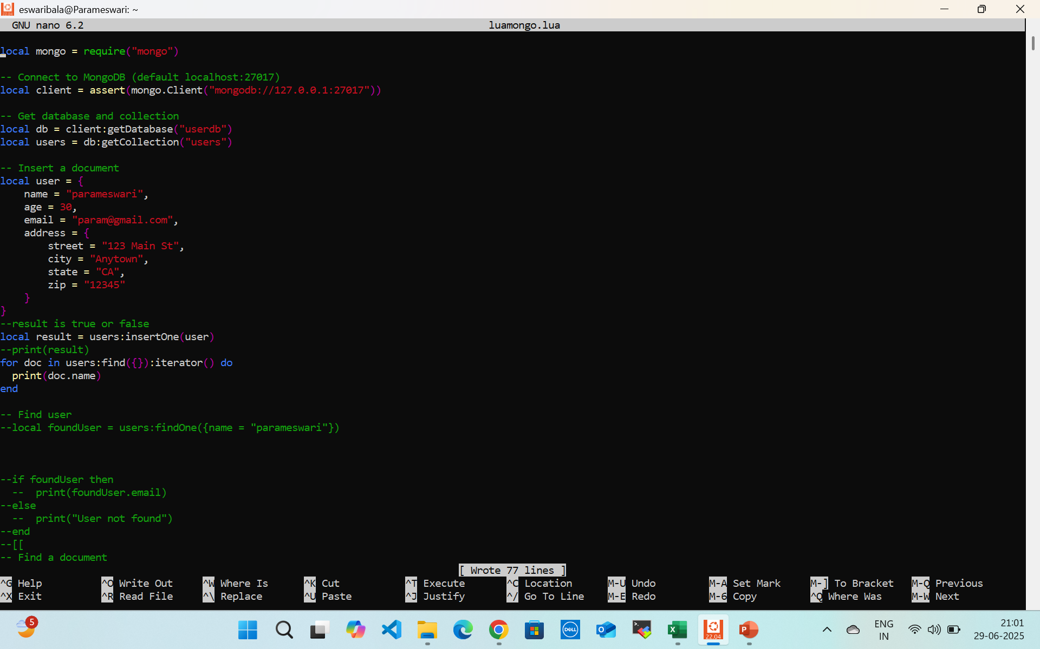
Lua mongo

Slide 20
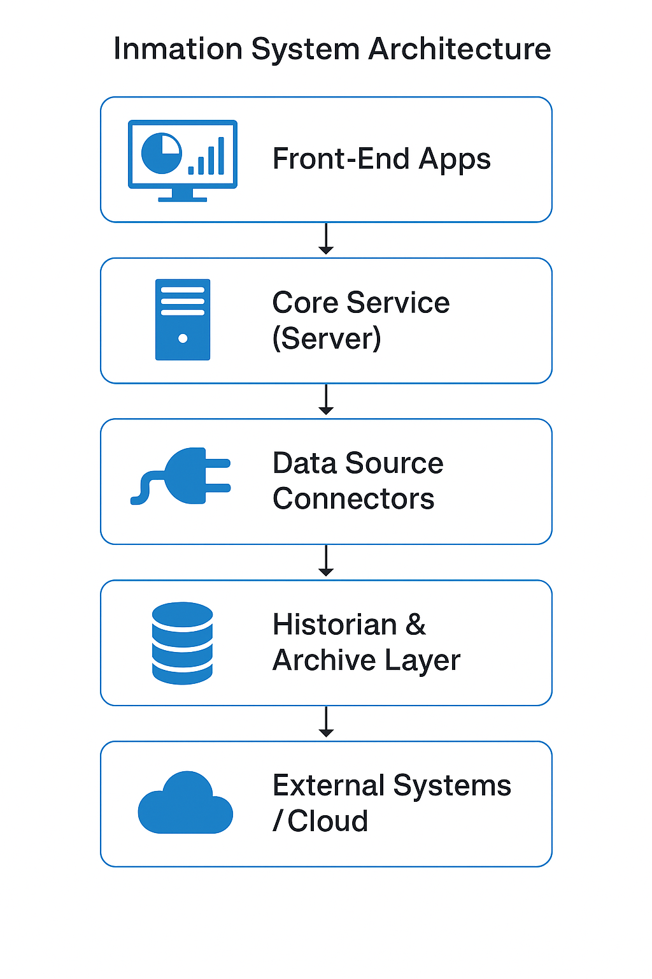
Inmation System Architecture

Slide 21
Inmation Architecture
Front-End Apps
(Dashboard, Excel Add-in, Studio)
Core Service (Server)
Data Source Connectors
(OPC UA, MQTT, REST, SQL, etc.)
Historian & Archiv Layer
External Systems / Cloud (SAP, Azure, AWS, Data Lakes)

Slide 22
1. Core (System CORE)
The main runtime service.
Manages data flows, user access, logging, and scripting (Lua).
Provides REST and WebSocket interfaces.
Stores configuration and runtime state.

Slide 23
Connector (System CONNECT)
Interfaces to industrial protocols:
OPC DA / OPC UA
MQTT
Modbus
DNP3, BACnet, etc.
Pushes raw data to Core.

Slide 24
Frontend Tools
DataStudio – configuration, scripting (Lua), system health.
WebStudio – dashboards and data visualization.
Excel Add-in – access real-time & historical data.
Python API / REST API – integration and automation.

Slide 25
Historian & Storage
Real-time and time-series data storage.
Long-term compression and archiving.
SQL queries via Lua or Python APIs.

Slide 26
Security Layers
User/group authentication (RBAC).
Audit logging.
TLS/SSL for APIs and frontend.

Slide 27
Protocol Support
OPC UA/DA
MQTT (with Sparkplug B support)
REST, SQL, CSV
File Watchers (for CSV/XML ingest)

Slide 28
🧠 Scripting & Automation
Lua scripting is built-in for:
Custom calculations
Alarm/condition handling
Data routing
Scheduled jobs

Slide 29
Real-Time Processing
Supports publish/subscribe model.
Pushes updates in milliseconds to subscribers.
Event and alarm management built-in.

Slide 30
Integration
Compatible with:
Azure IoT Hub
AWS IoT Core
SAP
Ignition SCADA
MES/ERP systems

Slide 31
Use Cases
Pharma 21 CFR Part 11 compliance (audit trail, versioning)
Predictive maintenance
Real-time production monitoring
Digital twin for process optimization

Slide 32
Typical Deployment Model
On-Premise:
Core + Connectors + Studio run on Windows Servers.
Uses secure internal network.
Hybrid/Cloud:
Push data to cloud via MQTT or REST.
Data lake integration with Azure/AWS/GCP.

Slide 33
Matrices and Multi Dimesional Arrays
-- Tags like: SensorGrid.Row1.Col1, Row1.Col2, ..., Row4.Col4
local rows, cols = 4, 4
local matrix = {}
for i = 1, rows do
matrix[i] = {}
for j = 1, cols do
local tag_path = string.format("EnterpriseModel.Plant1.SensorGrid.Row%d.Col%d", i, j)
local tag = syslib.getobjectbyname(tag_path)
matrix[i][j] = tag and tag.value or 0
end
end

Slide 34
Matrices and Multi Dimesional Arrays
-- Check and log values
for i = 1, rows do
for j = 1, cols do
server.log(string.format("Sensor [%d,%d]: %.2f", i, j, matrix[i][j]), 1)
end
end

Slide 35
Queues for Task Scheduling
Maintain a FIFO task queue
Each task has:
id
name
scheduled_time
status (pending, running, done)
Execute tasks at or after scheduled time
Log task execution in Inmation logs

Slide 36
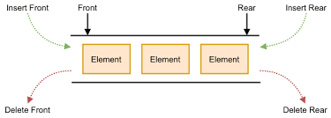
Double Ended Queue
A deque allows you to:
push_front(value) → insert at the beginning
push_back(value) → insert at the end
pop_front() → remove from the beginning
pop_back() → remove from the end

Slide 37
Reverse table
function reverse_list(t)
local reversed = {}
for i = #t, 1, -1 do
table.insert(reversed, t[i])
end
return reversed
end
-- Example
local t = { "one", "two", "three" }
local r = reverse_list(t)
for _, v in ipairs(r) do print(v) end

Slide 38
Reverse Set
Extract keys
Sort them
Reverse that list

Slide 39
String Buffer graph
local buffer = {}
function buffer_append(buf, str)
table.insert(buf, str)
end
function buffer_to_string(buf, separator)
return table.concat(buf, separator or "")
end

Slide 40
String Buffer graph
local buf = {}
buffer_append(buf, "Line 1")
buffer_append(buf, "Line 2")
buffer_append(buf, "Line 3")
local output = buffer_to_string(buf, "\n")
print(output)

Slide 41
Packing and Unpacking Binary Data
Format | Meaning | Size
i1 | signed 1-byte int | 1 byte
i2 | signed 2-byte int | 2 bytes
i4 | signed 4-byte int (int32) | 4 bytes
i8 | signed 8-byte int (int64) | 8 bytes
I4 | unsigned 4-byte int | 4 bytes

Slide 42
Packing and Unpacking Binary Data
local data = string.pack("i4i4i4", 10, 20, 30)
local offset = 1
for i = 1, 3 do
local val
val, offset = string.unpack("i4", data, offset)
print("Unpacked:", val)
end

Slide 43
Questions

Slide 44
Module Summary
Lua Getting Started
Numbers
Strings

