Slide 1

Application Delivery Fundamentals :
Lua Proramming

Slide 2
Goals
Lua Getting Started
Numbers
Strings
Tables
Functions
The External World
Miscellaneous Topics
Closures

Slide 3
Goals
Pattern Matching
Date and Time
Bits and Bytes
Data Structures
Data Files and Serialization
Compilation, Execution, and Errors
Modules and Packages
Iterators and the Generic for

Slide 4
Lua Getting Started
Lua is a robust, lightweight, and embeddable scripting language.
It supports multiple programming methods, including procedural, object-oriented, functional, and data-driven programming.
As the primary focus on Lua is for scripting, it is rarely used as a standalone programming language.
Instead, it is used as a scripting language that can be integrated (embedded) into other programs written in mainly C and C++.
It also supports other programming languages via third-party plugins (NLua/KeraLua for .NET/C#).

Slide 5

Lua Getting Started

Slide 6
Popular use cases for Lua
As a popular component in video game and game engine development.
For example, War frame, World of Warcraft, and CRYENGINE all use Lua.
As a programming language in many network programs, like CISCO Systems, Nmap, and Mod Security.
As a programming language in industrial programs such as Adobe Lightroom and MySQL Workbench.
As a library that developers can integrate with their programs to enable scripting functionality.

Slide 7
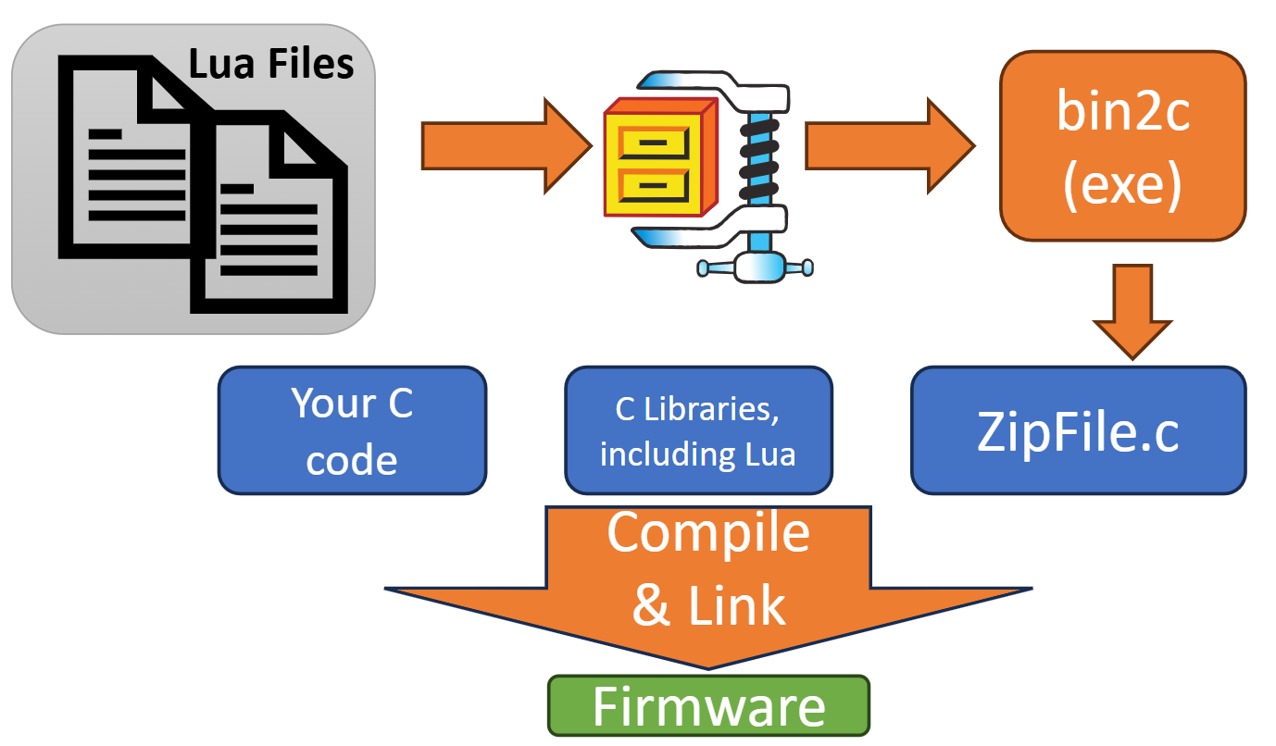
Popular use cases for Lua

Slide 8
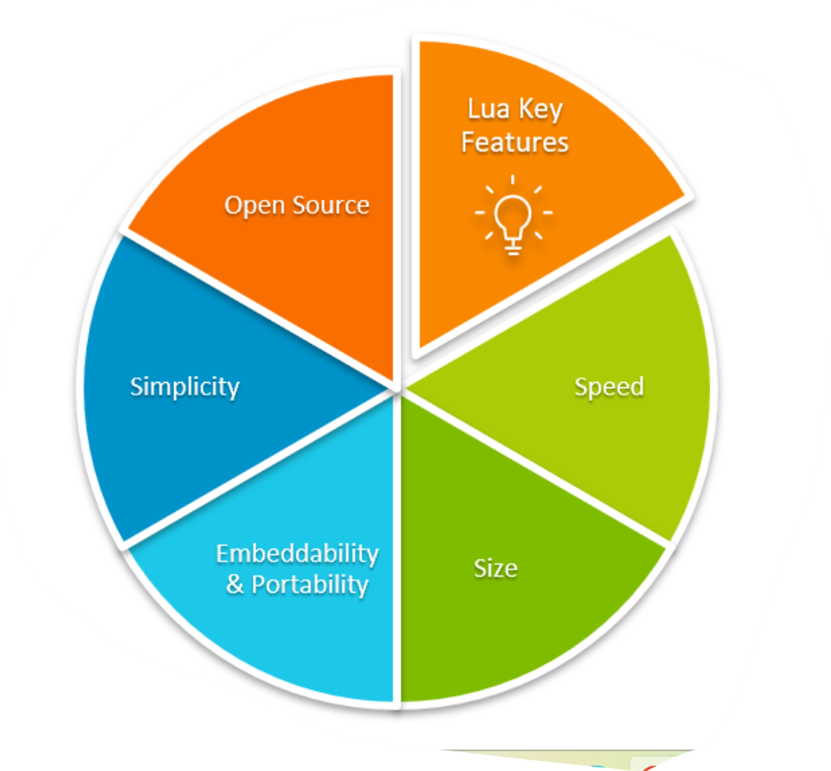
Lua Getting Started

Slide 9
Top Reasons to Use Lua
1. Lightweight and Fast
Tiny footprint (~300 KB compiled)
Written in ANSI C — extremely portable
Fast startup and execution time, ideal for embedded or real-time systems

Slide 10
Top Reasons to Use Lua
2. Embeddable in Other Applications
Easily integrates with C/C++ using Lua’s C API
Commonly used to extend functionality of applications without recompiling
Popular in games: Used by Roblox, World of Warcraft, and Adobe Lightroom

Slide 11
Top Reasons to Use Lua
3. Simple and Easy to Learn
Clean and minimalistic syntax
No unnecessary complexity or boilerplate
Perfect for scripting and quick prototyping

Slide 12
Top Reasons to Use Lua
4. Flexible and Powerful
Everything is a table (can behave like arrays, dictionaries, classes)
Supports coroutines, closures, metatables for powerful behaviors
Dynamically typed, yet safe and stable

Slide 13
Top Reasons to Use Lua
5. Cross-Platform
Runs on Windows, Linux, macOS, iOS, Android, and even microcontrollers
Just recompile Lua and it works nearly anywhere

Slide 14
Top Reasons to Use Lua
Domain | Usage Example
Gaming | Roblox, Angry Birds, WoW
IoT/Embedded | NodeMCU (ESP8266), OpenResty (Nginx)
Image/Video Tools | Adobe Lightroom, VLC, OBS
Web | Nginx with Lua scripts (OpenResty)

Slide 15
Top Reasons to Use Lua
7. Safe for Sandboxing
Lua is often used to run untrusted scripts in a sandboxed environment
Ideal for plugin systems, configuration scripts, and modding

Slide 16
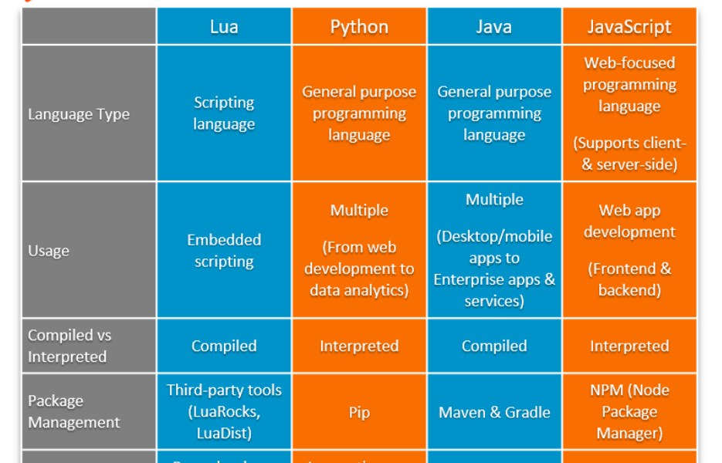
Lua vs Other Scripting Languages

Slide 17
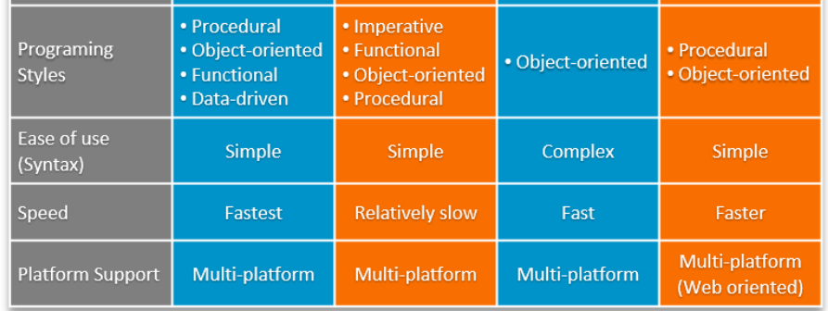
Lua vs Other Scripting Languages

Slide 18
Lua Architecture Overview
Lua Core
Lua VM
Lua Garbage Collector
Lua Standard Libraries
Lua API

Slide 19
Lua Architecture Overview
Lua consists of:
Lua Core (C library) – responsible for memory management, parsing, and execution
Lua VM (Virtual Machine) – a register-based interpreter (not stack-based)
API Layer – allows C/C++ to interact with Lua
Garbage Collector – uses incremental or generational GC
Standard Libraries – I/O, string, math, etc., built atop the core

Slide 20
Lua Architecture Overview
Lua Script (.lua)
Lua Virtual Machine (VM) | Stack based | Bytecode Interpreter
Lua Interpreter
ANSI C Runtime + Memory

Slide 21
Example: Lua Code → Compilation Flow (Source → Bytecode)
Lexer & Parser (llex.c, lparser.c)
Abstract Syntax Tree (AST)
Code Generator (lcode.c)
Bytecode (Prototype)
Lua Source Code (.lua)

Slide 22
What Is an Abstract Syntax Tree (AST)?
An AST is a tree-structured representation of source code where:
Each node represents a construct: variable, function, operator, etc.
Child nodes represent arguments, expressions, or blocks.

Slide 23
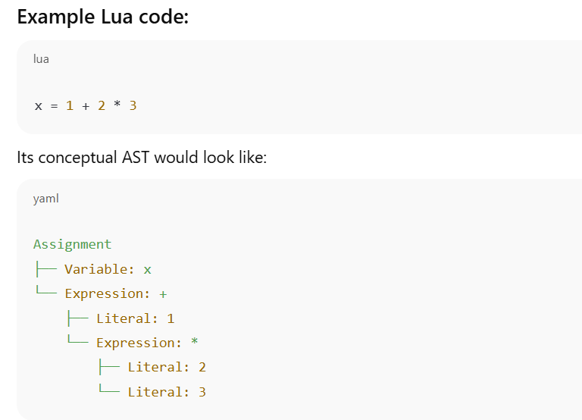
What Is an Abstract Syntax Tree (AST)?

Slide 24
Internals in Lua Source Code
AST is constructed in lparser.c
Parser produces a tree of expressions and statements
That tree is passed to lcode.c to generate bytecode
Lua doesn't keep the AST around at runtime — it is discarded after bytecode generation.

Slide 25
How to View or Generate the AST in Lua?
1. Use Metalua (for Lua 5.1)
mlc = require 'metalua.compiler'
ast = mlc:new():src_to_ast("x = 1 + 2 * 3")
require('pl.pretty').dump(ast)

Slide 26

How to View or Generate the AST in Lua?
2. Use a Lua parser written in Lua (e.g., LuaSrcDiet, luaparse)
LuaSrcDiet: Tokenizer and parser that can extract structure
luaparse (JavaScript): Parses Lua and emits an AST in JS (used in VSCode)
const luaparse = require('luaparse');
const ast = luaparse.parse('x = 1 + 2 * 3');
console.log(JSON.stringify(ast, null, 2));

Slide 27
How to View or Generate the AST in Lua?
Use Lua language servers (for tooling)
Tools like Lua Language Server internally build ASTs to power:
Syntax highlighting
Code navigation
Linting
But they don’t expose it directly unless you're modifying the server.

Slide 28
Summary
Approach | AST Access | Notes
Standard Lua | ❌ No AST exposed | AST discarded after bytecode
Metalua | ✅ Full AST access | Lua 5.1 only
luaparse (JS) | ✅ Full AST in JS | Good for tooling
Language Servers | ✅ Internal use only | For LSP features

Slide 29
Execution Flow
Write Script: write a .lua file or pass a string to luaL_loadstring.
luaL_loadstring is a function from the Lua C API (in lauxlib.h) that compiles a Lua chunk from a given C string and loads it onto the Lua stack. It doesn't execute the chunk -with lua_pcall.
Compilation to Bytecode: Lua source is compiled into intermediate bytecode by the interpreter.
Execution via Virtual Machine (VM): Lua VM is stack-based, executing bytecode instructions.
Interaction with Host Program:
Lua calls C functions (via require, ffi, etc.)
C/C++ calls Lua functions (via the C API)

Slide 30
Lua VM
The Lua Virtual Machine (Lua VM) is the core component of the Lua interpreter that executes compiled Lua bytecode.
It is a register-based virtual machine, which makes it compact and fast compared to stack-based VMs.

Slide 31
Key Features of the Lua VM
Feature | Description
Register-based | Uses registers (virtual) instead of a stack for instruction operands.
Portable | Written in ANSI C; runs on nearly all platforms.
Lightweight | Small footprint; embeddable.
Bytecode interpreter | Executes bytecode generated by the Lua compiler.

Slide 32
Lua VM Components
1. Registers
The Lua VM uses virtual registers (like R0, R1, ...) for local variables and function calls.
Each function call has its own set of registers.
2. Call Stack
Stores information about function calls (return addresses, arguments, etc.).
Managed using Call Info structures.

Slide 33
3. Lua VM Components Instruction Set (Bytecode)
Each instruction is a 32-bit value and has the format:
c
// Types:
iABC, iABx, iAsBx, iAx
// Example:
OP_ADD A B C → R[A] := R[B] + R[C]

Slide 34
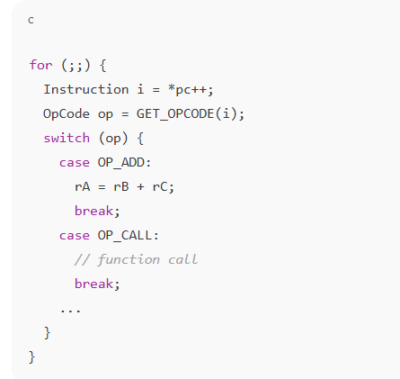
4. Lua VM Dispatch Loop
The Lua VM runs an infinite loop that fetches, decodes, and executes bytecode instructions.

Slide 35
Example: Lua Code → Bytecode
a = 10 + 20
LOADK 0 1 ; R0 = 10
LOADK 1 2 ; R1 = 20
ADD 2 0 1 ; R2 = R0 + R1

Slide 36
Common Bytecode Instructions
Opcode | Action
LOADK | Load constant into register
MOVE | Copy value between registers
ADD | Add values in two registers
CALL | Call a Lua function
RETURN | Return from function
JMP | Jump to another instruction
EQ | Compare equality

Slide 37
Lua VM (Standard Lua Interpreter)
What It Is:
The standard Lua interpreter (e.g., Lua 5.1–5.4) uses a register-based virtual machine.
It interprets bytecode generated from Lua source code.
How It Works:
Your Lua code is compiled into bytecode (Proto).
The Lua VM reads and interprets each bytecode instruction in a loop.
Functions are closures that contain bytecode and data.

Slide 38
Lua VM (Standard Lua Interpreter)
Characteristics:
Slower than native machine code execution
Portable and simple
Easier to debug
Great for scripting and embedded environments

Slide 39
Lua VM (Standard Lua Interpreter)
local x = 10
print(x + 1)
Gets compiled into instructions like LOADK, ADD, CALL (executed one by one by VM).

Slide 40
LuaJIT (Just-In-Time Compiler)
🔧 What It Is:
A high-performance implementation of Lua 5.1 with a JIT compiler.
Translates Lua bytecode into native machine code at runtime.
⚙️ How It Works:
LuaJIT starts interpreting just like the standard VM.
Hot code paths (frequently executed functions/loops) are identified.
These paths are compiled into native machine code and cached.
The next time they're run, the native code executes directly.

Slide 41
LuaJIT (Just-In-Time Compiler)
📈 Characteristics:
Much faster than standard Lua (often 5–20x)
Uses trace-based JIT (records linear paths of execution)
Retains compatibility with most Lua 5.1 code (plus some 5.2 features)

Slide 42
Lua VM (Standard Lua Interpreter)
What It Is:
The standard Lua interpreter (e.g., Lua 5.1–5.4) uses a register-based virtual machine.
It interprets bytecode generated from Lua source code.

Slide 43
Key Differences Table:
Feature | Lua VM (PUC-Rio) | LuaJIT
Execution model | Interpreted bytecode | JIT-compiles hot code to machine code
Performance | Slower | Much faster
Memory usage | Lower | Higher (due to JIT traces/cache)
Debugging | Simpler | Harder to debug native code paths
Compatibility | Lua 5.1–5.4 | Lua 5.1 (partial 5.2/FFI extensions)
Portability | Highly portable | Architecture-dependent
Used in | Embedded systems, games | Performance-critical apps, games

Slide 44
When to Use Which?
Scenario | Use
Simple scripting or embedded | Standard Lua VM
Heavy computation, game logic, or high-performance scripting | LuaJIT
Need for full Lua 5.3+ features (e.g., integers, bitwise ops) | Lua 5.3+ VM
Need for C interoperability and speed | LuaJIT (with FFI)

Slide 45
Bonus: LuaJIT’s FFI (Foreign Function Interface)
LuaJIT’s FFI allows you to call C functions directly from Lua without writing C glue code:
local ffi = require("ffi")
ffi.cdef[[ double cos(double x); ]]
print(ffi.C.cos(0)) --> 1.0

Slide 46
Optimization: Lua JIT
Lua JIT replaces the Lua VM with a JIT compiler.
Translates bytecode into native machine code on-the-fly.
Up to 10x faster than standard Lua VM in many cases.

Slide 47
Detect Lua or LuaJIT:
lua -v
# or
luajit –v

Slide 48
Detect Lua or LuaJIT:
Detect LuaJIT at runtime:
if jit then
print("Running with LuaJIT", jit.version)
else
print("Running with standard Lua", _VERSION)
end

Slide 49
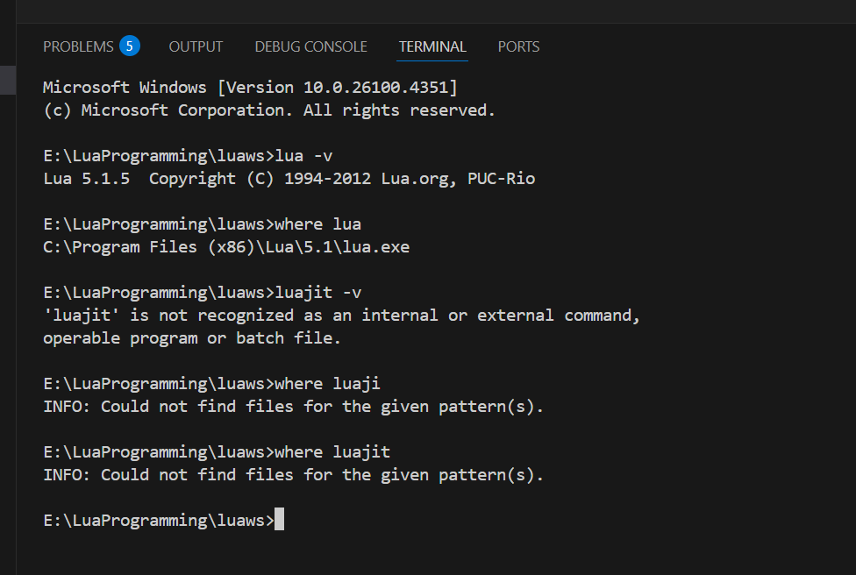
Detect Lua or LuaJIT:

Slide 50
Summary
Method | Detects | Code/Command
CLI | Interpreter type | lua -v, luajit -v
Lua code | Lua vs LuaJIT | if jit then ...
C API | Embedded interpreter | lua_getglobal(L, "_VERSION")
Executable path | Runtime being called | which lua or where lua

Slide 51
Lua Core
The Lua Core is the heart of the Lua interpreter.
It's written entirely in ANSI C, making it portable, lightweight, and embeddable.
The core includes the essential parts that power Lua's runtime and execution.

Slide 52
1. Components of Lua Core
File | Responsibility
lapi.c | Public C API implementation
lcode.c | Bytecode generator
llex.c | Lexical analyzer (tokenizer)
lparser.c | Recursive descent parser
lvm.c | Virtual machine (bytecode execution engine)
ltable.c | Hash table (table) implementation
lgc.c | Garbage collection logic
lstate.c | State machine (Lua state lua_State)
lfunc.c | Closures, function objects, upvalues
lobject.c | Value tagging, object management
lstring.c | String interning and management
lmem.c | Memory allocator wrappers

Slide 53
2. Key Data Structures
lua_State
The main execution context (like a Lua thread).
Contains:
Call stack
Global environment
Registry
Error handling info

Slide 54
2. Key Data Structures
TValue
Generic tagged value representation.
All Lua types (number, boolean, string, function, etc.) use this unified format.
typedef struct TValue {
int tt_;
union {
double n; // Number
int b; // Boolean
GCObject *gc; // Pointer to GC-managed objects
void *p; // Light userdata
} value_;
} TValue;

Slide 55
2. Key Data Structures
Table
Lua's primary data structure.
Implements both arrays and hashes using hybrid storage.
Dynamically resizes and rehashes.

Slide 56
3. How the Lua Core Executes Code Step-by-step
Lexing – llex.c:
Breaks script into tokens.
Skips whitespace/comments.
Parsing – lparser.c:
Converts tokens into an abstract syntax tree (AST).
Builds function prototypes (Proto).
Code Generation – lcode.c:
Translates AST into register-based bytecode.
Execution – lvm.c:
Executes bytecode instruction-by-instruction in Lua VM.

Slide 57
4. Garbage Collection (GC)
Managed in lgc.c:
Uses incremental or generational GC
Can be configured via the API: lua_gc
GC handles all heap-allocated objects:
Tables
Strings
Functions
User data

Slide 58
5. Lua C API Interface (lapi.c)
This is the interface for embedding Lua in C/C++.
Common functions:
lua_getglobal(L, "varname")
lua_pushnumber(L, 42)
lua_settable(L, -3)
lua_pcall(L, nargs, nresults, errfunc)
The Lua stack (virtual) is the bridge for C↔Lua interaction.

Slide 59
6. Customization & Portability
You can replace Lua's memory allocator via lua_newstate().
Can remove/replace standard libraries (base, io, os, etc.).
Lua compiles easily on any platform with a C compiler.

Slide 60
Summary: Core Responsibilities
Component | Purpose
Lexer & Parser | Tokenize and parse Lua code
CodeGen | Generate bytecode from AST
VM | Execute bytecode (register-based)
GC | Automatic memory management
C API | Allow C code to run/manipulate Lua
Tables | Backbone of Lua data structure
Functions | First-class, closures supported

Slide 61
Lua Memory Management
Lua's memory management is automatic and efficient, designed to be lightweight for embedding in applications.
It uses a garbage collector (GC) based on an incremental, generational, mark-and-sweep algorithm.

Slide 62
Lua Memory Management
Concept | Description
Automatic Memory | All memory (tables, functions, strings, etc.) is allocated dynamically.
Garbage Collector | Frees unused objects to reclaim memory.
Userdata Support | Allows C/C++ objects to be managed by Lua's GC using metatables.
Memory Limits | Memory can be tracked and limited via hooks for embedded systems.

Slide 63
Lua Memory Management - Garbage Collection Process
Marking
Start with root objects and mark all reachable objects.
Propagation
Traverse tables, closures, etc., and mark what they reference.
Pause
Wait until the next GC cycle.
Atomic
Sweeping
Final marking to handle any missed objects during propagation.
Finalization
Unreachable (unmarked) objects are freed.
Call __gc metamethods for objects with finalizers.

Slide 64
Lua Memory Management - Memory Allocation Functions
All Lua allocations go through a customizable allocator:
void *(*lua_Alloc)(void *ud, void *ptr, size_t osize, size_t nsize);
ptr: current block (NULL if allocating)
osize: old size
nsize: new size (0 means free)
You can set this allocator using lua_newstate().

Slide 65
What Lua Collects
Type | Collected? | Notes
Tables | ✅ | Even metatables are collectable
Strings | ✅ | Interned, collected if unreferenced
Functions | ✅ | Lua and C closures are managed
Userdata | ✅ | With optional __gc finalizers
Threads | ✅ | Coroutines are collectable

Slide 66
Memory Management in Embedded Systems
In embedded environments (like games or IoT), you can:
Set custom allocators to track or limit memory usage.
Use meta tables to add destructors (__gc) to complex objects.
Monitor memory usage via lua_gc() in C.

Slide 67
Source Code Pointers
File | Role
lgc.c | Implements the garbage collector
lmem.c | Memory allocator interface
lstring.c | String interning and freeing
ltable.c | Table management and resizing
lapi.c | Exposes memory functions via C API

Slide 68
Best Practices for Efficient Memory Use
Avoid
Avoid long-lived unused tables – can delay GC.
Use
Use nil to clear references (e.g., t[i] = nil).
Minimize
Minimize string creation – Lua interns strings, which takes memory.
Use
Use collect garbage wisely – especially in memory-constrained environments.
Watch
Watch closures – they retain their upvalues.

Slide 69
Lua Version History
Version | Release Year | Key Features
1.0 | 1993 | First release; simple procedural language
2.1 | 1994 | Added real functions and tag methods (early metatables)
3.0 | 1997 | Lexical scoping; improved tables
4.0 | 2000 | Better support for C API; upvalues introduced
5.0 | 2003 | Coroutines, closures, require(), improved GC
5.1 | 2006 | Module system, package, **setfenv/getfenv`, new VM
5.2 | 2011 | _ENV (lexical environments), goto, bit32, better xpcall
5.3 | 2015 | Integers, bitwise operators, utf8 lib, math.type()
5.4 | 2020 | To-be-closed variables, const, generational GC, warning system

Slide 70
Summary
Version | Most Known For
5.0 | Coroutines, closures
5.1 | Widely adopted, LuaJIT base
5.2 | _ENV, goto, bitwise ops
5.3 | Integers, UTF-8 support
5.4 | Const, close vars, GenGC

Slide 71
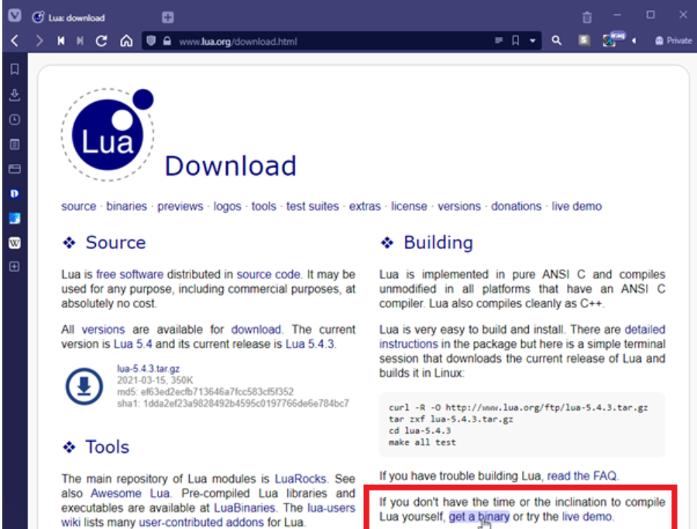
Installing Lua
Navigate to the Lua.org download page.

Slide 72
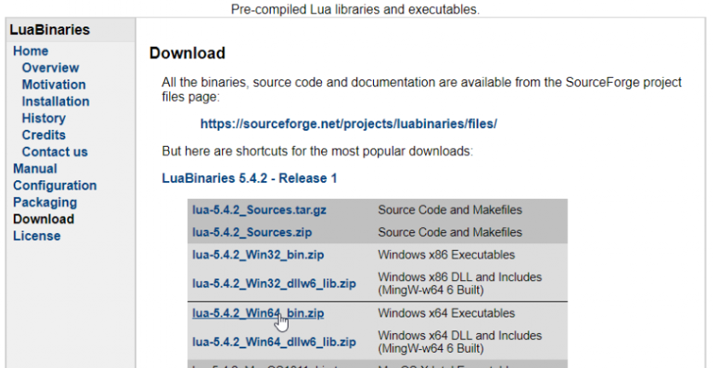
Installing Lua

Slide 73
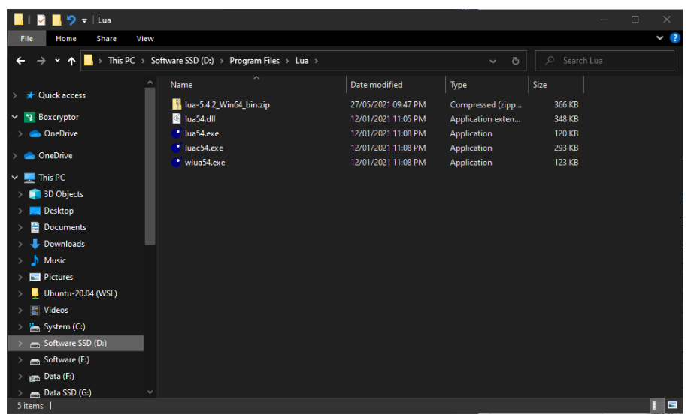
Installing Lua

Slide 74
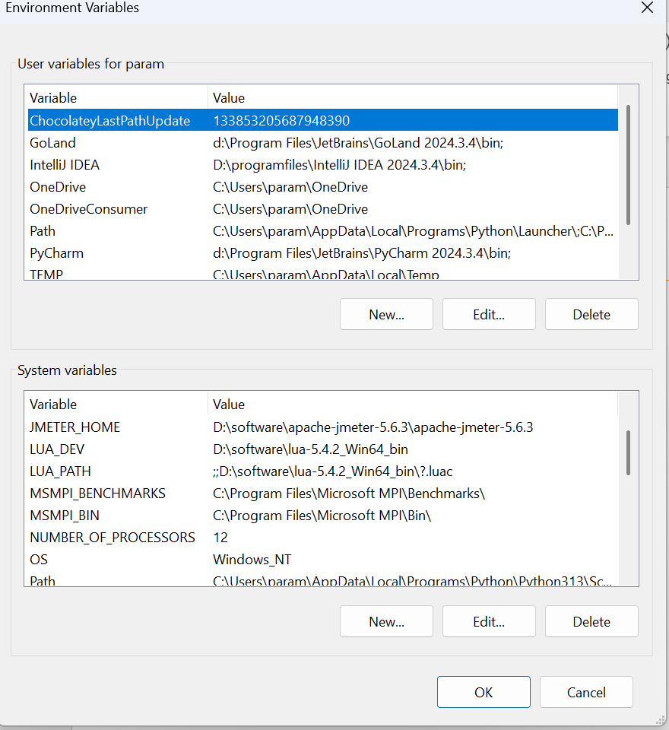

Installing Lua

Slide 75
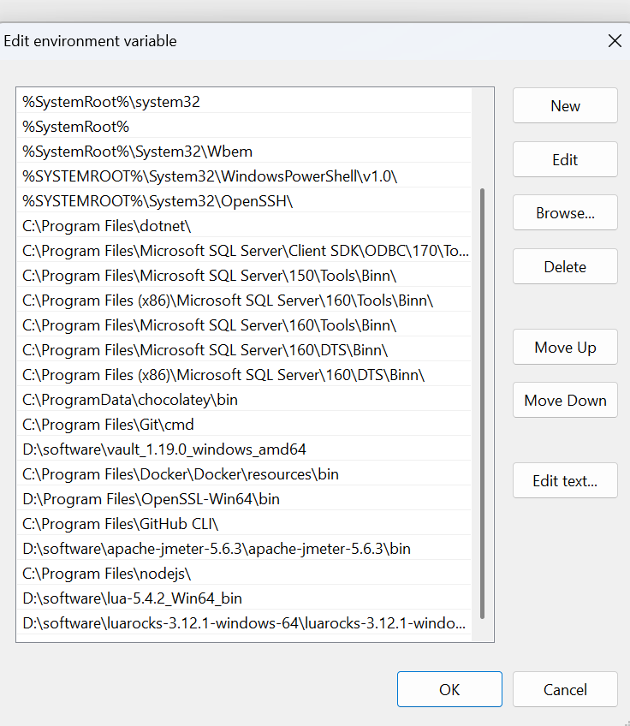

Installing Lua

Slide 76
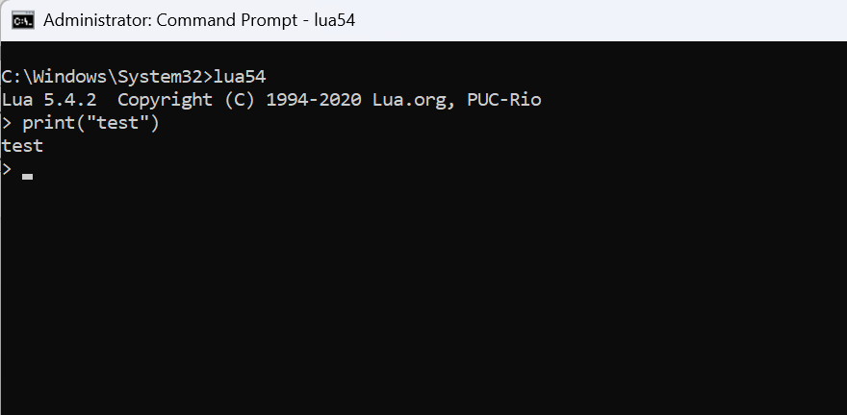
Installing Lua

Slide 77
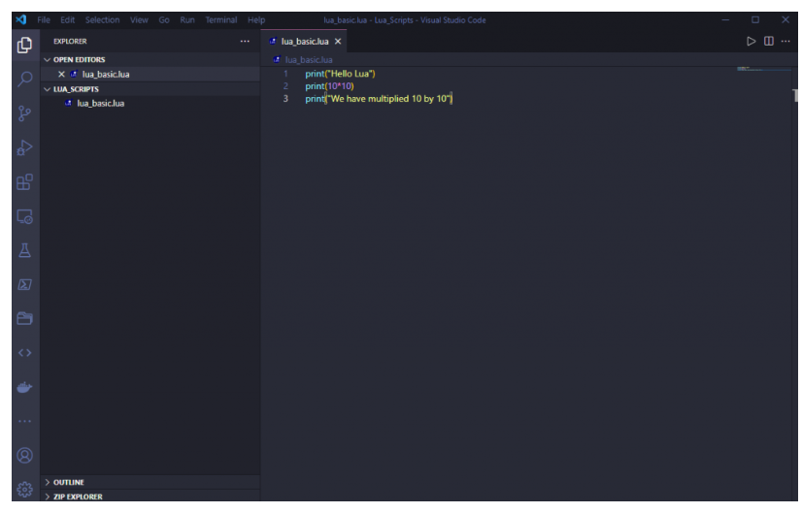
VS Code

Slide 78
1. What Is a Chunk?
In Lua, a chunk is the fundamental unit of execution — a compilable and executable block of code.
Internally, a chunk is compiled into a function prototype (Proto) which is managed by the Lua virtual machine (VM).
This allows Lua to treat chunks as first-class functions.

Slide 79
1. What Is a Chunk?
In Lua, a chunk is the unit of execution — essentially, any piece of Lua code that can be executed.
This includes:
A file loaded via dofile, loadfile, or require
A string loaded via load, loadstring, or luaL_loadstring (in C)
Inline code passed to the interpreter

Slide 80
1. What Is a Chunk?
A chunk can be:
A Lua file (e.g., myscript.lua)
A string of Lua code (e.g., from load() or loadstring() in older versions)
A bytecode block (precompiled with luac)
-- File as a chunk
dofile("myscript.lua")
-- String as a chunk
load("print('Hello from chunk')")()

Slide 81
1. What Is a Chunk?
When executed, a chunk behaves like an anonymous function:
It can contain statements and expressions.
It can return values.
It can define local/global variables, functions, etc.

Slide 82
Internals of a Lua Chunk
1. Definition
A chunk is:
A file or string of Lua code
Parsed by the Lua compiler
Translated into bytecode (for the Lua VM)
Executed as a Lua closure

Slide 83
Internals of a Lua Chunk
2. Compilation Steps
load("print('hello')")
Internally, this performs:
Lexical analysis → Tokenizes the code
Parsing → Builds an abstract syntax tree (AST)
Code generation → Compiles to a Proto (prototype object)
Closure creation → A C closure wraps the prototype for executionluaL_loadstring(L, "print('hi')");

Slide 84
Internals of a Lua Chunk
2. Compilation Steps
luaL_loadstring(L, "print('hi')");
This pushes a Lua function (closure) on top of the stack, compiled from a hidden internal Proto struct.

Slide 85
Chunk as Anonymous Function
A chunk is treated like:
function(...)
-- chunk code here
end
That’s why you can:
Use return at top-level
Store chunks in variables or pass them as functions
Expect local variables inside a chunk to die after execution

Slide 86
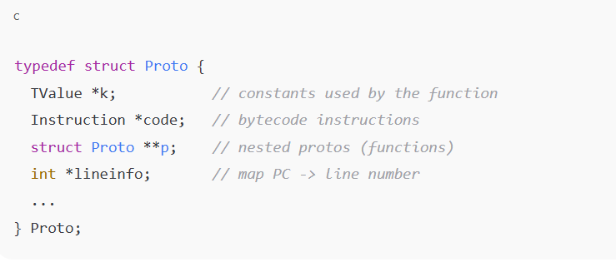
Internal Structure (Proto)
Lua represents a compiled chunk with the Proto structure (from lobject.h in Lua's C source):

Slide 87
Internal Structure (Proto)
Each compiled chunk stores:
Constants (k) – literals, strings, numbers
Bytecode instructions (code)
Nested functions (p)
Debug info – line mapping, local variable names

Slide 88
Execution Process
print("Lua internals")
Lua internally does:
Parse → AST
Compile → Proto
Wrap in LClosure (Lua closure)
Push closure onto the stack
Call using lua_pcall

Slide 89
Summary
Feature | Description
Chunk | Executable block of Lua code
Compiled into | Function prototype (Proto)
Runtime form | Lua closure (LClosure)
Scope | Local (lexical) scope per chunk
Stored in | Constants table, bytecode, debug info
Use cases | Scripts, modules, REPL input, sandbox

Slide 90
Why to use chunk
Modularize code (each module is a chunk)
Dynamically load and execute Lua code
Sandbox execution
Lua’s REPL runs one chunk at a time

Slide 91
Lexical Scoping in Chunks
Each chunk creates its own scope:
load("local x = 42")()
print(x) -- nil; x was local to the chunk

Slide 92
2. How Chunks Are Executed
Internally:
Source code is parsed into an Abstract Syntax Tree (AST).
AST is compiled into bytecode (Proto object).
Bytecode is executed by the Lua Virtual Machine (VM).
This is managed through:
lua_load(): compiles a chunk.
lua_pcall(): calls the compiled function safely.

Slide 93
Types of Chunks
Type | Example | Function
File Chunk | dofile("my.lua") | Executes the entire file
String Chunk | load("x = 2 + 3")() | Compiles and runs the string
Binary Chunk | Precompiled via luac -o a.luac | Faster loading in production

Slide 94
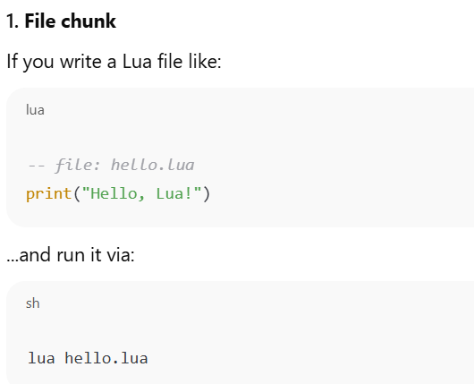
Types of Chunks

Slide 95
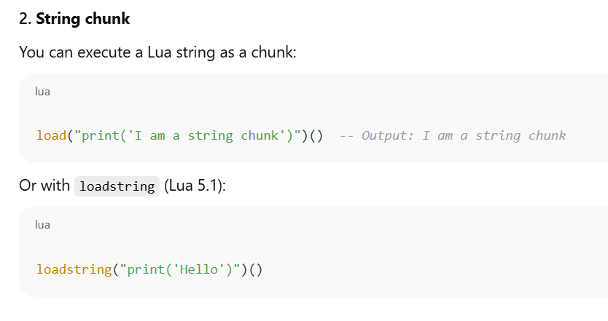
Types of Chunks

Slide 96
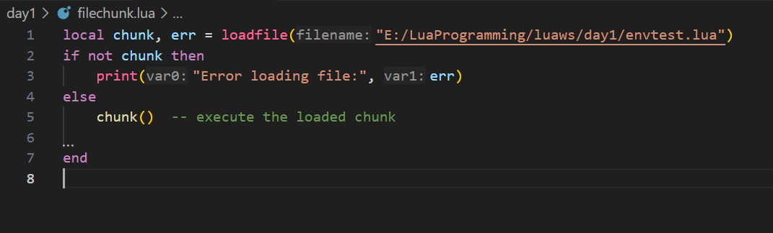
File Chunk

Slide 97
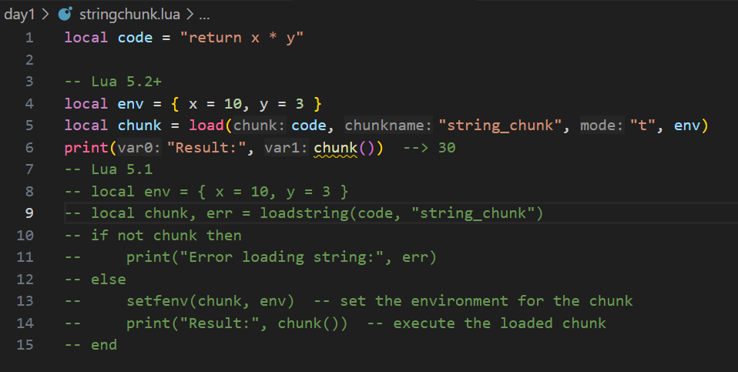
String Chunk

Slide 98
Binary Chunk
A binary chunk in Lua is a precompiled version of a Lua script. Instead of saving your code as plain .lua, you compile it into a bytecode file using the luac compiler.
🧠 This is useful for:
Speeding up loading (faster than parsing)
Obfuscating source code (not readable as text)
Embedding Lua code into applications

Slide 99
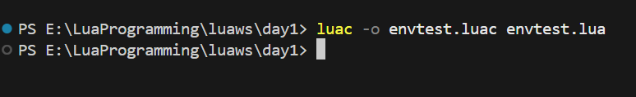
Binary Chunk - Compile to binary chunk using luac
luac -o mychunk.luac myscript.lua

Slide 100
Binary Chunk – How to load Binary Chunk
local chunk = loadfile("mychunk.luac")
if chunk then
local result = chunk()
print("Result:", result)
else
print("Failed to load binary chunk.")
end

Slide 101
Chunk Structure
Every chunk behaves like the body of an anonymous function:
-- top-level chunk
local x = 10
print(x)
Is internally
return function()
local x = 10
print(x)
end

Slide 102
Chunk Structure
Chunks from C (via C API)
luaL_loadstring(L, "print('From C chunk')"); // Compiles chunk
lua_pcall(L, 0, 0, 0); // Executes chunk

Slide 103
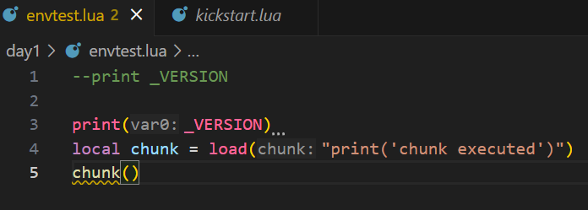
Chunks Are Functions
When a chunk is loaded, Lua wraps it in an anonymous function:
local f = load("return 2 + 2")
print(f()) -- prints 4
You can assign this to variables or call it later.
The chunk inherits the environment it's executed in (_ENV).

Slide 104
Chunk Environments
In Lua 5.2+, chunks run in a specific environment using the _ENV table:
_ENV = { print = print }
load("print('Hello')")() --> OK
-- Limiting environment
load("os.exit()")() --> Error if `os` is not in _ENV
In Lua 5.1, environments were set with setfenv.

Slide 105
Precompiled Chunks (Bytecode)
Use luac to compile:
luac -o mychunk.luac mychunk.lua
Load it in Lua:
dofile("mychunk.luac")
This skips parsing and speeds up execution but reduces portability across Lua versions.

Slide 106
Example: Lua Code → Compilation Flow (Source → Bytecode)
Lexer → Tokens
↓ (lparser.c)
Parser → AST
↓ (lcode.c)
CodeGen → Bytecode (Proto)
↓ (lvm.c)
Execution in Lua VM
Chunk (source code)
↓ (llex.c)

Slide 107
Practical Use Cases
Dynamic evaluation: load() code at runtime
Code sandboxing: run chunks in restricted environments
Plugin systems: load custom logic from files or DB
Optimization: use luac to speed up load time

Slide 108
Lua Lexical Conventions & Global Variables
Lexical conventions define the syntax rules of the language — how tokens (keywords, variables, operators, etc.) are formed and recognized.
Understanding these is essential for writing valid Lua code and managing global/local variables properly.

Slide 109
Lexical Elements in Lua
Element | Description
Identifiers | Names for variables, functions, etc.
Keywords | Reserved words like if, then, end
Operators | +, -, .., ==, etc.
Separators | (, ), {, }, ,, ;, etc.
Literals | Numbers, strings, booleans, nil
Comments | -- line, --[[ block ]]

Slide 110
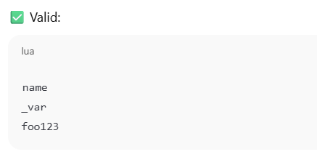
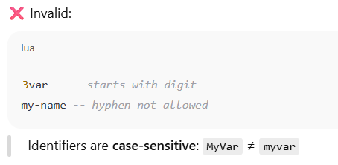
Identifiers
Used to name variables, functions, tables, etc.,
Used to name variables, functions, tables, etc.,
Rules:
Must start with a letter (A–Z, a–z) or underscore_
Followed by letters, digits, or underscores

Slide 111
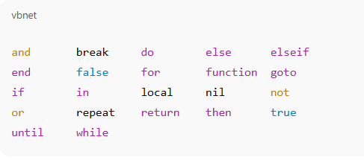
Keywords in Lua
Cannot be used as keywords

Slide 112
Global Variables
By default, any variable assigned without local is global.
x = 10 -- global
local y = 5 -- local
print(x, y)

Slide 113
Accessing/Modifying Globals Programmatically
Lua stores all global variables in the _G table:
x = 42
print(_G["x"]) --> 42
_G["newVar"] = "Hello"
print(newVar) --> Hello

Slide 114
Literals
Numbers: 10, 3.14, 0xFF
Strings: 'hello', "world", [[multiline]]
Booleans: true, false
Nil: nil (absence of a value)

Slide 115
Comments
-- single-line comment
--[[
multi-line comment
]]

Slide 116
Types and Values Nil Booleans
Lua: Types and Values Overview
Lua has 8 basic types
nil
Boolean
Number
String
Function
Userdata
Thread
table

Slide 117
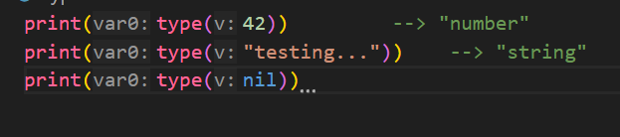
Type Checking

Slide 118
Type: nil
Represents the absence of a value or non-existence.
Used to delete table entries or mark uninitialized variables.
local x
print(x) --> nil
x = nil -- explicitly clearing a variable
Accessing a non-existent global returns nil
print(someUndefinedVar) --> nil

Slide 119
Type: boolean
Lua uses boolean values:
true
False
Only false and nil are falsy
Everything else (even 0 and "") is treated as true.

Slide 120
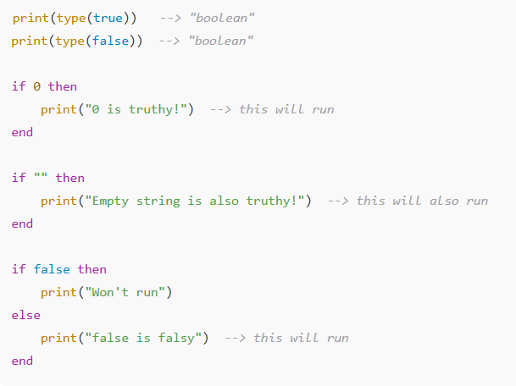
Type: boolean

Slide 121
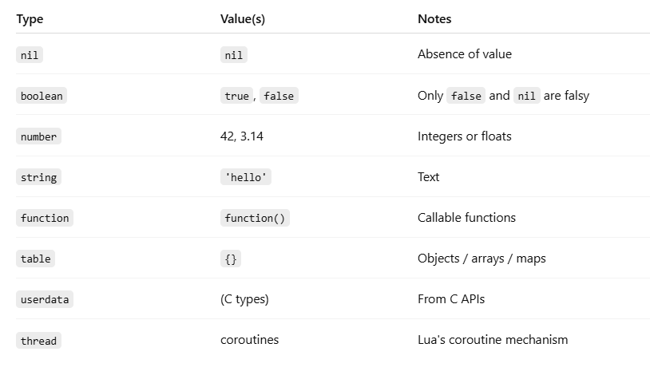
Summary Table

Slide 122
Standalone Interpreter
The Stand-Alone Interpreter typically refers to the command-line version of a language interpreter.
It runs independently, without requiring embedding into another application or development environment.

Slide 123
Definition
A stand-alone interpreter is an executable program that:
Reads code (from files or directly from standard input),
Parses and executes the code line-by-line or as a whole script,
Requires no additional embedding in another application.

Slide 124
Examples of Stand-Alone Interpreters
Language | Interpreter Command | Description
Lua | lua | The stand-alone Lua interpreter that executes .lua scripts.
Python | python / python3 | Runs .py files or opens an interactive shell.
Ruby | irb / ruby | Executes .rb files or opens an interactive Ruby shell.
Node.js (JavaScript) | node | Runs .js files or opens a JavaScript REPL.

Slide 125
Lua Example (Stand-Alone Interpreter)
lua myscript.lua
lua
> print(“Ticking…")
lua is the stand-alone interpreter.
It reads the file or user input and executes Lua code directly.

Slide 126
Features of Stand-Alone Interpreters
✔️ Simple and fast setup
✔️ Useful for scripting, testing, and automation
✔️ Portable across systems (especially with small interpreters like Lua)
❌ May lack the full capabilities of integrated environments or frameworks

Slide 127
Use Cases
Running simple scripts or automation tasks
Quick prototyping or interactive debugging
Embedding logic in command-line utilities
Learning and experimenting with code

Slide 128
Numerals – In Programming and Scripting (e.g., Lua, Python)
Numerals refer to the number literals used to represent numeric values directly in the code.

Slide 129
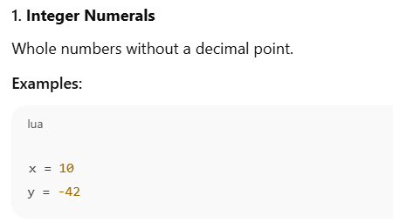
Types of Numerals

Slide 130
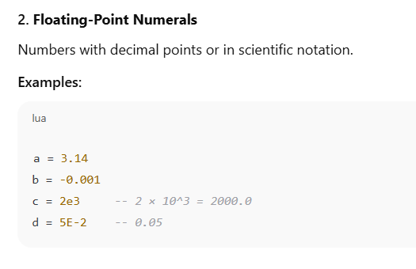
Types of Numerals

Slide 131
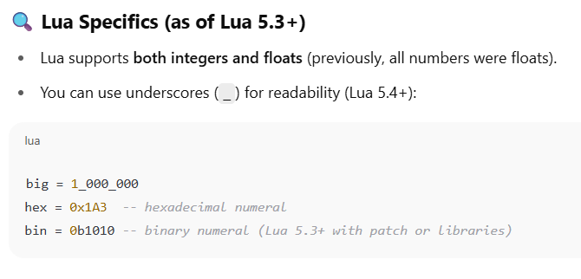
Types of Numerals

Slide 132
Types of Numerals
Language | Integer Example | Float Example | Scientific Notation
Python | x = 42 | y = 3.14 | z = 1.5e2
JavaScript | let a = 10; | let b = 2.5; | let c = 1.2e-3;
C | int x = 5; | float y = 6.7; | double z = 3.0e4;

Slide 133
Arithmetic Operators
Operator | Description | Example (Lua/Python) | Result
+ | Addition | 5 + 3 | 8
- | Subtraction | 9 - 4 | 5
* | Multiplication | 7 * 2 | 14
/ | Division | 10 / 2 | 5.0
// | Floor Division | 10 // 3 (Python) | 3
% | Modulus (Remainder) | 10 % 3 | 1
^ | Exponentiation | 2 ^ 3 (Lua) | 8
** | Exponentiation | 2 ** 3 (Python) | 8
-x | Negation (Unary) | -7 | -7

Slide 134
Relational Operators
Operator | Meaning | Example (Lua/Python) | Result
== | Equal to | 5 == 5 | true
~= | Not equal to (Lua) | 5 ~= 3 | true
!= | Not equal to (Python) | 5 != 3 | true
> | Greater than | 7 > 4 | true
< | Less than | 3 < 9 | true
>= | Greater than or equal | 6 >= 6 | true
<= | Less than or equal | 5 <= 8 | true

Slide 135
Example in Lua
print(4 + 5) --> 9
print(10 % 3) --> 1
print(2 ^ 3) --> 8
print(5 == 5) --> true
print(6 ~= 7) --> true
print(3 > 1) --> true

Slide 136
The Mathematical Library
Lua provides a standard math library under the global math table.
It includes functions for:
Arithmetic
Trigonometry
Exponentiation/logarithms
Rounding
Random number generation

Slide 137
Random-Number Generator Functions
Function | Description | Example
math.random() | Random float in range (0,1) | math.random()
math.random(n) | Integer in range [1, n] | math.random(10)
math.random(m, n) | Integer in range [m, n] | math.random(5, 15)
math.randomseed(x) | Seed the random generator (important for reproducibility) | math.randomseed(os.time())

Slide 138
Rounding Functions
Function | Description | Example
math.floor(x) | Rounds down to the nearest integer | math.floor(2.8) → 2
math.ceil(x) | Rounds up to the nearest integer | math.ceil(2.2) → 3
math.abs(x) | Absolute value | math.abs(-5) → 5
math.modf(x) | Splits number into integer + fraction | math.modf(5.75) → 5, 0.75
math.max(a, b) | Max of values | math.max(3, 8) → 8
math.min(a, b) | Min of values | math.min(3, 8) → 3

Slide 139
Summary
Use math.random() for random values, and seed with math.randomseed().
Use math.floor, math.ceil, math.modf for rounding operations.
These functions are part of Lua’s math library, which must not be imported manually — it's available by default.

Slide 140
Representation Limits Conversions Precedence
Representation in Lua
Primitive Types in Lua:
Lua has a few basic types:
Number
String
Boolean
Nil
table (Lua’s primary data structure)
function, thread, and user data

Slide 141
Representation Limits Conversions Precedence
Representation in Lua
Numbers:
Since Lua 5.3, there are two numeric types:
Integer (e.g., 42)
Float / Number (e.g., 3.14)
print(type(5)) --> integer
print(type(5.0)) --> number (float)
Behind the scenes:
Uses IEEE 754 double-precision floating point for number
Uses 64-bit signed integers for integer

Slide 142
Representation Limits Conversions Precedence
Representation in Lua
Limits
Integer Limits:
Lua integers are 64-bit signed integers.
print(math.maxinteger) --> 9223372036854775807
print(math.mininteger) --> -9223372036854775808

Slide 143
Representation Limits Conversions Precedence
Representation in Lua
Floating Point (number):
Min: ~-1.8e308
Max: ~1.8e308
Smallest > 0: 2^-1022 (~2.2e-308)
Special values:
math.huge,
-math.huge,
0/0 (NaN)
print(math.huge) --> inf
print(1/0) --> inf
print(0/0) --> nan

Slide 144
Representation Limits Conversions Precedence
Conversions in Lua
Automatic Conversions:
print("5" + 2) --> 7 (string "5" is converted to number)
print(10 .. 20) --> "1020" (number is converted to string for concatenation)
Explicit Conversions:
tonumber("123") --> 123
tostring(456) --> "456"
Caution:
print("hello" + 1) --> error: attempt to perform arithmetic on a string value

Slide 145
Operator Precedence in Lua
Precedence | Operators | Type
1 (highest) | ^ | Exponentiation
2 | not, #, unary - | Unary operators
3 | *, /, //, % | Multiplicative
4 | +, - | Additive
5 | .. | Concatenation
6 | <, >, <=, >=, ==, ~= | Relational
7 | and | Logical AND
8 | or | Logical OR
9 (lowest) | Assignment (via =) | Not an operator

Slide 146
Operator Precedence in Lua
print(2 + 3 * 4) --> 14 (multiplication first)
print(2 ^ 3 ^ 2) --> 512 (right-associative)
print("a" .. "b" .. "c")--> "abc" (right-associative)

Slide 147
Lua Before Integers
Prior to Lua 5.3, Lua had only one numeric type:
📌 number — implemented as IEEE 754 double-precision floating-point (64-bit float).
There was no separate integer type, so all numbers were floats.

Slide 148
Lua Before Integers
Representation of Numbers (Lua ≤ 5.2)
Lua stored all numeric values as floating-point numbers:
Accurate up to 15–17 significant digits.
Could represent very large or very small numbers.
But not ideal for exact integers when very large (e.g., 2^53+1 is not precisely represented).
print(type(5)) --> number
print(5.0 + 0.1) --> 5.1

Slide 149
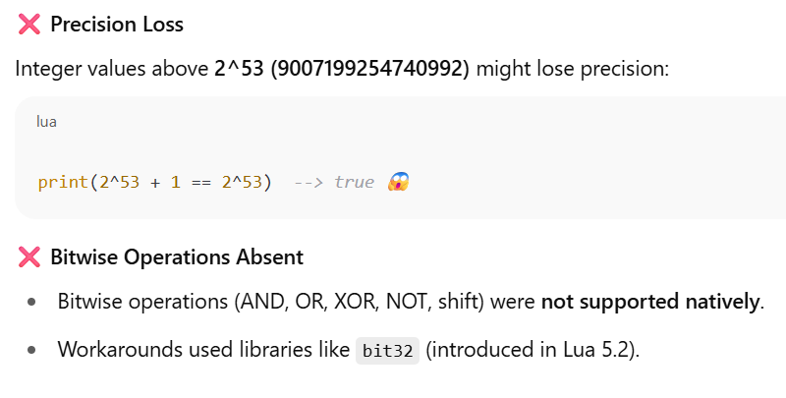
Lua Before Integers
Representation of Numbers (Lua ≤ 5.2)
Issues Before Integers

Slide 150
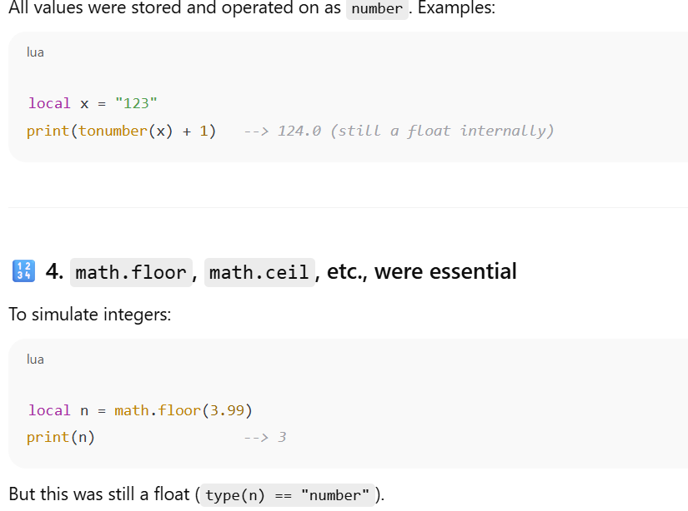
Lua Before Integers
Conversions Were All Float-Based

Slide 151
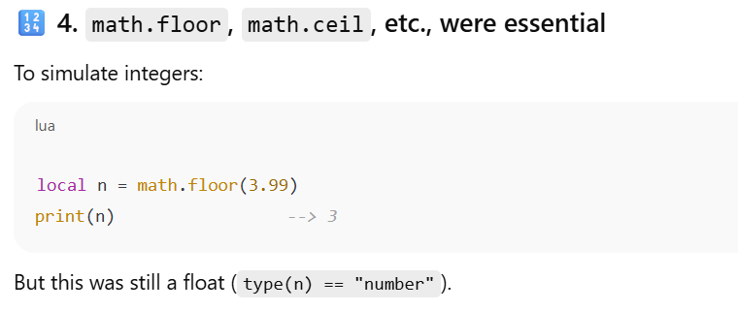
Lua Before Integers
Conversions Were All Float-Based

Slide 152
What Changed in Lua 5.3+
Feature | Lua ≤ 5.2 | Lua 5.3+
Numeric type | number (float) | number + integer
Integer precision | Limited by float | Exact 64-bit integers
Bitwise operations | ❌ (use libraries) | ✅ Built-in (&, `
Distinction in type() | No | Yes (type(1) → "integer")

Slide 153
Literal strings Long strings Coercions
Literal Strings in Lua
Definition:
A literal string is text enclosed in single (') or double quotes (").
Lua allows interchangeably.
local a = 'Hello'
local b = "World"
print(a .. " " .. b) --> Hello World

Slide 154
Literal strings Long strings Coercions
Escapes in Literal Strings:
Lua supports escape sequences:
\n → newline
\t → tab
\\ → backslash
\" or \' → quote
print("Line1\nLine2") --> Line1 (newline) Line2

Slide 155
Long Strings in Lua
Definition:
Enclosed using double square brackets: [[ ... ]]
Used to avoid escaping characters and for multi-line strings.
local msg = [[
This is a long
multi-line string.
It preserves formatting!
]]
print(msg)

Slide 156
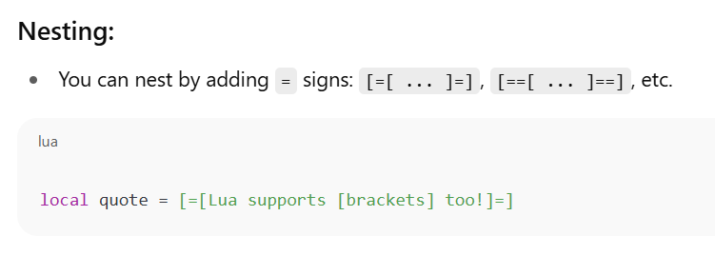
Long Strings in Lua

Slide 157
Coercions in Lua
Definition:
Coercion is an automatic conversion between types when needed (e.g., string ↔ number).

Slide 158
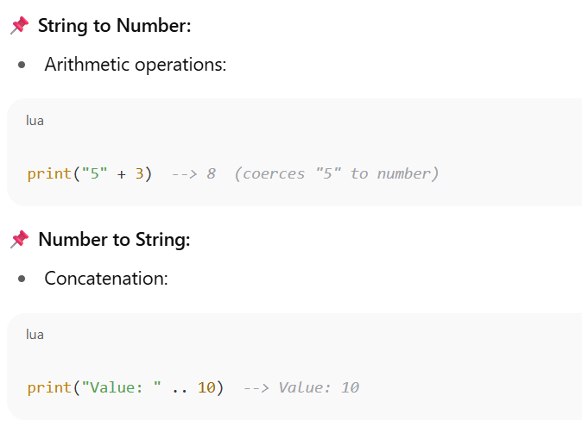
Coercions in Lua
When does coercion happen?

Slide 159
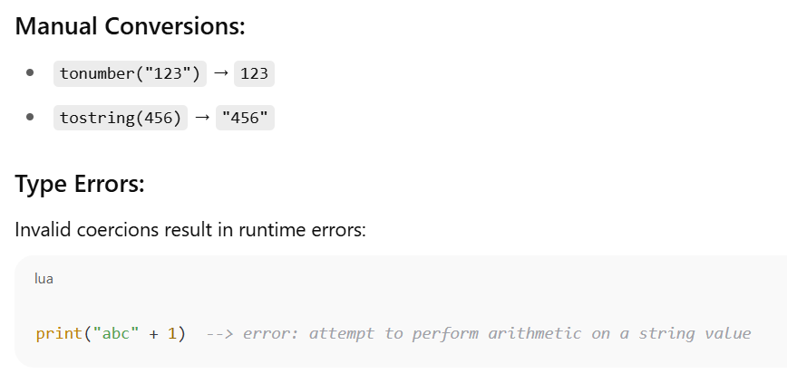
Coercions in Lua

Slide 160
Summary Table
Feature | Syntax | Notes
Literal String | 'text', "text" | Escape sequences allowed
Long String | [[text]], [=[text]=] | Multi-line, raw, no escapes
Coercion (Auto) | "5" + 3, "value" .. 10 | String ↔ Number (when needed)
Coercion (Manual) | tonumber(), tostring() | Safer and explicit

Slide 161
The String Library & Unicode in Lua
Lua has a powerful built-in string library.
Lua does not natively support full Unicode strings—it treats all strings as byte sequences.

Slide 162
The string Library in Lua
Function | Description
string.len(s) | Returns length (in bytes) of s
string.sub(s, i, j) | Substring from position i to j
string.upper(s) | Convert to uppercase
string.lower(s) | Convert to lowercase
string.reverse(s) | Reverse string
string.rep(s, n) | Repeat string n times
string.find(s, pattern) | Find substring or pattern match
string.match(s, pat) | Returns first match for pattern
string.gsub(s, pat, repl) | Global substitution (replace all matches)
string.byte(s, i) | Byte value at position i
string.char(n) | Character from byte value n

Slide 163
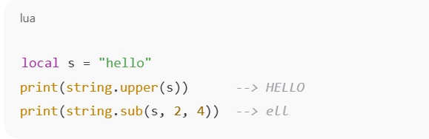
The string Library in Lua

Slide 164
Unicode in Lua
Lua strings are byte-based, not character-based.
"ñ" in UTF-8 is two bytes: 0xC3 0xB1
string.len("ñ") returns 2, not 1

Slide 165
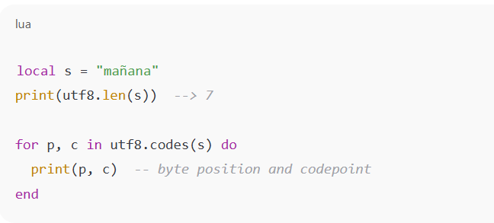
Handling Unicode (UTF-8) in Lua
Function | Description
utf8.len(s) | Number of UTF-8 characters
utf8.codes(s) | Iterator over Unicode code points
utf8.char(n) | Convert code point to character
utf8.codepoint(s) | Returns code point(s) of UTF-8 chars

Slide 166
ASCII vs Unicode
local s = "é" -- 'e' + combining acute accent (U+0301)
print(string.len(s)) --> 3 (in bytes)
print(utf8.len(s)) --> 2 (in characters)

Slide 167
Summary
Feature | Lua (Default) | Notes
String encoding | Byte sequences | UTF-8 supported but not interpreted
ASCII handling | Works perfectly | 1 byte = 1 char
Unicode (UTF-8) | Use utf8 lib | Lua 5.3+ only
Pattern matching | Byte-level only | Not Unicode-aware

Slide 168
Lua Regex
Pattern | Meaning
. | (dot) matches any character
%a | letters (a-z, A-Z)
%d | digits (0-9)
%s | whitespace
%w | alphanumeric
+ | one or more repetitions
* | zero or more repetitions
- | zero or more (non-greedy)
^ | beginning of string
$ | end of string
[] | set of characters
[^] | negated set

Slide 169
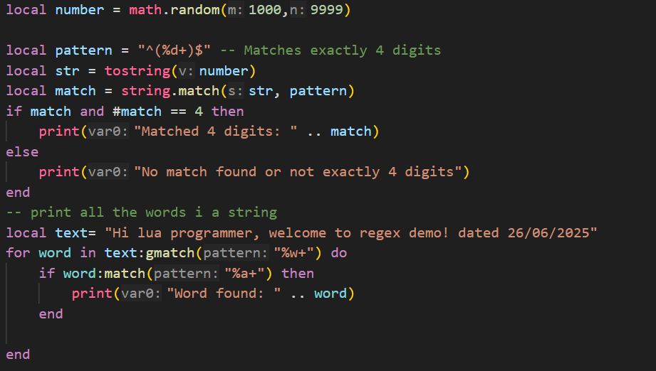
Lua Regex

Slide 170
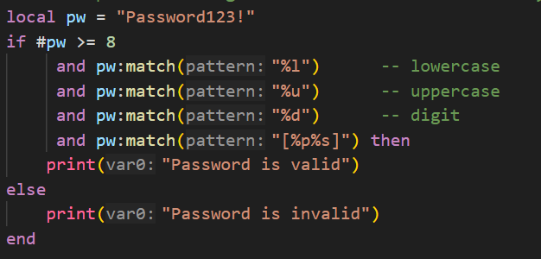
Lua Regex
-- check password using lua has at least 8 characters, one uppercase letter, one lowercase letter, one number, and one special character

Slide 171
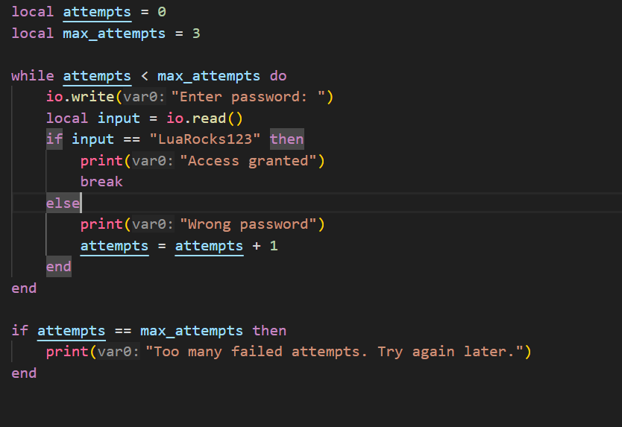
Loops

Slide 172
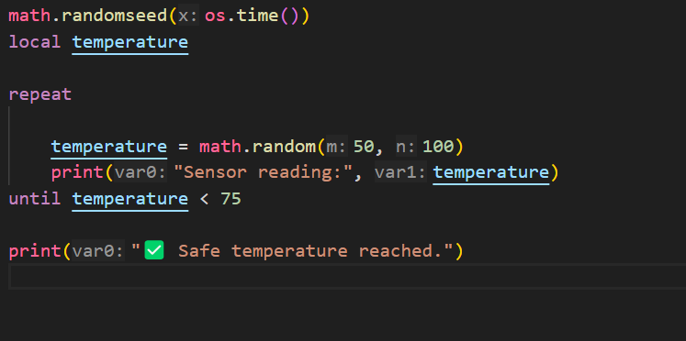
Loops

Slide 173
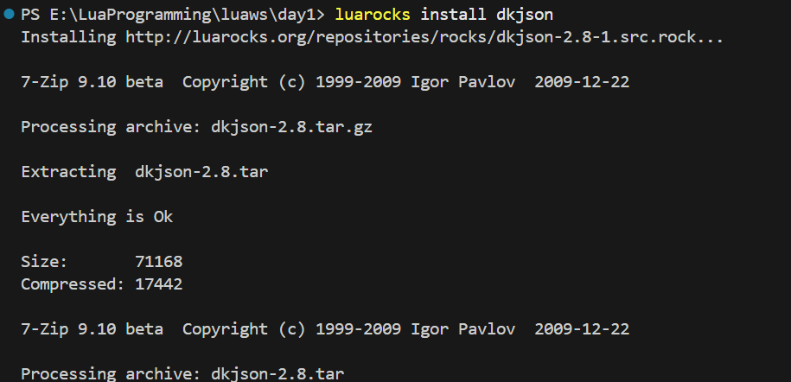
External Libraries
Json Parsing

Slide 174
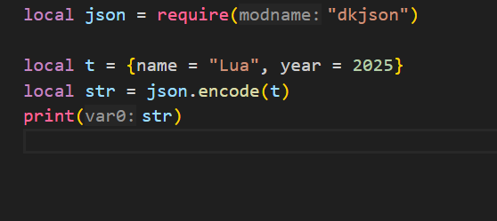
External Libraries
Json Parsing

Slide 175
Tables
Lua tables are the only data structure in the language — they serve as:
Arrays
Dictionaries (maps)
Objects
Records
Sets
Modules

Slide 176
Table Constructor
Empty table
local t = {}
Array-style constructor (numerical indices)
local colors = { "red", "green", "blue" }
-- Equivalent to:
-- colors = { [1] = "red", [2] = "green", [3] = "blue" }

Slide 177
Table Constructor
Key-value constructor (dictionary)
local person = {
name = "Alice",
age = 28,
city = "Delhi"
}
-- Internally: { ["name"] = "Alice", ["age"] = 28, ... }

Slide 178
Table Constructor
Mixed constructor
local mix = {
"cat",
species = "feline",
[10] = "ten",
[true] = "boolean key"
}

Slide 179
Table Indices
Valid Lua table keys (indices):
Any value except nil and NaN
Common: number, string, boolean, even table and function

Slide 180
Important Index Rules
Keys must not be nil or NaN:
local t = {}
t[nil] = "X" -- ❌ Error
t[0/0] = "Y" -- ❌ NaN: invalid
You can overwrite values with same keys:
local t = { a = 1, a = 2 } -- Final value: a = 2

Slide 181
Tables
-- Empty table
local t = {}
-- With values
local t2 = { "apple", "banana", "cherry" }
-- Key-value table (like a dictionary)
local t3 = {
name = "Alice",
age = 30,
city = "Chennai"
}

Slide 182
Tables Iteration
For array-style:
for i, v in ipairs(fruits) do
print(i, v)
end

Slide 183
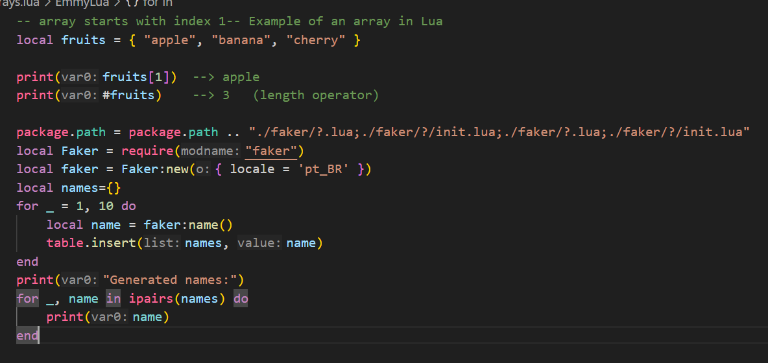
Tables as Arrays
Lua arrays start at index 1 (not 0):

Slide 184
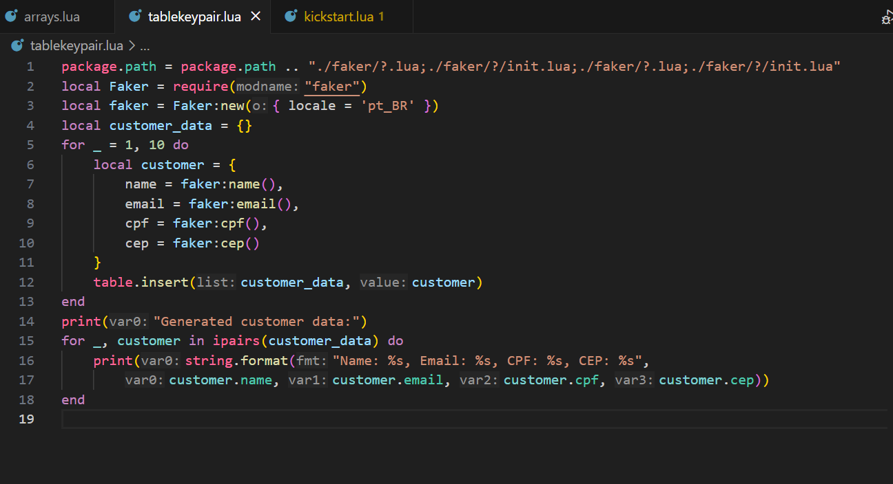
Table as Dictionary

Slide 185
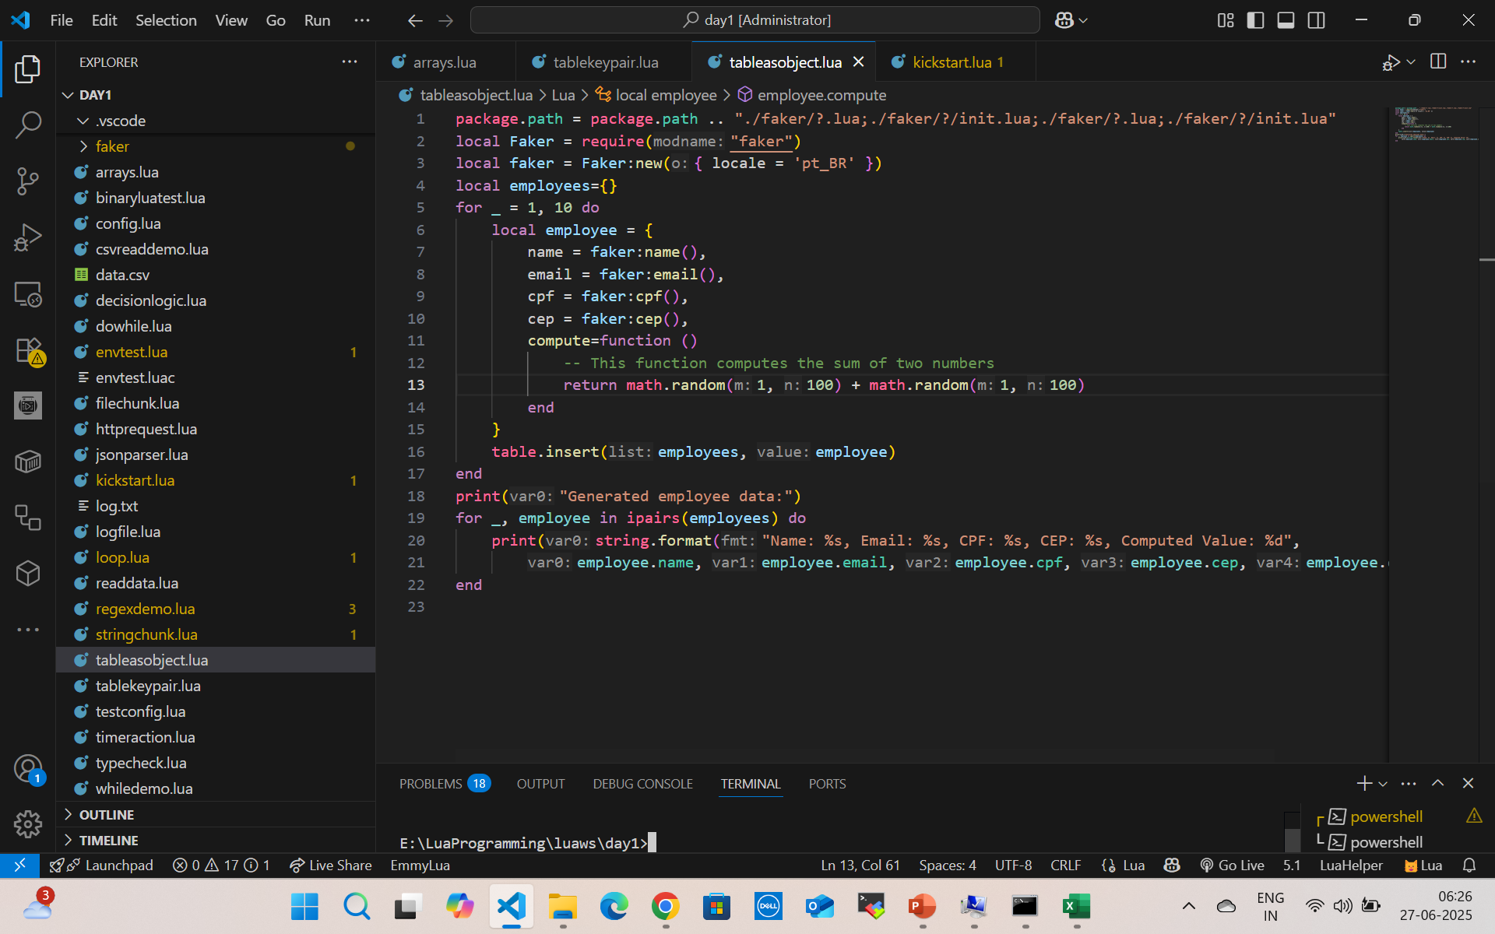

Tables as Objects (with functions)

Slide 186
MetaTable
A metatable is a table that defines how another table behaves in special situations, like:
Adding two tables
Accessing a missing field
Making a table callable like a function
Used to add behavior like operator overloading, default values, or OO-like features.

Slide 187
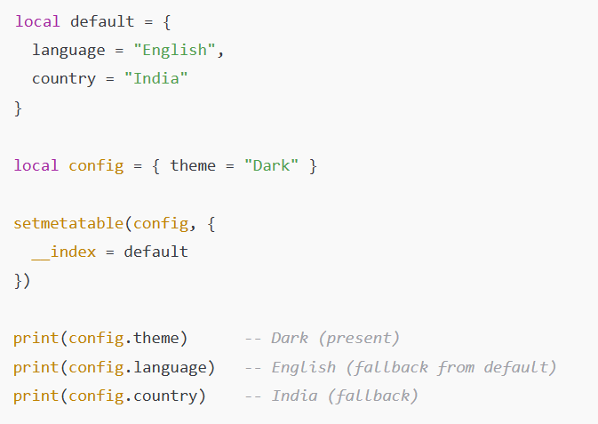
Meta tables Missing Index
__index as a table (default values) – Missing Index

Slide 188

Meta tables addition
function newMatrix(a, b)
local mat = { a = a, b = b }
local mt = {
__add = function(m1, m2)
return newMatrix(m1.a + m2.a, m1.b + m2.b)
end
}
return setmetatable(mat, mt)
end
local m1 = newMatrix(10, 20)
local m2 = newMatrix(1, 2)
local m3 = m1 + m2
print(m3.a, m3.b) --> 11 22

Slide 189
Extend to Other Operators
Metamethod | Operator
__add | +
__sub | -
__mul | *
__div | /
__mod | %
__pow | ^
__unm | Unary -

Slide 190
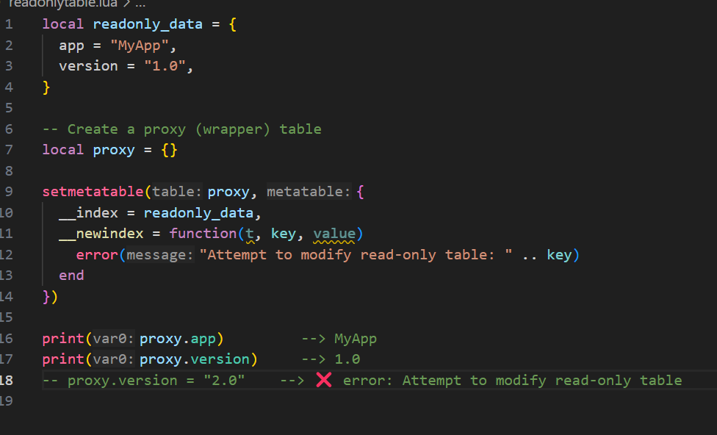
Read-only table (__newindex)

Slide 191
What is a Sequence in Lua?
A sequence is a table with positive integer keys starting from 1, with no gaps (i.e., t[1], t[2], ..., t[n], where n = #t).

Slide 192
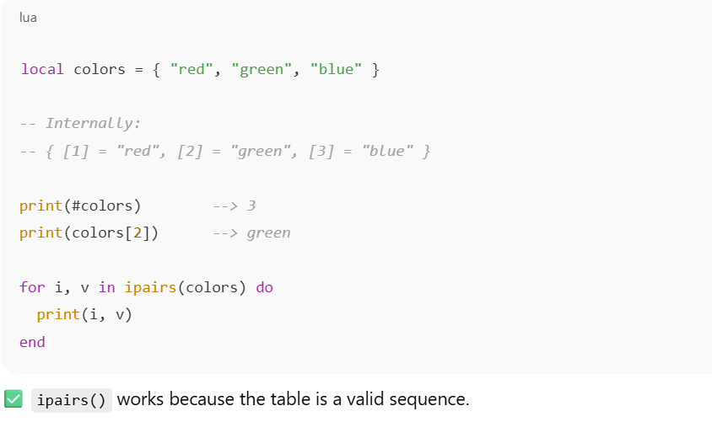

What is a Sequence in Lua?

Slide 193

What is a Sequence in Lua?
#bad and ipairs(bad) stop at the first nil, so they're unreliable for non-continuous integer keys.

Slide 194
Useful Functions for Sequences (from table module)
Function | Purpose
#t | Length of sequence (consecutive keys)
ipairs(t) | Iterates over sequence safely
table.insert(t, v) | Adds v at end
table.remove(t, i) | Removes index i, shifts others
table.concat(t, sep) | Joins all values as string
table.sort(t) | Sorts values in-place

Slide 195

Table Sort

Slide 196
Table Sort
local names = { "Charlie", "Alice", "Bob" }
table.sort(names)
-- Output: Alice, Bob, Charlie

Slide 197
Table concat
local fruits = { "apple", "banana", "cherry" }
local result = table.concat(fruits, ", ")
print(result)
-- Output: apple, banana, cherry

Slide 198
What Is Safe Navigation?
Safe navigation means accessing nested fields without errors, even if intermediate tables or keys are nil.

Slide 199
Functions
In Lua, functions are first-class values, meaning you can:
Assign them to variables
Pass them as arguments
Return them from other functions

Slide 200
Types of functions
Function Basics
Function with Parameters
Function with Return Values
Anonymous Functions (Lambdas)
Multiple Return Values
Variadic Functions (...)
Recursive Functions
Local vs Global Functions
Functions as Table Fields (Methods)

Slide 201

Multiple Return

Slide 202

Multiple Return

Slide 203
Variadic Function
function formatCSV(...)
return table.concat({...}, ",")
end
print(formatCSV("apple", "banana", "cherry")) -- apple,banana,cherry

Slide 204
Variadic Function
function log(...)
local args = {...}
print("[LOG]", table.concat(args, " "))
end
log("User", "logged", "in", "at", os.date())

Slide 205
Table.unpack
Returns all values from a table as separate arguments (like JS ...arr or Python *args).
table.unpack(t [, i [, j]])
t: The table (usually a sequence)
i: Starting index (default 1)
j: Ending index (default #t)

Slide 206
Table.unpack
Unpack Simple
local t = {"Lua", "Rocks", 2024}
print(table.unpack(t)) --> Lua Rocks 2024
Unpack Subset
local t = {"a", "b", "c", "d"}
print(table.unpack(t, 2, 3)) --> b c

Slide 207
Proper Tail Calls (PTC)
What is a Tail Call?
A tail call is when a function returns the result of another function directly.

Slide 208

Real Example: Recursive Tail Call

Slide 209
Real Example: Recursive Tail Call
function route(path)
if path == "/home" then return show_home()
if path == "/login" then return show_login()
return show_404()
end
function show_home()
print("🏠 Home Page")
return route("/login") -- Tail call
end
function show_login()
print("🔐 Login Page")
end
route("/home")

Slide 210
Simple I/O Model (Interactive Console)
-- Simple Input
io.write("Enter your name: ")
local name = io.read()
print("Hello, " .. name .. "!")

Slide 211

Simple File Read/Write

Slide 212

Read Text File

Slide 213

Read XML file

Slide 214
Summary Table
Operation | Function | Notes
Read input | io.read() | from keyboard
Write output | io.write() | no newline
Print line | print() | newline included
Open file | io.open(filename, mode) | "r", "w", "a" modes
Read from file | file:read("*l") or "*a" | line or all
Write to file | file:write("text") | writes as string
Close file | file:close() | must close after write

Slide 215

System Calls

Slide 216
Custom Date Formats with os.date(format)
Format | Description | Example
%Y | Year (4 digits) | 2025
%y | Year (2 digits) | 25
%m | Month (01–12) | 06
%B | Full month name | June
%b | Abbreviated month name | Jun
%d | Day of the month (01–31) | 28
%H | Hour (00–23) | 15
%I | Hour (01–12) | 03
%p | AM/PM | PM
%M | Minute | 20
%S | Second | 12
%A | Full weekday name | Saturday
%a | Abbreviated weekday name | Sat

Slide 217
Custom Date Formats with os.date(format)
print(os.date("%Y-%m-%d")) --> 2025-06-28
print(os.date("%d/%m/%Y")) --> 28/06/2025
print(os.date("%I:%M %p")) --> 03:20 PM
print(os.date("%A, %B %d, %Y")) --> Saturday, June 28, 2025

Slide 218
Convert Table → String
local dt = {
year = 2025,
month = 12,
day = 25,
hour = 10,
min = 30,
sec = 0
}
print(os.date("%Y-%m-%d %H:%M:%S", os.time(dt)))
-- Output: 2025-12-25 10:30:00

Slide 219
Convert String → Table
local t = os.date("*t")
for k, v in pairs(t) do
print(k, v)
end

Slide 220
os.setlocale(locale, category) — Overview
locale: string like "en_US", "fr_FR.UTF-8", "C", or """ (empty for default)
category: optional, one of:
"all" (default)“
collate" (sorting)
"ctype" (char types like upper/lower)
"monetary" (currency)
"numeric" (decimal separator, etc.)
"time" (date/time formatting)

Slide 221
os.setlocale(locale, category) — Overview
print("Before:", os.date("%A, %B %d, %Y"))
local ok = os.setlocale("French_France", "time") -- Try Windows-style first
if not ok then
ok = os.setlocale("fr_FR.utf8", "time") -- Try Linux/macOS style
end
if ok then
print("After (locale applied):", os.date("%A, %B %d, %Y"))
else
print("Locale not supported on this system")
end

Slide 222

Install GCC

Slide 223
Lua Source and Binaries
https://luabinaries.sourceforge.net/download.html
https://sourceforge.net/projects/luabinaries/files/5.4.2/Windows%20Libraries/Dynamic/

Slide 224

Call C code from Lua
gcc -shared -o mylib.dll mylib.c -I"D:\software\lua-5.4.2_Sources\lua54\include" -L"D:\software\lua-5.4.2_Win64_dll17_lib" -llua54

Slide 225


Call C dll from Lua

Slide 226
Variable Scope
Declaring Local Variables
local x = 10
print(x) --> 10
local means x is only accessible in the block or function where it's declared.
If you omit local, the variable becomes global (bad practice).

Slide 227
Variable Scope
Using Blocks
A block is a chunk of code enclosed in do ... end, or an implicit block in control structures or functions.
do
local a = 5
print(a) --> 5
end
print(a) --> nil or error (a is local to the block)

Slide 228
Variable Scope
Block Examples in Control Structures
if true then
local msg = "Inside if"
print(msg)
end
-- msg is not visible here
-- print(msg) --> error

Slide 229
Variable Scope
Nested Locals (Shadowing)
local x = 1
do
local x = 2 -- shadows outer x
print(x) --> 2
end
print(x) --> 1

Slide 230
Variable Scope
Function-Level Scope
function add(a, b)
local result = a + b
return result
end
-- result is not visible outside
-- print(result) --> error

Slide 231
Summary
Feature | Behavior
local | Restricts variable scope to current block
do ... end | Creates a block
Function scope | Has its own local space
Shadowing | Inner local hides outer one

Slide 232
break
break exits the loop immediately, skipping the rest of the body and the next iteration.
for i = 1, 10 do
if i == 5 then
break
end
print(i)
end
-- Output: 1 2 3 4

Slide 233
goto
goto can jump forward or backward to a label inside the same block.
It cannot jump into the scope of a local variable declared after it (Lua prevents unsafe jumps).
for i = 1, 5 do
if i == 3 then
goto skip
end
print(i)
end
::skip::
print("Loop skipped at i == 3")

Slide 234
Invalid goto
You cannot use goto to jump forward into a place where a local variable is declared — because that would skip the variable’s initialization, which can lead to unpredictable behavior.
goto jump_here -- ERROR
local x = 10 -- this line is skipped!
::jump_here::
print(x) -- illegal: x was never declared in this path

Slide 235
Closures
A function that captures the variables from its enclosing scope, forming a persistent environment.
Even if the outer function finishes execution, the inner function retains access to those variables.

Slide 236
Anatomy of a Closure
function outer()
local a = 5
return function()
return a
end
end
local f = outer()
print(f()) -- prints 5

Slide 237
Anatomy of a Closure
a is a local variable to outer
The anonymous function captures it
outer() returns the function
The function retains access to a even after outer() ends

Slide 238
Scope Chain: Closures Capture Upvalues
Lua functions form a lexical scope chain.
An upvalue is a reference to a local variable from an outer scope.
Lua does not copy the variable — it references it.

Slide 239
Scope Chain: Closures Capture Upvalues
function makeWriter()
local text = ""
return function(t)
text = text .. t
return text
end
end
local writer = makeWriter()
print(writer("Hi")) --> Hi
print(writer(" there"))--> Hi there

Slide 240
Internal Behavior (How Lua Stores It)
Lua converts this:
function outer()
local x = 1
return function() return x end
end

Slide 241
Internal Behavior (How Lua Stores It)
To this (conceptually):
-- pseudo-C-style environment structure
Closure {
function_body = function(...)
return upvalues[1] -- x
end,
upvalues = {
[1] = reference to x
}
}

Slide 242
Internal Behavior (How Lua Stores It)
function counters()
local x = 0
return function() x = x + 1; return x end,
function() x = x + 10; return x end
end
local inc1, inc2 = counters()
print(inc1()) --> 1
print(inc2()) --> 11 (they share `x`)
print(inc1()) --> 12

Slide 243
Use Cases for Closures
Encapsulation & Stateful Functions
Encapsulation means hiding internal data and logic, exposing only what is necessary.
In languages like Java or Python, you use private or protected keywords.
In Lua, we achieve the same behavior using closures.

Slide 244
Use Cases for Closures
How Closures Provide Encapsulation
A closure can "capture" local variables from its enclosing scope.
These variables become private:
they live if the closure does, but they're inaccessible from outside.

Slide 245
Use Cases for Closures
function makeAccount(initialBalance)
local balance = initialBalance -- 👈 private variable
return {
deposit = function(amount)
balance = balance + amount
return balance
end,
withdraw = function(amount)
if amount > balance then
return "Insufficient funds"
end
balance = balance - amount
return balance
end,
getBalance = function()
return balance
end
}
end

Slide 246
Use Cases for Closures
What’s Happening:
balance is a local variable in the factory (makeAccount).
It is captured by the returned functions.
It's inaccessible from outside — even if you try, it doesn’t exist on the table.
local acc = makeAccount(100)
print(acc.deposit(50)) --> 150
print(acc.withdraw(70)) --> 80
print(acc.getBalance()) --> 80
-- print(acc.balance) --> nil (encapsulated!)

Slide 247
Benefits of Closure Encapsulation
Benefit | Explanation
Encapsulation | Internal state is protected from external access
Modularity | Self-contained reusable units
No naming conflict | Captured variables are not globals
Security | Prevents accidental or malicious overwrite
Scoped GC | Memory managed automatically when closure dies

Slide 248
Real-World Use Cases
Bank accounts, user sessions, timers
Encapsulating database connection state
Plugins or modules with private config
Reusable UI components in Lua-based game engines

Slide 249
Functions as First-Class Values in Lua
A first-class value means:
A value that can be assigned to variables, passed as arguments, returned from other functions, and stored in tables.
In Lua, functions are first-class citizens.

Slide 250
Assigning Functions to Variables
local function sayHello()
print("Hello!")
end
-- or anonymously:
local greet = function()
print("Hi there!")
end
greet() --> Hi there!

Slide 251
Passing Functions as Arguments
function apply(f, x)
return f(x)
end
function square(n)
return n * n
end
print(apply(square, 5)) --> 25

Slide 252
Returning Functions from Functions
function makeMultiplier(factor)
return function(x)
return x * factor
end
end
local double = makeMultiplier(2)
print(double(10)) --> 20

Slide 253
Non-Global Functions
In Lua, if you define a function without local, it becomes global:
function globalFunc()
print("I'm global!")
End
This is equivalent to:
_G["globalFunc"] = function()
print("I'm global!")
end

Slide 254
Local / Non-Global Function
local function localFunc()
print("I'm local to this file or block!")
end
Exists only in current scope (block, file, or function)
Not visible globally
Safer and preferred for modularity

Slide 255
Summary Table
Feature | Example
Assign to variable | local f = function() end
Pass as argument | apply(f, x)
Return from function | return function() end
Stored in table | tbl.handler = function() ... end
Local function | local function myFunc() end
Global function (not recommended) | function myFunc() end

Slide 256
String.find
startIndex, endIndex = string.find(subject, pattern [, init [, plain]])
Parameter | Description
subject | The string to search in
pattern | The substring or Lua pattern to search for
init | (optional) Index to start the search (default is 1)
plain | (optional) If true, disables pattern matching (literal match)

Slide 257
String.find
local s = "Hello, Lua!"
local i, j = string.find(s, "Lua")
print(i, j) --> 8 10
print(s:sub(i, j)) --> Lua
i and j start index and end index of result

Slide 258
String.find
local s = "Lua is Lua"
print(string.find(s, "Lua", 5)) --> 8 10 (starts searching from index 5)
Starts search from 5th position

Slide 259
String.find
if string.find("hello world", "world") then
print("Found")
else
print("Not found")
End
print(string.find("abc", "xyz")) --> nil

Slide 260
Lua Pattern Character Classes
Pattern | Meaning | Example Match
%u | Uppercase letter (A–Z) | "A", "Z"
%l | Lowercase letter (a–z) | "a", "z"
%p | Punctuation character | ".", ",", "!", "?", etc.
%s | Whitespace character | " ", "\t", "\n", "\r"

Slide 261
String.match
local password = "Hello@123"
if string.match(password, "%u") and -- has uppercase
string.match(password, "%l") and -- has lowercase
string.match(password, "%d") and -- has digit
string.match(password, "%p") and -- has punctuation
string.len(password) >= 8 then -- length check
print("Valid password")
else
print("Invalid password")
end

Slide 262
Inverted Match
Pattern | Matches
%S | Non-space character
%P | Non-punctuation
%U | Invalid (Lua doesn't have)

Slide 263
string.gsub
string.gsub (global substitution) is used to replace parts of a string using a pattern.
result, count = string.gsub(subject, pattern, replacement [, n])

Slide 264
string.gsub
Parameter | Description
subject | The original string
pattern | Lua pattern (what to search for)
replacement | Replacement value (string, table, or function)
n (optional) | Max number of substitutions
result | Final string with replacements
count | Number of substitutions made

Slide 265
String.gsub
local s = "Lua is great"
local new = string.gsub(s, "great", "awesome")
print(new) --> Lua is awesome
local s = "a+b=c"
print(string.gsub(s, "+", "-", 1)) --> a-b=c (1st only)
print(string.gsub(s, "+", "-")) --> a-b=c (all)

Slide 266
String.gsub
local s = "ID:123, Code:456"
local result = string.gsub(s, "%d+", "###")
print(result) --> ID:###, Code:###

Slide 267
String.gsub
local s = "first LAST"
local result = string.gsub(s, "(%a+)%s+(%a+)", "%2, %1")
print(result) --> LAST, first
(%a+) captures a word
%2, %1 swaps the captured parts

Slide 268
String.gsub
local s = "1,2,3"
local result = string.gsub(s, "%d+", function(n)
return tonumber(n) * 2
end)
print(result) --> 2,4,6

Slide 269
URL Encoding in Lua
URL encoding (a.k.a. percent-encoding) is used to encode characters in a string so they can be safely included in a URL. For example:
"Hello World!" → "Hello%20World%21"

Slide 270
URL Encoding in Lua
function url_encode(str)
str = str:gsub("\n", "\r\n")
str = str:gsub("([^%w%-_%.~])", function(c)
return string.format("%%%02X", string.byte(c))
end)
return str
end

Slide 271
URL Encoding in Lua
[^%w%-_%.~]: matches all characters not safe for URLs
string.byte(c): gets ASCII code
string.format("%%%02X", ...): turns it into %XX form

Slide 272
URL Decoding
function url_decode(str)
str = str:gsub("%%(%x%x)", function(hex)
return string.char(tonumber(hex, 16))
end)
return str
end
print(url_decode("Hello%20World%21")) --> Hello World!

Slide 273
Tab Expansion
Tab expansion means replacing tabs (\t) with spaces, typically 4 or 8 spaces per tab.

Slide 274
Common Code Formats
Code | Meaning | Example
%Y | Year (4 digits) | 2025
%m | Month (01–12) | 06
%d | Day of month (01–31) | 29
%H | Hour (00–23) | 10
%M | Minute (00–59) | 15
%S | Second (00–59) | 32
%A | Weekday name | Saturday
%B | Month name | June

Slide 275
Date Time Manipulation
print(os.date("%Y-%m-%d %H:%M:%S"))
-- Output: "2025-06-29 10:15:32“
local t = {
year = 2025,
month = 12,
day = 31,
hour = 23,
min = 59,
sec = 59
}
local ts = os.time(t)
print(ts) --> Unix timestamp for 2025-12-31 23:59:59

Slide 276
Date Time Manipulation
local ts = 1751182532
print(os.date("%Y-%m-%d %H:%M:%S", ts))
local t1 = os.time({year=2025, month=6, day=29})
local t2 = os.time({year=2025, month=7, day=1})
print(os.difftime(t2, t1)) --> 172800 (2 days in seconds)

Slide 277
Date Time Manipulation
local now = os.time()
local one_day = 60 * 60 * 24
local tomorrow = now + one_day
print(os.date("%Y-%m-%d", tomorrow)) --> Tomorrow's date

Slide 278
Date Time Manipulation
local dt = os.date("*t") -- returns a table
print(dt.year, dt.month, dt.day)
-- Output: 2025 6 29

Slide 279
Date Time Manipulation
os.execute("sleep 1") -- sleep for 1 second (Unix)
os.execute("ping -n 2 127.0.0.1 > nul") -- Windows workaround for 1 second

Slide 280

Scheduled Job

Slide 281
Summary
Task | Function
Get current time | os.date() / os.time()
Format date string | os.date("%Y-%m-%d")
Parse date → timestamp | os.time{year=..., month=...}
Timestamp → date | os.date(nil, ts)
Difference in seconds | os.difftime(t1, t2)
Add/subtract time | os.time() ± seconds

Slide 282

Lua Socket
Download Luasocket from Luarocks
https://github.com/alain-riedinger/luasocket/releases
Create socket folder and keep socet c, header and lua
Create mime folder to keep lib

Slide 283

Lua Socket

Slide 284

Lua Socket

Slide 285
Luasec for ssl
sudo apt update
sudo apt install openssl libssl-dev
sudo apt install libssl-dev
openssl version
dpkg -L libssl-dev | grep include
sudo apt update
sudo apt install libssl-dev
ls /usr/include/openssl/ssl.h

Slide 286
Luasec for ssl
sudo luarocks install luasec OPENSSL_INCDIR=/usr/include OPENSSL_LIBDIR=/usr/lib/x86_64-linux-gnu

Slide 287

Luasec for ssl

Slide 288
Common Lua Database Connections
Database | Lua Library | LuaRocks Package | Notes
SQLite | lsqlite3 | luarocks install lsqlite3 | Easiest, no server needed
MySQL | luasql.mysql | luarocks install luasql-mysql | Needs MySQL client installed
PostgreSQL | luasql.postgres | luarocks install luasql-postgres | Needs PostgreSQL client installed
MongoDB | luamongo (C++) or REST | Manual build or REST | Complex to build, or use via HTTP
Via Python/REST | Any DB via bridge | Use os.execute or io.popen | Practical and lightweight

Slide 289
Mysql Connection
Now, to install MySQL 8, simply type:
sudo apt install mysql-server
sudo nano /etc/mysql/mysql.conf.d/mysqld.cnf(change port)
sudo service mysql start
sudo mysql_secure_installation
#login as admin
sudo mysql

Slide 290
Mysql Connection
#after that set password
ALTER USER 'root'@'localhost' IDENTIFIED WITH mysql_native_password BY 'newpassword';
mysql -u root -p
create database ecommercedb;
use ecommercedb;
create table Product(ProductId int primary key, Name varchar(50), Cost int);
Notes:
`

Slide 291

Lua mysql
sudo apt-get install lua-sql-mysql

Slide 292

Lua mysql
Lua testmysql.lua

Slide 293
Lua Mongodb
sudo apt update
sudo apt install libbson-dev libmongoc-dev
ls /usr/include/libbson-1.0/bson/bson.h
sudo apt install cmake build-essential pkg-config libssl-dev
git clone https://github.com/mongodb/mongo-c-driver.git
cd mongo-c-driver
git checkout 1.24.4 # Use a stable version
mkdir cmake-build
cd cmake-build
cmake -DENABLE_AUTOMATIC_INIT_AND_CLEANUP=OFF ..
make -j$(nproc)
sudo make install

Slide 294
Lua Mongodb
sudo luarocks install lua-mongo \
LIBBSON_INCDIR=/usr/local/include/libbson-1.0 \
LIBMONGOC_INCDIR=/usr/local/include/libmongoc-1.0 \
LIBBSON_LIBDIR=/usr/local/lib \
LIBMONGOC_LIBDIR=/usr/local/lib

Slide 295

Lua Mongodb

Slide 296
Install mongodb
# Import MongoDB GPG key
curl -fsSL https://pgp.mongodb.com/server-7.0.asc | \
sudo gpg -o /usr/share/keyrings/mongodb-server-7.0.gpg --dearmor
# Add MongoDB repository (for Ubuntu 20.04/22.04/24.04)
echo "deb [ signed-by=/usr/share/keyrings/mongodb-server-7.0.gpg ] https://repo.mongodb.org/apt/ubuntu $(lsb_release -sc)/mongodb-org/7.0 multiverse" | \
sudo tee /etc/apt/sources.list.d/mongodb-org-7.0.list
# Update package list
sudo apt update
# Install MongoDB server, shell, tools
sudo apt install -y mongodb-org

Slide 297

Install mongodb
sudo systemctl start mongod
sudo systemctl status mongod
Mongosh

Slide 298

Lua mongo

Slide 299

Inmation System Architecture

Slide 300
Inmation Architecture
Front-End Apps
(Dashboard, Excel Add-in, Studio)
Core Service (Server)
Data Source Connectors
(OPC UA, MQTT, REST, SQL, etc.)
Historian & Archiv Layer
External Systems / Cloud (SAP, Azure, AWS, Data Lakes)

Slide 301
1. Core (System CORE)
The main runtime service.
Manages data flows, user access, logging, and scripting (Lua).
Provides REST and WebSocket interfaces.
Stores configuration and runtime state.

Slide 302
Connector (System CONNECT)
Interfaces to industrial protocols:
OPC DA / OPC UA
MQTT
Modbus
DNP3, BACnet, etc.
Pushes raw data to Core.

Slide 303
Frontend Tools
DataStudio – configuration, scripting (Lua), system health.
WebStudio – dashboards and data visualization.
Excel Add-in – access real-time & historical data.
Python API / REST API – integration and automation.

Slide 304
Historian & Storage
Real-time and time-series data storage.
Long-term compression and archiving.
SQL queries via Lua or Python APIs.

Slide 305
Security Layers
User/group authentication (RBAC).
Audit logging.
TLS/SSL for APIs and frontend.

Slide 306
Protocol Support
OPC UA/DA
MQTT (with Sparkplug B support)
REST, SQL, CSV
File Watchers (for CSV/XML ingest)

Slide 307
🧠 Scripting & Automation
Lua scripting is built-in for:
Custom calculations
Alarm/condition handling
Data routing
Scheduled jobs

Slide 308
Real-Time Processing
Supports publish/subscribe model.
Pushes updates in milliseconds to subscribers.
Event and alarm management built-in.

Slide 309
Integration
Compatible with:
Azure IoT Hub
AWS IoT Core
SAP
Ignition SCADA
MES/ERP systems

Slide 310
Use Cases
Pharma 21 CFR Part 11 compliance (audit trail, versioning)
Predictive maintenance
Real-time production monitoring
Digital twin for process optimization

Slide 311
Typical Deployment Model
On-Premise:
Core + Connectors + Studio run on Windows Servers.
Uses secure internal network.
Hybrid/Cloud:
Push data to cloud via MQTT or REST.
Data lake integration with Azure/AWS/GCP.

Slide 312
The Function Table.unpack Proper Tail Calls
Expanding Table Elements into Arguments
table.unpack(table, i, j)
table: The table to unpack.
i: (optional) Start index (default = 1).
j: (optional) End index (default = #table).
Real-Time Use Case in inmation
Use Case: Dynamic Argument Processing for Event Notification
Suppose you're receiving OPC UA alarms, and you want to dynamically forward selected fields of those alarms to another system (e.g., an MQTT broker or a custom log formatter).

Slide 313


The Function Table.unpack Proper Tail Calls

Slide 314
Benefits:
table.unpack() dynamically passes fields.
Maintains clean code as alarms change format.
Compatible with Script Engine/Script Rule in inmation.

Slide 315
Proper Tail Calls – Optimized Recursive Calls
What is a Proper Tail Call (PTC)?
A function call is in tail position if it's the last action in another function.
Lua optimizes tail calls to reuse the current stack frame, preventing stack overflow in deep recursion.

Slide 316
Proper Tail Calls – Optimized Recursive Calls
In System.Inmation, tail calls in Lua are especially useful in Script Objects, Script Rules, or Calculation Objects.
When performing loop-like recursive operations — such as waiting for a condition, retrying a task, or walking a data structure — without growing the Lua stack.

Slide 317
Why Tail Calls in inmation?
inmation runs Lua in long-lived execution environments (like script loops or polling systems).
Recursive functions without tail calls cause stack overflow if left uncontrolled.
Tail calls reuse stack frames – ideal for event loops, retry logic, or watchdogs.

Slide 318
Example: Recursive Watchdog for a Process Tag
function waitForCoolDown(tagPath, threshold)
local currentTemp = inmation.getvalue(tagPath)
if currentTemp <= threshold then
return "OK: Temperature normalized at " .. tostring(currentTemp)
else
inmation.sleep(2) -- Delay before retrying
return waitForCoolDown(tagPath, threshold) -- ✅ Tail call
end
end
-- Usage in Script Object or Rule
local status = waitForCoolDown("Model:/Sensors/Temp001", 75)
inmation.setvalue("Model:/Logs/CoolDownStatus", status)

Slide 319
Real Use Cases in inmation Tail Call Scenarios
Use Case | Description
Retry OPC Write | Keep writing until success with tail call retry.
Recursive Tag Scan | Traverse a hierarchy of tags or paths recursively.
Poll Until Condition Met | Monitor a batch, pump, or event using tail call polling.
Recursive Alarm Escalation Logic | Check alarm state history or dependency trees recursively.

Slide 320
URL encoding Tab expansion
URL encoding replaces unsafe or non-ASCII characters with %XX hex codes.
Tab Expansion – Replace \t with Spaces

Slide 321
URL encoding Tab expansion Use Cases
Sending HTTP requests from a Script Object or Dispatcher (e.g., REST API integration)
Creating clean log strings or CSV entries with consistent formatting
Encoding special characters in OPC UA string values, MQTT messages, or file paths

Slide 322
Real-Time inmation Use Case
Example: Send formatted sensor data to a remote HTTP endpoint
SensorName = "TempSensor-1"
Reading = "75\t°C"
You need to
Expand tab (\t) to spaces for readability in logs.
URL encode the string before sending via HTTP.

Slide 323
Step-by-step inmation Lua Script
url_encode and expand_tabs inside inmation:
function expand_tabs(text, tabsize)
tabsize = tabsize or 4
return text:gsub("\t", string.rep(" ", tabsize))
end
function url_encode(str)
if str == nil then return "" end
str = str:gsub("\n", "\r\n")
str = str:gsub("([^%w%-_.~])", function(c)
return string.format("%%%02X", string.byte(c))
end)
return str
end

Slide 324
Send Encoded Data via HTTP (with LuaSec + socket.http)
local sensor = "TempSensor-1"
local reading = "75\t°C"
-- Clean the string
local formatted = "Sensor=" .. sensor .. "&Reading=" .. expand_tabs(reading)
-- URL encode for safe HTTP
local encoded = url_encode(formatted)

Slide 325
Send Encoded Data via HTTP (with LuaSec + socket.http)
-- Log to inmation for visibility
inmation.logmessage("Formatted (tabs expanded): " .. formatted)
inmation.logmessage("Encoded: " .. encoded)
-- Send over HTTP (if socket/http is available in your runtime)
-- local http = require("socket.http")
-- local response = http.request("https://example.com/api?" .. encoded)
-- inmation.logmessage("HTTP Response: " .. tostring(response))

Slide 326
Pcall()
pcall stands for protected call.
It is a built-in Lua function used to safely execute another function without crashing your script when an error occurs.
local success, result = pcall(function_to_call, arg1, arg2, ...)

Slide 327
When to Use pcall
Situation | Should Use pcall?
Reading non-guaranteed tag | ✅ Yes
File I/O or network | ✅ Yes
Known-safe math | ❌ Not needed
Parsing JSON | ✅ Yes
External module calls | ✅ Yes

Slide 328

Tricks of the Trade
Always Use pcall() for Safety
Inmation will fail the whole script if a single Lua error occurs.
Wrap risky calls to avoid breaking production.
local success, result = pcall(function()
return inmation.getvalue("Model:/Bad/Tag/Path")
end)
if success then
inmation.logmessage("Value: " .. tostring(result))
else
inmation.logmessage("Error reading value: " .. tostring(result))
end

Slide 329
Tricks of the Trade
Log Internals for Debugging
Use inmation.logmessage() generously during dev:
inmation.logmessage("DEBUG: Received input=" .. tostring(myInput))
Pro Tip: Prefix your logs with "DEBUG: " or "ALERT: " so you can filter them easily in the Studio log viewer.

Slide 330
Tricks of the Trade
Use tostring() for Safe Concatenation
Lua crashes on "abc" .. nil. Always wrap uncertain values:
inmation.logmessage("Sensor: " .. tostring(sensorValue))

Slide 331
Tricks of the Trade
Tail Recursion for Monitoring Loops
Expand Tabs for Clean Formatting
Store JSON in Text Tags
Inmation doesn’t support native Lua tables in tags.
Use dkjson or cjson to convert Lua tables to JSON strings:
local json = require("dkjson")
local data = {name = "Pump1", status = "ON"}
local jsonStr = json.encode(data)
inmation.setvalue("Model:/Logs/StatusJSON", jsonStr)

Slide 332
Tricks of the Trade
Throttle with inmation.sleep() in Loops
Avoid 100% CPU usage in polling or retry loops.
repeat
...
inmation.sleep(0.5)
until someCondition

Slide 333
Bitwise Operators
Bitwise operators work directly on the binary representation of numbers.
In Lua 5.3 and later, these are built-in and very useful for low-level programming, hardware flags, and OPC/Modbus integrations (common in inmation scripting).

Slide 334
Bitwise Operators in Lua (5.3+)
Operator | Symbol | Example | Description
AND | & | a & b | Bitwise AND
OR | ` | ` | `a
XOR | ~ | a ~ b | Bitwise exclusive OR
NOT | ~ | ~a | Bitwise NOT (unary)
Left Shift | << | a << n | Shift left by n bits
Right Shift | >> | a >> n | Shift right by n bits
Bitwise Test | (a & b) ~= 0 |  | Check if bits are set

Slide 335
Bitwise Operators in Lua (5.3+)
local status = inmation.getvalue("Model:/Devices/Pump1/Status")
-- Bit 0: Running, Bit 1: Error, Bit 2: Maintenance
local isRunning = (status & 1) ~= 0
local isError = (status & 2) ~= 0
local isMaint = (status & 4) ~= 0
inmation.logmessage("Pump Running: " .. tostring(isRunning))
inmation.logmessage("Pump Error: " .. tostring(isError))
inmation.logmessage("Maintenance Mode: " .. tostring(isMaint))

Slide 336
Bitwise Operators in Lua (5.3+)
& is bitwise AND: It compares each bit of status with the number 1 (which is 00000001 in binary).
If bit 0 of status is set (1), then status & 1 will return 1.
If it's not set (0), then status & 1 returns 0.
~= 0 checks if it's non-zero, i.e., the bit is set.
local status = 5 -- binary: 0101
local result = (status & 1) ~= 0
print(result) --> true

Slide 337
Unsigned Integers
Lua (starting from version 5.3) introduces integers and floats as distinct number types.
However, it does not have a native unsigned integer type like C or Java.

Slide 338
🧠 What Is an Unsigned Integer?
An unsigned integer is a non-negative whole number.
Typical ranges (in 32-bit):
Signed: −2³¹ to 2³¹−1 → −2,147,483,648 to 2,147,483,647
Unsigned: 0 to 2³²−1 → 0 to 4,294,967,295

Slide 339
Real-Time Use Case: Inmation, OPC/Modbus Bitmasks
-- OPC status word = unsigned 16/32-bit register
local raw = inmation.getvalue("Model:/Devices/PumpStatus")
local masked = raw & 0xFFFF -- Keep only 16-bit unsigned portion

Slide 340
Packing and Unpacking Binary Data
Packing and unpacking binary data in Lua (or any language) means converting between structured data (like numbers or strings) and raw binary formats (like bytes stored in a file or transmitted over a network).
Lua doesn’t include native binary packing/unpacking functions, but this is commonly handled via the struct module (a Lua library that mimics Python’s struct module).

Slide 341
Basic Concepts
Concept | Description
Packing | Converts Lua values into a binary string.
Unpacking | Extracts values from a binary string back into Lua values.

Slide 342
Packing and Unpacking Binary Data
Binary data handling is crucial when you're working with:
Network protocols (e.g., Modbus, MQTT)
File I/O with binary formats
OPC UA extensions or vendor-specific payloads
Integration with C libraries or hardware buffers

Slide 343
string.pack and string.unpack
1. string.pack(format, v1, v2, ...)
Packs multiple values into a binary string.
2. string.unpack(format, data, pos)
Extracts values from a binary string, starting at a position (default = 1).
3. string.packsize(format)
Returns number of bytes the format would occupy.

Slide 344
Packing and Unpacking Binary Data
Format | Meaning | Size
i1 | signed 1-byte int | 1 byte
i2 | signed 2-byte int | 2 bytes
i4 | signed 4-byte int (int32) | 4 bytes
i8 | signed 8-byte int (int64) | 8 bytes
I4 | unsigned 4-byte int | 4 bytes

Slide 345
Packing and Unpacking Binary Data
local data = string.pack("i4i4i4", 10, 20, 30)
local offset = 1
for i = 1, 3 do
local val
val, offset = string.unpack("i4", data, offset)
print("Unpacked:", val)
end

Slide 346
Packing and Unpacking Binary Data
>: big-endian (use < for little-endian)
i4: 4-byte signed integer
f: 4-byte float

Slide 347
Binary Files
This reads any image (PNG, JPG, etc.) as raw bytes.
Use Case | Description
Image Upload | Read and encode image for API
QR/Barcode | Read image, decode using C binding
Image Viewer | Raw image bytes → canvas (Love2D / SDL)
ML Preprocessing | Convert to grayscale, resize, save as tensor

Slide 348
Manipulate Image (Lua Bindings)
Library | Description
magick | Lua binding to ImageMagick (powerful image toolkit)
gd | Lua bindings for libgd – create/resize images
love.graphics.newImage | In Love2D (game engine), works on images
torch/image | In Lua Torch (ML framework) for tensors/images

Slide 349
Matrices and Multi Dimesional Arrays
-- Tags like: SensorGrid.Row1.Col1, Row1.Col2, ..., Row4.Col4
local rows, cols = 4, 4
local matrix = {}
for i = 1, rows do
matrix[i] = {}
for j = 1, cols do
local tag_path = string.format("EnterpriseModel.Plant1.SensorGrid.Row%d.Col%d", i, j)
local tag = syslib.getobjectbyname(tag_path)
matrix[i][j] = tag and tag.value or 0
end
end

Slide 350
Matrices and Multi Dimensional Arrays
-- Check and log values
for i = 1, rows do
for j = 1, cols do
server.log(string.format("Sensor [%d,%d]: %.2f", i, j, matrix[i][j]), 1)
end
end

Slide 351
Queues for Task Scheduling
Maintain a FIFO task queue
Each task has:
id
name
scheduled_time
status (pending, running, done)
Execute tasks at or after scheduled time
Log task execution in Inmation logs

Slide 352

Double Ended Queue
A deque allows you to:
push_front(value) → insert at the beginning
push_back(value) → insert at the end
pop_front() → remove from the beginning
pop_back() → remove from the end

Slide 353
Reverse table
function reverse_list(t)
local reversed = {}
for i = #t, 1, -1 do
table.insert(reversed, t[i])
end
return reversed
end
-- Example
local t = { "one", "two", "three" }
local r = reverse_list(t)
for _, v in ipairs(r) do print(v) end

Slide 354
Reverse Set
Extract keys
Sort them
Reverse that list

Slide 355
Bag
In Lua, a bag (also known as a multiset) is a collection where:
Elements can appear multiple times
Order is not important
The focus is on how many times each item appears (its count)

Slide 356
String Buffer graph
local buffer = {}
function buffer_append(buf, str)
table.insert(buf, str)
end
function buffer_to_string(buf, separator)
return table.concat(buf, separator or "")
end

Slide 357
String Buffer graph
local buf = {}
buffer_append(buf, "Line 1")
buffer_append(buf, "Line 2")
buffer_append(buf, "Line 3")
local output = buffer_to_string(buf, "\n")
print(output)

Slide 358
Common Lua Errors
Error Type | Example | Cause
attempt to index a nil value | print(user.name) when user is nil | Dereferencing nil
attempt to call a nil value | foo() when foo = nil | Calling a non-function
attempt to perform arithmetic on a nil value | x + 1 when x = nil | Using nil in math
file not found | io.open("nofile.txt") | File doesn't exist
bad argument #1 | string.len(nil) | Invalid function argument
division by zero | print(5 / 0) | Zero denominator
stack overflow | Infinite recursion | Function calls itself endlessly

Slide 359
Error Handling
pcall(func, ...) – Protected Call
local success, result = pcall(function()
return 10 / 0
end)
if success then
print("Result:", result)
else
print("Error:", result)
end

Slide 360
Error Handling
xpcall(func, error_handler) – Advanced Protected Call
local function risky()
error("Something broke!")
end
local function handler(err)
return "Custom Handler: " .. err
end
local ok, result = xpcall(risky, handler)
print(result)

Slide 361
Error Handling
error(message [, level]) – Throw an Error
Forcefully raise your own error.
function withdraw(balance, amount)
if amount > balance then
error("Insufficient balance")
end
return balance - amount
end

Slide 362
Error Handling
assert(condition, [message]) – Auto Error If False
Used to validate inputs or assumptions.
local file = assert(io.open("data.txt", "r"), "File not found!")

Slide 363
Error Traces
function risky()
error("Something went wrong")
end
function trace(err)
return debug.traceback("Error: " .. err, 2)
end
local ok, result = xpcall(risky, trace)
print(result)

Slide 364
Error Traces
level | Meaning
1 | Start traceback from the current function (debug.traceback)
2 | Start from the caller of debug.traceback (skip current function)
3+ | Skip even more levels (e.g., caller of the caller)

Slide 365
Data File Serialization
Serialization is the process of converting data structures (tables, strings, numbers) into a format that can be stored (e.g., in a file) or transmitted and later reconstructed.
Lua does not have built-in serialization like JSON or pickle, but you can easily implement or use a simple serializer.

Slide 366
Types of Serialization
Simple Manual Serialization to Lua File
Serialize to JSON (if you want text-based format)
Serialize to CSV (for tables)

Slide 367
When to Use Which Format
Format | Best For | Human-Readable | Portable
.lua | Lua apps, config files | ✅ Yes | ❌ Lua only
.json | Web, APIs, cross-language | ✅ Yes | ✅ Yes
.csv | Flat tabular data (Excel) | ✅ Yes | ✅ Yes
Binary | Fast but non-human readable | ❌ No | ✅ With spec

Slide 368
Serialization to json
local json = require("dkjson")
local encoded = json.encode(data)
local f = io.open("data.json", "w")
f:write(encoded)
f:close()

Slide 369
Table Without Cycles (Simple Tree)
local t1 = {
name = "Alice",
age = 25,
address = {
city = "New York",
zip = "10001"
}
}

Slide 370
Table With Cycle (Self-Reference)
local t2 = {}
t2.name = "Bob"
t2.self = t2 -- cycle here!
t2 references itself via t2.self.
This is a cyclic table — it cannot be saved with naive serializers.

Slide 371
Table With Shared Sub table (Reference Cycle)
local shared = { score = 100 }
local t3 = {
player1 = shared,
player2 = shared
}
Both player1 and player2 point to the same table, shared.
This is not a cycle, but it's a shared reference, which behaves like:

Slide 372
Summary
Type | Example | Cyclic?
No cycles (tree) | t1 | ❌ No
Self-reference | t2.self = t2 | ✅ Yes
Shared subtable | t3.player1 = t3.player2 = x | ✅ Yes* (shared ref)

Slide 373
Example: Summary Table
Feature | With Cycle 🔁 | Without Cycle ✅
Easy to save (JSON/Lua file) | ❌ No | ✅ Yes
Models real-world graphs | ✅ Yes | ❌ No
Risk of infinite loops | ❌ Yes | ✅ No
Suitable for config/state | ⚠️ Sometimes | ✅ Yes
Needs special serializers | ✅ Yes (track tables) | ❌ No (simple dump works)

Slide 374
Built-in Iterators
ipairs() – Sequential numeric keys (1..n)
pairs() – All key-value pairs (unordered)
Custom Iterators

Slide 375
Dynamic Iterator
A dynamic iterator is an iterator function that responds to changes in state at runtime, rather than looping over a fixed, static collection like a table.

Slide 376
Key Characteristics
Feature | Dynamic Iterator | Static Iterator
🔁 Changes During Iteration | Yes – state can change mid-loop | No – based on a fixed structure
📦 Input | Grows, shrinks, or updates dynamically | Set at loop start
🧠 Memory of State | Often keeps internal state | Only uses loop variables
💡 Common Use Cases | Queues, generators, schedulers, streams | Tables, arrays, maps

Slide 377
Use Cases in Real Life
Use Case | Why It’s Dynamic
🕒 Task scheduler | Tasks may arrive during execution
📥 Message queue | Messages come in during iteration
🎛 Sensor stream | Generates values in real-time
🔁 Lazy generators | Only computes next when needed
🧪 Polling loops | Responds to changing state

Slide 378
UpValue
An upvalue is a variable from an outer function's scope that is captured and kept alive by a nested function (closure) even after the outer function returns.
So, in the example:countdown(3) is called n = 3 is local to countdown.
But...the returned function keeps a reference to that n, as an upvalue.
That upvalue lives in memory if the closure exists, and it can be read and modified across multiple calls.

Slide 379
Stateless Iterator
A stateless iterator uses a closure to maintain internal state — meaning it returns a single function (not function + state + control like a stateful iterator).

Slide 380
Iteration Table
Iteration | n (Upvalue) Before Call | Returned Value (i) | n After Call | Output of print(i)
1 | 3 | 3 | 2 | 3
2 | 2 | 2 | 1 | 2
3 | 1 | 1 | 0 | 1
4 | 0 | nil | 0 | loop exits

Slide 381
Use cases
Countdowns / Sequences
Repeat a Fixed Message
Generate Random Items on Demand

Slide 382
Stateful Iteraor
Stateful iterator — the classic Lua “true” iterator used with for loops that explicitly separates:
the iterator function
the state (invariant value, like a table)
the control variable (like an index or key)

Slide 383
Use Cases
Iterating Over a Table with Sorted Keys
Paged or Chunked Processing
Multiple Iterators on the Same Data

Slide 384
True Iterator
In Lua, a true iterator is a function used with the for loop that maintains its own internal state, returns successive values, and follows a specific protocol.
It's more than just a loop — it's a function + state + control variable trio
for var_1, ..., var_n in iterator_function, invariant_state, control_var do
-- body
end

Slide 385
Use Cases in Production
IoT device task polling
Event-driven automation
Real-time game event triggering
Background job schedulers
Workflow engines (e.g., Camunda/Zeebe-like logic)

Slide 386
Summary
Type | Description
Stateless | Only a function; uses closure to store state internally
Stateful (true) | Returns 3 values: iterator function, state, and initial control
True iterator | All for loops using in use this format under the hood

Slide 387
Summary
Feature | Stateless (Closure) | Stateful (True Iterator)
Return to for loop | Just a function | Function + state + control
State stored in | Closure’s upvalues | Explicit parameters (state, control)
Reusable? | ❌ No — must recreate | ✅ Yes — can restart with new state
Example use | Simple sequences, countdowns | Arrays, maps, paginated data

Slide 388
Questions

Slide 389
Module Summary
Lua Getting Started
Numbers
Strings

