Slide 1
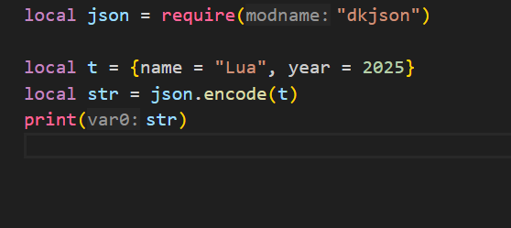
External Libraries
Json Parsing

Slide 2
Tables
Lua tables are the only data structure in the language — they serve as:
Arrays
Dictionaries (maps)
Objects
Records
Sets
Modules

Slide 3
Table Constructor
Empty table
local t = {}
Array-style constructor (numerical indices)
local colors = { "red", "green", "blue" }
-- Equivalent to:
-- colors = { [1] = "red", [2] = "green", [3] = "blue" }

Slide 4
Table Constructor
Key-value constructor (dictionary)
local person = {
name = "Alice",
age = 28,
city = "Delhi"
}
-- Internally: { ["name"] = "Alice", ["age"] = 28, ... }

Slide 5
Table Constructor
Mixed constructor
local mix = {
"cat",
species = "feline",
[10] = "ten",
[true] = "boolean key"
}

Slide 6
Table Indices
Valid Lua table keys (indices):
Any value except nil and NaN
Common: number, string, boolean, even table and function

Slide 7
Important Index Rules
Keys must not be nil or NaN:
local t = {}
t[nil] = "X" -- ❌ Error
t[0/0] = "Y" -- ❌ NaN: invalid
You can overwrite values with same keys:
local t = { a = 1, a = 2 } -- Final value: a = 2

Slide 8
Tables
-- Empty table
local t = {}
-- With values
local t2 = { "apple", "banana", "cherry" }
-- Key-value table (like a dictionary)
local t3 = {
name = "Alice",
age = 30,
city = "Chennai"
}

Slide 9
Tables Iteration
For array-style:
for i, v in ipairs(fruits) do
print(i, v)
end

Slide 10
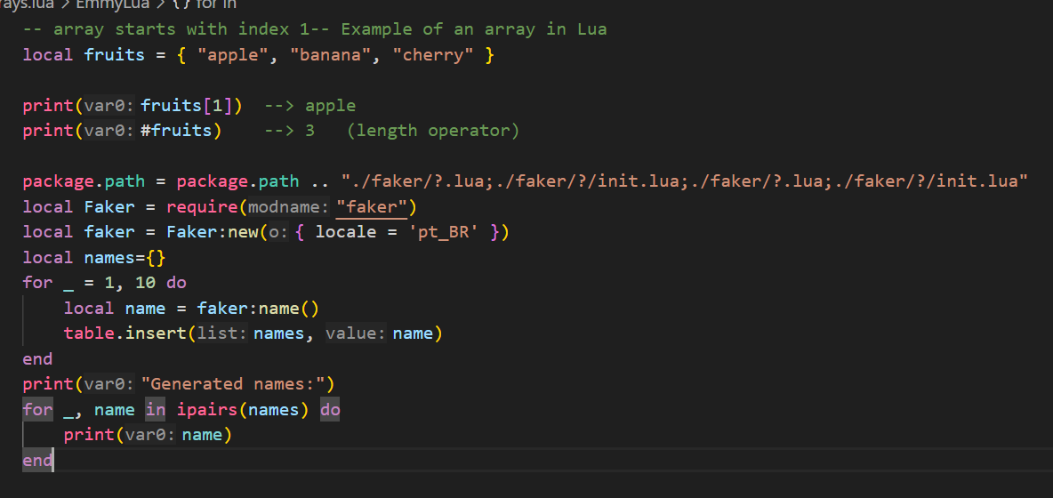
Tables as Arrays
Lua arrays start at index 1 (not 0):

Slide 11
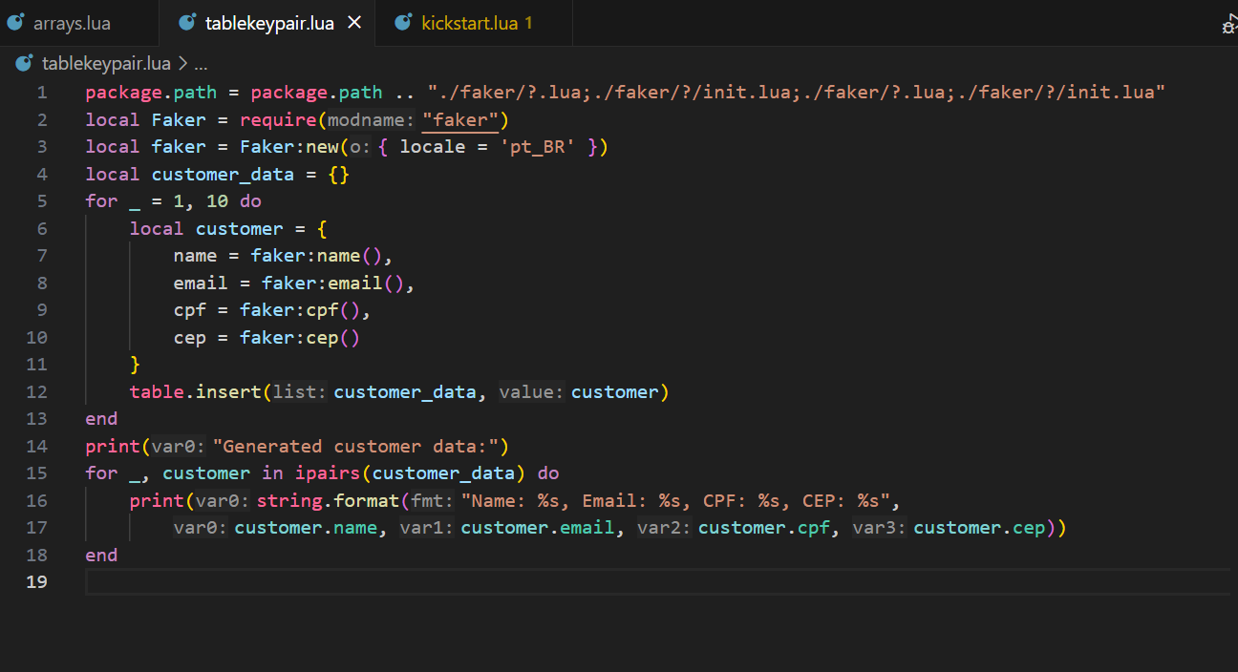
Table as Dictionary

Slide 12
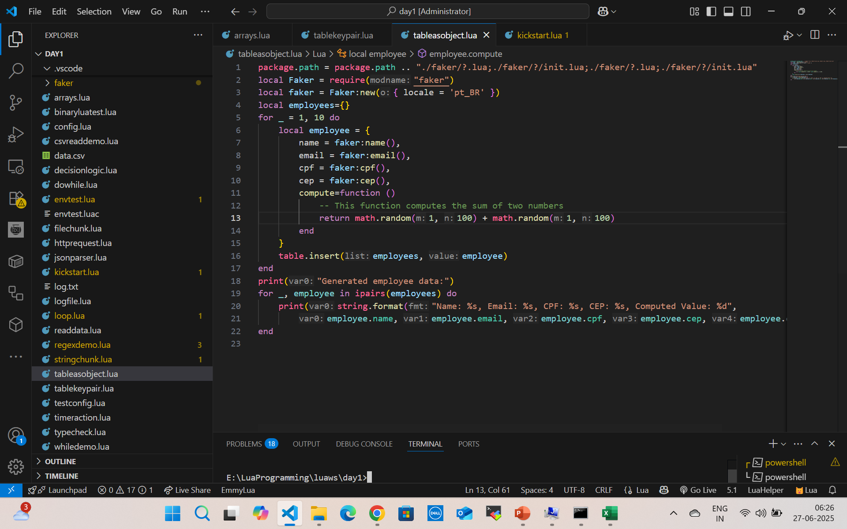

Tables as Objects (with functions)

Slide 13
MetaTable
A metatable is a table that defines how another table behaves in special situations, like:
Adding two tables
Accessing a missing field
Making a table callable like a function
Used to add behavior like operator overloading, default values, or OO-like features.

Slide 14
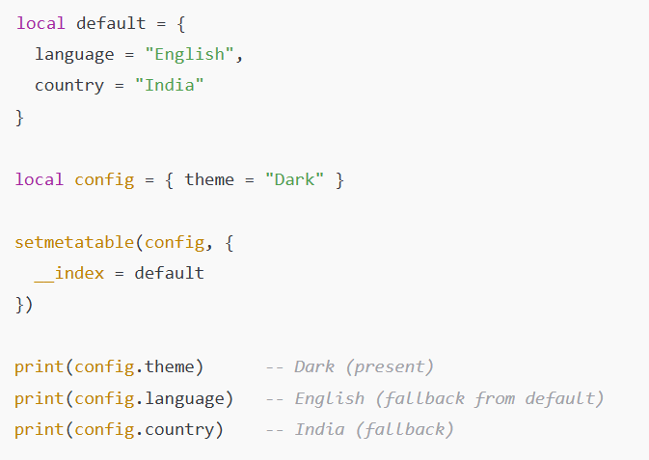
Meta tables Missing Index
__index as a table (default values) – Missing Index

Slide 15

Meta tables addition
function newMatrix(a, b)
local mat = { a = a, b = b }
local mt = {
__add = function(m1, m2)
return newMatrix(m1.a + m2.a, m1.b + m2.b)
end
}
return setmetatable(mat, mt)
end
local m1 = newMatrix(10, 20)
local m2 = newMatrix(1, 2)
local m3 = m1 + m2
print(m3.a, m3.b) --> 11 22

Slide 16
Extend to Other Operators
Metamethod | Operator
__add | +
__sub | -
__mul | *
__div | /
__mod | %
__pow | ^
__unm | Unary -

Slide 17
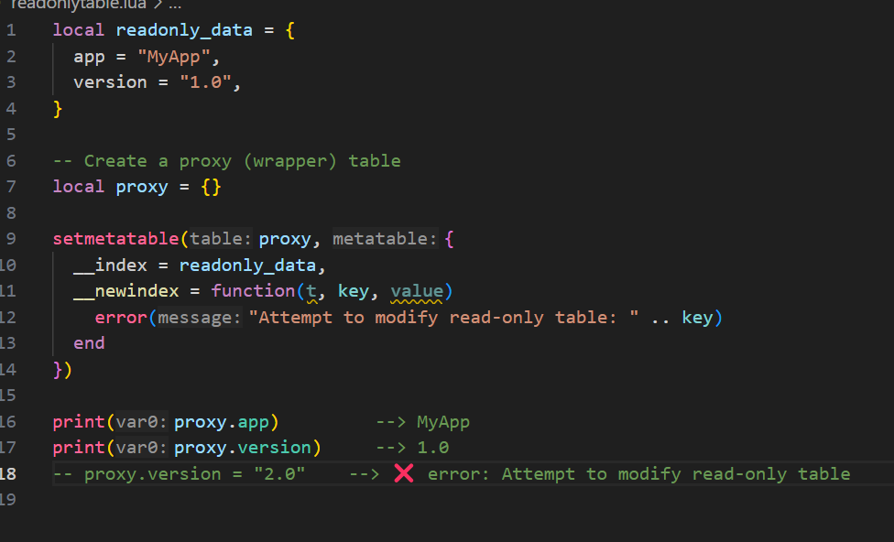
Read-only table (__newindex)

Slide 18
What is a Sequence in Lua?
A sequence is a table with positive integer keys starting from 1, with no gaps (i.e., t[1], t[2], ..., t[n], where n = #t).

Slide 19
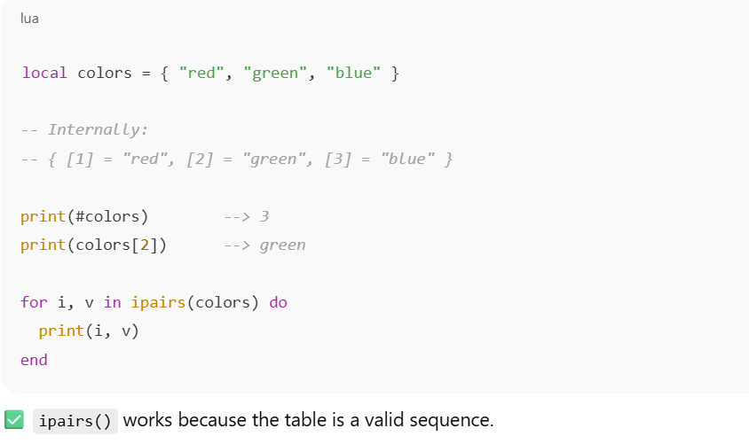

What is a Sequence in Lua?

Slide 20
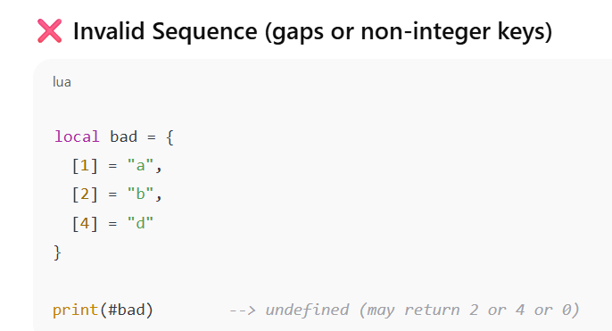
What is a Sequence in Lua?
#bad and ipairs(bad) stop at the first nil, so they're unreliable for non-continuous integer keys.

Slide 21
Useful Functions for Sequences (from table module)
Function | Purpose
#t | Length of sequence (consecutive keys)
ipairs(t) | Iterates over sequence safely
table.insert(t, v) | Adds v at end
table.remove(t, i) | Removes index i, shifts others
table.concat(t, sep) | Joins all values as string
table.sort(t) | Sorts values in-place

Slide 22
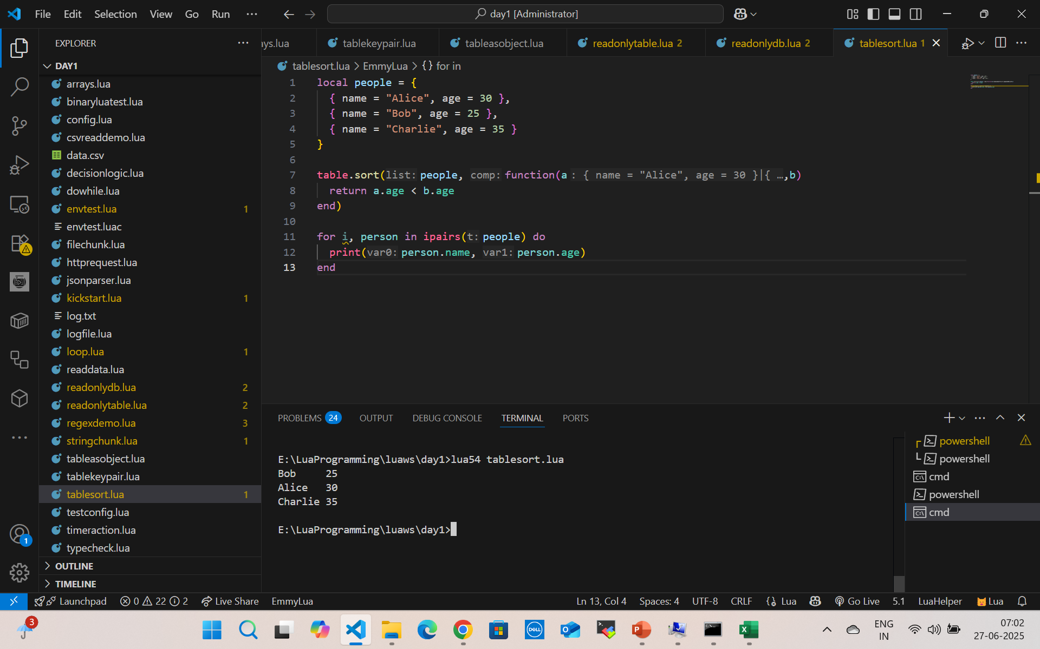
Table Sort

Slide 23
Table Sort
local names = { "Charlie", "Alice", "Bob" }
table.sort(names)
-- Output: Alice, Bob, Charlie

Slide 24
Table concat
local fruits = { "apple", "banana", "cherry" }
local result = table.concat(fruits, ", ")
print(result)
-- Output: apple, banana, cherry

Slide 25
What Is Safe Navigation?
Safe navigation means accessing nested fields without errors, even if intermediate tables or keys are nil.

Slide 26
Functions
In Lua, functions are first-class values, meaning you can:
Assign them to variables
Pass them as arguments
Return them from other functions

Slide 27
Types of functions
Function Basics
Function with Parameters
Function with Return Values
Anonymous Functions (Lambdas)
Multiple Return Values
Variadic Functions (...)
Recursive Functions
Local vs Global Functions
Functions as Table Fields (Methods)

Slide 28
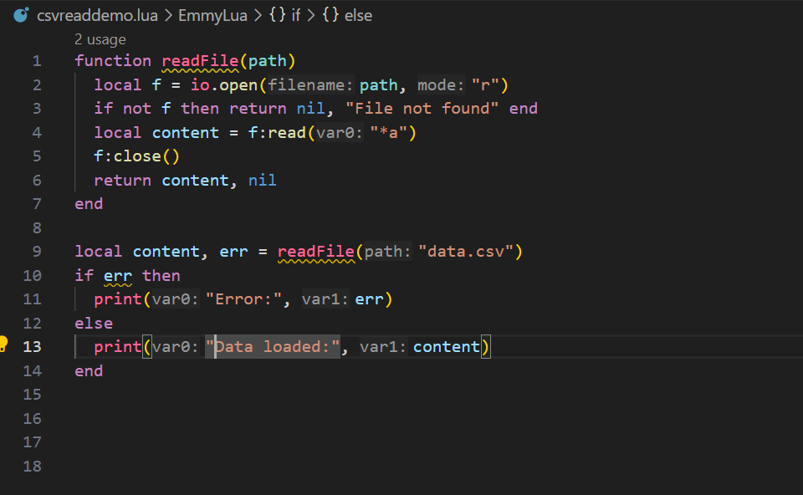
Multiple Return

Slide 29
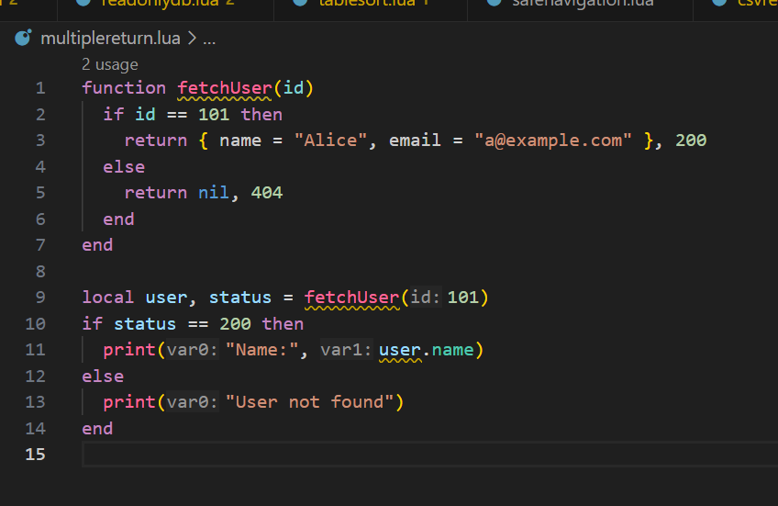
Multiple Return

Slide 30
Variadic Function
function formatCSV(...)
return table.concat({...}, ",")
end
print(formatCSV("apple", "banana", "cherry")) -- apple,banana,cherry

Slide 31
Variadic Function
function log(...)
local args = {...}
print("[LOG]", table.concat(args, " "))
end
log("User", "logged", "in", "at", os.date())

Slide 32
Table.unpack
Returns all values from a table as separate arguments (like JS ...arr or Python *args).
table.unpack(t [, i [, j]])
t: The table (usually a sequence)
i: Starting index (default 1)
j: Ending index (default #t)

Slide 33
Table.unpack
Unpack Simple
local t = {"Lua", "Rocks", 2024}
print(table.unpack(t)) --> Lua Rocks 2024
Unpack Subset
local t = {"a", "b", "c", "d"}
print(table.unpack(t, 2, 3)) --> b c

Slide 34
Proper Tail Calls (PTC)
What is a Tail Call?
A tail call is when a function returns the result of another function directly.

Slide 35
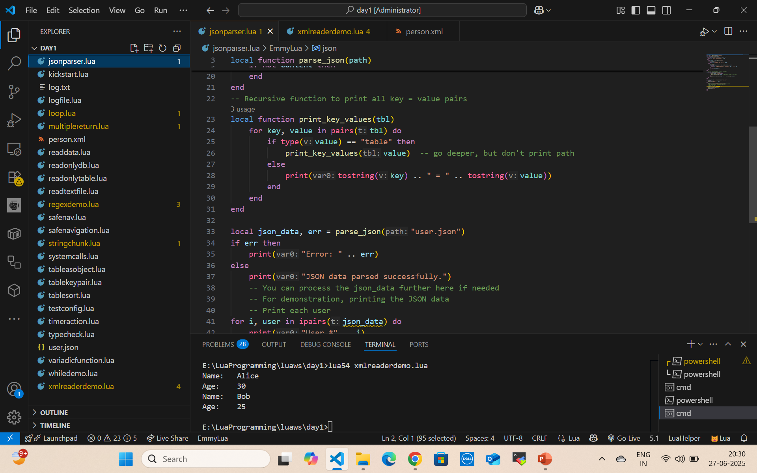
Real Example: Recursive Tail Call

Slide 36
Real Example: Recursive Tail Call
function route(path)
if path == "/home" then return show_home()
if path == "/login" then return show_login()
return show_404()
end
function show_home()
print("🏠 Home Page")
return route("/login") -- Tail call
end
function show_login()
print("🔐 Login Page")
end
route("/home")

Slide 37
Simple I/O Model (Interactive Console)
-- Simple Input
io.write("Enter your name: ")
local name = io.read()
print("Hello, " .. name .. "!")

Slide 38
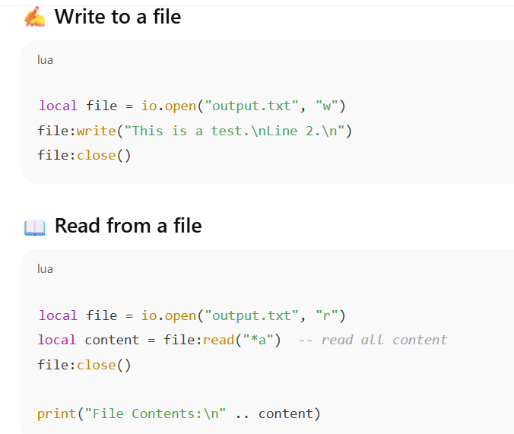
Simple File Read/Write

Slide 39
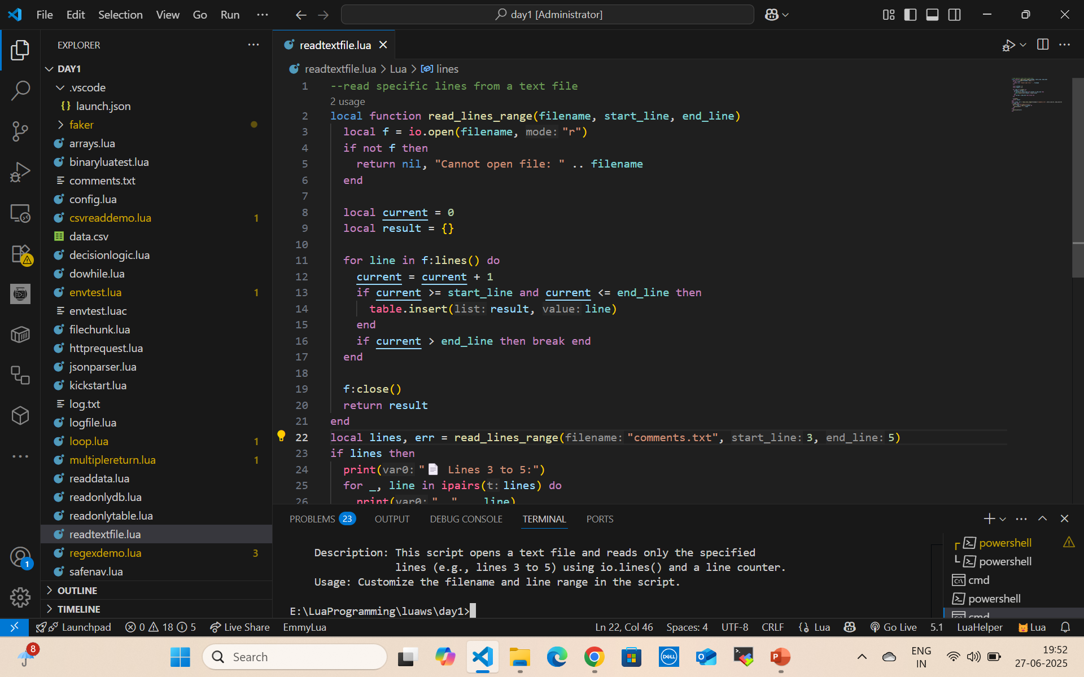
Read Text File

Slide 40
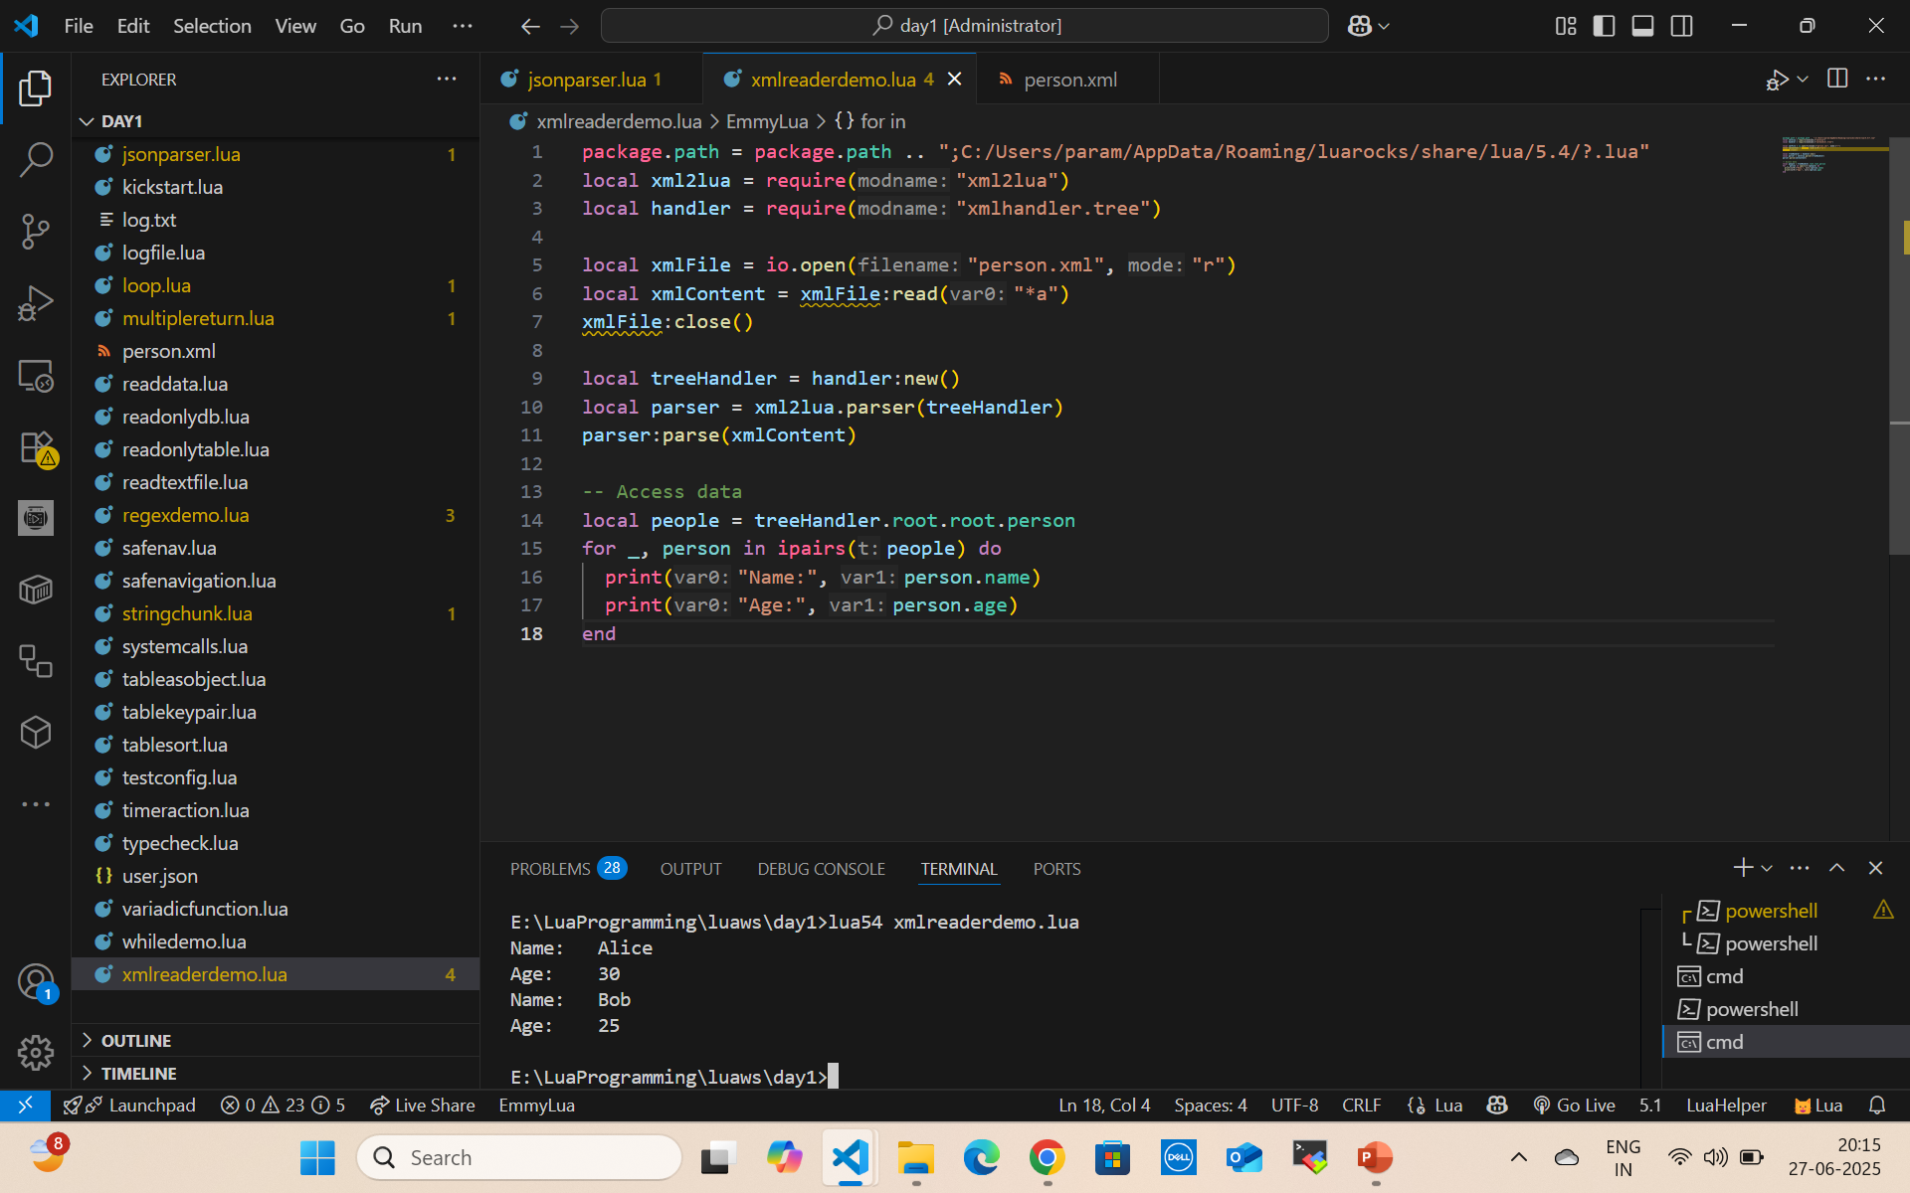
Read XML file

Slide 41
Summary Table
Operation | Function | Notes
Read input | io.read() | from keyboard
Write output | io.write() | no newline
Print line | print() | newline included
Open file | io.open(filename, mode) | "r", "w", "a" modes
Read from file | file:read("*l") or "*a" | line or all
Write to file | file:write("text") | writes as string
Close file | file:close() | must close after write

Slide 42
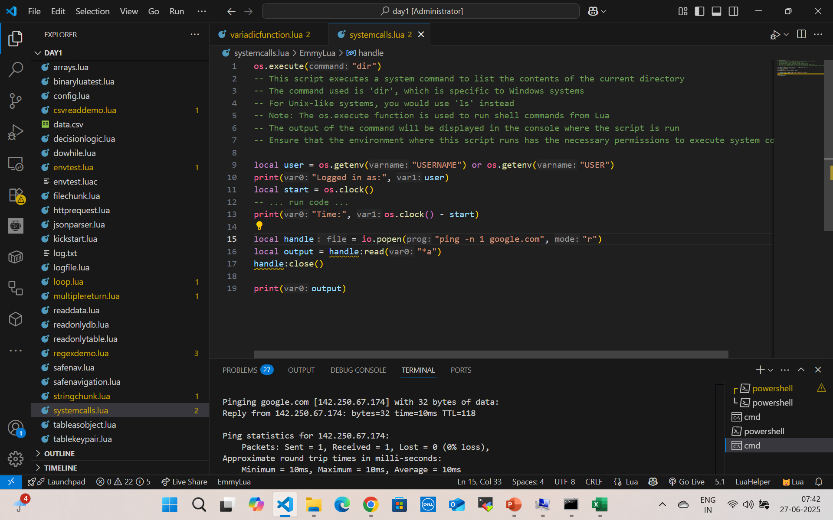
System Calls

Slide 43
Custom Date Formats with os.date(format)
Format | Description | Example
%Y | Year (4 digits) | 2025
%y | Year (2 digits) | 25
%m | Month (01–12) | 06
%B | Full month name | June
%b | Abbreviated month name | Jun
%d | Day of the month (01–31) | 28
%H | Hour (00–23) | 15
%I | Hour (01–12) | 03
%p | AM/PM | PM
%M | Minute | 20
%S | Second | 12
%A | Full weekday name | Saturday
%a | Abbreviated weekday name | Sat

Slide 44
Custom Date Formats with os.date(format)
print(os.date("%Y-%m-%d")) --> 2025-06-28
print(os.date("%d/%m/%Y")) --> 28/06/2025
print(os.date("%I:%M %p")) --> 03:20 PM
print(os.date("%A, %B %d, %Y")) --> Saturday, June 28, 2025

Slide 45
Convert Table → String
local dt = {
year = 2025,
month = 12,
day = 25,
hour = 10,
min = 30,
sec = 0
}
print(os.date("%Y-%m-%d %H:%M:%S", os.time(dt)))
-- Output: 2025-12-25 10:30:00

Slide 46
Convert String → Table
local t = os.date("*t")
for k, v in pairs(t) do
print(k, v)
end

Slide 47
os.setlocale(locale, category) — Overview
locale: string like "en_US", "fr_FR.UTF-8", "C", or """ (empty for default)
category: optional, one of:
"all" (default)“
collate" (sorting)
"ctype" (char types like upper/lower)
"monetary" (currency)
"numeric" (decimal separator, etc.)
"time" (date/time formatting)

Slide 48
os.setlocale(locale, category) — Overview
print("Before:", os.date("%A, %B %d, %Y"))
local ok = os.setlocale("French_France", "time") -- Try Windows-style first
if not ok then
ok = os.setlocale("fr_FR.utf8", "time") -- Try Linux/macOS style
end
if ok then
print("After (locale applied):", os.date("%A, %B %d, %Y"))
else
print("Locale not supported on this system")
end

Slide 49
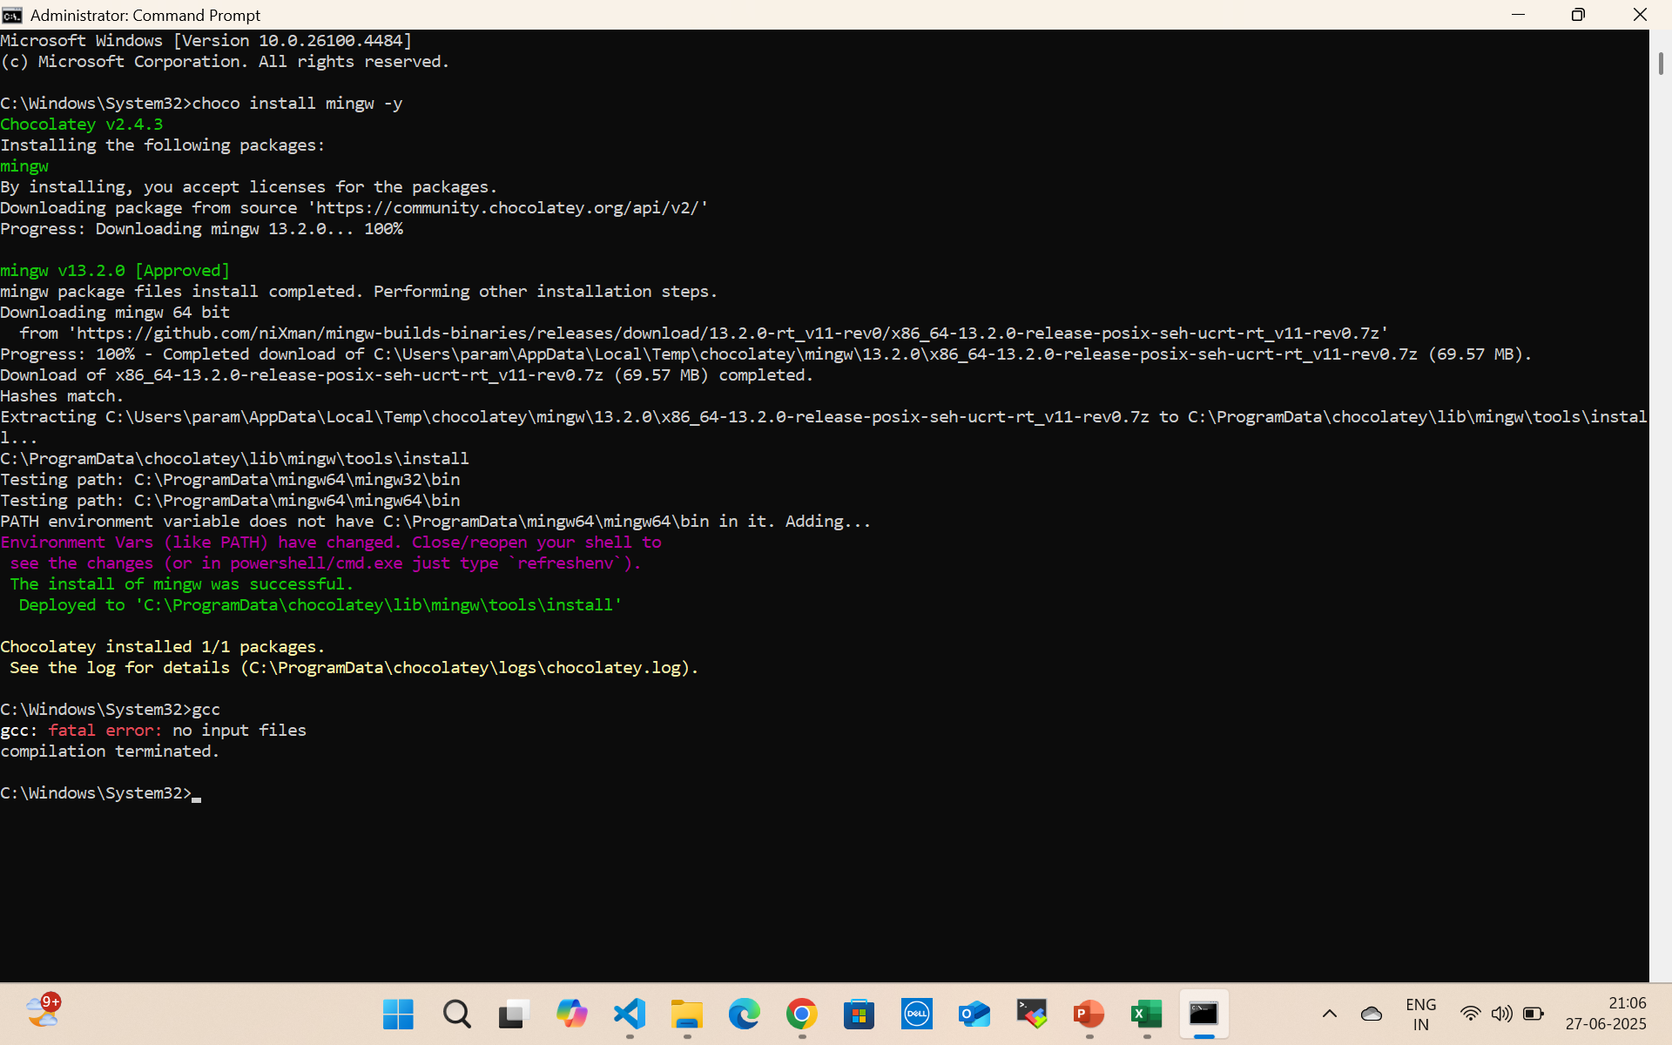
Install GCC

Slide 50
Lua Source and Binaries
https://luabinaries.sourceforge.net/download.html
https://sourceforge.net/projects/luabinaries/files/5.4.2/Windows%20Libraries/Dynamic/

Slide 51
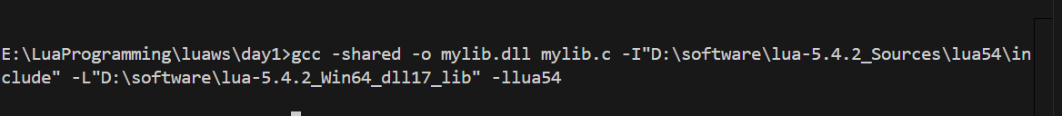
Call C code from Lua
gcc -shared -o mylib.dll mylib.c -I"D:\software\lua-5.4.2_Sources\lua54\include" -L"D:\software\lua-5.4.2_Win64_dll17_lib" -llua54

Slide 52
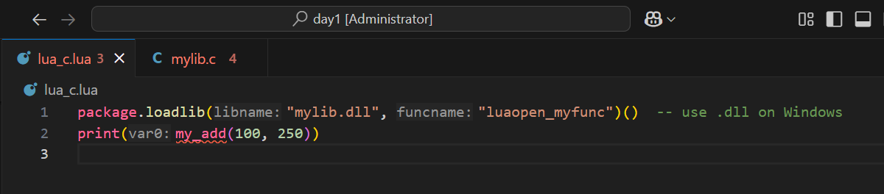
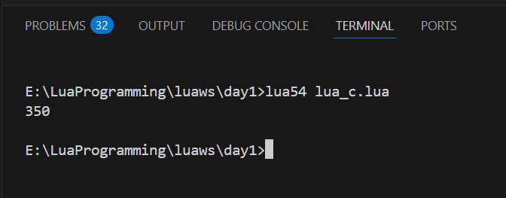
Call C dll from Lua

Slide 53
Variable Scope
Declaring Local Variables
local x = 10
print(x) --> 10
local means x is only accessible in the block or function where it's declared.
If you omit local, the variable becomes global (bad practice).

Slide 54
Variable Scope
Using Blocks
A block is a chunk of code enclosed in do ... end, or an implicit block in control structures or functions.
do
local a = 5
print(a) --> 5
end
print(a) --> nil or error (a is local to the block)

Slide 55
Variable Scope
Block Examples in Control Structures
if true then
local msg = "Inside if"
print(msg)
end
-- msg is not visible here
-- print(msg) --> error

Slide 56
Variable Scope
Nested Locals (Shadowing)
local x = 1
do
local x = 2 -- shadows outer x
print(x) --> 2
end
print(x) --> 1

Slide 57
Variable Scope
Function-Level Scope
function add(a, b)
local result = a + b
return result
end
-- result is not visible outside
-- print(result) --> error

Slide 58
Summary
Feature | Behavior
local | Restricts variable scope to current block
do ... end | Creates a block
Function scope | Has its own local space
Shadowing | Inner local hides outer one

Slide 59
break
break exits the loop immediately, skipping the rest of the body and the next iteration.
for i = 1, 10 do
if i == 5 then
break
end
print(i)
end
-- Output: 1 2 3 4

Slide 60
goto
goto can jump forward or backward to a label inside the same block.
It cannot jump into the scope of a local variable declared after it (Lua prevents unsafe jumps).
for i = 1, 5 do
if i == 3 then
goto skip
end
print(i)
end
::skip::
print("Loop skipped at i == 3")

Slide 61
Invalid goto
You cannot use goto to jump forward into a place where a local variable is declared — because that would skip the variable’s initialization, which can lead to unpredictable behavior.
goto jump_here -- ERROR
local x = 10 -- this line is skipped!
::jump_here::
print(x) -- illegal: x was never declared in this path

Slide 62
Closures
A function that captures the variables from its enclosing scope, forming a persistent environment.
Even if the outer function finishes execution, the inner function retains access to those variables.

Slide 63
Anatomy of a Closure
function outer()
local a = 5
return function()
return a
end
end
local f = outer()
print(f()) -- prints 5

Slide 64
Anatomy of a Closure
a is a local variable to outer
The anonymous function captures it
outer() returns the function
The function retains access to a even after outer() ends

Slide 65
Scope Chain: Closures Capture Upvalues
Lua functions form a lexical scope chain.
An upvalue is a reference to a local variable from an outer scope.
Lua does not copy the variable — it references it.

Slide 66
Scope Chain: Closures Capture Upvalues
function makeWriter()
local text = ""
return function(t)
text = text .. t
return text
end
end
local writer = makeWriter()
print(writer("Hi")) --> Hi
print(writer(" there"))--> Hi there

Slide 67
Internal Behavior (How Lua Stores It)
Lua converts this:
function outer()
local x = 1
return function() return x end
end

Slide 68
Internal Behavior (How Lua Stores It)
To this (conceptually):
-- pseudo-C-style environment structure
Closure {
function_body = function(...)
return upvalues[1] -- x
end,
upvalues = {
[1] = reference to x
}
}

Slide 69
Internal Behavior (How Lua Stores It)
function counters()
local x = 0
return function() x = x + 1; return x end,
function() x = x + 10; return x end
end
local inc1, inc2 = counters()
print(inc1()) --> 1
print(inc2()) --> 11 (they share `x`)
print(inc1()) --> 12

Slide 70
Use Cases for Closures
Encapsulation & Stateful Functions
Encapsulation means hiding internal data and logic, exposing only what is necessary.
In languages like Java or Python, you use private or protected keywords.
In Lua, we achieve the same behavior using closures.

Slide 71
Use Cases for Closures
How Closures Provide Encapsulation
A closure can "capture" local variables from its enclosing scope.
These variables become private:
they live if the closure does, but they're inaccessible from outside.

Slide 72
Use Cases for Closures
function makeAccount(initialBalance)
local balance = initialBalance -- 👈 private variable
return {
deposit = function(amount)
balance = balance + amount
return balance
end,
withdraw = function(amount)
if amount > balance then
return "Insufficient funds"
end
balance = balance - amount
return balance
end,
getBalance = function()
return balance
end
}
end

Slide 73
Use Cases for Closures
What’s Happening:
balance is a local variable in the factory (makeAccount).
It is captured by the returned functions.
It's inaccessible from outside — even if you try, it doesn’t exist on the table.
local acc = makeAccount(100)
print(acc.deposit(50)) --> 150
print(acc.withdraw(70)) --> 80
print(acc.getBalance()) --> 80
-- print(acc.balance) --> nil (encapsulated!)

Slide 74
Benefits of Closure Encapsulation
Benefit | Explanation
Encapsulation | Internal state is protected from external access
Modularity | Self-contained reusable units
No naming conflict | Captured variables are not globals
Security | Prevents accidental or malicious overwrite
Scoped GC | Memory managed automatically when closure dies

Slide 75
Real-World Use Cases
Bank accounts, user sessions, timers
Encapsulating database connection state
Plugins or modules with private config
Reusable UI components in Lua-based game engines

Slide 76
Functions as First-Class Values in Lua
A first-class value means:
A value that can be assigned to variables, passed as arguments, returned from other functions, and stored in tables.
In Lua, functions are first-class citizens.

Slide 77
Assigning Functions to Variables
local function sayHello()
print("Hello!")
end
-- or anonymously:
local greet = function()
print("Hi there!")
end
greet() --> Hi there!

Slide 78
Passing Functions as Arguments
function apply(f, x)
return f(x)
end
function square(n)
return n * n
end
print(apply(square, 5)) --> 25

Slide 79
Returning Functions from Functions
function makeMultiplier(factor)
return function(x)
return x * factor
end
end
local double = makeMultiplier(2)
print(double(10)) --> 20

Slide 80
Non-Global Functions
In Lua, if you define a function without local, it becomes global:
function globalFunc()
print("I'm global!")
End
This is equivalent to:
_G["globalFunc"] = function()
print("I'm global!")
end

Slide 81
Local / Non-Global Function
local function localFunc()
print("I'm local to this file or block!")
end
Exists only in current scope (block, file, or function)
Not visible globally
Safer and preferred for modularity

Slide 82
Summary Table
Feature | Example
Assign to variable | local f = function() end
Pass as argument | apply(f, x)
Return from function | return function() end
Stored in table | tbl.handler = function() ... end
Local function | local function myFunc() end
Global function (not recommended) | function myFunc() end

Slide 83
String.find
startIndex, endIndex = string.find(subject, pattern [, init [, plain]])
Parameter | Description
subject | The string to search in
pattern | The substring or Lua pattern to search for
init | (optional) Index to start the search (default is 1)
plain | (optional) If true, disables pattern matching (literal match)

Slide 84
String.find
local s = "Hello, Lua!"
local i, j = string.find(s, "Lua")
print(i, j) --> 8 10
print(s:sub(i, j)) --> Lua
i and j start index and end index of result

Slide 85
String.find
local s = "Lua is Lua"
print(string.find(s, "Lua", 5)) --> 8 10 (starts searching from index 5)
Starts search from 5th position

Slide 86
String.find
if string.find("hello world", "world") then
print("Found")
else
print("Not found")
End
print(string.find("abc", "xyz")) --> nil

Slide 87
Lua Pattern Character Classes
Pattern | Meaning | Example Match
%u | Uppercase letter (A–Z) | "A", "Z"
%l | Lowercase letter (a–z) | "a", "z"
%p | Punctuation character | ".", ",", "!", "?", etc.
%s | Whitespace character | " ", "\t", "\n", "\r"

Slide 88
String.match
local password = "Hello@123"
if string.match(password, "%u") and -- has uppercase
string.match(password, "%l") and -- has lowercase
string.match(password, "%d") and -- has digit
string.match(password, "%p") and -- has punctuation
string.len(password) >= 8 then -- length check
print("Valid password")
else
print("Invalid password")
end

Slide 89
Inverted Match
Pattern | Matches
%S | Non-space character
%P | Non-punctuation
%U | Invalid (Lua doesn't have)

Slide 90
string.gsub
string.gsub (global substitution) is used to replace parts of a string using a pattern.
result, count = string.gsub(subject, pattern, replacement [, n])

Slide 91
string.gsub
Parameter | Description
subject | The original string
pattern | Lua pattern (what to search for)
replacement | Replacement value (string, table, or function)
n (optional) | Max number of substitutions
result | Final string with replacements
count | Number of substitutions made

Slide 92
String.gsub
local s = "Lua is great"
local new = string.gsub(s, "great", "awesome")
print(new) --> Lua is awesome
local s = "a+b=c"
print(string.gsub(s, "+", "-", 1)) --> a-b=c (1st only)
print(string.gsub(s, "+", "-")) --> a-b=c (all)

Slide 93
String.gsub
local s = "ID:123, Code:456"
local result = string.gsub(s, "%d+", "###")
print(result) --> ID:###, Code:###

Slide 94
String.gsub
local s = "first LAST"
local result = string.gsub(s, "(%a+)%s+(%a+)", "%2, %1")
print(result) --> LAST, first
(%a+) captures a word
%2, %1 swaps the captured parts

Slide 95
String.gsub
local s = "1,2,3"
local result = string.gsub(s, "%d+", function(n)
return tonumber(n) * 2
end)
print(result) --> 2,4,6

Slide 96
URL Encoding in Lua
URL encoding (a.k.a. percent-encoding) is used to encode characters in a string so they can be safely included in a URL. For example:
"Hello World!" → "Hello%20World%21"

Slide 97
URL Encoding in Lua
function url_encode(str)
str = str:gsub("\n", "\r\n")
str = str:gsub("([^%w%-_%.~])", function(c)
return string.format("%%%02X", string.byte(c))
end)
return str
end

Slide 98
URL Encoding in Lua
[^%w%-_%.~]: matches all characters not safe for URLs
string.byte(c): gets ASCII code
string.format("%%%02X", ...): turns it into %XX form

Slide 99
URL Decoding
function url_decode(str)
str = str:gsub("%%(%x%x)", function(hex)
return string.char(tonumber(hex, 16))
end)
return str
end
print(url_decode("Hello%20World%21")) --> Hello World!

Slide 100
Tab Expansion
Tab expansion means replacing tabs (\t) with spaces, typically 4 or 8 spaces per tab.

Slide 101
Common Code Formats
Code | Meaning | Example
%Y | Year (4 digits) | 2025
%m | Month (01–12) | 06
%d | Day of month (01–31) | 29
%H | Hour (00–23) | 10
%M | Minute (00–59) | 15
%S | Second (00–59) | 32
%A | Weekday name | Saturday
%B | Month name | June

Slide 102
Date Time Manipulation
print(os.date("%Y-%m-%d %H:%M:%S"))
-- Output: "2025-06-29 10:15:32“
local t = {
year = 2025,
month = 12,
day = 31,
hour = 23,
min = 59,
sec = 59
}
local ts = os.time(t)
print(ts) --> Unix timestamp for 2025-12-31 23:59:59

Slide 103
Date Time Manipulation
local ts = 1751182532
print(os.date("%Y-%m-%d %H:%M:%S", ts))
local t1 = os.time({year=2025, month=6, day=29})
local t2 = os.time({year=2025, month=7, day=1})
print(os.difftime(t2, t1)) --> 172800 (2 days in seconds)

Slide 104
Date Time Manipulation
local now = os.time()
local one_day = 60 * 60 * 24
local tomorrow = now + one_day
print(os.date("%Y-%m-%d", tomorrow)) --> Tomorrow's date

Slide 105
Date Time Manipulation
local dt = os.date("*t") -- returns a table
print(dt.year, dt.month, dt.day)
-- Output: 2025 6 29

Slide 106
Date Time Manipulation
os.execute("sleep 1") -- sleep for 1 second (Unix)
os.execute("ping -n 2 127.0.0.1 > nul") -- Windows workaround for 1 second

Slide 107
Summary
Task | Function
Get current time | os.date() / os.time()
Format date string | os.date("%Y-%m-%d")
Parse date → timestamp | os.time{year=..., month=...}
Timestamp → date | os.date(nil, ts)
Difference in seconds | os.difftime(t1, t2)
Add/subtract time | os.time() ± seconds

Slide 108
Common Lua Database Connections
Database | Lua Library | LuaRocks Package | Notes
SQLite | lsqlite3 | luarocks install lsqlite3 | Easiest, no server needed
MySQL | luasql.mysql | luarocks install luasql-mysql | Needs MySQL client installed
PostgreSQL | luasql.postgres | luarocks install luasql-postgres | Needs PostgreSQL client installed
MongoDB | luamongo (C++) or REST | Manual build or REST | Complex to build, or use via HTTP
Via Python/REST | Any DB via bridge | Use os.execute or io.popen | Practical and lightweight

Slide 109
Sqlite3
https://www.sqlite.org/download.html
Download sqlite-dll-win-x64-3500100.zip and
sqlite-amalgamation-3500100.zip

Slide 110
Questions

Slide 111
Module Summary
Lua Getting Started
Numbers
Strings

