Slide 1
Modules
Bid/Ask Values
Discount
Factor
Par-Value
Risk
Predicted Rates
PV-01 Values

Slide 2

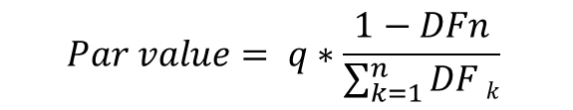
Bid / Ask Calculation
Objective: PV of both the Fixed and Floating legs should be the same.
$$\frac{\frac{C}{q}}{1+Libor\left(3M\right)∗\frac{90}{360}}+\frac{\frac{C}{q}}{1+Libor\left(6M\right)∗\frac{180}{360}}+\frac{\frac{C}{q}}{1+Libor\left(9M\right)∗\frac{270}{360}}+\frac{\frac{C}{q}+Bfix}{1+Libor\left(12M\right)∗\frac{360}{360}}=Bfl$$
$$Par value= q∗\frac{1−DFn}{\sum_{k=1}^{n}{DF}k}$$

Slide 3
Discount Factor
Finding PV of Future Cash-flows
Annual Compounding
$$DF=\left[\frac{1}{{\left(1+rate\right)}^{years}}\right]∗\left[\frac{1}{\left(1+rate∗time_left\right)}\right]$$
DF Calc
Market Data
Discount Factor Table
Par Value Calc

Slide 4
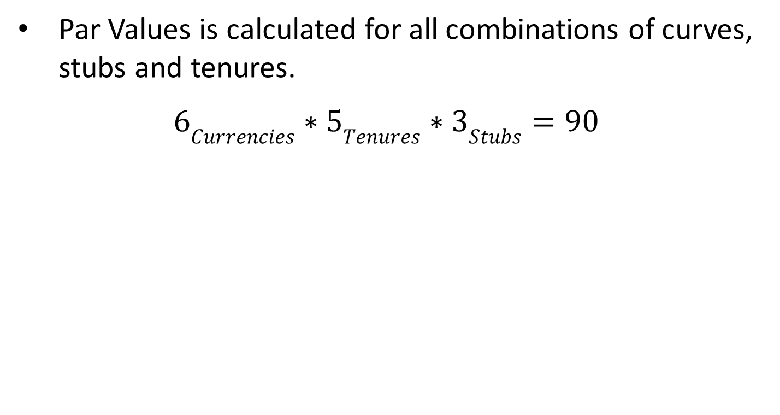
Par Value
Par Values is calculated for all combinations of curves, stubs and tenures.
$6Currencies∗5Tenures∗3Stubs=90$
DF Calc
Market Data (HashMap impl.)
Par Value Calc
Discount Factor Table
To Deal Booking
Bid/Ask Rates based on Spread

Slide 5
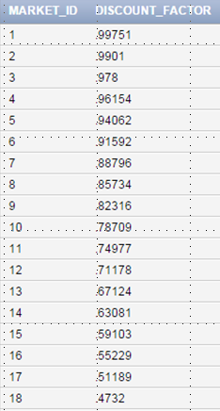
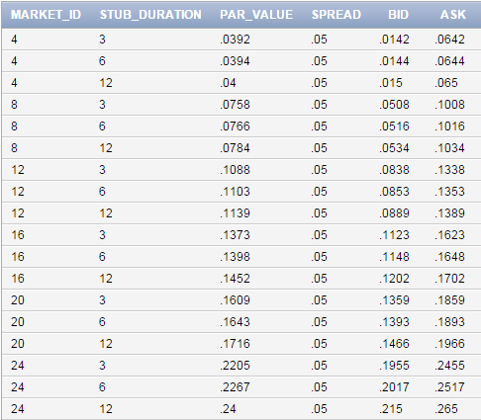
Bid / Ask Calculation
Discount Factor Table
Bid / Ask Table

Slide 6
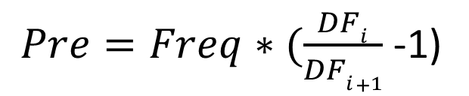
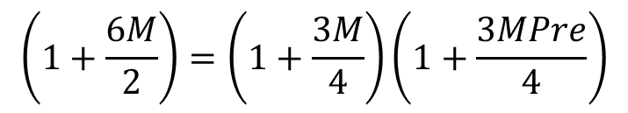
Predicted Interest Rates
$$\left(1+\frac{6M}{2}\right)=\left(1+\frac{3M}{4}\right)\left(1+\frac{3MPre}{4}\right)$$
$Pre=Freq∗(\frac{DFi}{DFi+1}$ -1)
Known Rates
0
3M
6M
9M
Predicted Rates

Slide 7
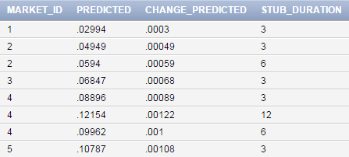
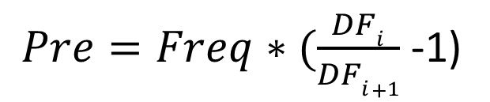
Predicted Interest Rates
Predicted Rates are computed for all combinations of curves, stubs and curve durations.
$Pre=Freq∗(\frac{DFi}{DFi+1}$ -1)
$$6 Curves ∗ 5years ∗ 7 occurences per year = 210 values$$

Slide 8
Batch
Flow of the Module
Start
Truncate all tables
Fetch market data into HashMap
HashMap<String,HashMap<Integer,Integer>>
marketDataHashMap
Calculate Discount factor
Fetch Discount factor into HashMap
HashMap<Integer , Double> discFactorHashMap
Par Value Calculation
Computing Predicted Rates
Generate Bid / Ask Quotes

Slide 9
Risk Analysis: PV01
Objective: Predict change in future cashflows if interest rates change by 1% of interest rate.
$$PV01 \left(Delta\right)=Notional ∗Predicted Change in IR ∗Discounting factor$$
Discount to PV
0
3M
6M
9M
Predicted Cashflows

Slide 10
Risk Analysis: PV01
$$PV01 \left(Delta\right)=Notional ∗Predicted Change in IR ∗Discounting factor$$
View Risk
Home
Compute PV01 for all the stubs till End Date.
& Store in DB
Book Deal
Confirm Deal
What if Risk

Slide 11
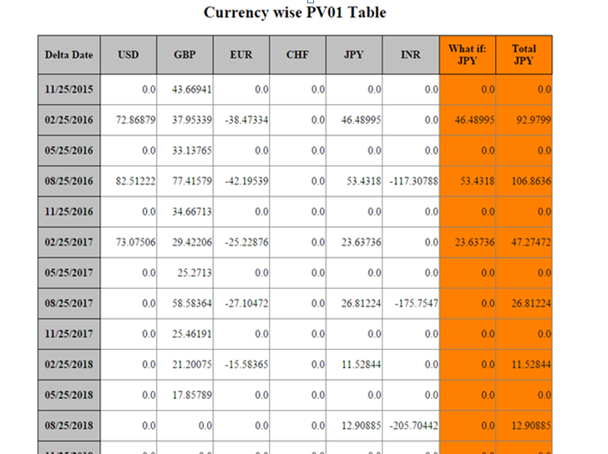
What if Risk

Slide 12
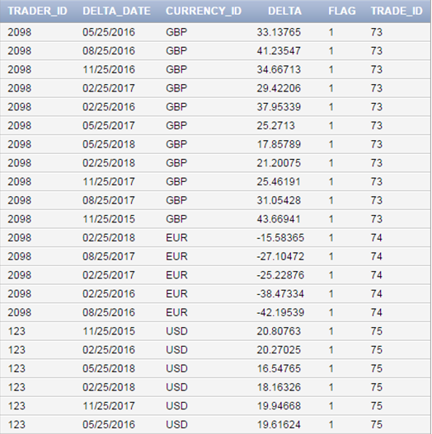
PV01 Database Table

