Slide 1
Trading System
User ID
Password

Slide 2
DERIVATIVE TRADING SYSTEM
Version 1.0
Static Data
Market Data
Trade booking
Exit/Logout

Slide 3
STATIC DATA
Calendars
Customer
Currency
Calendars
Bank Related
Calendars
Trader creation
Create
Create
Create
Create
Edit
Edit
Edit
Edit
Delete
Delete
Delete
Delete
Main Page
Logout
CUSTOMER CREATION
Name:
Country:
Address1:
Bank Details:
Back
Main Page
Logout

Slide 4
MARKET DATA
Interest Rates
Upload
View
Edit
Main Page
Logout
Publish
MARKET DATA - UPLOAD
Browse:
Upload More
(upload .txt/ .xml/ .xls files only)
Back
Main Page
Logout

Slide 5
TRADE BOOKING – INTEREST RATE SWAPS
Non-Economic Details
Economic Details
Trade Non- Economic Details
Trade Date:
Trader ID:
Desk ID:
Bank Book:
Bank Legal Entity:
Customer ID:
Settlement/Confirmation Advice Type :
Main Page
Exit/Logout

Slide 6
TRADE BOOKING – INTEREST RATE SWAPS
Non-Economic Details
Economic Details
Trade Economic Details
Trade Date:
Effective Date:
End Date:
Trade Type: SWAP
Leg1: Pay / Receive
Leg2: Pay / Receive
Currency:
Day Count
Convention:
Currency:
Day Count
Convention:
Notional:
Notional:
Interest Rate Benchmark:
Interest Rate Benchmark:
Fixed Rate (if applicable):
Fixed Rate (if applicable):
Spread:
Spread:
Holiday Calendar ID:
Holiday Calendar ID:
Settle Frequency
Settle Frequency
Leg1: Gen. Cash Schedule
Leg2: Gen. Cash Schedule
Main Page
Exit/Logout

Slide 7
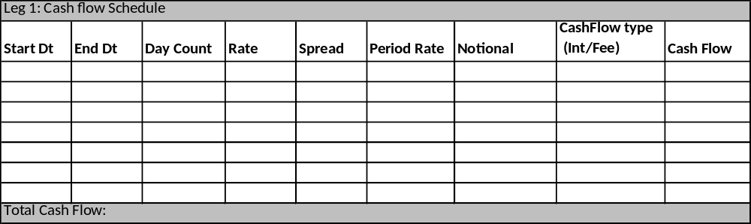

Slide 8
Risk (delta sensitivity)

