Slide 1

REAL TIME STAGNANT WATER MONITORING SYSTEM IN STREETS USING IOT AND ANDROID
Using IOT
Project Guide: Dr. Balaji
By,
Eswarraj.B
Enturi Shanmukha Sai
Ashwin.N

Slide 2
ABSTRACT:
In the latest of times due to heavy monsoons roads and houses are flooded with water. Mainly due to poor drainage systems and also because of the constructions in low-lying areas. As a result of this water stagnation is a major concern as it could become an incubator for different parasites , bacteria and a breeding for mosquitoes which indeed could lead to the spread of malaria, dengue and also accidents. The proposed IOT device would help detect stagnant water in streets and alert the department with which necessary measures can be taken in the areas and roads to clear out the water and also to provide real time updates to the public regarding the routes that are blocked due to excessive water .

Slide 3
LITERATURE SURVEY :
NAME | AUTHOR | YEAR | MERITS
Multi Sesor Remote Sensing Technologies in Water System Management | Shu Shibu | 2011 | It combines all of the product advantages of the normal water meters with the possibility of carrying out remote meter readouts.
Development of Wireless Sensor Network Based Quality Monitoring and Notification System | M.P.P. Sithole, N.I.Nwulu, E.M. Dogo | 2019 | The Notification System Accommodates people with disabilities as the buzzer can be heared those who cannnot see and the LED can be seen by those who can't hear.
Internet of Things (IOT) Enabled Water Monitoring system | Thinagaran Perumal, Md. Nasir Sulaiman, C.Y.Leong | 2015 | A water level sensor is used to detect the desired parameter, and if the water level reaches the parameter, the signal will be feed in rea ltime to social network like Twitter

Slide 4
PROBLEM STATEMENT:
Devloping a system which helps to monitor water stagnation in the real time using IOT and Mobile Application.
Impacts of the product;
Live Location of The Street Is Shared When The Respected Street Is Flooded
Real Time Route Updation of The Flooded Street
Real Time Stagnant Water Monitoring
Devices Status Monitoring
Easy To Find Which Street is Flooded

Slide 5
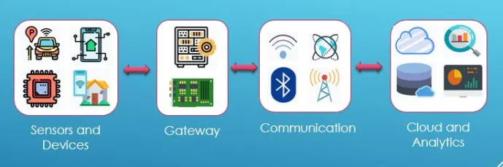
TECHNOLOGY STACK:

Slide 6
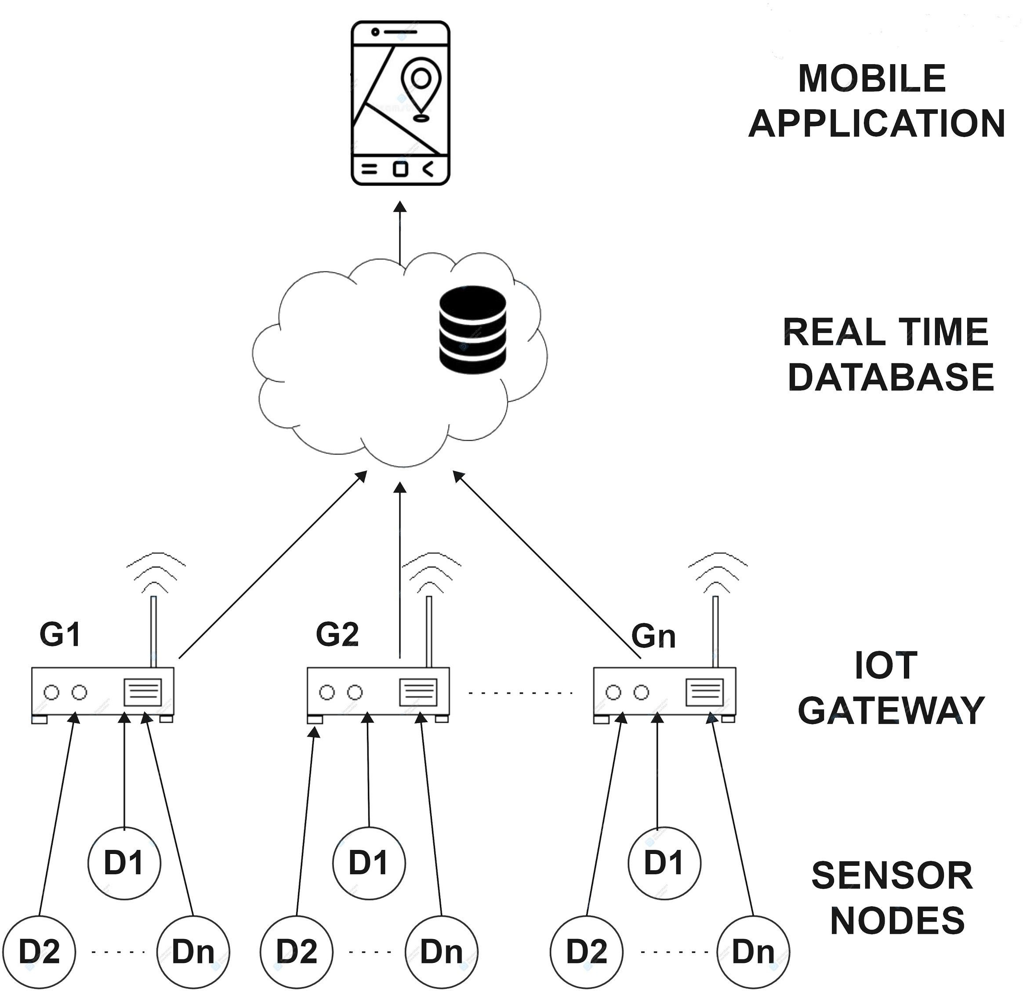
SYSTEM ARCHITECTURE:

Slide 7
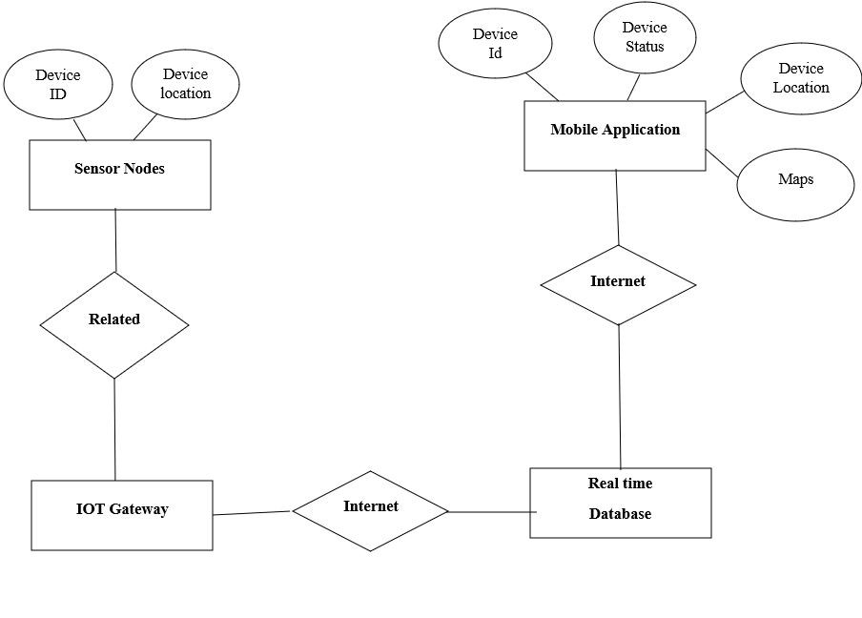
SYSTEM DESIGN:

Slide 8
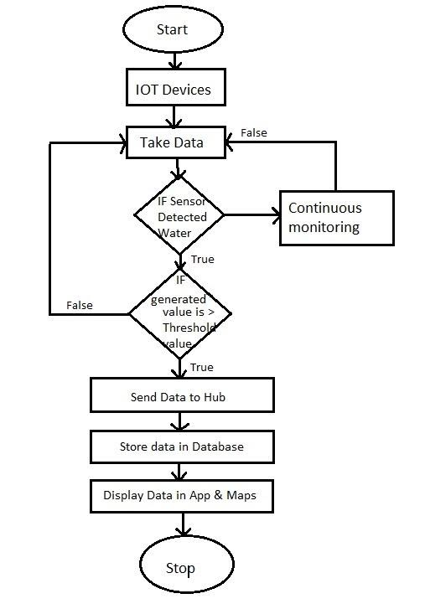
FLOWCHART:

Slide 9
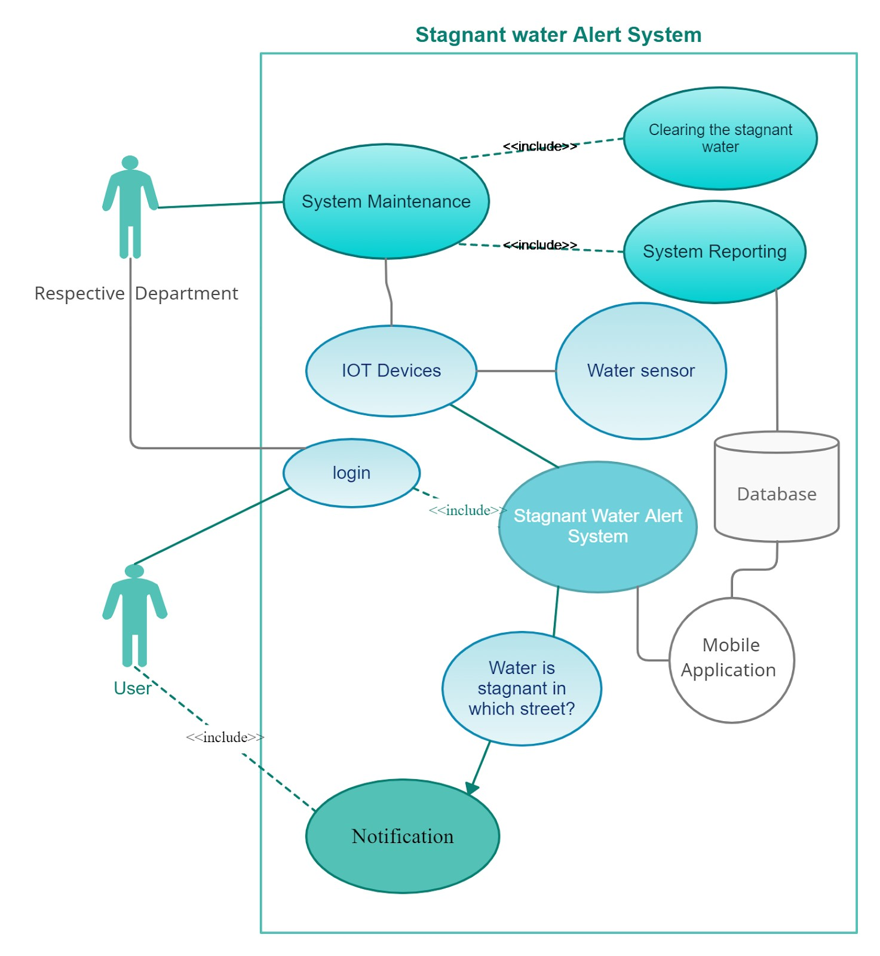
UML DIAGRAM:

Slide 10
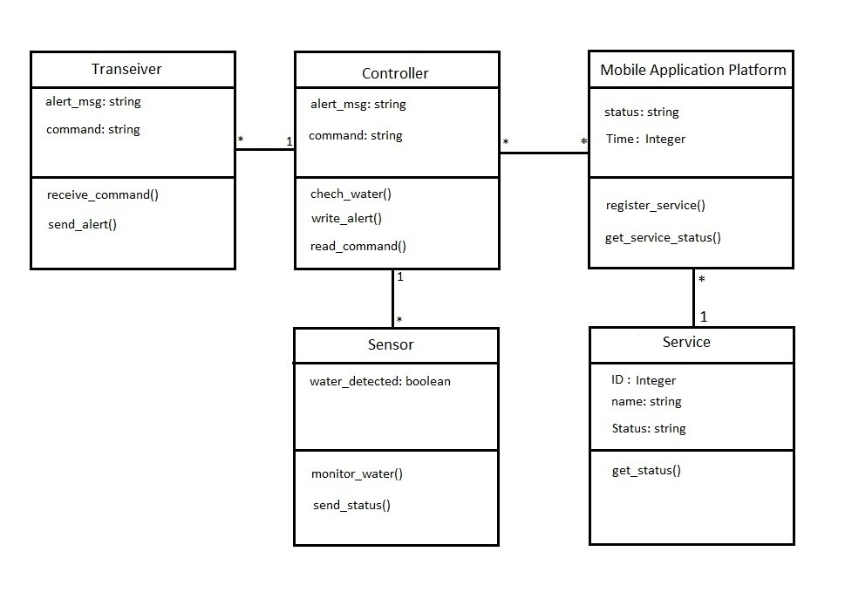
CLASS DIAGRAM:

Slide 11
MODULES DESCRIPTION:
ARDUINO NANO:
Arduino Nano is a low cost development board with very minimal form factor.
It uses an ATmega328p microcontroller that follows AVR Architecture.
It has built in digital and analog pins used to connect different Sensors and also other boards using specific protocols.
Nano can be programmed using an open source application called Arduino IDE.
This development board acts as an interface between different analog (potentiometer, LDR) and digital components (LED, LCD display).

Slide 12
MODULES DESCRIPTION:
WATER SENSOR:
Water Sensor is used for detecting the presence of water.
It consists of two types of intermixed Copper lines called Power Trace and Sense Trace.
These Lines when in Contact with water act as variable Resistor and thereby detecting Level of Water.

Slide 13
MODULES DESCRIPTION:
nRF MODULE:
nRF24l01 is a low cost RF Transceiver used for wireless Communication between the Sensor nodes & IOT Gateway.
The nRF24l01 module operates under 2.4GHz frequency bands and has data transfer rates upto 1 Mbps.

Slide 14
MODULES DESCRIPTION:
NODE MCU:
Node MCU is a development Board with Embedded, built in wifi module.
i.eESP8266 Microchip with Microcontroller capabilities and also follows internet protocol suite Node MCU has an operating Voltage from 3 to 3.6V.
It has a total of 17 GPIO pins for interfacing and Communication.

Slide 15
MODULES DESCRIPTION:
Firebase:
Firebase is Google’s Cross platform tool for developing Web and Mobile Application with Cloud Capabilities.
Firebase real Time Database is a Cloud enabled NoSQL Database that stores data is the form of JSON Scripts and allows, Real Time Data Synchronization
It sends the updated information within no time to the client.

Slide 16
MODULES DESCRIPTION:
MOBILE APPLICATION:
User friendly android application is built to notify end users regarding stagnant water in streets .
Mobile app is interfaced with Google Maps API using which custom map overlays and styling layouts can be applied
i.e. adding markers , circles , polylines to the android application.

Slide 17
TESTING / PERFORMANCE:
Test Case Id | Test Cases | Priority | Input Test Data | Test Case Description | Expected Results | Actual Results | Pass/Fail
TU01 | Status | A | - | Check with DB | Device active | Active | Pass
TU002 | Maps Location | A | On click view map | Display Map | Pinpoint device location | Pinned location of device | Pass
TU03 | Status | A | - | Check with DB | Device Inactive | Inactive | Pass

Slide 18
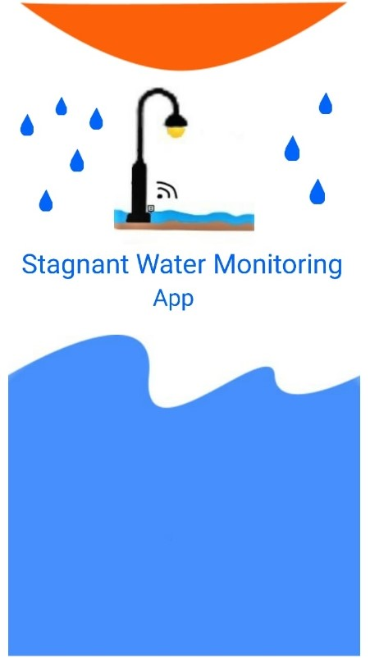
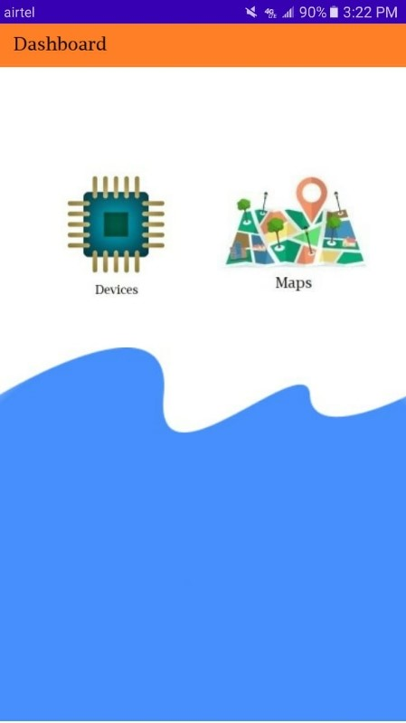
SCREENSHOTS:

Slide 19
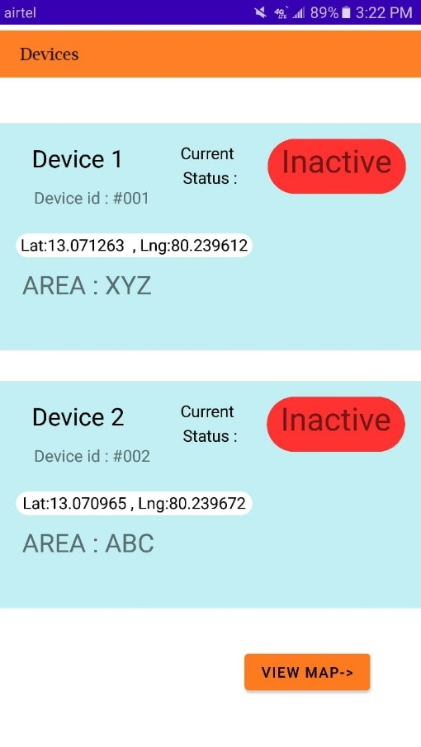
SCREENSHOTS:

Slide 20
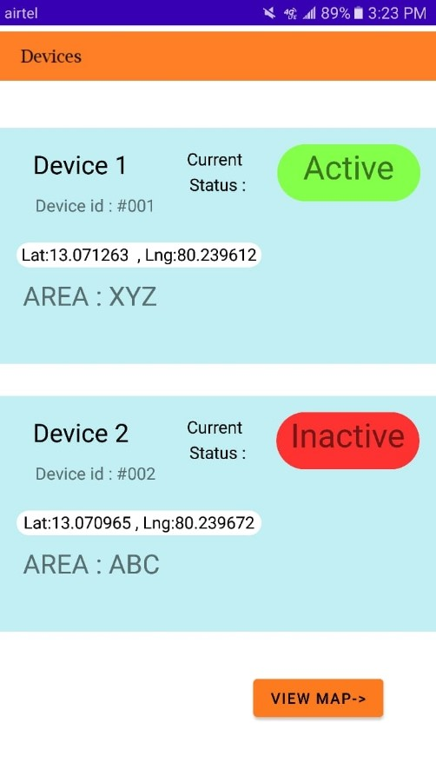
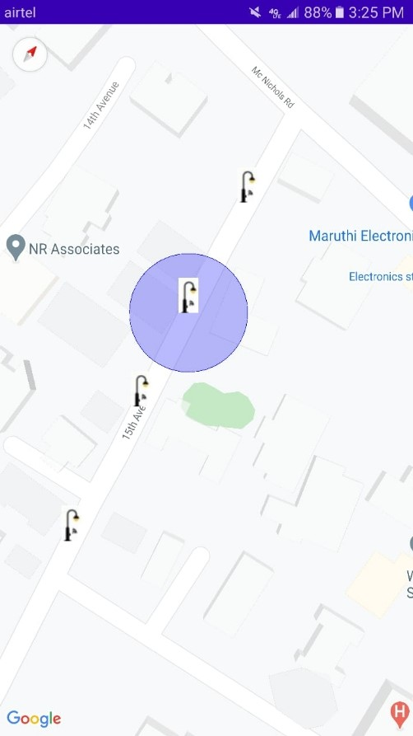
SCREENSHOTS:

Slide 21
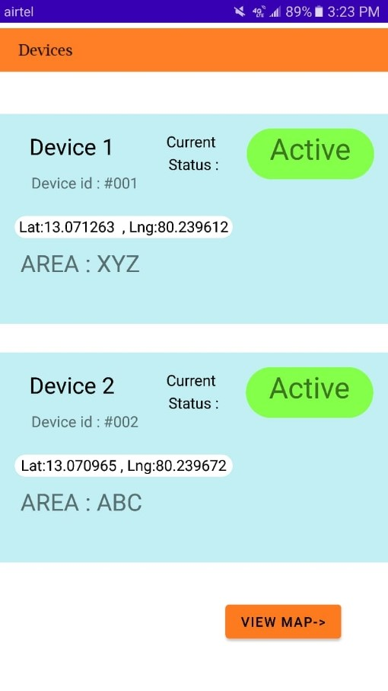
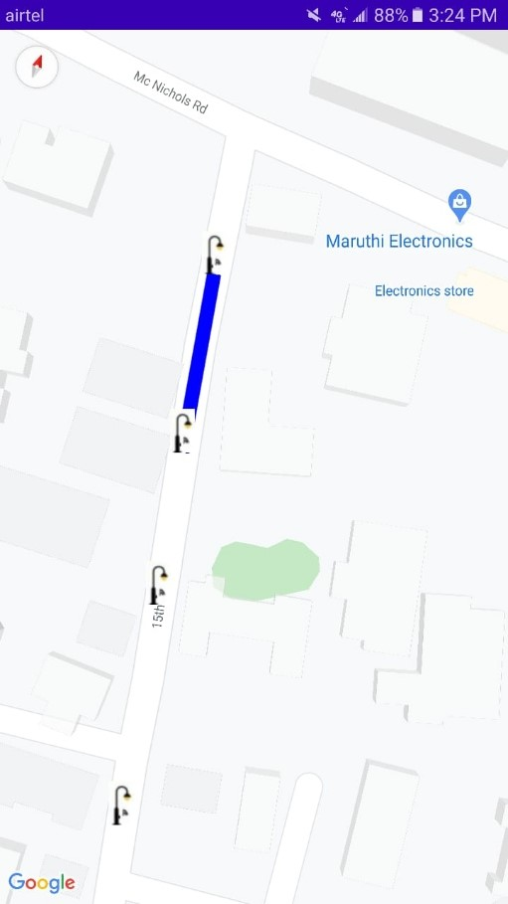
SCREENSHOTS:

Slide 22
CONCLUSION AND FUTURE ENHANCEMENT:
In this project our proposed system is used to detect the Stagnant water in Streets / Roads which are flooded, When the Sensor is active it sends an alert message to the Respective departments and also pin the location of the flooded streets in the Maps that can be viewed through the Mobile application.

Slide 23
REFERENCE:
Shu Shibu. Multi-sensor Remote Sensing Technologies in Water System Management. Procedia Environmental Sciences, 2011 Volume 10, Part A, Pages 152-157.
Thinagaran Perumal, Md Nasir Sulaiman, C. Y. Leong. Internet of Things (IOT) Enabled Water Monitoring system. 2015 IEEE 4th Global Conference on Consumer Electronics (GCCE), 27-30 Oct 2015.
Manish Kumar Jha, Rajni Kumari Sah, M. S. Rashmitha, Rupam Sinha, B. Sujatha, K. V. Suma. Smart Water Monitoring System for Real-Time Water Quality and Usage Monitoring. 2018 International Conference on Inventive Research in Computing Applications (ICIRCA), 11-12 July 2018.
M. P. P. Sithole, N. I. Nwulu, E. M. Dogo. Development of a Wireless Sensor Network Based Water Quality Monitoring and Notification System. 2019 International Artificial Intelligence and Data Processing Symposium (IDAP), 1-22 Sept. 2019.

Slide 24


