Slide 1
Estimating Weibull parameters for wind resource assessment in a tropical region
Two Parameter estimation for Weibull distribution

Slide 2
TEAM DETAILS
Yalakanti Eswar - s20210020332
Akhil Sai Sriram R - s20210020316
Sreenivas Vaditya – s20210020327

Slide 3
Report Contents
Problem Description and Data Distribution
Feature Extraction
Models and Results
Comparisons
Conclusion

Slide 4
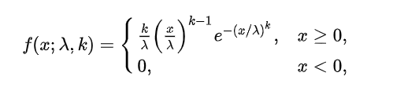



Problem Description and Data Distribution
Weibull distribution is a continuous probability distribution. It models a broad range of random variables, largely in the nature of a time to failure or time between events
The probability density function of a Weibull random variable is k represents beta and lambda represents alpha
The mean and variance and Loglikelihood of a Weibull random variable can be expressed as

Slide 5
Problem Description and Data Distribution
Weibull Distributions: Specifically for wind energy assessment in tropical regions with frequent low wind speeds, the study analyzes two Weibull distributions
Bayesian Approach: A more reliable method for precise wind resource assessment is provided by proposing a Bayesian method for estimating Weibull parameters
Data Analysis: Based on an analysis of data from seven tropical sites, it was shown that sites with a higher fraction of low wind speeds fit better into the three-parameter distribution with a non-zero shift parameter.
Wind Energy Context: In order to achieve sustainable development goals and enhance energy security, developing nations must have reliable wind data, according to the research.

Slide 6
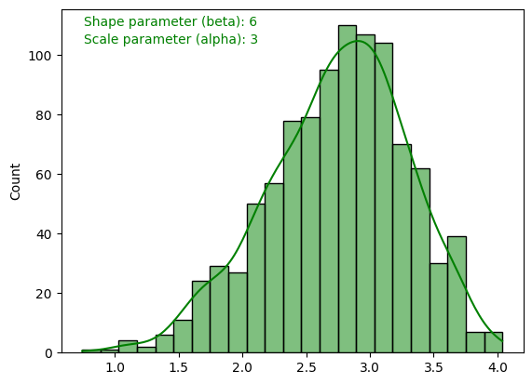
Data Distribution of the data

Slide 7
OPTIMAL MODEL
Distribution
Two parameter Weibull distribution.
Parameters to be estimated:
Shape parameter (alpha)
Scale parameter (beta)

Slide 8
Estimation Methods
Maximum likelihood estimation
Iterative method (Newton Raphson method)
Method of moments
Maximum likelihood estimation:
This method involves finding the parameter values that maximize the likelihood function.
Method of moments: This approach involves equating sample moments (such as the mean, variance, etc.) to population moments and solving for the parameters.

Slide 9
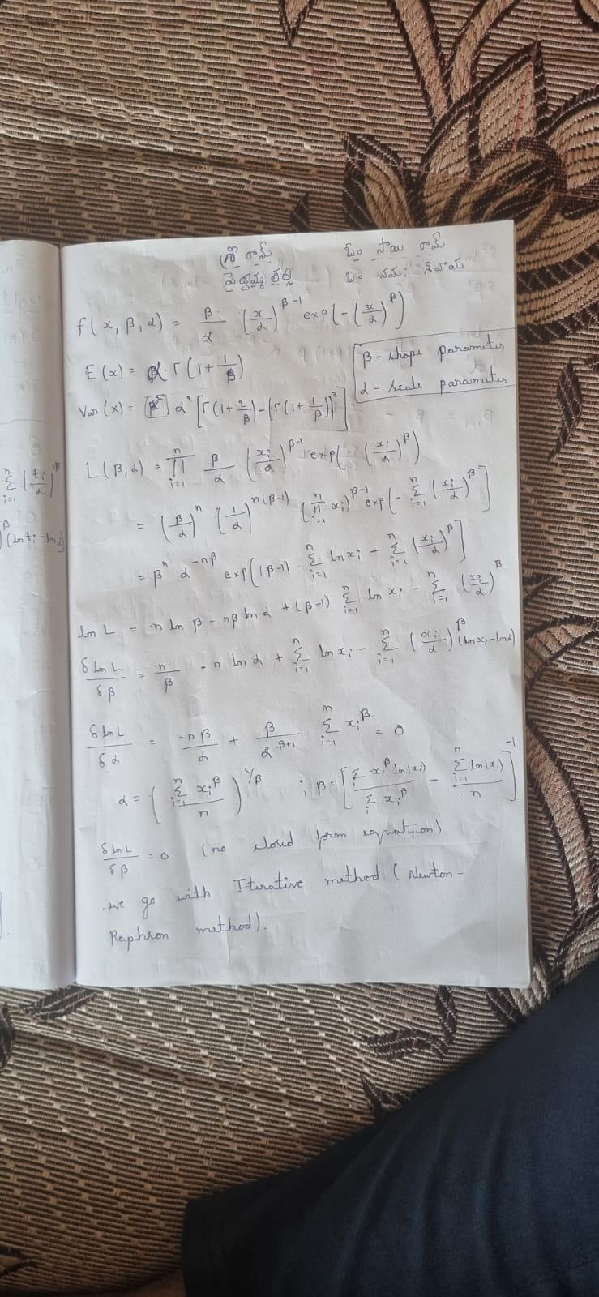
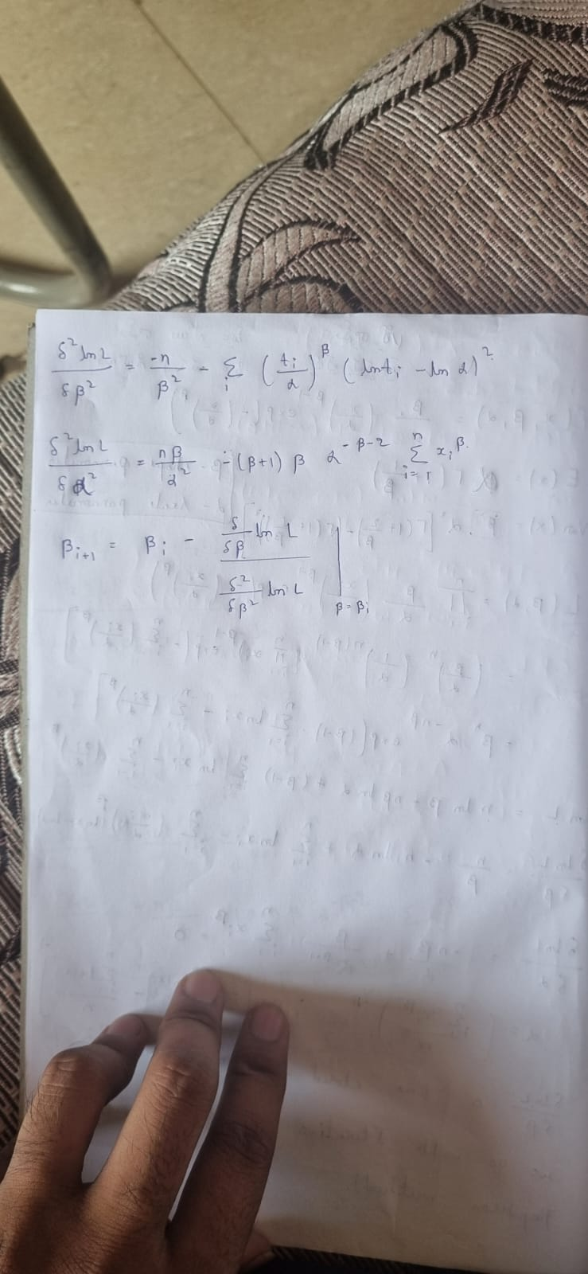
Mathematical solving

Slide 10
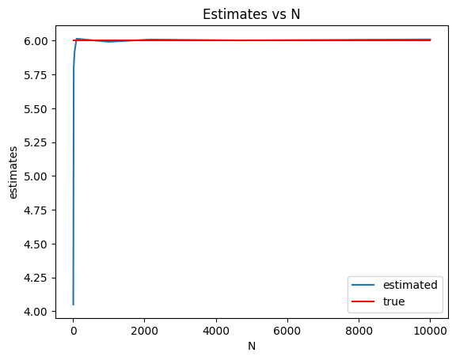
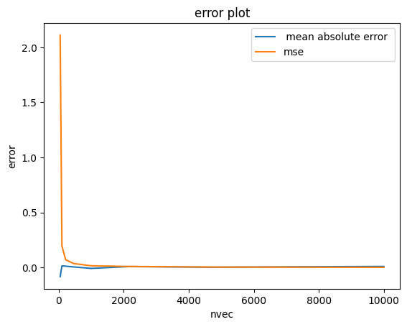
Results
Shape parameter (iterative method

Slide 11
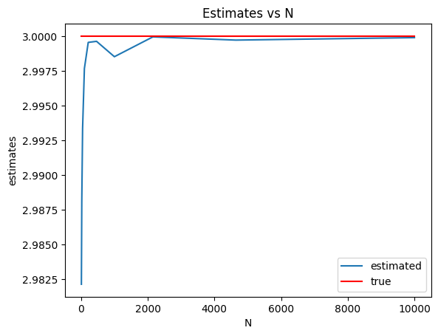
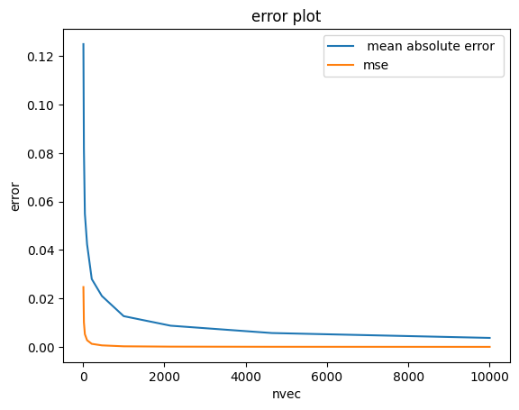
Results
Scale parameter (iterative method)

Slide 12
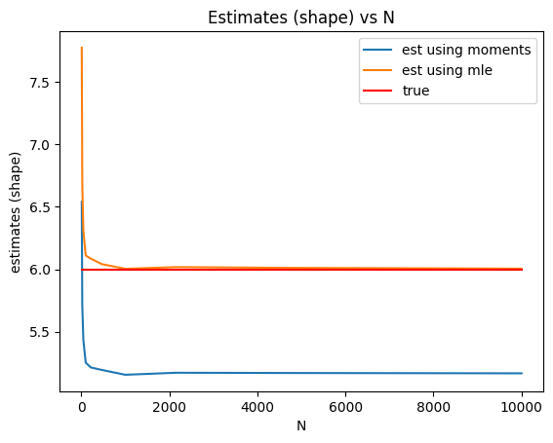
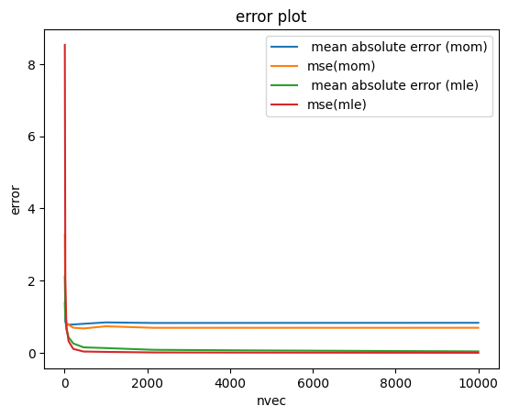
Results
Shape parameter (Method of moments and MLE)

Slide 13
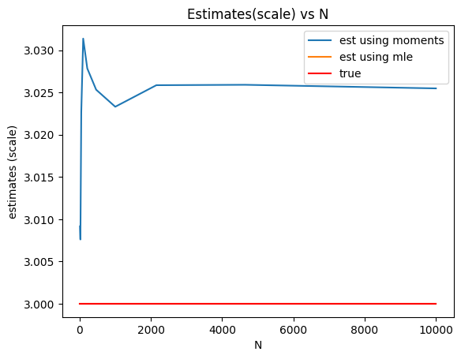
Results
Scale parameter (Method of moments and MLE)

Slide 14
Thank You

