Slide 1
PATTERN RECOGNITION
Diamond Image Classification

Slide 2
TEAM DETAILS
Yalakanti Eswar - s20210020332
Akhil Sai Sriram R - s20210020316
Adi Narayana Reddy M - s20210020292

Slide 3
Report Contents
Problem Description and Data Distribution
Feature Extraction
Models and Results
Comparisons
Conclusion

Slide 4
Problem Description and Data Distribution
The task is to develop a machine learning model for the classification of diamond images. In the data set diamonds have various characteristics such as shape, cut, color, carat, symmetry, fluorescence and clarity, and these factors contribute to their overall quality and value.
The main goal is to create a model that can automatically classify diamonds based on their images into predefined categories.
Data set contains various diamonds with different shapes and classification is done using the above factors of the diamonds and output will be given as the name of the type of the diamond
Here in the given dataset we have seven classes cushion , emerald, heart ,pear ,princess, round.

Slide 5
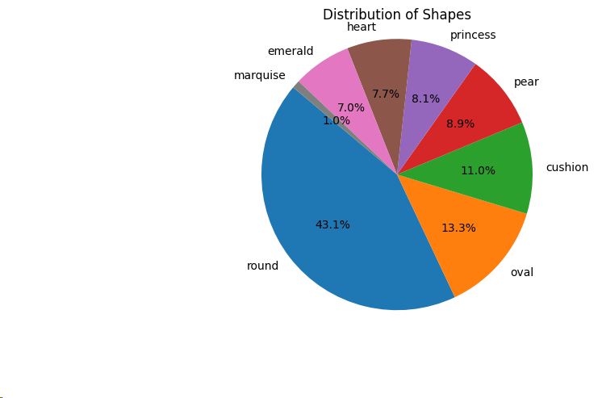
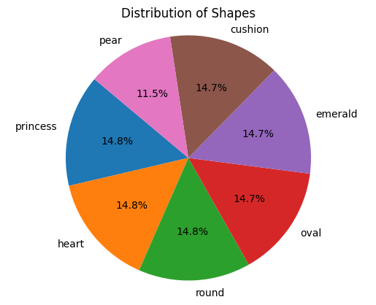
Data Distribution of the data
Data Distribution before balancing
Data distribution after balancing

Slide 6
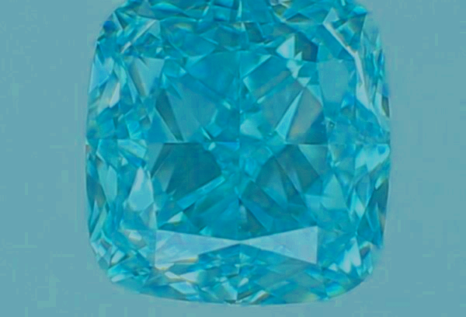
Feature Extraction:Data Augmentation
Flipping from left to right and up to down, increasing brightness and saturation

Slide 7
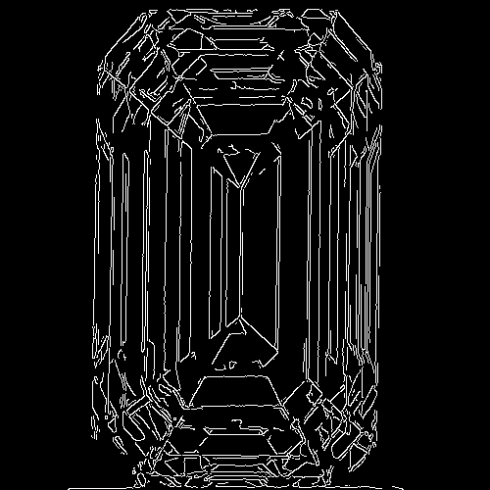
Feature Extraction: Canny-Edge detection
Edge detection: Here in edge detection we will use canny edge detection from this we will get an array and from that array we will find the edge_histogram , edge density and edge length.
Edge histogram is a type of image feature that captures information about the distribution of edges in an image.

Slide 8
Wavelet Transform
Wavelet transform is like a tool that helps us look at image in a way that's great for spotting details at different levels of zoom. Imagine a picture zoomed out and zoomed in ,wavelets help us see both the big picture and the little details.
In feature extraction, we use wavelets to find interesting things in signals, like a unique pattern or a sudden change, and turn them into useful information for tasks like recognizing patterns.
Along with the above features we extracted the color histogram and shape features(hu movements)

Slide 9
Models and Results
SVM
RANDOM FOREST
K-NEAREST NEIGHBOURS
ANN
XG BOOST
CAT BOOST

Slide 10
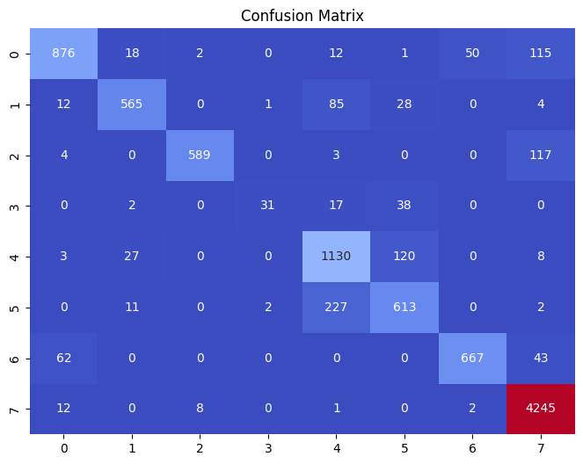
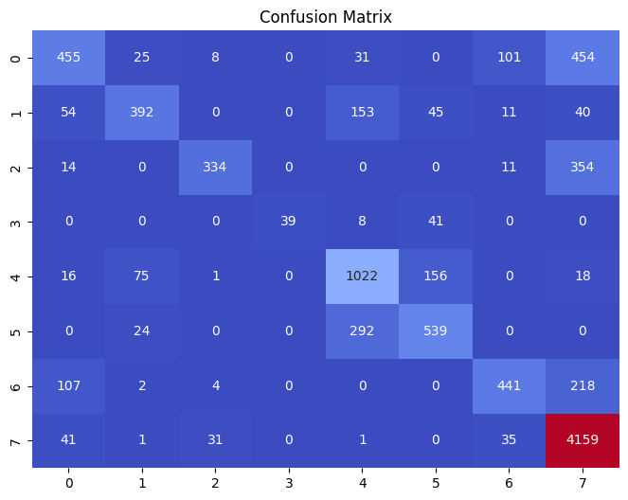
Confusion Matrices for different models(Results)
For Random Forest
For KNN

Slide 11
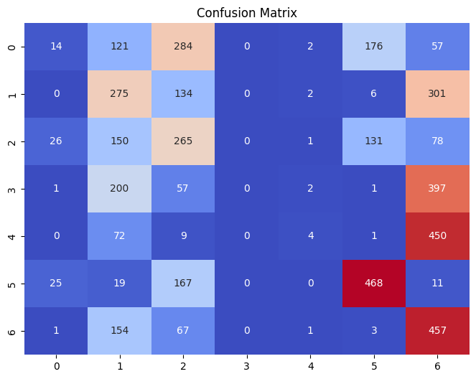
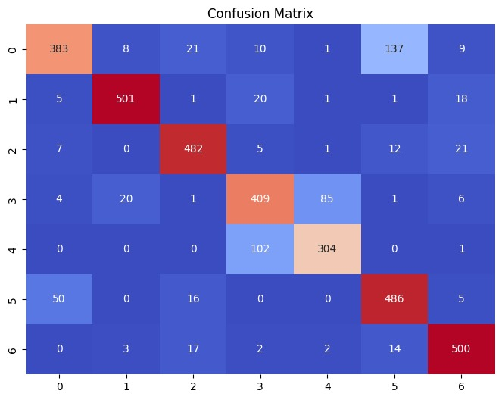
For SVM
For CAT Boost

Slide 12
Comparisons of accuracy for different models
 | Accuracy(%) | F1_score(%)
SVM(with images) | 75 | 73.25
RANDOM FOREST | 89.37 | 89.16
K-NEAREST NEIGHBOUR | 75.68 | 74.12
ANN(with images) | 84.33 | 83.63
XG BOOST | 96 | 95.67
CAT BOOST | 86 | 85.99

Slide 13
Conclusion:
By combining the features extracted from wavelet transform and canny-edge detection with the shape, cut, color, carat, symmetry, fluorescence and clarity we get the best accuracy by using the XGBoost Model.

Slide 14
Thank You

