Slide 1
Failed Banking Transaction Analysis
Eswar Yarapatni

Slide 2
Introduction
This project analyzes failed banking transactions from different regions and branches, leveraging cloud and big data tools for deep insights.

Slide 3
Objective
- Understand failure patterns
- Improve transaction reliability
- Enhance decision-making with data

Slide 4
Tools & Technologies Used
- Python
- PySpark
- Google Cloud Storage
- Dataproc
- Cloud SQL (MySQL)
- BigQuery

Slide 5
Dataset Description
- Multiple CSVs from different cities/branches
- Fields include Transaction ID, Branch, Status, Timestamp
- Uploaded to Cloud Storage for processing

Slide 6
Workflow Architecture
CSV → Cloud Bucket → PySpark on Dataproc → Cloud SQL (MySQL) → BigQuery for Analysis

Slide 7
Data Cleaning & Filtering
- Filtered failed transactions only
- Converted timestamps and standardized branch names

Slide 8
Analysis & Visualization Results
- Failure trends by city and branch
- Peak failure time slots
- Visualization using BigQuery charts

Slide 9
Challenges Faced
- Handling large datasets
- Integration across multiple cloud services
- Optimizing PySpark jobs

Slide 10
Conclusion
- Cloud-based processing enables scalable transaction analysis
- Identified key failure causes and patterns

Slide 11
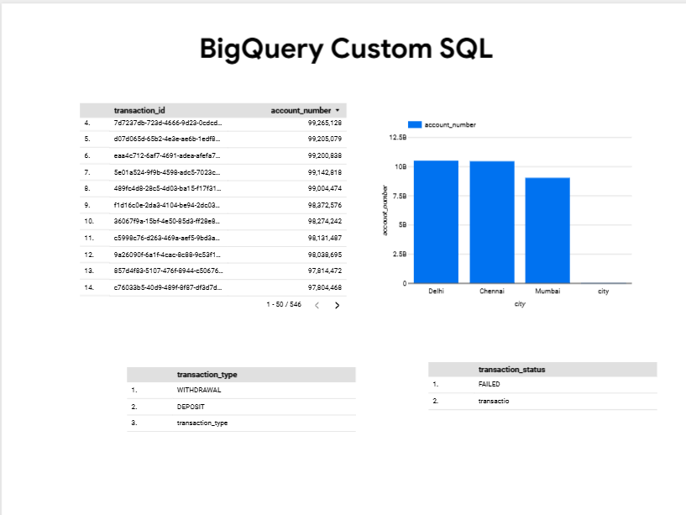
Analysis:

Slide 12
Thank You…!

