Slide 1

A SPARQL extension for generating RDF from heterogeneous formats
Ease the accessibility of Semantic Web principles and formalisms
for companies, Web services, and constrained devices
Maxime Lefrançois,
Antoine Zimmermann,
Noorani Bakerally
MINES Saint-Etienne, CNRS,
Laboratoire Hubert Curien UMR 5516

Slide 2



6 countries, 34 partners, 16M€, 160 person-yrs, coordinated by ENGIE
« Design and develop a global ecosystem of services and smart things collectively capable of ensuring the stability and the energy efficiency in the future energy grid »
Mines Saint-Etienne involved in:
T2.2 SEAS Knowledge Model

Slide 3







« Fostering Uses and Usages of Open Sensor Data in Smart Cities »

Slide 4

A datalake of data with heterogeneous formats
XML CSV JSON ……………….
EXI CBOR ……………….
Image: https://headleaks.com/

Slide 5

Key step: generate some RDF
RDF Data Model
XML CSV JSON ……………….
EXI CBOR ……………….
Image: https://headleaks.com/

Slide 6
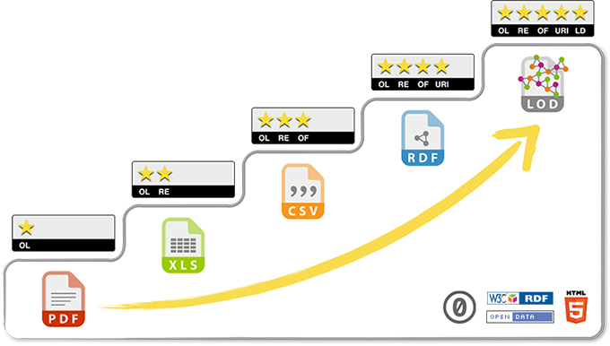
Requirements for RDF generation
RDF Data Model
Transform multiple sources …
… having heterogeneous formats
Be extensible to new data formats
Be easy to use by Semantic Web experts
Integrate in a typical semantic web engineering workflow
Be flexible and easily maintainable
Fast
Image: https://headleaks.com/

Slide 7

Besoins pour la génération de RDF
RDF Data Model
Transform multiple sources …
… having heterogeneous formats
Be extensible to new data formats
Be easy to use by Semantic Web experts
Integrate in a typical semantic web engineering workflow
Be flexible and easily maintainable
Fast
Transform binary formats as well as textual formats
Contextualize the transformation with an RDF Dataset
Image: https://headleaks.com/

Slide 8
Existing approaches
RDFizers (see https://www.w3.org/wiki/ConverterToRdf )
A lot of tools are specific to one or a few formats (44 referenced formats)
Some frameworks support several/many formats
ad hoc methods,
little or no control on the structure of the output
=> may require an additional transformation

Slide 9
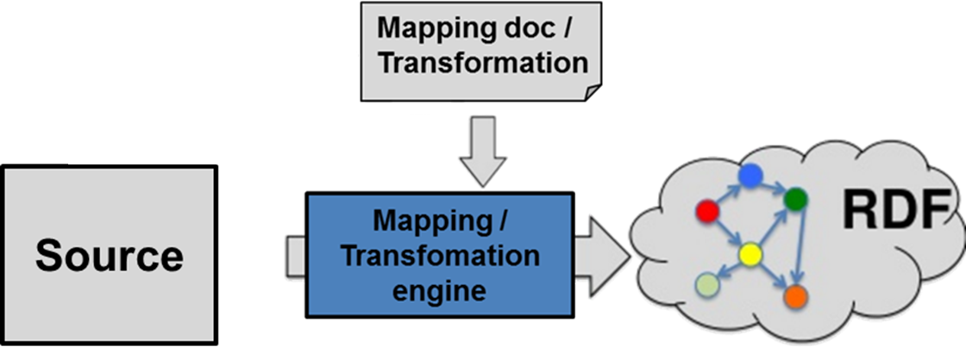
Existing approaches
Approaches based on mapping/transformation languages

Slide 10
GRDDL
<html xmlns=http://www.w3.org/1999/xhtml
xmlns:grddl='http://www.w3.org/2003/g/data-view#'
grddl:transformation="http://example.com/getAuthor.xsl" >
<head>
<title>Are You Experienced?</title>
[...]
</html>
<album xmlns:grddl='http://www.w3.org/2003/g/data-view#'
grddl:transformation="http://example.org/getAlbum.xsl" >
<artist mbid="">The Jimi Hendrix Experience</artist>
<name>Are You Experienced?</name>
...
</album>
(W3C REC 2007)

Slide 11
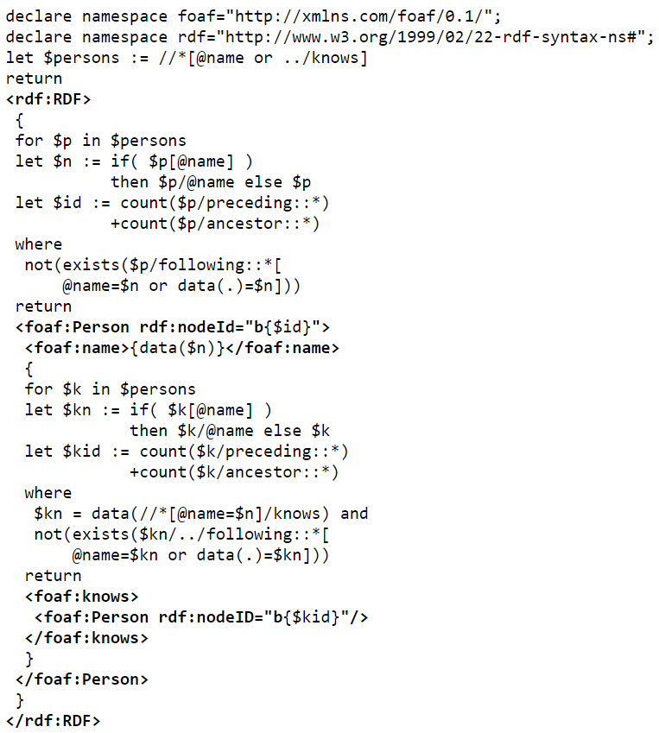
XSPARQL
(W3C member submission 2009)

Slide 12
R2RML
(W3C REC 2012)
<#TriplesMap2>
rr:logicalTable <#DeptTableView>;
rr:subjectMap [
rr:template "http://data.example.com/department/{DEPTNO}";
rr:class ex:Department;
];
rr:predicateObjectMap [
rr:predicate ex:name;
rr:objectMap [ rr:column "DNAME" ];
];
rr:predicateObjectMap [
rr:predicate ex:location;
rr:objectMap [ rr:column "LOC" ];
];
rr:predicateObjectMap [
rr:predicate ex:staff;
rr:objectMap [ rr:column "STAFF" ];
].

Slide 13
CSVW
{
"@context": ["http://www.w3.org/ns/csvw", {"@language": "en"}],
"url": "tree-ops.csv",
"dc:title": "Tree Operations",
"dcat:keyword": ["tree", "street", "maintenance"],
"dc:publisher": {
"schema:name": "Example Municipality",
"schema:url": {"@id": "http://example.org"}
},
"dc:license": {"@id": "http://opendefinition.org/licenses/cc-by/"},
"dc:modified": {"@value": "2010-12-31", "@type": "xsd:date"},
"tableSchema": {
"columns": [{
"name": "GID",
"titles": ["GID", "Generic Identifier"],
"dc:description": "An identifier for the operation on a tree.",
"datatype": "string",
"required": true
}, {
"name": "on_street",
"titles": "On Street",
"dc:description": "The street that the tree is on.",
"datatype": "string"
}, {
"name": "species",
"titles": "Species",
"dc:description": "The species of the tree.",
"datatype": "string"
}, {
"name": "trim_cycle",
"titles": "Trim Cycle",
"dc:description": "The operation performed on the tree.",
"datatype": "string"
}, {
"name": "inventory_date",
"titles": "Inventory Date",
"dc:description": "The date of the operation that was performed.",
"datatype": {"base": "date", "format": "M/d/yyyy"}
}],
"primaryKey": "GID",
"aboutUrl": "#gid-{GID}"
}
}
(W3C REC 2015)

Slide 14
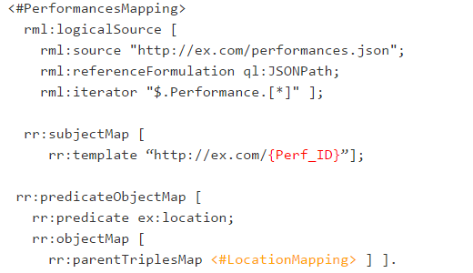
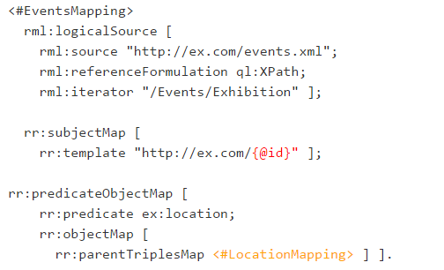
RML
(Dimou et al., 2013)

Slide 15
RML: some issues for RDF generation
- Does not cover low resource devices data formats
- Subject-centric
- Not easily extensible
- One logical source per mapping
- No RDF context, filter, aggregate, etc.

Slide 16
Research questions
How to design a mapping language that…
…can be easily extended to any source format?
…is expressive enough to cover all of our use cases?
…is still rather simple to use?

Slide 17
RDF generation process

Slide 18
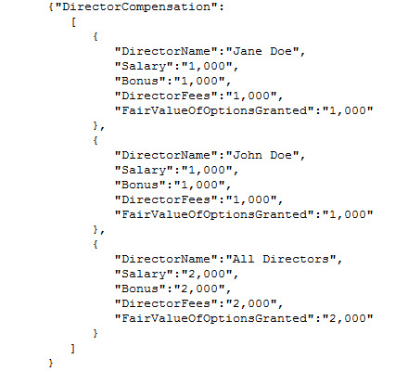
RDF generation process

Slide 19
RDF generation process
Selection patterns Xpath, JSONpath, CSS selectors, regex, etc.

Slide 20
RDF generation process
Selection patterns Xpath, JSONpath, CSS selectors, regex, etc.

Slide 21
RDF generation process
ex:Director
rdf:type
foaf:name
?
ex:salary
?
ex:fee
?
Selection patterns Xpath, JSONpath, CSS selectors, regex, etc.
Graph pattern definition

Slide 22
RDF generation process
ex:Director
rdf:type
foaf:name
?
ex:salary
?
ex:fee
?
+ Select ontologies
Selection patterns Xpath, JSONpath, CSS selectors, regex, etc.
Graph pattern definition

Slide 23
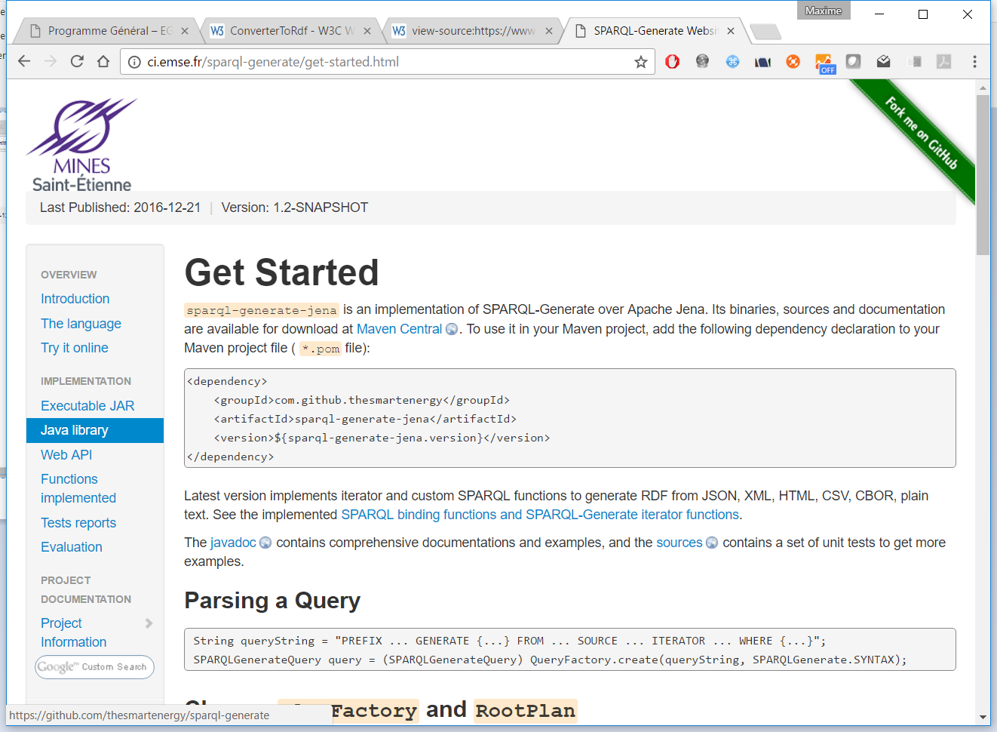
https://w3id.org/sparql-generate
Open-source implementation on top of Jena
+ doc & tuto
Maven

Slide 24
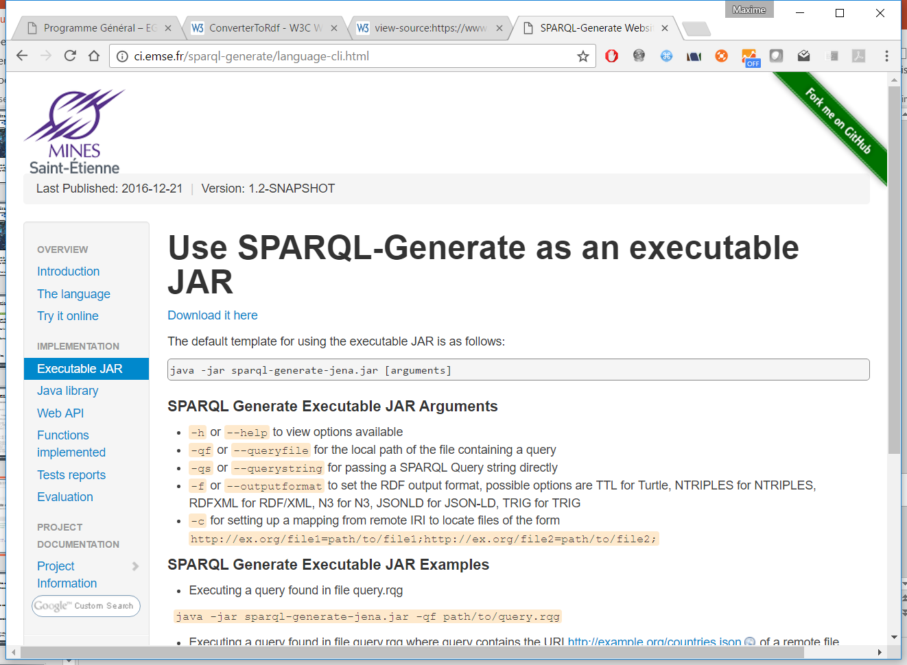
https://w3id.org/sparql-generate
Usable as JAR

Slide 25
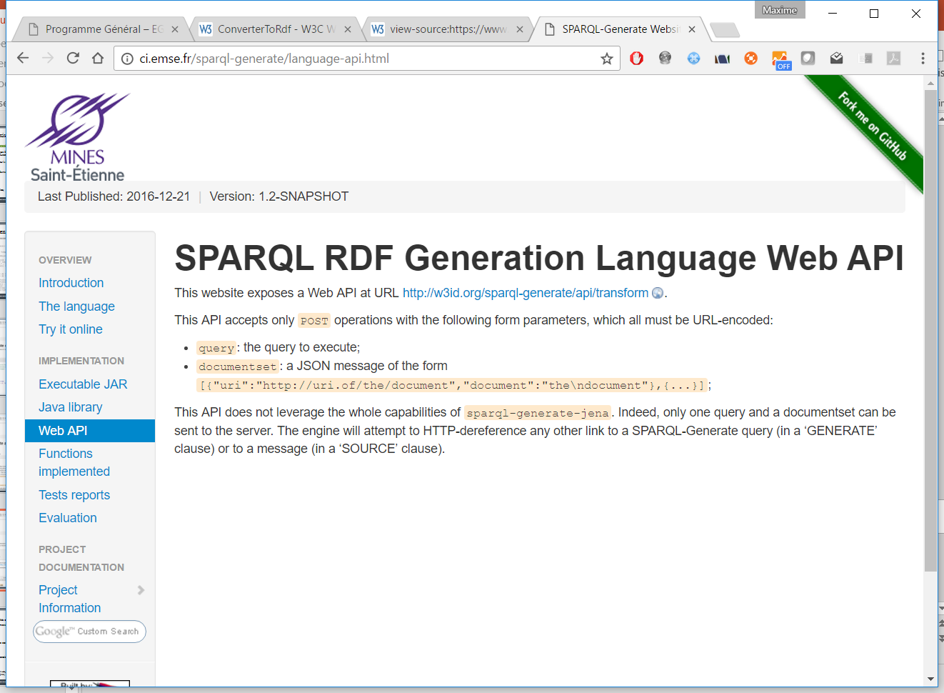
https://w3id.org/sparql-generate
Usable as Web API (similar to SPARQL Protocol)

Slide 26
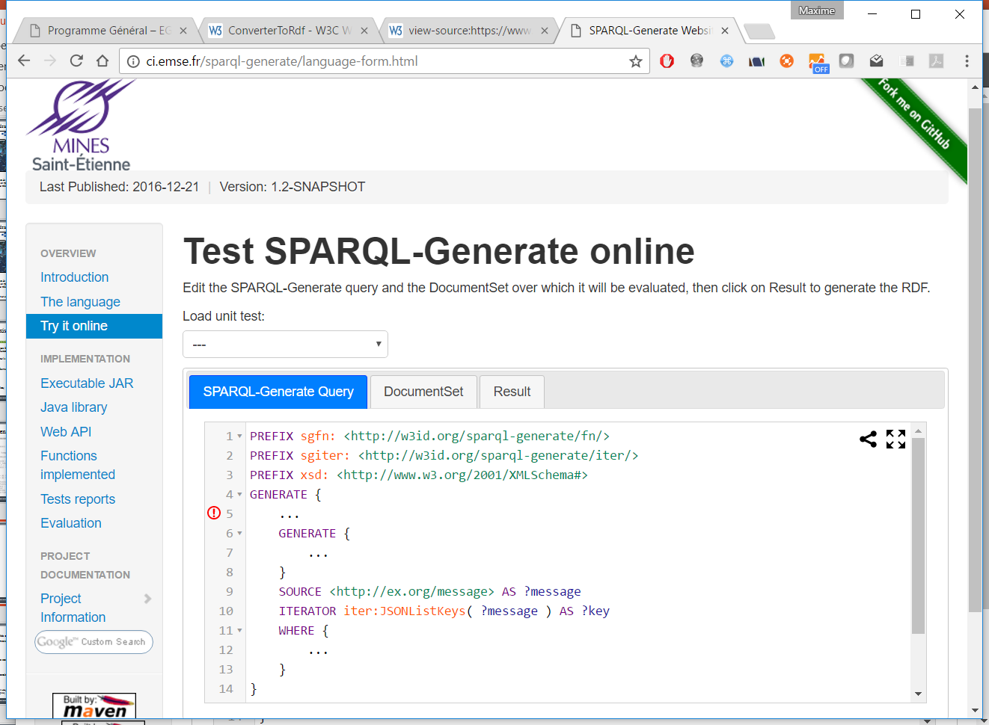
https://w3id.org/sparql-generate
Web form – syntax checking
(extends YASGUI)

Slide 27
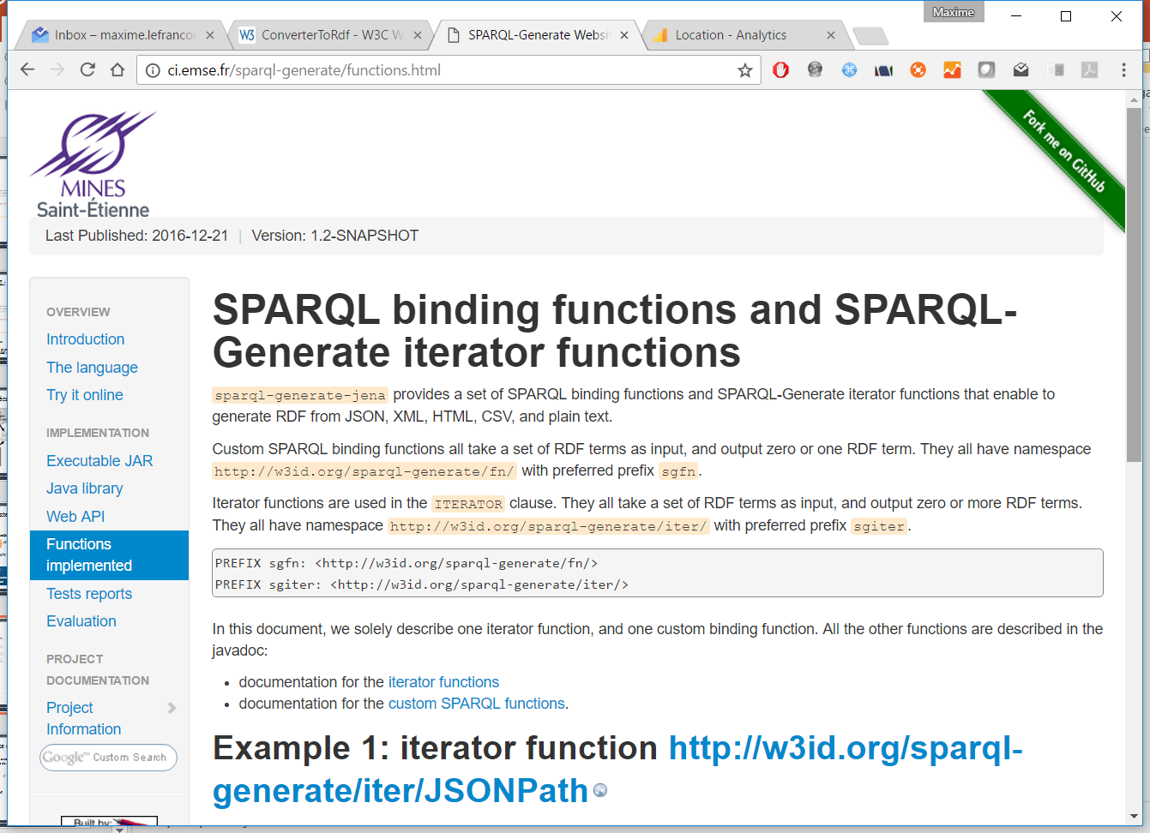
https://w3id.org/sparql-generate
Set of implemented custom functions
XML (Xpath)
JSON (JSONPath, select the list of an object keys,…)
CSV, TSV
HTML5 (CSS3 selectors)
CBOR
Plain text (regular expressions)
Dates conversion

Slide 28
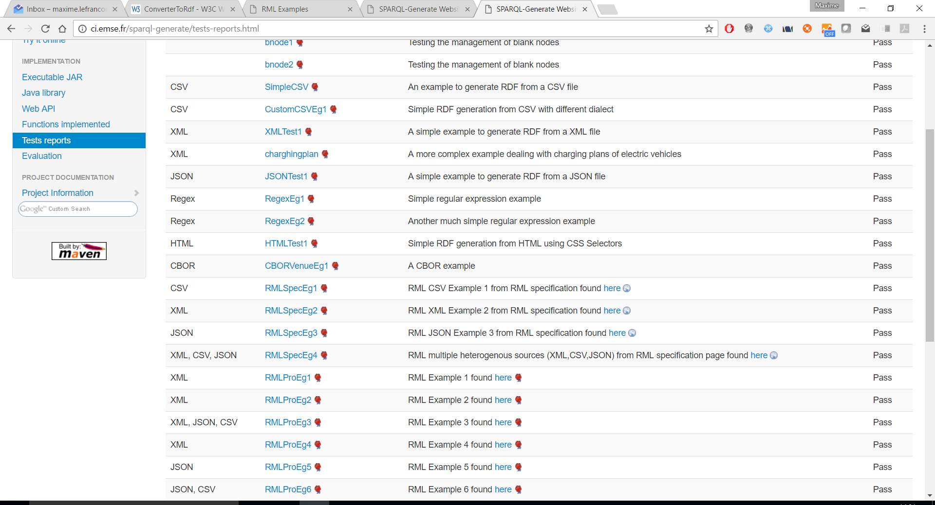
https://w3id.org/sparql-generate
Unit tests based on competitor approaches

Slide 29
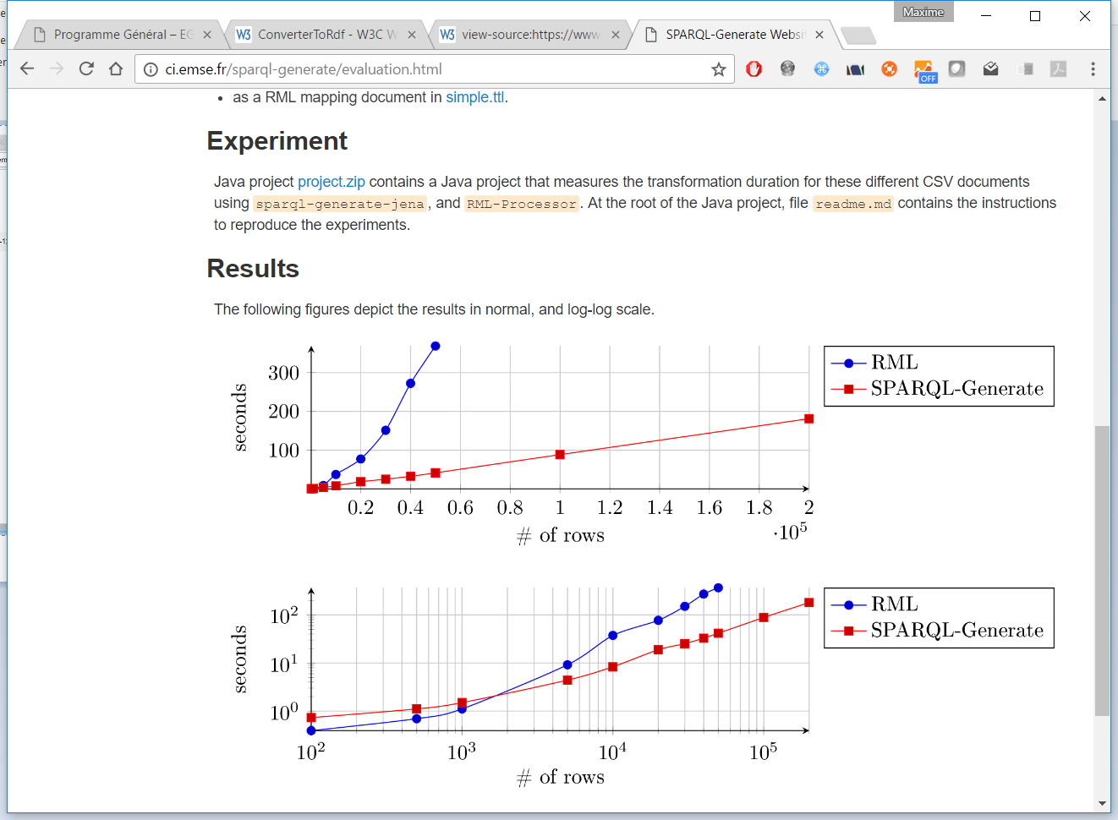
SPARQL-Generate vs RML
comparison of reference implementation performances

Slide 30
Conclusions & next steps
SPARQL generate
…is expressive, flexible, extensible
…integrates well in a SemWeb workflow
…is formalised, implemented, evaluated
Next we want to add
…custom functions for more data formats
…syntactic sugar: use expressions directly in the GENERATE clause
…support for data streams (on it way)

Slide 31
A SPARQL extension for generating RDF from heterogeneous formats
More information about SPARQL-Generate - https://w3id.org/sparql-generate/
Web form and demonstrator, open source implementation, mailing list, …
Maxime Lefrançois,
Antoine Zimmermann,
Noorani Bakerally
MINES Saint-Etienne, CNRS,
Laboratoire Hubert Curien UMR 5516

Slide 32
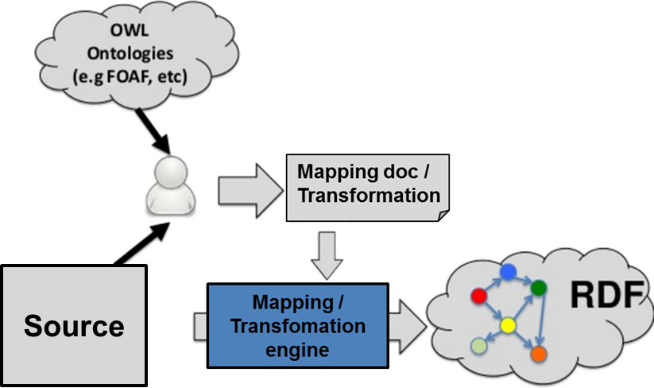
Who writes the transformation ?

Slide 33
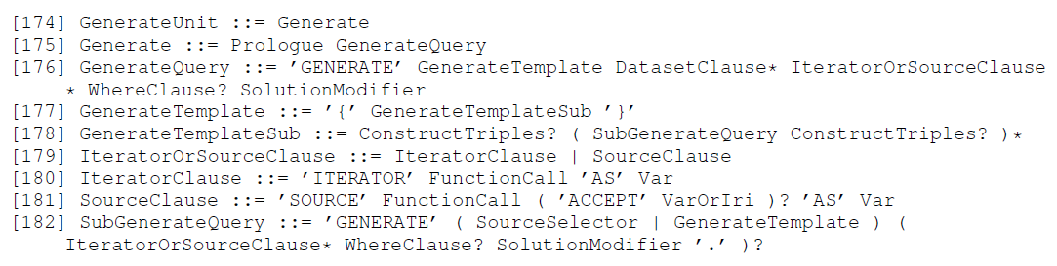
A SPARQL 1.1 extension
PREFIX declarations
GENERATE template
FROM and FROM NAMED clauses
ITERATOR … AS …
SOURCE … AS …
WHERE { … }
Solution modifiers ( group by, order by, limit, offset,... like in SPARQL 1.1)
Any number and order
Expressive / flexible
Extensible
Usually already mastered by ontologists
Implementable on top of existing engines?

Slide 34
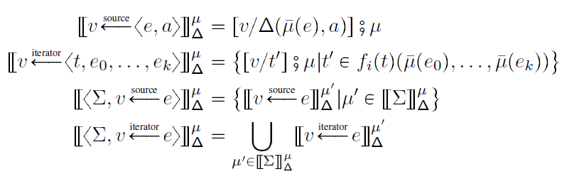
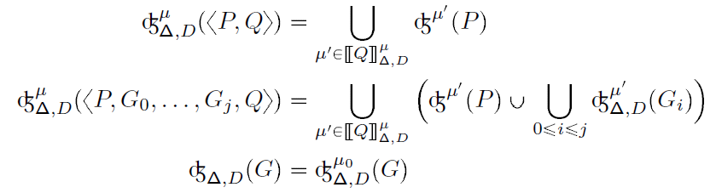
Formal syntax and semantics
Queries a RDF dataset and a RDF Documentset (named RDF literals)
Generates a RDF Graph

Slide 35
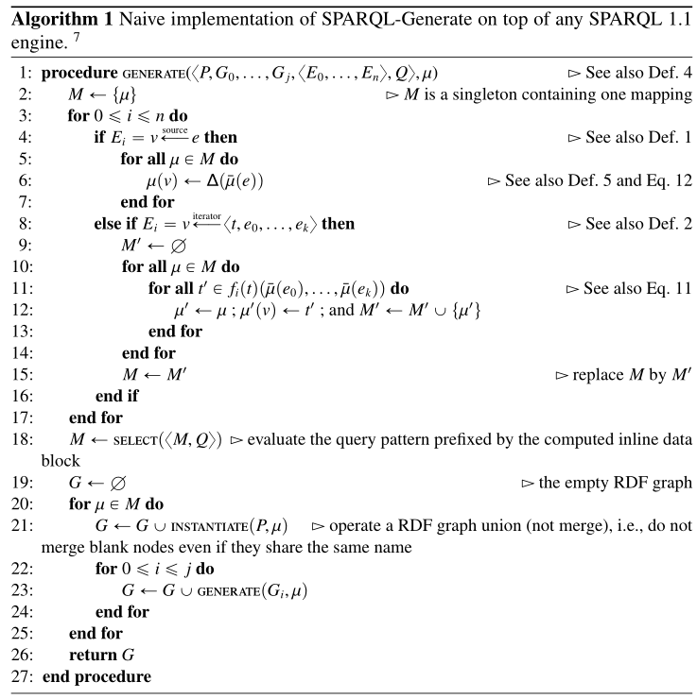
Implementable on top of SPARQL 1.1 engines
Theorem + naive algorithm

Slide 36
