Slide 1
RDF Presentation and Correct Content Conveyance for Legacy
Services and the Web of Things
Maxime Lefrançois
http://maxime-lefrancois.info/
Mines Saint-Étienne, Univ Lyon, Univ Jean Monnet, IOGS, CNRS, UMR 5516, LHC, Institut Henri Fayol

Slide 2
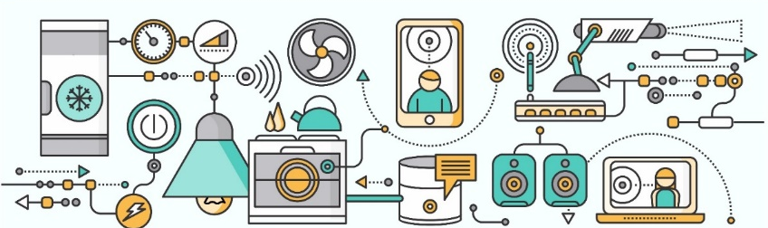

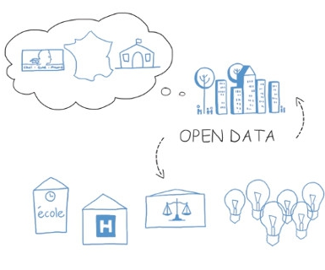
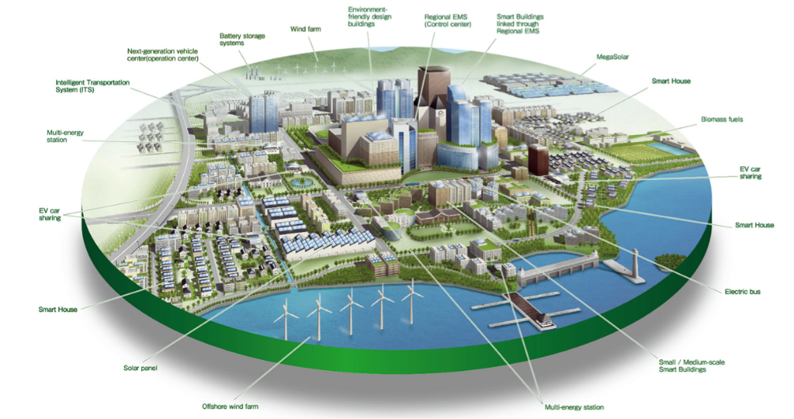

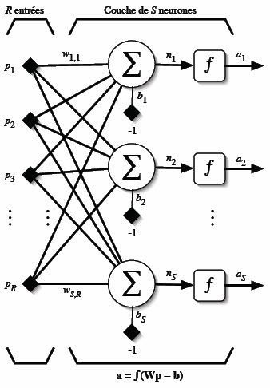
How to reach semantic interoperability at the data level between heterogeneous things and services?
Smart Things
Humans
Services
Data

Slide 3












How to reach semantic interoperability at the data level between heterogeneous things and services?

Slide 4

Goal: RDF data model as lingua franca for Semantic Interoperability

Slide 5


Idea: just send RDF!
application/rdf+xml
text/turtle
application/ld+json
…
ERI
HDTQ
RDF data formats will never be the only ones on the web
Developers prefer JSON, …

Slide 6
Idea: just send RDF! JSON-LD!
Solution:
to rely on *one* RDF syntax like JSON-LD
Requires:
Global adoption of JSON-LD
Maintaining during the development or the evolution phase
Utopian
Abstract data model
(ontology)
+ RDF validation: SHACL/SHeX
JSON-LD Context
+ JSON validation: JSON Schema

Slide 7


Approx. modeling of the communication between heterogeneous agents on the Web.
send
X
sender wants to send some content
e.g., state of a resource
medium
receiver

Slide 8

Approx. modeling of the communication between heterogeneous agents on the Web.
send
X
received
X
1
2
3
Generates a representation of the content
Transmits
the message via the internet
Decodes and get understanding
sender wants to send some content
e.g., state of a resource
medium
receiver

Slide 9
Approx. modeling of the communication between heterogeneous agents on the Web.
send
X
received
X
1
2
3
Generates a representation of the content
Transmits
the message via the internet
Decodes and get understanding
sender
medium
receiver
Correct Content Conveyance iif:
all of the essential characteristics of the content is encoded in the message
the encoding and the decoding phase are symmetric
the message is not altered in the transmission medium

Slide 10
Assumption:
content is always a RDF graph
send
received
1
2
3
Generates a representation of the content
Transmits
the message via the internet
Decodes and get understanding
sender
medium
receiver
Correct Content Conveyance iif:
The RDF graph the sender encodes is equivalent to the RDF
graph the receiver obtained after decoding the message

Slide 11
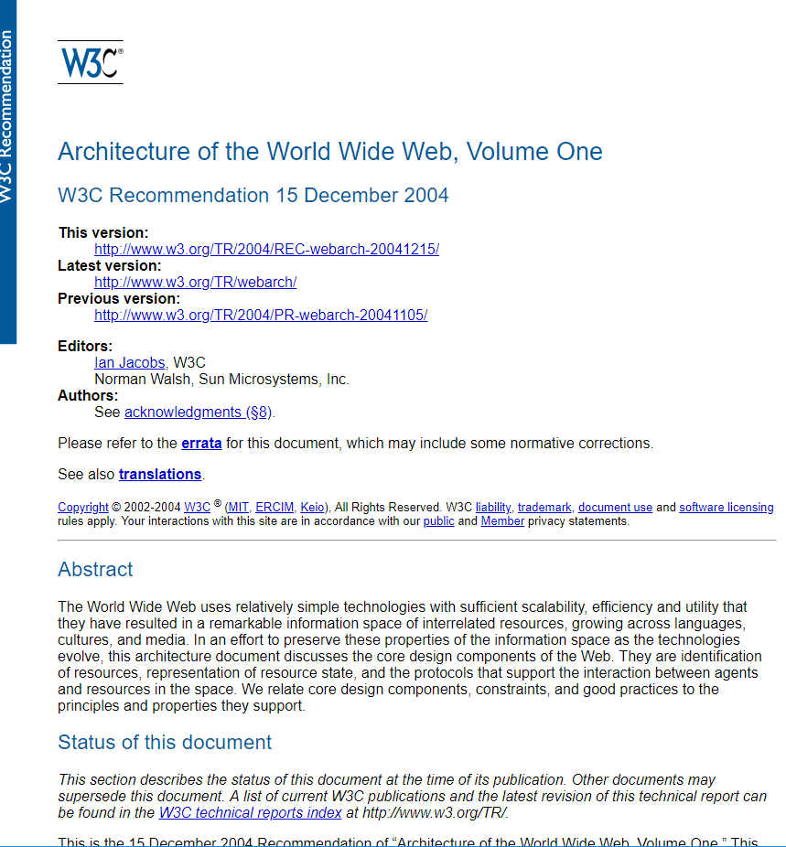
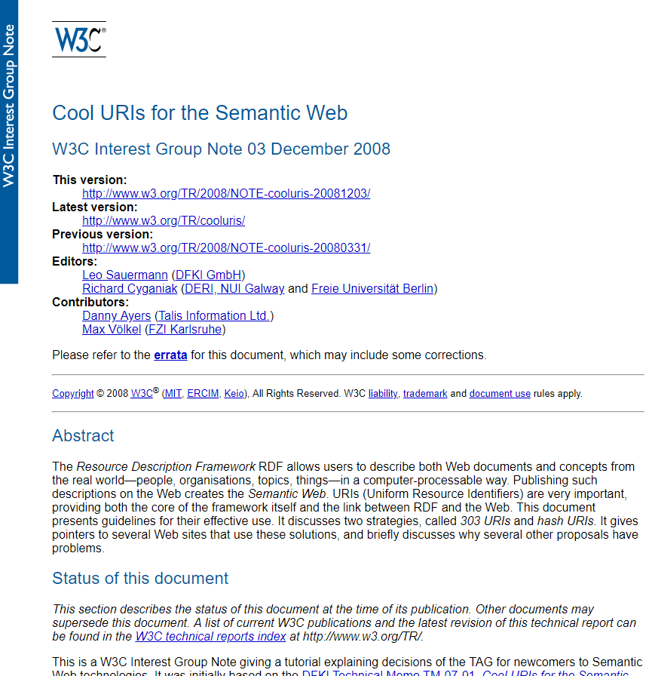
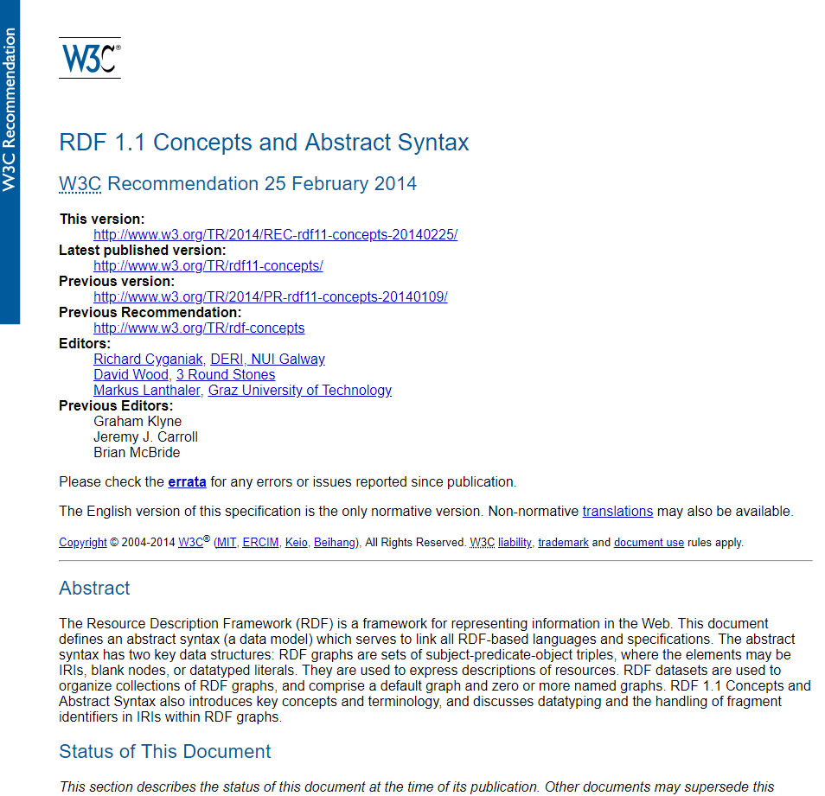
Approach
Knowledge engineering methodology
Formalize the domain
Develop scenarios.
Extract competency questions to define the scope of the ontology.
Develop an ontology to model the knowledge.
Qualitatively validate the ontology by showing how it answers the competency questions.
Conform to and leverage
Web’s architectural principles
The linked data principles

Slide 12


step1
Step 1: Analyze the domain
RDF Graphs
Typed octet streams

Slide 13

step1
Define RDF Presentations
RDF Graphs
Typed octet streams
RDF Presentation

Slide 14
step1
Define lifting, lowering, valid.
Lowering
Validation
Representation validation
Lifting
RDF Graphs
Typed octet streams
Lifting rule maps all the tos in p to their corresponding graph (unique)
Lowering rule maps all the graphs in p to a *chosen* corresponding typed stream
Validation rule checks if there is a pair with that graph
Representation validation rule checks if there is a pair with that tos

Slide 15
step1
+ categorisation of tools
+ analysis of RDF formats
Lowering
- STTL
- ad hoc code...
Validation
- SHACL
- ShEx
- SPIN
- ad hoc code...
Representation validation
- JSON Schema
- XML Schema
- ad hoc code...
Lifting
- XSLT
- Triplifiers
- SPARQL-Generate
- RML
- ad hoc code...
RDF Graphs
Typed octet streams

Slide 16
step2
Different scenarios
send
The sender can be…
Req/Res: client sends some content to the server
Req/Res: server responds to the client
Pub/Sub: client broadcasts some content to its subscribers
Both agents can also…
be constrained in some ways (battery, storage, comput,…)
implement some of the principles we devise (be semantically flexible)
rely on a third party to operate lifting/lowering/…
sender
receiver

Slide 17
step2
Scenario 1: server/publisher sends its message to a client/subscriber
send
initiates interaction
How to lift ?
I lowered this way, just lift accordingly
server/
publisher
client/
subscriber
receiver discovers how to lift (from the sender, or elsewhere)
sender can be constrained… / receiver can be constrained…

Slide 18
step2
Scenario 2: A client asks a server for the representation of a resource
send
I will lift this way, please lower accordingly
initiates interaction
How to lower ?
server
client
server discovers a presentation suitable for the client
client can be constrained… / server can be constrained…

Slide 19
step2
Scenario 3: A client sends some encoded content to a server
send
I will lift this way, please lower accordingly
initiates interaction
How to lower ?
client
server
client discovers a presentation suitable for the server
client can be constrained… / server can be constrained…

Slide 20
step3
Competency questions
CQ1-CQ4
How to represent/use
CQ5-CQ8
How to discover
CQ9-CQ11
Combine with SSN and TD
CQ1: What are the RDF lifting and lowering procedures one can use for a specific RDF presentation?
[…]
CQ5: How can a server inform its client on the RDF presentation it can use to lift the message?
CQ6: How can a server directly inform its client of the RDF lifting procedure it can use to lift the message?
[…]
CQ10: How can one describe the RDF presentation that is used in the output of a sensor?
CQ11: How can one describe the RDF presentation that is used in the input and output of the interaction pattern a thing implements?

Slide 21
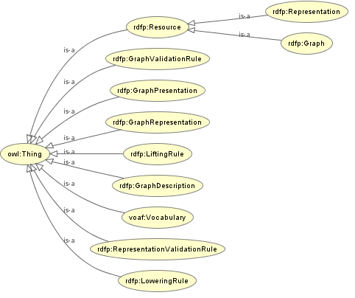
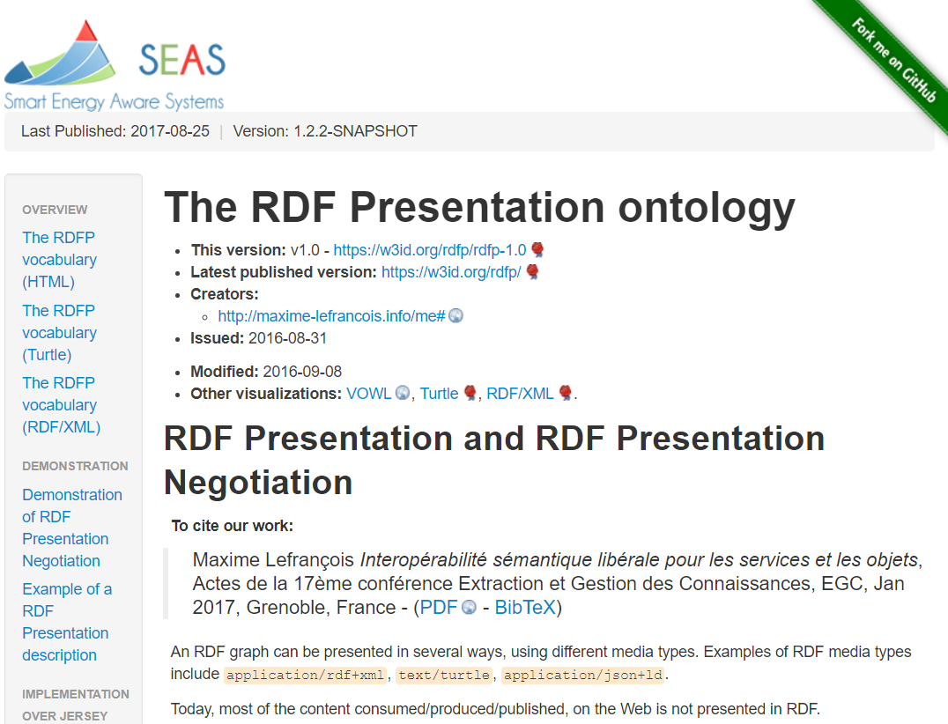
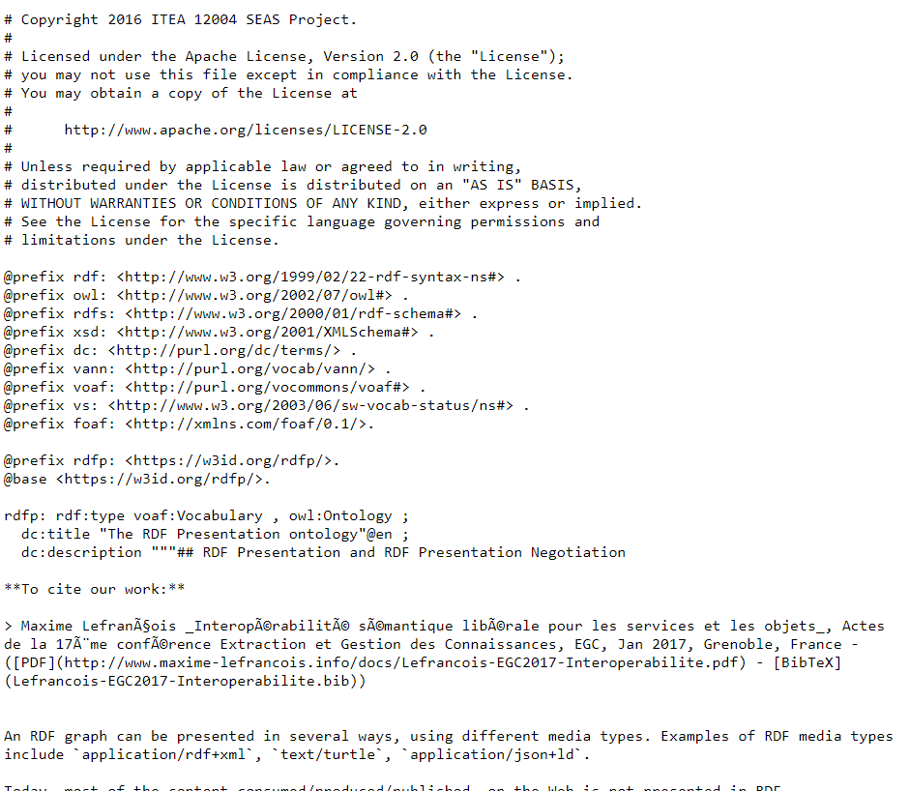
step4
The RDFP Ontology
https://w3id.org/rdfp/

Slide 22

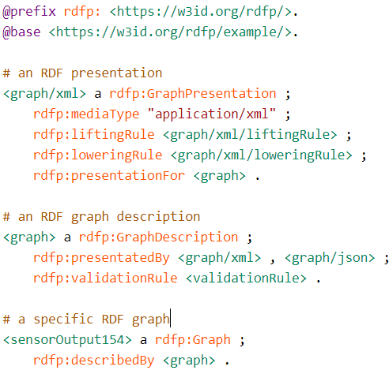

step4
The RDFP Ontology
https://w3id.org/rdfp/
step5
CQ1-CQ4
How to represent/use

Slide 23

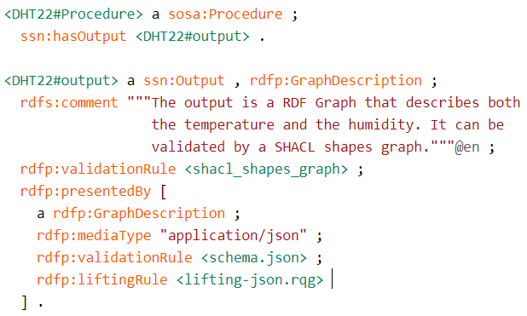
step4
The RDFP Ontology
https://w3id.org/rdfp/
step5
CQ9-CQ11
Combine with SSN and TD

Slide 24

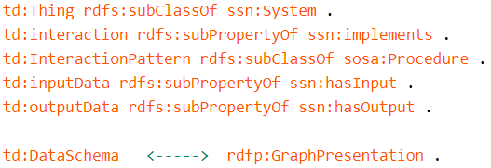
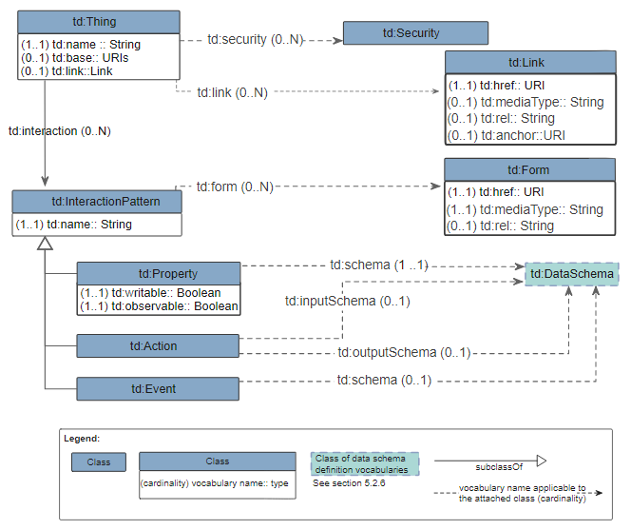
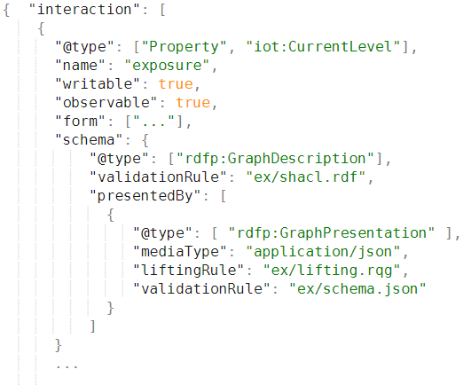
step4
The RDFP Ontology
https://w3id.org/rdfp/
step5
CQ9-CQ11
Combine with SSN and TD

Slide 25
step4
The RDFP Ontology
https://w3id.org/rdfp/
step5
CQ9-CQ11
Combine with SSN and TD

Slide 26
Direct discovery
step5
CQ5-CQ8
How to discover
Indirectly using RDF
Indirectly using CoRE Link Format
Directly during a single interaction

Slide 27

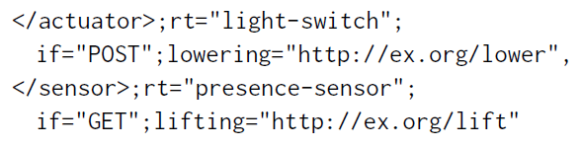
Direct discovery
step5
CQ5-CQ8
How to discover
Indirectly using RDF
Indirectly using CoRE Link Format
Directly during a single interaction
OPTION A
OPTION B

Slide 28
Direct discovery
step5
CQ5-CQ8
How to discover
Indirectly using RDF
Indirectly using CoRE Link Format
Directly during a single interaction
HTTP headers fields – CoAP options
Examples
Content-Lifting-Rule: <http://example.org/api/temp/sparql-generate-rule>
Accept-Lowering-Rule: <http://example.org/api/temperature/sttl-transformation>

Slide 29
Conclusion
RDF as an abstract data model for messages passed on the Web
Different scenarios where Web agents can adapt one to another (be flexible )
Scenarios for non-constrained but also constrained agents (using third agent)
Conceptual framework, formalized
RDF Presentation (RDFP) ontology to describe presentations
Direct and indirect discovery of (some information about) presentations
Future work
Experimental settings to demonstrate the flexibility
Settings with different frameworks and standards
Evaluation of the ease of use, adoption
Cost of the flexibility?

Slide 30
RDF Presentation and Correct Content Conveyance for Legacy
Services and the Web of Things
Maxime Lefrançois
http://maxime-lefrancois.info/
Mines Saint-Étienne, Univ Lyon, Univ Jean Monnet, IOGS, CNRS, UMR 5516, LHC, Institut Henri Fayol

