Slide 1
Ontologies, langages, tools,
to ease the usage of RDF as a lingua franca
Maxime Lefrançois
Maxime.Lefrancois@emse.fr
http://maxime-lefrancois.info/
MINES Saint-Étienne – Institut Henri Fayol
Laboratoire Hubert Curien UMR CNRS 5516
Notes:
"Ouverture, décentralisation sont des caractéristiques essentielles de l’industrie du futur dans laquelle l’Internet des Objets, l’Intégration de données et de services sont de plus en plus présents«
"Interopérabilité sémantique est un verrou à lever pour la mise en place d’échanges de données entre acteurs hétérogènes, pour fournir une abstraction des données captées sur laquelle différents raisonnements puissent être mis en place"

Slide 2





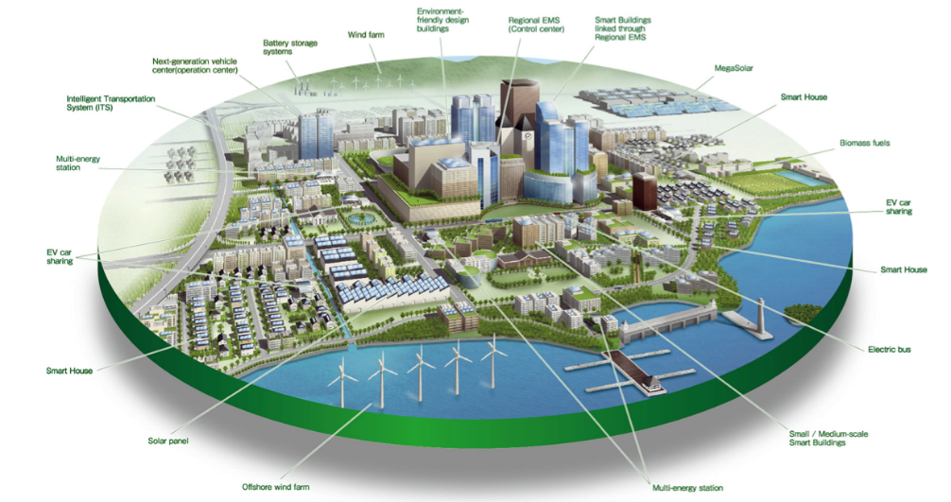







There is a multitude of data formats/models on the Web
M. Lefrançois, RDF presentation and correct content conveyance for legacy services and the web of things. IOT 2018

Slide 3

Can we use RDF as a lingua franca?
M. Lefrançois, RDF presentation and correct content conveyance for legacy services and the web of things. IOT 2018

Slide 4
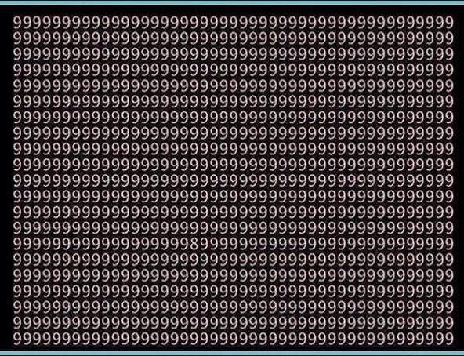

Idea: just send RDF!
application/rdf+xml
text/turtle
application/ld+json
…
ERI
HDTQ
RDF data formats will never be the only ones on the web
Developers prefer JSON, …

Slide 5
Idea: just send RDF! JSON-LD!
Solution:
to rely on *one* RDF syntax like JSON-LD
Requires:
Global adoption of JSON-LD
Maintaining during the development or the evolution phase
Utopian
Abstract data model
(ontology)
+ RDF validation: SHACL/SHeX
JSON-LD Context
+ JSON validation: JSON Schema
M. Lefrançois, RDF presentation and correct content conveyance for legacy services and the web of things. IOT 2018

Slide 6


Approx. modeling of the communication between heterogeneous agents on the Web.
send
X
sender wants to send some content
e.g., state of a resource
medium
receiver
M. Lefrançois, RDF presentation and correct content conveyance for legacy services and the web of things. IOT 2018

Slide 7

Approx. modeling of the communication between heterogeneous agents on the Web.
send
X
received
X
1
2
3
Generates a representation of the content
Transmits
the message via the internet
Decodes and get understanding
sender wants to send some content
e.g., state of a resource
medium
receiver
M. Lefrançois, RDF presentation and correct content conveyance for legacy services and the web of things. IOT 2018

Slide 8
Approx. modeling of the communication between heterogeneous agents on the Web.
send
X
received
X
1
2
3
Generates a representation of the content
Transmits
the message via the internet
Decodes and get understanding
sender
medium
receiver
Correct Content Conveyance iif:
all of the essential characteristics of the content is encoded in the message
the encoding and the decoding phase are symmetric
the message is not altered in the transmission medium

Slide 9
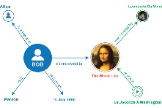
Assumption:
content is always a RDF graph
send
received
1
2
3
Generates a representation of the content
Transmits
the message via the internet
Decodes and get understanding
sender
medium
receiver
Correct Content Conveyance iif:
The RDF graph the sender encodes is equivalent to the RDF
graph the receiver obtained after decoding the message

Slide 10
Assumption:
content is always a RDF graph
send
received
ontologies
1
2
3
Generates a representation of the content
Transmits
the message via the internet
Decodes and get understanding
sender
medium
receiver
Correct Content Conveyance iif:
The RDF graph the sender encodes is equivalent to the RDF
graph the receiver obtained after decoding the message

Slide 11
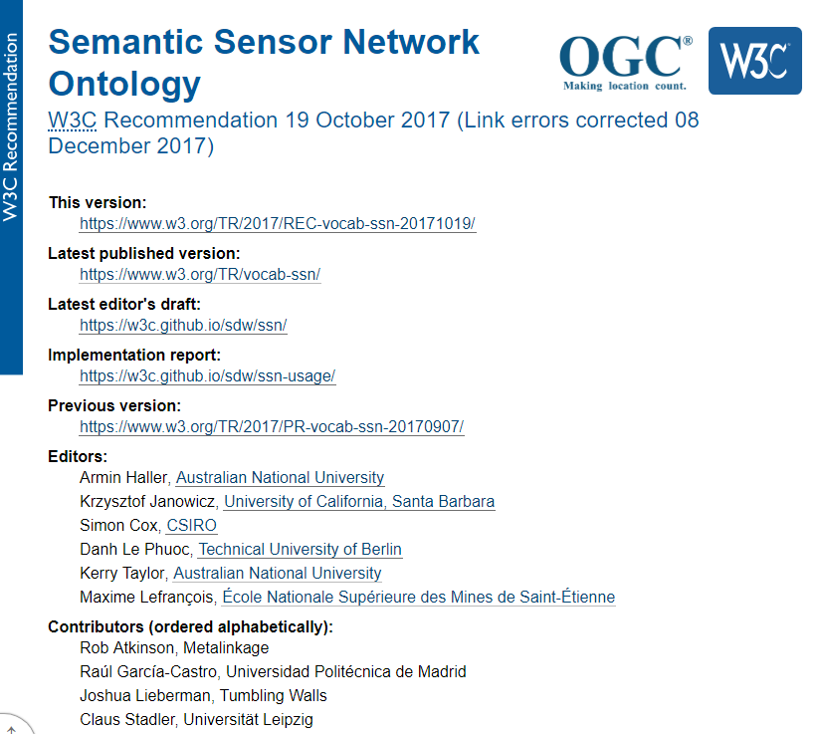
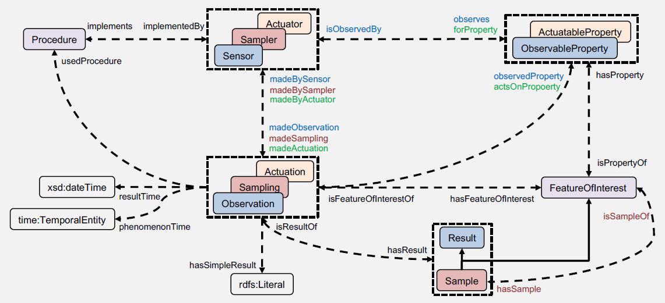
Ontologies, contribution to standardization
SOSA/SSN ontology
Standard OGC et W3C
A. Haller, K. Janowicz, S. Cox, D. Le Phuoc, K. Taylor, and M. Lefrançois, Semantic Sensor Network Ontology, W3C Recommendation, W3C, 19 October 2017

Slide 12
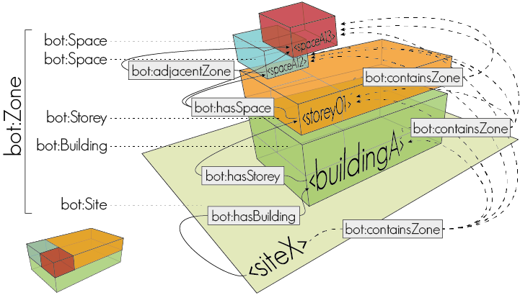
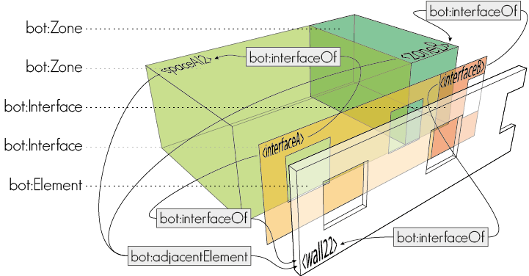
Ontologies, contribution to standardization
BOT ontology
Mads Holten Rasmussen, Maxime Lefrançois, Georg Ferdinand Schneider, Pieter Pauwels, BOT: the Building Topology Ontology of the W3C Linked Building Data Group (submitted May 2019 to Semantic Web Journal)

Slide 13
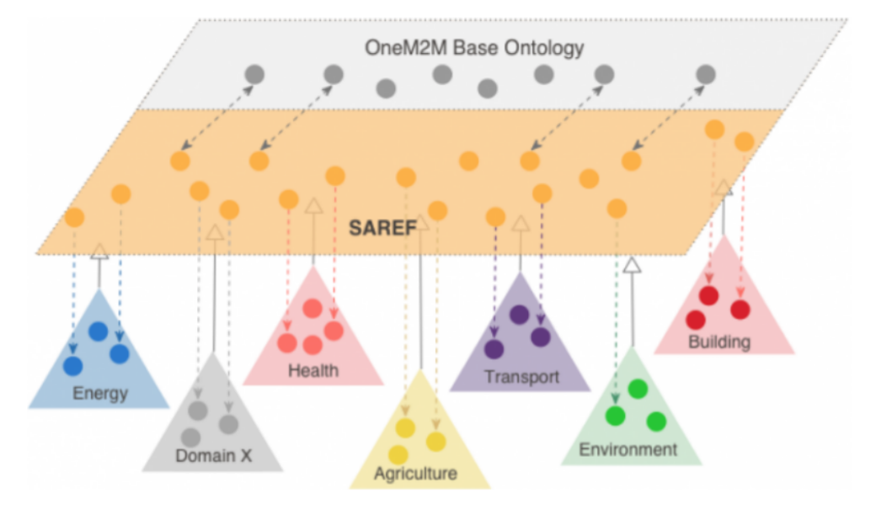
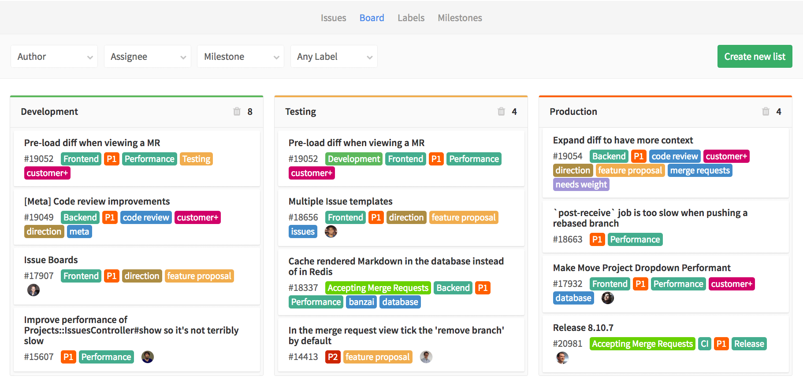

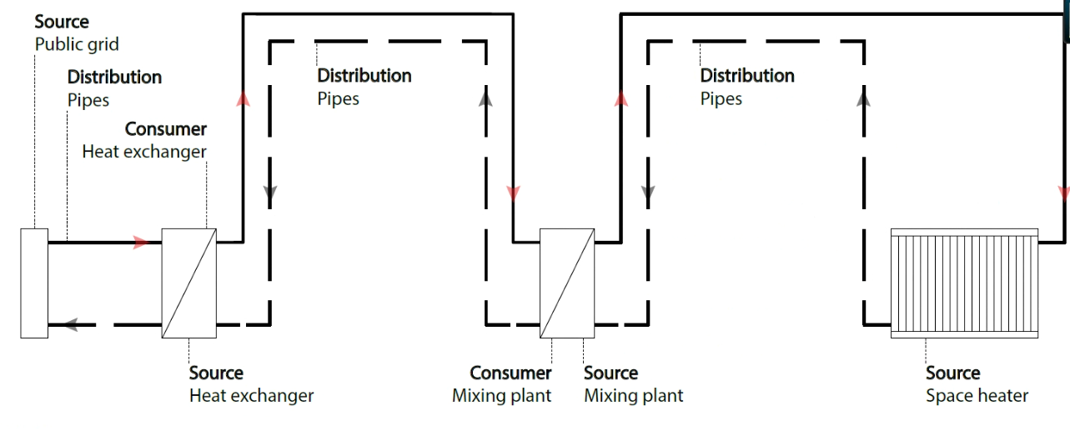
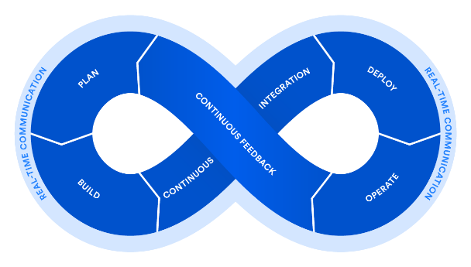



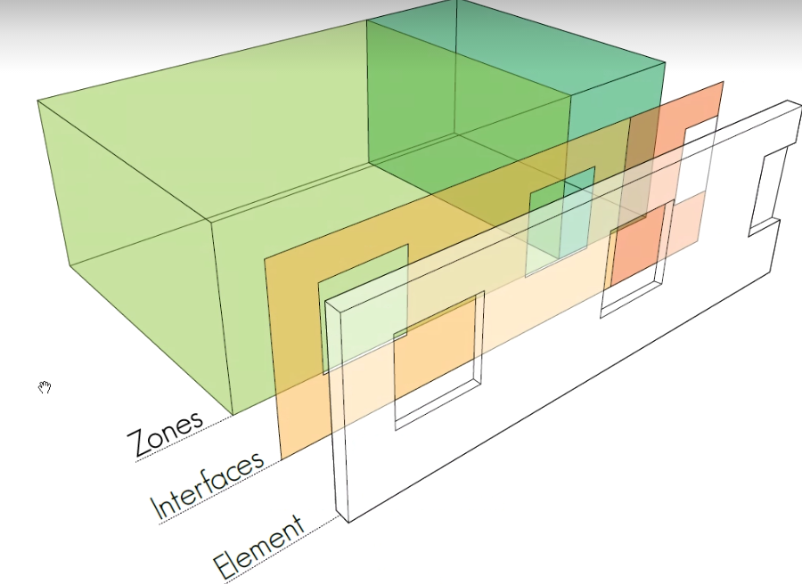

Ontologies, contribution to standardization
SAREF + influences
HVAC
Smart Grid
Core of SEAS
Ontology patterns
Simple
Smart Home
Transport
Building
http://saref.etsi.org/
@prefix seas: <http://w3id.org/seas/>.
SAREF patterns
+ instances

Slide 14
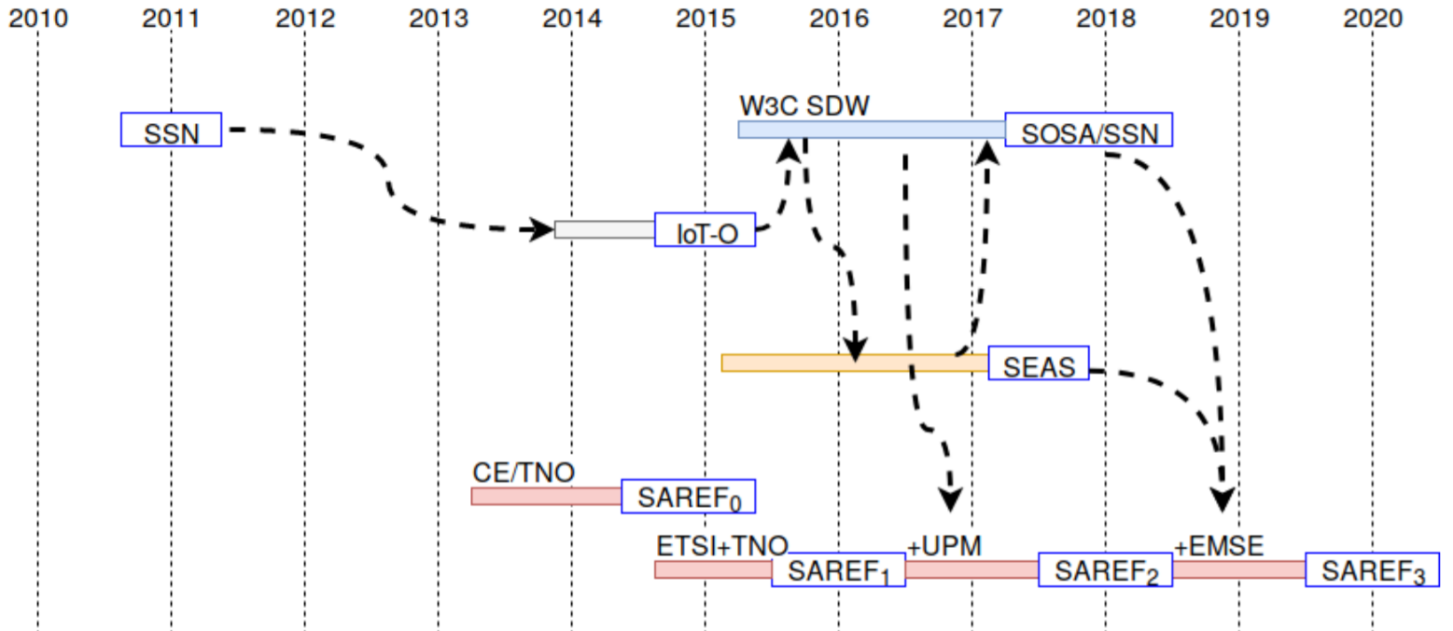
Ontologies, contribution to standardization
A work-in progress at international level

Slide 15
Assumption:
content is always a RDF graph
send
received
1
2
3
Generates a representation of the content
Transmits
the message via the internet
Decodes and get understanding
STTL
SPARQL-Generate
sender
medium
receiver
Correct Content Conveyance iif:
The RDF graph the sender encodes is equivalent to the RDF
graph the receiver obtained after decoding the message

Slide 16

SPARQL-Generate Heterogeneous data integration language
M. Lefrançois, ,A. Zimmermann, N. Bakerally, A SPARQL extension for generating RDF from heterogeneous formats,
In Proc. Extended Semantic Web Conference, 2017
+ EKAW, Hackatons, Tutoriel à ESWC 2018

Slide 17
SPARQL-Generate Heterogeneous data integration language
https://w3id.org/sparql-generate/
Query and generate both RDF and heterogeneous documents.
Generates RDF or text from documents in XML, JSON, CSV, GeoJSON, HTML, CBOR, texte, …
Generates RDF or text streams from streams of big CSV documents, MQTT streams, WebSocket, …
Open-source Licence Apache 2.0 implementation (financed by ITEA, ANR, ENGIE)
Expressive, Perfomant, extensible to other formats
M. Lefrançois, ,A. Zimmermann, N. Bakerally, A SPARQL extension for generating RDF from heterogeneous formats,
In Proc. Extended Semantic Web Conference, 2017
+ EKAW, Hackatons, Tutoriel à ESWC 2018

Slide 18
Additions in the past months/weeks
Syntactic sugar
Data streams
More expressive fuctions
RDF Lists
Asynchronicity / multi-threading
Aggregates
SPARQL SELECT
SPARQL FUNCTION
SPARQL TEMPLATE

Slide 19
Additions in the past weeks
Simple integration
GENERATE
TEMPLATE
SELECT
FUNCTION

Slide 20
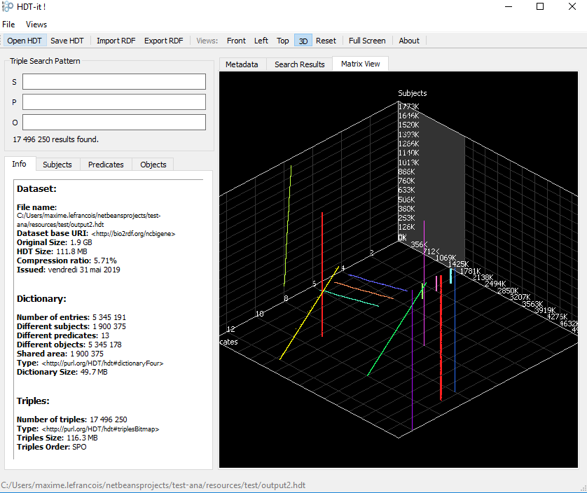
Additions in the past weeks
HDT
HDT viewer http://www.rdfhdt.org/downloads/
20 seconds now only for the 20 M sample, output is 17 M of HDT
9 min, 20 sec for the 145 M file, output is the same "only" 114 M HDT

Slide 21
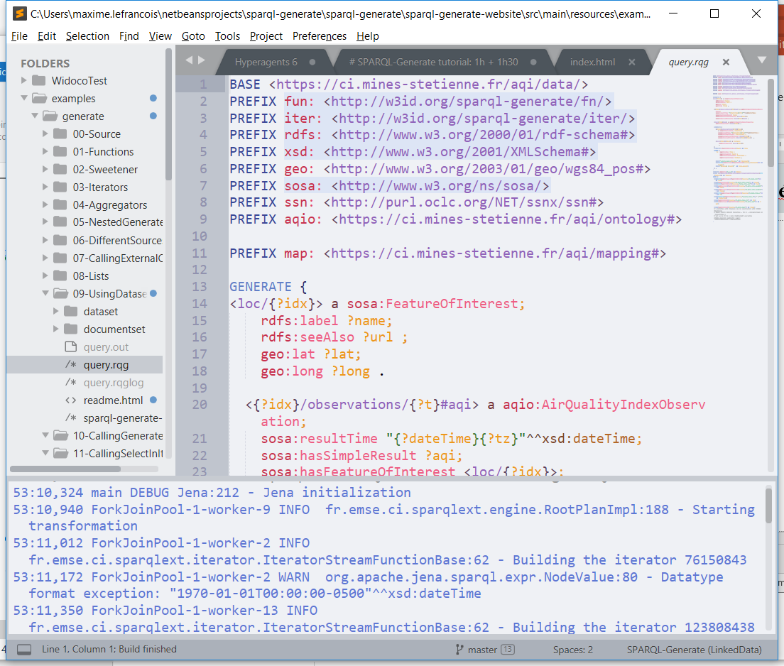
Additions in the past weeks
Sublime Package

Slide 22
Take away message
RDF as lingua franca
Research in Ontology Engineering applied to engineering
Sem Web – based solutions for semantic interoperability
Maxime Lefrançois
Maxime.Lefrancois@emse.fr
http://maxime-lefrancois.info/
MINES Saint-Étienne – Institut Henri Fayol
Laboratoire Hubert Curien UMR CNRS 5516
Ontologies, langages, tools,
to ease the usage of RDF as a lingua franca

