Slide 1
Comparative Analysis of Deep Learning Approaches to Twitter Sentiment Classification
By Ethan Swistak, Mohammed Sujith Ahamed, Nikhil Betgov,
Saurav Gupta, Singhal Tushar

Slide 2
Approach
Compare the accuracy of two different neural network architectures in the classification of Tweets
Architecture 1 – Convolutional Neural Network
Architecture 2 – Recurrent Neural Network
Architecture 3 – Ensemble Approach
Dataset consists of a number of Tweets in several tab delineated text files from the SemEval 2017 task 4 dataset, including:
Tweet ID
Sentiment(Positive, Negative, Neutral)
Content(140 characters or less)
50,334 Tweets in Train, 12,284 Tweets in Test

Slide 3
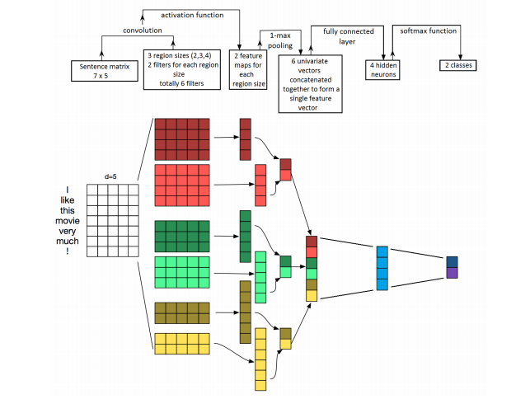
Convolutional Architecture

Slide 4
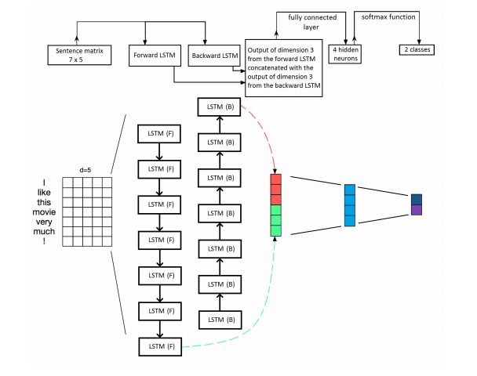
Recurrent Architecture

Slide 5
Methods
Tweet representation will be achieved by additional Word2Vec network trained to represent words via locality sensitive vector embedding, using a word dictionary as an additional input.
Ensemble approach uses soft voting of different network outputs with different hyperparameters.
Evaluation metric is F1-score, combining precision and recall in single metric.

Slide 6
Further Research?
Are there additional discoverable classifications for Tweets other than simply positive or negative?
Can the outputs of various neural networks be combined in a more organic fashion

