Slide 1
Microsoft Azure Application Insights

Slide 2


Diogo Moura
Estagiário de Verão 2021

Slide 3
Agenda Timeline
Introduction
Configuration
General Overview
Objectives
Pricing
Client-side
Server-Side
Client-side Proxy

Slide 4
Agenda Timeline
SDK
Visualization & Demo
Custom Metrics
Custom Events
PerformanceCounters
EventCounters
Logs
Exceptions
API REST
Power BI
Alerts and Notifications
Demo

Slide 5
Introdução

Slide 6
Visão Geral
What does it monitor?
Request Rates
Dependency Rates
Exceptions
Page Views
Load Performance
HTTP(s) calls
User and session counts
Performance Counters
Host Diagnostics
Diagnostic Trace Logs
Custom events

Slide 7
Objetivos
Objetives:
Diagnostic errors in the application
Improve user experience in a SaaS product
Observability

Slide 8
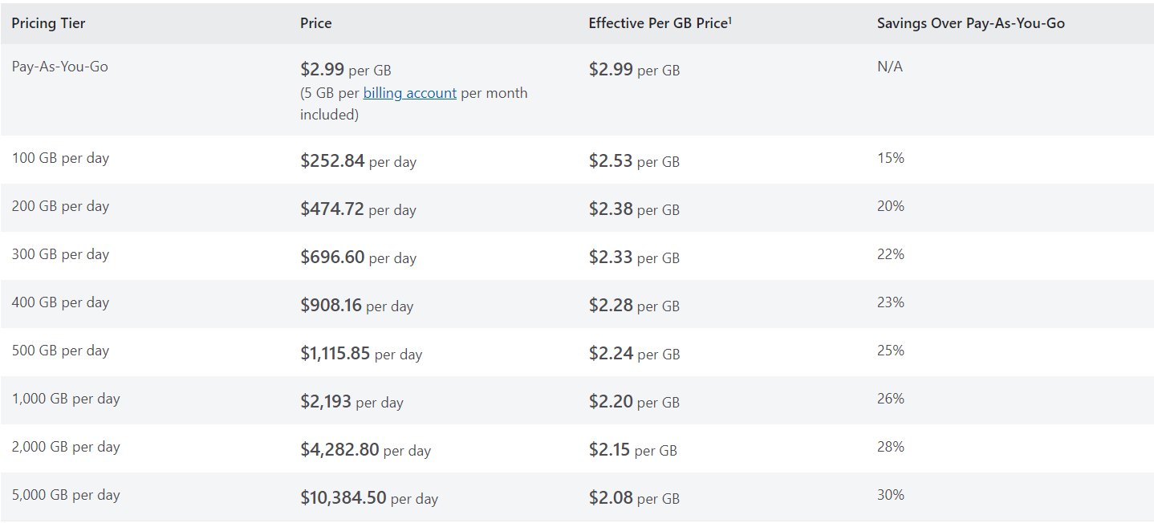
Pricing
Log Data Ingestion
Referência – [1]

Slide 9
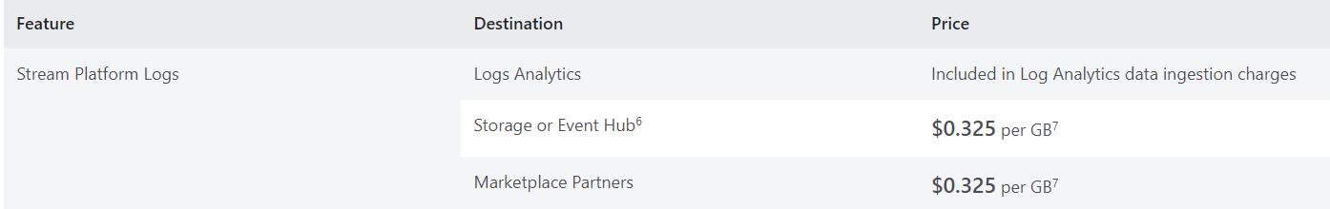
PriCing
Referência – [1]
Log Data Retention
Log Data Export
Platform Logs

Slide 10
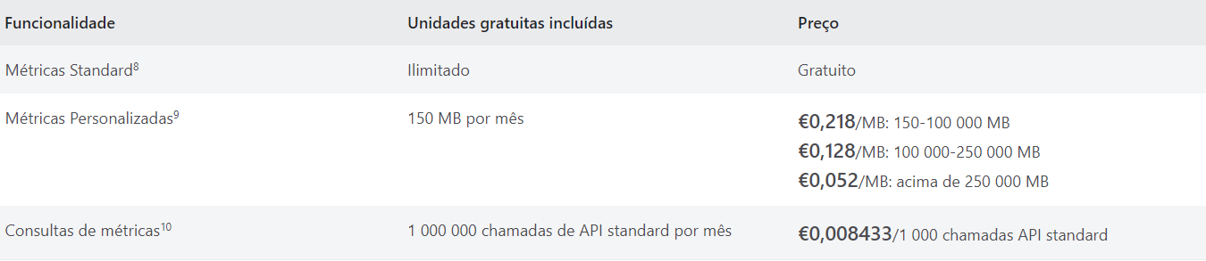
Pricing
Metrics
Standard metrics are available for free and include select metrics originating from Azure resources, services and first party solutions.
Each Custom Metric datapoint written is considered 8 bytes in size.
Metric queries are charged based on the number of standard API calls. A standard API call is a call that analyzes 1,440 data points

Slide 11
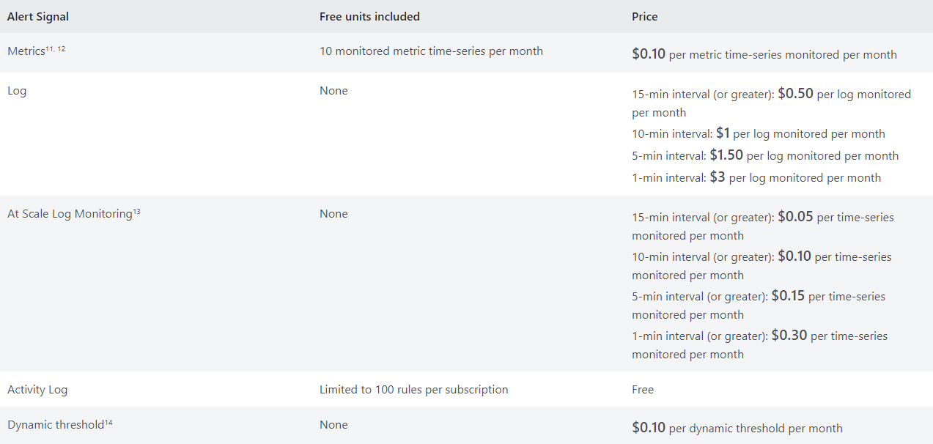
Health Monitoring
Health monitoring is billed for the number of metric time-series monitored using health criteria for an Azure resource.
There are no charges for health monitoring while in preview. After health monitoring becomes generally available, the pricing plan below will go into effect.
Alert Rules

Slide 12
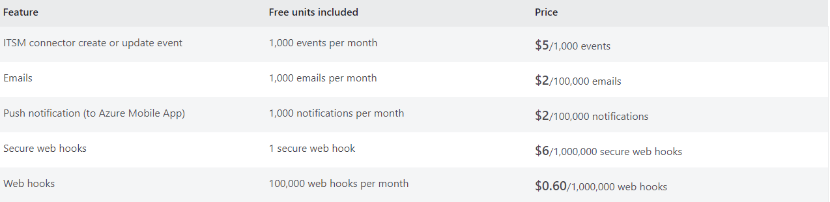
Notificações
SMS and Voice calls
Notifications

Slide 13
Configuration

Slide 14
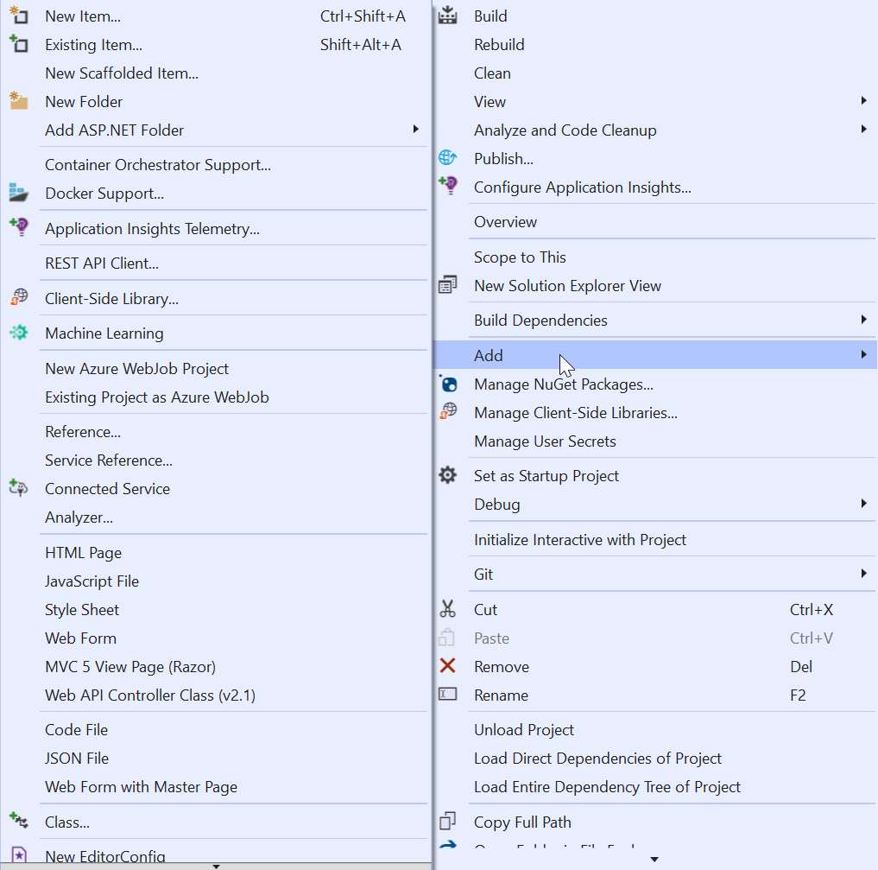
Server-Side Configuration
Select Add Application Insights Telemetry > Application Insights Sdk (local) > Next > Finish > Close.
Or Install the Nugget Packages manually:
Microsoft.ApplicationInsights.WindowsServer
Microsoft.ApplicationInsights.Web
Microsoft.AspNet.TelemetryCorrelation
2. Open the ApplicationInsights.config file.
Configure Instrumentation Key, Connection String
and modules.

Slide 15
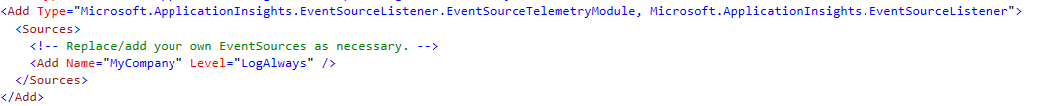
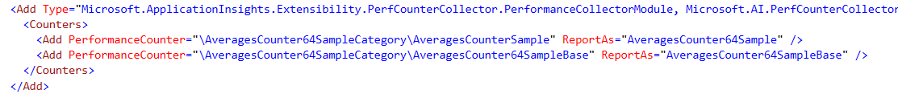
Server-Side Configuration
ApplicationInsights.config file
edocCloudWeb/ApplicationInsights.config

Slide 16
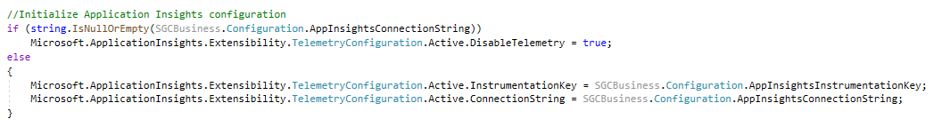
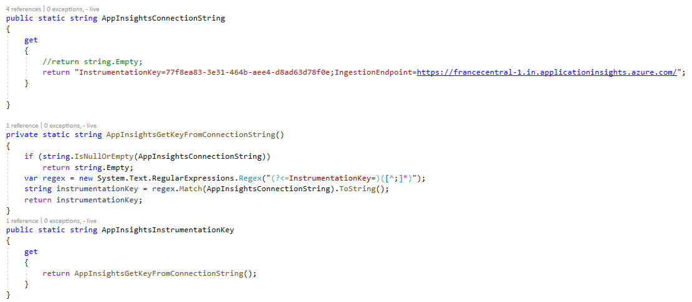
Server-Side Configuration
Configuration through code – Connection String
SGCBusiness/Configuration.cs
edocCloudWeb/Global.asax.cs [function Application_Start]

Slide 17
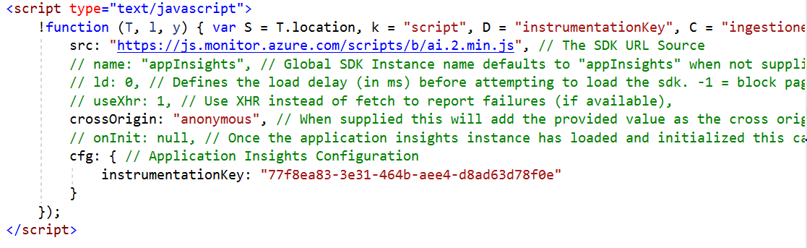
Client-Side Configuraton
Insert script at bottom of <Head/> section
edocCloudWeb/Master Pages/Default.Master

Slide 18
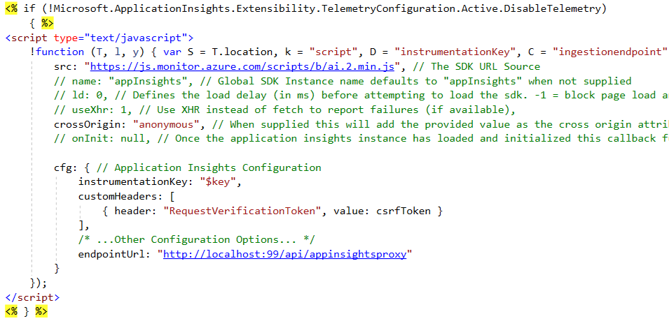
Client-side Configuration
Proxy – Add CSRF Header and Instrumentation Key Placeholder
edocCloudWeb/Master Pages/Default.Master

Slide 19
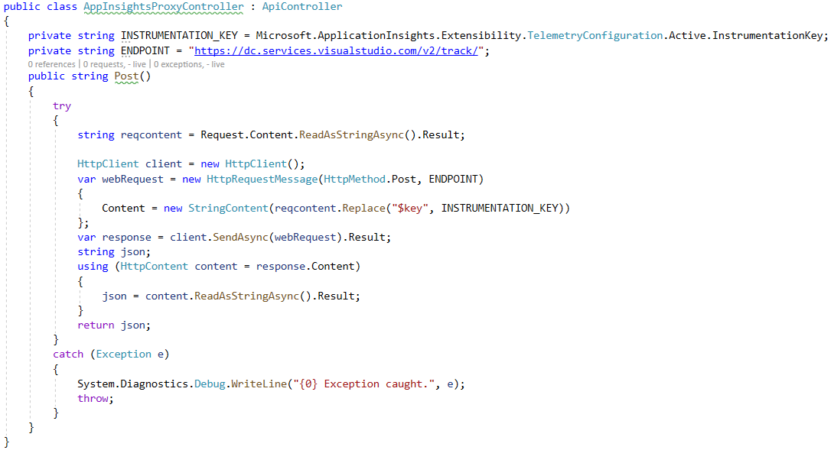
Client-side Configuration
Proxy – WEB API 2 Controller
edocCloudWeb/Services/AppInsightsProxyController.cs

Slide 20
SDK

Slide 21
SDK
Azure Application Insights Telemetry
Distributed Logging
Metrics-Based System composed of:
Metrics
Logs
Traces

Slide 22
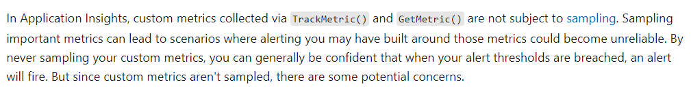
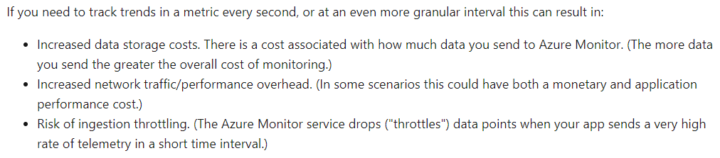
SDK
Push vs Pull
Push Pull /Sampling
TrackMetric EventCounter Collector
GetMetric PerformanceCounter Collector
TrackDependency
TrackEvent
TrackTrace
Logs

Slide 23
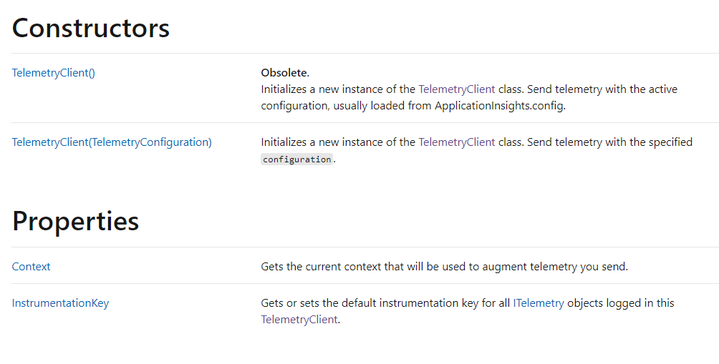

SDK
Telemetry Client
Send events, metrics and other telemetry to the Application Insights service.
. Telemetry client is thread-safe
. However, creating several instances might be useful to set
Operation ID or other fields.
. You can set properties for example to identify the machine
This information is attached to all the events sent by the instance

Slide 24
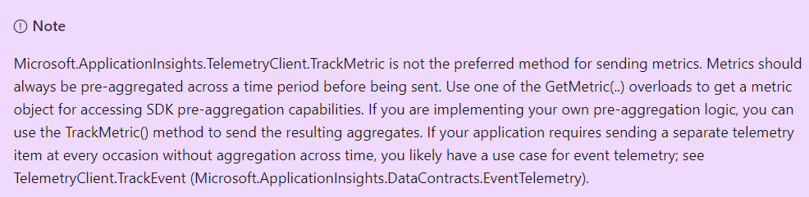


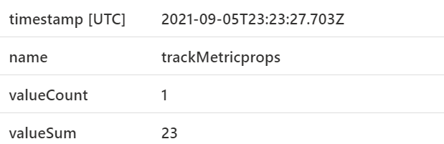
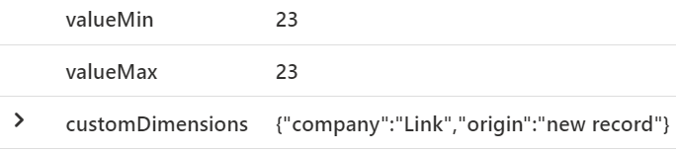
SDK
Custom Metrics – Track metric

Slide 25
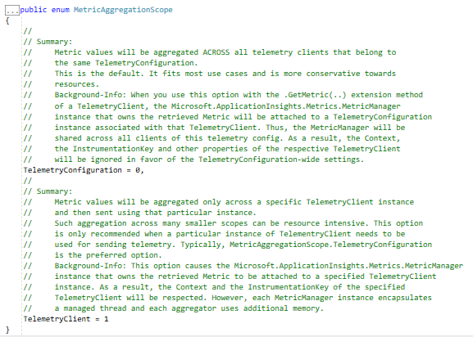
SDK
Custom Metrics – Get metric
Aggregate metrics across all telemetry clients or on a single Instance

Slide 26
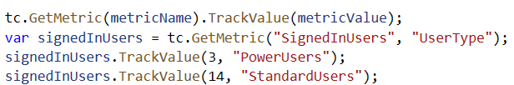
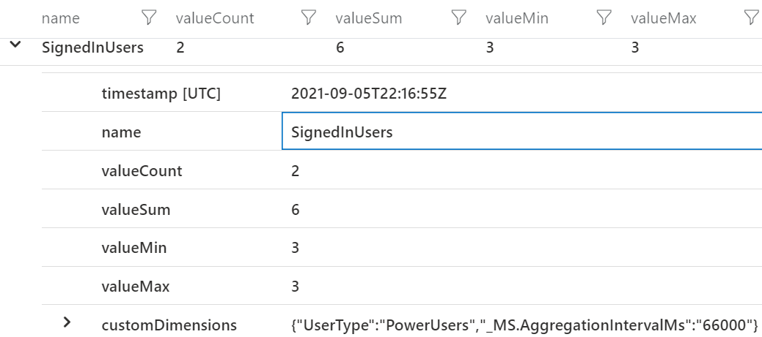
SDK
Custom Metrics – Get metric
GetMetric() handles local pre-aggregation for you and then only submits an aggregated summary metric at a fixed interval of one minute.

Slide 27
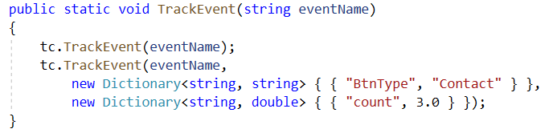
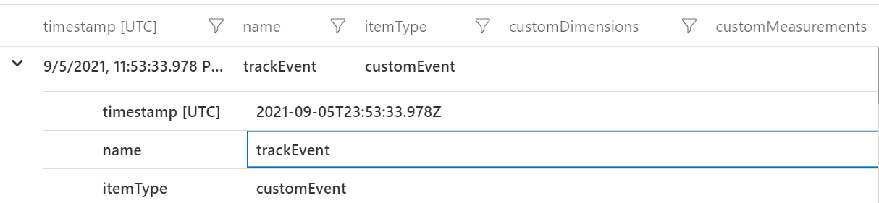
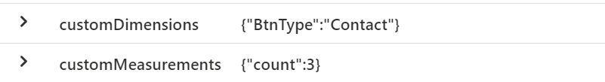
SDK
Custom Events

Slide 28
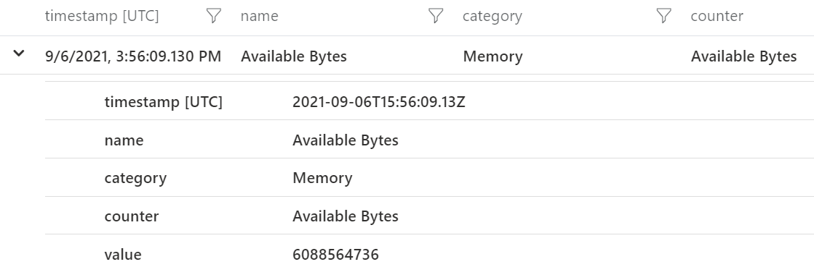
SDK
Performance Counters
The current default counters that are configured to be collected for ASP.NET web applications are:
% Process\Processor Time
% Process\Processor Time Normalized
Memory\Available Bytes
ASP.NET Requests/Sec
.NET CLR Exceptions Thrown / sec
ASP.NET ApplicationsRequest Execution Time
Process\Private Bytes
Process\IO Data Bytes/sec
ASP.NET Applications\Requests In Application Queue
Processor(_Total)\% Processor Time

Slide 29
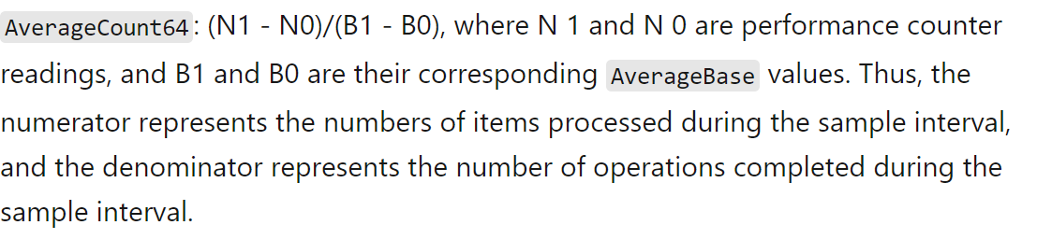
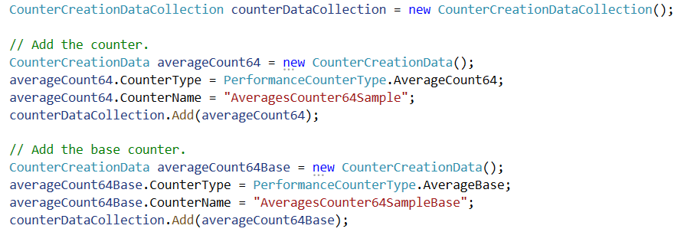
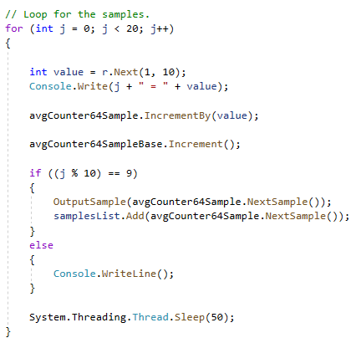
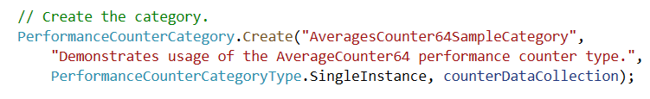
SDK
Performance Counters
Performance Counters Collectors collect Performance Counters measurements every minute.
Several types of Performance Counters exist – i.e. Ellapsed time or Average Base Count.

Slide 30
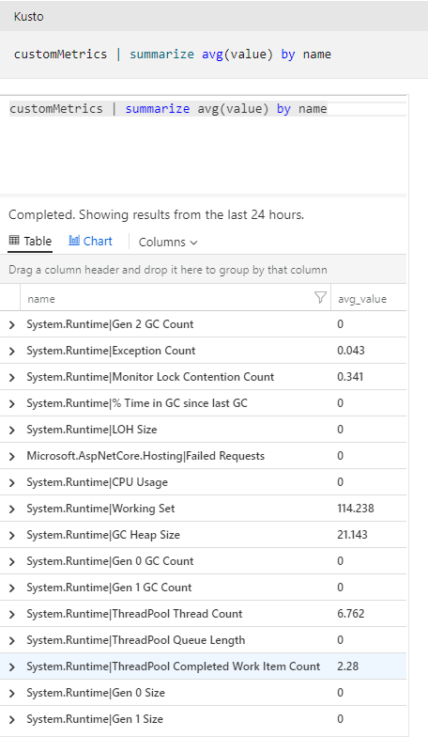
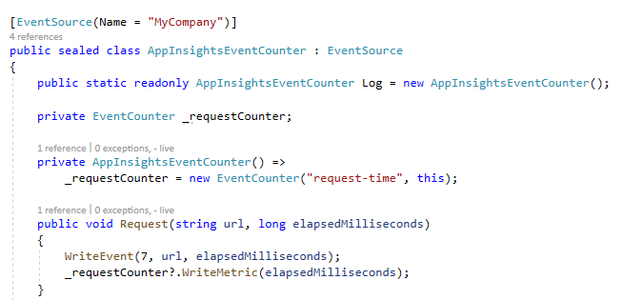
SDK
Event Counters

Slide 31
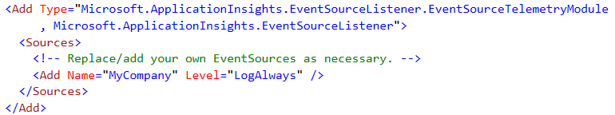
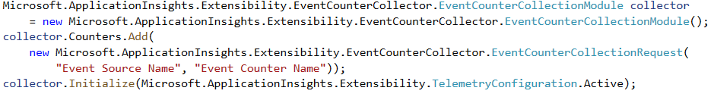
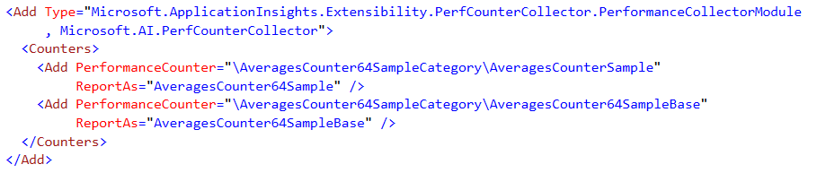
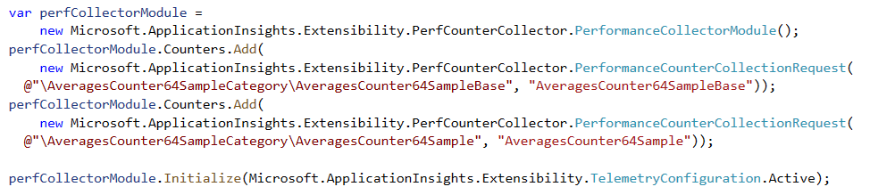
SDK
PerformanceCounters & EventCounter Collectors
ApplicationInsights.config vs Configuration through code

Slide 32
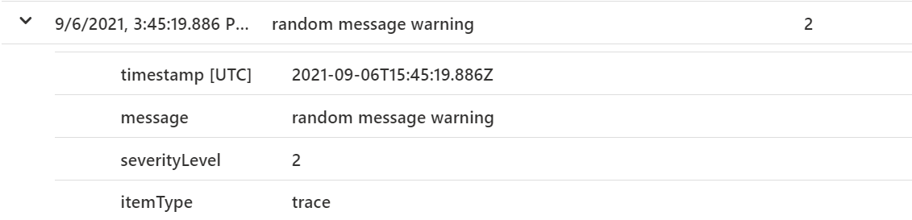
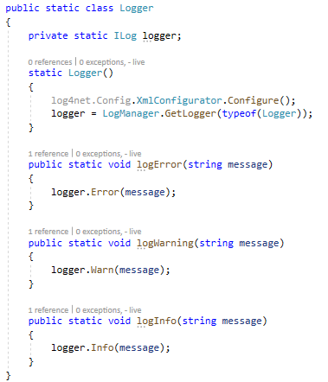
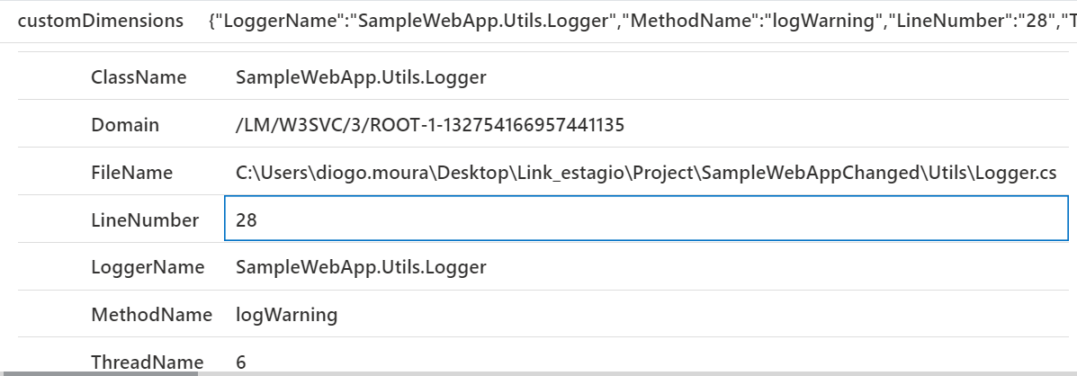
SDK
Logs

Slide 33
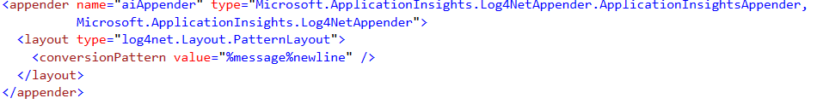
SDK
Log Application Insights Appender
edocCloudWeb/Web.config
The logs are reported to Application Insights after the appended is added.

Slide 34
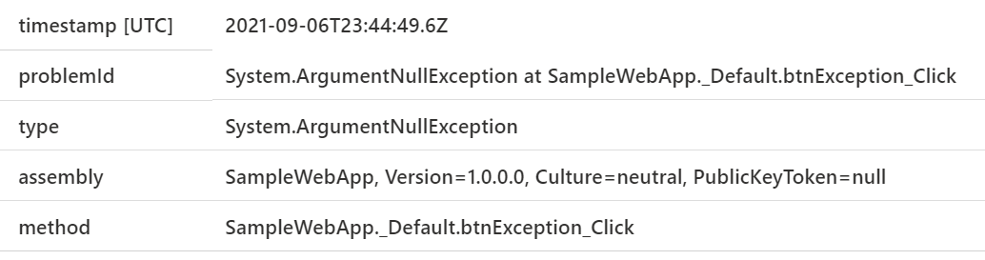
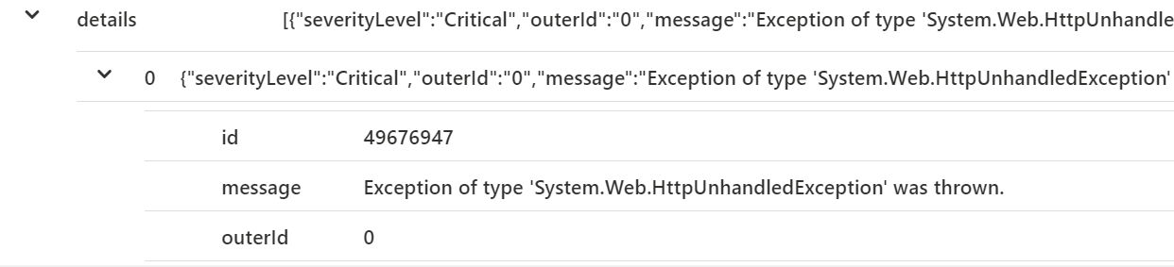
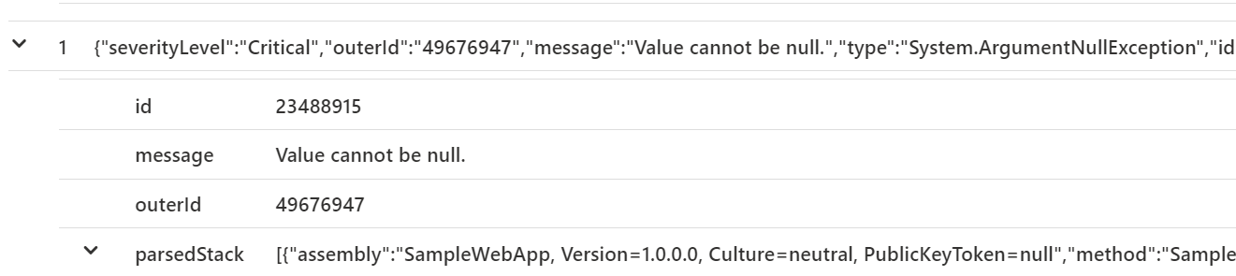
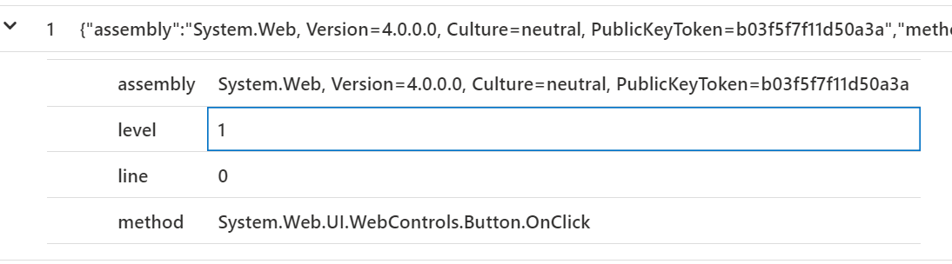
SDK
Exceptions
Modules automatically added to .config file:
Whole exception stack gets reported:

Slide 35
Visualization

Slide 36
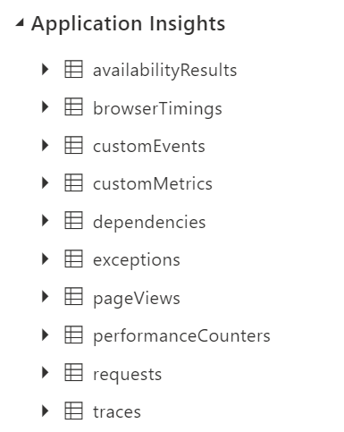
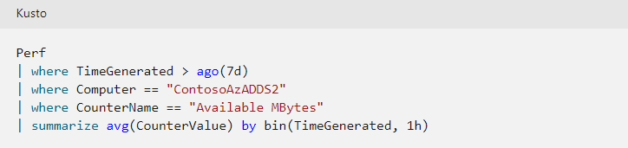
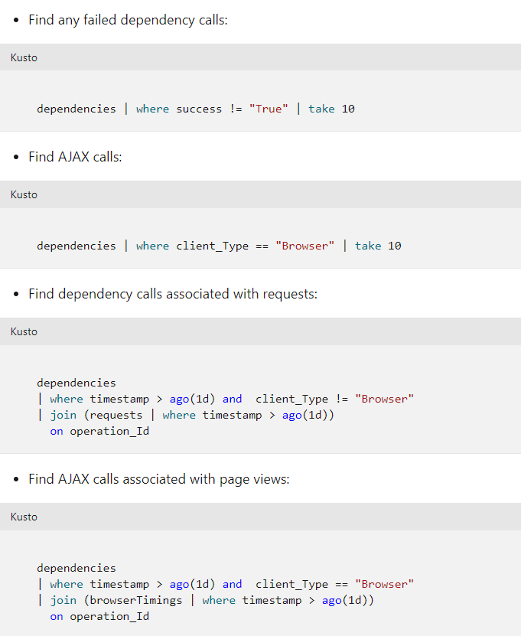
Visualization
Log Analytics
Available logs: Example queries:

Slide 37
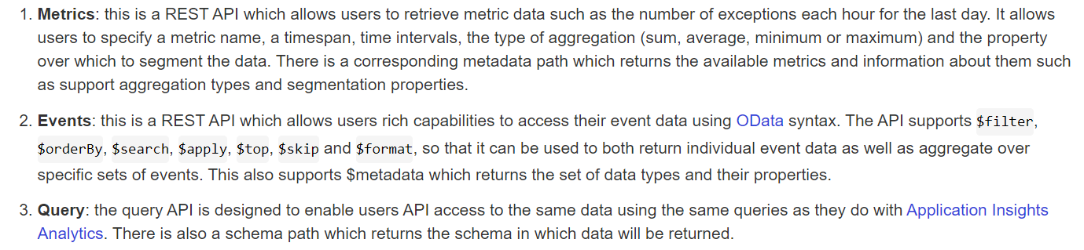
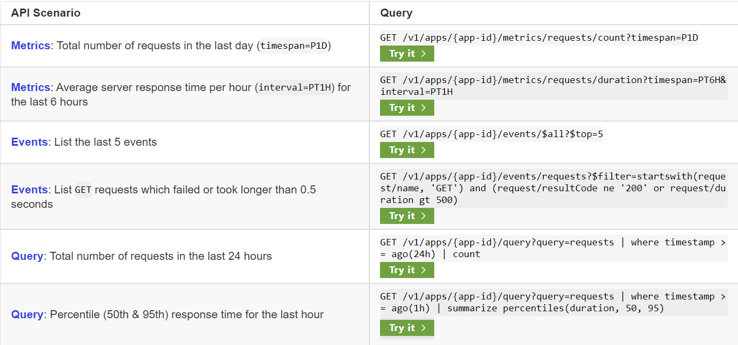
Visualization
API REST

Slide 38
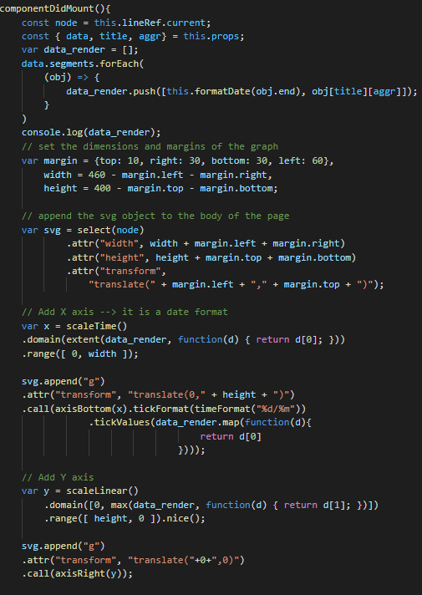

Visualization
API REST

Slide 39




Visualization
Power BI

Slide 40




Visualization
Alerts and Notifications
Condition Scope
Actions

Slide 41



Visualization
Alerts and Notifications - Microsoft Teams Logic App

Slide 42
Visualization
Demo

Slide 43
References and Further Reading
[1] https://azure.microsoft.com/ptpt/pricing/details/monitor/?cdn=disable
[2] https://docs.microsoft.com/en-us/azure/azure-monitor/app/asp-net#add-application-insights-automatically
[3] https://docs.microsoft.com/enus/dotnet/api/microsoft.applicationinsights.telemetryclient.trackmetric?view=azuredotnet#Microsoft_ApplicationInsights_TelemetryClient_TrackMetric_Microsoft_ApplicationInsights_DataContracts_MetricTelemetry_
[4] https://docs.microsoft.com/pt-pt/azure/azure-monitor/app/get-metric
[5] https://docs.microsoft.com/en-us/dotnet/api/system.diagnostics.performancecountertype?view=net-5.0
[6] https://docs.microsoft.com/pt-pt/azure/azure-monitor/app/asp-net-exceptions
[7] https://docs.microsoft.com/en-us/azure/azure-monitor/app/asp-net-dependencies#advanced-sql-tracking-to-get-full-sql-query

Slide 44
This presentation and the recording will be shared soon at Innovation site:
https://linkcomsa.sharepoint.com/sites/Innovation
Thank You!

