Slide 1

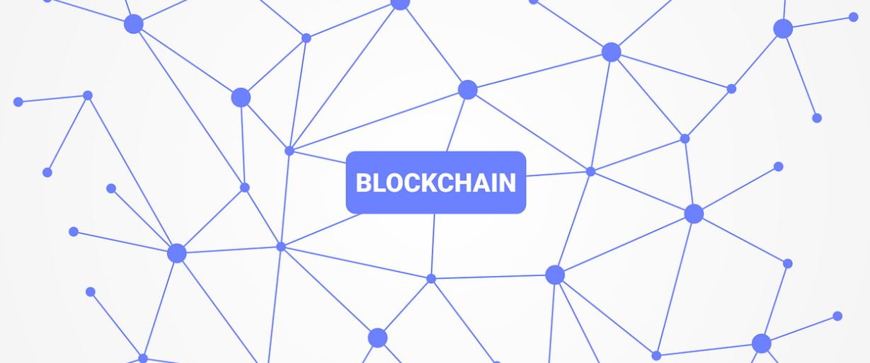
Blockchain Telecare Medical Information System Integration

Slide 2
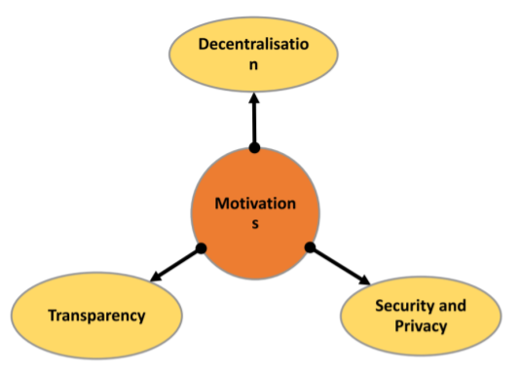
Motivations

Slide 3
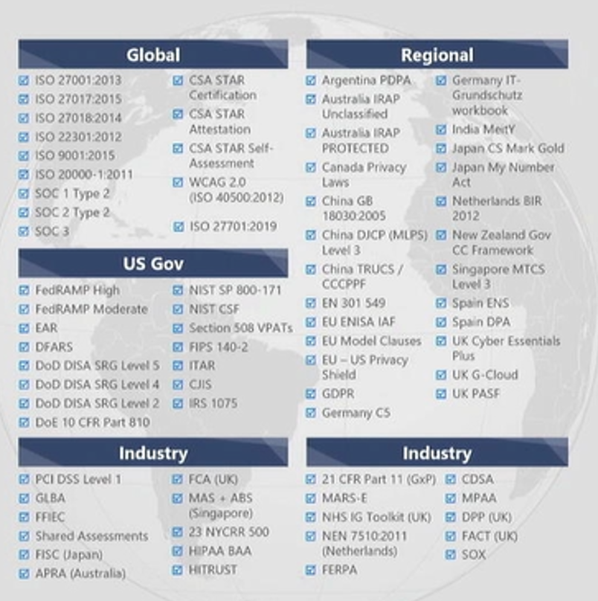

Regulations

Slide 4
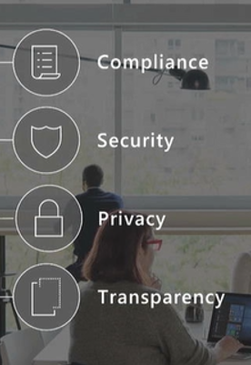
GDPR
Apart from prospective transparency, where a data subject is informed about the data processing beforehand, transparency requires retrospective transparency, meaning the ability to follow the data processing step-by-step, for audit purposes.
1) transparency is a core principle enshrined in Art. 5 (1)(a) of the GDPR
2) Transparency law is an obligation imposed on data controllers to communicate a series of pieces of information, and to communicate them ”in a concise, transparent, intelligible and easily accessible form, using clear and plain language” (Art. 12(1))
3) Art. 22 GDPR gives individuals the right not to be subject to a decision based solely on automated processing that significantly affects him/her.
4) Recital 71 GDPR gives the subject the right to obtain human intervention, express his or her point of view, and obtain an explanation of the decision

Slide 5
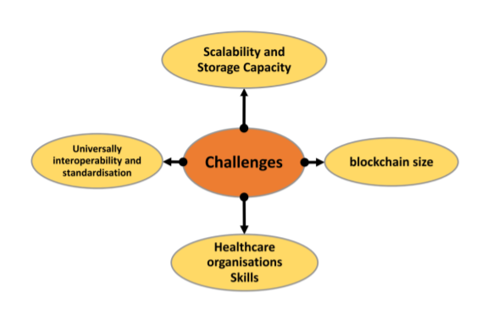
Challenges

Slide 6
Problems thesis wants to solves
In summary, the problems that this thesis will try to solver are:
1) Design of a secure encryption scheme that can be used by IoT devices and robots to transmit data safely, namely a secure cryptographic scheme that can be used by robots using the ROS operative system.
2) Desing of a scalable, secure, distributed and resilient blockchain-based Telecare Medical Information System where trustworthiness and enforceability between users can be achieved without third parties
3) Integration of the TMIS into Telecare Medicine business processes and Organization Skills

Slide 7
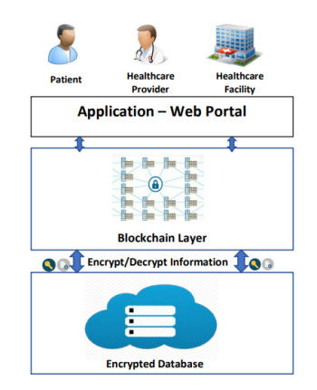

Slide 8
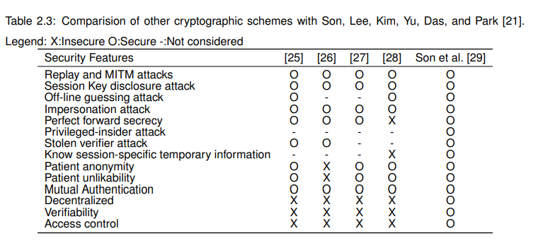
Vulnerabilities

