Slide 1
Bridge & Composite Pattern
Gergely Szilágyi

Slide 2
Agenda
Bridge Pattern
Real life example
Code example
Class Diagram
Common usages

Slide 3
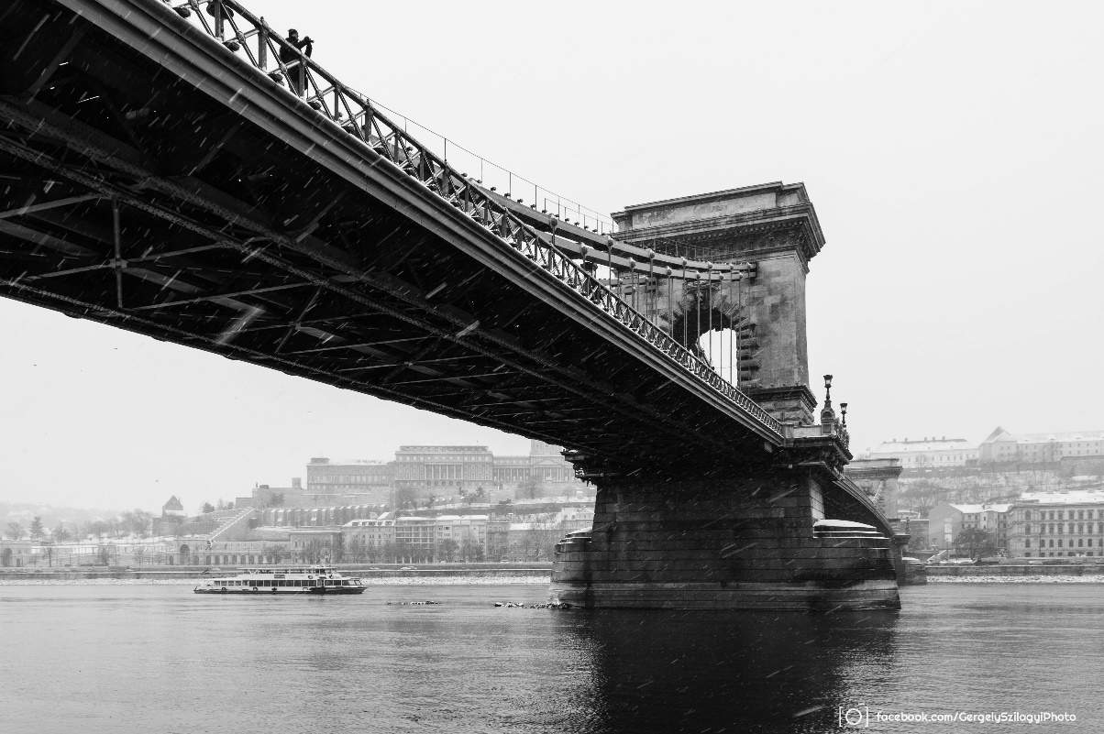
Bridge Pattern
„Decouple an abstraction from its implementation so the two can vary independently.”(GOF)
Abstractions are coupled to implementations by default.
Notes:
It a little bit hard to understand but we can break this down to understand it better.
Abstraction: some way of classifiing a group of things, might be a base class or an interface that we are using to abstract a way a concept of something that can be a different implementations.
We usually have ain interface which is an abstract class. We create an implementation which implements a specific interface. In this case the abstraction and the implmentation are coupled together.
What does coupled mean: if we would like to change the interface then we have to change the implementations, and vica versa.
What the bridge pattern does:
Decouple these two.
Reason: that the two can vary independently
We are creating one level of a higher abstraction.
Abstraction will use another abstraction as its implementation, this allow us to do to vary the two. This „middle” layer abstraction will be the bridge between teh abstraction and the implementation.

Slide 4
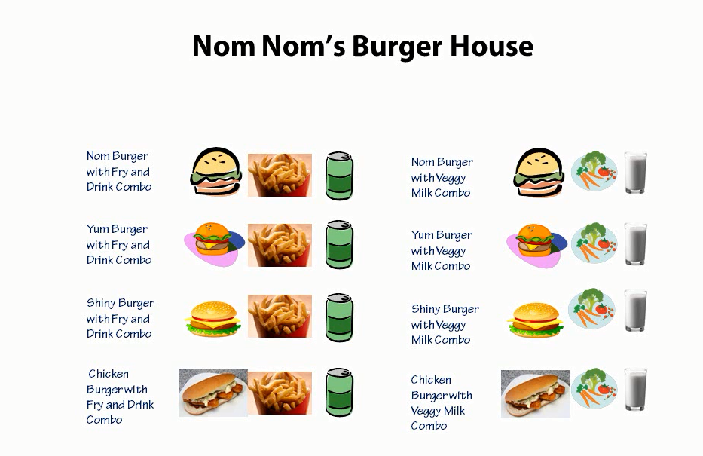
Bridge in real word
Notes:
Here is a full menu.
Here are al the possible items that this burger house sell.
There is some duplication.
Abstraction as a burger, implementation is the combo, we have two implementations here.
Fry and drink or the veggy and milk
We are selling the meal not the burger.
We are separationg these two concepts.
What happens if we introduce a new combo meal, we have to create 4 new menu items. If we add a new burger we need to add 4 new menu item. Or if we change..

Slide 5
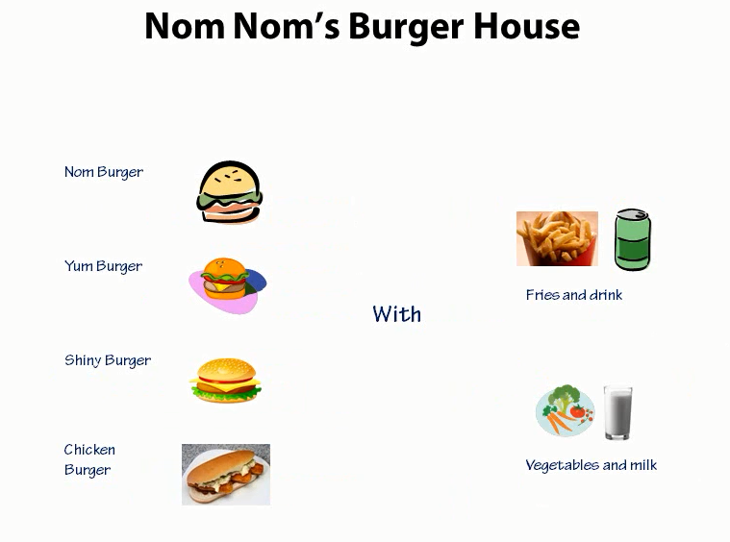
Bridge in real word
Notes:
Here is a simplified menu.
Creating meals by combining these two together.
Abstraction and implementation is now two separate things.
Buger is not tight to the combo anymore.
We can add a different combo or a new burger. The other part does not have to change
The custumor can decide how they want to couple these two together, not me who create the menu..
25.

Slide 6
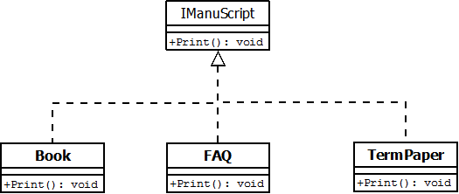
Initial problem
https://github.com/esziger/design_patterns/tree/master/Bridge_Examples/BridgeExample_Base/
Notes:
Faq, book are all kinds of documents or manuscripts. These has different attributes.
Each has a Print.

Slide 7
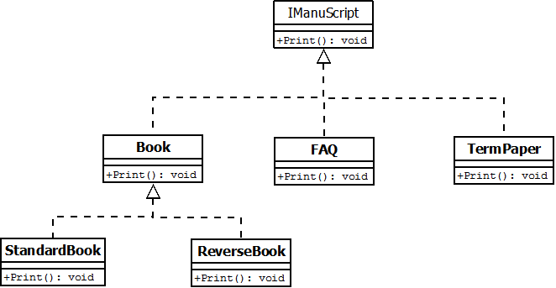
Add reverse book
New requirements:
„Print the book backwards”
https://github.com/esziger/design_patterns/tree/master/Bridge_Examples/BridgeExample_WrongSolution/
Notes:
Faq, book are all kinds of documents or manuscripts. These has different attributes.
Each has a Print.
If we would stick to this solution than we would have a large headachin the mantenance.
For a new formatting we have to create a new Book, faq and Termpaper fancy formatting version.
Print is an implementation of the IManuscript interface.
But what we want is to have an other level of abstraction.
We are going to create an abstraction for the implementation of formatting and that is going to take us to the Bridge pattern.

Slide 8
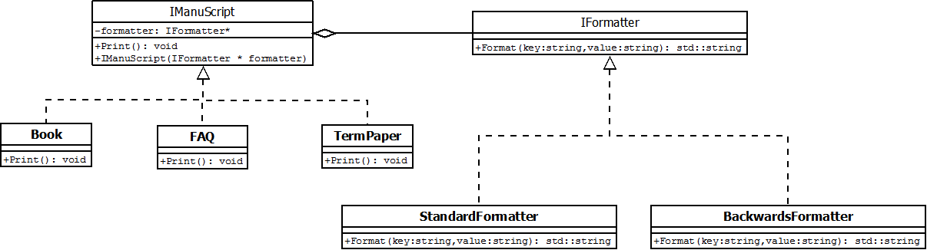
Reverse book - Bridge Example
Refactoring to Bridge Pattern
https://github.com/esziger/design_patterns/tree/master/Bridge_Examples/BridgeExample_BackwardsBook/
Notes:
What we really want is to force those who implements the IManuScript to tak a formatter.
If you are an ImanuScript, then you need to have a formatter.
Lets define a constructor in the IManuScript, which accepts a formatter.
We extended the abilitiy of a set of classes.
We successfully decouple the abstraction from the implementation.

Slide 9
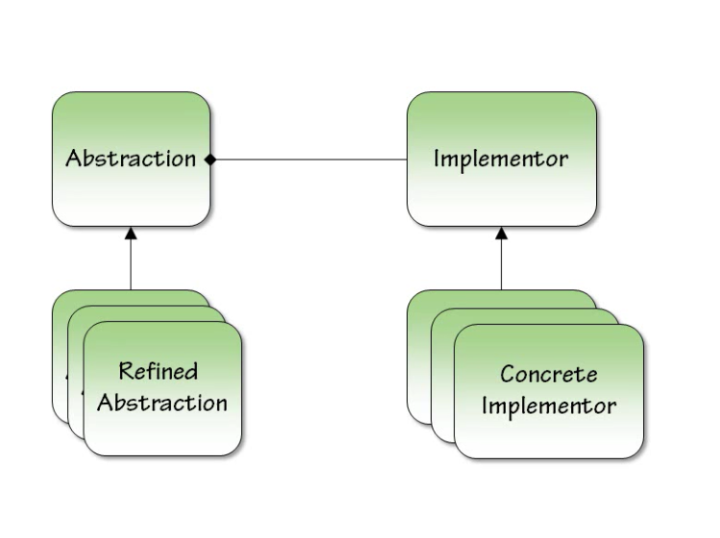
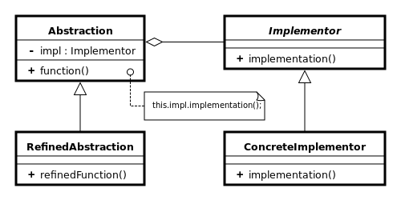
Bridge Pattern UML Diagram
Notes:
Abstraction in our example was the IManuscript.
That was a way to Print a document. That was the concept behind the abstraction.
Refined Abstraction implemented the IManuScript interface. We had a book a paper and a FAQ.
Implementor in our example is the formatter.
The Abstraction uses the implementor to implement the formatting of the book.
We didnt watn the formatter to be tide to the type of the manuscript. We didnt want that a book should have only one type of formatting, like standard or Reverse.
We didnt want to have all of these combination for every abstraction and every implementation.
Implementor have several ConcreteImplementor. This hieararchy allows us to create new IManuScript or new formatting and combining them together.
One thing with this Bridge pattern, you can play it multiple times. There are other aspects of the Manuscripts. We can have differnt type of Printers , or language.
We could bridge these implementations together, mix and match them to have our own customized implementation.

Slide 10
Common Usages
Persistence
Database persistence
Filesystem persistence
Streaming over the network persistence
User Interface
Multiplatform interfaces usually using the Bridge Pattern.
Notes:
Whatever type of persistence do you have you bridging the abstraction the ability to persist and the actual iplemntation of persistence.

Slide 11
Related Patterns
Bridge - has a structure similar to an object adapter, but Bridge has a different intent: It is meant to separate an interface from its implementation so that they can be varied easily and independently. An adapter is meant to change the interface of an existing object.
Facade - Provide a unified interface to a set of interfaces in a subsystem. Facade defines a higher-level interface that makes the subsystem easier to use.

Slide 12
Bridge in our Application
Results for searching to ”Bridge”:

Slide 13
References
Design Patterns: Elements of Reusable Object-Oriented Software (1994)
Head First Design Patterns
PluralSight – Design Patterns Library

Slide 14
Q&A

