Slide 1
Bridge & Composite Pattern
Gergely Szilágyi

Slide 2
Agenda
Bridge & Composite Pattern
Real life example
Code example
Class Diagram
Common usages
Applicability
Consequences
Related Patterns

Slide 3

Bridge Pattern
„Decouple an abstraction from its implementation so the two can vary independently.”(GOF)
Abstractions are coupled to implementations by default.
Notes:
It a little bit hard to understand but we can break this down to understand it better.
Abstraction: some way of classifiing a group of things, might be a base class or an interface that we are using to abstract a way a concept of something that can be a different implementations.
We usually have ain interface which is an abstract class. We create an implementation which implements a specific interface. In this case the abstraction and the implmentation are coupled together.
What does coupled mean: if we would like to change the interface then we have to change the implementations, and vica versa.
What the bridge pattern does:
Decouple these two.
Reason: that the two can vary independently
We are creating one level of a higher abstraction.
Abstraction will use another abstraction as its implementation, this allow us to do to vary the two. This „middle” layer abstraction will be the bridge between teh abstraction and the implementation.

Slide 4
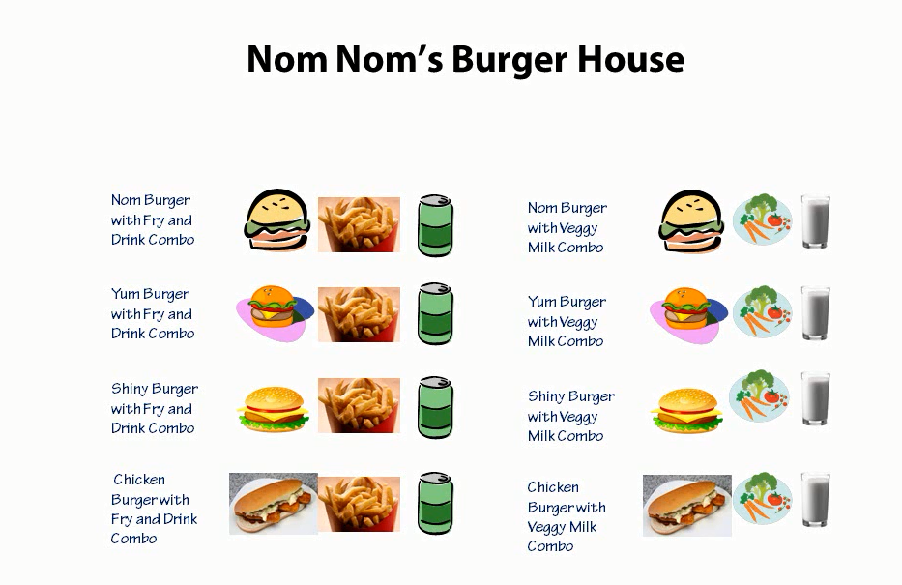
Bridge in real word
Notes:
Here is a full menu.
Here are al the possible items that this burger house sell.
There is some duplication.
Abstraction as a burger, implementation is the combo, we have two implementations here.
Fry and drink or the veggy and milk
We are selling the meal not the burger.
We are separationg these two concepts.
What happens if we introduce a new combo meal, we have to create 4 new menu items. If we add a new burger we need to add 4 new menu item. Or if we change..

Slide 5
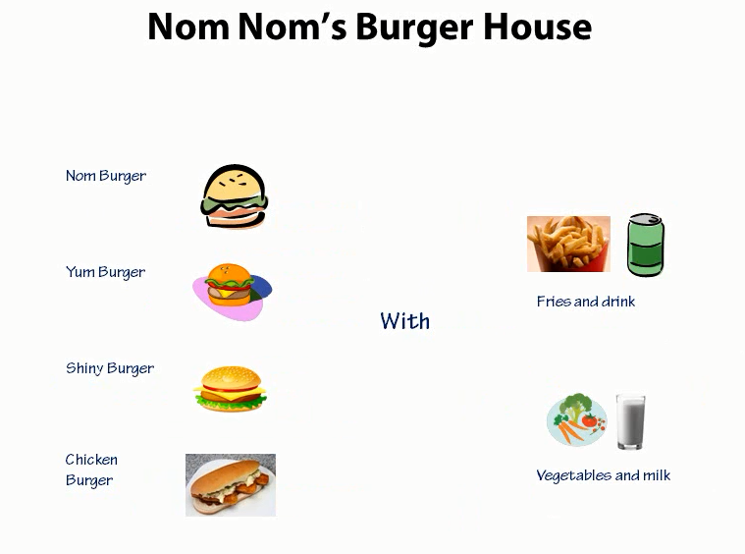
Bridge in real word
Notes:
Here is a simplified menu.
Creating meals by combining these two together.
Abstraction and implementation is now two separate things.
Buger is not tight to the combo anymore.
We can add a different combo or a new burger. The other part does not have to change
The custumor can decide how they want to couple these two together, not me who create the menu..
25.

Slide 6
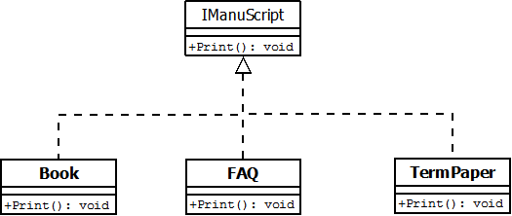
Initial problem
https://github.com/esziger/design_patterns/tree/master/Bridge_Examples/BridgeExample_Base/
Notes:
Faq, book are all kinds of documents or manuscripts. These has different attributes.
Each has a Print.

Slide 7
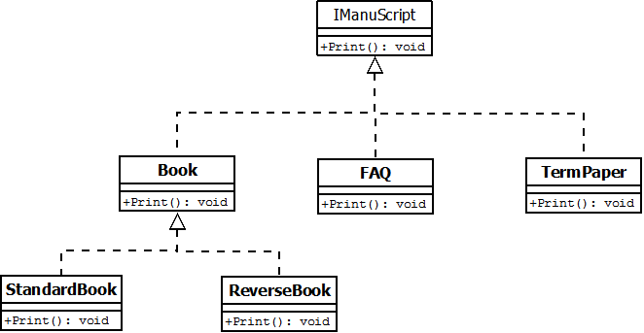
Add reverse book
New requirements:
„Print the book backwards”
https://github.com/esziger/design_patterns/tree/master/Bridge_Examples/BridgeExample_WrongSolution/
Notes:
Faq, book are all kinds of documents or manuscripts. These has different attributes.
Each has a Print.
If we would stick to this solution than we would have a large headachin the mantenance.
For a new formatting we have to create a new Book, faq and Termpaper fancy formatting version.
Print is an implementation of the IManuscript interface.
But what we want is to have an other level of abstraction.
We are going to create an abstraction for the implementation of formatting and that is going to take us to the Bridge pattern.

Slide 8
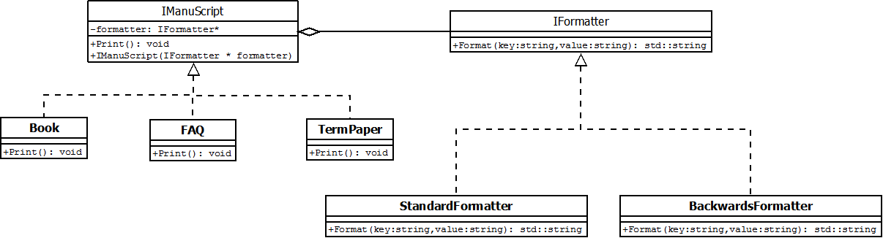
Reverse book - Bridge Example
Refactoring to Bridge Pattern
https://github.com/esziger/design_patterns/tree/master/Bridge_Examples/BridgeExample_BackwardsBook/
Notes:
What we really want is to force those who implements the IManuScript to tak a formatter.
If you are an ImanuScript, then you need to have a formatter.
Lets define a constructor in the IManuScript, which accepts a formatter.
We extended the abilitiy of a set of classes.
We successfully decouple the abstraction from the implementation.
We refer to the relationship between IManuScript an Iformatter as a bridge, because its bridges the abstraction and its implementation, and letting them vary independently.

Slide 9
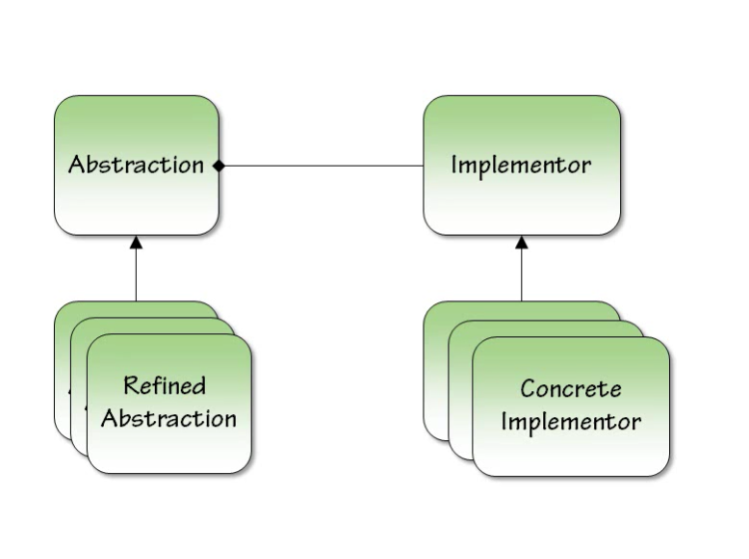
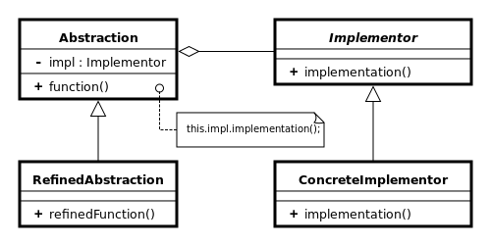
Bridge Pattern UML Diagram
Notes:
Abstraction in our example was the IManuscript.
That was a way to Print a document. That was the concept behind the abstraction.
Refined Abstraction implemented the IManuScript interface. We had a book a paper and a FAQ.
Implementor in our example is the formatter.
The Abstraction uses the implementor to implement the formatting of the book.
We didnt watn the formatter to be tide to the type of the manuscript. We didnt want that a book should have only one type of formatting, like standard or Reverse.
We didnt want to have all of these combination for every abstraction and every implementation.
Typically the
Implementor interface provides only primitive operations, and
Abstraction defines higher-level operations based on these
primitives.
Implementor have several ConcreteImplementor. This hieararchy allows us to create new IManuScript or new formatting and combining them together.
One thing with this Bridge pattern, you can play it multiple times. There are other aspects of the Manuscripts. We can have differnt type of Printers , or language.
We could bridge these implementations together, mix and match them to have our own customized implementation.

Slide 10
Applicability
Use the Bridge pattern when:
you want to avoid a permanent binding between an abstraction and its implementation. This might be the case, for example, when the implementation
both the abstractions and their implementations should be extensible by subclassing. In this case, the Bridge pattern lets you combine the different abstractions and implementations and extend them independently.n must be selected or switched at run-time.
(C++) you want to hide the implementation of an abstraction completely from clients.
you have a proliferation of classes as shown earlier in the first Motivation diagram. Such a class hierarchy indicates the need for splitting an object into two parts.

Slide 11
Consequences
Bridge pattern has the following consequences:
Decoupling interface and implementation. An implementation is not bound permanently to an interface. The implementation of an abstraction can be configured at run-time. It's even possible for an object to change its implementation at run-time.
this decoupling encourages layering that can lead to a better-structured system. The high-level part of a system only has to know about Abstraction and Implementor.
Improved extensibility. You can extend the Abstraction and Implementor hierarchies independently.
Hiding implementation details from clients. You can shield clients from implementation details, like the sharing of implementor objects

Slide 12
Common Usages
Persistence
Database persistence
Filesystem persistence
Streaming over the network persistence
User Interface
Multiplatform interfaces usually using the Bridge Pattern.
Notes:
Whatever type of persistence do you have you bridging the abstraction the ability to persist and the actual iplemntation of persistence.

Slide 13
Related Patterns
The Adapter pattern is geared toward making unrelated classes work together. It is usually applied to systems after they're designed. Bridge, on the other hand, is used up-front in a design to let abstractions and implementations vary independently.
Abstract Factory: can create and configura a particular Bridge.

Slide 14
Bridge in our Application
Results for searching to ”Bridge”:

Slide 15

Composite Pattern
Compose objects into tree structures to represent part-whole hierarchies. Composite lets clients treat individual objects and compositions of objects uniformly.(GOF)

Slide 16
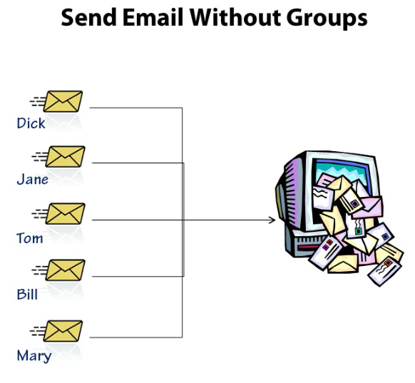
Real world example

Slide 17
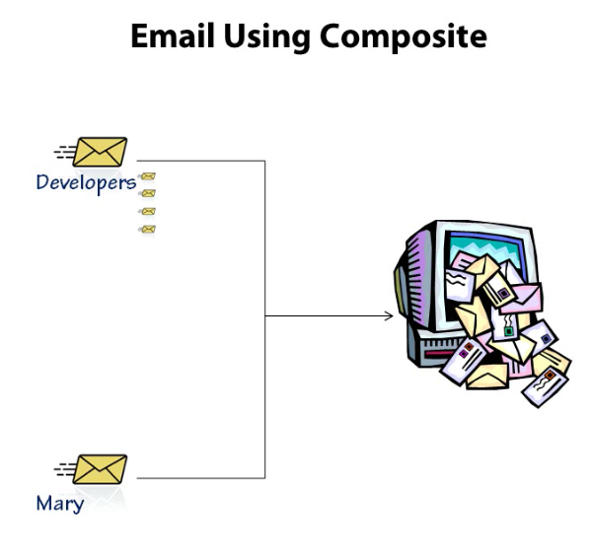
Real world example

Slide 18
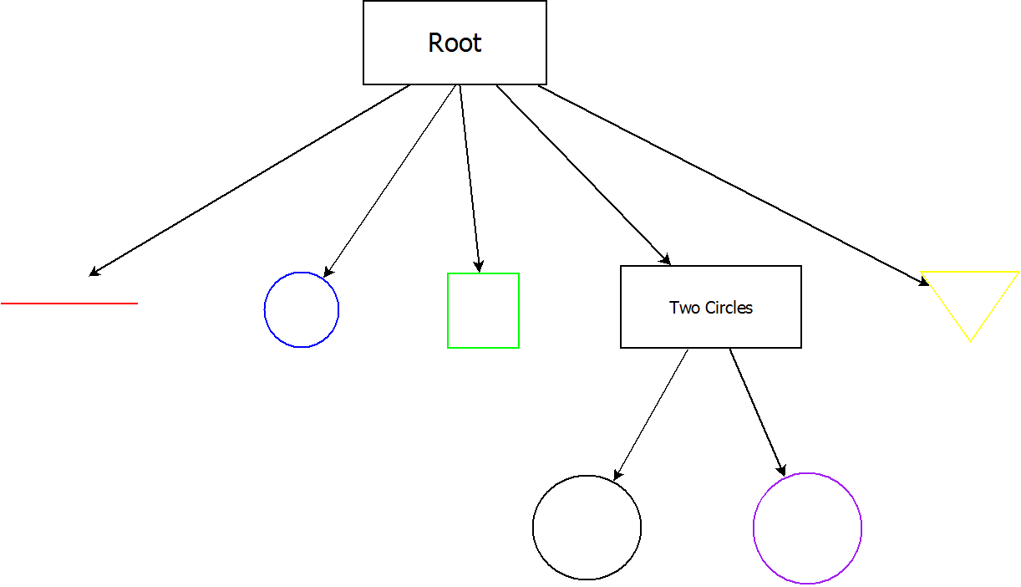
Composite Example
https://github.com/esziger/design_patterns/tree/master/Composite_Examples/Composite_Drawing_example
Notes:
First thing for the composite pattern is an interface which the person and the group will implement.
We have to treat a group as like a person.
One person can be a party or a group of people can be a party.
We can create a tree as many level of depth as we want. The logic is still going to work.
We can treat the group as an individual.
We put the differences in the group and the person class. So our main proem doesnt have to know about the differences.
It doesnt matter that is it a leaf or a composite.

Slide 19
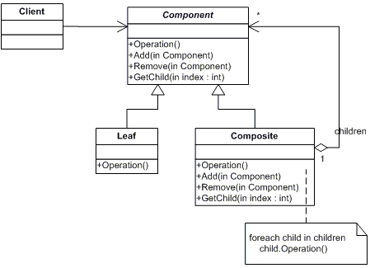
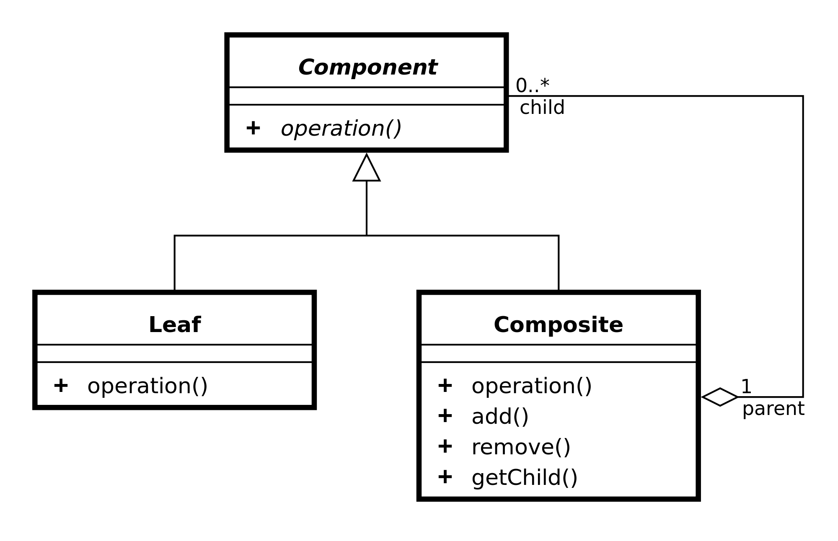
UML diagram
Notes:
Component is an interface.
It declares the interface for objects in the composition.
It also declares the interface for accessing and managing its child components.
Component will treat the composite and the leaf as the same.
Leaf represents leaf objects in the composition. Leaf has no child.
Leaf defines behaviour for primitive objects.
Composite will contains a list of components, which can be a leaf or a composite as well.
Composite needs to handle its children, so it defines a behavior for components having children.
Stores child components.
Usually Composite will implement methods by delegating to the children.
The client simply uses the Component interface to manipulate the objects. Clients will treat all objects in the composite structure uniformly.

Slide 20
When to use
Represent objects in a hierarchical fashion.
Need objects and composites to be treated uniformly.
Groups or collections
Can you add an interface?
In case of tree structure (like menu system)
Anything that can be modelled as a tree structure can be considered an Example of Composite, lsuch an organization chart.
Graphics frameworks : The base Graphic object provides the base class for all other graphic objects, such as Line, Rectangle, which provide their own implementations of the paint()/draw() method.
Distribution (e.g: distributing gold in a party)
Notes:
You should think like:
Can I add some kind of interface to theat group thats going to let me treat that group of things as one individual thing.
Mixed groups.
Can I simplify navigiating through the tree by using composite?

Slide 21
Consequences
Defines class hierarchies consisting of primitive objects and composite objects. Primitive objects can be composed into more complex objects, which in turn can be composed, and so on recursively.
Wherever client code expects a primitive object, it can also take a composite object.
makes the client simple. It avoids having to write tag-and-case-statement-style functions over the classes that define the composition.
makes it easier to add new kinds of components.
Newly defined Composite or Leaf subclasses work automatically with existing structures and client code.
Clients don't have to be changed for new Component classes.

Slide 22
Trade-off
Violates the Single-Responsibility principle, since it allows us to treat both nodes and leafs in the same way.
It can make your design overly general. The disadvantage of making it easy to add new components is that it makes it harder to restrict the components of a composite. Sometimes you want a composite to have only certain components. With Composite, you can't rely on the type system to enforce those constraints for you. You'll have to use run-time checks instead.
Notes:
Composite is a collection of Component objects where any of these objects can be a composite or a leaf.

Slide 23
Related Patterns
Often the component-parent link is used for a Chain of Responsibility
Decorator is often used with Composite. When decorators and composites are used together, they will usually have a common parent class. So decorators will have to support the Component interface with operations like Add, Remove, and GetChild.
Iterator can be used to traverse composites. E.g.: when child ordering is important, we can use iterator pattern.

Slide 24
References
Design Patterns: Elements of Reusable Object-Oriented Software (1994)
Head First Design Patterns
PluralSight – Design Patterns Library

Slide 25
Q&A

