Slide 1
Information visualization 3. assignment
Wiener Linien Representation
Johannes Brand
Eszter Horváth

Slide 2
Data from Wiener Linien
Viennese Open Data platform: https://digitales.wien.gv.at/open-data/
Wiener Linien API: Fair use, accessed via Flask and displayed in frontend
Different queries possible such as traffic information, station monitor or routing
Response as JSON and fully OSM compatible
The base map is a query from OSM using the Overpass API

Slide 3
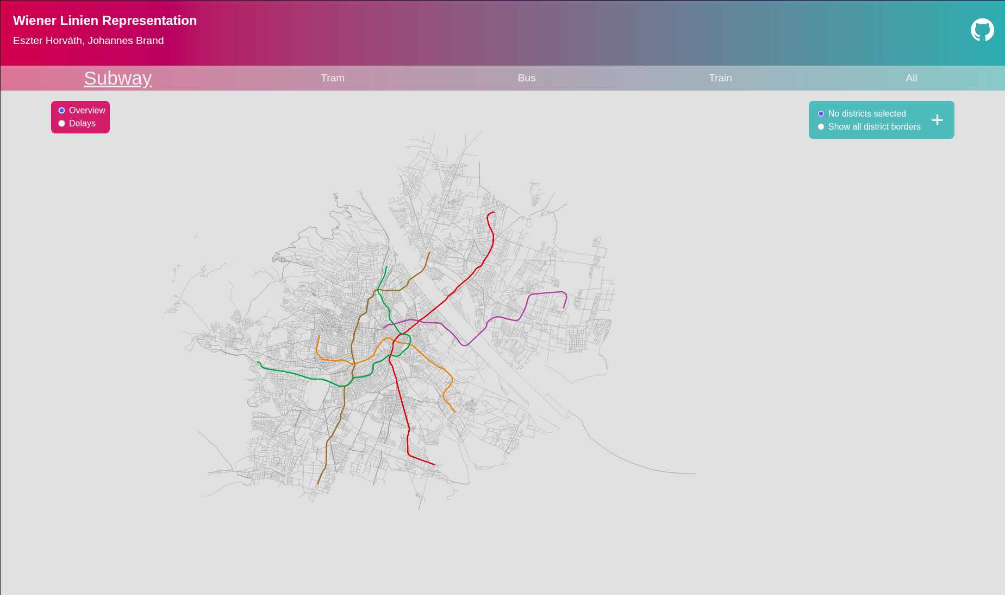

Slide 4
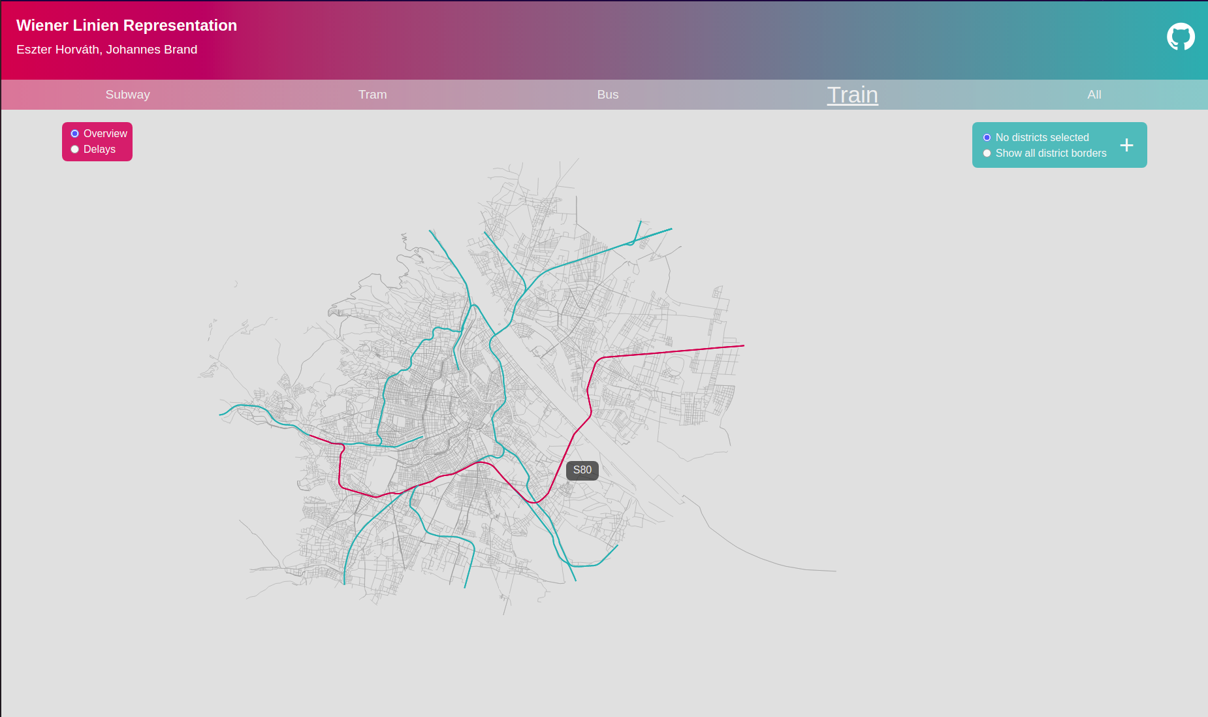

Slide 5
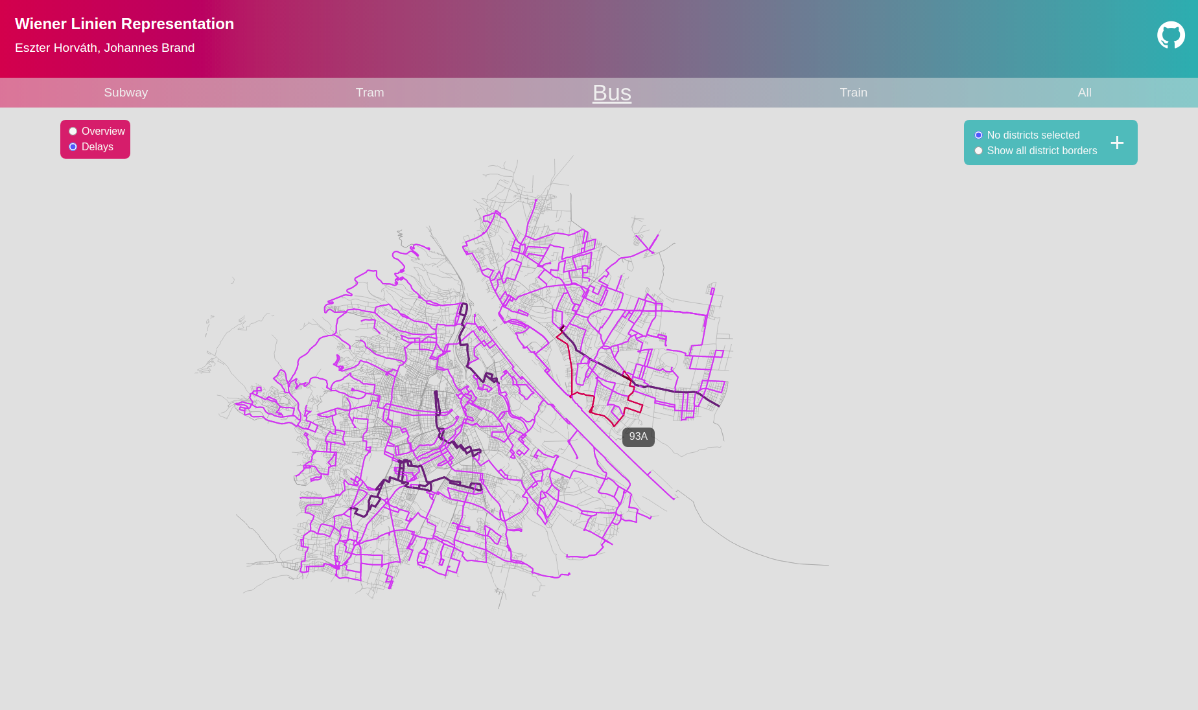

Slide 6
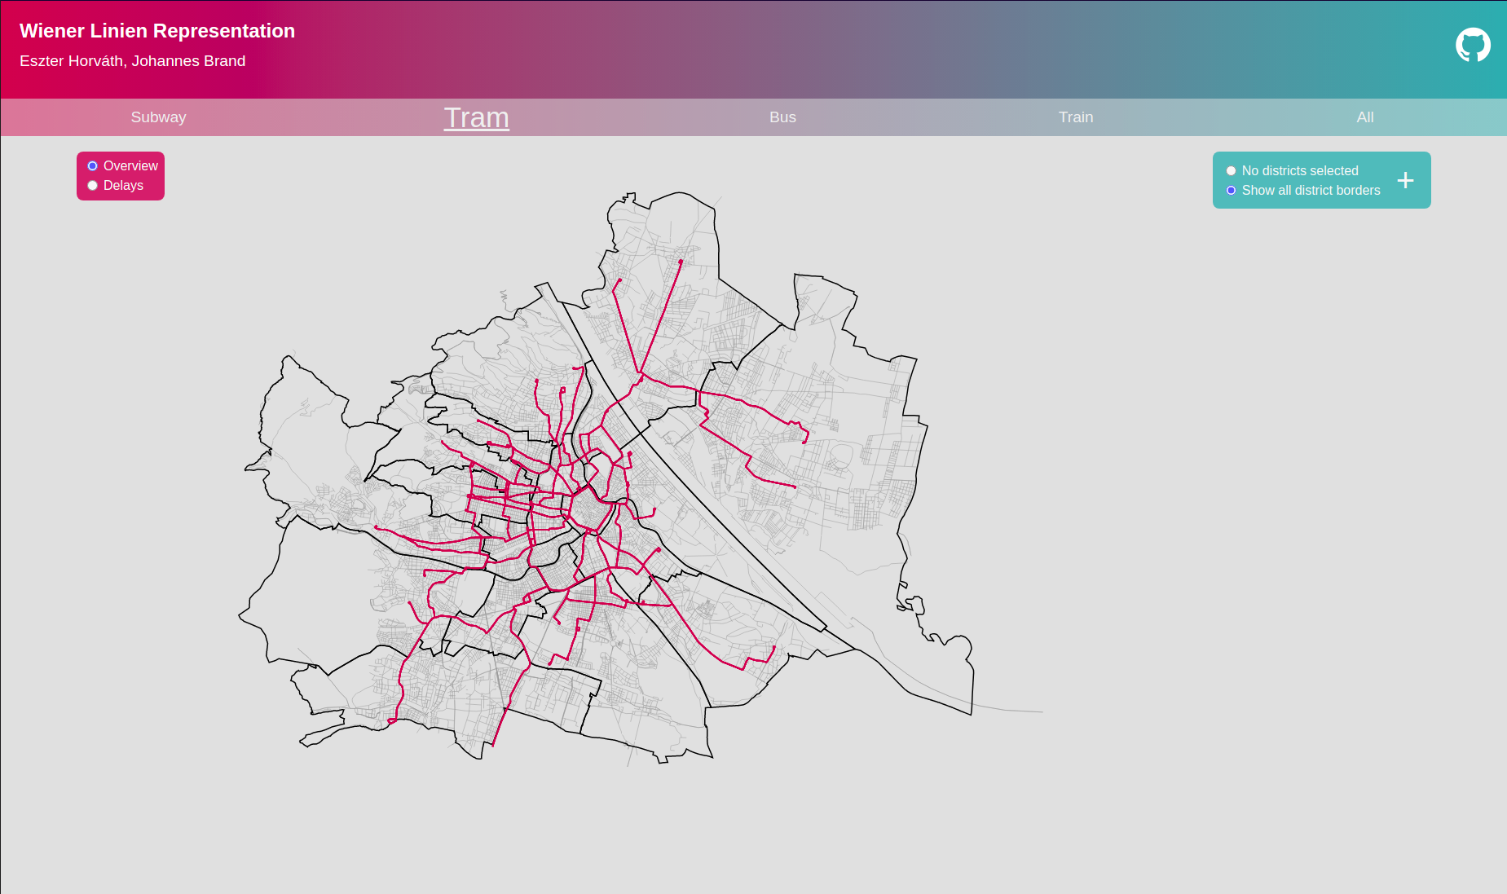

Slide 7
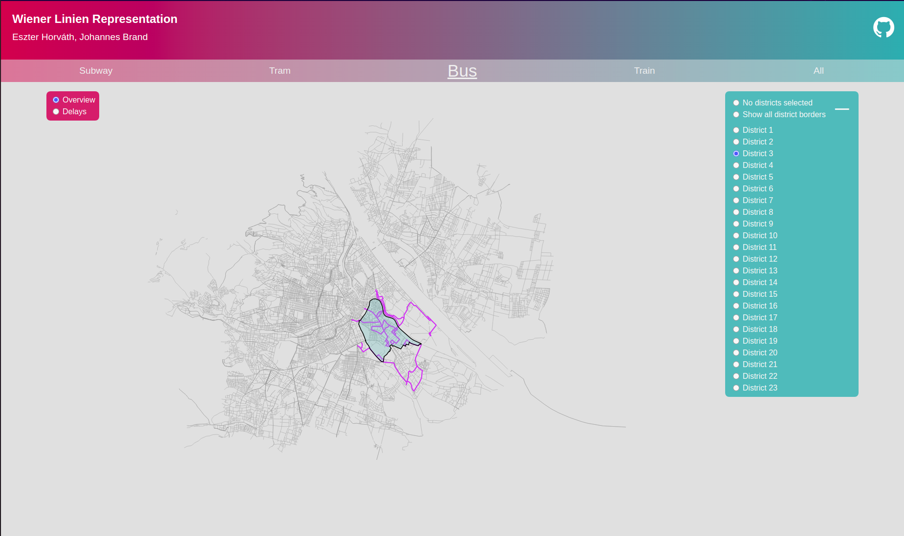

Slide 8
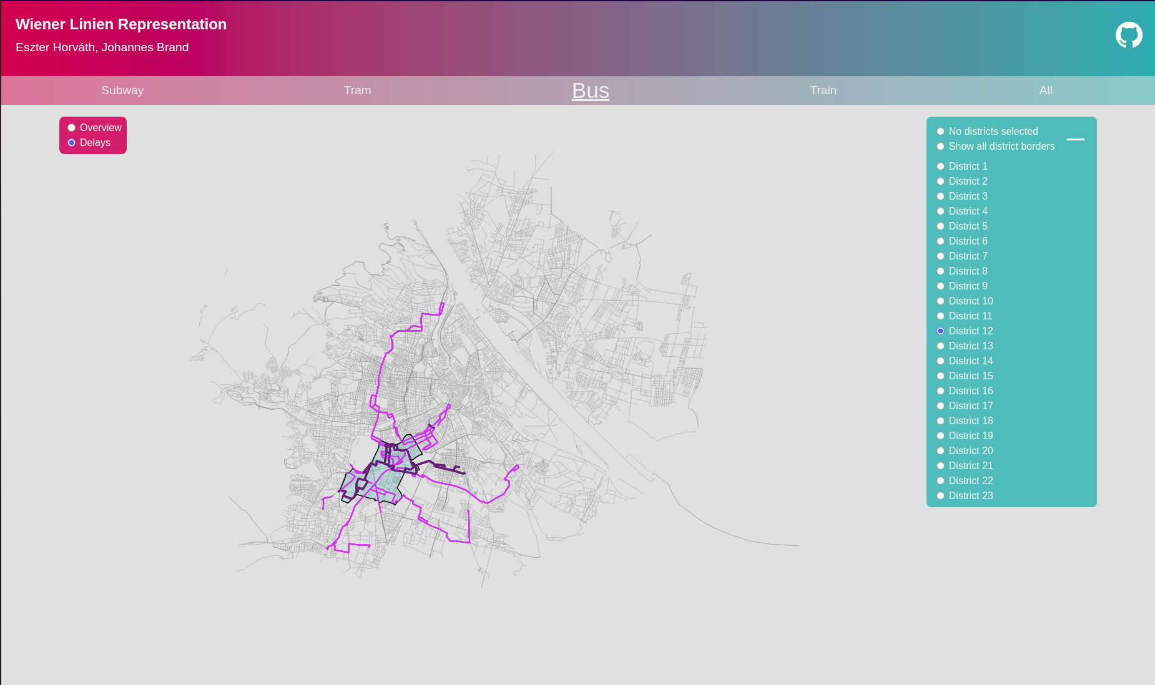

Slide 9
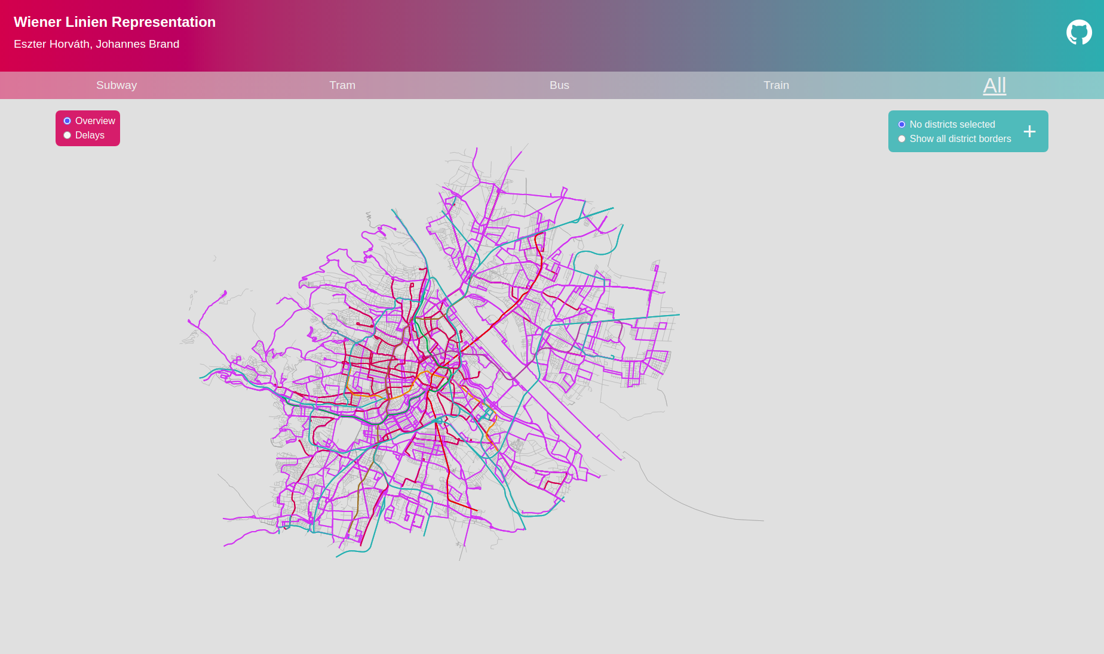

Slide 10
Thank you for your attention!

