Slide 1
Money In Education
Sara McCarthy
Nicholas Scope
Andrew Carr
Tzu-Hao Peng
CSC672
Predictive Analytics Capstone
Milestone 5

Slide 2
Task at Hand
Produce a comprehensive analysis of the Illinois educator compensation system and a predictive model that will help determine which variables have the greatest influence on compensation.
Assess fairness in educator compensation.

Slide 3
Goals
Perform Exploratory Data Analysis.
Develop models for salary prediction and classification.
Identify which variables are influencing salary.
Assess fairness in the compensation system.

Slide 4
Initial Data
Raw Data
~1.6 million instances
Data collected from 2003-2012
Each instance represents a teacher in a specific year
62 features
Numerical and Categorical
Some features are descriptors of other features

Slide 5
Preprocessing

Slide 6
Cleaning
Filled in all blank Genders (6)
Removed all instances with blank location data (54)
Dropped column ‘Status’ (All were active)
Dropped one column in cases where two columns said the same thing
Renamed remaining columns

Slide 7
Filtering
Removed instances with:
No district or school number (42)
$0 salary (7,882)
Salary < $20,000 (3,501)
Part Time (47,617)
Employed less than 9 months (20,643)
Greater than 75% administration (100,147)
Outside IL (20)
5 high outlier salaries (5)

Slide 8
New Features
‘Assignments’
Total # of non blank assignment columns per instance
Up to 7 job assignments per instance
‘School_ID’
Each school was assigned a unique identifier
‘Teacher_ID’
Each teacher was assigned a unique identifier

Slide 9
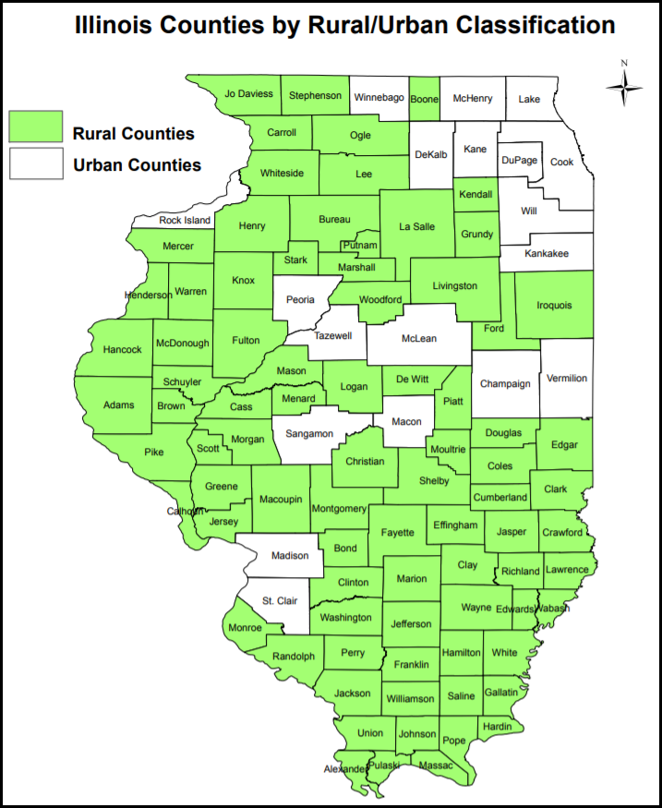
New Features
‘School_County’
(102)
‘Urban_or_Rural’
19 Urban Counties
740,224 instances
83 Rural Counties
233,168 instances
Notes:
Rural is defined as a county not part of a metropolitan statistical area (MSA), as defined by the U.S. Census Bureau; or a county that is part of a MSA but has a population less than 60,000.
Information from the Illinois Critical Access Hospital Network

Slide 10
New Features
‘Primary_Assignment_Group’: Recast 200+ Job Titles from ‘Primary_Assignment’ into 12 categories:
Administration 13,008
Business/Trade 28,651
Elective 154,739
Facilities 5,528
Foreign Language 70,074
General Education 457,349
Language Arts 152,971
Librarian 19,702
Social Studies 60,699
Special Education 186,645
STEM 189,824
Student Support 105,557

Slide 11
Feature Mapping
‘Race’
Due to differences in the way race was recorded, we group them into new classifications:
White 1,228,420
Black 124,591
Hispanic 64,390
Asian or Pacific Islander 16,907
Native American 2,329
Multiple 2,182

Slide 12
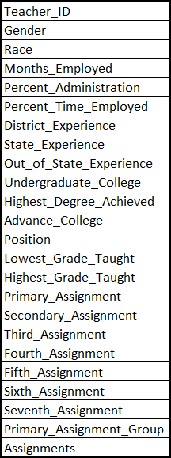
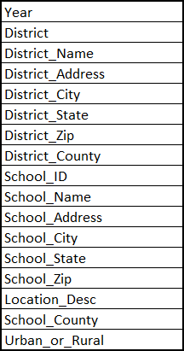
Final Data
41 variables
Year
16 based on school /district / location
24 based on educator role / qualifications

Slide 13
Exploratory Data Analysis

Slide 14
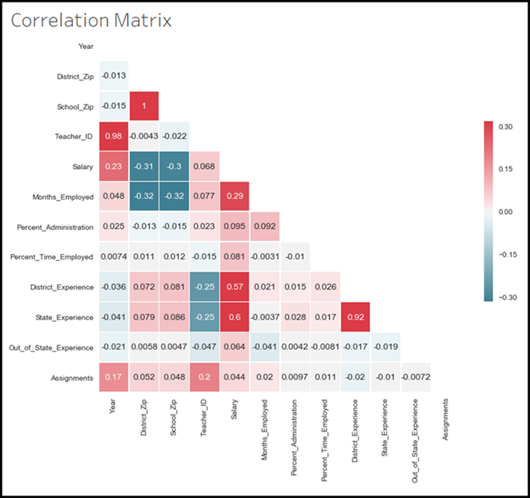

Slide 15
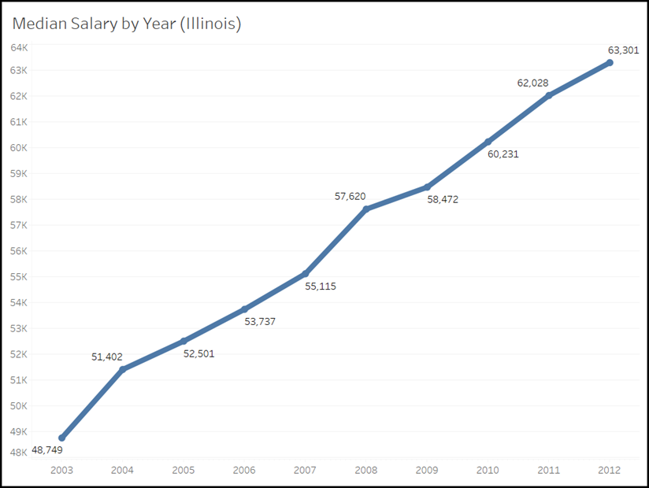

Slide 16
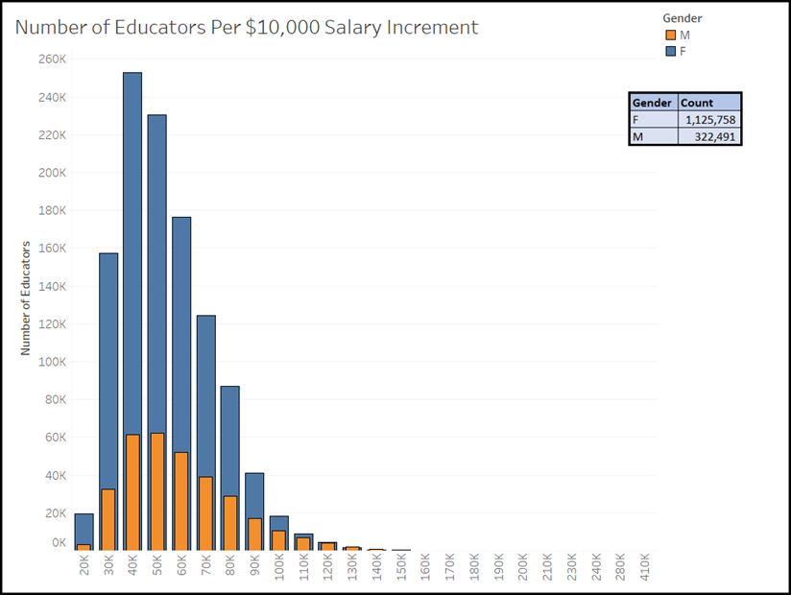

Slide 17
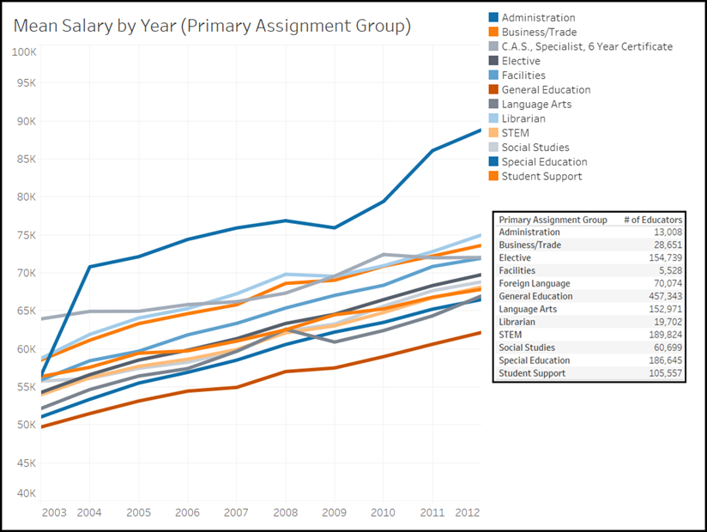

Slide 18
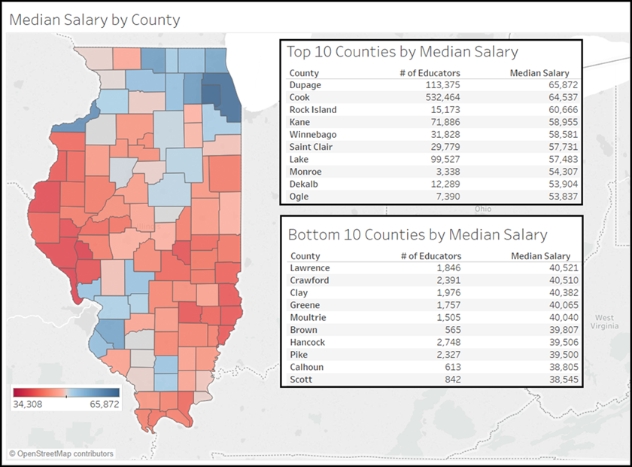

Slide 19
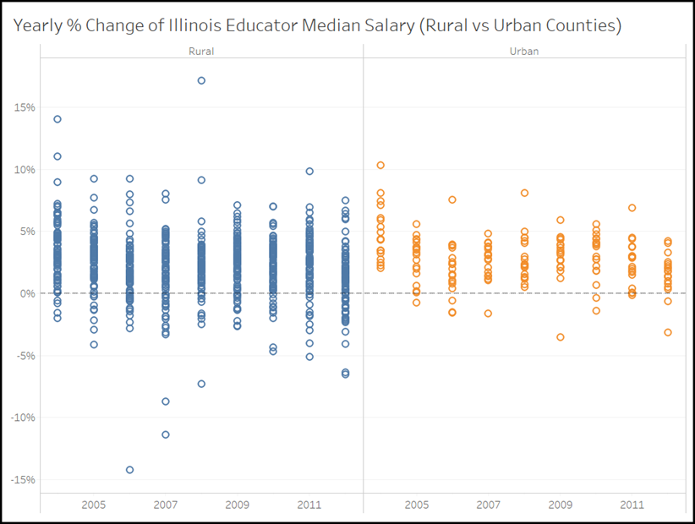

Slide 20
Linear Model

Slide 21
Final Model
Year
Percent_Administration
State_Experience
Out_of_State_Experience
Gender
Race
Highest_Degree_Achieved
Primary_Assignment
District_County

Slide 22
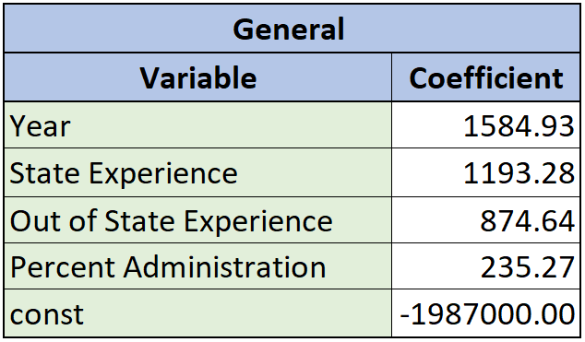
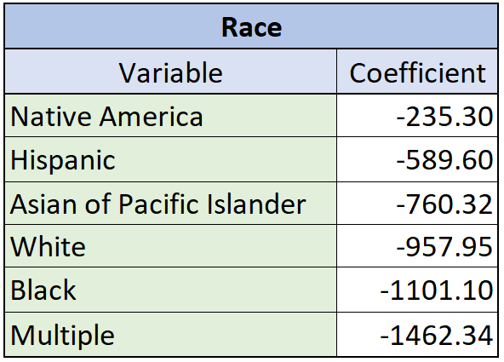
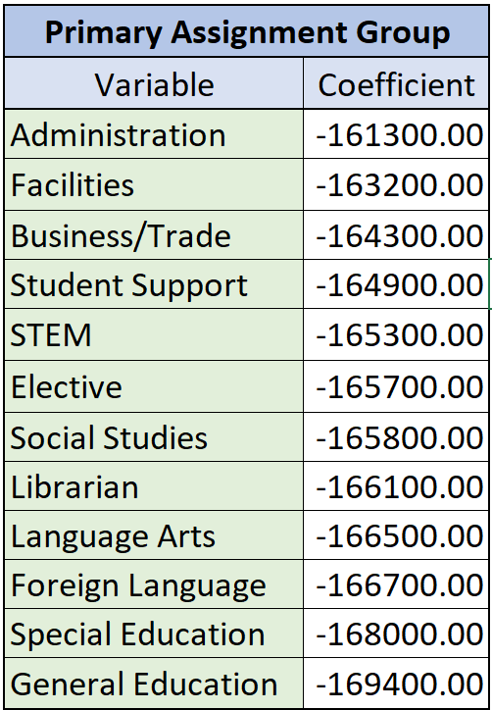
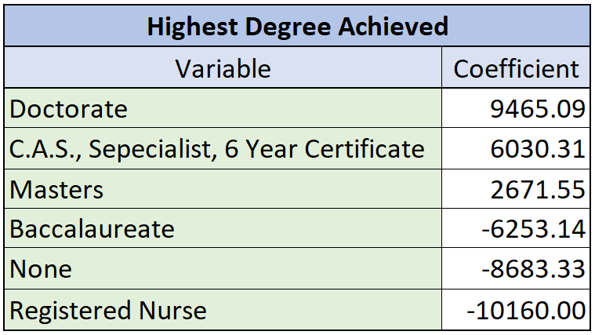
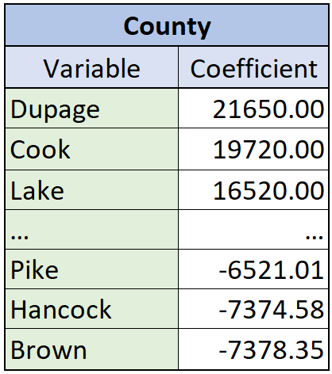
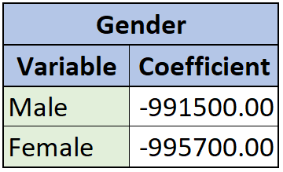
Final Model

Slide 23
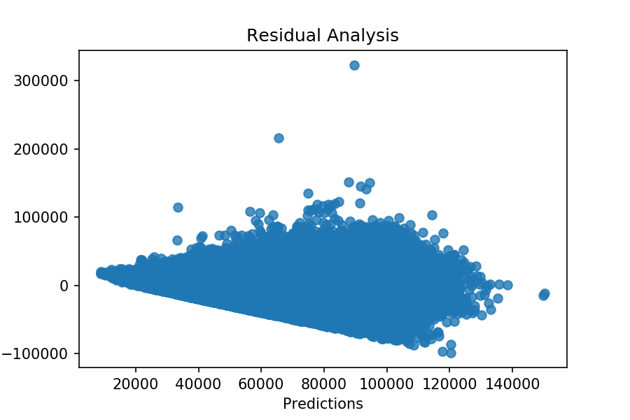
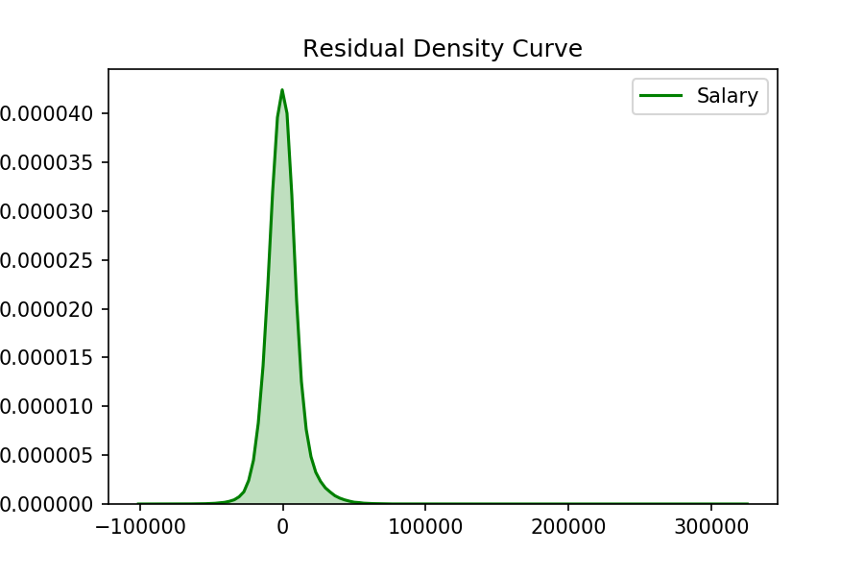
Linear Model - Residuals

Slide 24
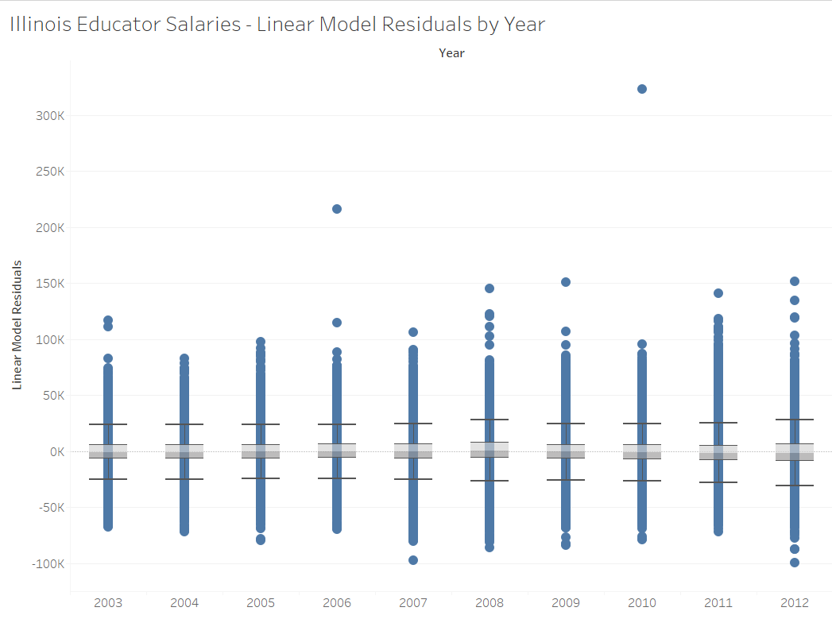

Slide 25
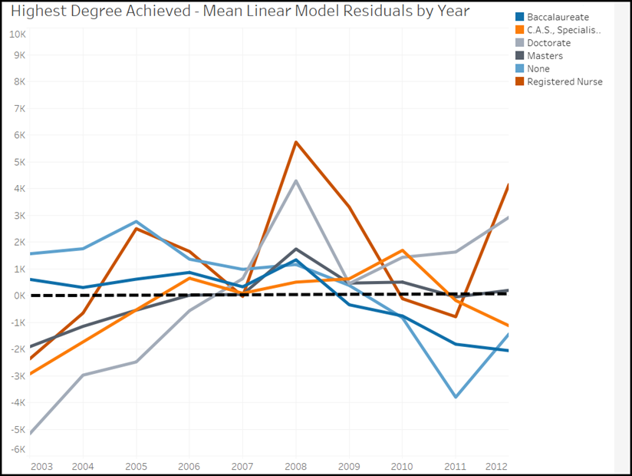

Slide 26
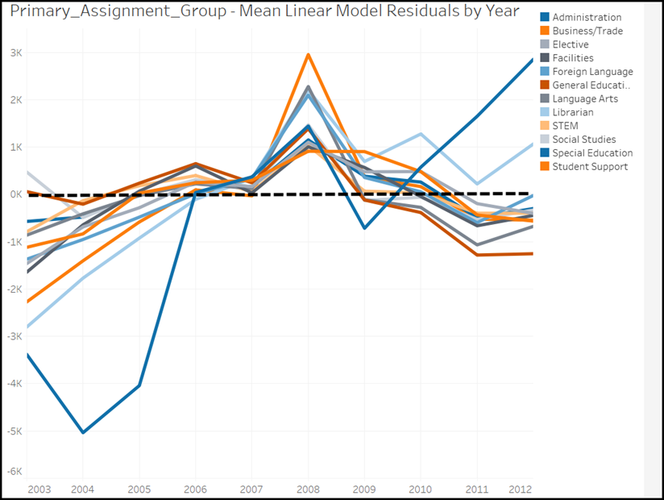

Slide 27
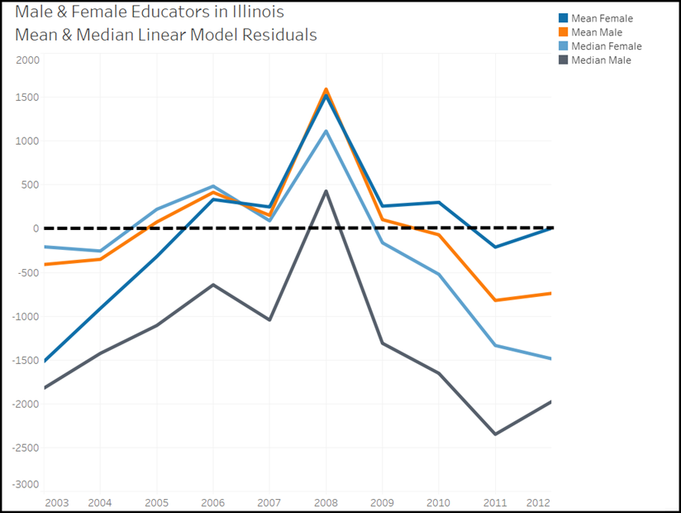

Slide 28
Classification Models

Slide 29
Feature Selection
Percent_Administartion
State_Experience
Out_of_State_Experience
Gender
Race
Highest_Degree_Achieved
Primary_Assignment_Group
District_County
Urban_or_Rural
323 Features in Non Feature Selected models
134 in Feature Selected
That’s over 50% reduction in feature space

Slide 30
Class Bins
2 Classes
3 Classes
2 Class Distinction created via kmeans clustering
0 : Salaries > $65,530.92
1 : Salaries <= $65,530.92
3 Class Distinction created via kmeans clustering & Intuitional Separation
0 : Salaries >= $65,530.92
1 : $65,530.92 > Salaries < $100,000.00
2 : Salaries >= $100,000.00

Slide 31
Class Balancing
2 Classes
3 Classes
Straight Under Sampling
0 : 491,129 Instances
1 : 953,618 Instances
Balanced to 491,129 each
Straight Under Sampling
0: 953,618 Instances
1: 431,294 Instances
2: 59,835 Instances
Balanced to 59,835 each

Slide 32
Decision Tree - Exploratory
Results on Testing
Naive-Bayes fails at this classification problem
Decision Trees are explainable and controllable
Parameter turning via GridSearchCV
2-Class & 3-Class: Criterion = ‘gini’ Minimum Split = 100
Metrics | No Feature Selection 2-Class | Feature Selection 2-Class | No Feature Selection 3-Class | Feature Selection 3-Class
Accuracy | 0.88 | 0.85 | 0.79 | 0.75
Precision | 0: 0.87 1: 0.88 | 0: 0.83 1: 0.87 | 0: 0.85 1: 0.69 2: 0.83 | 0: 0.84 1: 0.64 2: 0.76
Recall | 0: 0.89 1: 0.86 | 0: 0.88 1: 0.83 | 0: 0.84 1: 0.70 2: 0.83 | 0: 0.81 1: 0.61 2: 0.81

Slide 33
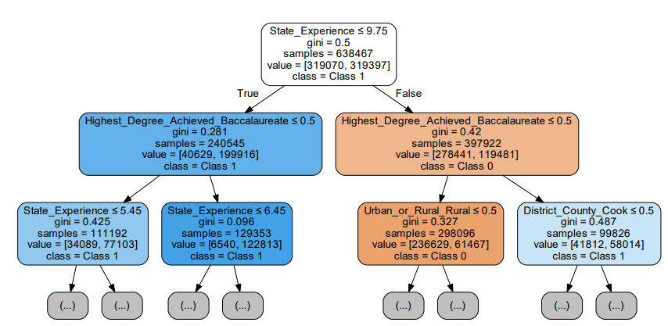
2 Class Feature Selected Decision Tree Visual

Slide 34
Random Forest
Results on Testing
Random Forest performed the best with the least overfitting and least computational cost
A comparison of results on non-feature selected data vs. final features
# of Estimators FS: 10, 15
# of Estimators non-FS: 10, 10
Train test split of 35% test yielded a nearly even split between all classes
Metrics | No Feature Selection 2-Class | Feature Selection 2-Class | No Feature Selection 3-Class | Feature Selection 3-Class
Accuracy | 0.89 | 0.85 | 0.81 | 0.74
Precision | 0: 0.87 1: 0.91 | 0: 0.84 1: 0.86 | 0: 0.85 1: 0.72 2: 0.86 | 0: 0.83 1: 0.63 2: 0.75
Recall | 0: 0.92 1: 0.87 | 0: 0.87 1: 0.83 | 0: 0.86 1: 0.71 2: 0.85 | 0: 0.81 1: 0.60 2: 0.78

Slide 35
SVM - Hard to Classify Instances
Run on only 3-Class Problem due to computational cost
Similar or slightly better results on accuracy, precision, and recall than Random Forest model - but much more computationally costly
Less than 4% of the support vectors included teachers with any administrative duties
There were:
13,854 instances for Class 0
29,780 instances for Class 1
17,429 instances for Class 2
Percentage Female:
Class 0: 77%
Class 1: 73%
Class 2: 68%
Percentage Minority was approx. 15% for all classes
Metrics | No Feature Selection 3-Class | Feature Selection 3-Class
Accuracy | 0.80 | 0.75
Precision | 0: 0.89 1: 0.71 2: 0.82 | 0: 0.85 1: 0.63 2: 0.75
Recall | 0: 0.84 1: 0.71 2: 0.86 | 0: 0.81 1: 0.61 2: 0.82

Slide 36
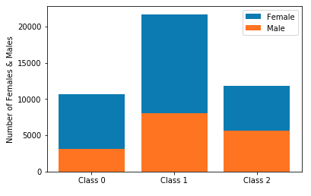
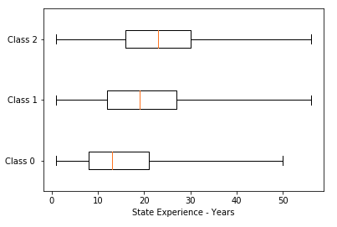
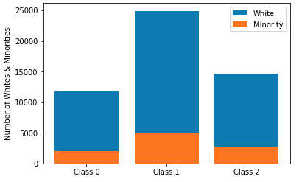
Hard to Classify Instances
Distributions of Assignments and Percent_Admin were the same across all three classes.
Hard to classify instances were typically of female employees with high levels of in-state experience

Slide 37
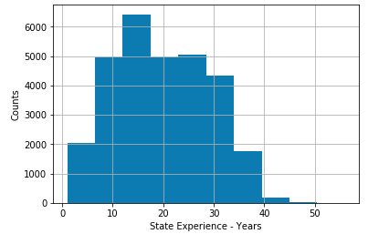
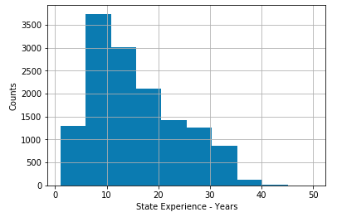
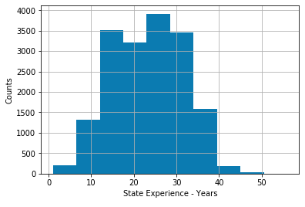
Hard to Classify Instances - State Experience
Experience Distribution - Class 1
Experience Distribution -Class 0
Experience Distribution - Class 2

Slide 38
Bayesian Network

Slide 39
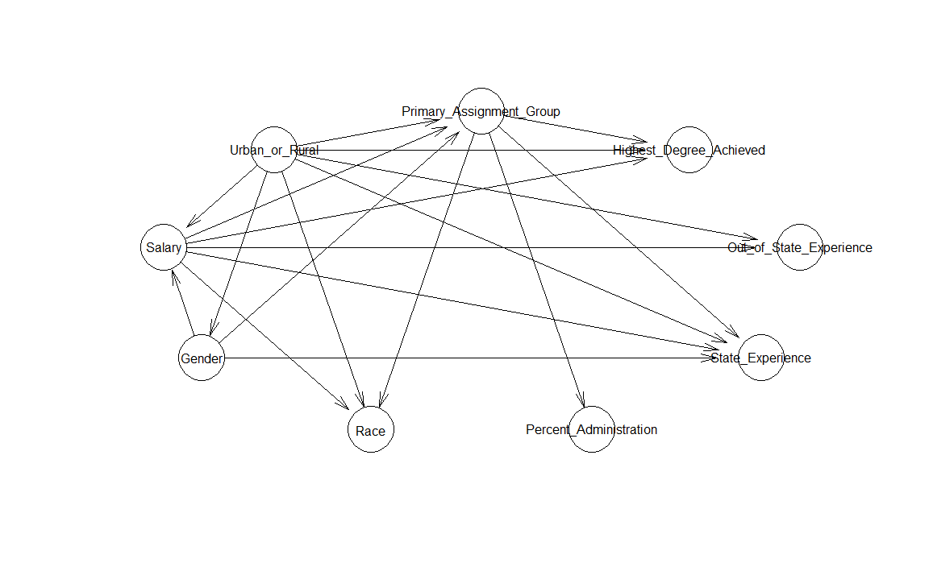
Notes:
From Bayesian Networks, I am using the variables which was selected from our linear model to do the analysis, try to see the conditional probability between target variable(salary) and other variables. Before the analysis, I was trying to bin some variables such as Salary, Urban or Rural, State experience, & Out of state experience and removed some variables which cannot be binning such as Year & District County. After data preprocessing, the Bayesian Network plot is above, there are some grouping between each variables. I’ll make a summary of each groups in the next slide.

Slide 40
Conditional Dependency
Salary*
Gender & Urban_or_Rural
Primary_Assignment_Group
Urban_or_Rural, Salary, & Gender
Highest_Degree_Achieved
Primary_Assignment_Group, Urban_or_Rural, & Salary
Out_of_State_Experience
Urban_or_Rural & Salary
State_Experience
Primary_Assignment_Group, Urban_or_Rural, Salary, & Gender
Race
Salary, Urban_or_Rural, & Primary Assignment Group
Notes:
From the plot, we could see the conditional dependency between each variables. From the salary node, salary is connected with gender & urban_or_rural. Primary assignment group is connected with urban or rural, salary, & gender. Highest degree achieved is connected with primary assignment group, urban or rural, & salary. Out of state experience is connected with urban or rural & salary. State experience is connected with primary assignment group, urban or rural, & gender. Race is connected with salary, urban or rural, & primary assignment group. Because our target variable is salary, so we are only going to analysis the connection in salary node.

Slide 41
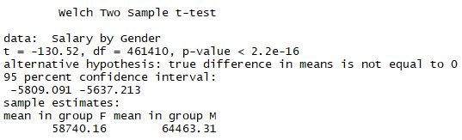

T-test & ANOVA
Statistically significant difference in means
p-value < 0.05
Significant relationship between
Salary & Gender
Salary & Urban_or_Rural
Valid model
Notes:
Before the further analysis between salary and gender and salary and urban or rural, we have to perform t-test and ANOVA test to see if our model is significant. I’ve performed t-test between salary and gender, and performed ANOVA test between salary and urban or rural. And the result is above, both tests are statistically significant difference in means with p-value < 0.05. So there is a significant relationship between salary & gender and salary & urban or rural. It is a valid model. We could use it to further our analysis.

Slide 42
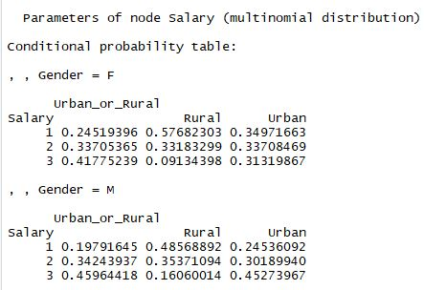
Conditional Probability Table - Salary node
Low Salary in Rural
Female: 57.68%
Male: 48.57%
Salary is equally distributed for Female in Urban
Low: 34.97%
Middle: 33.71%
High: 31.32%
High Salary for Male in Urban(45.27%) than Female(31.32%)
Notes:
After testing the significant, I created the conditional probability table in salary node. From the table, we could see that there is low salary in rural(57.68% for female and 48.57% in male). Salary is equally distributed for female in urban(low: 34.97%, middle: 33.71%, and high: 31.32%) and high salary for male in urban(45.27%) than female(31.32%).

Slide 43


Salary vs Gender &
Salary vs Urban_or_Rural
Salary vs Gender
Male’s Salaries are higher than Females
Female’s Salaries are equally distributed
Male: Low(27.56%) High(40.73%)
Female: Low(35.14%) high(31.35%)
Salary vs Urban_or_Rural
Rural Salaries are lower than Urban’s
Urban Salaries are equally distributed
Rural: Low(55.61%) High(11.30%)
Urban: Low(33.48%) High(34.84%)
Notes:
Next, we are going to see it individually, so I created the conditional probability table between salary vs gender and salary vs urban or rural. From the table between salary vs gender, male’s salaries are higher than females. Female’s salaries are equally distributed. There is a rising trend in male’s salaries(low: 27.56% to high: 40.73%), however, there is a declining trend in female’s salaries(low: 35.14% to high: 31.35%).
From the table between salary vs urban or rural, rural’s salaries are lower than urban’s. Urban’s salaries are equally distributed. There is a declining trend in rural salaries(low: 55.61% to high: 11.30%), however, there is a rising trend in urban’s salaries(low: 33.48% to high: 34.84%).
In conclusion, the target variable salary is conditioned on gender & rural or urban. Female teachers who teaching in rural are having the highest conditional probability in low salaries(over 50%) and the lowest in high salary(not over 10%). Male’s salaries are higher than females, and urban salaries are higher that rural.

Slide 44
Influential Features

Slide 45

Influential Features
Year
Percent_Admistration
State_Experience
Out_of_State_Experience
Gender
Race
Highest_Degree_Acheived
Primary_Assignment_Group
County
Urban_or_Rural

Slide 46
Fairness Assessment

Slide 47
Gender

Slide 48
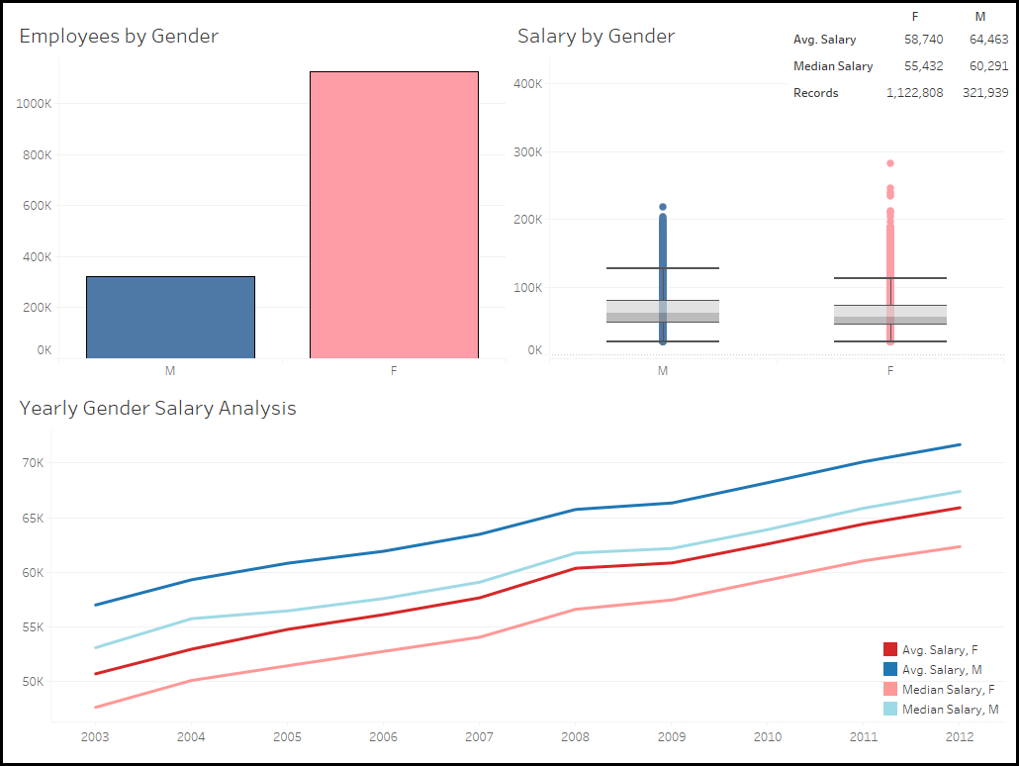
Notes:
· Females outnumbers males nearly 4 to 1
· Each year in the data both the mean and median male salaries are higher than those of female
· Point to slide and point out differences – you can see that it is getting better but there is still disparity – 10-11% in 2003 and 7.5-8% 2012.

Slide 49
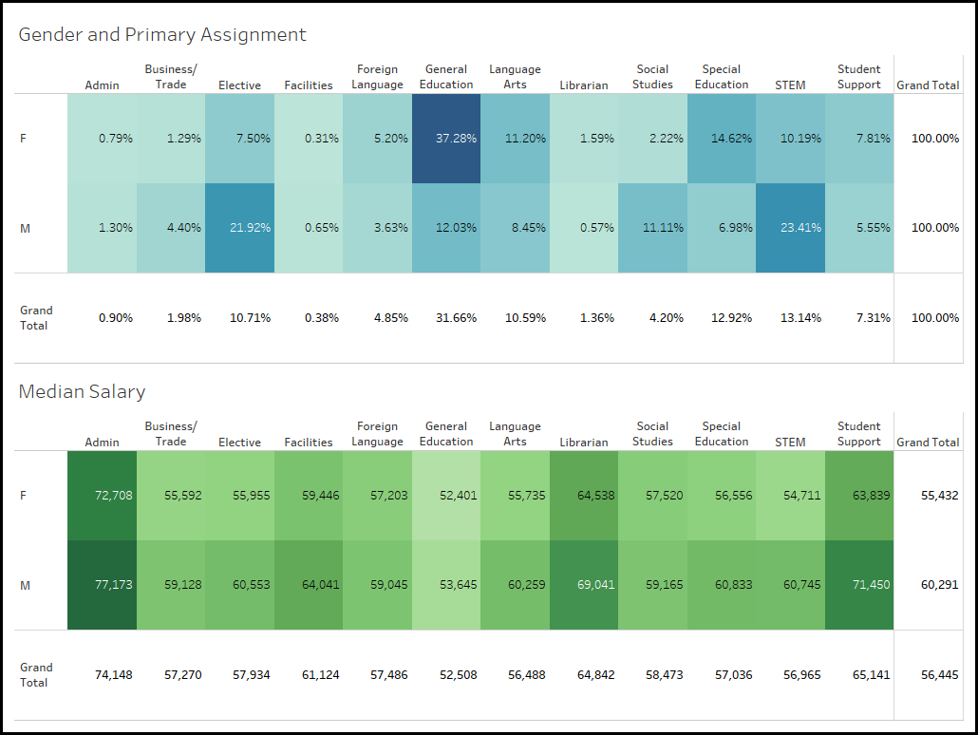
Notes:
· Top Table – shows the distribution of Primary Assignment Group for each gender
o Females are more likely to be General Education than any other group
o Males are more likely to be STEM and Elective than any other group
· Bottom Table – shows the median salary of each Primary Assignment Group for each Gender
o Males make more in every category – anywhere from $1.5k (Social Studies) to $8K (Student Support – example: counselor)

Slide 50
Race

Slide 51
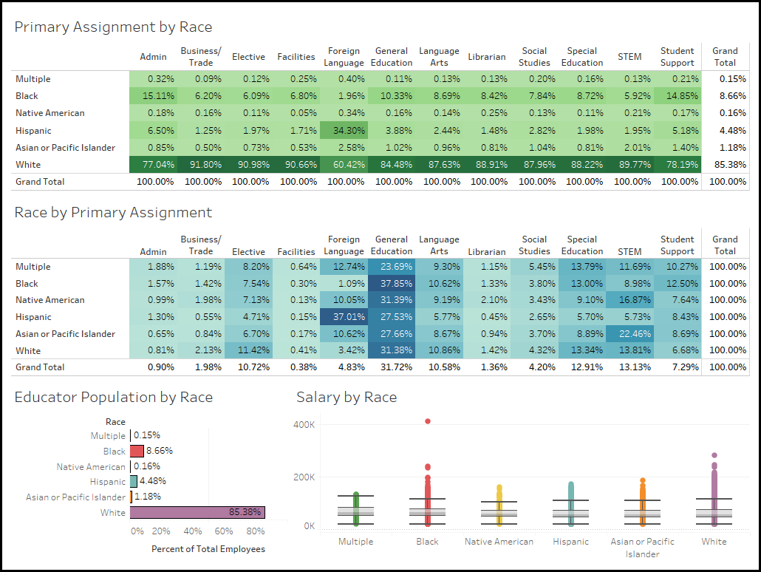
Notes:
· Top Table – shows the distribution of the Races across the Primary Assignment Groups
o Due to whites being the largest group, the make up the majority of all assignments
o Standout is Hispanic for foreign language, black is second highest for remaining categories
· Bottom Table – shows the distribution of Primary Assignment Groups for each Race
o For each Race
§ Highest % is general education for all except Hispanic (foreign language)
§ Foreign language has the most variety
o Black and multiple more student support than other races
o If you are Asian you are next likely to be STEM after general ed
· Note all items are sorted highest to lowest by median salary of race for the whole dataset – whites make the least median

Slide 52
Primary Assignment Group

Slide 53
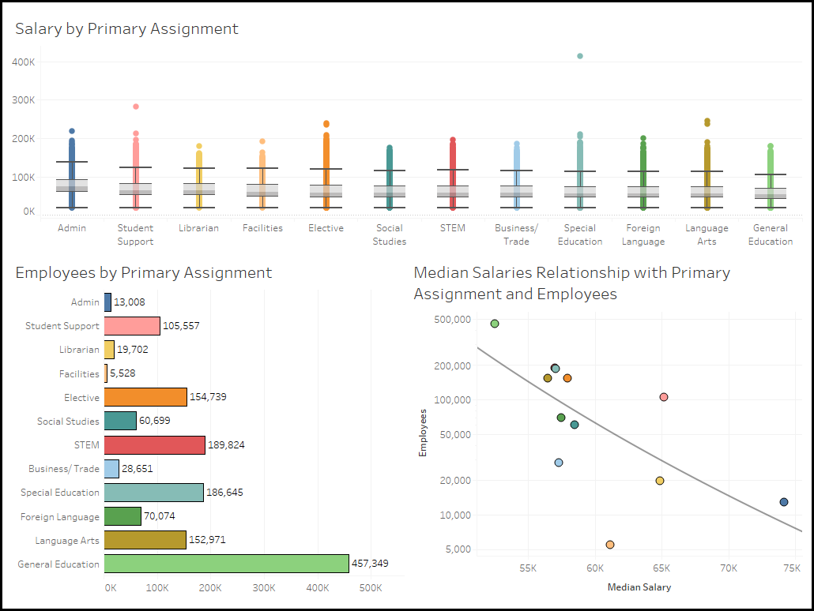

Slide 54
Location

Slide 55
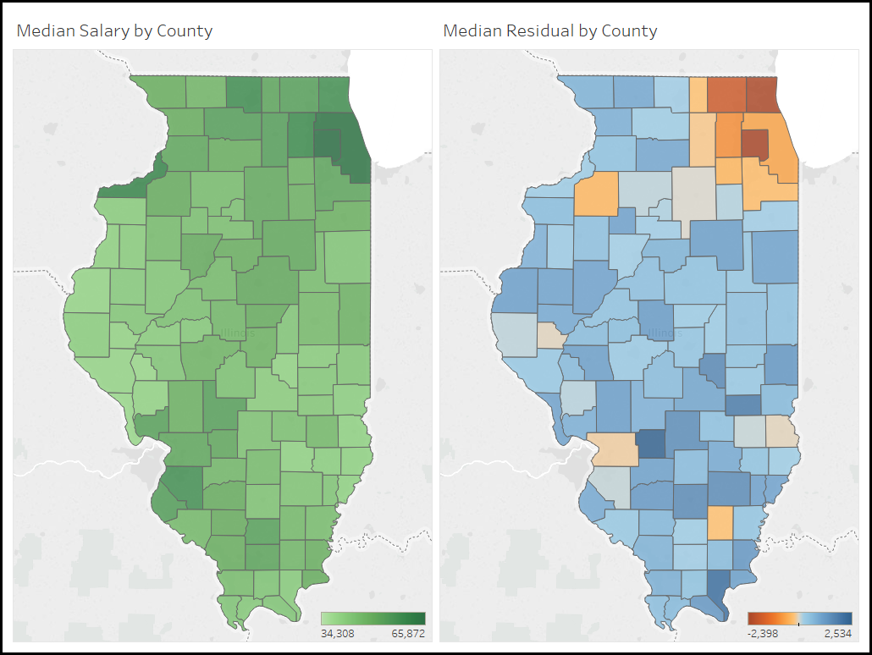

Slide 56
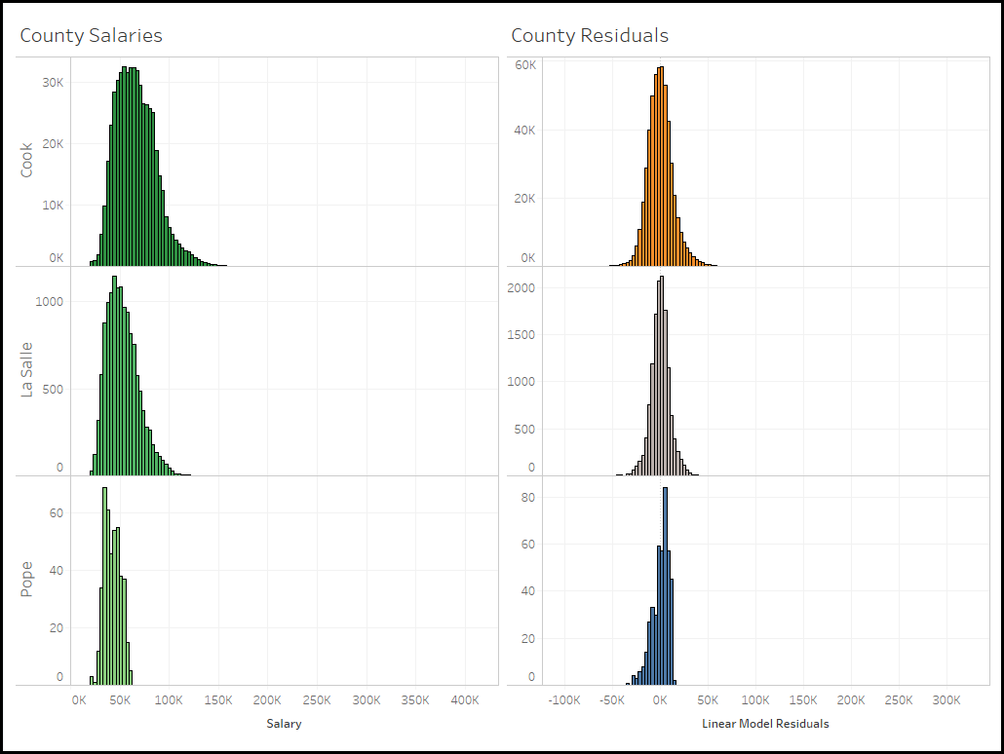

Slide 57
Highest Degree Achieved

Slide 58
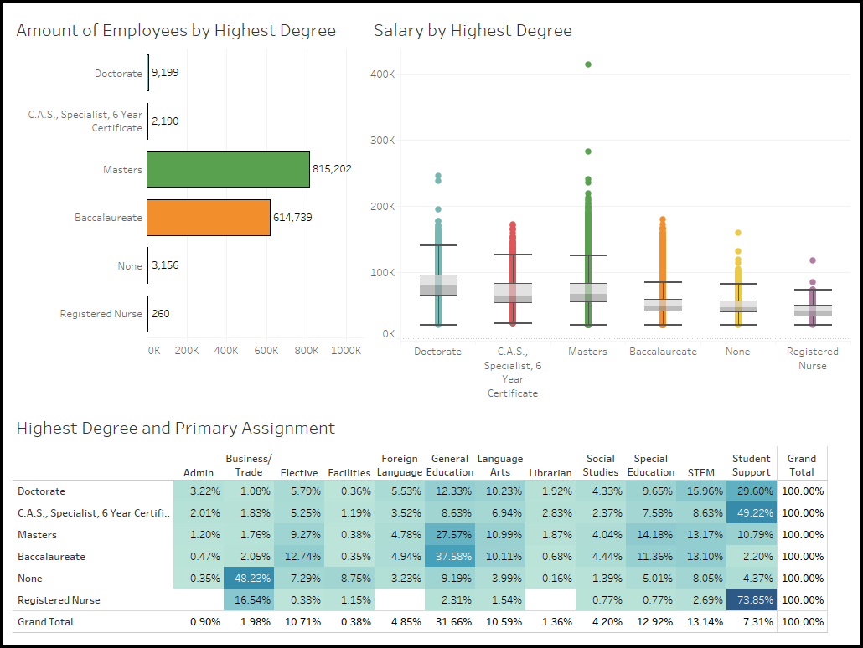

Slide 59
Experience

Slide 60
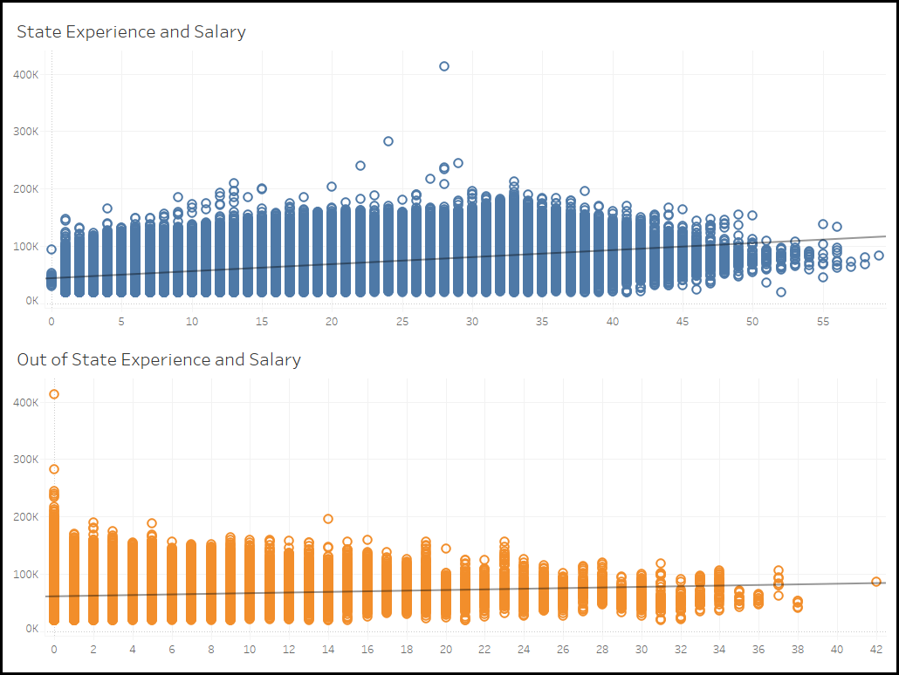

Slide 61
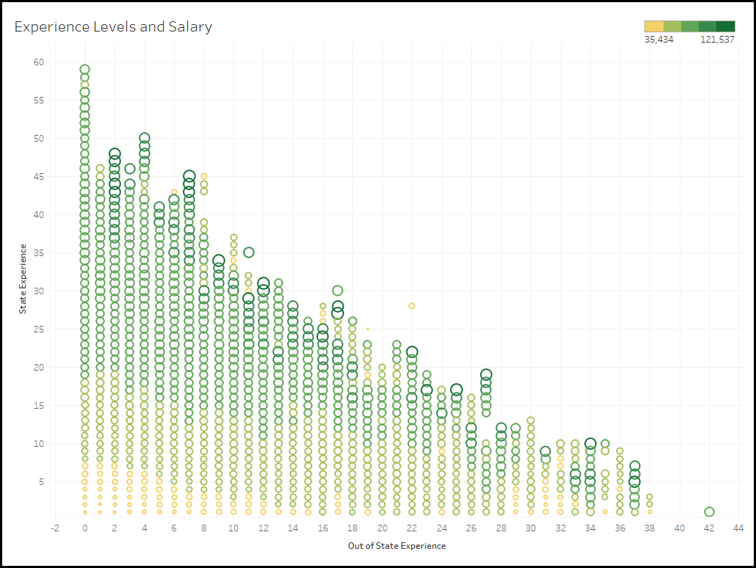

Slide 62
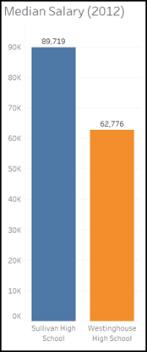
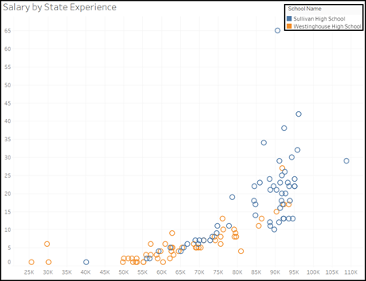
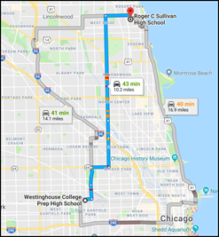
School Comparison
Notes:
Here are two schools in the city. Sullivan High School in Rogers Park and Westinghouse High School by the United Center. They are 10 miles apart.
Median Salary at Sullivan is 27K higher than Westinghouse - I only used 2012 data. Sullivan has way more teachers with experience which explains why they make more.
However the CPS scores provided are way better at Westinghouse (Sullivan is on Probation). So it seems like teacher performance is not being considered (is that fair?).
Sullivan has more teachers than westinghouse in our data but its not clear proportionally if the makeup of Primary Assignment Group in our data is different.
Rogers Park is certainly a “rougher area” than by the United Center (confirmed by the non -teacher scores?).

Slide 63
Conclusions & Future Work

Slide 64
Conclusions

Slide 65
Future Work
100% Administrators
Part-Time workers
Survey to get a sense of what fairness means to people

Slide 66
Questions?

