Slide 1
Safavieh CEO In-Office
June MSBD performance · Badging simulation · Same-day induction
Wayfair Small Parcel · July 2026

Slide 2
Executive summary
June 2026 MSBD · Rugs dropship · 73k ops

Slide 3
• 90% IFR in June — strong month; 68.3% same-day induction before 2pm (Mon–Fri)
• Fri/Sat −1 o2d (Sun MSBD): +9.0 pp at 3-day · 6,595 newly badged orders vs current stated
• Full policy stack: 6.8% 1-day · 27.1% 2-day · 60.2% 3-day (includes cutoff + Fri/Sat −1)
• Cutoff extension: weekdays only (Mon–Fri), after cutoff before 2pm — 5,557 orders
• Ops check: 68.3% same-day induct before 2pm · ~90% IFR — can they deliver faster badges?

Slide 4
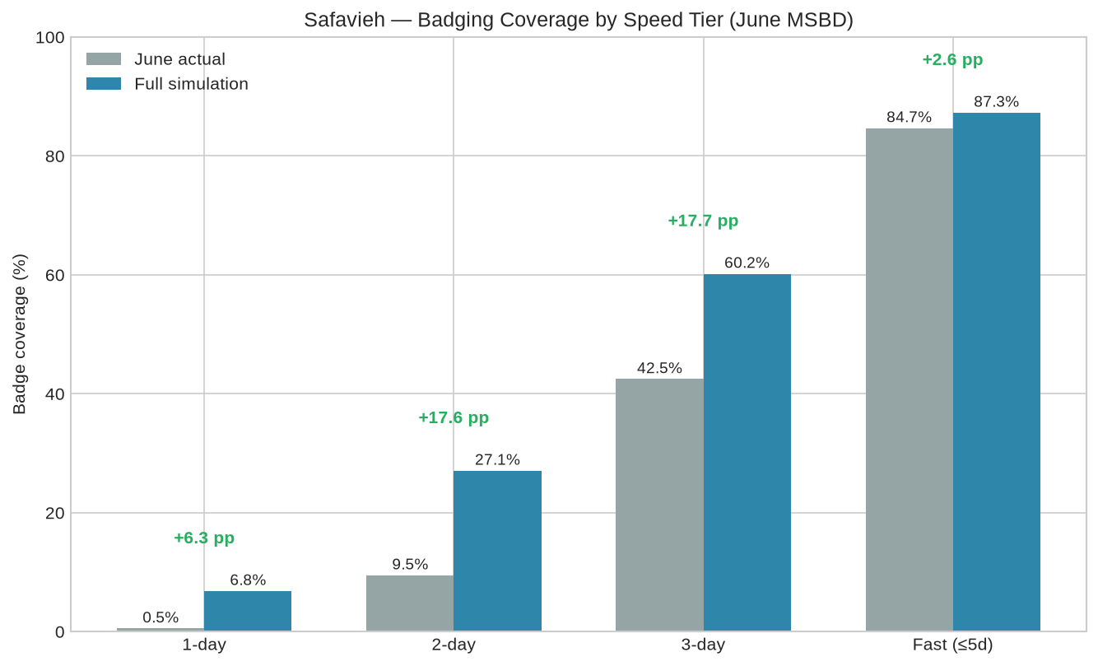
Badging by speed tier — June vs full simulation

Slide 5
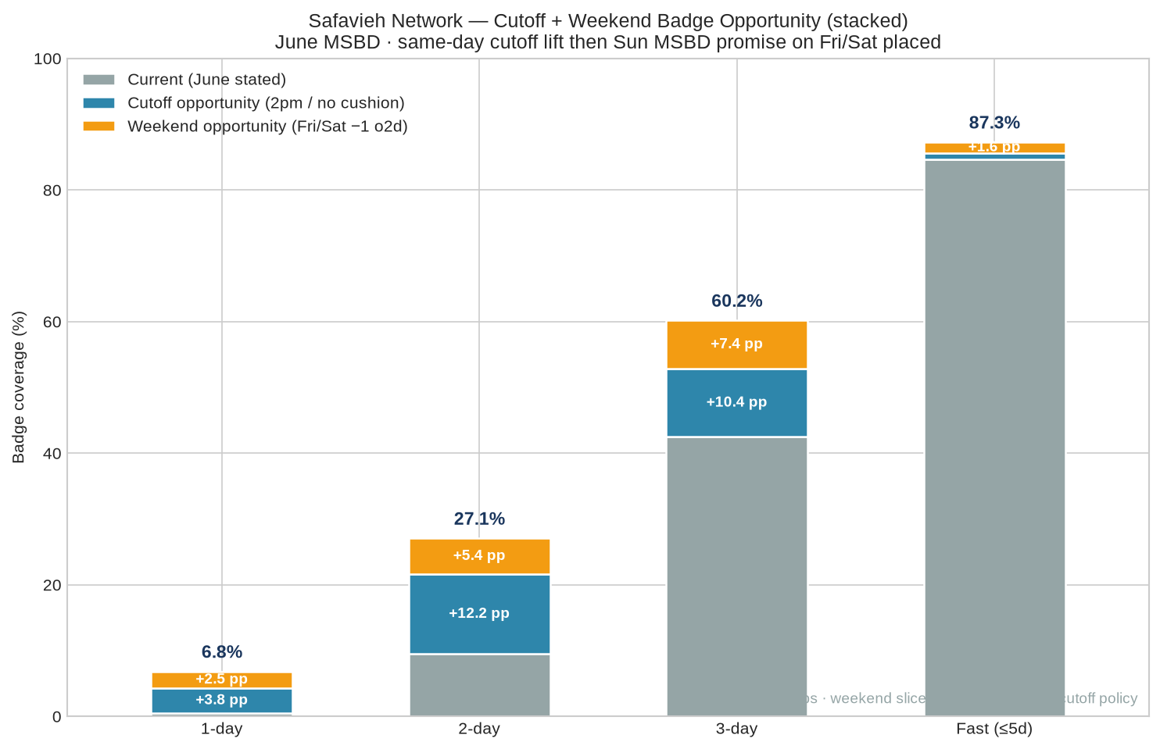
Cutoff + weekend badge opportunity (stacked)

Slide 6
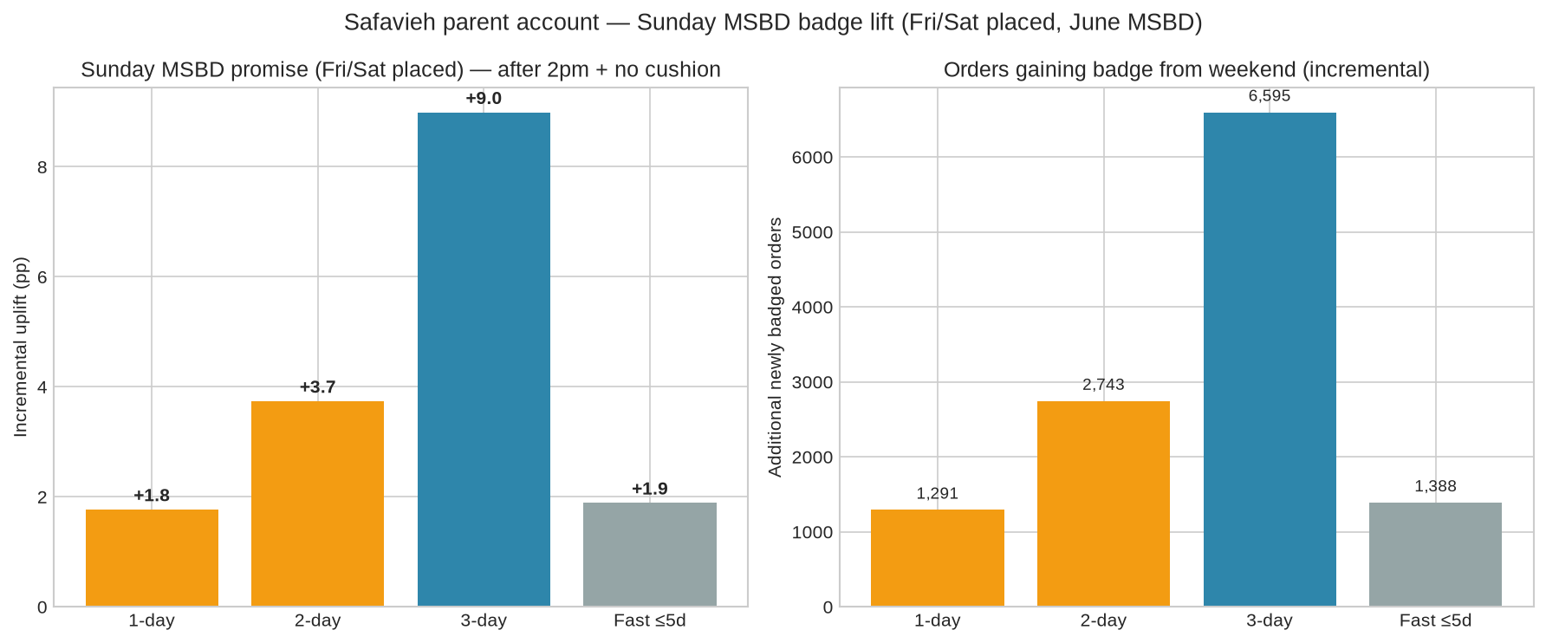
Sunday MSBD — Fri/Sat −1 o2d lift vs current stated

Slide 7
• Fri/Sat placed → o2d_stated − 1 vs current stated (17,881 orders in June)
• Lift vs current: +1.8 pp 1-day · +3.7 pp 2-day · +9.0 pp 3-day · +1.9 pp fast
• 6,595 additional 3-day badges · 1,388 additional fast badges
• ~33% of Fri/Sat orders induct Sat/Sun in June (execution; separate from stated lift)

Slide 8
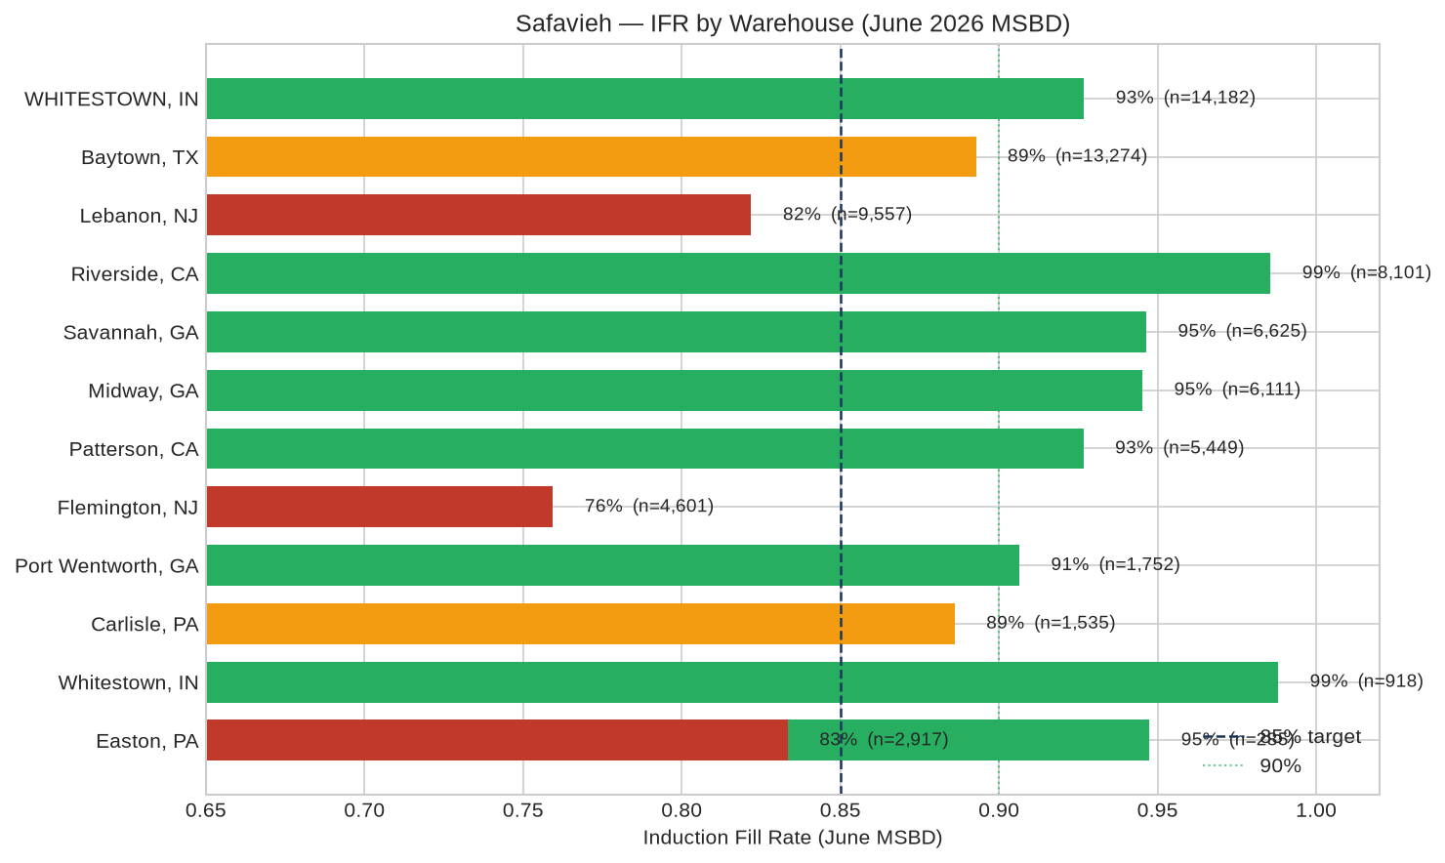
IFR by warehouse (June MSBD)

Slide 9
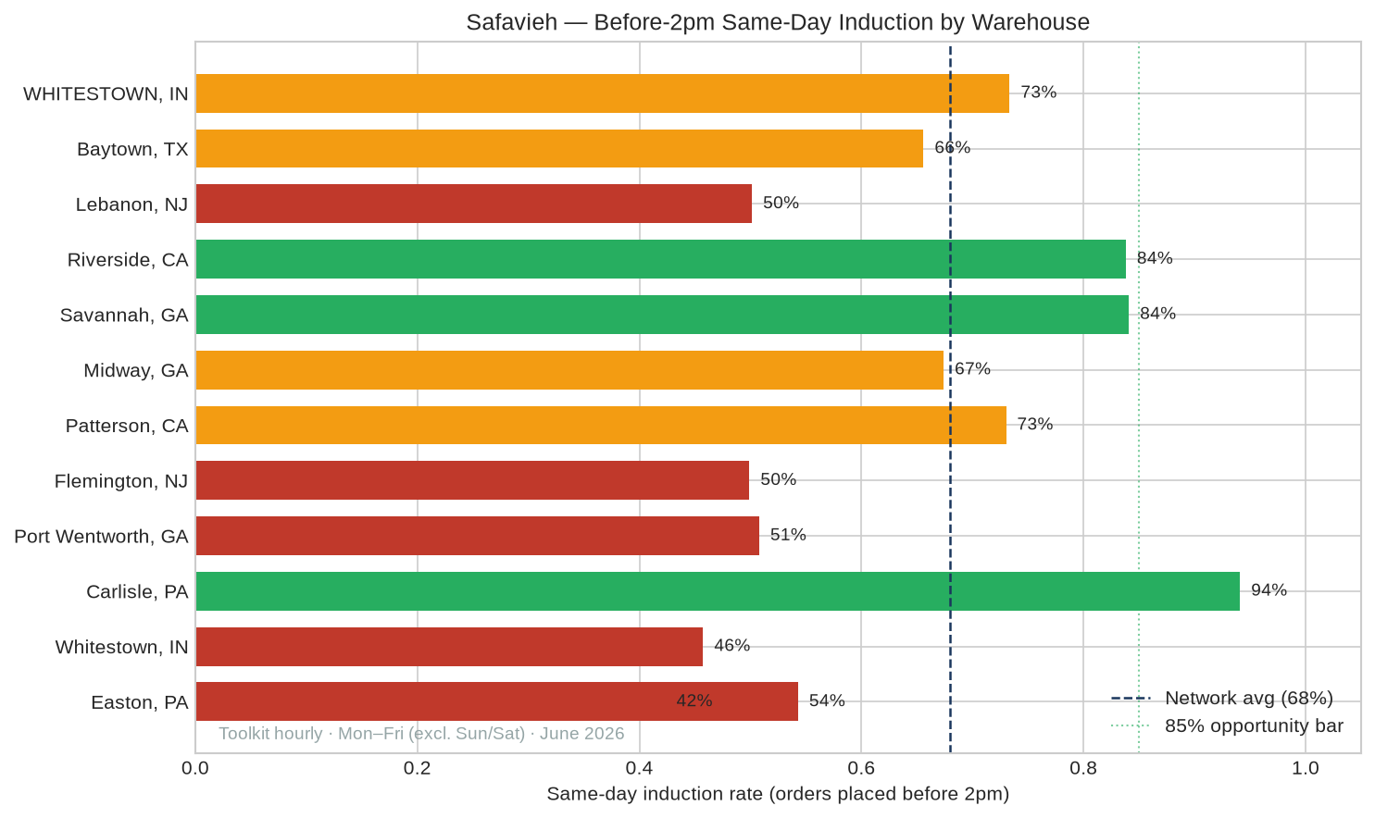
Same-day induction before 2pm by warehouse

Slide 10
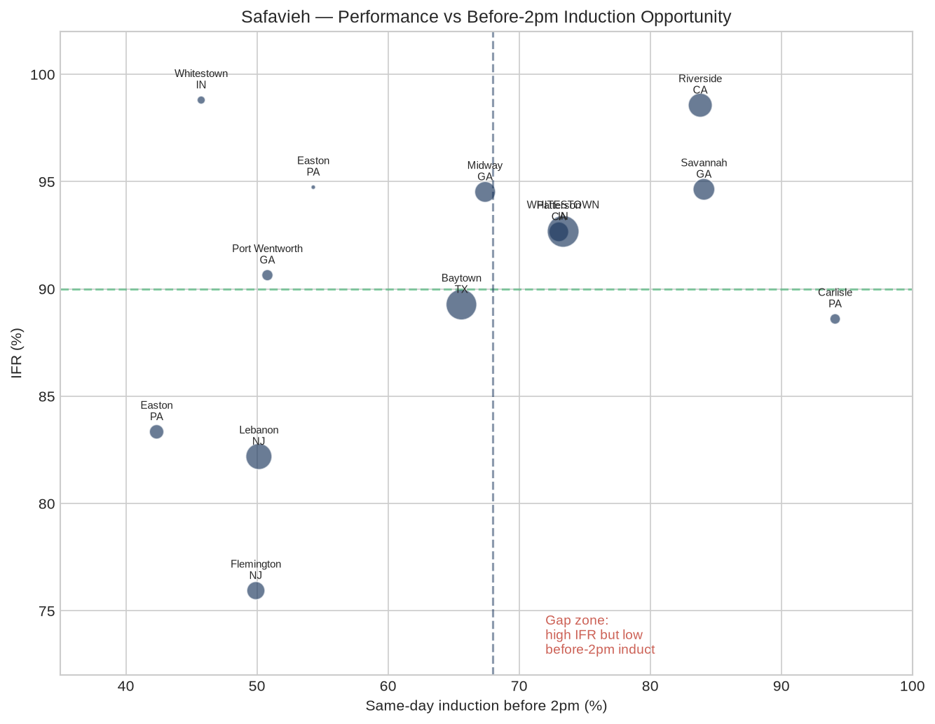
IFR vs before-2pm induction

Slide 11
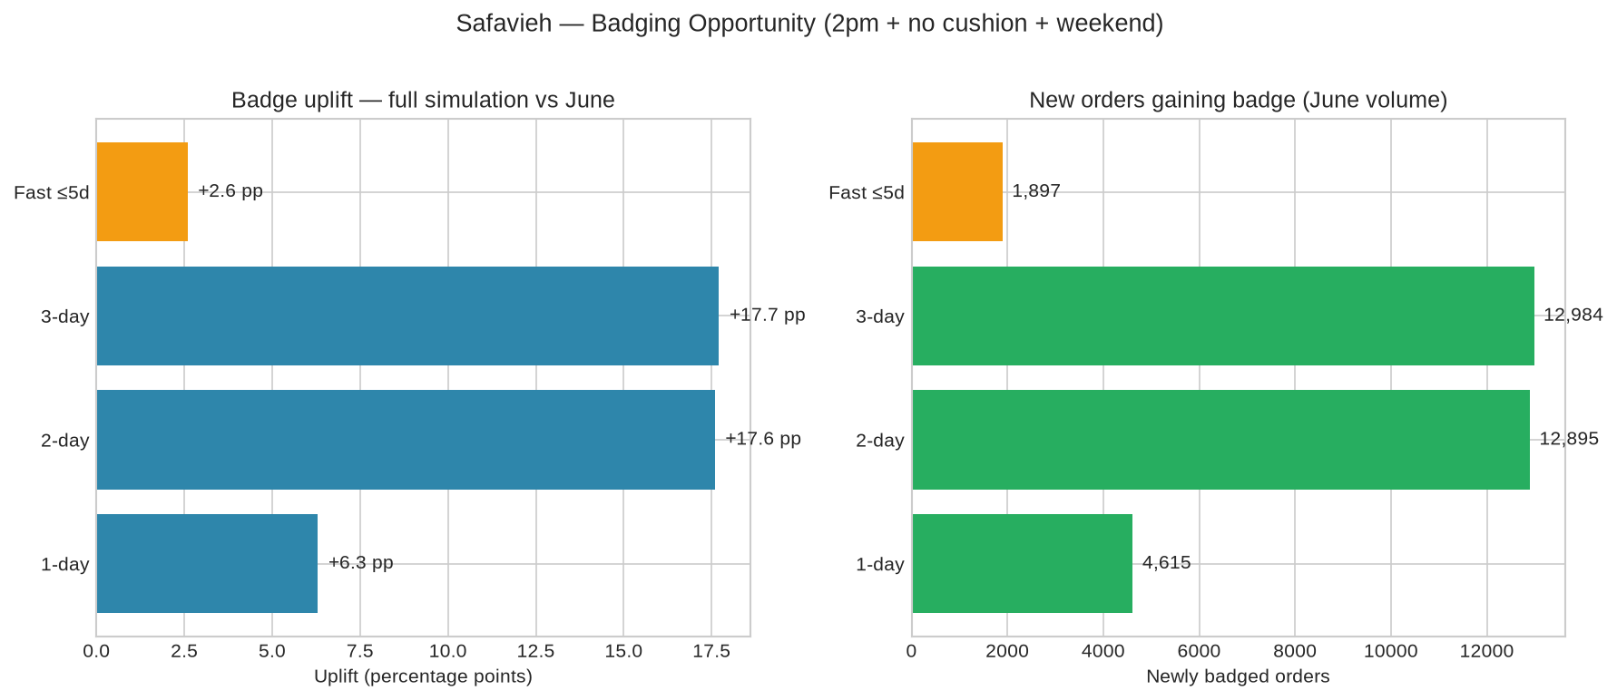
Total badging opportunity by tier

Slide 12
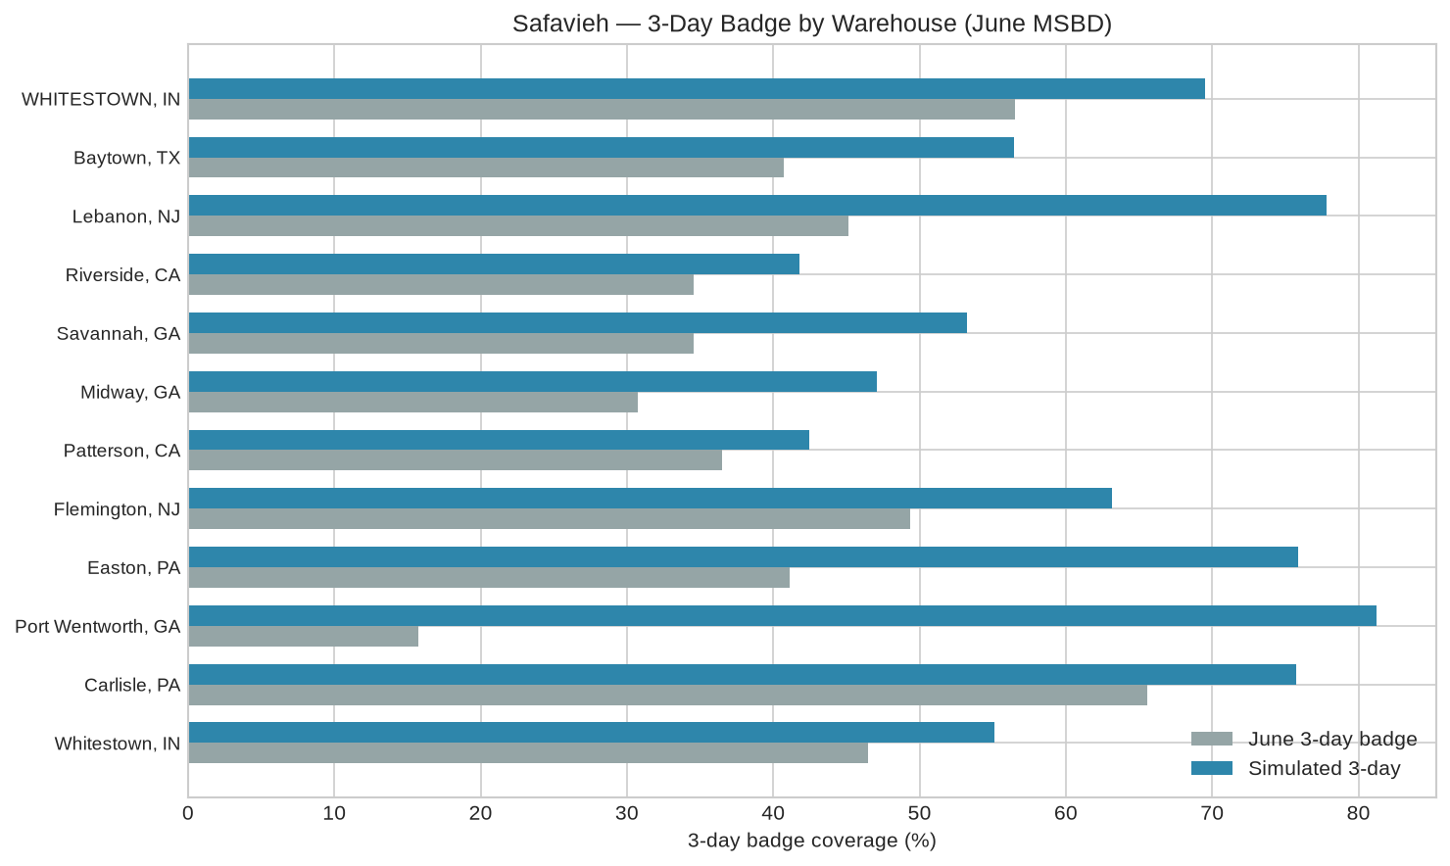
3-day badge by warehouse

Slide 13
Discussion questions
CEO conversation

Slide 14
• Prioritize 2pm + no cushion first — drives most 2- and 3-day badge lift
• Weekend stated promise: +9.0 pp at 3-day · 6,595 newly badged orders (Fri/Sat −1 vs current)
• Can NJ/PA sites improve before-2pm induction (42–50% vs 94% Carlisle)?
• FedEx pickup schedule vs proposed 2pm window at each DC?

