Slide 1
DOE / ORISE MARINE ENERGY FELLOWSHIP · MARINESITU
Parts of a Deployment
A year of powering a scientific instrument on a battery that only refills when the sun cooperates.
Aditi Kalle
9 slides · ~40 minutes · questions after

Slide 2
SLIDE 1 · AGENDA
This year, laid out like a planet
Core · Power measurement
What does this system actually draw?
Inner mantle · Optimization math
Given those numbers, how do you divide the power?
Outer mantle · Forecasting
Can the schedule see tomorrow coming?
Crust · Safety floor
What actually stops the battery from dying?
Surface · Real deployment
Did any of this hold up against the real world?
Each layer sits on the one below it. That is genuinely how it got built, and why a wrong number at the core invalidated work three layers up.

Slide 3
SLIDE 2 · CORE
What does this system actually draw?
IMTA BUOY · MEASURED
Solar panel 100 W rated
Battery 1200 Wh 12 V, 100 Ah LiFePO4
Standby 1.7 W particle board only, never off
Awake 33.7 W Jetson + cameras together
AMEC BUOY · BUDGET STILL OPEN
Jetson, P1 active 18.6 W
Marine systems, duty-cycle adjusted 71.4 W
Active-phase total 90.0 W
Battery + solar sizing unresolved
Corrected 8 Sep: 33.7 W was labelled “the camera”. It is the whole package awake. A Jetson alone draws around 15 W and a camera never more than 5 to 6 W, so a 33.7 W camera was never possible. 1.7 W was labelled “Jetson + router”; it is the particle board alone, the cell link that stays awake so the rest can be switched on remotely.
All four IMTA values measured and confirmed against the hardware.

Slide 4
SLIDE 2 · CORE
Same panel, same system. Only the site changes.
HOW TO READ IT
Fixed: a 100 W panel, 1.7 W standby, 33.7 W package.
Varying: the site.
Out comes hours per day the payload can stay awake.
Nearly 3x the uptime from the same hardware, purely from latitude and weather.
Flip it for procurement: to buy Anchorage back up to Hawaii's uptime, you fit roughly a 150 W panel.
hours awake = (100 W × sun hours × 0.85 derate − 1.7 W × 24 h) / 33.7 W

Slide 5
SLIDE 3 · INNER MANTLE
Given those numbers, how do you divide the power?
1
Read battery and tomorrow's forecast
600 Wh in the pack, 9.6 W average forecast
THE KNOB
The 5 W safety margin is the tuning parameter.
Raise it and the system gets conservative and wastes sun.
Lower it and you get more data and more risk.
Right now it is set by judgment, not derived from anything.
2
Does the forecast clear standby plus margin?
9.6 W > 1.7 W + 5 W margin → yes
3
If no: stay in standby
package duty 0%, ride the battery down and wait
4
If yes: allocate by priority, standby paid first
9.6 − 1.7 = 7.9 W left to spend
5
Divide by what the package needs
7.9 / 33.7 = 23% of the day, about 5.5 hours awake
Runs once every morning.

Slide 6
SLIDE 4 · OUTER MANTLE
Can the schedule see tomorrow coming?
ACT 1 The dumbest model won, and that was the clue
Held out only the last 48 hours. “Just repeat yesterday” looked near perfect. That was leakage: the 24-hour lag features it was scored on still reached into training.
THE ACTUAL FINDING
8 classical models landed within 0.95 to 1.23 W of each other.
The spread between completely different model families was smaller than the spread one change to the data split opened up.
Model choice barely moved the number. Data composition moved it a lot.
Which leaves the real question: solar and battery state cannot be separated, so the honest target is a joint model.
ACT 2 Rebuilt with a strict 28-day train / 7-day test split
Eleven models. The ranking flipped completely. LSTM wins at 0.93 W mean absolute error, naive baselines fall to the bottom where they belong.
ACT 3 I was never forecasting sunlight
The target was panel watts, the power arriving at the battery, which curtailment caps once the battery is full. Closer to a load forecast than a solar forecast.

Slide 7
SLIDE 4 · OUTER MANTLE
The verified 11-model benchmark
LOWER IS BETTER
LSTM 0.93 W
Classical ML 0.95 to 1.23 W
Prophet 3.58 W
Naive 3.8 to 19.3 W
For scale: 0.93 W against an 85 W midday peak is about one percent, thinner than the plotted line itself.
28 days to train, 7 unseen days to grade on. The split is what changed the ranking.

Slide 8
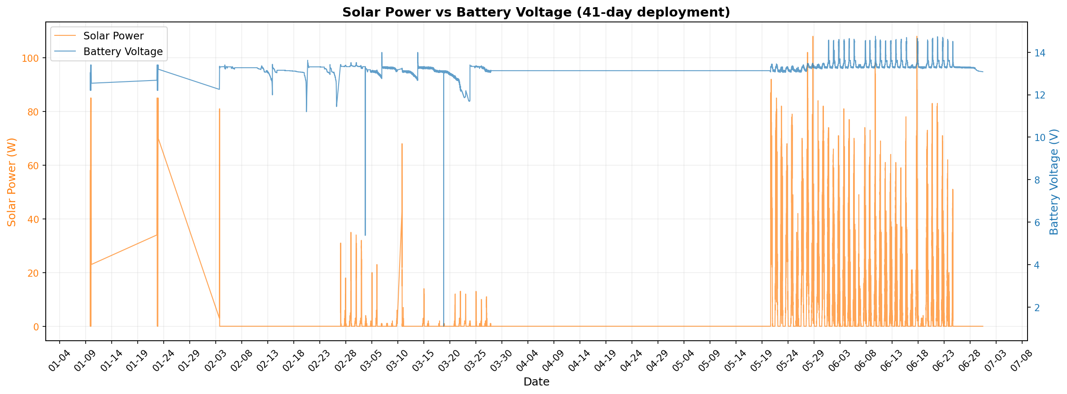
SLIDE 5 · CRUST
What actually stops the battery from dying?
IT IS NOT HARDWARE
There is no protection circuit doing this. It is a rule inside the scheduler.
Before committing to any duty cycle, it simulates the battery forward hour by hour and refuses to output a schedule that crosses the floor. It does not care what the forecast said.
Battery next hour =
battery now
+ solar in
− standby (1.7 W)
− (duty × package 33.7 W)
Across all 41 days of telemetry, no schedule ever crossed the floor.
Real telemetry: battery voltage holds a flat plateau near float almost the entire deployment. That plateau is the floor holding. The two sharp drops are what it exists to catch.

Slide 9
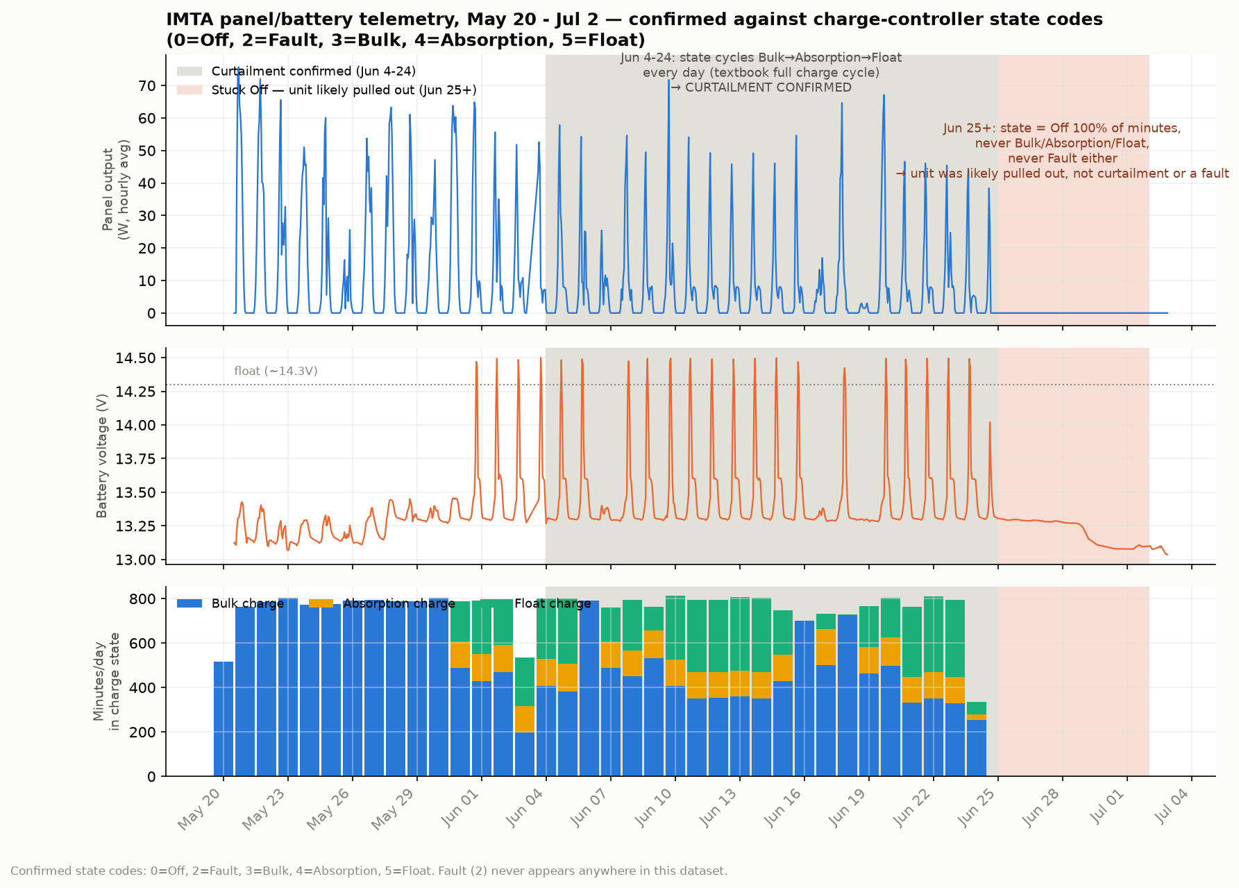
SLIDE 6 · SURFACE
One dip, two completely different causes
GULF COAST BUOY
First read: roughly 60% panel degradation. Fouling or wear. That held for weeks.
Actually: curtailment. The controller backing off because the battery was already full. Confirmed against its own state codes cycling bulk, absorption, float, daily.
Hidden inside it: a genuine 8-day outage, 25 June to 2 July. State pinned at Off for 100% of those minutes, never charging, and never logging a fault code.
One explanation had been covering for the other.

Slide 10
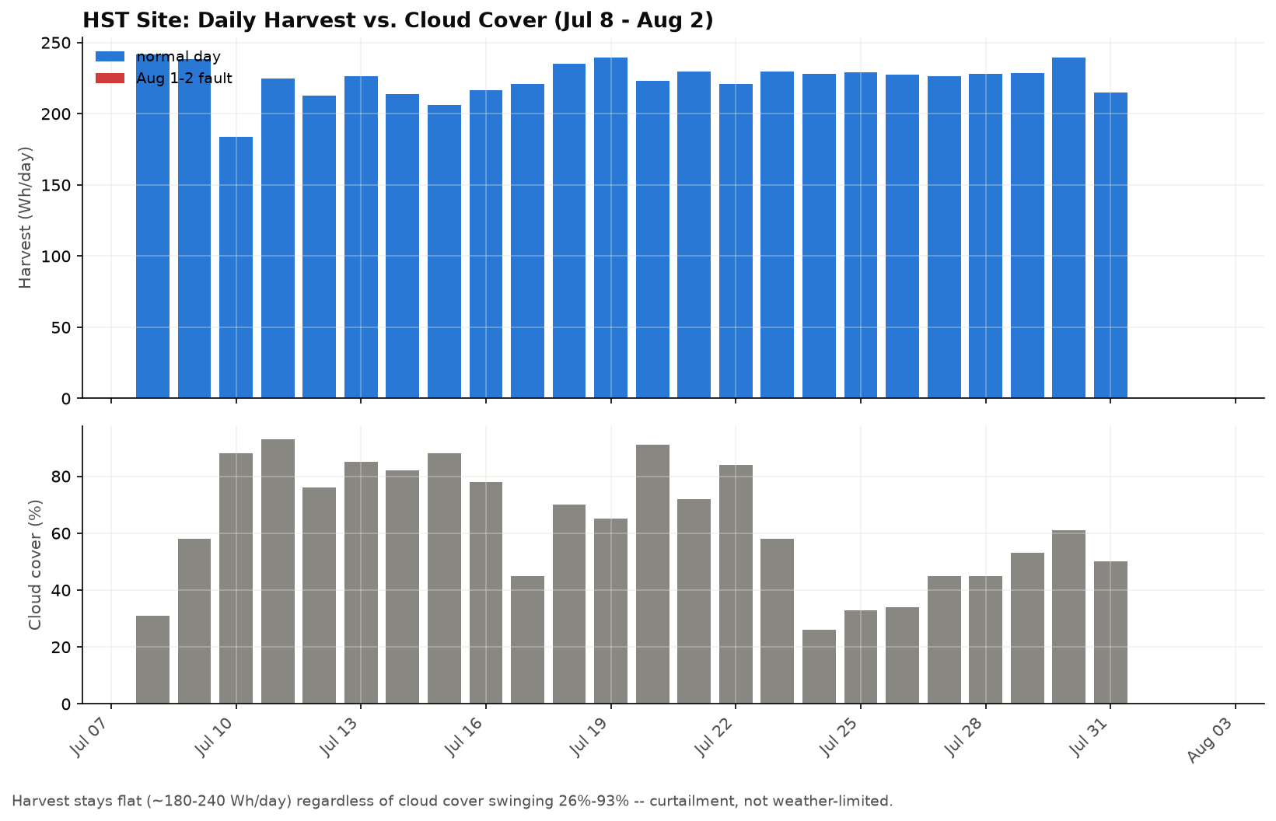
SLIDE 6 · SURFACE
Second site, different hardware, same method
HAWAII ISLAND
Harvest flat at 180 to 240 Wh/day while cloud cover swung from 26% to 93%.
Harvest decoupled from weather is the curtailment signature. It reproduced on hardware I had never touched.
Then a two-day collapse lining up exactly with a wind spike. The panel had physically torn off its mount.
I could see the anomaly. I could not have told you the cause. Someone who could see the roof told me.

Slide 11
SLIDE 7 · CORRECTIONS
Five things I had wrong
33.7 W
Was labelled “the camera”. It is the whole package awake, Jetson and cameras together. A Jetson alone draws around 15 W and a camera never more than 5 to 6 W.
1.7 W
Was labelled “Jetson + router”. It is the particle board alone, the cell link that stays awake so the rest can be switched on remotely.
Panel loss
Read as ~60% degradation. It was curtailment, with a genuine 8-day outage hiding inside the same window.
Naive wins
“Just repeat yesterday” looked near perfect. That was leakage in the train/test split, not a real result.
Solar forecast
I thought I was forecasting sun. I was forecasting panel watts, which curtailment caps once the battery tops off.
Four of those five were caught by someone who could see the hardware. Not by better modelling. The fifth I caught by re-checking my own split. Remote diagnosis gets you a short list of candidates, not an answer. The last step is always a person who was there.

Slide 12
SLIDE 8 · LATER RESEARCH
One open question per layer
Core
Validate the sizing formula against a real AMEC install, and measure sonar and UV-C in the field instead of off a datasheet.
Inner mantle
Move the LP from safety-only to primary scheduler, and extend the priority formula past two payloads.
Outer mantle
Predict solar and battery state together, not solar alone. Ground-truth irradiance as one input, battery state as the other, then test whether the joint model actually schedules better than either half.
Crust
Grow the safety simulation into a real twin: thermal model, degradation model, running live on a deployed buoy rather than in replay.
Surface
Both Hawaii hardware questions are closed. Next: can curtailment-versus-fault become predictive, flagging a fault before it fully develops?
ML
Get the forecast model running live on-device, not just as an offline benchmark.
If you had to fund one of these, which one?

Slide 13
CLOSING
The surface kept correcting the core.
A core fact, a schedule built on it, a forecast layered on the schedule, a floor protecting all of it, and a surface where the real world gets the final word.
Every time I went out to the real deployment, it sent me back down to fix something I thought was settled. That is the part I did not expect, and the part I will carry.
Thank you: MarineSitu and ORISE, Paul for the guidance, Mitchell for the technical framing, and Corey and Tony for telling me what the hardware was doing when the telemetry could not.

