Slide 1

BOOK
GIFT
PROJECT
Best Seller
Cheon Ahyun
Kim Jeong Hun
Lee Eun Taek

Slide 2
Team and roles
Idea
Requirement analysis
E-R Diagram
Database
Tuning
Queries
Application
Demo
Conclusion
Table of Content

Slide 3

1. Team & Role
Cheon Ahyun
Lee Eun Taek
Kim Jeong Hun
Team Leader
JSP & DB
CSS design
Developer
Team Member
JSP & DB
DB administrator
Developer
Team Member
JSP & DB
CSS design
Developer

Slide 4

2. Idea
Average number of readings
per year per person
The results of the 2017
National Reading Survey
12.8
11.2
9.1
8.3
2011
2013
2015
2017
(a copy of the book)
The National Statistical Office

Slide 5


2. Idea
EXCHANGE & DONATION
RECOMMENDED & MEMBERSHIP
Choose one event.
You can exchange a book with stranger.
You can recommend books.
You can manage your reviews and application list.
You can donate the books where the books are needed.

Slide 6




2. Idea
2. Idea
Inspire
- can excite people
- cause them to read.
Support
Donation events can provide warm help.
Increasing
increase people's reading
increase book sales.

Slide 7
3. Requirement
10. One user can send multiple messages of inquiry, and one message of inquiry can be sent by one user.
11. One manager can renew multiple bestsellers, and one bestseller can be renewed by multiple managers.
12. One manager can answer multiple questions, and one answer can be answered by multiple manager.
(skip attribute)
7. One user can register multiple donations, and one donation can be registered by one user.
8. One user can register multiple reviews, and one review can be registered by one user.
9. One user can exchange gifts with other users.

Slide 8
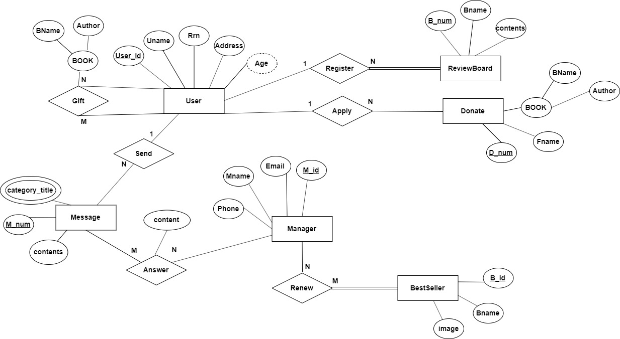
4. E-R Diagram

Slide 9
5. Database
<Result of Mapping>
User(User_id, Uname, Rrn, Address)
Manager(M_id, Mname, Email, Phone)
BestSeller(B_id, Bname, Image)
ReviewBoard(B_num, Bname, Contents, User_id)
Donate(D_num, Bname, Author, Fname, User_id)
Message(M_num, Contents, User_id)
Answer(M_id, M_num, Content)
Renew(M_id, B_id)
Gift(User_id, Target_id, Bname, Author)
Category(M_num, Category_title)

Slide 10
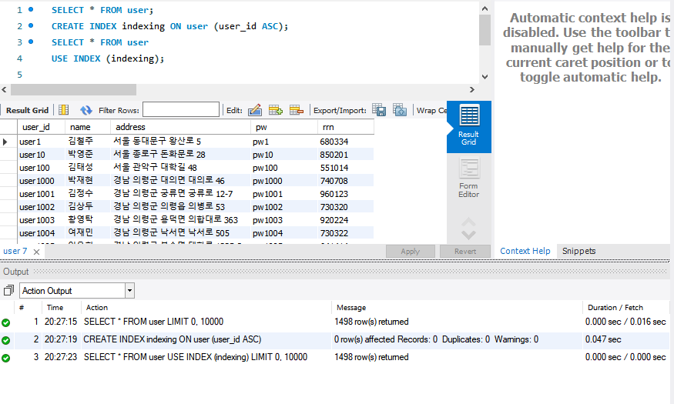
6. Tuning (Index)

Slide 11
7. Queries
<Basic Query>
<Join Query>
INSERT INTO user VALUES (?,?,?,?,?);
INSERT INTO donate VALUES (NULL,?,?,?,?);
INSERT INTO gift VALUES (?,?,?,?);
INSERT INTO review VALUES (NULL,?,?,?);
INSERT INTO message VALUES (NULL,?,?,?);
SELECT user_id,count(user_id) AS count
FROM donate
GROUP BY user_id
ORDER BY COUNT(user_id) DESC
LIMIT 3; ->Donator TOP3
SELECT gift.target_id, gift.author, gift.bookname, user.name
FROM gift,user
WHERE gift.target_id=user.user_id
AND gift.user_id='" + id + "'; ->My gift list
DELETE * FROM review WHERE user_id='“
+ id+"'and bname='"+book+"' ;
UPDATE user SET name='" + name + "'
,address='"+ address + "' ,rrn='"+ birth
+"' WHERE user_id='" + id+"';
SELECT user.name,user.address
FROM user,gift
WHERE user.user_id=gift.target_id
AND gift.target_id; ->Random Target of gift

Slide 12






8. Application
INSERT
Store information
- Member
- Fill out Form
SELECT
Print out on the web
- Application result
- Donator TOP3
- Review
- My Information

Slide 13
9. Demo

Slide 14
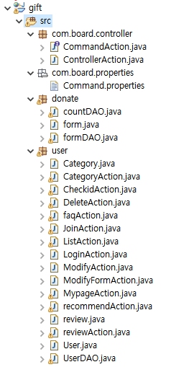

I hope you read a lot of books, too.
10. Conclusion
Desired thing
Expectancy effects
An Inefficient Language
for development
This can create an opportunity for people to visit libraries or bookstores.
This can increase reading and increase book sales.

Slide 15
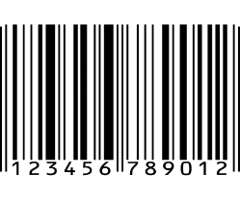
THANK YOU !

