Slide 1
Alpha-Refine: Boosting Tracking Performance by Precise Bounding Box Estimation
An analysis of the work by Bin Yan et al (CVPR 2021)
Or Sagiv & Etai Sella

Slide 2
Agenda
Background and Motivation
AlphaRefine Overview
Our addition – Particle Filter with AR
Tests and Simulations
Conclusions and Future Work

Slide 3
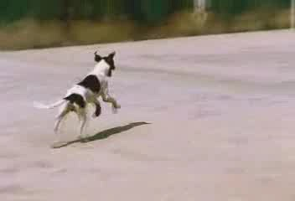
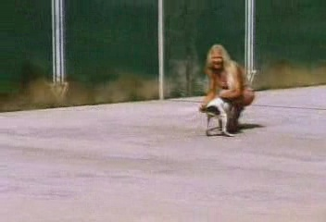
Background and Motivation – Tracking
Object Tracking consists of finding a moving target in a video according to some “ground truth”:
First Frame:
111’th Frame:
Tracking Result
Ground Truth

Slide 4
Background and Motivation – Tracking
Finding the precise bounding box that best represents the object in each frame is challenging for multiple reasons:
First Frame:
111’th Frame:
Tracking Result
Ground Truth

Slide 5
Background and Motivation – Tracking
Finding the precise bounding box that best represents the object in each frame is challenging for multiple reasons:
Occlusions: The target is obscured (partially or completely) by another object in the scene
Deformations: The target’s shape changes between frames
Illumination Changes: Lighting changes between frames, altering pixel values

Slide 6
Background and Motivation – Tracking
For this reason, most state-of-the-art tracking algorithms use a multi-stage approach:
First the Target is coarsely located
Then the bounding box, or correlation mask is refined

Slide 7
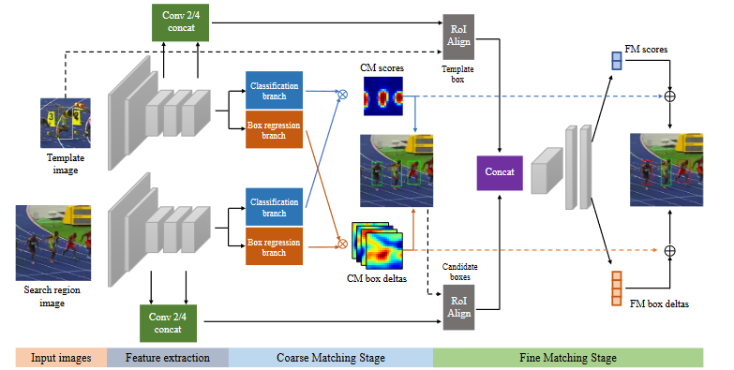
Background and Motivation – Tracking
For example, SPM-Tracker by Wang et al:

Slide 8
Background and Motivation – Tracking

Slide 9
Questions?

