Slide 1
Alpha-Refine: Boosting Tracking Performance by Precise Bounding Box Estimation
An analysis of the work by Bin Yan et al (CVPR 2021)
Or Sagiv & Etai Sella

Slide 2
Agenda
Background and Motivation
AlphaRefine Overview
Our addition – Particle Filter with AR
Tests and Simulations
Conclusions and Future Work

Slide 3
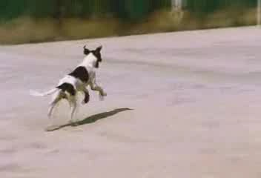

Background and Motivation – Tracking
Object Tracking consists of finding a moving target in a video according to some “ground truth”:
First Frame:
111’th Frame:
Tracking Result
Ground Truth

Slide 4
Background and Motivation – Tracking
Finding the precise bounding box that best represents the object in each frame is challenging for multiple reasons:
First Frame:
111’th Frame:
Tracking Result
Ground Truth

Slide 5
Background and Motivation – Tracking
Finding the precise bounding box that best represents the object in each frame is challenging for multiple reasons:
Occlusions: The target is obscured (partially or completely) by another object in the scene
Deformations: The target’s shape changes between frames
Illumination Changes: Lighting changes between frames, altering pixel values

Slide 6
Background and Motivation – Tracking
For this reason, most state-of-the-art tracking algorithms use a multi-stage approach:
First the Target is coarsely located
Then the bounding box, or correlation mask is refined

Slide 7
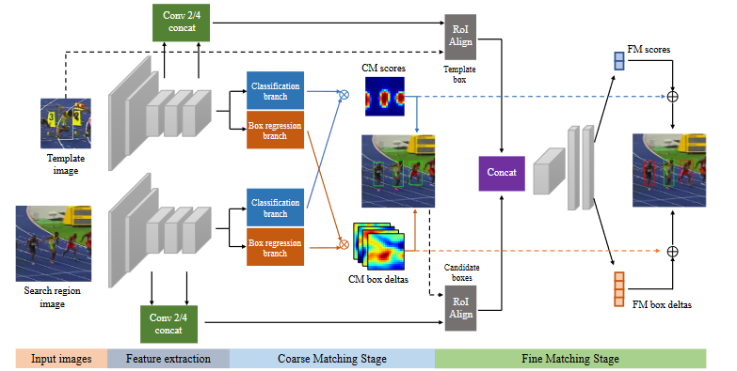
Background and Motivation – Tracking
For example, SPM-Tracker by Wang et al:
Notes:
Point out the Fine matching Stage

Slide 8
Background and Motivation – Tracking
This method produces good results, however:
It still has limited precision
The refining stage, as good as it may be, can only be used as part of its original tracker – it lacks transferability
For these reasons, Bin Yan et al proposed a novel method of refining tracker results called - AlphaRefine.
Notes:
Point out the Fine matching Stage

Slide 9
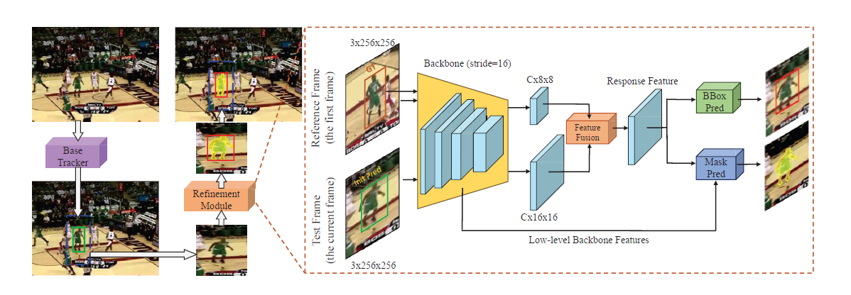
AlphaRefine - Overview
Alpha-Refine is a refinement module which can efficiently refine the base tracker’s outputs and significantly improve the tracking performance in terms of precision (the center of the box compared to the center of the tracked object) and overlapping (between the box and the tracked object).
This is an overview of the architecture of the proposed Alpha-Refine module. The figure also shows how it can be added in a “Plug and Play” style to the base tracker in order to get better results.

Slide 10
AlphaRefine – Main Components
First, the module has two input branches, namely, the reference branch (first frame) and the test branch (current frame).
As we can clearly see from the figure, the AlphaRefine module is consisted of 3 main components:
Backbone - A parameter-shared backbone is applied to both branches for feature extraction (using ResNet).
Feature Fusion - Features extracted from the two branches (reference and test) by the backbone are aggregated by a fusion module, which is typically a correlation module (pixel-wise correlation). The fused feature is further processed by some convolutional layers, producing the features for the prediction heads.
Prediction Heads - Predicting the bounding box and the mask (only during the training).

Slide 11
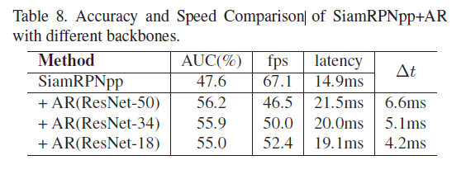
Backbone – Feature Extraction
This module is used for extracting the features of the two branches used as the AR module’s input.
The given table compares Alpha-Refine module with different backbones and reports the comparison results.
When the ResNet-18 backbone is used, the latency of our AR model is very low, but the corresponding performance is also lower than those we get for deeper ResNet networks. As the backbone goes deeper, the AUC score (performance) is better, but the speed is slower.
The chosen backbone was ResNet-34 in order to balance accuracy and speed.

Slide 12
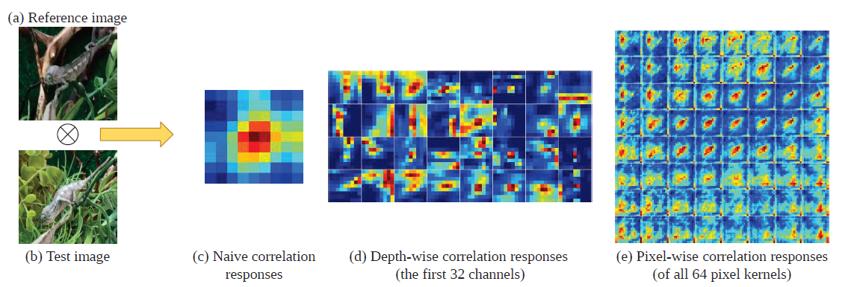
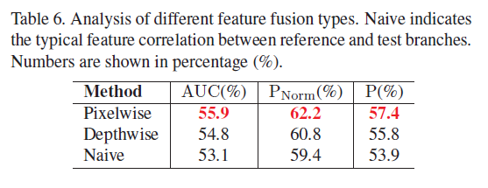
Feature Fusion – Pixelwise Correlation
The given figure shows some feature fusion outputs:
Naive correlation can only roughly represent the center location of the object while losing most of the shape and scale information.
Depth-wise correlation must encode the blurred location into channels, which is less explainable and inefficient.
Pixel-wise correlation is better at retaining the target’s boundary and other detailed spatial information. Pixel-wise correlation avoiding an extremely large correlation window from blurring the feature.
The given table compares the AR variants using different feature fusion options (Naive, Depth-wise, or Pixel-wise).
The results show that the adopted pixelwise correlation performs the best, indicating that the pixelwise correlation is better at extracting and maintaining spatial information than the depth-wise correlation or naïve correlation.

Slide 13
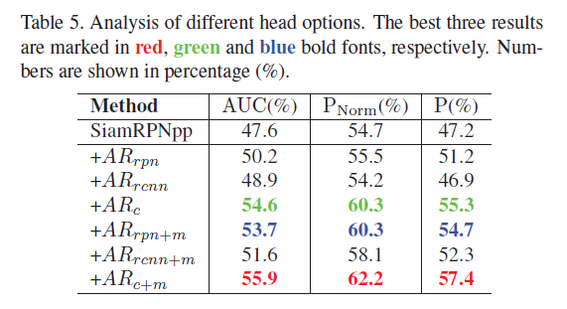
Prediction Heads – Box and Mask
As Alpha-Refine is a module for precisely estimating the bounding box, additional detailed shape information would be helpful. To this end, an auxiliary mask head was added parallel to the box head, which introduces pixel-level supervision into training.
When the box head is trained with the auxiliary mask head, the network is encouraged to extract more detailed spatial information which is required by the mask head and facilitates precise box estimation.
In addition, supervision from mask annotation also teach the model to better discriminate foreground and background, which is required by the segmentation task and beneficial to tracking.
At the inference stage, the mask head is by default disabled to speed up Alpha-Refine.
From the given table, we have the following two conclusions:
All adopted box estimation heads improve the original SiamRPNpp method, and the corner head performs much better than the other two.
The auxiliary mask head further makes additional improvements, and the combination of the corner and mask heads obtains the best performance.

Slide 14
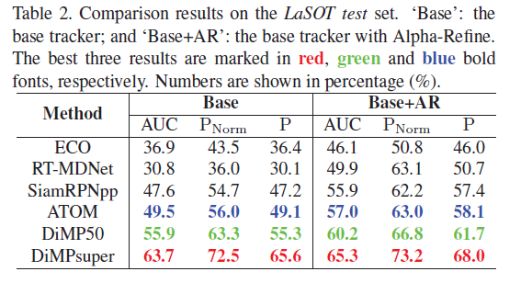
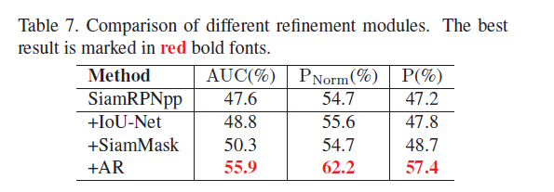
Main Advantages of AlphaRefine:
Plug and Play: Alpha- Refine can be combined with arbitrary trackers in a Plug and Play style and improve their performance.
Smaller search region: Notably, compared with independent trackers, the size of Alpha-Refine’s search region is roughly two times the size of the object, which is smaller than normal trackers (four times in most cases). The smaller search region can depress the cluttered background and enable the model to focus on more detailed spatial information, which is beneficial to precise localization. Small search region also lowers the computation cost, so that Alpha-Refine can improve the base tracker with little latency increase.

Slide 15
Our Addition – Particle Filter + AR
To test AR’s transferability and make use of its low latency we built our own custom tracker and applied AR to it.
Our tracker is made up of two core components:
Particle Filter
“Edge Preserving” State Update

Slide 16
Particle Filter
Particle filter is a technique for estimating the state of a dynamic system
It is based making multiple guesses about the system’s state – particles
At each step the guesses are evaluated and updated according to former particles
Particles which agree with observations get more weight, and have a bigger effect on future particles

Slide 17
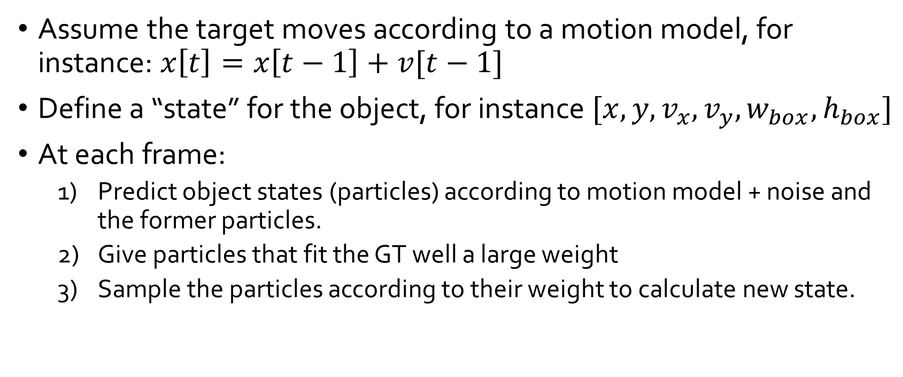
Particle Filter
Assume the target moves according to a motion model, for instance: $x\left[t\right]=x\left[t−1\right]+v[t−1]$
Define a “state” for the object, for instance $[x, y, v_{x}, v_{y}, w_{box}, h_{box}]$
At each frame:
Predict object states (particles) according to motion model + noise and the former particles.
Give particles that fit the GT well a large weight
Sample the particles according to their weight to calculate new state.

Slide 18
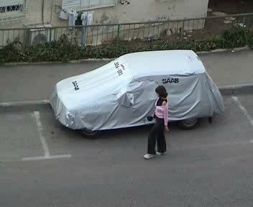
Particle Filter
Predicted Particles
Former Particles
Prediction

Slide 19
Particle Filter
Weighted Particles
(represented by width)
Next Frame’s Particles
Sampling
Weighted Average

Slide 20
State Update
The location in the first Frame is used as ground truth
After a few frames, the target might not resemble its appearance in the first frame, for example if it moved Infront of a new background
Thus, we update the ground truth every few frames.
In order to stay close to the

Slide 21
Questions?

