Slide 1
Parameter estimation of LFM signal based on STFT and RANSAC
An analysis of the work by Xiaolei Fan and Bing Li (2020)
Yarden Akaby & Etai Sella

Slide 2
Agenda
Background and Motivation
Overview of Fan & Li’s method
Our innovation – Using the Hough transform
Tests and Simulations
Conclusions

Slide 3
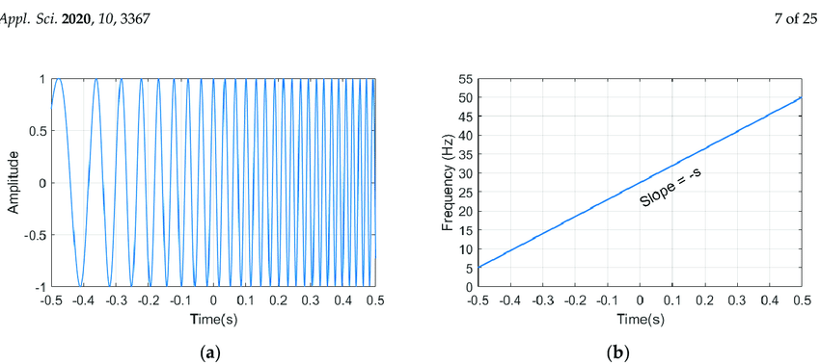
Background and Motivation – LFM Signals
Linear Frequency Modulated signals, or LFM signals, are a type of chirp signal in which the frequency of the signal either increases or decreases in a linear manner over a certain time interval

Slide 4
Background and Motivation – LFM Signals
LFM signals have a variety of different uses:
Chirp Modulation:
A communication method which uses chirp signals to transmit data.
In binary chirp modulation a positive slope LFM (or upchirp) represents “1” and a negative LFM (or downchirp) represents “0”
Radar Technology:
The classic example of the usage of LFM signals in radar signal reconnaissance is transmitting an LFM signal towards a moving object and deriving the object's range and radial velocity from the received signal:

Slide 5
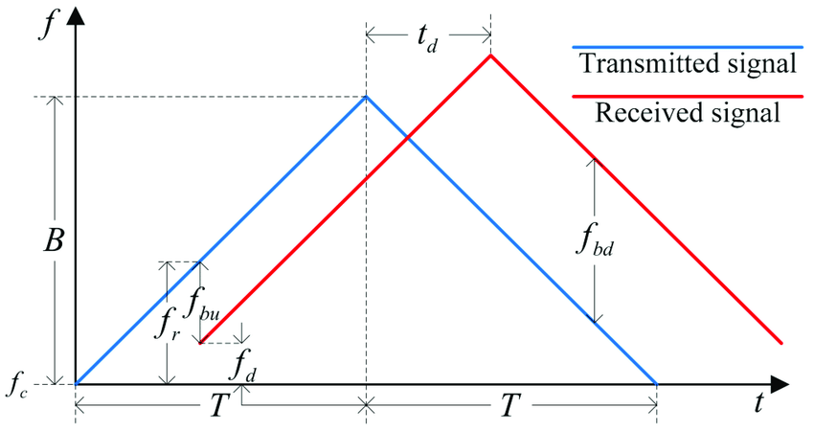
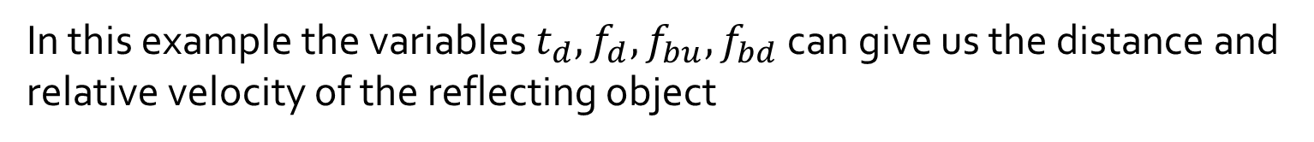
Background and Motivation – LFM Signals
LFM Signal in Radar Technology:
In this example the variables $t_{d}, f_{d}, f_{bu}, f_{bd}$ can give us the distance and relative velocity of the reflecting object

Slide 6
Background and Motivation – LFM Signals
These varied applications make the task of estimating the LFM signal's parameters (slope and intercept) an important task
There are few suggested methods for doing this, explained in different articles:
Liu, Wang and Xiao (2007) – “Detection performance of linear frequency modulated signals based on wigner-hough transform”
Wang, Su and Chen (2014) – “Accurate parameters estimation of chirp signal in low SNR“
Our work will cover the article published in 2020 by Xiaolei Fan and Bing Li, which they claim works in even lower SNRs and is more efficient in terms of calculation

Slide 7
Overview of Fan & Li’s method
…

Slide 8
Our innovation – Using Hough transform
…

Slide 9
Tests and Simulations
Define evaluation method
Test using RANSAC
Test using HOUGH Transform
Notes:
First, we need to define a correct rate of estimation - CRE

Slide 10
Tests and Simulations - Evaluation
Correct rate of estimation – CRE
The division between the times estimated correctly and the total trial number, and the correct estimation is that the error of estimation is in range of ±1% of the real parameter.
Notes:
First, we need to define a correct rate of estimation - CRE

Slide 11
Tests and Simulations - RANSAC
Create 500 chirp signals with random noise (500 Trials)
Use STFT
Extract time frequency curves
Use Median Filter
Compare 3 methods of estimation:
RANSAC
RANSAC with median filter
LSM

Slide 12
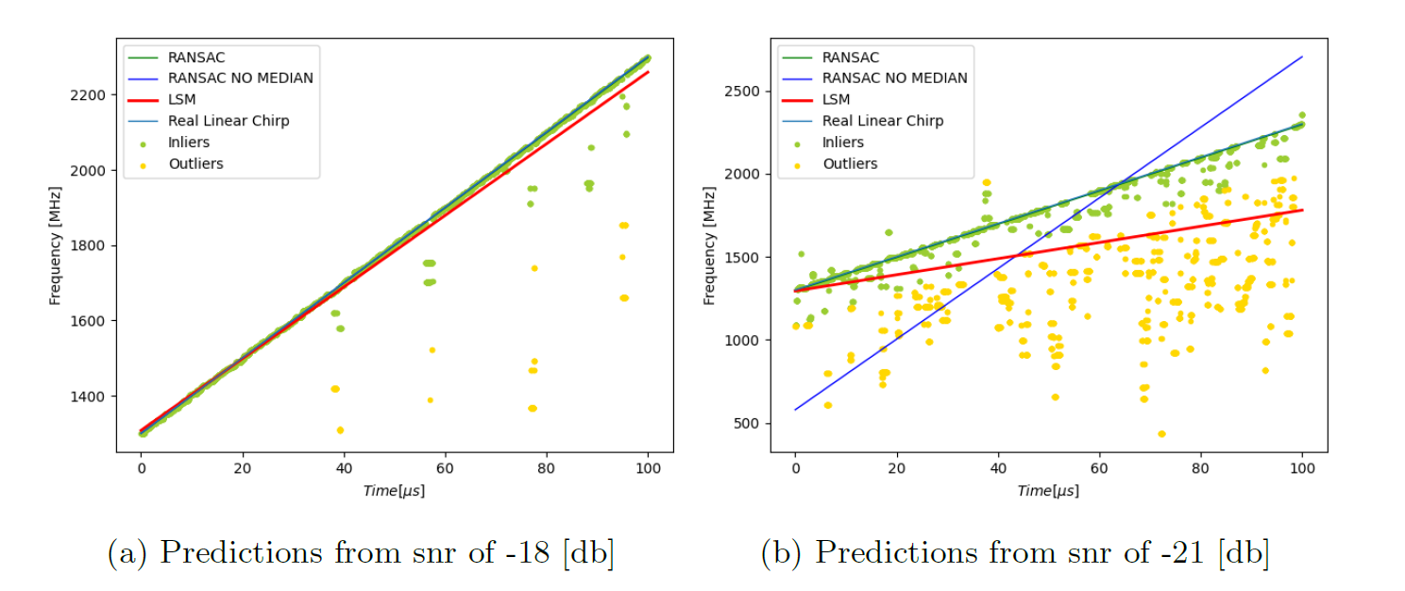
Tests and Simulations - RANSAC
Example of estimations

Slide 13
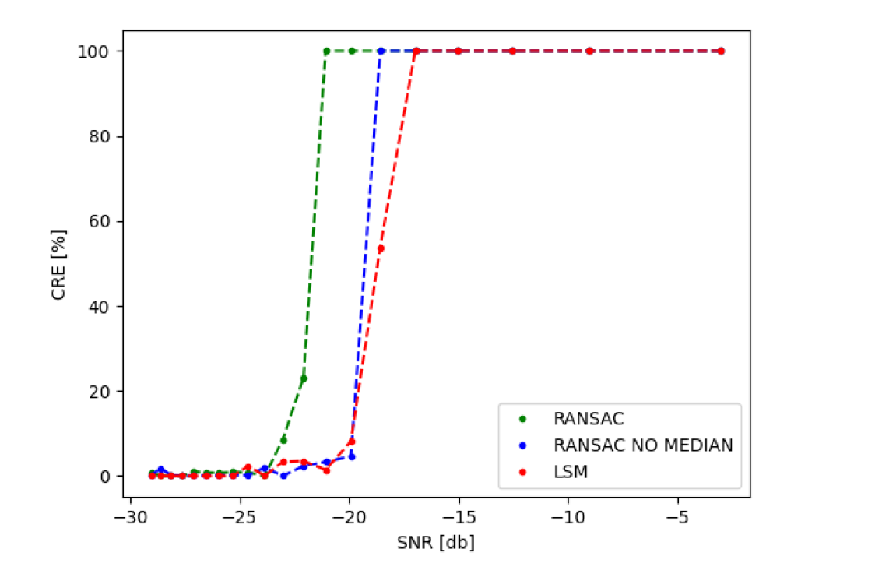
Tests and Simulations - RANSAC
Graph of CRE against SNR

Slide 14
Tests and Simulations - HOUGH
Create 100 Trials:
2 different chirp signals
15 different noise variation
Use STFT
Extract 2 time frequency curves using Hough transform
Evaluate CRE of each curve –Left & Right

Slide 15
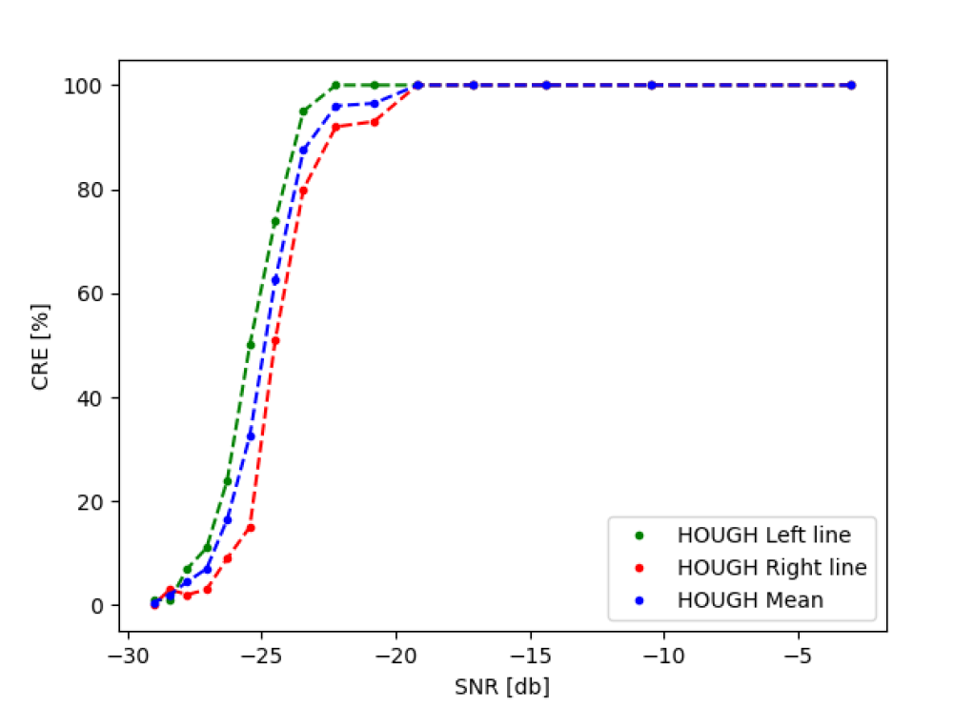
Tests and Simulations - HOUGH
Graph of CRE against SNR

Slide 16
Conclusions
Chirp estimation using RANSAC is superior than LSM
Median Filter is a helpful tool in smoothing the noisy curves
Hough Transform is good as RANSAC in estimating linear chirp signals
Hough Transform can estimate changing linear chirps

