Slide 1
Parameter estimation of LFM signal based on STFT and RANSAC
An analysis of the work by Xiaolei Fan and Bing Li (2020)
Yarden Akebi & Etai Sella

Slide 2
Agenda
Background and Motivation
Overview of Fan & Li’s method
Our innovation – Using the Hough transform
Tests and Simulations
Conclusion

Slide 3
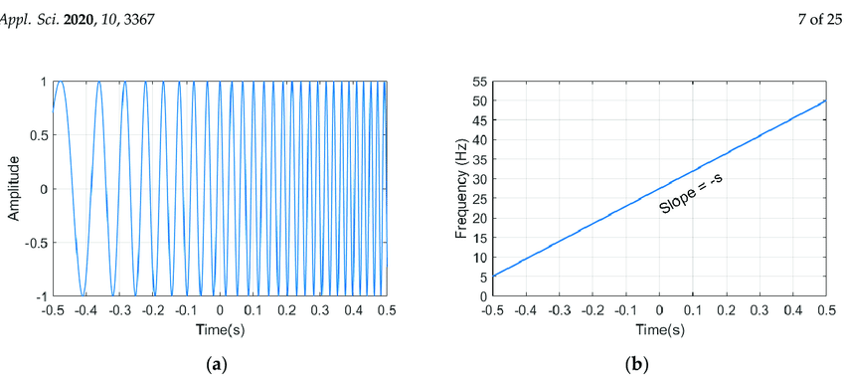
Background and Motivation – LFM Signals
Linear Frequency Modulated signals, or LFM signals, are a type of chirp signal in which the frequency of the signal either increases or decreases in a linear manner over a certain time interval

Slide 4
Background and Motivation – LFM Signals
LFM signals have a variety of different uses:
Chirp Modulation:
A communication method which uses chirp signals to transmit data.
In binary chirp modulation a positive slope LFM (or upchirp) represents “1” and a negative LFM (or downchirp) represents “0”
Radar Technology:
The classic example of the usage of LFM signals in radar signal reconnaissance is transmitting an LFM signal towards a moving object and deriving the object's range and radial velocity from the received signal:

Slide 5
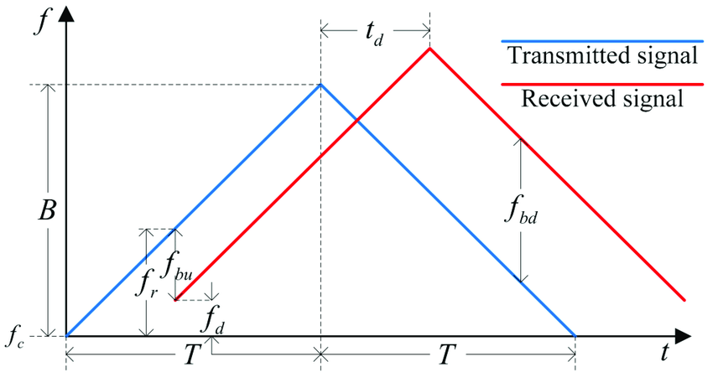

Background and Motivation – LFM Signals
LFM Signal in Radar Technology:
In this example the variables $t_{d}, f_{d}, f_{bu}, f_{bd}$ can give us the distance and relative velocity of the reflecting object

Slide 6
Background and Motivation – LFM Signals
These varied applications make the task of estimating the LFM signal's parameters (slope and intercept) an important task
There are few suggested methods for doing this, explained in different articles:
Liu, Wang and Xiao (2007) – “Detection performance of linear frequency modulated signals based on wigner-hough transform”
Wang, Su and Chen (2014) – “Accurate parameters estimation of chirp signal in low SNR“
Our work will cover the article published in 2020 by Xiaolei Fan and Bing Li, which they claim works in even lower SNRs and is more efficient in terms of calculation

