Slide 1
Parameter estimation of LFM signal based on STFT and RANSAC
An analysis of the work by Xiaolei Fan and Bing Li (2020)
Yarden Akaby & Etai Sella

Slide 2
Agenda
Background and Motivation
Overview of Fan & Li’s method
Our innovation – Using the Hough transform
Tests and Simulations
Conclusions

Slide 3
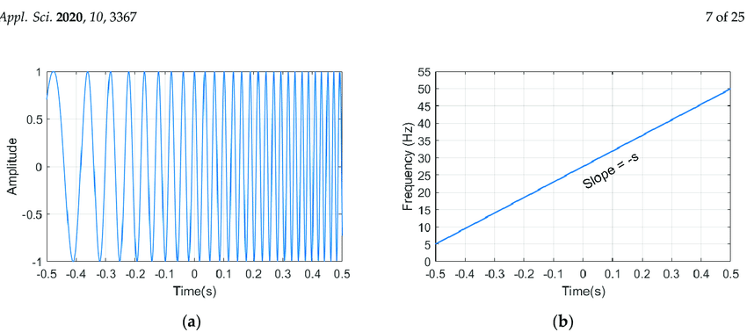
Background and Motivation – LFM Signals
Linear Frequency Modulated signals, or LFM signals, are a type of chirp signal in which the frequency of the signal either increases or decreases in a linear manner over a certain time interval

Slide 4
Background and Motivation – LFM Signals
LFM signals have a variety of different uses:
Chirp Modulation:
A communication method which uses chirp signals to transmit data.
In binary chirp modulation a positive slope LFM (or upchirp) represents “1” and a negative LFM (or downchirp) represents “0”
Radar Technology:
The classic example of the usage of LFM signals in radar signal reconnaissance is transmitting an LFM signal towards a moving object and deriving the object's range and radial velocity from the received signal

Slide 5
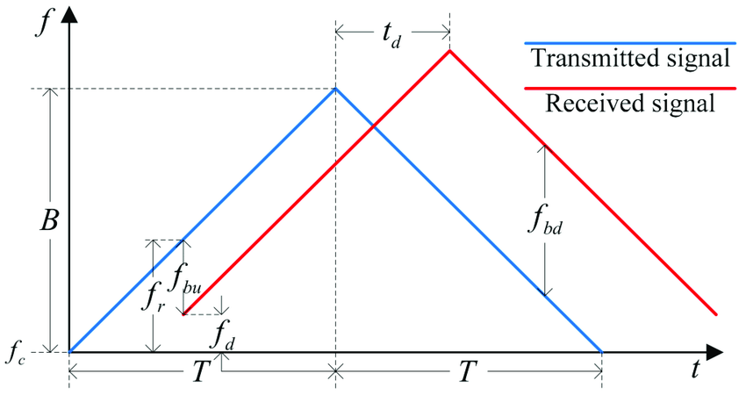
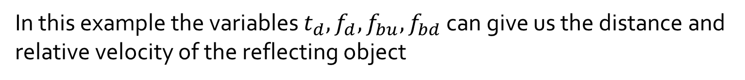
Background and Motivation – LFM Signals
LFM Signal in Radar Technology:
In this example the variables $t_{d}, f_{d}, f_{bu}, f_{bd}$ can give us the distance and relative velocity of the reflecting object

Slide 6
Background and Motivation – LFM Signals
These varied applications make the task of estimating the LFM signal's parameters (slope and intercept) an important task
There are few suggested methods for doing this, explained in different articles:
Liu, Wang and Xiao (2007) – “Detection performance of linear frequency modulated signals based on wigner-hough transform”
Wang, Su and Chen (2014) – “Accurate parameters estimation of chirp signal in low SNR“
Our work will cover the article published in 2020 by Xiaolei Fan and Bing Li, which they claim works in even lower SNRs and is more efficient in terms of calculation

Slide 7
Overview of Fan & Li’s method
STFT
Extracting Maximas & Median Filtering
RANSAC

Slide 8


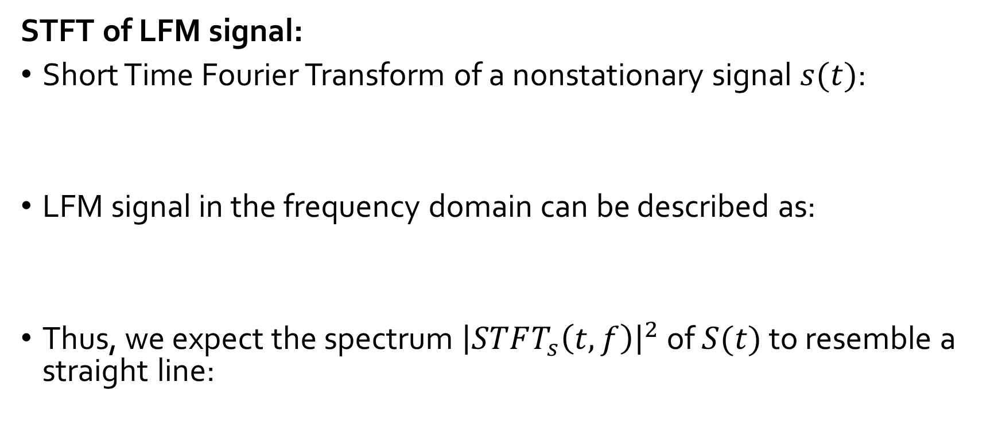
Overview of Fan & Li’s method
STFT of LFM signal:
Short Time Fourier Transform of a nonstationary signal $s(t)$:
LFM signal in the frequency domain can be described as:
Thus, we expect the spectrum ${\left|STFT_{s}\left(t,f\right)\right|}^{2}$ of $S(t)$ to resemble a straight line:
Notes:
Mention that Fan and Li offer a proof for this

Slide 9
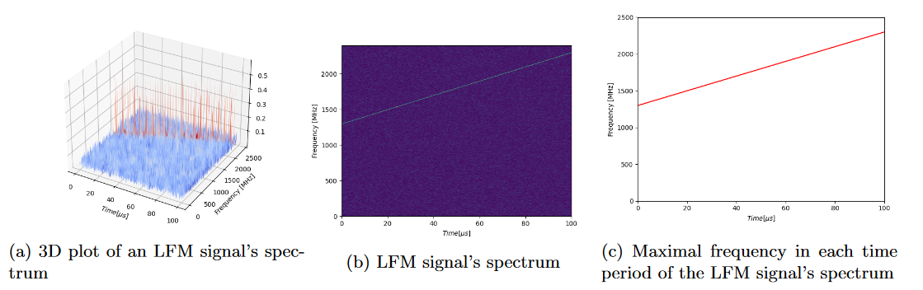
Overview of Fan & Li’s method
STFT of LFM signal:
Notes:
Mention that Fan and Li offer a proof for this

Slide 10
Overview of Fan & Li’s method
Extracting Maximas:
In each time window we extract only the maximal frequency
This transforms the 2D time-frequency image into a 1D time-frequency curve
Median Filtering:
These filters are usually used to filter random “salt and pepper” type noise from an image without hurting its quality
Each pixel takes the value of the median of its neighboring pixels:

Slide 11
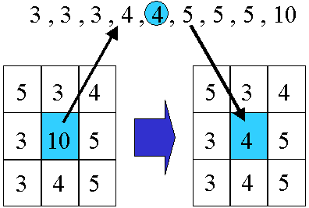
Overview of Fan & Li’s method
Median Filtering:
In 2D:

Slide 12
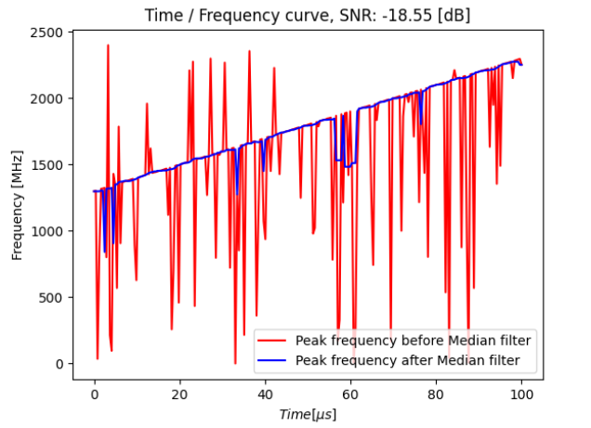
Overview of Fan & Li’s method
Median Filtering:
In Fan and Li’s approach a 1D median filter is used to filter out “glitch frequencies”:

Slide 13
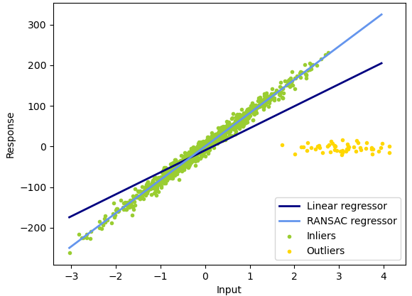
Overview of Fan & Li’s method
RANSAC:
Random Sample Consensus – Used to find the parameters of the line which fits the data best.
Aims to make a distinction between data points that belong to the actual function- “inliers” and points that are caused by noise “outliers”:

Slide 14
Overview of Fan & Li’s method
RANSAC:
In our case, the RANSAC algorithm works like so:
For a given number of iterations:
1) Draw 2 points from the data at random
2) Construct a line according to these points
3) If the number of points that “agree” with this line is more than a given threshold – continue, else- return to step 1
4) Build a refined model according the points that “agree” with the line
5) If the error of the refined model over the points that “agree” with is the best we have seen so far – save it as the output
Notes:
Explain that RANSAC does more than find straight lines

Slide 15
Our innovation – Using Hough transform
Our proposed modification to the process described by Fan and Li is to use the Hough transform instead of RANSAC in order to find parameters for multiple LFM signals at once, or to find the parameters of a single LFM signal which changes over time
The Hough transform is more computationally demanding than RANSAC, but its advantage is that it can find multiple lines in one image:

Slide 16
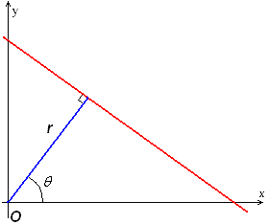

Our innovation – Using Hough transform
The Hough Transform:
Lines can be described by $(r, Θ)$ as follows: $r=xcosΘ+ysinΘ$

Slide 17
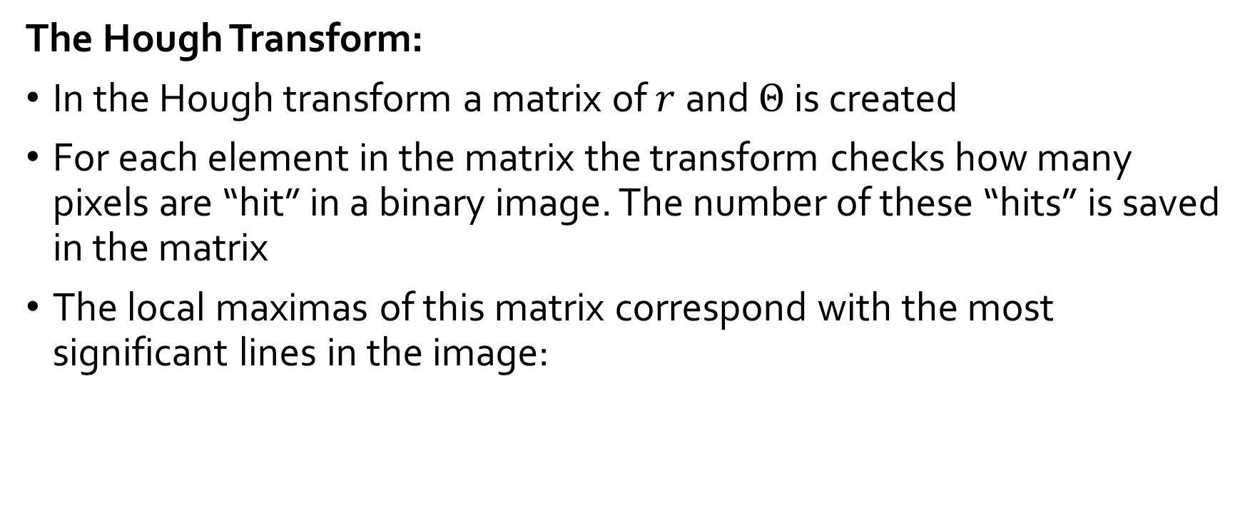
Our innovation – Using Hough transform
The Hough Transform:
In the Hough transform a matrix of $r$and $Θ$ is created
For each element in the matrix the transform checks how many pixels are “hit” in a binary image. The number of these “hits” is saved in the matrix
The local maximas of this matrix correspond with the most significant lines in the image:

Slide 18
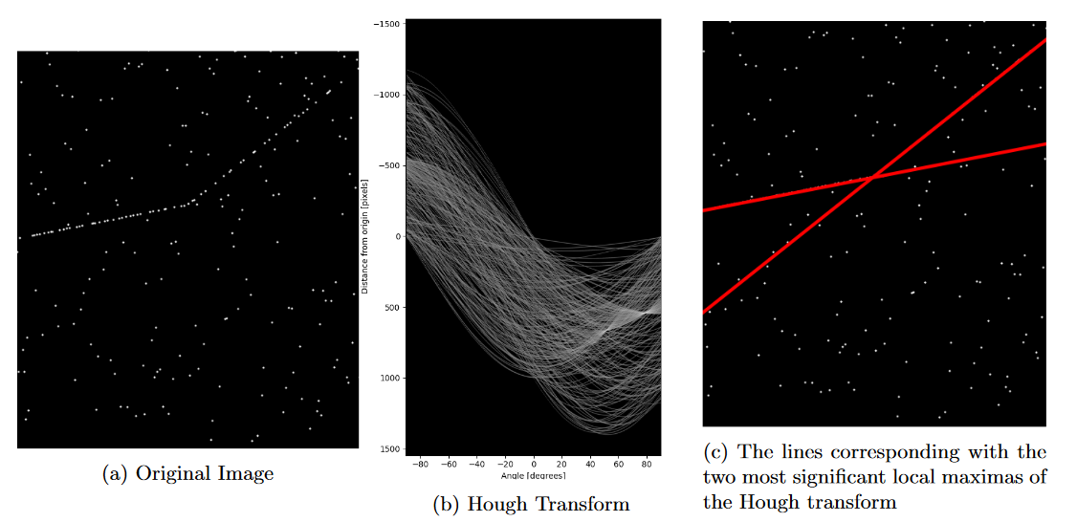
Our innovation – Using Hough transform
The Hough Transform:

Slide 19
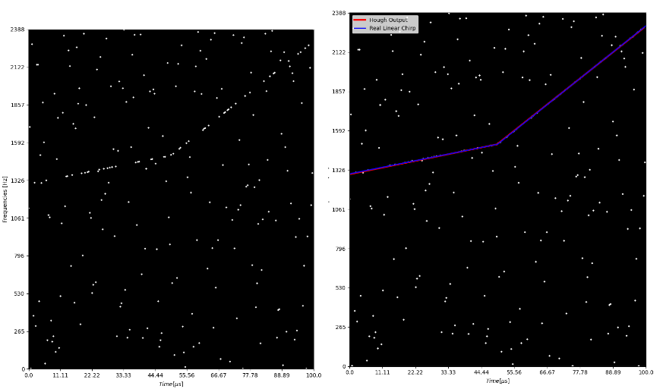
Our innovation – Using Hough transform
Parameter changes mid-chirp:
As part of our modification, we suggest a system that fits parameters to different sections of a chirp signal which changes “mid-chirp”:
Notes:
Talk about why this may be useful

Slide 20
Our innovation – Using Hough transform
Parameter changes mid-chirp:
Our system works as follows:
Calculate STFT
Extract maximas
Morphologically dilate the image
Run the Hough transform, extract the 2 most significant lines from it
Find the lines intersection point, split the image along the x-axis according to it
Check the ”score” for each line at each image in order to determine which line belongs where
Notes:
Explain that this can be extended to any number of changes

Slide 21
Tests and Simulations
Define evaluation method
Test using RANSAC
Test using Hough Transform

Slide 22
Tests and Simulations - Evaluation
Correct rate of estimation – CRE
The division between the times estimated correctly and the total trial number, and the correct estimation is that the error of estimation is in range of ±1% of the real parameter.
Notes:
הדרך לייצג "כמה נכונה ההערכה שלנו" היא ע"י CRE
היחס בין מס' הפעמים שצדקנו בהערכת העקומה לבין מס' הפעמים שהערכנו את העקומה
הערכה נכונה היא בטווח של 1 אחוז מהערך האמיתי

Slide 23
Tests and Simulations - RANSAC
Create 100 trials (1500 chirps):
1 chirp signal
15 different noise variation
Use STFT
Extracting Maximas & Median Filtering
Compare 3 methods of estimation:
RANSAC
RANSAC with median filter
LSM
Notes:
....

Slide 24
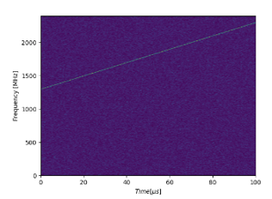
Tests and Simulations - RANSAC
Create 100 trials:
1 chirp signal
15 different noise variation
Use STFT
Extracting Maximas & Median Filtering
Compare 3 methods of estimation:
RANSAC
RANSAC with median filter
LSM
Notes:
....

Slide 25
Tests and Simulations - RANSAC
Create 100 trials:
1 chirp signal
15 different noise variation
Use STFT
Extracting Maximas & Median Filtering
Compare 3 methods of estimation:
RANSAC
RANSAC with median filter
LSM
Notes:
....

Slide 26
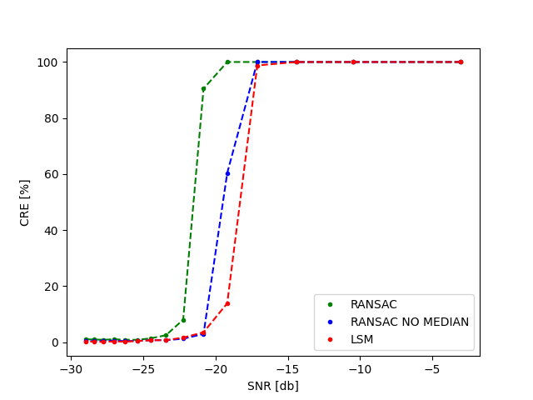
Tests and Simulations - RANSAC
Create 100 trials:
1 chirp signal
15 different noise variation
Use STFT
Extracting Maximas & Median Filtering
Compare 3 methods of estimation:
RANSAC
RANSAC with median filter
LSM
Notes:
....

Slide 27
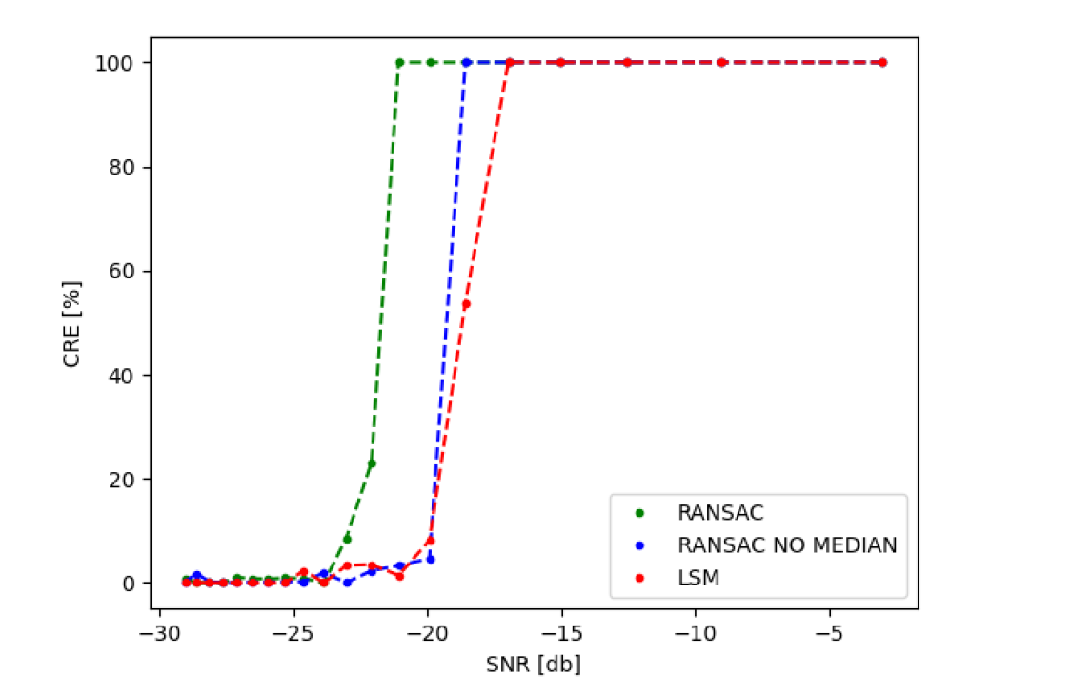
Tests and Simulations - RANSAC
Graph of CRE against SNR

Slide 28
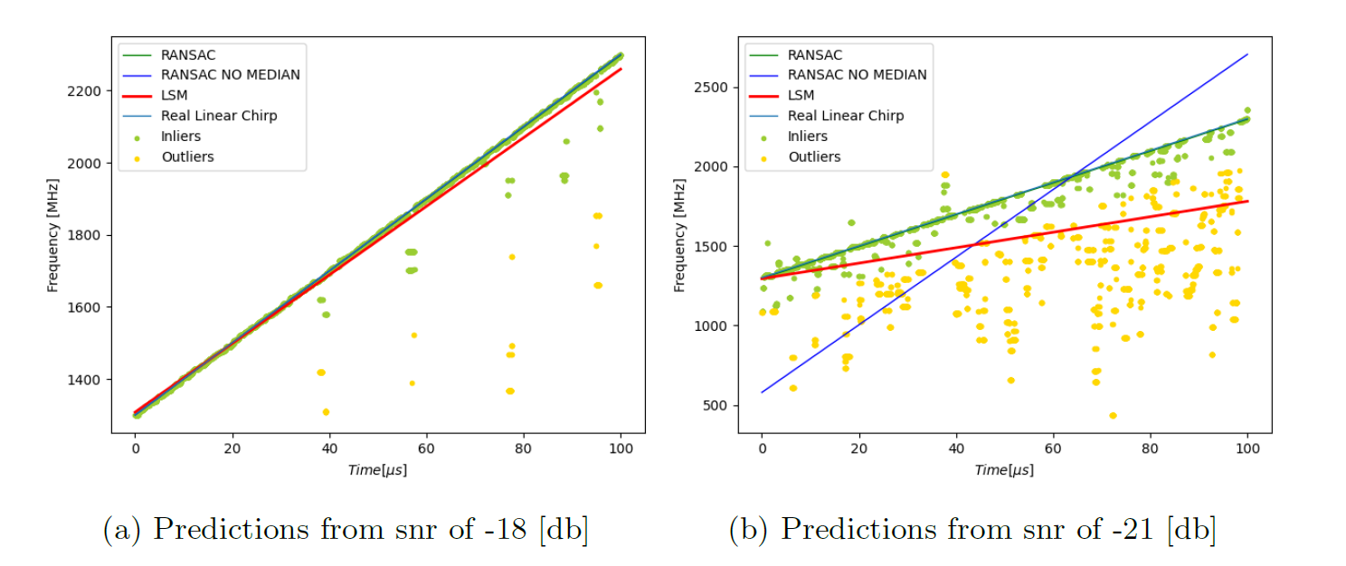
Tests and Simulations - RANSAC
Example of estimations

Slide 29
Tests and Simulations - Hough
Create 100 trials:
2 different chirp signals
15 different noise variation
Use STFT
Extract 2 time frequency curves using Hough transform
Evaluate CRE of each curve –Left & Right

Slide 30
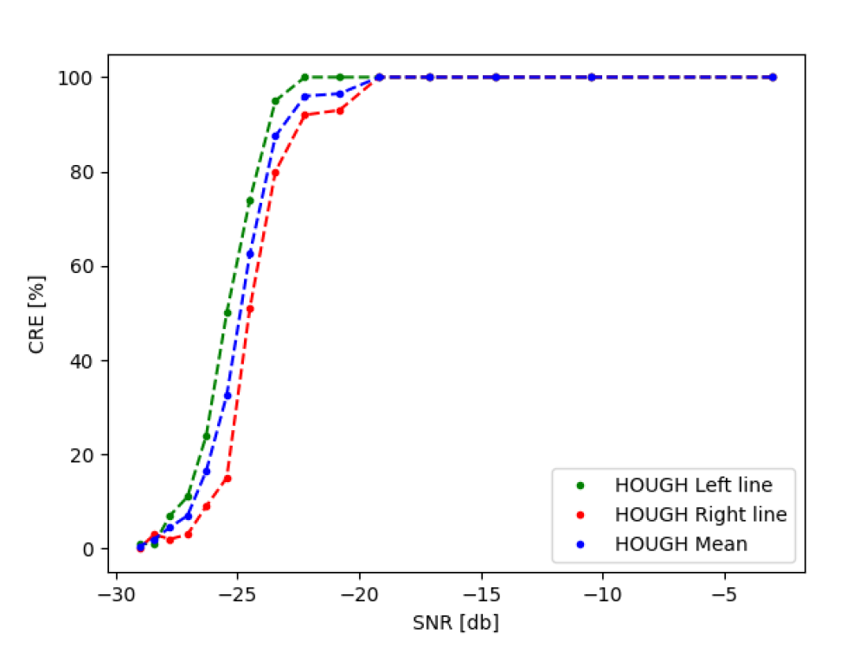
Tests and Simulations - Hough
Graph of CRE against SNR

Slide 31
Conclusions
Chirp estimation using RANSAC is superior than LSM
Median Filter is a helpful tool in smoothing the noisy curves
Hough Transform is good as RANSAC in estimating linear chirp signals
Hough Transform can estimate changing linear chirps

