Slide 1

Financial data – two sample applications

Slide 2

Outline
Full data pipeline with correlation and VaR

Slide 3

Outline
Full data pipeline with correlation and VaR
Loan default prediction

Slide 4
IMPORTANT: In the following we present two sample applications with basic features. These examples are meant to show our adesso bank-experts some examples on what we could do as a data team. Once we know what is important/interesting for our costumers we can focus there.

Slide 5
Full data pipeline with correlation and VaR

Slide 6
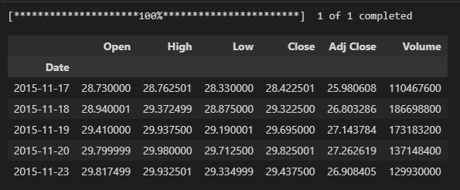
Full data pipeline with correlation and VaR
Data collection
We obtain data from the yahoo-finance package
import yfinance as yf symbol = "AAPL"
interval = "1d"
str_start = "2015-11-17"
str_end = "2016-11-17"
df = yf.download(tickers = symbol, interval = interval,start=str_start, end=str_end)
df.head()

Slide 7
Full data pipeline with correlation and VaR
Database
In all steps we initially write into a staging table
and merge from there in the target table.
merge
CANDLE_DATA as target
using
CANDLE_DATA_STG as source
CANDLE_DATA_STG
CANDLE_DATA
df.to_sql(name=table_name + "_STG",if_exists='replace',con = eng, index = False)

Slide 8
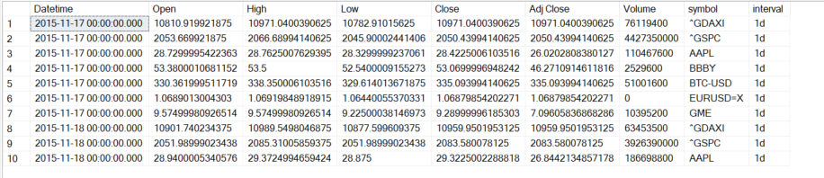
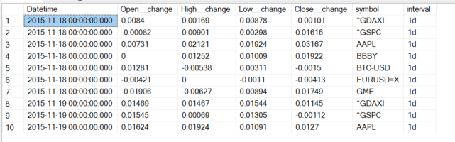
Full data pipeline with correlation and VaR
Relative change
Calculated as relative change based on previous value;
Could possibly merge dinto a single table

Slide 9
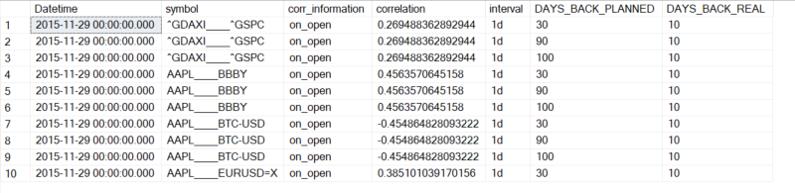
Full data pipeline with correlation and VaR
Correlation

Slide 10
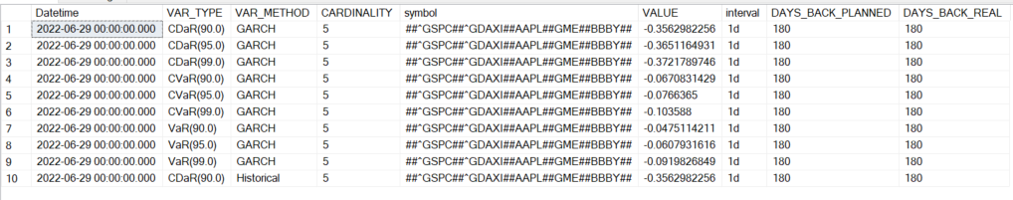
Full data pipeline with correlation and VaR
Value at Risk (VaR)
Calculated
measures
Method
used
Calculated for
these values
(cardinality = # symbols used)

Slide 11
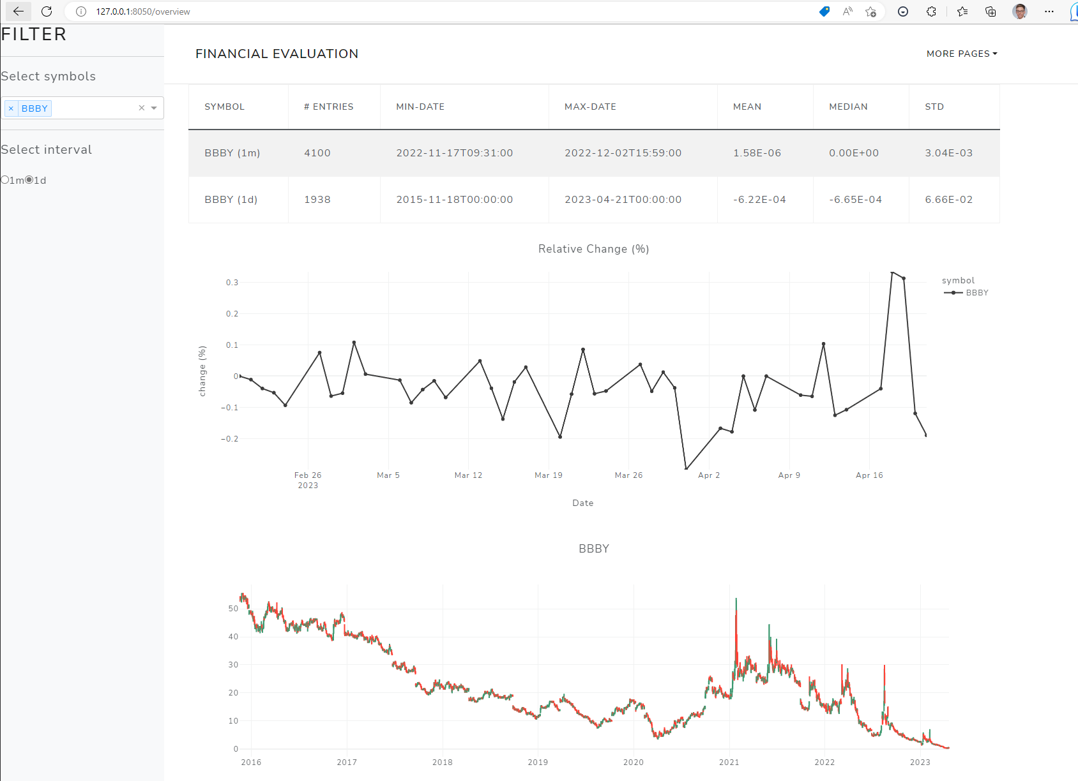
Full data pipeline with correlation and VaR
Visualization - overview
http://127.0.0.1:8050/overview: Overview over the symbols from the database

Slide 12
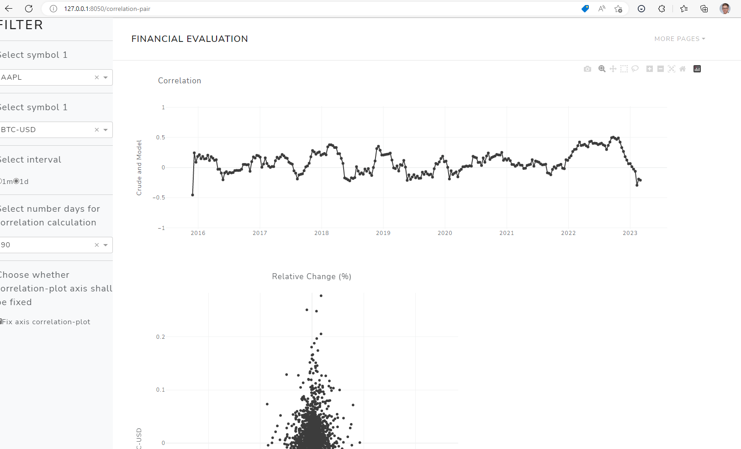
Full data pipeline with correlation and VaR
Visualization - correlation
http://127.0.0.1:8050/correlation-pair: Comparison correlation between two symbols

Slide 13
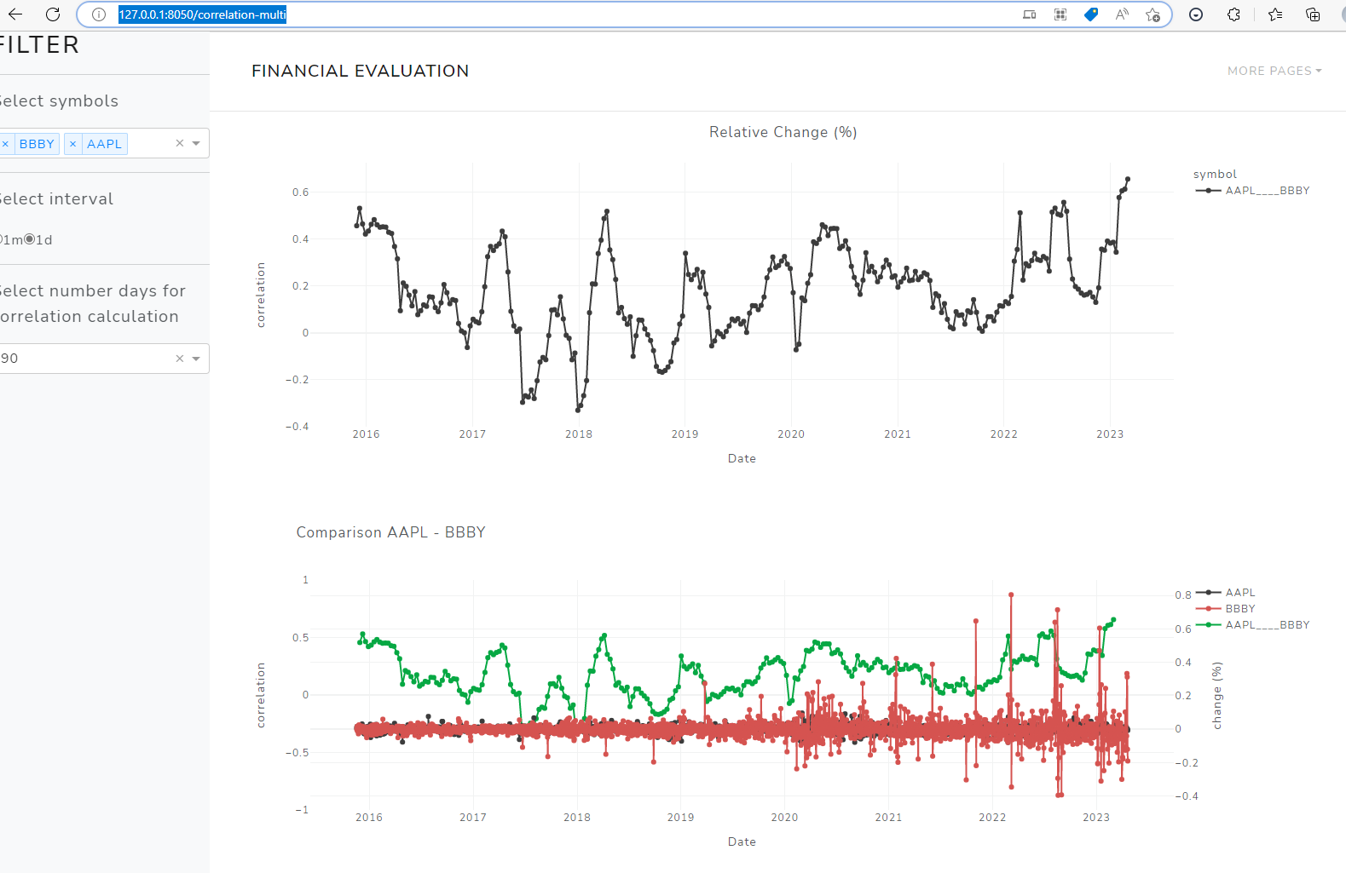
Full data pipeline with correlation and VaR
Visualization - correlation
http://127.0.0.1:8050/correlation-multi: Comparison correlation multiple symbols

Slide 14
Loan default prediction

Slide 15
Loan default prediction
Assumption: 205 loans
182 loans payed back, average profit: 4.000 $
23 loans default, average loss: 30.000$
Policy 1: Give every costumer a loan
Earned: 38.000 $
Policy 2: Loan only to certain costumers
Earned: 106.000 $

Slide 16
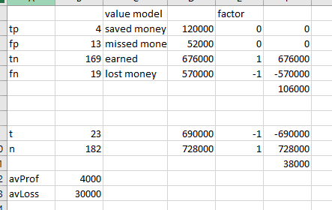
Loan default prediction

Slide 17
Loan default prediction
Berka dataset
The Berka dataset is a collection of financial information from a Czech bank. The dataset deals with over 5,300 bank clients with approximately 1,000,000 transactions. Additionally, the bank represented in the dataset has extended close to 700 loans and issued nearly 900 credit cards, all of which are represented in the data.
CARD
LOAN
DISP
ORDER
ACCOUNT
CLIENT
TRANS
What can we do with
these data?
DISTRICT

Slide 18
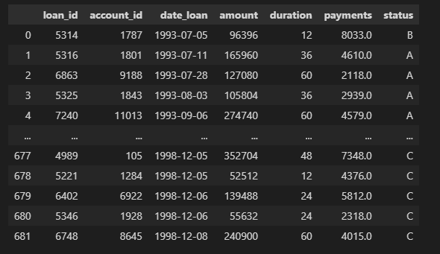
Loan default prediction
Loan defaults
Credit Card Analysis of Czech Bank | Domain (charlotte.edu)
'A' stands for contract finished, no problems 'B' stands for contract finished, loan not payed 'C' stands for running contract, OK thus-far 'D' stands for running contract, client in debt

Slide 19
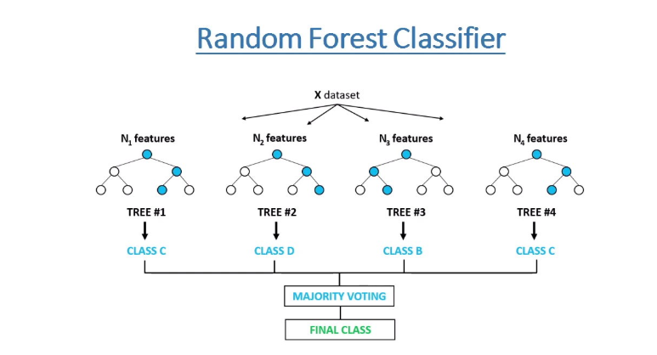
Loan default prediction
Loan default prediction
- Presents estimates for
variable importance
- Good for working with missing data
- Can balance datasets

Slide 20
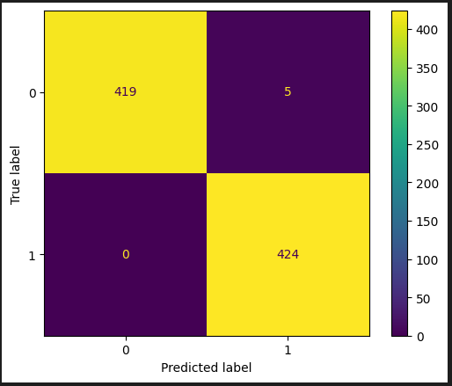
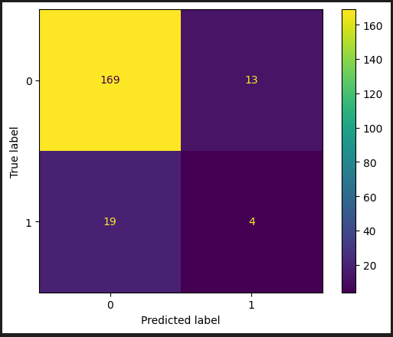
Loan default prediction
Performance
Training (oversampling)
Testing

Slide 21
Summary
We presented two sample applications on financial data.
Where to go from here?
Before wasting time it is important to talk now with bank-experts on what could be interesting for our costumers.

