Slide 1
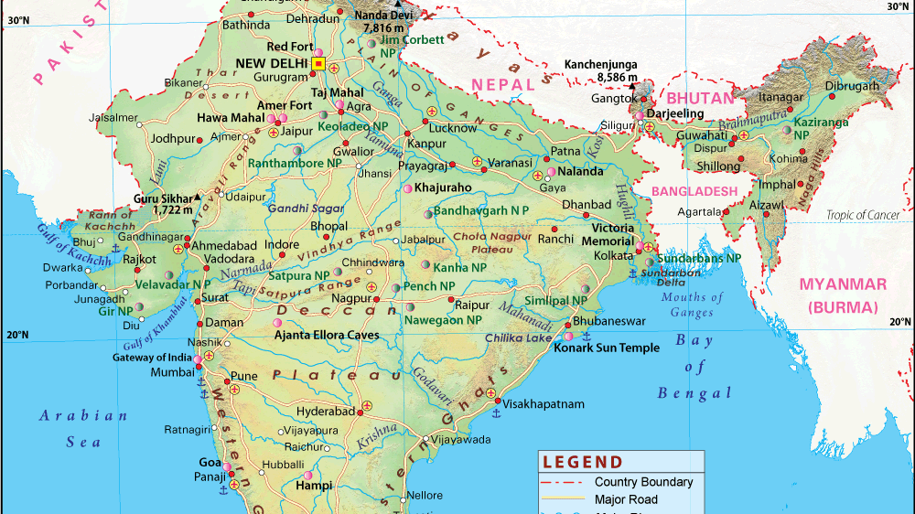
Scraping & Manipulating Data from the South Asia Terrorism Portal
Emily Tallo
PLSC31101 Final Project

Slide 2
Approach
Goal: add data to project about how terrorist attacks by state-sponsored terror groups → interstate crises in South Asia
Data: India, 2000-2018
Major terrorist incidents
Dates of incidents
Plan:
Webscrape from 19 tables
Extract the named entities (locations, terror groups)
Visualize the data

Slide 3
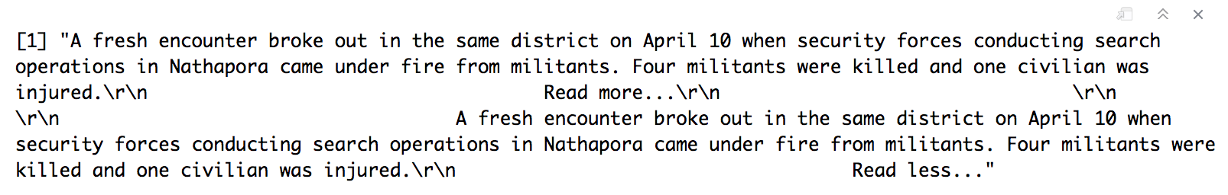
Challenge #1: Webscraping
Webscraping the right data required attention to detail, customization
Created a function to remove:
Duplication
Whitespace
Formatting

Slide 4
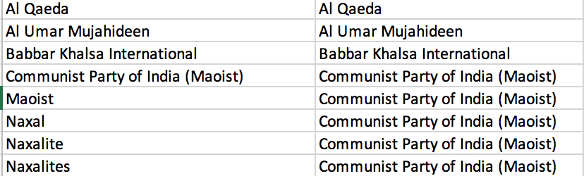
Challenge #2: Extracting Named Entities
OpenNLP, MonkeyLearn packages didn’t work
Manual route:
Create dictionaries (.csvs) of entities - states, districts, terrorist organizations
Preprocess text - standardize spellings, lowercase
Function to extract match entities in column 1, print entities in column 2
Result: dataframe with date, incident text, district, state, and named terrorist organization

Slide 5
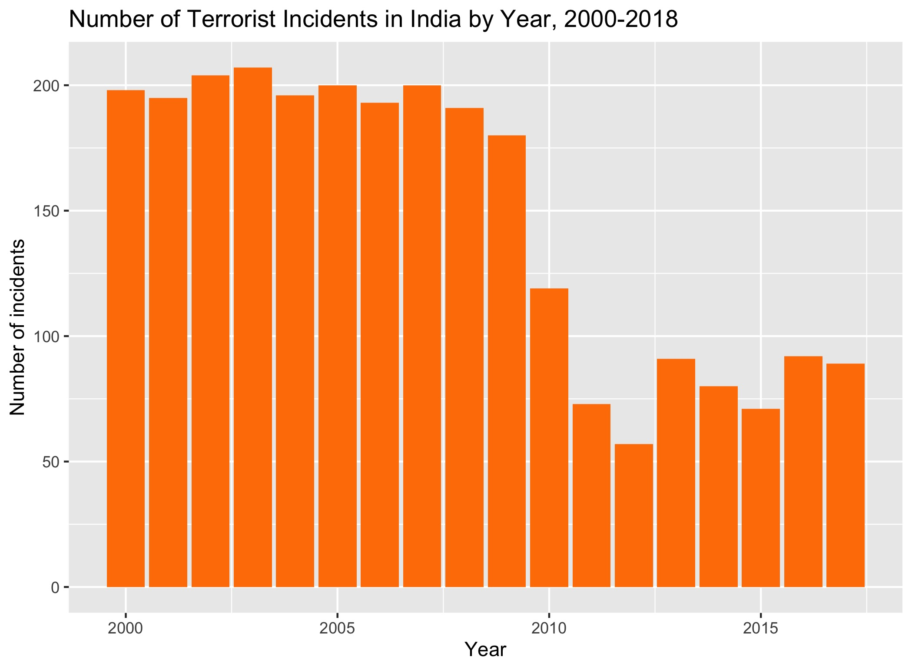
Analysis & Going Forward

Slide 6
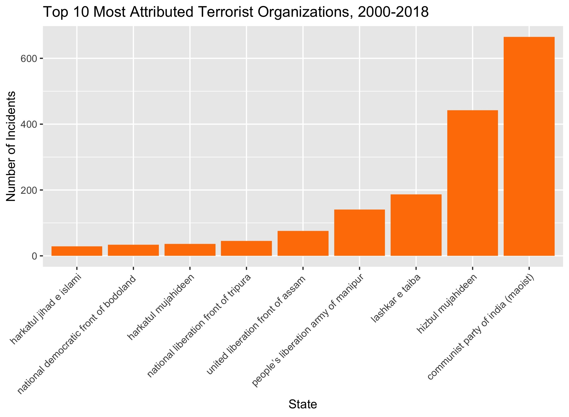
Analysis & Going Forward

Slide 7
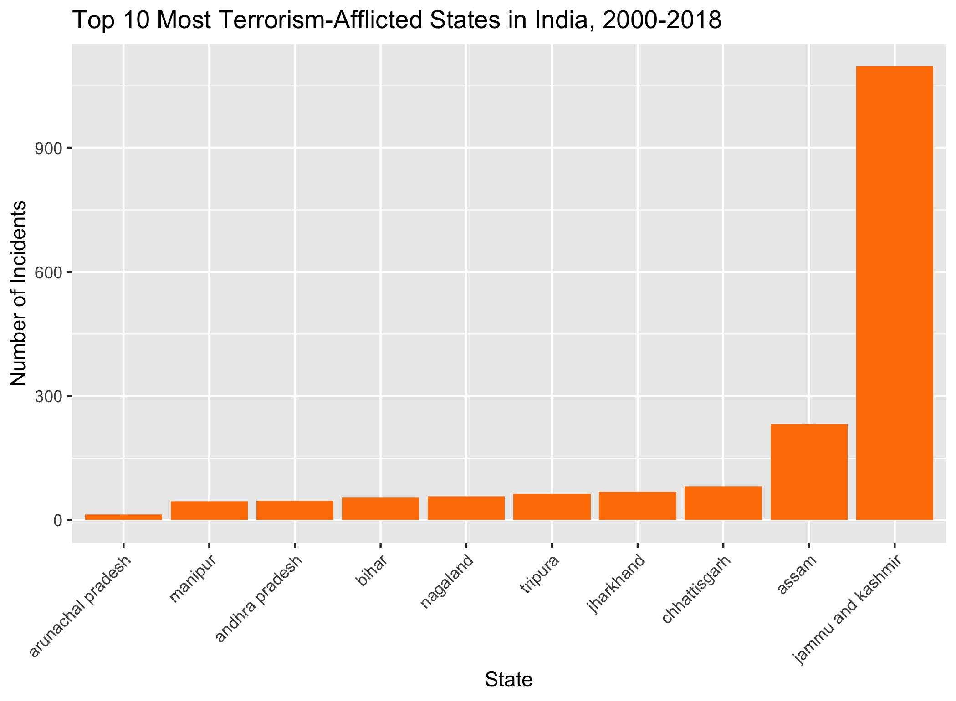
Analysis & Going Forward

