Slide 1
Verifying wallets Light clients and SSZ
Devcon 2024 Bangkok

Slide 2

Wallet
4.75 ETH
ETH balance
0.1 BTC
Tokens / NFTs
Metadata
Balances & allowances
Exchange rates
500 USDC
→ theprotocolguild.eth 2024-11-12 –50 USDC
History
Transaction details
Fees & gas usage
Staking operations & rewards
No missing entries
← vitalik.eth 2024-11-11 1 ETH
🎉 Block #123 produced 2024-11-09 0.08 ETH

Slide 3

ETH balance
😇
4.75 ETH
“trust me bro”
0.1 BTC
eth_getBalance
Web3 API provider
500 USDC
4.75 ETH
→ theprotocolguild.eth 2024-11-12 –50 USDC
🕵️‍♀️
← vitalik.eth 2024-11-11 1 ETH
IP | Wallet
123.xyz.0.0 | 0x131..aF8
123.xyz.0.0 | 0x42a..E02
🎉 Block #123 produced 2024-11-09 0.08 ETH

Slide 4
ETH balance (trust-minimized)
4.75 ETH
/eth/v1/beacon/light_client
Beacon API provider
0.1 BTC
Root hash
Light client data
500 USDC
→ theprotocolguild.eth 2024-11-12 –50 USDC
eth_getProof
Web3 API provider
← vitalik.eth 2024-11-11 1 ETH
4.75 ETH
Merkle proof
🎉 Block #123 produced 2024-11-09 0.08 ETH
(may use anonymizing network)

Slide 5
ETH balance (with purifier)
Wallet
Web3 purifier
Beacon API provider
/eth/v1/beacon/light_client
Root hash
Light client data
eth_getProof
Web3 API provider
eth_getBalance
4.75 ETH
4.75 ETH
Merkle proof
(may use anonymizing network)

Slide 6
Wallet
🥰
4.75 ETH
ETH balance
0.1 BTC
Tokens / NFTs
Metadata
Balances & allowances
Exchange rates
500 USDC
→ theprotocolguild.eth 2024-11-12 –50 USDC
History
Transaction details
Fees & gas usage
Staking operations & rewards
No missing entries
← vitalik.eth 2024-11-11 1 ETH
🎉 Block #123 produced 2024-11-09 0.08 ETH

Slide 7

Token balance
4.75 ETH
Web3 purifier
eth_call
EVM
eth_getCode
eth_getProof
0.1 BTC
0.1 BTC
Code
Code
Proof
500 USDC
Web3 API
→ theprotocolguild.eth 2024-11-12 –50 USDC
eth_getStorageAt
eth_getProof
← vitalik.eth 2024-11-11 1 ETH
State database
Data
Data
Proof
🎉 Block #123 produced 2024-11-09 0.08 ETH

Slide 8
Wallet
🥰
4.75 ETH
ETH balance
0.1 BTC
Tokens / NFTs
Metadata
Balances & allowances
Exchange rates
🫤
Access lists are best effort
Lots of round trips
500 USDC
→ theprotocolguild.eth 2024-11-12 –50 USDC
History
Transaction details
Fees & gas usage
Staking operations & rewards
No missing entries
← vitalik.eth 2024-11-11 1 ETH
🎉 Block #123 produced 2024-11-09 0.08 ETH

Slide 9
Transaction details
4.75 ETH
📤
From address
0.1 BTC
To address
📥
500 USDC
💰
Value transferred
→ theprotocolguild.eth 2024-11-12 –50 USDC
📆
Transaction data
← vitalik.eth 2024-11-11 1 ETH
🎉 Block #123 produced 2024-11-09 0.08 ETH
⛽️
Gas fees

Slide 10
Transaction details
Web3 API
4.75 ETH
Transactions Merkle-Patricia Trie
0.1 BTC
tx_hash
(no on-chain commitment)
500 USDC
→ theprotocolguild.eth 2024-11-12 –50 USDC
MPT type
Type
Transaction data
Signature
← vitalik.eth 2024-11-11 1 ETH
ecrecover
Sender address
🎉 Block #123 produced 2024-11-09 0.08 ETH
sig_hash
Nonce
(create tx)
Contract address

Slide 11
Transaction details
Web3 API
4.75 ETH
Receipts Merkle-Patricia Trie
0.1 BTC
500 USDC
→ theprotocolguild.eth 2024-11-12 –50 USDC
MPT type
Type
Status
Cumulative gas used
Logs Bloom
Logs
n - 1
← vitalik.eth 2024-11-11 1 ETH
MPT type
Type
Status
Cumulative gas used
Logs Bloom
Logs
n
🎉 Block #123 produced 2024-11-09 0.08 ETH
Gas used

Slide 12
Transaction details
Full tx data required
Expensive ecrecover
4.75 ETH
📤
From address
0.1 BTC
CREATE contract address requires from address
📥
To address
500 USDC
💰
Value transferred
→ theprotocolguild.eth 2024-11-12 –50 USDC
✅
📆
Transaction date
← vitalik.eth 2024-11-11 1 ETH
Tx type inconsistencies
Inefficient hashes
🎉 Block #123 produced 2024-11-09 0.08 ETH
⛽️
Gas fees
Full data required incl logs
Prior receipt needed

Slide 13
Wallet
🥰
4.75 ETH
ETH balance
0.1 BTC
Tokens / NFTs
Metadata
Balances & allowances
Exchange rates
🫤
Access lists are best effort
Lots of round trips
500 USDC
→ theprotocolguild.eth 2024-11-12 –50 USDC
History
Transaction details
Fees & gas usage
Staking operations & rewards
No missing entries
🤯
← vitalik.eth 2024-11-11 1 ETH
🎉 Block #123 produced 2024-11-09 0.08 ETH

Slide 14
History
4.75 ETH
Contract address
Topic 0
Topic 1
Topic 2
Topic 3
Data
0.1 BTC
USDC
Transfer
From
To
n/a
Value
500 USDC
USDC
Approval
Owner
Spender
n/a
Value
→ theprotocolguild.eth 2024-11-12 –50 USDC
eth_getLogs(address/topic)
Web3 API provider
← vitalik.eth 2024-11-11 1 ETH
Log 1
Log 2
Log 3
🎉 Block #123 produced 2024-11-09 0.08 ETH
Fetch corersponding tx / receipt

Slide 15
History (withholding mitigation)
4.75 ETH
Contract address
Topic 0
Topic 1
Topic 2
Topic 3
Data
0.1 BTC
USDC
Transfer
From
To
n/a
Value
500 USDC
USDC
Approval
Owner
Spender
n/a
Value
→ theprotocolguild.eth 2024-11-12 –50 USDC
← vitalik.eth 2024-11-11 1 ETH
Logs Bloom
Logs Bloom
Logs Bloom
lots of false positives
🎉 Block #123 produced 2024-11-09 0.08 ETH
Block #200
Block #201
Block #202
⚠️
Get all block headers, check Bloom, get all transactions / receipts…

Slide 16
Wallet
🥰
4.75 ETH
ETH balance
0.1 BTC
Tokens / NFTs
Metadata
Balances & allowances
Exchange rates
🫤
Access lists are best effort
Lots of round trips
500 USDC
→ theprotocolguild.eth 2024-11-12 –50 USDC
History
Transaction details
Fees & gas usage
Staking operations & rewards
No missing entries
🤯
← vitalik.eth 2024-11-11 1 ETH
🎉 Block #123 produced 2024-11-09 0.08 ETH
😡
Terribly inefficient
🚫
ETH transfers
from smart contracts

Slide 17
EIP-7708: ETH transfers emit a log
4.75 ETH
Contract address
Topic 0
Topic 1
Topic 2
Topic 3
Data
0.1 BTC
System
Transfer
From
To
n/a
Value
500 USDC
System
Fee
From
n/a
n/a
Value
→ theprotocolguild.eth 2024-11-12 –50 USDC
Transfer log
Transaction start
Nonzero-value CALL
Nonzero-value SELFDESTRUCT
Fee log
Transaction end
← vitalik.eth 2024-11-11 1 ETH
🎉 Block #123 produced 2024-11-09 0.08 ETH
✅
Accurate ETH balance history is available (without local EVM)

Slide 18
EIP-7668: Remove bloom filters
4.75 ETH
Receipts Merkle-Patricia Trie
Bloom verification requires
full receipt data (incl logs)
0.1 BTC
500 USDC
→ theprotocolguild.eth 2024-11-12 –50 USDC
MPT type
Type
Status
Cumulative gas used
Logs Bloom
Logs
← vitalik.eth 2024-11-11 1 ETH
Remove Logs Bloom
Saves 256 bytes per transaction
🎉 Block #123 produced 2024-11-09 0.08 ETH
✅
ETH transfer logs can be stored in saved disk space

Slide 19
EIP-7792: Verifiable logs
EIP-7745: Two dimensional log filter data structure
4.75 ETH
Accumulator
n - 1
n - 2
…
0.1 BTC
Log entry
Log entry
Log entry
500 USDC
Meta
Log
Separate accumulator per filter
Address
Topic
Address & topic combination
Accumulators stored in state
Fetchable with eth_getProof
→ theprotocolguild.eth 2024-11-12 –50 USDC
Block
Tx index
← vitalik.eth 2024-11-11 1 ETH
🎉 Block #123 produced 2024-11-09 0.08 ETH
Timestamp
Block number
✅
Incomplete eth_getLogs responses can be detected

Slide 20
EIP-7799: System logs
4.75 ETH
Contract address
Topic 0
Topic 1
Topic 2
Topic 3
Data
0.1 BTC
System
Priority
Rewards
To
n/a
n/a
Value
500 USDC
System
With-drawal
To
n/a
n/a
Value
→ theprotocolguild.eth 2024-11-12 –50 USDC
Priority Fees (EIP-1559)
No longer paid after each tx
Single combined credit after all txs
Better parallel tx execution
← vitalik.eth 2024-11-11 1 ETH
System logs root
🎉 Block #123 produced 2024-11-09 0.08 ETH
Block #456
✅
Accurate staking reward tracking (without historical block headers)

Slide 21
Wallet
🥰
4.75 ETH
ETH balance
0.1 BTC
Tokens / NFTs
Metadata
Balances & allowances
Exchange rates
🫤
Access lists are best effort
Lots of round trips
500 USDC
→ theprotocolguild.eth 2024-11-12 –50 USDC
History
Transaction details
Fees & gas usage
Staking operations & rewards
No missing entries
🤯
← vitalik.eth 2024-11-11 1 ETH
🎉 Block #123 produced 2024-11-09 0.08 ETH
😡
Terribly inefficient
🚫
ETH transfers
from smart contracts

Slide 22
EIP-6466: SSZ receipts
4.75 ETH
MPT type
Type
Status
Cumulative gas used
Logs Bloom
Logs
0.1 BTC
StableContainer
Forward compatibility
Remove
500 USDC
Tx gas used
Prior receipt no longer needed
Better parallel tx execution
SSZ binary tree
Proofs for partial data
Simpler L2 bridge designs
→ theprotocolguild.eth 2024-11-12 –50 USDC
← vitalik.eth 2024-11-11 1 ETH
Add From, Contract (CREATE), and Authority (EIP-7702) addresses
Transaction data and ecrecover no longer needed for verification
Reduced dependency on EVM internals
🎉 Block #123 produced 2024-11-09 0.08 ETH
✅
On-chain commitments to relevant data (fewer round trips, more efficient)

Slide 23
EIP-7706: Separate gas types
4.75 ETH
Nonce
Max fee per gas
Gas limit
To
Value
Input
Replayable signature
Legacy
Nonce
Max fee per gas
Gas limit
To
Value
Input
Signature
+ Chain ID
EIP-155
0.1 BTC
0x01
Chain ID
Nonce
Max fee per gas
Gas limit
To
Value
Input
Access list
Sig
500 USDC
0x02
Chain ID
Nonce
Prio fee per gas
Max fee per gas
Gas limit
To
Value
Input
Access list
Sig
0x03
Chain ID
Nonce
Prio fee per gas
Max fee per gas
Gas limit
To
Value
Input
Access list
Fee per blob gas
Blob hashes
Sig
→ theprotocolguild.eth 2024-11-12 –50 USDC
0x04
Chain ID
Nonce
Prio fee per gas
Max fee per gas
Gas limit
To
Value
Input
Access list
Auth list
Sig
← vitalik.eth 2024-11-11 1 ETH
🎉 Block #123 produced 2024-11-09 0.08 ETH
0x06
Chain ID
Nonce
Gas limit
To
Value
Input
Access list
Blob hashes
Auth list
Max fees per gas
Prio fees per gas
Sig
✅
Normalized gas fee computation

Slide 24
EIP-6404: SSZ transactions
4.75 ETH
RLP type
Nonce
Gas limit
To
Value
Input
Max fees per gas
Sig
RLP type
Chain ID
Nonce
Gas limit
To
Value
Input
Max fees per gas
Sig
0.1 BTC
RLP type
Chain ID
Nonce
Gas limit
To
Value
Input
Access list
Max fees per gas
Sig
500 USDC
RLP type
Chain ID
Nonce
Gas limit
To
Value
Input
Access list
Max fees per gas
Prio fees per gas
Sig
RLP type
Chain ID
Nonce
Gas limit
To
Value
Input
Access list
Blob hashes
Max fees per gas
Prio fees per gas
Sig
→ theprotocolguild.eth 2024-11-12 –50 USDC
RLP type
Chain ID
Nonce
Gas limit
To
Value
Input
Access list
Auth list
Max fees per gas
Prio fees per gas
Sig
← vitalik.eth 2024-11-11 1 ETH
🎉 Block #123 produced 2024-11-09 0.08 ETH
RLP type
Chain ID
Nonce
Gas limit
To
Value
Input
Access list
Blob hashes
Auth list
Max fees per gas
Prio fees per gas
Sig
✅
Type safety for different transaction profiles

Slide 25
EIP-7495: SSZ StableContainer
4.75 ETH
RLP type
n/a
Nonce
Gas limit
To
Value
Input
n/a
n/a
n/a
Max fees per gas
n/a
Sig
RLP type
Chain ID
Nonce
Gas limit
To
Value
Input
n/a
n/a
n/a
Max fees per gas
n/a
Sig
0.1 BTC
RLP type
Chain ID
Nonce
Gas limit
To
Value
Input
Access list
n/a
n/a
Max fees per gas
n/a
Sig
500 USDC
RLP type
Chain ID
Nonce
Gas limit
To
Value
Input
Access list
n/a
n/a
Max fees per gas
Prio fees per gas
Sig
RLP type
Chain ID
Nonce
Gas limit
To
Value
Input
Access list
Blob hashes
n/a
Max fees per gas
Prio fees per gas
Sig
→ theprotocolguild.eth 2024-11-12 –50 USDC
RLP type
Chain ID
Nonce
Gas limit
To
Value
Input
Access list
n/a
Auth list
Max fees per gas
Prio fees per gas
Sig
← vitalik.eth 2024-11-11 1 ETH
🎉 Block #123 produced 2024-11-09 0.08 ETH
RLP type
Chain ID
Nonce
Gas limit
To
Value
Input
Access list
Blob hashes
Auth list
Max fees per gas
Prio fees per gas
Sig
✅
Re-usable verifier (all profiles share stable SSZ merkleization)

Slide 26
EIP-6493: SSZ transaction signature scheme
4.75 ETH
BasicTransaction
EIP-1559 functionality
BlobTransaction
EIP-4844 functionality
SetCodeTransaction
EIP-7702 functionality
0.1 BTC
500 USDC
n/a
Chain ID
Nonce
Gas limit
To
Value
Input
Access list
n/a
n/a
Max fees per gas
Prio fees per gas
Sig
n/a
Chain ID
Nonce
Gas limit
To
Value
Input
Access list
Blob hashes
n/a
Max fees per gas
Prio fees per gas
Sig
→ theprotocolguild.eth 2024-11-12 –50 USDC
n/a
Chain ID
Nonce
Gas limit
To
Value
Input
Access list
n/a
Auth list
Max fees per gas
Prio fees per gas
Sig
← vitalik.eth 2024-11-11 1 ETH
🎉 Block #123 produced 2024-11-09 0.08 ETH
RLP type
Chain ID
Nonce
Gas limit
To
Value
Input
Access list
Blob hashes
Auth list
Max fees per gas
Prio fees per gas
Sig
✅
Native SSZ (no conversion back to RLP for sig_hash / tx_hash)

Slide 27
EIP-7807: SSZ execution blocks
4.75 ETH
Block metadata
Parent hash
Miner
State root
Number
Time-stamp
Extra data
Mix hash
Parent CL root
0.1 BTC
Gas accounting (separate gas types)
Operations
500 USDC
Gas limits
Gas used
Base fees
Excess gas
Transactions root
Withdrawals root
Receipts root
System logs root
→ theprotocolguild.eth 2024-11-12 –50 USDC
Removed fields (PoW era / Bloom)
Ommers hash
Difficulty
Block nonce
Logs Bloom
Requests hash
← vitalik.eth 2024-11-11 1 ETH
🎉 Block #123 produced 2024-11-09 0.08 ETH
✅
Merkle-Patricia Tries (MPT) removed, encoding and hashing normalized

Slide 28
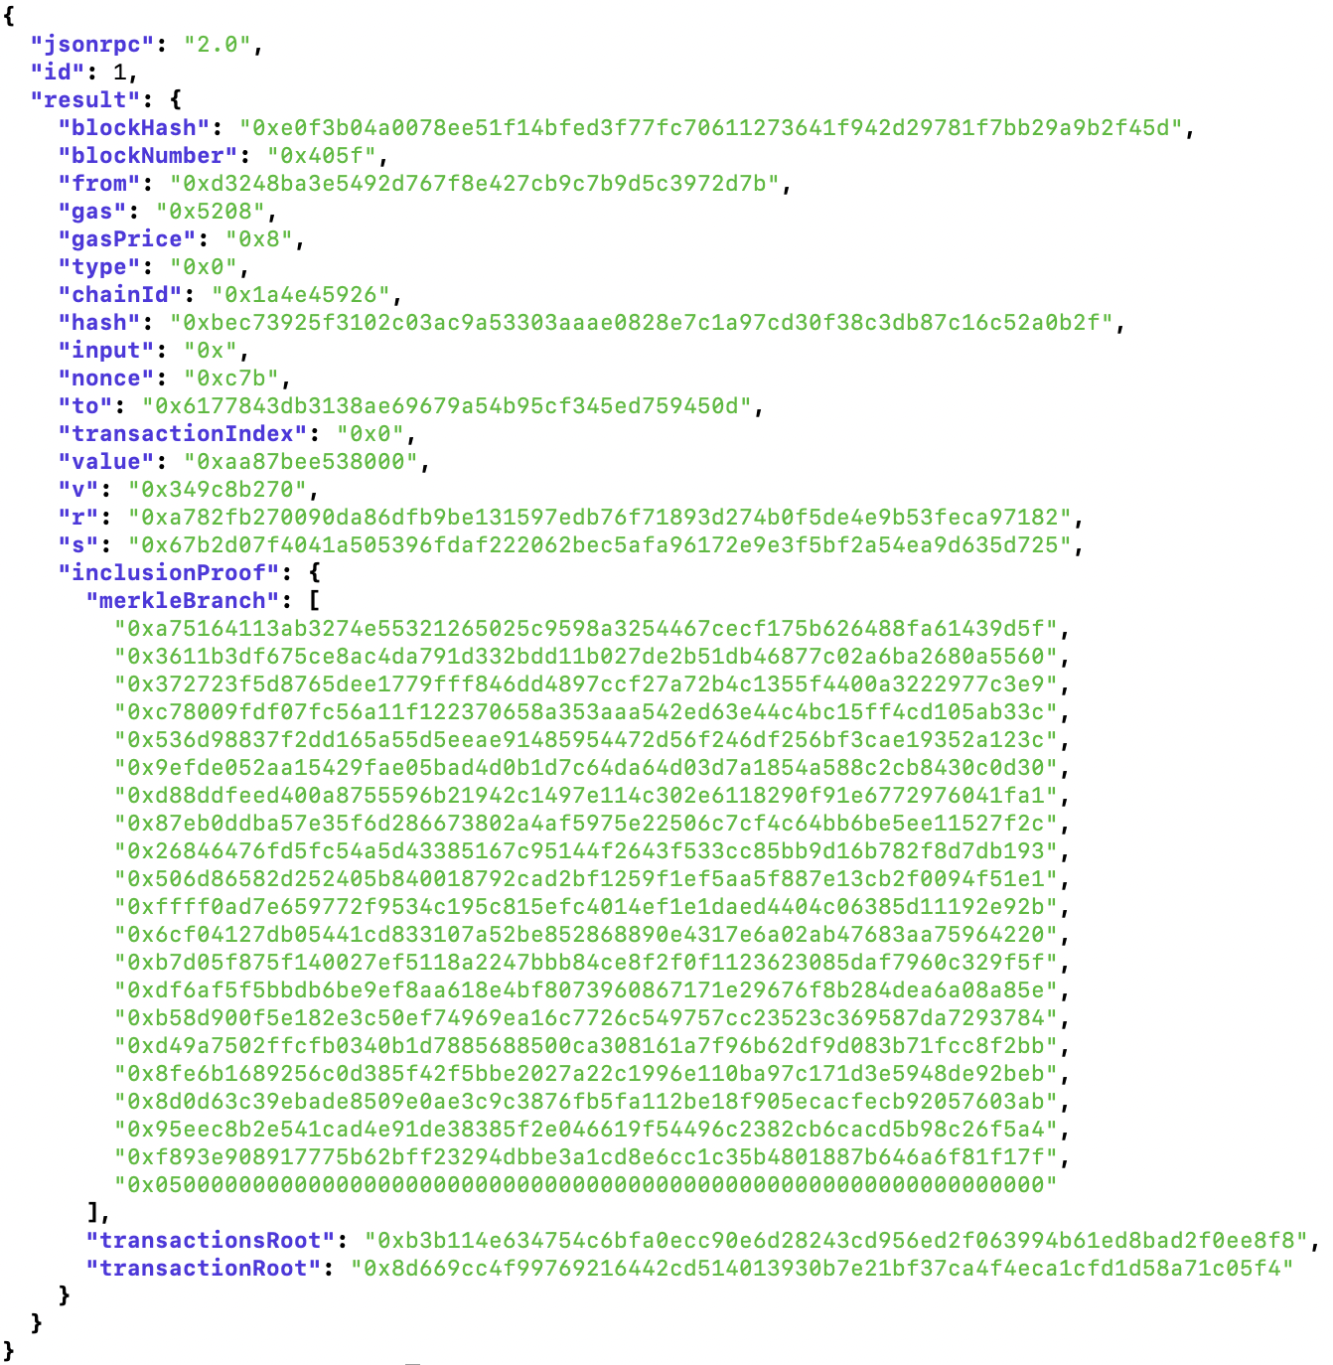
Inclusion proofs
4.75 ETH
0.1 BTC
500 USDC
→ theprotocolguild.eth 2024-11-12 –50 USDC
← vitalik.eth 2024-11-11 1 ETH
🎉 Block #123 produced 2024-11-09 0.08 ETH
No extra data
required to verify tx
✅

Slide 29
Wallet
🥰
4.75 ETH
ETH balance
0.1 BTC
Tokens / NFTs
Metadata
Balances & allowances
Exchange rates
🫤
Access lists are best effort
Lots of round trips
500 USDC
→ theprotocolguild.eth 2024-11-12 –50 USDC
History
Transaction details
Fees & gas usage
Staking operations & rewards
No missing entries
🤯
← vitalik.eth 2024-11-11 1 ETH
🎉 Block #123 produced 2024-11-09 0.08 ETH
😡
Terribly inefficient
🚫
ETH transfers
from smart contracts

Slide 30

Learn more
4.75 ETH
Devnet
Nimbus + EthereumJS + Helios
Buidling guides
Verifying wallets
Web3 purifiers
Developer tools
Kurtosis network config
RLP → SSZ converting explorer
SSZ StableContainer implementations
0.1 BTC
500 USDC
→ theprotocolguild.eth 2024-11-12 –50 USDC
https://purified-web3.box
← vitalik.eth 2024-11-11 1 ETH
🎉 Block #123 produced 2024-11-09 0.08 ETH

Slide 31


Related sessions
Gajinder Singh, Jason Chaskin
Today Verkle + Tomorrow ZK =
Everything Stateless, Everything Lightclient
Nov 13th — 4:30 PM - 5:00 PM Talk - Stage 2
Noah Citron
The Future of Light Clients
Nov 13th — 5:30 PM - 6:00 PM Talk - Stage 5

