Slide 1
EIP-7919 Pureth
Glamsterdam headliner proposal
19 Jun 2025

Slide 2
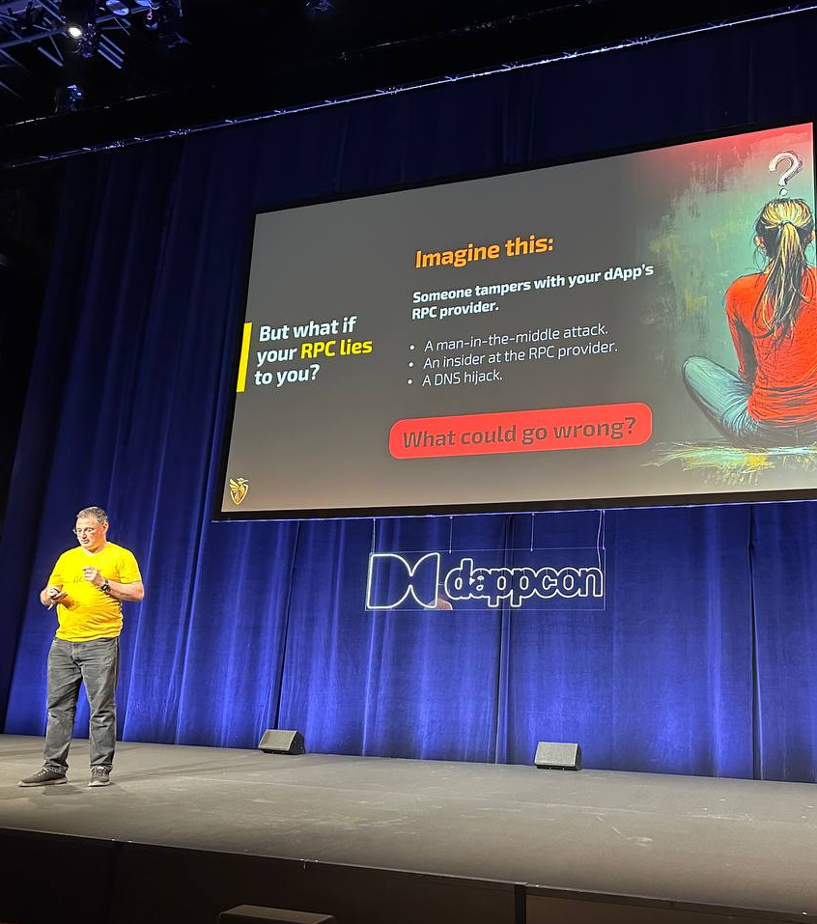
Don’t trust, verify
🔒 eth_getBalance
🔒 eth_getTransactionCount (nonce)
🔒 eth_getStorageAt
🔒 eth_getCode
🔒 eth_call
🔒 eth_estimateGas
✅ EIP-1186 eth_getProof
CorpusCore.tech - 16 Jun 2025

Slide 3

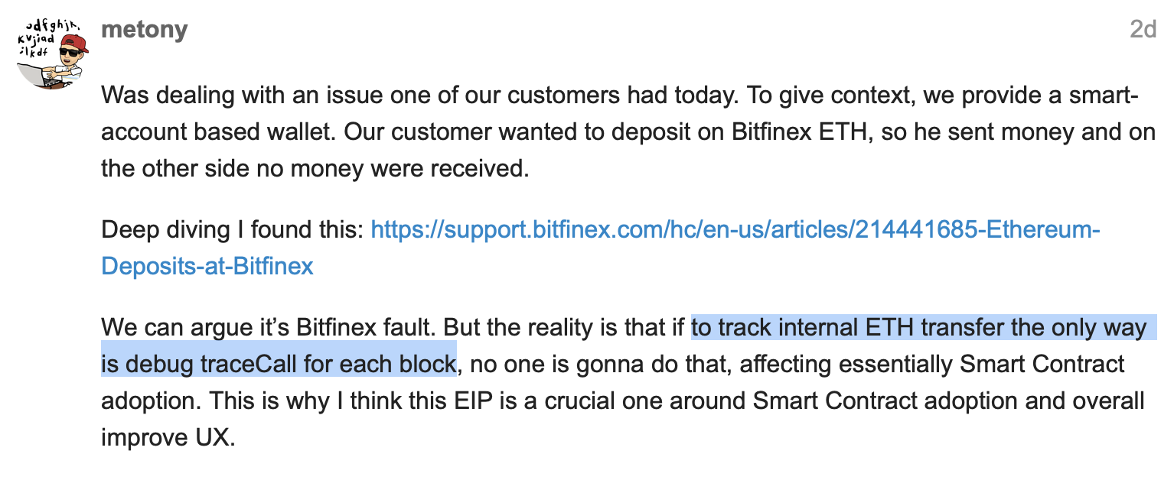
❌ ETH transfers
❌ SELFDESTRUCT ❌ EIP-1559 Priority fees ❌ Beacon withdrawals

Slide 4

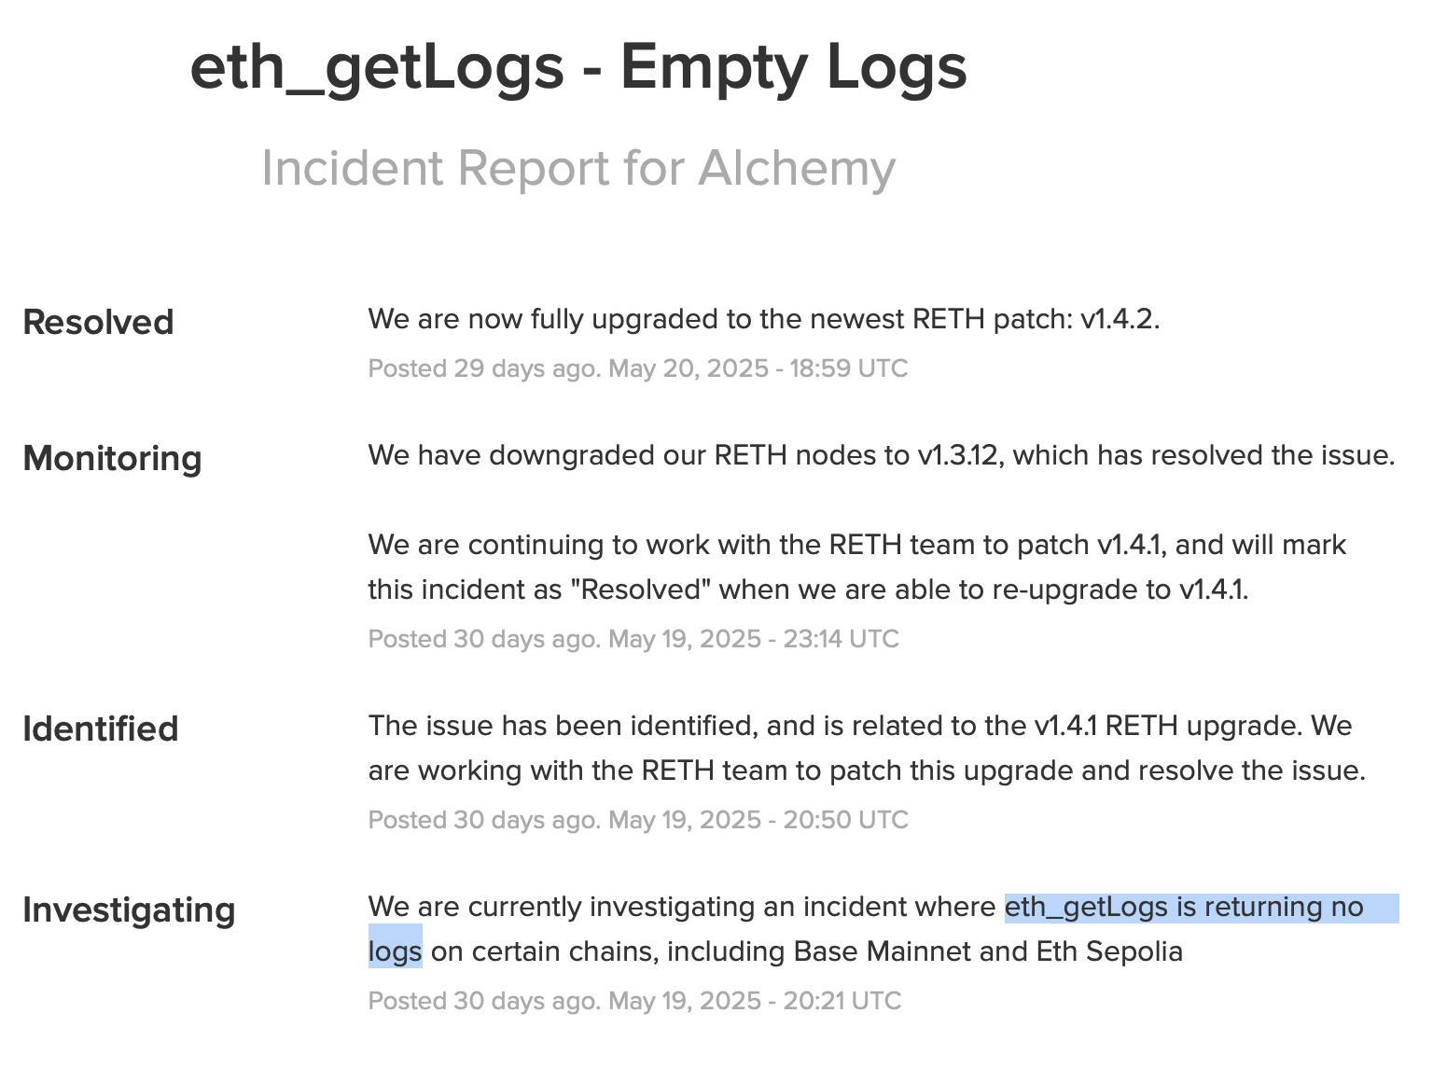
❌

Slide 5
⚠️ Inefficient receipts
❌ from
❌ contractAddress
❌ authority
needs transaction + ecrecover
Receipts Merkle-Patricia Trie
❌ logIndex (index within block) needs ALL receipts
MPT type
Type
Status
Cumulative gas used
Logs Bloom
Logs
n - 1
MPT type
Type
Status
Cumulative gas used
Logs Bloom
Logs
n
gasUsed ❌ needs prior receipt
❌ logsBloom needs full logs (flat hash)
Gas used

Slide 6
⚠️ Transaction hashes
1. sig_hash
2. tx_hash
3. transactions trie hash
4. SSZ ByteVector hash (CL)
Transactions Merkle-Patricia Trie
tx_hash
❌ no on-chain commitment
(cannot compute txs_root from hashes)
MPT type
Type
Transaction data
Signature
ecrecover
Sender address
sig_hash
Nonce
(create tx)
Contract address

Slide 7
⚠️ Inconsistent tx types
❌ legacy
Nonce
Max fee per gas
Gas limit
To
Value
Input
Replayable signature
Legacy (v = 27 + yParity)
Nonce
Max fee per gas
Gas limit
To
Value
Input
Signature
+ Chain ID
EIP-155 (v = 35 + 2*chainId + yParity)
0x01
Chain ID
Nonce
Max fee per gas
Gas limit
To
Value
Input
Access list
Sig
0x02
Chain ID
Nonce
Prio fee per gas
Max fee per gas
Gas limit
To
Value
Input
Access list
Sig
0x03
Chain ID
Nonce
Prio fee per gas
Max fee per gas
Gas limit
To
Value
Input
Access list
Fee per blob gas
Blob hashes
Sig
0x04
Chain ID
Nonce
Prio fee per gas
Max fee per gas
Gas limit
To
Value
Input
Access list
Auth list
Sig
❌ new field added in middle
❌ legacy

Slide 8

EIP-7919 Pureth
Minimal scope:
1. EIP-7745 log index
2. Logs for ETH transfers
3. MPT hashes -> SSZ
4. ExecutionPayload -> SSZ
Synergies with block level access lists and ePBS / FOCIL
No changes:
State trie, EVM
Signature schemes
Networking, database
Internal data structures

Slide 9
EIP-7919 Pureth
UX
Verifying RPC improves security and enables anonymous access
More efficient data structures reduce need for indexers
L1
New log index scales to high gas limits
Better RPC latency for transactions, receipts, logs, engine
L2
Inherit security, privacy, and performance gains from L1
Lower gas cost to prove L2 log on L1

