Slide 1
Trust-minimized wallets with purified web3
Etan Kissling, Nimbus, IFT
30 Jan 2025 / EthereumZuri.ch

Slide 2
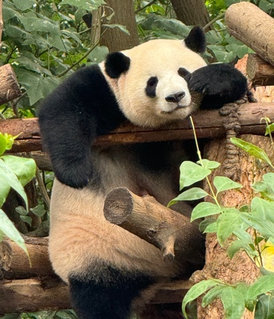
Wallet
4.75 ETH
Mobile app
0.1 BTC
Browser extension
500 USDC
→ theprotocolguild.eth 2025-01-30 –50 USDC
← vitalik.eth 2025-01-15 1 ETH
🎉 Block #123 produced 2025-01-09 0.08 ETH

Slide 3
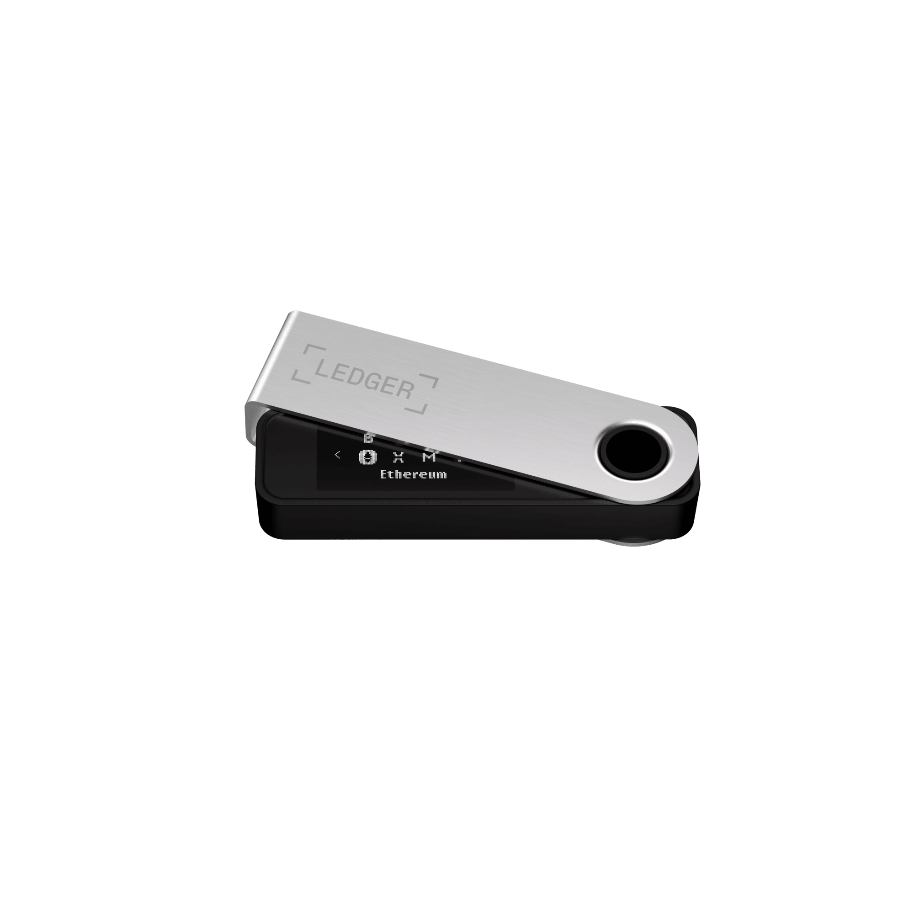
Wallet security
4.75 ETH
Mobile app
0.1 BTC
Browser extension
500 USDC
→ theprotocolguild.eth 2025-01-30 –50 USDC
← vitalik.eth 2025-01-15 1 ETH
+ Hardware wallet (optional)
🎉 Block #123 produced 2025-01-09 0.08 ETH

Slide 4
Wallet security
4.75 ETH
Mobile app
0.1 BTC
Browser extension
500 USDC
→ theprotocolguild.eth 2025-01-30 –50 USDC
← vitalik.eth 2025-01-15 1 ETH
🔒 Secure transaction signing
🎉 Block #123 produced 2025-01-09 0.08 ETH

Slide 5
Wallet security
4.75 ETH
❓ ETH balance
0.1 BTC
❓ Tokens / NFTs
500 USDC
❓ History
→ theprotocolguild.eth 2025-01-30 –50 USDC
← vitalik.eth 2025-01-15 1 ETH
🔒 Secure transaction signing
🎉 Block #123 produced 2025-01-09 0.08 ETH

Slide 6

Wallet (obtaining data)
4.75 ETH
❓ ETH balance
0.1 BTC
❓ Tokens / NFTs
500 USDC
❓ History
→ theprotocolguild.eth 2025-01-30 –50 USDC
← vitalik.eth 2025-01-15 1 ETH
🎉 Block #123 produced 2025-01-09 0.08 ETH

Slide 7
Wallet (obtaining data)
4.75 ETH
❓ ETH balance
0.1 BTC
❓ Tokens / NFTs
500 USDC
❓ History
→ theprotocolguild.eth 2025-01-30 –50 USDC
eth_getBalance
← vitalik.eth 2025-01-15 1 ETH
4.75 ETH
🎉 Block #123 produced 2025-01-09 0.08 ETH

Slide 8
Wallet (obtaining data)
4.75 ETH
❓ ETH balance
0.1 BTC
❓ Tokens / NFTs
500 USDC
❓ History
→ theprotocolguild.eth 2025-01-30 –50 USDC
eth_getBalance
← vitalik.eth 2025-01-15 1 ETH
4.75 ETH
😇
🎉 Block #123 produced 2025-01-09 0.08 ETH
“trust me bro”

Slide 9

Wallet (run your own node)
4.75 ETH
❓ ETH balance
0.1 BTC
❓ Tokens / NFTs
500 USDC
❓ History
4 core CPU
16 GB RAM
2 TB SSD
→ theprotocolguild.eth 2025-01-30 –50 USDC
eth_getBalance
← vitalik.eth 2025-01-15 1 ETH
4.75 ETH
🎉 Block #123 produced 2025-01-09 0.08 ETH

Slide 10
Wallet (RPC provider)
4.75 ETH
❓ ETH balance
0.1 BTC
❓ Tokens / NFTs
500 USDC
❓ History
→ theprotocolguild.eth 2025-01-30 –50 USDC
Web3 API
provider
eth_getBalance
← vitalik.eth 2025-01-15 1 ETH
4.75 ETH
🎉 Block #123 produced 2025-01-09 0.08 ETH

Slide 11
Decentralization?
4.75 ETH
❓ ETH balance
0.1 BTC
❓ Tokens / NFTs
500 USDC
❓ History
→ theprotocolguild.eth 2025-01-30 –50 USDC
😇
Web3 API
provider
eth_getBalance
← vitalik.eth 2025-01-15 1 ETH
4.75 ETH
🎉 Block #123 produced 2025-01-09 0.08 ETH

Slide 12
Decentralization?
4.75 ETH
❓ ETH balance
⚡️ Downtimes
❓ Tokens / NFTs
⚡️ Security
0.1 BTC
500 USDC
❓ History
⚡️ Censorship
⚡️ Privacy
→ theprotocolguild.eth 2025-01-30 –50 USDC
😇
🕵️‍♀️
Web3 API
provider
eth_getBalance
← vitalik.eth 2025-01-15 1 ETH
IP | Wallet
123.xyz.0.0 | 0x131..aF8
123.xyz.0.0 | 0x42a..E02
4.75 ETH
🎉 Block #123 produced 2025-01-09 0.08 ETH

Slide 13
Decentralization?
4.75 ETH
❓ ETH balance
✔️ Works on mobile
❓ Tokens / NFTs
✔️ High reliability
0.1 BTC
500 USDC
❓ History
✔️ Scales at low cost
→ theprotocolguild.eth 2025-01-30 –50 USDC
😇
Web3 API
provider
eth_getBalance
← vitalik.eth 2025-01-15 1 ETH
4.75 ETH
🎉 Block #123 produced 2025-01-09 0.08 ETH

Slide 14
Decentralization?
4.75 ETH
❓ ETH balance
✔️ Works on mobile
❓ Tokens / NFTs
✔️ High reliability
0.1 BTC
500 USDC
❓ History
✔️ Scales at low cost
→ theprotocolguild.eth 2025-01-30 –50 USDC
😇
eth_getBalance
Web3 API provider
← vitalik.eth 2025-01-15 1 ETH
4.75 ETH
🎉 Block #123 produced 2025-01-09 0.08 ETH

Slide 15
Today’s reality
4.75 ETH
❓ ETH balance
0.1 BTC
❓ Tokens / NFTs
500 USDC
❓ History
→ theprotocolguild.eth 2025-01-30 –50 USDC
😇
eth_getBalance
Web3 API provider
← vitalik.eth 2025-01-15 1 ETH
4.75 ETH
🎉 Block #123 produced 2025-01-09 0.08 ETH
(only a handful of large providers)

Slide 16
How to fix it?
4.75 ETH
0.1 BTC
500 USDC
→ theprotocolguild.eth 2025-01-30 –50 USDC
😇
eth_getBalance
Web3 API provider
← vitalik.eth 2025-01-15 1 ETH
4.75 ETH
🎉 Block #123 produced 2025-01-09 0.08 ETH
(only a handful of large providers)

Slide 17

EIP-1186: eth_getProof
4.75 ETH
✌️ Add correctness proof
0.1 BTC
500 USDC
→ theprotocolguild.eth 2025-01-30 –50 USDC
😇
eth_getProof
Web3 API provider
← vitalik.eth 2025-01-15 1 ETH
4.75 ETH
Proof
🎉 Block #123 produced 2025-01-09 0.08 ETH
(only a handful of large providers)

Slide 18
EIP-1186: eth_getProof
4.75 ETH
✌️ Add correctness proof
0.1 BTC
✌️ Data can be verified
500 USDC
→ theprotocolguild.eth 2025-01-30 –50 USDC
eth_getProof
Web3 API provider
← vitalik.eth 2025-01-15 1 ETH
4.75 ETH
Proof
🎉 Block #123 produced 2025-01-09 0.08 ETH
(only a handful of large providers)

Slide 19
EIP-1186: eth_getProof
4.75 ETH
✌️ Add correctness proof
0.1 BTC
✌️ Data can be verified
500 USDC
✌️ Can ask any provider → decentralization
→ theprotocolguild.eth 2025-01-30 –50 USDC
eth_getProof
Web3 API provider
← vitalik.eth 2025-01-15 1 ETH
4.75 ETH
Proof
🎉 Block #123 produced 2025-01-09 0.08 ETH

Slide 20
Merkle trees
4.75 ETH
State root
0.1 BTC
Block #201
500 USDC
→ theprotocolguild.eth 2025-01-30 –50 USDC
← vitalik.eth 2025-01-15 1 ETH
🎉 Block #123 produced 2025-01-09 0.08 ETH
4.75 ETH

Slide 21
Merkle trees
4.75 ETH
State root
0.1 BTC
Block #201
500 USDC
→ theprotocolguild.eth 2025-01-30 –50 USDC
← vitalik.eth 2025-01-15 1 ETH
🎉 Block #123 produced 2025-01-09 0.08 ETH
4.75 ETH

Slide 22
Merkle trees
4.75 ETH
State root
0.1 BTC
Block #201
Proof
500 USDC
→ theprotocolguild.eth 2025-01-30 –50 USDC
Proof
← vitalik.eth 2025-01-15 1 ETH
🎉 Block #123 produced 2025-01-09 0.08 ETH
4.75 ETH
Proof

Slide 23
Merkle trees
4.75 ETH
State root
0.1 BTC
Block #201
Proof
500 USDC
→ theprotocolguild.eth 2025-01-30 –50 USDC
Proof
Only minimal data required
to compute root hash
← vitalik.eth 2025-01-15 1 ETH
🎉 Block #123 produced 2025-01-09 0.08 ETH
4.75 ETH
Proof

Slide 24
EIP-1186: eth_getProof
4.75 ETH
State root
State root
State root
0.1 BTC
500 USDC
Block #200
Block #201
Block #202
→ theprotocolguild.eth 2025-01-30 –50 USDC
eth_getProof
Web3 API provider
← vitalik.eth 2025-01-15 1 ETH
4.75 ETH
Merkle proof
🎉 Block #123 produced 2025-01-09 0.08 ETH

Slide 25
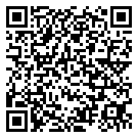
Altair light client protocol
Sync committee signature
Sync committee signature
Sync committee signature
4.75 ETH
State root
State root
State root
0.1 BTC
500 USDC
Block #200
Block #201
Block #202
→ theprotocolguild.eth 2025-01-30 –50 USDC
eth_getProof
Web3 API provider
← vitalik.eth 2025-01-15 1 ETH
4.75 ETH
Merkle proof
🎉 Block #123 produced 2025-01-09 0.08 ETH

Slide 26
Altair light client protocol
/eth/v1/beacon/light_client
Beacon API provider
4.75 ETH
Sync committee signature
State root
0.1 BTC
500 USDC
→ theprotocolguild.eth 2025-01-30 –50 USDC
eth_getProof
Web3 API provider
← vitalik.eth 2025-01-15 1 ETH
4.75 ETH
Merkle proof
🎉 Block #123 produced 2025-01-09 0.08 ETH

Slide 27
Altair light client protocol
/eth/v1/beacon/light_client
Beacon API provider
4.75 ETH
Sync committee signature
State root
0.1 BTC
500 USDC
Sync committee
public keys
accept if ≥ ⅔ out of 512 signed BLS aggregate signature
→ theprotocolguild.eth 2025-01-30 –50 USDC
eth_getProof
Web3 API provider
← vitalik.eth 2025-01-15 1 ETH
4.75 ETH
Merkle proof
🎉 Block #123 produced 2025-01-09 0.08 ETH

Slide 28
Altair light client protocol
/eth/v1/beacon/light_client
Beacon API provider
4.75 ETH
Next committee
public keys
Sync committee signature
State root
0.1 BTC
500 USDC
Sync committee
public keys
accept if ≥ ⅔ out of 512 signed BLS aggregate signature
→ theprotocolguild.eth 2025-01-30 –50 USDC
eth_getProof
Web3 API provider
← vitalik.eth 2025-01-15 1 ETH
4.75 ETH
Merkle proof
🎉 Block #123 produced 2025-01-09 0.08 ETH

Slide 29

Web3 purifier library
/eth/v1/beacon/light_client
Beacon API provider
Wallet
Web3 purifier
4.75 ETH
Next committee
public keys
Sync committee signature
State root
0.1 BTC
500 USDC
Sync committee
public keys
accept if ≥ ⅔ out of 512 signed BLS aggregate signature
→ theprotocolguild.eth 2025-01-30 –50 USDC
eth_getBalance
eth_getProof
Web3 API provider
← vitalik.eth 2025-01-15 1 ETH
4.75 ETH
4.75 ETH
Merkle proof
🎉 Block #123 produced 2025-01-09 0.08 ETH

Slide 30
Web3 purifier library
4.75 ETH
Web3 purifier
eth_getBalance
0.1 BTC
✌️ Universal API
4.75 ETH
500 USDC
→ theprotocolguild.eth 2025-01-30 –50 USDC
← vitalik.eth 2025-01-15 1 ETH
🎉 Block #123 produced 2025-01-09 0.08 ETH

Slide 31
Web3 purifier library
4.75 ETH
Web3 purifier
eth_getBalance
0.1 BTC
✌️ Universal API
4.75 ETH
500 USDC
✌️ Use any upstream RPC
→ theprotocolguild.eth 2025-01-30 –50 USDC
← vitalik.eth 2025-01-15 1 ETH
🎉 Block #123 produced 2025-01-09 0.08 ETH

Slide 32
Web3 purifier library
4.75 ETH
Web3 purifier
eth_getBalance
0.1 BTC
✌️ Universal API
4.75 ETH
500 USDC
🔒
✌️ Use any upstream RPC
→ theprotocolguild.eth 2025-01-30 –50 USDC
✌️ Security
← vitalik.eth 2025-01-15 1 ETH
🎉 Block #123 produced 2025-01-09 0.08 ETH

Slide 33
Web3 purifier library
4.75 ETH
Web3 purifier
eth_getBalance
0.1 BTC
✅ ETH balance
4.75 ETH
500 USDC
🔒
❓ Tokens / NFTs
→ theprotocolguild.eth 2025-01-30 –50 USDC
❓ History
← vitalik.eth 2025-01-15 1 ETH
🎉 Block #123 produced 2025-01-09 0.08 ETH

Slide 34

Token balance
4.75 ETH
Web3 purifier
contract EIP20Interface {
// Returns the account balance
// of another account with address `_owner`.
function balanceOf(
address _owner
) public view returns (
uint256 balance
);
}
eth_call
0.1 BTC
0.1 BTC
500 USDC
→ theprotocolguild.eth 2025-01-30 –50 USDC
← vitalik.eth 2025-01-15 1 ETH
🎉 Block #123 produced 2025-01-09 0.08 ETH

Slide 35
Token balance
4.75 ETH
Web3 purifier
eth_call
EVM
eth_getCode
0.1 BTC
0.1 BTC
Code
500 USDC
→ theprotocolguild.eth 2025-01-30 –50 USDC
← vitalik.eth 2025-01-15 1 ETH
🎉 Block #123 produced 2025-01-09 0.08 ETH

Slide 36
Token balance
4.75 ETH
Web3 purifier
eth_call
EVM
eth_getCode
0.1 BTC
0.1 BTC
Code
500 USDC
→ theprotocolguild.eth 2025-01-30 –50 USDC
eth_getStorageAt
← vitalik.eth 2025-01-15 1 ETH
State database
Data
🎉 Block #123 produced 2025-01-09 0.08 ETH

Slide 37
Token balance
4.75 ETH
Web3 purifier
eth_call
EVM
eth_getCode
eth_getProof
0.1 BTC
0.1 BTC
Code
Code
Proof
500 USDC
Web3 API provider
→ theprotocolguild.eth 2025-01-30 –50 USDC
eth_getStorageAt
eth_getProof
← vitalik.eth 2025-01-15 1 ETH
State database
Data
Data
Proof
🎉 Block #123 produced 2025-01-09 0.08 ETH

Slide 38
Token balance
4.75 ETH
Web3 purifier
State root
eth_call
EVM
eth_getCode
eth_getProof
0.1 BTC
0.1 BTC
Code
Code
Proof
500 USDC
Web3 API provider
🔒
→ theprotocolguild.eth 2025-01-30 –50 USDC
eth_getStorageAt
eth_getProof
← vitalik.eth 2025-01-15 1 ETH
State database
Data
Data
Proof
🎉 Block #123 produced 2025-01-09 0.08 ETH

Slide 39
Token balance
4.75 ETH
Web3 purifier
eth_call
0.1 BTC
✅ ETH balance
0.1 BTC
500 USDC
🔒
✅ Tokens / NFTs
→ theprotocolguild.eth 2025-01-30 –50 USDC
❓ History
← vitalik.eth 2025-01-15 1 ETH
🎉 Block #123 produced 2025-01-09 0.08 ETH

Slide 40
History
4.75 ETH
Web3 purifier
contract EIP20Interface {
// Triggers when tokens are transferred,
// including zero value transfers.
event Transfer(
address indexed _from,
address indexed _to,
uint256 _value
);
}
eth_getLogs
0.1 BTC
500 USDC
Log entry
Log entry
→ theprotocolguild.eth 2025-01-30 –50 USDC
Log entry
← vitalik.eth 2025-01-15 1 ETH
≤ 3 indexed arguments total
🎉 Block #123 produced 2025-01-09 0.08 ETH

Slide 41
History
4.75 ETH
Log
Contract address
contract EIP20Interface {
// Triggers when tokens are transferred,
// including zero value transfers.
event Transfer(
address indexed _from,
address indexed _to,
uint256 _value
);
}
0.1 BTC
Transfer
500 USDC
_from
≤ 4 topics
_to
→ theprotocolguild.eth 2025-01-30 –50 USDC
n/a
← vitalik.eth 2025-01-15 1 ETH
_value
≤ 3 indexed arguments total
🎉 Block #123 produced 2025-01-09 0.08 ETH
eth_getLogs
(address, topic)

Slide 42
History
4.75 ETH
Log
Receipt
Contract address
MPT type
0.1 BTC
Transfer
Transaction type
500 USDC
_from
Status
≤ 4 topics
_to
Cumulative gas used
→ theprotocolguild.eth 2025-01-30 –50 USDC
n/a
Logs Bloom
← vitalik.eth 2025-01-15 1 ETH
_value
Logs
🎉 Block #123 produced 2025-01-09 0.08 ETH
eth_getLogs
(address, topic)
eth_getTransactionReceipt

Slide 43
History
4.75 ETH
Log
Receipt
Block header
Contract address
MPT type
0.1 BTC
Receipts root
Transfer
Transaction type
500 USDC
_from
Status
≤ 4 topics
Block #201
_to
Cumulative gas used
→ theprotocolguild.eth 2025-01-30 –50 USDC
n/a
Logs Bloom
← vitalik.eth 2025-01-15 1 ETH
_value
Logs
🎉 Block #123 produced 2025-01-09 0.08 ETH
eth_getLogs
(address, topic)
eth_getTransactionReceipt
verifiable against Altair light client
🔒

Slide 44
History
4.75 ETH
Log
Receipt
Block header
Contract address
MPT type
0.1 BTC
Receipts root
Transfer
Transaction type
500 USDC
_from
Status
≤ 4 topics
Block #201
_to
Cumulative gas used
→ theprotocolguild.eth 2025-01-30 –50 USDC
n/a
Logs Bloom
← vitalik.eth 2025-01-15 1 ETH
_value
Logs
🎉 Block #123 produced 2025-01-09 0.08 ETH
eth_getLogs
maybe incomplete
eth_getTransactionReceipt
verifiable against Altair light client
❓
🔒

Slide 45
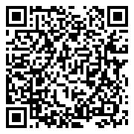
Bloom filter
4.75 ETH
Log
Logs Bloom (2048 bits total)
Contract address
0
0
1
1
0
1
0
0
0
0
0
0
0
0
0
0
0.1 BTC
Transfer
Set ≤ 3 bits based on keccak256(address)
500 USDC
_from
≤ 4 topics
_to
→ theprotocolguild.eth 2025-01-30 –50 USDC
n/a
← vitalik.eth 2025-01-15 1 ETH
_value
🎉 Block #123 produced 2025-01-09 0.08 ETH

Slide 46
Bloom filter
4.75 ETH
Log
Logs Bloom (2048 bits total)
Contract address
0
0
1
1
0
1
0
0
0
0
0
0
0
0
0
0
0.1 BTC
Transfer
0
0
0
0
0
0
0
0
0
1
0
0
1
0
1
0
500 USDC
_from
0
1
0
0
0
0
1
0
0
1
0
0
0
0
0
0
_to
1
0
1
0
0
0
0
0
0
0
0
0
0
0
0
1
→ theprotocolguild.eth 2025-01-30 –50 USDC
n/a
Set ≤ 3 bits based on each keccak256(topic)
← vitalik.eth 2025-01-15 1 ETH
_value
🎉 Block #123 produced 2025-01-09 0.08 ETH

Slide 47
Bloom filter
4.75 ETH
Log
Logs Bloom (2048 bits total)
Contract address
0
0
1
1
0
1
0
0
0
0
0
0
0
0
0
0
0.1 BTC
Transfer
0
0
0
0
0
0
0
0
0
1
0
0
1
0
1
0
500 USDC
_from
0
1
0
0
0
0
1
0
0
1
0
0
0
0
0
0
_to
1
0
1
0
0
0
0
0
0
0
0
0
0
0
0
1
→ theprotocolguild.eth 2025-01-30 –50 USDC
n/a
Union
← vitalik.eth 2025-01-15 1 ETH
_value
1
1
1
1
0
1
1
0
0
1
0
0
1
0
1
1
🎉 Block #123 produced 2025-01-09 0.08 ETH

Slide 48
Bloom filter
4.75 ETH
Log
Logs Bloom (2048 bits total)
Contract address
0
0
1
1
0
1
0
0
0
0
0
0
0
0
0
0
0.1 BTC
Transfer
0
0
0
0
0
0
0
0
0
1
0
0
1
0
1
0
500 USDC
_from
0
1
0
0
0
0
1
0
0
1
0
0
0
0
0
0
_to
1
0
1
0
0
0
0
0
0
0
0
0
0
0
0
1
→ theprotocolguild.eth 2025-01-30 –50 USDC
n/a
Union
← vitalik.eth 2025-01-15 1 ETH
_value
1
1
1
1
0
1
1
0
0
1
0
0
1
0
1
1
🎉 Block #123 produced 2025-01-09 0.08 ETH
Query
1
0
1
0
0
0
0
0
0
0
0
0
0
0
0
1
✅ Match

Slide 49
Bloom filter
4.75 ETH
Log
Logs Bloom (2048 bits total)
Contract address
0
0
1
1
0
1
0
0
0
0
0
0
0
0
0
0
0.1 BTC
Transfer
0
0
0
0
0
0
0
0
0
1
0
0
1
0
1
0
500 USDC
_from
0
1
0
0
0
0
1
0
0
1
0
0
0
0
0
0
_to
1
0
1
0
0
0
0
0
0
0
0
0
0
0
0
1
→ theprotocolguild.eth 2025-01-30 –50 USDC
n/a
Union
← vitalik.eth 2025-01-15 1 ETH
_value
1
1
1
1
0
1
1
0
0
1
0
0
1
0
1
1
🎉 Block #123 produced 2025-01-09 0.08 ETH
Query
1
0
0
0
0
0
0
0
0
0
1
0
1
0
0
0
🚫 No match

Slide 50
Bloom filter
4.75 ETH
Log
Logs Bloom (2048 bits total)
Contract address
0
0
1
1
0
1
0
0
0
0
0
0
0
0
0
0
0.1 BTC
Transfer
0
0
0
0
0
0
0
0
0
1
0
0
1
0
1
0
500 USDC
_from
0
1
0
0
0
0
1
0
0
1
0
0
0
0
0
0
_to
1
0
1
0
0
0
0
0
0
0
0
0
0
0
0
1
→ theprotocolguild.eth 2025-01-30 –50 USDC
n/a
Union
← vitalik.eth 2025-01-15 1 ETH
_value
1
1
1
1
0
1
1
0
0
1
0
0
1
0
1
1
🎉 Block #123 produced 2025-01-09 0.08 ETH
Query
0
0
0
0
0
0
1
0
0
0
0
0
0
0
1
1
‼️ False pos.

Slide 51
Bloom filter
4.75 ETH
Log
Mainnet: > 1000 addresses and topics per block
Contract address
0.1 BTC
Logs Bloom
Logs Bloom
Logs Bloom
Transfer
500 USDC
_from
Block #200
Block #201
Block #202
_to
→ theprotocolguild.eth 2025-01-30 –50 USDC
n/a
Logs Bloom (2048 bits total)
← vitalik.eth 2025-01-15 1 ETH
_value
1
1
1
1
0
1
1
0
0
1
0
0
1
0
1
1
🎉 Block #123 produced 2025-01-09 0.08 ETH
Query
0
0
0
0
0
0
1
0
0
0
0
0
0
0
1
1
‼️ False pos.

Slide 52

EIP-7745: Two dimensional log filter
4.75 ETH
Log
Contract address
0.1 BTC
Transfer
500 USDC
_from
_to
→ theprotocolguild.eth 2025-01-30 –50 USDC
n/a
← vitalik.eth 2025-01-15 1 ETH
_value
🎉 Block #123 produced 2025-01-09 0.08 ETH

Slide 53
EIP-7745: Two dimensional log filter
Global index
4.75 ETH
Log
Contract address
#1
0.1 BTC
Transfer
#2
500 USDC
_from
#3
_to
#4
→ theprotocolguild.eth 2025-01-30 –50 USDC
n/a
← vitalik.eth 2025-01-15 1 ETH
_value
🎉 Block #123 produced 2025-01-09 0.08 ETH

Slide 54
EIP-7745: Two dimensional log filter
Log value
Global index
4.75 ETH
Contract address
#1
0.1 BTC
Transfer
#2
500 USDC
_from
#3
_to
#4
→ theprotocolguild.eth 2025-01-30 –50 USDC
← vitalik.eth 2025-01-15 1 ETH
🎉 Block #123 produced 2025-01-09 0.08 ETH

Slide 55
EIP-7745: Two dimensional log filter
Log value
Global index
4.75 ETH
Filter map (2¹² rows x 2³² cols)
Contract address
#1
0.1 BTC
Transfer
#2
500 USDC
_from
#3
_to
#4
→ theprotocolguild.eth 2025-01-30 –50 USDC
← vitalik.eth 2025-01-15 1 ETH
🎉 Block #123 produced 2025-01-09 0.08 ETH

Slide 56
EIP-7745: Two dimensional log filter
Log value
Global index
4.75 ETH
Filter map (2¹² rows x 2³² cols)
Contract address
#1
0.1 BTC
Transfer
#2
500 USDC
_from
#3
_to
#4
→ theprotocolguild.eth 2025-01-30 –50 USDC
← vitalik.eth 2025-01-15 1 ETH
row
🎉 Block #123 produced 2025-01-09 0.08 ETH
Stable across large index range

Slide 57
EIP-7745: Two dimensional log filter
Log value
Global index
4.75 ETH
Filter map (2¹² rows x 2³² cols)
Contract address
#1
X
X
0.1 BTC
Transfer
#2
500 USDC
_from
#3
X
_to
#4
X
→ theprotocolguild.eth 2025-01-30 –50 USDC
← vitalik.eth 2025-01-15 1 ETH
row
col
Log value specific
Index → Column
🎉 Block #123 produced 2025-01-09 0.08 ETH
Stable across large index range

Slide 58
EIP-7745: Two dimensional log filter
Log value
Global index
4.75 ETH
Filter map (2¹² rows x 2³² cols)
Contract address
#1
X
X
0.1 BTC
Transfer
#2
500 USDC
_from
#3
X
_to
#4
X
→ theprotocolguild.eth 2025-01-30 –50 USDC
← vitalik.eth 2025-01-15 1 ETH
row
col
Log value specific
Index → Column
Query
row
🎉 Block #123 produced 2025-01-09 0.08 ETH
Stable across large index range

Slide 59
EIP-7745: Two dimensional log filter
Log value
Global index
4.75 ETH
Filter map row (2³² cols)
Contract address
#1
X
X
0.1 BTC
Transfer
#2
500 USDC
_from
#3
_to
#4
→ theprotocolguild.eth 2025-01-30 –50 USDC
← vitalik.eth 2025-01-15 1 ETH
row
col
Log value specific
Index → Column
Query
row
🎉 Block #123 produced 2025-01-09 0.08 ETH
Stable across large index range

Slide 60
EIP-7745: Two dimensional log filter
Log value
Global index
4.75 ETH
Filter map row (2³² cols)
Contract address
#1
X
X
0.1 BTC
Transfer
#2
500 USDC
_from
#3
_to
#4
Log value specific
Column → Opt[Index]
col⁻¹
→ theprotocolguild.eth 2025-01-30 –50 USDC
← vitalik.eth 2025-01-15 1 ETH
row
col
Log value specific
Index → Column
Query
row
🎉 Block #123 produced 2025-01-09 0.08 ETH
Stable across large index range

Slide 61
EIP-7745: Two dimensional log filter
Log value
Global index
4.75 ETH
Filter map row (2³² cols)
Contract address
#1
?
#4
0.1 BTC
Transfer
#2
500 USDC
🚫
✅ Match
_from
#3
_to
#4
Log value specific
Column → Opt[Index]
col⁻¹
→ theprotocolguild.eth 2025-01-30 –50 USDC
← vitalik.eth 2025-01-15 1 ETH
row
col
Log value specific
Index → Column
Query
row
🎉 Block #123 produced 2025-01-09 0.08 ETH
Stable across large index range

Slide 62
EIP-7745: Two dimensional log filter
Log value
Global index
4.75 ETH
Filter map (2¹² rows x 2³² cols)
Contract address
#1
?
#4
0.1 BTC
Transfer
#2
500 USDC
_from
#3
X
_to
#4
X
→ theprotocolguild.eth 2025-01-30 –50 USDC
← vitalik.eth 2025-01-15 1 ETH
row
col
Fresh sparse filter map every ≤ 2¹⁶ marks
✌️ False positives are extremely rare
Log value → Row transform stable across 2⁶ maps
✌️ Efficient to fetch relevant rows
🎉 Block #123 produced 2025-01-09 0.08 ETH

Slide 63
EIP-7745: Two dimensional log filter
Global index
4.75 ETH
Log
Contract address
#1
0.1 BTC
Transfer
#2
500 USDC
_from
#3
_to
#4
→ theprotocolguild.eth 2025-01-30 –50 USDC
n/a
← vitalik.eth 2025-01-15 1 ETH
_value
🎉 Block #123 produced 2025-01-09 0.08 ETH

Slide 64
EIP-7745: Two dimensional log filter
Global index
4.75 ETH
Log
Log meta
Contract address
#1
Block number
0.1 BTC
Transfer
#2
Tx hash
500 USDC
_from
#3
Tx number in block
_to
#4
Log number in tx
→ theprotocolguild.eth 2025-01-30 –50 USDC
n/a
← vitalik.eth 2025-01-15 1 ETH
_value
Log entry
🎉 Block #123 produced 2025-01-09 0.08 ETH

Slide 65
EIP-7745: Two dimensional log filter
Global index
Global index
Block delimiter
4.75 ETH
Log
Log meta
Contract address
#1
Block number
Block number
#5
0.1 BTC
Transfer
#2
Tx hash
Block hash
500 USDC
_from
#3
Tx number in block
Timestamp
_to
#4
Log number in tx
Markers
→ theprotocolguild.eth 2025-01-30 –50 USDC
n/a
← vitalik.eth 2025-01-15 1 ETH
_value
Log entry
Log entry
Log entry
🎉 Block #123 produced 2025-01-09 0.08 ETH
✌️ Lookup each log address, topic, and block by global index
✌️ Enumerate all log entries within a block range

Slide 66
EIP-7745: Two dimensional log filter
4.75 ETH
Web3 purifier
eth_getLogs
0.1 BTC
✅ ETH balance
500 USDC
Log entry
Log entry
✅ Tokens / NFTs
→ theprotocolguild.eth 2025-01-30 –50 USDC
Log entry
✅ History
← vitalik.eth 2025-01-15 1 ETH
🔒
🎉 Block #123 produced 2025-01-09 0.08 ETH

Slide 67
EIP-7745: Two dimensional log filter
4.75 ETH
Web3 purifier
eth_getLogs
0.1 BTC
✅ ETH balance
500 USDC
Log entry
Log entry
✅ Tokens / NFTs
→ theprotocolguild.eth 2025-01-30 –50 USDC
Log entry
✅ History
← vitalik.eth 2025-01-15 1 ETH
🔒
❓ ETH balance history
🎉 Block #123 produced 2025-01-09 0.08 ETH

Slide 68

EIP-7708: ETH transfers emit a log
4.75 ETH
System address
System address
Transfer log
Transaction start
Nonzero-value CALL
Nonzero-value SELFDESTRUCT
0.1 BTC
Transfer
Fee
500 USDC
_from
_from
_to
n/a
Fee log
Transaction end
→ theprotocolguild.eth 2025-01-30 –50 USDC
n/a
n/a
← vitalik.eth 2025-01-15 1 ETH
_value
_value
✌️ Complete history for users
🎉 Block #123 produced 2025-01-09 0.08 ETH

Slide 69

EIP-7799: System logs
4.75 ETH
System address
System address
0.1 BTC
Priority Rewards
Withdrawal
500 USDC
_to
_to
System logs root
n/a
n/a
→ theprotocolguild.eth 2025-01-30 –50 USDC
Block #201
n/a
n/a
← vitalik.eth 2025-01-15 1 ETH
_value
_value
🎉 Block #123 produced 2025-01-09 0.08 ETH
✌️ Complete history for validator operators

Slide 70

Purified web3
4.75 ETH
Web3 purifier
eth_getLogs
0.1 BTC
✅ ETH balance
500 USDC
Log entry
Log entry
✅ Tokens / NFTs
→ theprotocolguild.eth 2025-01-30 –50 USDC
Log entry
✅ History (complete)
← vitalik.eth 2025-01-15 1 ETH
🔒
🎉 Block #123 produced 2025-01-09 0.08 ETH

Slide 71
Purified web3
4.75 ETH
Devnet available 🔥
Nimbus + EthereumJS backend
Helios web3 purifier
Buidling guides
Verifying wallets
Web3 purifiers
Developer info
Additional EIPs for efficiency
Kurtosis network config
0.1 BTC
500 USDC
→ theprotocolguild.eth 2025-01-30 –50 USDC
← vitalik.eth 2025-01-15 1 ETH
https://purified-web3.box
🎉 Block #123 produced 2025-01-09 0.08 ETH

Slide 73

Transaction details
4.75 ETH
📤
From address
0.1 BTC
To address
📥
500 USDC
💰
Value transferred
→ theprotocolguild.eth 2024-11-12 –50 USDC
📆
Transaction data
← vitalik.eth 2024-11-11 1 ETH
🎉 Block #123 produced 2024-11-09 0.08 ETH
⛽️
Gas fees

Slide 74
Transaction details
Web3 API
4.75 ETH
Transactions Merkle-Patricia Trie
0.1 BTC
tx_hash
(no on-chain commitment)
500 USDC
→ theprotocolguild.eth 2024-11-12 –50 USDC
MPT type
Type
Transaction data
Signature
← vitalik.eth 2024-11-11 1 ETH
ecrecover
Sender address
🎉 Block #123 produced 2024-11-09 0.08 ETH
sig_hash
Nonce
(create tx)
Contract address

Slide 75
Transaction details
Web3 API
4.75 ETH
Receipts Merkle-Patricia Trie
0.1 BTC
500 USDC
→ theprotocolguild.eth 2024-11-12 –50 USDC
MPT type
Type
Status
Cumulative gas used
Logs Bloom
Logs
n - 1
← vitalik.eth 2024-11-11 1 ETH
MPT type
Type
Status
Cumulative gas used
Logs Bloom
Logs
n
🎉 Block #123 produced 2024-11-09 0.08 ETH
Gas used

Slide 76
Transaction details
Full tx data required
Expensive ecrecover
4.75 ETH
📤
From address
0.1 BTC
CREATE contract address requires from address
📥
To address
500 USDC
💰
Value transferred
→ theprotocolguild.eth 2024-11-12 –50 USDC
✅
📆
Transaction date
← vitalik.eth 2024-11-11 1 ETH
Tx type inconsistencies
Inefficient hashes
🎉 Block #123 produced 2024-11-09 0.08 ETH
⛽️
Gas fees
Full data required incl logs
Prior receipt needed

Slide 77
EIP-6466: SSZ receipts
4.75 ETH
MPT type
Type
Status
Cumulative gas used
Logs Bloom
Logs
0.1 BTC
StableContainer
Forward compatibility
Remove
500 USDC
Tx gas used
Prior receipt no longer needed
Better parallel tx execution
SSZ binary tree
Proofs for partial data
Simpler L2 bridge designs
→ theprotocolguild.eth 2024-11-12 –50 USDC
← vitalik.eth 2024-11-11 1 ETH
Add From, Contract (CREATE), and Authority (EIP-7702) addresses
Transaction data and ecrecover no longer needed for verification
Reduced dependency on EVM internals
🎉 Block #123 produced 2024-11-09 0.08 ETH
✅
On-chain commitments to relevant data (fewer round trips, more efficient)

Slide 78
EIP-7706: Separate gas types
4.75 ETH
Nonce
Max fee per gas
Gas limit
To
Value
Input
Replayable signature
Legacy
Nonce
Max fee per gas
Gas limit
To
Value
Input
Signature
+ Chain ID
EIP-155
0.1 BTC
0x01
Chain ID
Nonce
Max fee per gas
Gas limit
To
Value
Input
Access list
Sig
500 USDC
0x02
Chain ID
Nonce
Prio fee per gas
Max fee per gas
Gas limit
To
Value
Input
Access list
Sig
0x03
Chain ID
Nonce
Prio fee per gas
Max fee per gas
Gas limit
To
Value
Input
Access list
Fee per blob gas
Blob hashes
Sig
→ theprotocolguild.eth 2024-11-12 –50 USDC
0x04
Chain ID
Nonce
Prio fee per gas
Max fee per gas
Gas limit
To
Value
Input
Access list
Auth list
Sig
← vitalik.eth 2024-11-11 1 ETH
🎉 Block #123 produced 2024-11-09 0.08 ETH
0x06
Chain ID
Nonce
Gas limit
To
Value
Input
Access list
Blob hashes
Auth list
Max fees per gas
Prio fees per gas
Sig
✅
Normalized gas fee computation

Slide 79
EIP-6404: SSZ transactions
4.75 ETH
RLP type
Nonce
Gas limit
To
Value
Input
Max fees per gas
Sig
RLP type
Chain ID
Nonce
Gas limit
To
Value
Input
Max fees per gas
Sig
0.1 BTC
RLP type
Chain ID
Nonce
Gas limit
To
Value
Input
Access list
Max fees per gas
Sig
500 USDC
RLP type
Chain ID
Nonce
Gas limit
To
Value
Input
Access list
Max fees per gas
Prio fees per gas
Sig
RLP type
Chain ID
Nonce
Gas limit
To
Value
Input
Access list
Blob hashes
Max fees per gas
Prio fees per gas
Sig
→ theprotocolguild.eth 2024-11-12 –50 USDC
RLP type
Chain ID
Nonce
Gas limit
To
Value
Input
Access list
Auth list
Max fees per gas
Prio fees per gas
Sig
← vitalik.eth 2024-11-11 1 ETH
🎉 Block #123 produced 2024-11-09 0.08 ETH
RLP type
Chain ID
Nonce
Gas limit
To
Value
Input
Access list
Blob hashes
Auth list
Max fees per gas
Prio fees per gas
Sig
✅
Type safety for different transaction profiles

Slide 80
EIP-7495: SSZ StableContainer
4.75 ETH
RLP type
n/a
Nonce
Gas limit
To
Value
Input
n/a
n/a
n/a
Max fees per gas
n/a
Sig
RLP type
Chain ID
Nonce
Gas limit
To
Value
Input
n/a
n/a
n/a
Max fees per gas
n/a
Sig
0.1 BTC
RLP type
Chain ID
Nonce
Gas limit
To
Value
Input
Access list
n/a
n/a
Max fees per gas
n/a
Sig
500 USDC
RLP type
Chain ID
Nonce
Gas limit
To
Value
Input
Access list
n/a
n/a
Max fees per gas
Prio fees per gas
Sig
RLP type
Chain ID
Nonce
Gas limit
To
Value
Input
Access list
Blob hashes
n/a
Max fees per gas
Prio fees per gas
Sig
→ theprotocolguild.eth 2024-11-12 –50 USDC
RLP type
Chain ID
Nonce
Gas limit
To
Value
Input
Access list
n/a
Auth list
Max fees per gas
Prio fees per gas
Sig
← vitalik.eth 2024-11-11 1 ETH
🎉 Block #123 produced 2024-11-09 0.08 ETH
RLP type
Chain ID
Nonce
Gas limit
To
Value
Input
Access list
Blob hashes
Auth list
Max fees per gas
Prio fees per gas
Sig
✅
Re-usable verifier (all profiles share stable SSZ merkleization)

Slide 81
EIP-6493: SSZ transaction signature scheme
4.75 ETH
BasicTransaction
EIP-1559 functionality
BlobTransaction
EIP-4844 functionality
SetCodeTransaction
EIP-7702 functionality
0.1 BTC
500 USDC
n/a
Chain ID
Nonce
Gas limit
To
Value
Input
Access list
n/a
n/a
Max fees per gas
Prio fees per gas
Sig
n/a
Chain ID
Nonce
Gas limit
To
Value
Input
Access list
Blob hashes
n/a
Max fees per gas
Prio fees per gas
Sig
→ theprotocolguild.eth 2024-11-12 –50 USDC
n/a
Chain ID
Nonce
Gas limit
To
Value
Input
Access list
n/a
Auth list
Max fees per gas
Prio fees per gas
Sig
← vitalik.eth 2024-11-11 1 ETH
🎉 Block #123 produced 2024-11-09 0.08 ETH
RLP type
Chain ID
Nonce
Gas limit
To
Value
Input
Access list
Blob hashes
Auth list
Max fees per gas
Prio fees per gas
Sig
✅
Native SSZ (no conversion back to RLP for sig_hash / tx_hash)

Slide 82
EIP-7807: SSZ execution blocks
4.75 ETH
Block metadata
Parent hash
Miner
State root
Number
Time-stamp
Extra data
Mix hash
Parent CL root
0.1 BTC
Gas accounting (separate gas types)
Operations
500 USDC
Gas limits
Gas used
Base fees
Excess gas
Transactions root
Withdrawals root
Receipts root
System logs root
→ theprotocolguild.eth 2024-11-12 –50 USDC
Removed fields (PoW era / Bloom)
Ommers hash
Difficulty
Block nonce
Logs Bloom
Requests hash
← vitalik.eth 2024-11-11 1 ETH
🎉 Block #123 produced 2024-11-09 0.08 ETH
✅
Merkle-Patricia Tries (MPT) removed, encoding and hashing normalized

Slide 83
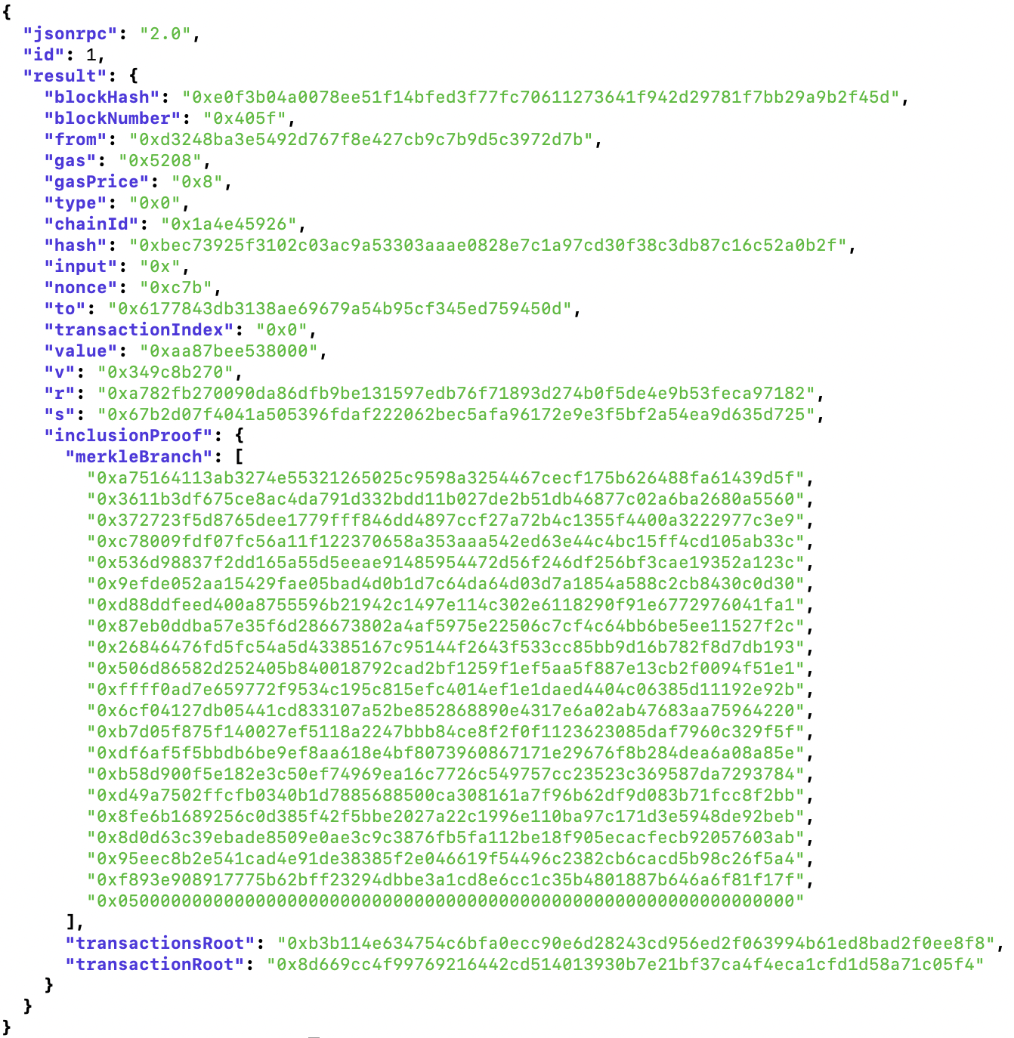
Inclusion proofs
4.75 ETH
0.1 BTC
500 USDC
→ theprotocolguild.eth 2024-11-12 –50 USDC
← vitalik.eth 2024-11-11 1 ETH
🎉 Block #123 produced 2024-11-09 0.08 ETH
No extra data
required to verify tx
✅

