Slide 1

Recipe Finder
Like Tinder? You‘re gonna love Recipe Finder

Slide 2
Have you scratched your head for hours figuring out what to make for Dinner?
Are you tired of eating the same meal over and over again?
Are you tired of finding recipes that don’t match your needs?
We present to you RECIPE FINDER

Slide 3
RECIPE FINDER
Your one stop app for all your food needs!
New Recipes updated regularly
Have specific dietary restrictions? Our algorithm sorts through to find recipes perfect for you
Have cuisine cravings just choose the cuisine you want to eat and we got you covered
Nutrition conscious? No problem all are recipes come with detailed nutrition contents
On a time crunch? All are recipes show you accurate preparation time so you can choose what matches your needs

Slide 4
Our Prototype Today
Uses a mongodb database
Hosted on google cloud
Uses a custom web scrapper
Web application made with React, CSS, JavaScript, and Node.js.
Backend is built on python uses Django API and CSV & Json databases
Uses firebase for secure authentication for user logins.
Algorithm used considers parameters like allergens, cuisine preference and meal type
Displays recipes in stack format arranged in order of user rating
The recipes are also tagged based on the ingredients (for ex: gluten free would be a tag if the recipe does not have any gluten

Slide 5

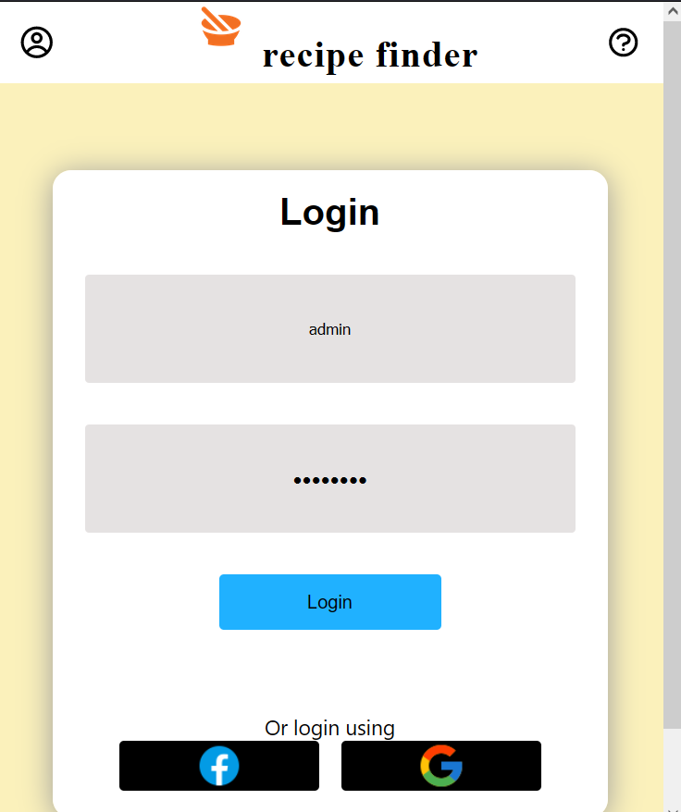
Login Page
Uses Firebase to authenticate and keep info secure

Slide 6
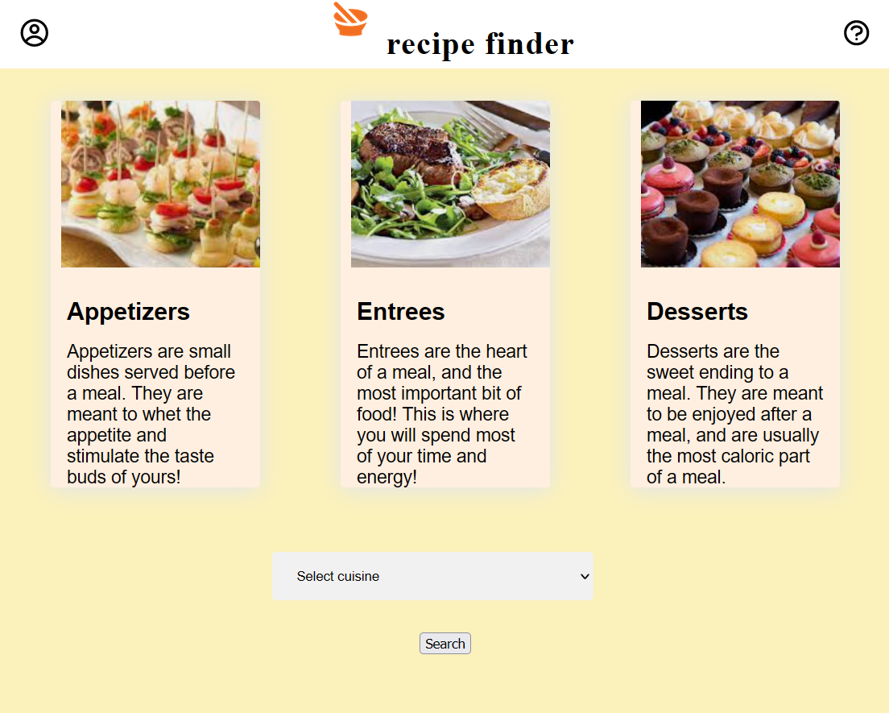
Selection Page
Here you choose the category and cuisine preference this sends request to the backend

Slide 7
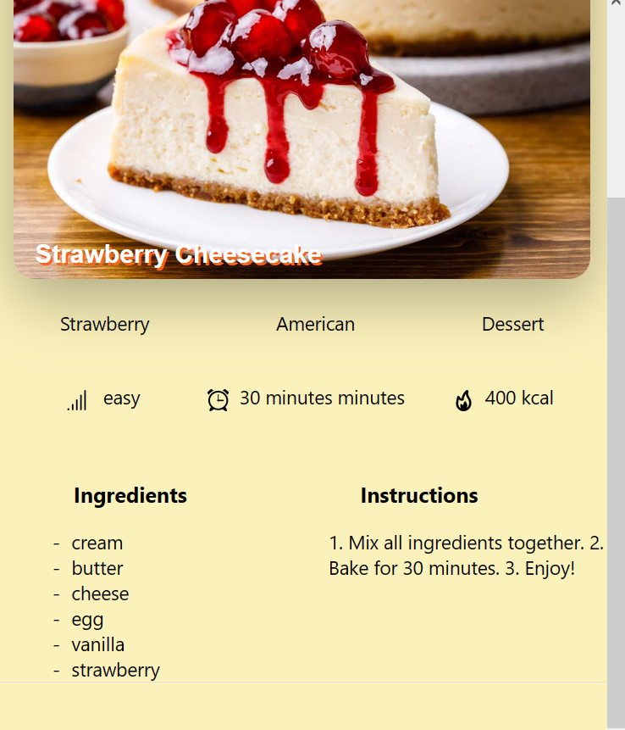
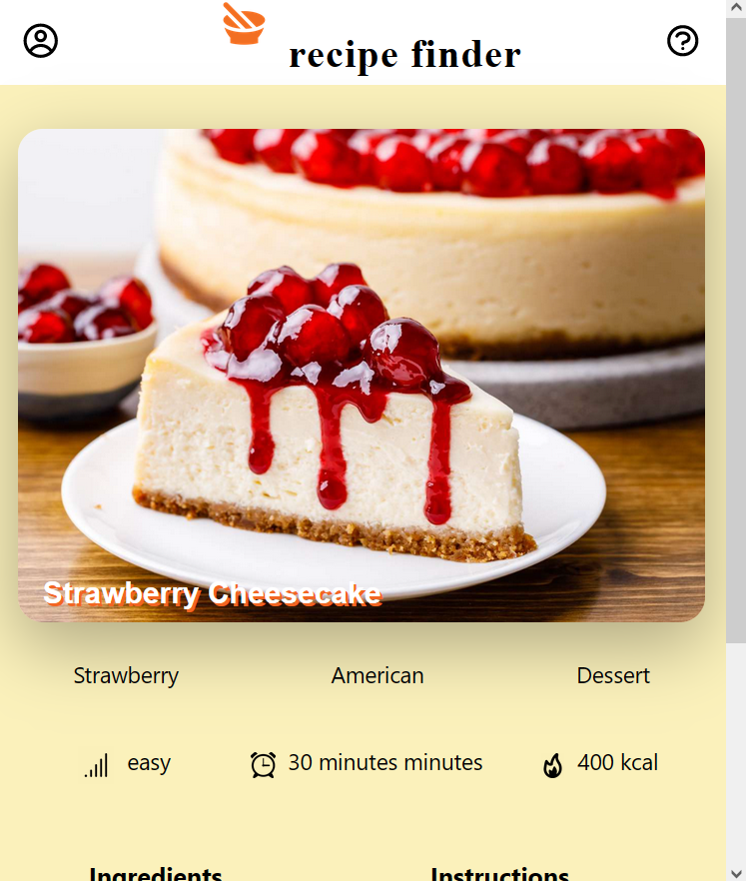
Recipe Page
Displays all important information and the recipe as a whole

Slide 8
You might not find love on tinder
but you will definitely love recipe finder

