Slide 1
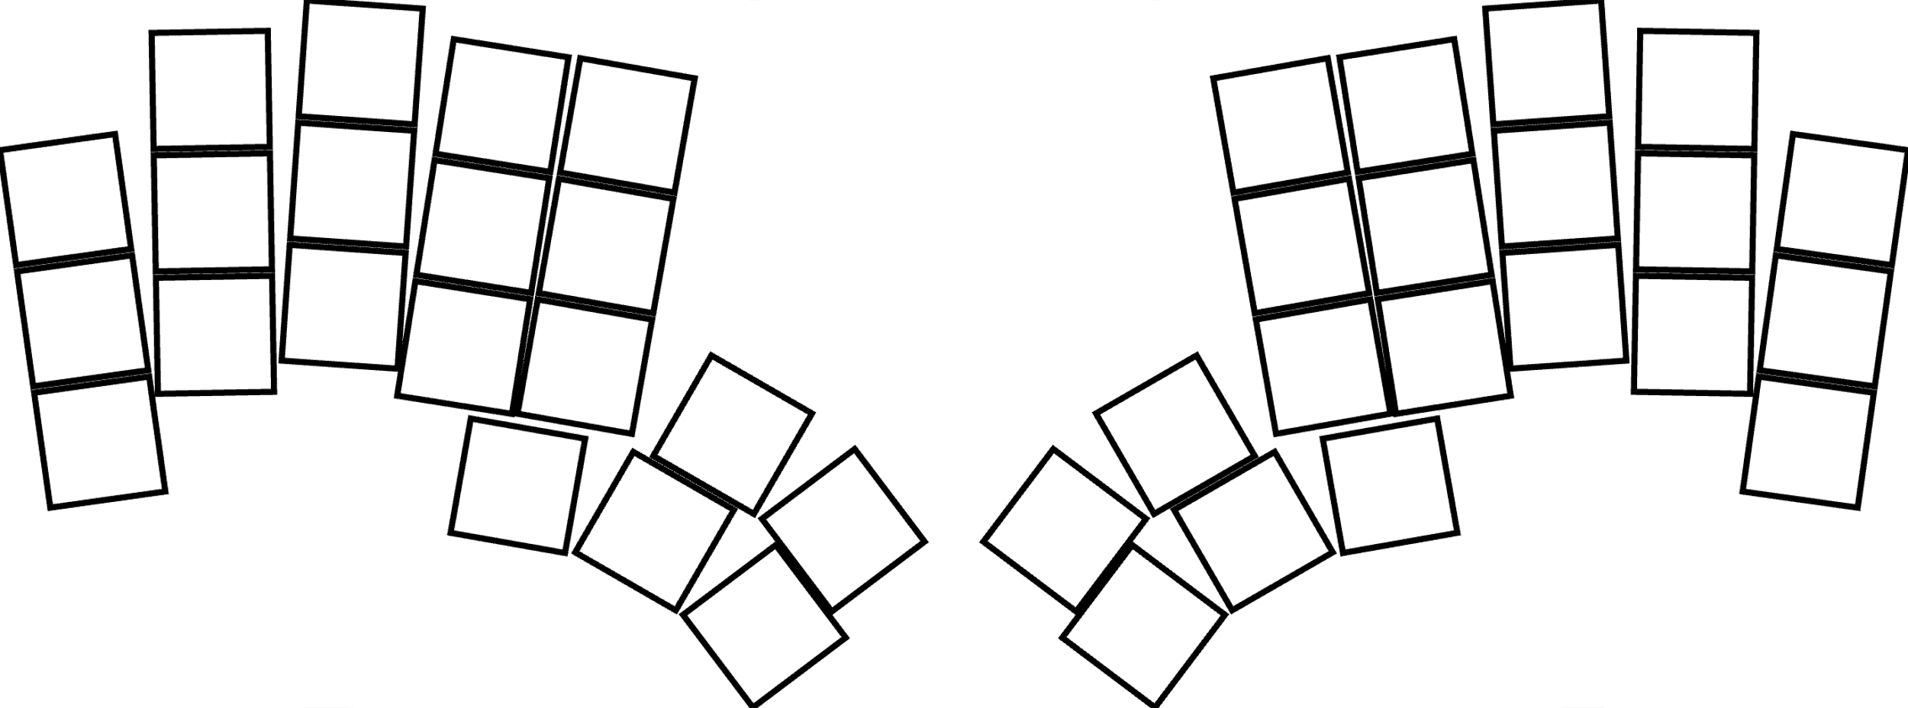
Home Layer
e
i
w
r
t
u
o
y
q
d
k
l
p
s
f
g
h
j
<
,
>
.
:
;
a
x
c
v
b
n
m
Tab
enter
?
/
z
Ctrl
Opt
Shift
Cmd
BackSp
Space
Symbols
Num + Nav
When pressed together forms Funcs

Slide 2
Num + Nav Layer
8
Up
7
9
null
home
End
null
esc
5
Down
Right
→
PgUp
4
Left
←
6
null
null
null
1
2
enter
null
backsp
del
3
null
null
0
Tab
enter
Opt
PgDn
Ctrl
Shift
Cmd
BackSp
Space
Symbols
Num + Nav
When pressed together forms Funcs

Slide 3
Symbol Layer
$
‘
%
null
null
~
“
^
esc
[
]
}
`
{
(
)
\
/
<
@
#
=
>
-
+
&
|
*
!
Tab
enter
Opt
?
Ctrl
Shift
Cmd
BackSp
Space
Symbols
Num + Nav
When pressed together forms Funcs

Slide 4
Func Layer
F8
Br+
Screenshot
F7
F9
null
Br-
null
F10
F5
pause
>>
Emoji Panel
F4
F6
null
<<
null
F11
F1
F2
Mute
null
Vol-
Vol+
F3
null
null
F12
Tab
enter
Opt
Lock Device
Ctrl
Shift
Cmd
BackSp
Space
Symbols
Num + Nav
When pressed together forms Funcs

