Slide 1
Furom
FUROM:
WEB Server
TCP Server
User Application Layer
Forum components
Description, Specification,
Project overview
& Workflow overview
Programmers: Niv Gafni
Etay Tchechanovsky
Shiran Yodev
Eliav Benzakan
Vadi Podolich
Probably The Best Forum In The World

Slide 2
OVERVIEW
System Structure – Layered View
System Structure – Class View
Server Workflow (Lower Layers)
Server Workflow (Sequence Diagram)
Client Application Workflow.
Client Application Workflow (Sequence Diagram)
Product VS Original Specification Documents
Behind The Curtains: The Development Proc.
Analysis & Conclusions

Slide 3
System Structure – Layered View: SeRVER
Logic Manager
Message Handler
Forum WEB Server
Forum Server
SQL Database
Logic Manager
EE Protocol
TCP Server
SQL Database
* Modules with the same name are the same module

Slide 4
System Structure – Layered View: Client
Client GUI Application
Protocol
Client GUI Listener
Protocol
Tcp Client
Logical Database
Tcp Client
* Modules with the same name are the same module

Slide 5
TCP Server Workflow (Lower Layers)
Massage Handler
TCP Server
Forum Server
MH=MassageHandler
FS=ForumServer
MH.readMassage()
msg = P.getMessage()
P= EEProtocol
Rmsg = TcpServer.receive()
MH=MassageHandler
Process(Rmsg)
LM.process(msg)
LM=LogicMannager
Prosess msg and add data to SQL Data Base
MH=MassageHandler
p.sendReplyMassage(msg)
P= EEProtocol
TcpServer.send()

Slide 6
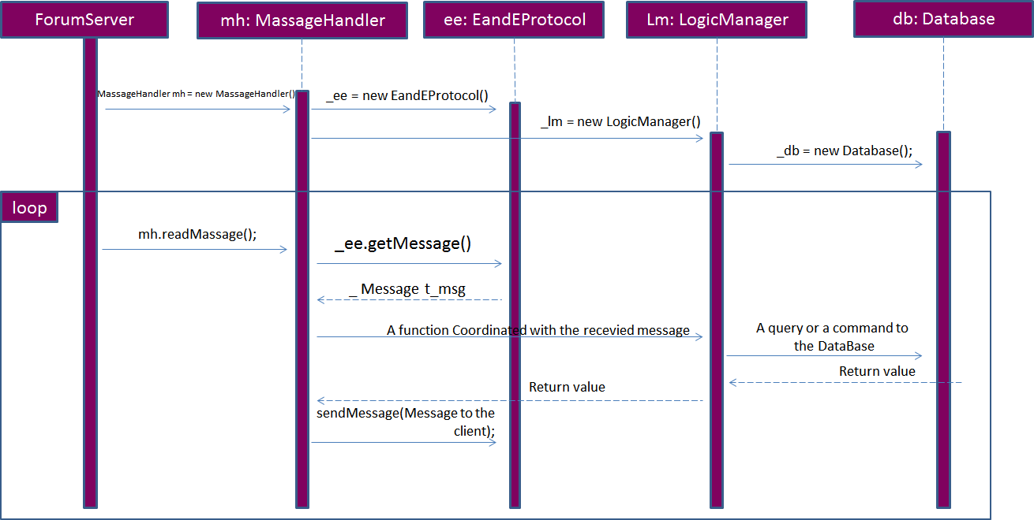
TCP Server Workflow (Sequence Diagram)

Slide 7
WEB Server Workflow (Lower Layers)
The lower level of the WEB Forum Server works exactly like the TCP Server without the TCP ☺ - the flow ends in the Database, and do not send information via tcp protocol.
The WEB Server communicate directly with the logic manager, there is no need to involve the massage handler (because of the absence of the lower comunication level – the TCP/IP Layer)

Slide 8
Client Application Workflow
GUI Client
Client Listener
TCP Client
P= EEProtocol
CL=Client Listener
Rmsg = TcpClient.receive()
msg = P.getMessage()
Process(Rmsg)
CL=Client Listener
Prosess msg and add data to SQL Data Base
P= EEProtocol
GC=GUI Client
Render GUI
TcpServer.send(msg)
msg=HandleEvents()
Start(CL)

Slide 9
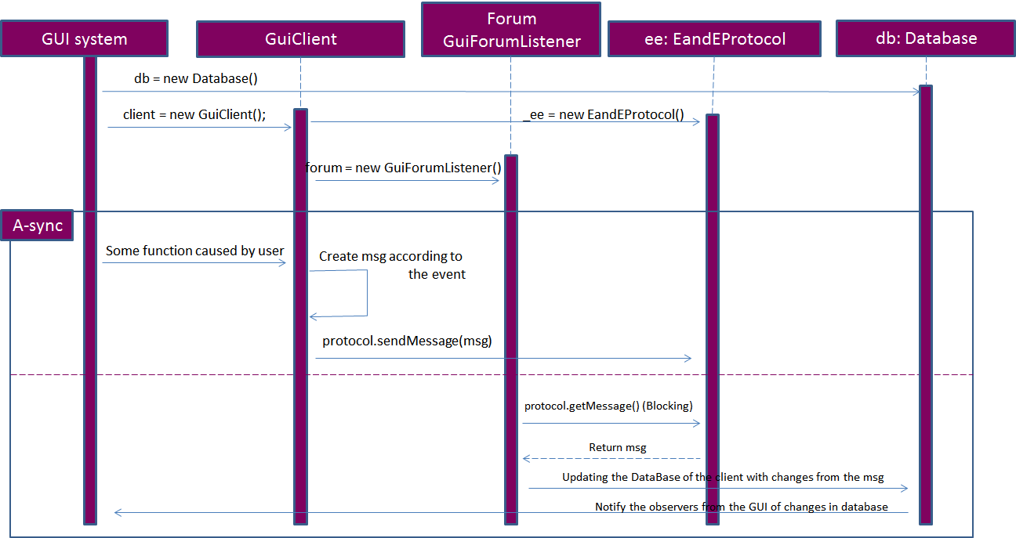
Client Application Workflow (Sequence Diagram)
* In the client side the db is a logical database (it is a class not SQL database)

Slide 10
Product VS Original Specification Document
There were several inconsistencies between the original Specs and the Final Product, Because of Clients Changes During the iterations and mostly because our misunderstanding of the requirements at the beginning of the project, which were clarified during the work.
The main changes were in the Domain Model with changed due to lack of modularity, and some small Glossary changes, which we will overview in details later on.

Slide 11
Product VS Original Specification Document (cont.)
The main inconsistencies we found in the Domain model:
The original Domain Model is small and describes only the logic of the Server, where in the final product the domain model is more complicated, and involves client side domain model.
Because of the SQL Data Base later requirement the logic manager in the new Domain Model doesn’t hold the forums, threads and post, all these entities are placed in the database, and the Logic manager getting the information with SQL Queries.
The moderator (administrator) concept was changed, the administrator doesn’t Inherit Info from regular member as was planned, instead the database contains table for users which are also administrators.

Slide 12
Product VS Original Specification Document (cont.)
The Logic Layer is more complicated in the final product then the Domain Model, because of the massage handling mechanism which controls the logic manager according to the parsed massages coming from the protocol (which receives RAW massages from the TCP client).
Some additional Inconsistencies in the Glossary:
The concept of popup posts was changed to popup massages, which notify the users interactively. The concept was changed because of lack of full understanding of the requirements.
The Forum System manager was changed to logic manager, and a new entity was added, the “massage handler” which was needed due to the TCP communication requirement.

Slide 13
Behind The Curtains: The Development Process
In the next few slides we will try to describe our Development process in different aspects, we will divide the development into three main ideas:
The Software Development aspect which mainly deals with software changes during the work, refactoring and design patterns usage.
The Team work aspect which mainly deals with the tasks distribution, equality, work efficiency and main workflow.
Development Tools we used and the affect of these on the process and software

Slide 14
Behind The Curtains: The Development Process (CONT.)
The Software Development process
The Initial software (after the second iteration) contained CMD client and Server, it was already a bit different from the original specs because of lack of full understanding of the demands, which were clarified during the code writing. There were no design pattern in the code, due to lack of knowledge about patterns, and the code was never refactored yet.
Because of the demand to Create GUI application for the client, medium scale refactoring was needed to the client lower layers.
After inserting the upper GUI layer , design patter was needed – to minimize the refactoring in the lower layers, we wanted that the change in the “old” logic manager will cause a change in the GUI layer, in order to design this behavior in the right way we refactored the code and added the MVC design pattern. The Massage Handler and all the layers beneath weren't changed.

Slide 15
Behind The Curtains: The Development Process (CONT.)
The Software Development process (CONT.)
In the third iteration we also added the SQL Database in the server side which caused a pretty large scale refactoring, all the data layer was removed and replaced with methods to retrieve the data from the database, the most of the API through which the LogicMannager communicated with the data layer wasn’t changed, only the methods content were changed to SQL statement instead of regular getters/setters.
In the forth iteration we developed the web server into which we imported the same LogicMannager with the Database layer. We did not use any special design patterns in the web server mostly due to the fact that WEB development was new to us and complicated enough.
The final transition to Ajax usage was the most painful in the project, we didn’t fully understand the web platform and the initial design wasn’t so good, adding Ajax to the server led to vary big changes in the web design and rewriting a lot of asp, JavaScript and c# code, along with adding code support in the LogicMannager.

Slide 16
Behind The Curtains: The Development Process (CONT)
The team work aspect along the Development
Every iteration, in the firs week we made so called “Furom Meeting” on which we reviewed the work done so far, analyzed the new demands and tasks were divided. We met once again in the middle of the iteration
Some times the division of labor wasn’t balanced intentionally due to other courses burden, or other events, in other occasions the lack of balance caused by misunderstanding of the complexity of the tasks.
In conclusion we think we could use the team’s size more efficiently, maybe that could happened if we met more times during the iteration.
We believe that also using task manager tool would of helped us be more efficient and balanced.

Slide 17
Behind The Curtains: The Development Process (CONT.)
Development Tools overview
Along the software development We used SVN to synchronize the software between us (we used Google server services). It was a vary good experience, though it took some time to learn how to use the SVN properly. In retrospect we should of write more comments after each commit to SVN, it would of help us synchronize on the new changes made
To keep tracking of the task status we used the phone.. Which was replaced by *.txt file in the DROPBOX. Like said before we should have used task manager tool.
As we started the project we used TDD development which was abandoned, because of the transition to GUI application, and lack of time.
Unit tests where written to test the main Logic layers

Slide 18
Analysis & Conclusions
In General we learned a lot in this project, about teamwork, programming in large group, developing WEB application and working with tools like SVN and Visual Studios. The next few bullets refer to our after work analysis and conclusions.
It is harder to develop software in bigger groups, and it require more synchronization between the team members, we think that a task management tool is essential to better organization.
It is hard to keep the code clean and consistent, so codding standards are essential, in the next project we surely will define them better then the txt file we defined this time.

Slide 19
Analysis & Conclusions
Every programmer should take responsibility on the code he wrote and fully understand it, and write some comments. At the final days of the software development we found ourselves with no fully understanding of the code because each team member modified functions he did not wrote –> because of that no programmer took responsibility on these code segments.
At least one developer should understand the full flow of the code, or else all the programmers live in their own functions and the integration becomes harder.

Slide 20
Summery
In Conclusion it was good programming experience, we enjoyed working on the project together, and observe the birth of a new product.
In our opinion the course flow was good, the submission policies were flexible, and the guidance was good.
One point for improvement- In our opinion there were too many new topics to learn, and a good references from your side could help us a lot, we feel that we spent more time on searching the net for information and references then learning the topics in deeper manner.

Slide 21
Furom
Probably the best forum in the world
The End

