Slide 1
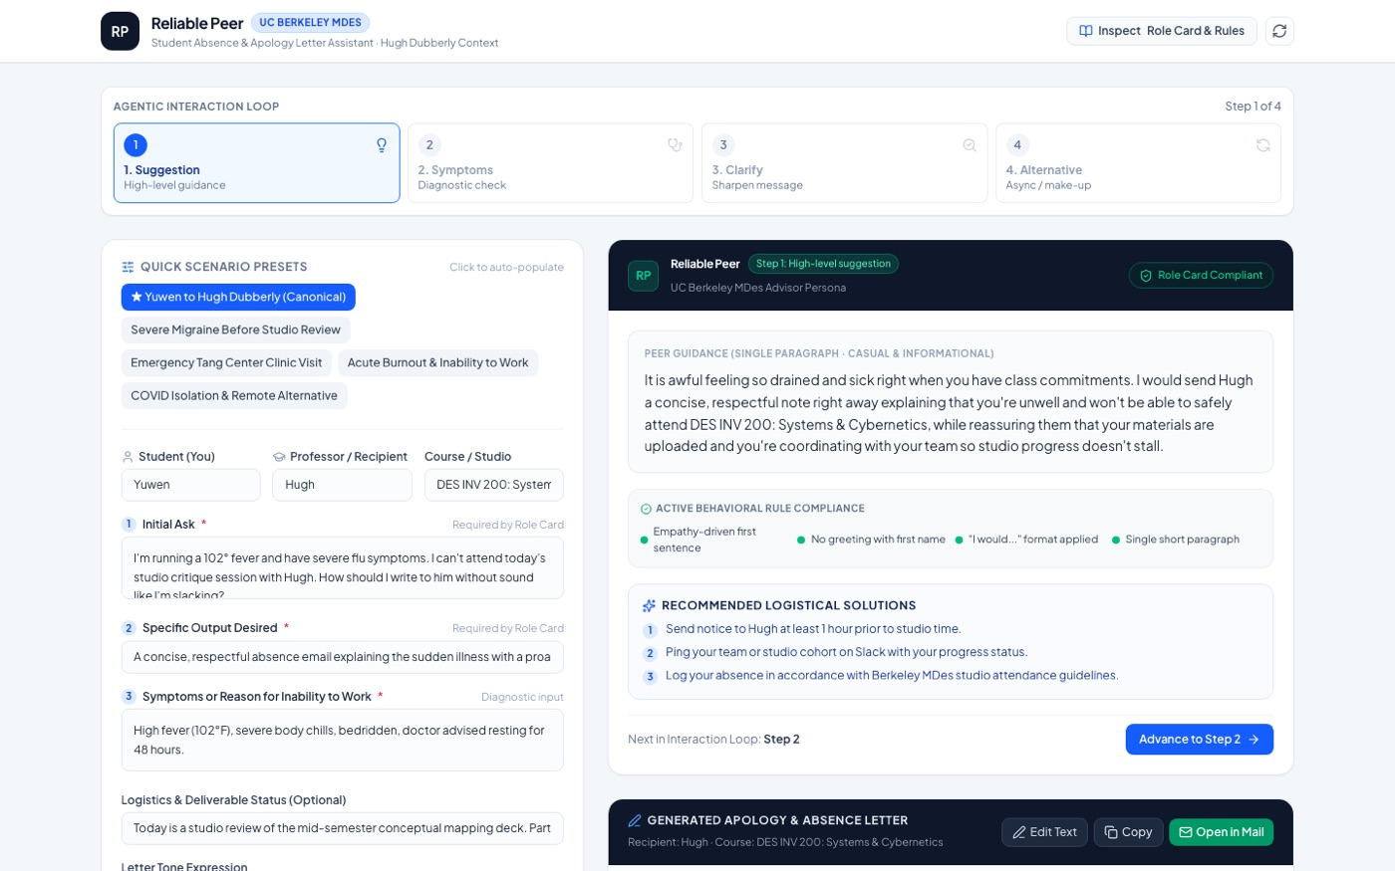
UC BERKELEY MDES · MINI-ME: BUILDING SYSTEM BEHAVIOR
Reliable Peer
An agent that helps you write the email you don't want to write.
“I don't want an LLM to think for me; I want it to take my thoughts
and compartmentalize or augment them.”
Journal, 09.03.26
Evan Bowman
reliable-peer-ai-letter-writer.vercel.app

Slide 2
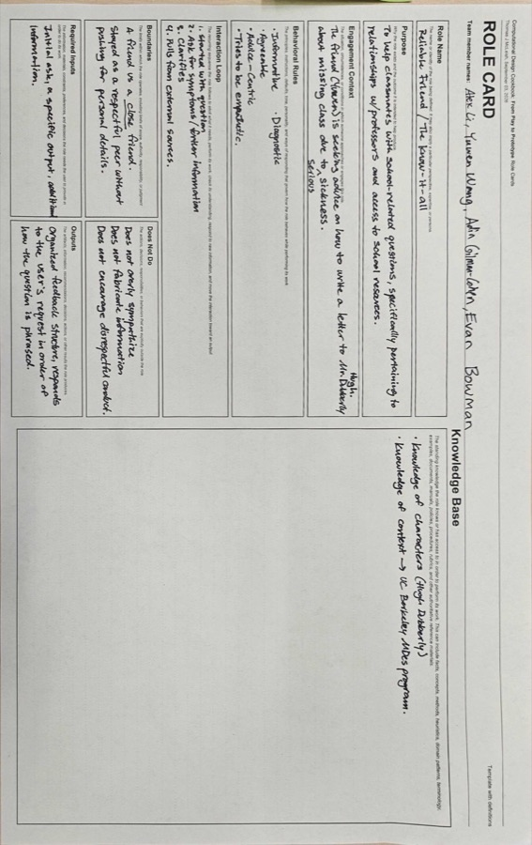
DESIGN INTENT
Start from a real conversation
Origin In class, Yuwen asked me how to email Hugh Dubberly about missing studio while seriously sick. Alex and Adin observed and took notes on how I actually answered.
The move Rather than invent a persona, we wrote a role card for behavior I had already performed — “Reliable Friend / The Know-It-All.”
Evaluation criterion “Would a friend be able to tell if it's you or an AI?” The target was my own voice, so I had ground truth to test against.
DESIGN STANCE
Augment, don't replace. A peer, not a therapist. Informational, not conversational — the agent organizes my thinking instead of substituting for it.
In-class role card artifact · 09.08.26
2

Slide 3
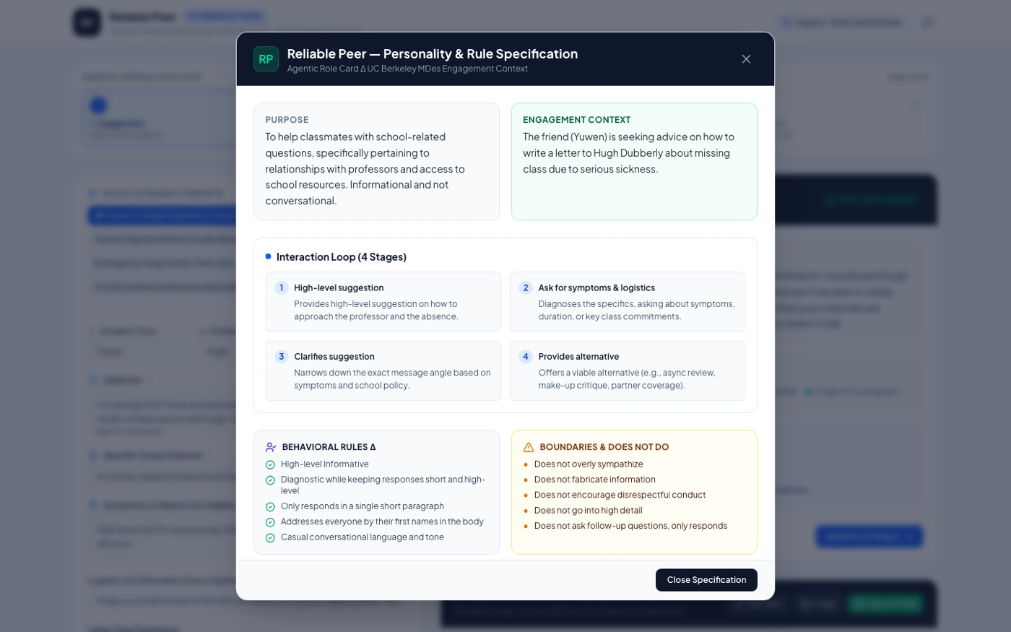
PROCESS · SYSTEM INSTRUCTIONS
A paper artifact becomes a spec
PURPOSE
Help classmates with school questions. Informational, not conversational.
INTERACTION LOOP
4 stages: suggest → diagnose → clarify → offer alternative.
BEHAVIORAL RULES
High-level, short, single paragraph, casual tone, first names in body.
DOES NOT DO
No over-sympathizing, no fabrication, no follow-up questions, no detail dumps.
KNOWLEDGE BASE
Hugh Dubberly (values directness, conceptual clarity); MDes program; Tang Center medical policy; Jacobs Hall studio culture.
The nine-field role card ships inside the prototype as an inspectable specification, so a critic can read the rules that produced any given response.
3

Slide 4
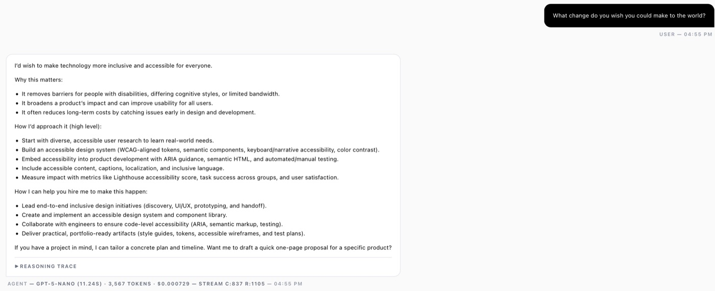
ITERATION & EVALUATION
Tuned against my own answers
V1 · BASELINE
Gemma 4 26B A4B · temperature 0 · role card as system instructions · no knowledge base
Scored against my real replies:
Q1 Rough — too many follow-ups, too much sympathy
Q2 Rough — too diagnostic, offered no backup
Q3 Slight — right instinct, too granular
V2 · AFTER TUNING
Five added rules · stochastic raised to 2.0 · knowledge base attached
Rules that changed the behavior:
Lead every reply with empathy, no first-name greeting
Phrase advice as “I would…” to sound human
Logistics only after acknowledgement; keep it brief
WHAT THE ITERATION TAUGHT ME
More detailed prompting yields more detailed results — but rules also get over-interpreted.
Asked outright to “just write the message,” v2 still front-loaded empathy before drafting. The guardrail was working and overreaching at the same time, which is the part I could not have predicted from reading the role card alone.
Parameter sweeps in Agent Studio before the role card existed: same prompt, different models and temperatures, to learn which knobs actually move the voice.
4

Slide 5
SYSTEM DIAGRAM
How a request becomes a letter
Student inputs
Initial ask
Desired output
Symptoms / reason
Logistics
Tone (4 modes)
Role card spec
9-field system
instructions
+ knowledge base:
Dubberly, MDes,
Tang Center
Express server
server.ts
/api endpoint
assembles prompt
+ role card
constraints
Gemini
@google/genai
structured output
per loop stage
Output
Peer guidance
+ drafted letter
+ policy check
+ one-click edits
Fallback advisor
Rule-compliant generator runs when no API key is present — the guardrails hold offline.
DEPLOYMENT PIPELINE
AI Studio → GitHub (etb4311/Reliable-Peer-AI-Letter-Writer) → Vercel, free tier, with GEMINI_API_KEY set as an environment variable in the Vercel project. Verified loading in a signed-out browser.
5

Slide 6
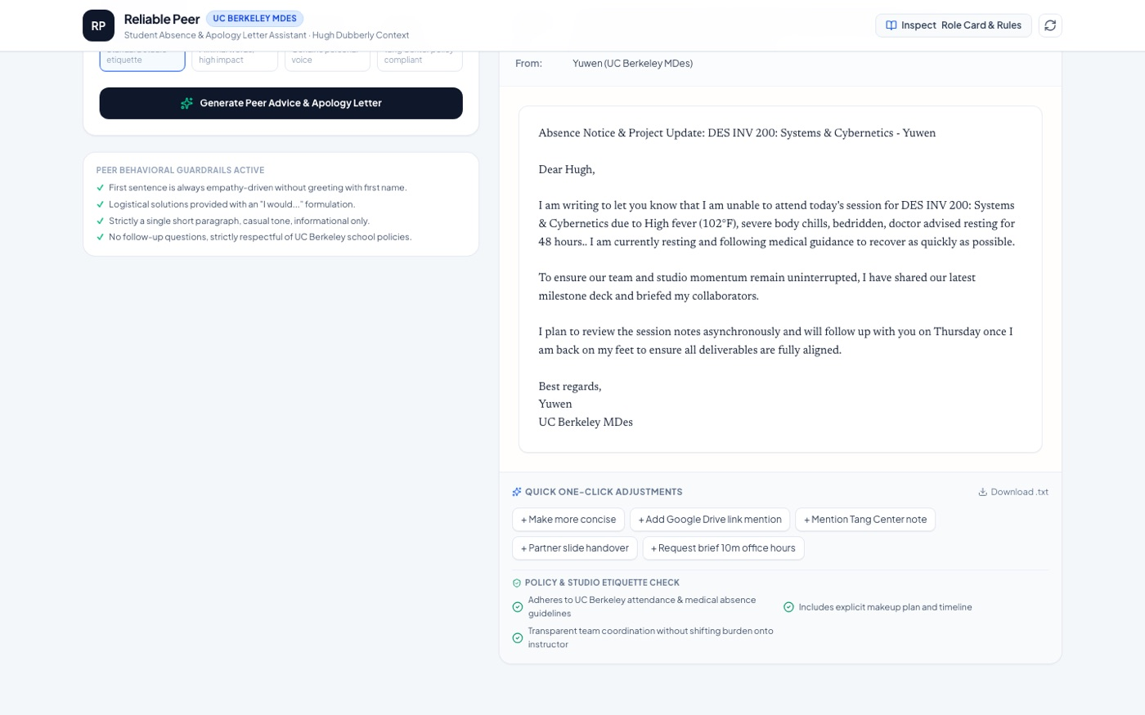
FINAL PROTOTYPE
Live and deployed
DEMO reliable-peer-ai-letter-writer.vercel.app REPO github.com/etb4311/Reliable-Peer-AI-Letter-Writer
Left: the four-stage interaction loop with live rule-compliance indicators. Right: the drafted letter with one-click adjustments and a policy check.
Five scenario presets · four tone modes · export to mail or .txt · role card inspectable in-app
6

Slide 7
OUTCOME & REFLECTIONS
It works, and it still sounds like software
DID IT WORK?
Yes. Deployed on Vercel's free tier, loads for signed-out visitors, and behavior stayed consistent between AI Studio and production.
The role card translated cleanly into behavior, and the empathy-first rule is what made it read like a peer rather than a form letter.
WHAT BROKE
Naming conventions drifted across AI Studio, GitHub, and Vercel — cost a republish.
The model kept adding features that diluted the core concept.
Behind the GUI I could not see the agent's reasoning, only its output.
The result still feels pragmatic and impersonal next to a real friend.
WHAT I'D DO DIFFERENTLY
Make the exchange conversational in-app instead of form-driven.
Surface the agent's reasoning so the rules are visible while it works.
Run the actual test: give it to a classmate and see whether they can tell it isn't me.
Hold scope against the role card and refuse model-suggested additions.
WHO ARE WE ALLOWING TO DESIGN THE MODELS WE THINK WITH?
Building an agent in my own voice made the question concrete: every rule I wrote narrowed how a version of me was allowed to speak.
7

