Slide 1
SparkSpace
Decentralized Creative Trading Platform
Start with the end in mind, connecting creativity with demand

Slide 2
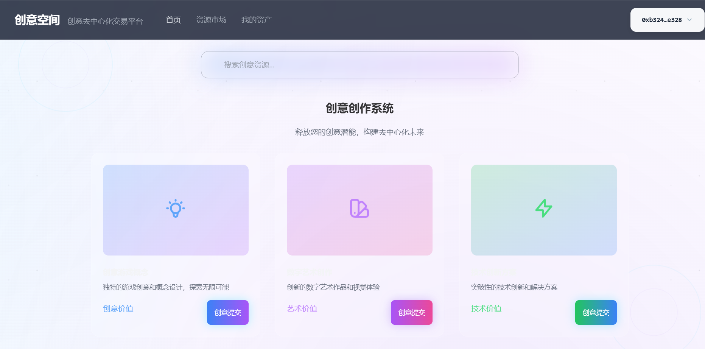
Project Overview
Project Name: SparkSpace v0.6 Core Concept: Start with the end in mind, helping creators find real demand through idea publishing Platform Positioning: A decentralized creative trading platform where app developers, game developers, and teams can list their creative ideas and game resources

Slide 3
Market Pain Points
• Inefficient traditional development process:立项, planning, development, then listing
• Creators struggle to validate market demand for their ideas
• Users lack channels to participate in and support creativity early on
• Imbalanced resource allocation and high investment risks

Slide 4
Solution
• Revolutionize the traditional process: List creative ideas first, find demand, then develop, iterate, and finally profit
• Establish a creative publishing and trading platform
• Users can support creativity with points, converted to "Audience Expectation Value"
• Early supporters receive point rewards and discounts when the creative work is realized

Slide 5
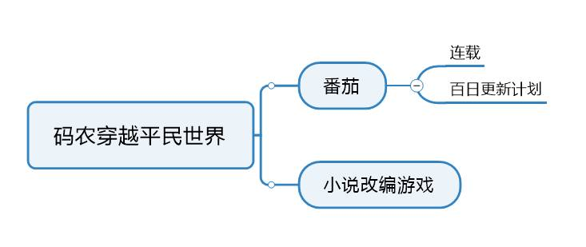
Core Features
Creator Module List creative ideas and game resources (animations, characters, maps, demos, etc.) User Module Browse, vote, buy, and sell game resources Points Module Points as the basis for settlement; creators can issue their own point tokens to exchange for "Audience Expectation Value"

Slide 6
Business Value
For Creators Provide a platform to showcase work, validate market demand, and reduce investment risks For Users Early participation in supporting creativity with point rewards and discounts For Platform Generate revenue through transaction fees and advertising

Slide 7
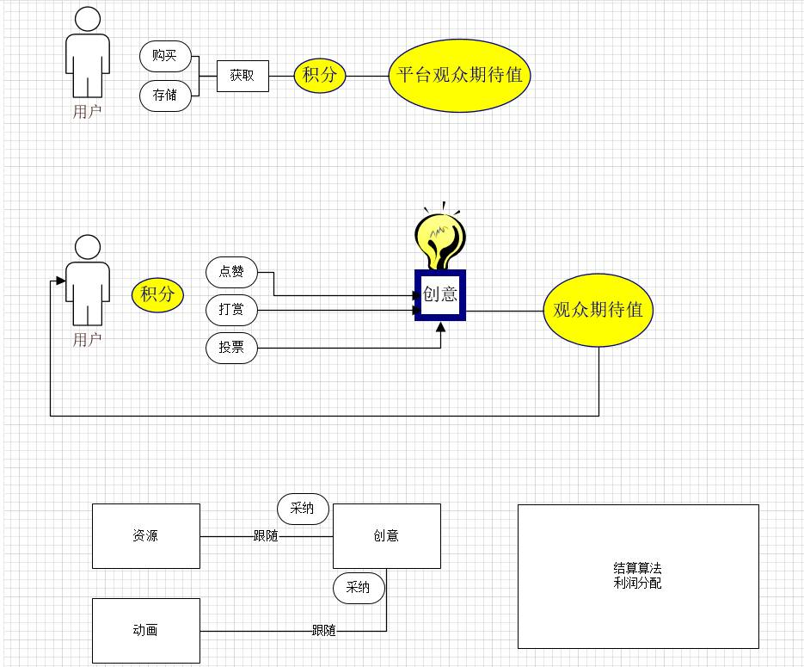
Profit Model
• Users earn CYKJ points through deposit/withdrawal/lending activities
• Platform profit distribution: 10% to platform, 20% to investors, 70% to platform profit treasury
User Reward = Creative Profit × Audience Expectation Value / Total Creative Expectation Value

Slide 8
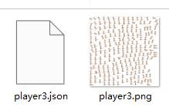
Technical Advantages
• AI-generated game resources to improve development efficiency
• AI vibe coding technology for rapid prototyping
• Solves game sprite image consistency issues to generate smooth animations
• Focus on full-process creative ideas in the AI track
• Provides efficient creative implementation tools

Slide 9
Vision and Outlook
• Transform the creative industry ecosystem to better reflect creative value
• Expand support for more resource types like Unity packages
• Build a complete creative ecosystem
• Connect creators with users to achieve value co-creation
• Reduce innovation risks with the "start with the end in mind" concept

Slide 10
Summary
Core Value: Connect creators with users to achieve value co-creation Conceptual Advantage: The "start with the end in mind" concept reduces innovation risks Technical Support: Leverage AI technology to enhance development efficiency
Thank You!

