Slide 1
sklearn-application
https://github.com/etbox/sklearn-application

Slide 2
Content
Preview dataset
Classification
Regression
Conclusion

Slide 3
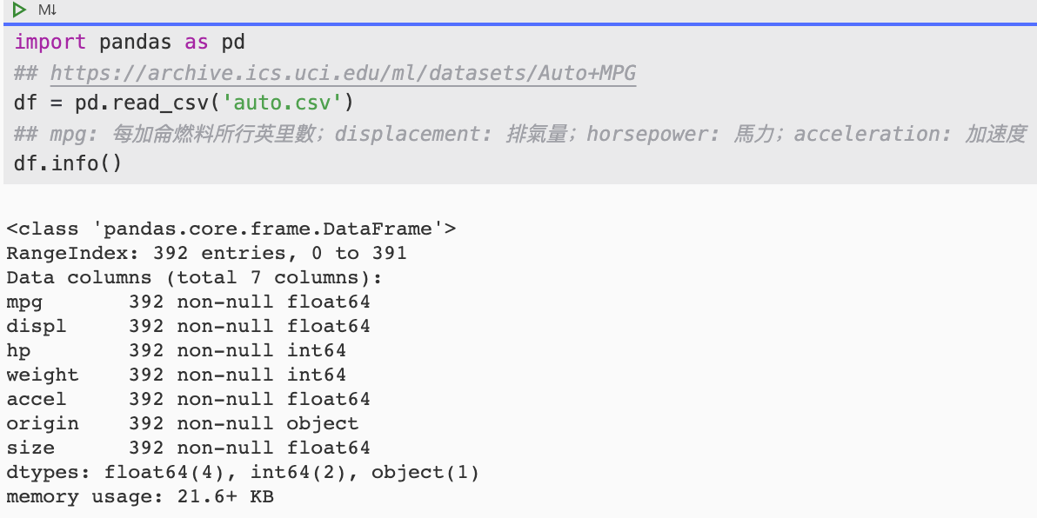
https://archive.ics.uci.edu/ml/datasets/Auto+MPG

Slide 4
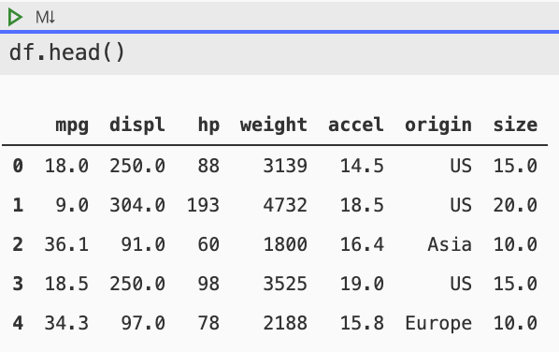
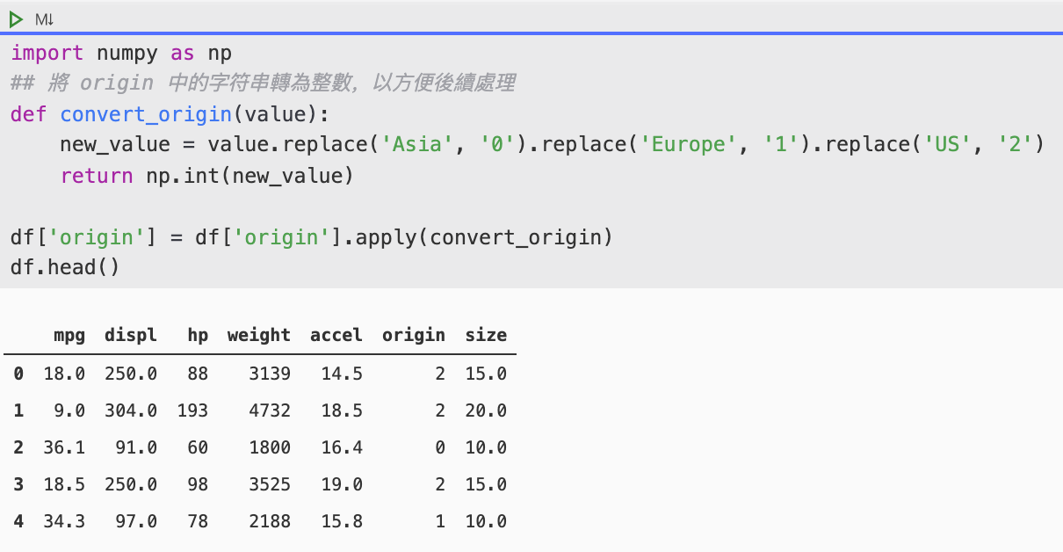
Preview dataset

Slide 5
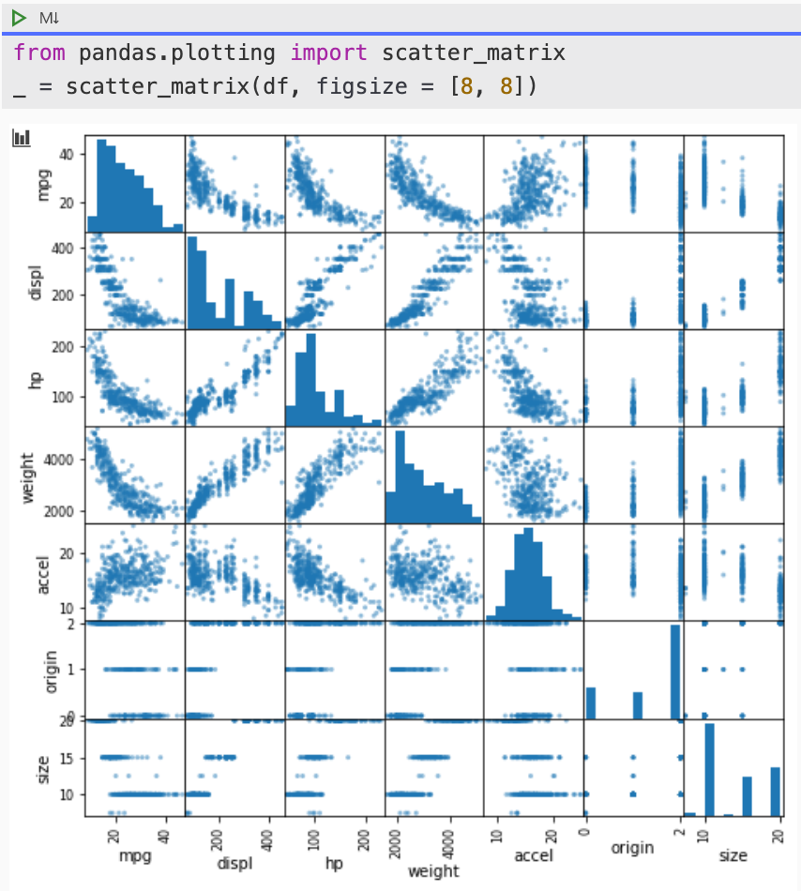
Preview dataset

Slide 6
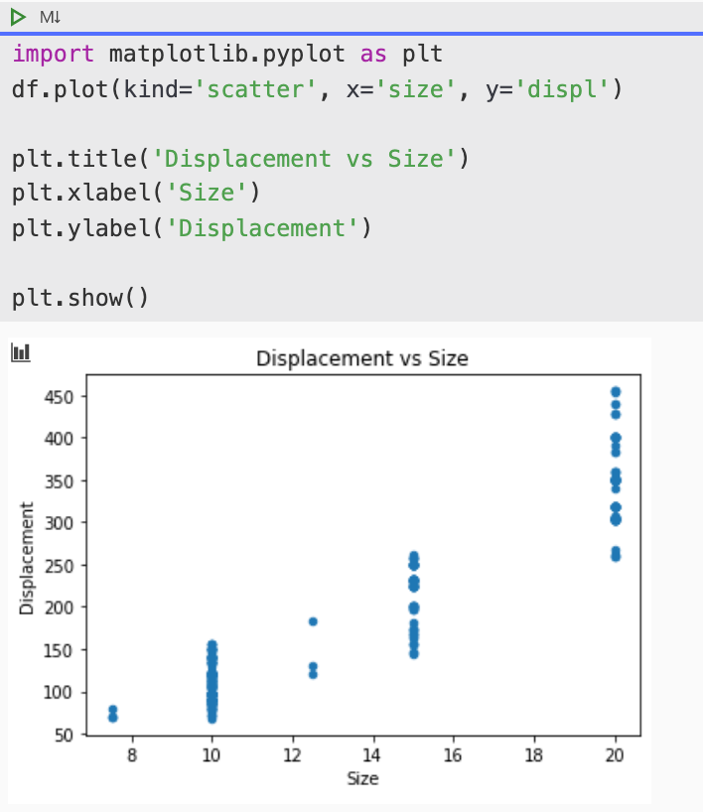
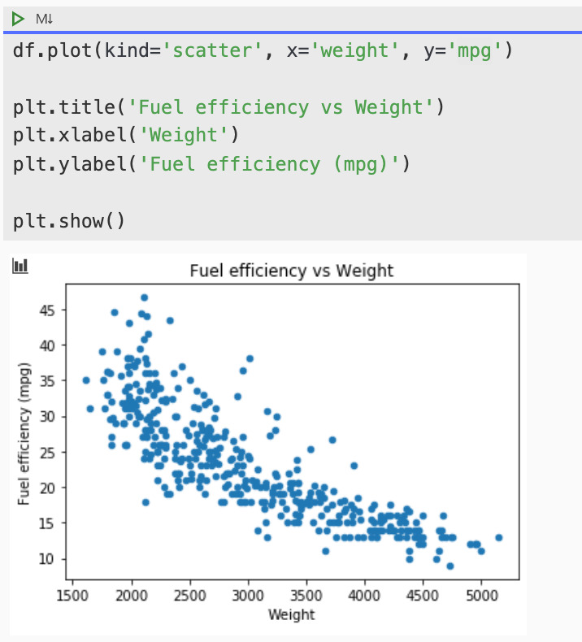
Preview dataset

Slide 7
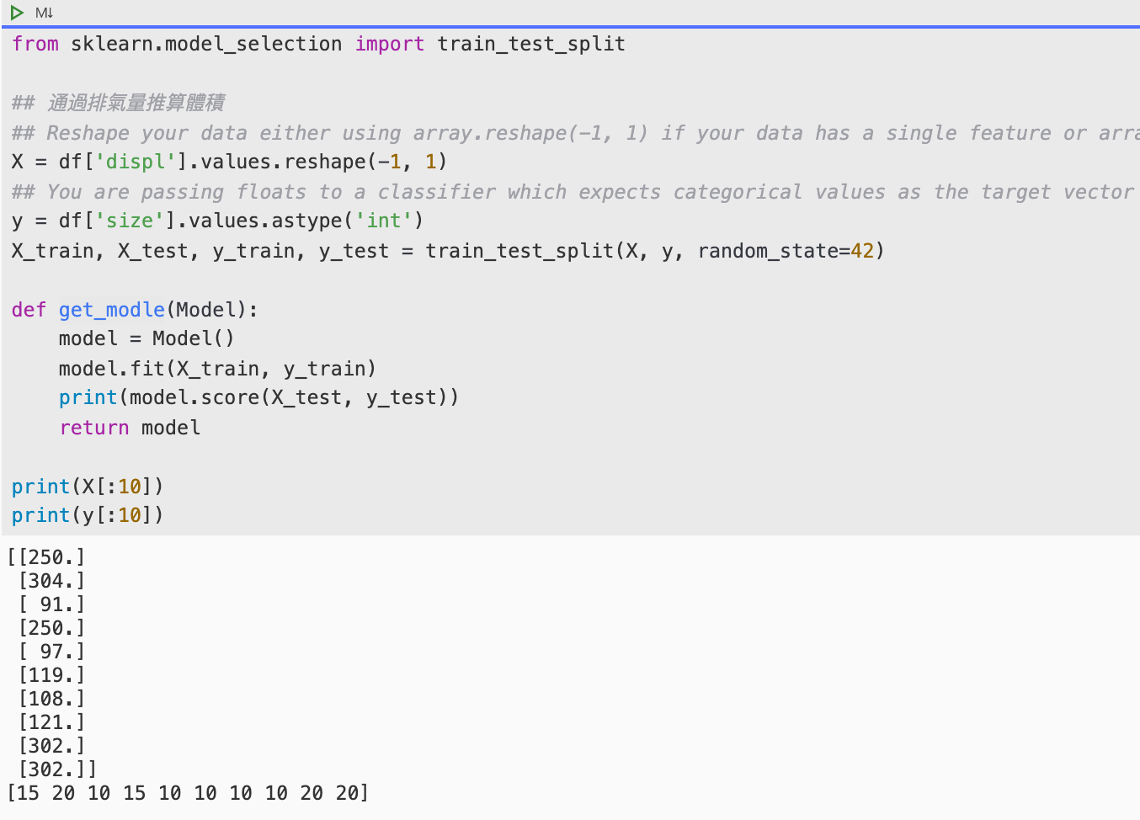
Classification

Slide 8
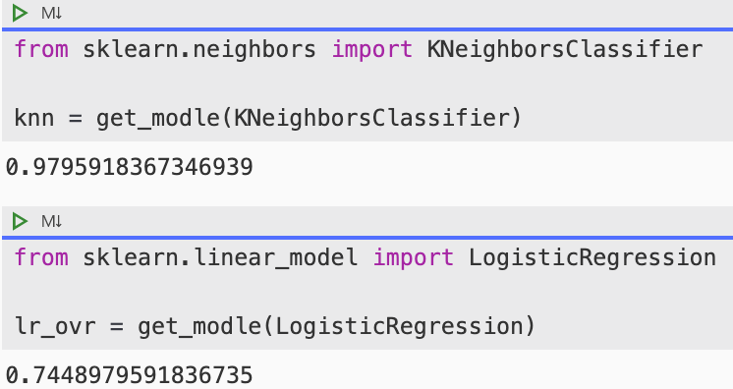
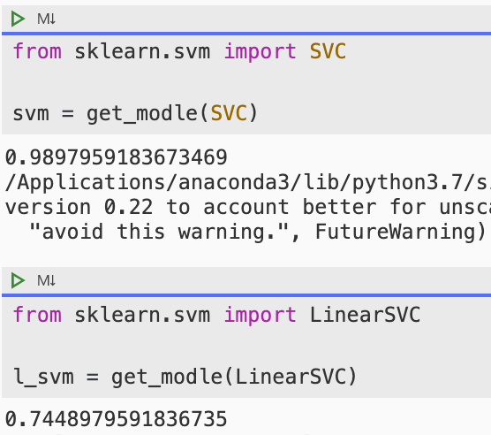
Classification

Slide 9
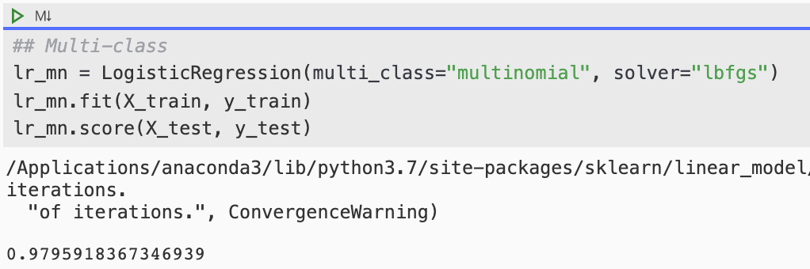
Classification

Slide 10
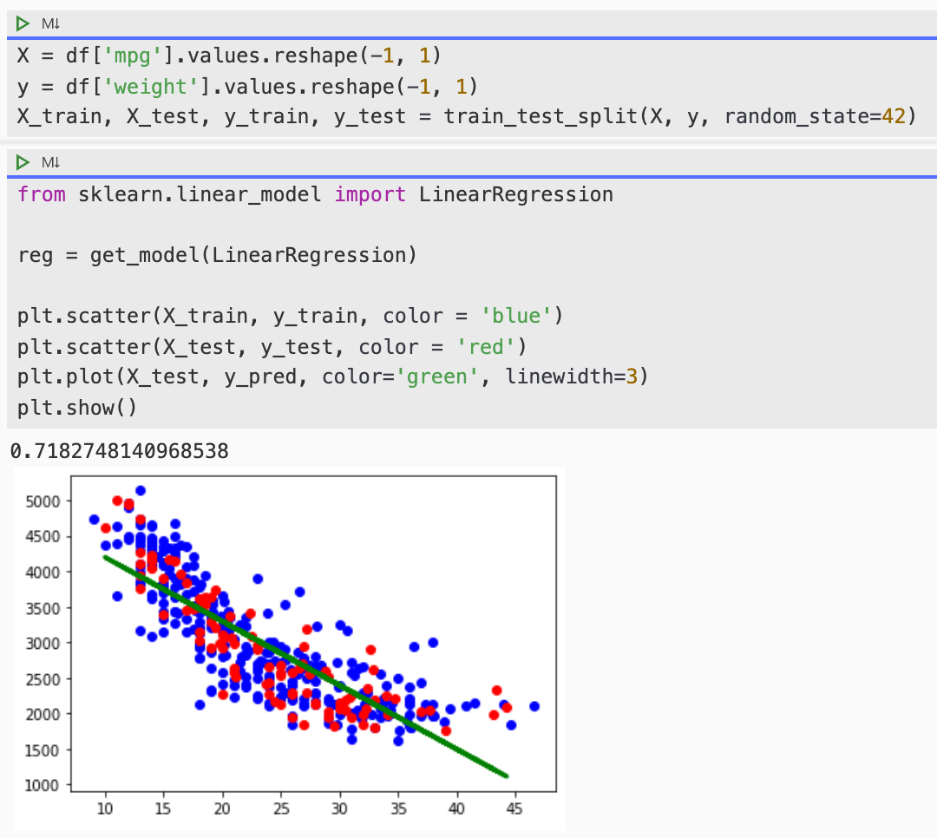
Regression

Slide 11
Conclusion
Choosing good features is very important!
Use mult-class classifier for complex data
Displacement vs Size
Fuel efficiency vs Weight

