Slide 1
Intelligent Systems in Gaming: Procedural Generation
Eugene Casuple
YWCC 307 101
Notes:
Today I will be discussing Procedural Generation, a method for creating data from handcrafted assets/algorithms and computer randomness and processing power. It is applied in many art, game, and film mediums, yet it lacks many concrete tutorials. That is what I am here to help provide.

Slide 2
What?
human
computer
assets
algorithms
randomness
processing power
Notes:
Today I will be discussing Procedural Generation, a method for creating data from handcrafted assets/algorithms and computer randomness and processing power. It is applied in many art, game, and film mediums, yet it lacks many concrete tutorials. That is what I am here to help provide.

Slide 3
Generative Methods
Distributive
Parametric
Tile-based

Slide 4
Distributive
Easy
Sophisticated
Little structure
e.g., battle royale shooters
Notes:
Distribution functions with large yet less structured tables of probability weights. This mainly concerns the elements IN an environment, such as the random guns in your battle royale shooter of choice. This method rarely concerns the environment as a whole.

Slide 5
Parametric
User input-reliant
Volatile
e.g., AI art, Spore, character creators
Notes:
Seen in products like AI art and Spore, the parametric method provides a number of variables that can be tweaked to a user's liking. The output may be something volatile, a characteristic that encourages further study and refining of the technique.

Slide 6
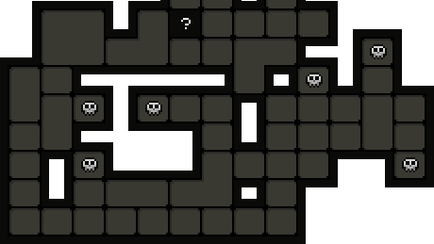
Tile-based
Small scale
Less flexibility
e.g., The Binding of Isaac, Warframe
Notes:
Tile based systems break problems into smaller pieces before recombining them in interesting ways. Studios like Digital Extremes frequently design themed tilesets for computers to algorithmically generate unique maps.

Slide 7


Benefits
Longevity
Efficiency(?)
Notes:
Some benefits of these methods take the form of longevity and efficiency. As the balance shifts more toward computer intervention, Procedural Generation systems can be upgraded and tweaked over time, saving hours that would otherwise go to manual design of assets.

Slide 8
Longevity
Handcrafted vs. Generated Content
Notes:
Some benefits of these methods take the form of longevity and efficiency. As the balance shifts more toward computer intervention, Procedural Generation systems can be upgraded and tweaked over time, saving hours that would otherwise go to manual design of assets.

Slide 9
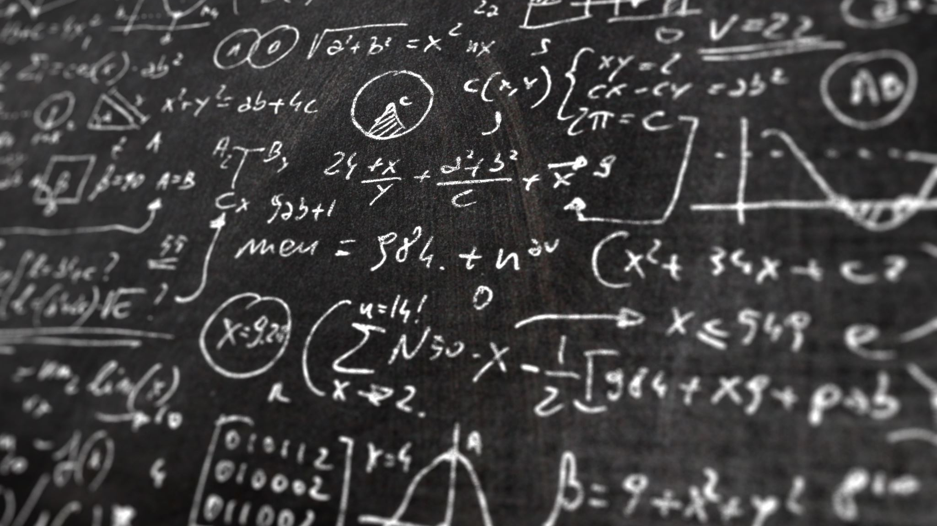
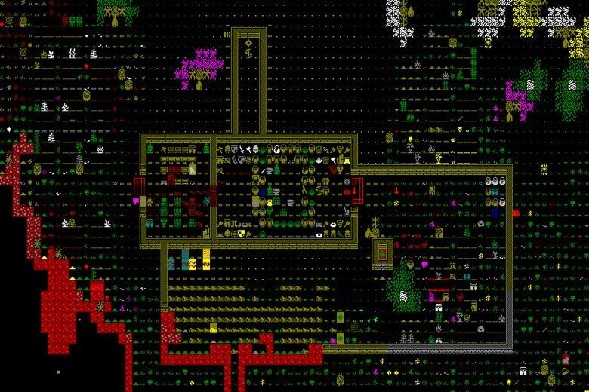
Efficiency(?)
Small program, big output
Notes:
Here, efficiency acts as a double edged sword, providing smaller file sizes at the expense of processing time. Players of the seemingly primitive yet complex Dwarf Fortress might find themselves leaving their computers running overnight before having a new game load.

Slide 10
Challenges
"Procedural Oatmeal"
Performance issues
Bad/Undesirable Output
Notes:
With these benefits follow existing challenges.

Slide 11
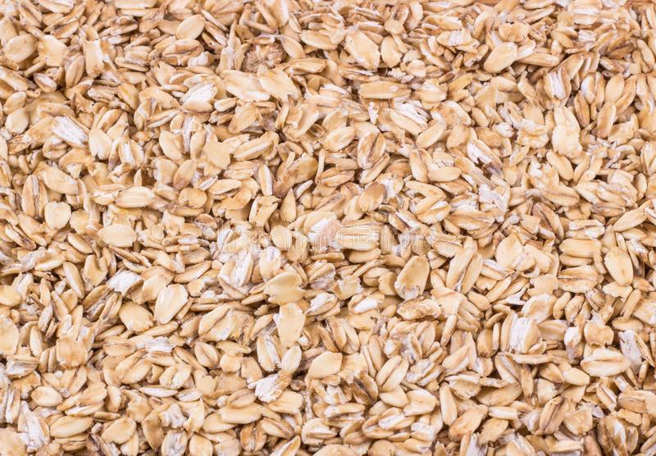
“Procedural Oatmeal”
“You can see something ‘new’, but never something surprising.”
Perceptual uniqueness/differentiation
Notes:
Let's say you generate 10,000 bowls of oatmeal, all with random sizes, shapes, amounts, and orientations of oats. The result is 10,000 containers of food that are mathematically unique, but visually uninteresting. This phenomenon manifests in "procedural oatmeal", a term coined by writer Kate Compton. In her essay "So you Want to Build a Generator", she uses the terms perceptual uniqueness and perceptual differentiation to isolate key factors of this problem. The former might pertain to a memorable character or location, which demands more human than computer intervention. The latter might pertain to a set of randomly generated trees, existing for the sake of aesthetic.

Slide 12
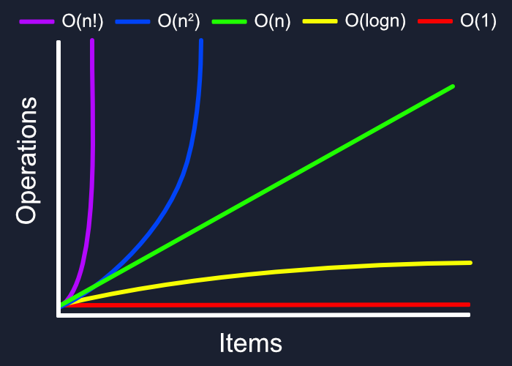
Performance Issues
Notes:
As touched upon by mention of efficiency, Procedural Generation is prone to performance issues. As projects grow in complexity, they demand greater amounts of assets and algorithms, which in turn lead to exponentially overwhelming interaction.

Slide 13
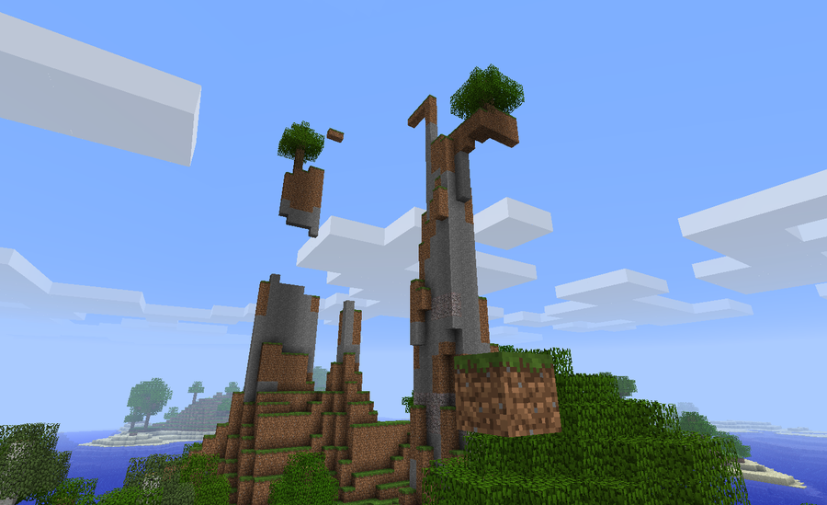
Bad/Undesirable Output
”I know it when I see it”
Notes:
Procedural Generation is imperfect. Most of the time, developers won't know what they want or don't want in an output. They inevitably fail to pinpoint some edge cases or constraints in a project, which remain unfixed until they are found. This emphasizes the importance of constant updates and maintenance in modern software.

Slide 14

Solution: Constraint Solvers
Brute Force
General purpose
delete “bad” outcomes
define min/max size range
Notes:
In the absence of any concrete or standardized tutorials on this topic, constraint solvers provide useful means of tackling these challenges. A brute force solver might generate thousands, if not millions of outputs before finding a perfect, constraint-satisfying outcome. This proves unintuitive for performance in larger projects. What next? On the rise are general purpose solvers, which serve to cut down brute force processing time as well as bad output. These "integrity constraints", as some of them are called, might simply delete bad outputs to save storage. They might also define a valid size range, to prevent bad outputs to begin with. In the end, we may not even live to see industry monoliths publish their final updates.

Slide 15
References
https://en.wikipedia.org/wiki/Procedural_generation#cite_note-1
https://www.gamedeveloper.com/design/alien-languages-how-we-talk-about-procedural-generation
https://www.textise.net/showText.aspx?strURL=https%253A//galaxykate0.tumblr.com/post/139774965871/so-you-want-to-build-a-generator

