Slide 1


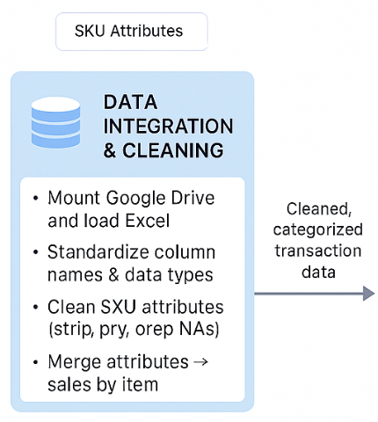
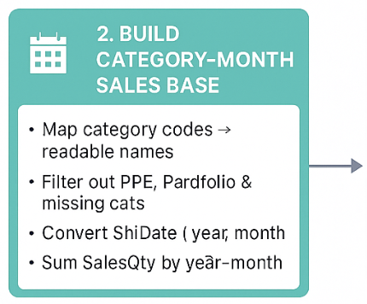

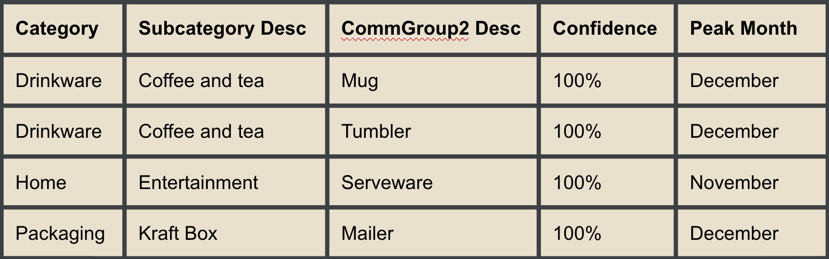
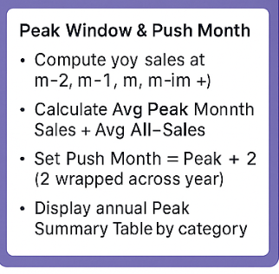

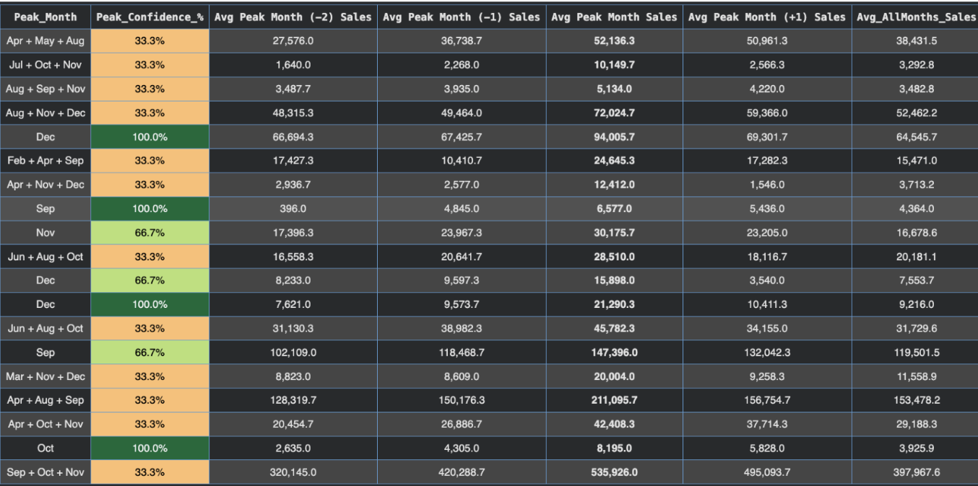
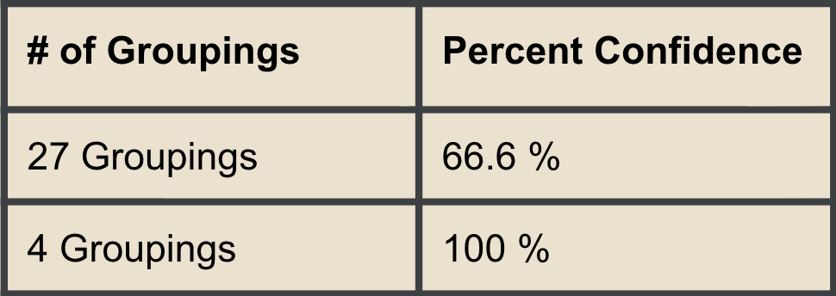
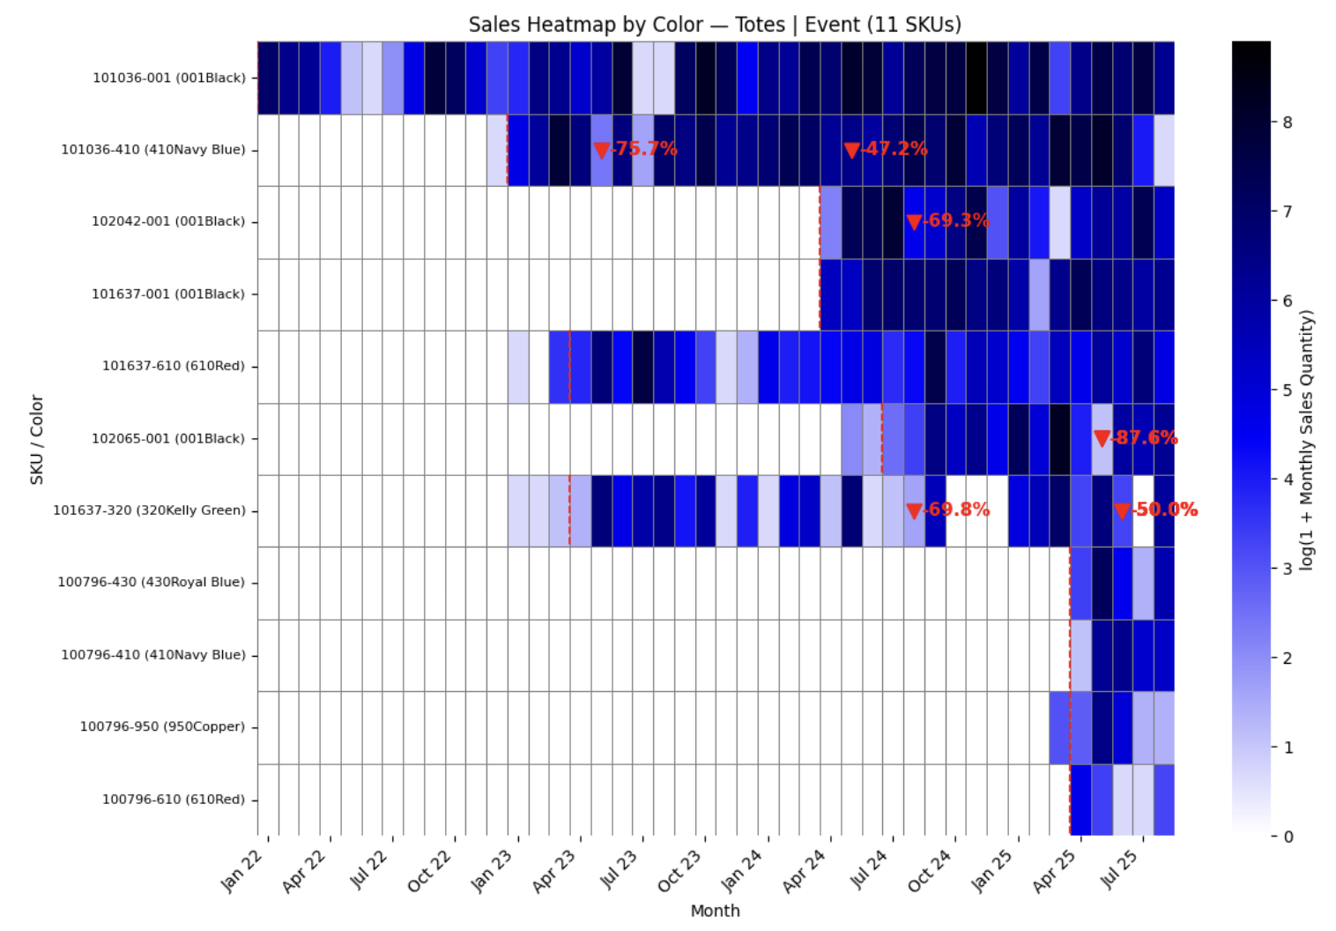


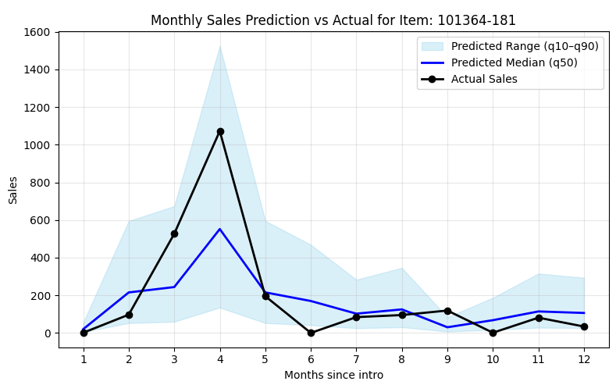
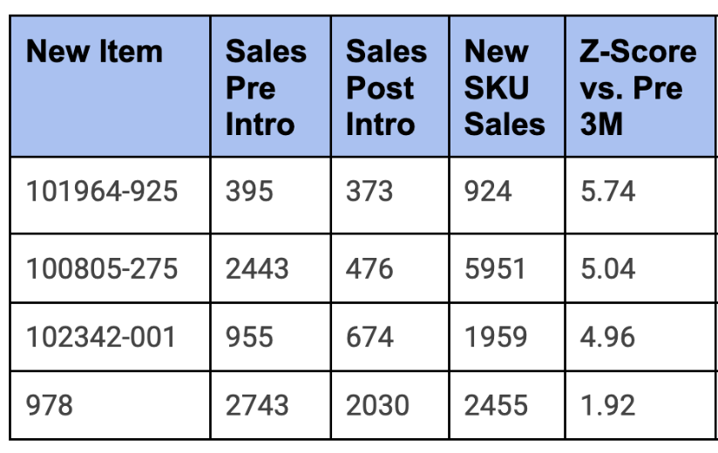
Timing is Key: Utilizing New Product Forecasting and Optimizing Market Entry to Limit Cannibalization
Nikhil Satpathy, Trinity Briggs, Emmanuel Tchonang, Valeria Marin-Gallo
Background
Market Entry Approach
Market Entry Findings and Recommendations
Founded in 1958, they are a leading supplier of promotional products.
Headquartered in Lawrence, MA, they serve some of the world’s largest global corporations, partnering with 40+ suppliers and brands like Samsonite and Moleskine.
Problem Statement
Uncertain New Product Performance: Gemline faces difficulty forecasting demand for newly introduced SKUs (e.g., bags, drinkware, and totes) due to limited historical data and changing customer preferences.
Market Entry: Having a wide variety of products, Gemline currently struggles with identifying the most optimal launch timing for each of their unique product categories and subcategories.
Potential Cannibalization: New product launches may reduce sales of existing items within the same category, but Gemline currently lacks a data-driven method to quantify and predict these effects.
Our market entry analysis identified 4 sub subcategories in which there was a 100% confidence of what the month with the highest amount of sales would be
Our market entry analysis identified 31 categories in which there was a 66+ % confidence of what the month with the highest amount of sales would be
Tree-Based Analytical Model Formulation
Cannibalization Results
Analytical Model Accuracy
Random Forest model
generated…
Gradient Boosting model
quantified…
Heatmap analysis included comparing the sales of items across varying colors and brands in the same category + subcategory grouping.
Further quantified cannibalization by:
● Taking a smoothed rolling average of sales to account for seasonality
● Then, tabulating instances where sales decreased by greater than 0.5𝜎
Our model was able to generate 7 subcategory forecast predictions with an accuracy ≥ 75% and 12 subcategory forecast predictions with an accuracy ≥ 65%.
Top 5 highest performing subcategory predictions had the following accuracies: 91.67%, 83.33%, 75.83%, 75%, and 75%.
Predicted Sales Distributions
+
Estimated Total Sales
Implementation & Impact
Monthly Sales Forecast
How our work will be used:
The team’s forecasting models will be integrated as an additional data point in the new-product planning process.
Expected improvements in new product forecasting:
Estimated Year-1 impact: $1–2 million, driven by
Reduced excess inventory from more accurate forecasting
Incremental sales revenue captured by better anticipating upside demand and having inventory available

