Slide 1


BPv7 Implementation: Configurable Faulty Network and Evaluation
Aidan Casey
Ethan Dickey
Jihun Hwang
Sachit Kothari
Raushan Pandey
Wenbo Xie
$$⊆$$

Slide 2
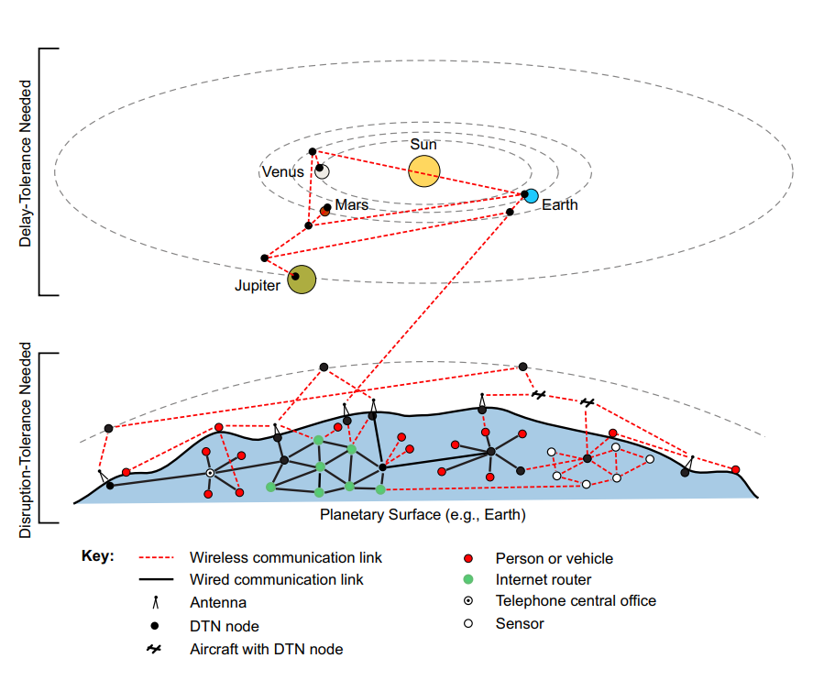
Delay/Disruption Tolerant Network (DTN)

Slide 3
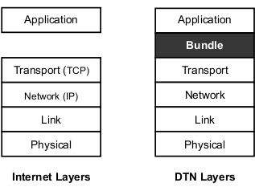
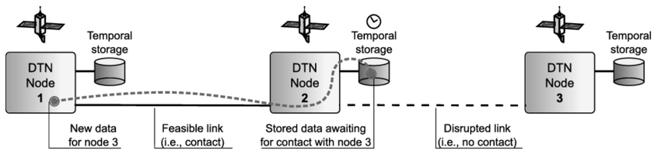
Bundle Layer

Slide 4
Bundle Protocol (BP)
April 2007
November 2007
January 2022
DTN Architecture
(RFC 4838)
BPv6
(RFC 5050)
BPv7
(RFC 9171)
The protocol for bundle layers
Bundles: data units of BP
IP datagram, TCP segment
Experimental Protocol
Updates from v6 to v7
Encoding method (v7 requires CBOR)
Some convergence layer adaptor (CLA) requirements
Data integrity (CRC)
Bundle format
(and so on)

Slide 5
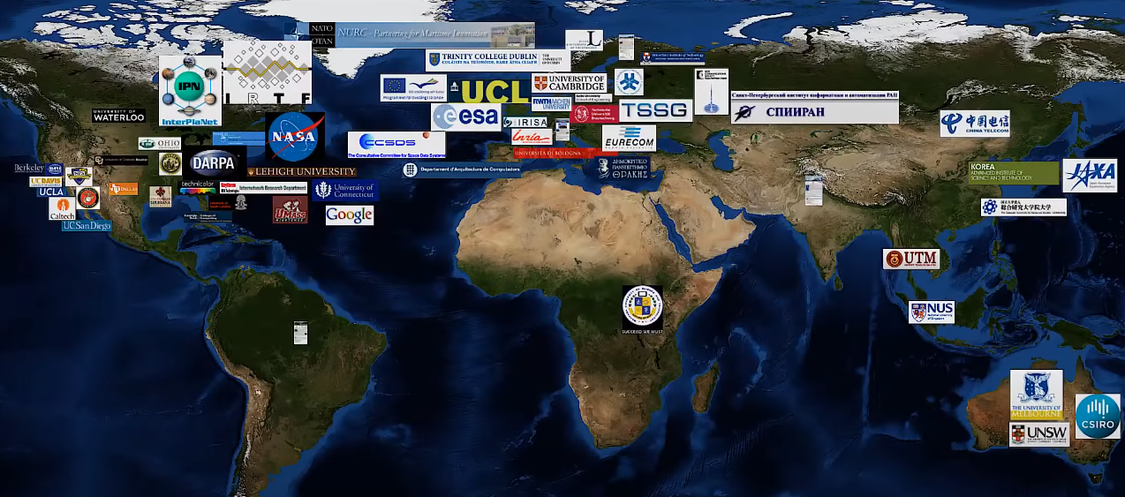
Project Motivation
DTN is being studied in many places...
But what about BP(v7)?!
Image source: https://youtu.be/nWtRTzXJvtI?si=tcuCufP9WPu0TtG3&t=210

Slide 6
Problem Statement
BP(v6) is an experimental protocol.
Will it (BPv7) remain in that stage?
Is it ready for full-integration?
Image source: https://youtu.be/nWtRTzXJvtI?si=tcuCufP9WPu0TtG3&t=210

Slide 7


Contribution
Developed a BPv7 testing framework
Flaws and Missing Specs in RFC 9171
Implemented BPv7 using Java solely based on RFC 9171
Software-Defined Networks: Easily configurable and extendable
Disruption TCP: TCP-based convergence layer for simulating disruptions
Lightweight and easy to understand
Architectural flaws from software engineering point-of-views
Missing specifications and inconsistencies with RFC 4838 (DTN) and 5050 (BPv6)
Future deployment issues (implementation details)

Slide 8
RFC 9171 Architecture Overview

Slide 9
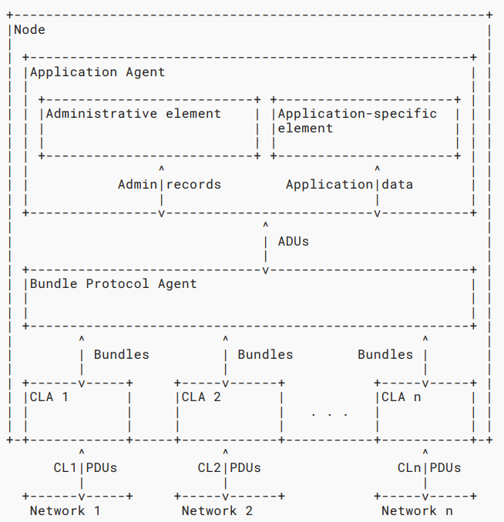
BPv7 Dissected
Application Agent (AA)
Bundle Protocol Agent (BPA)
Convergence Layer Adapters (CLAs)
Image source: RFC 9171

Slide 10
Application Agent (AA)
Socket between application and bundle layers
Receives data from BPA and makes it available to the application layer
Admin Element: 'Secretary' of BPA
Create and process admin records
Determines bundle error handling procedure
Image source: RFC 9171

Slide 11
Bundle Protocol Agent (BPA)
Core of BP
Generates bundles based on data received from the AA
Makes data available to AA
Admin element generates admin records as ADUs for BPA to send
Receives and sends bundles from and to the convergence layer (adaptors)
Image source: RFC 9171

Slide 12
Convergence Layer Adapter (CLA)
Sends and receives bundles from transport layer on behalf of BPA
Informs BPA necessary information regarding network status (disconnected, etc.)
Can be TCP-based, UDP-based, LTP-based, etc.
Image source: RFC 9171

Slide 13
Framework Overview

Slide 14
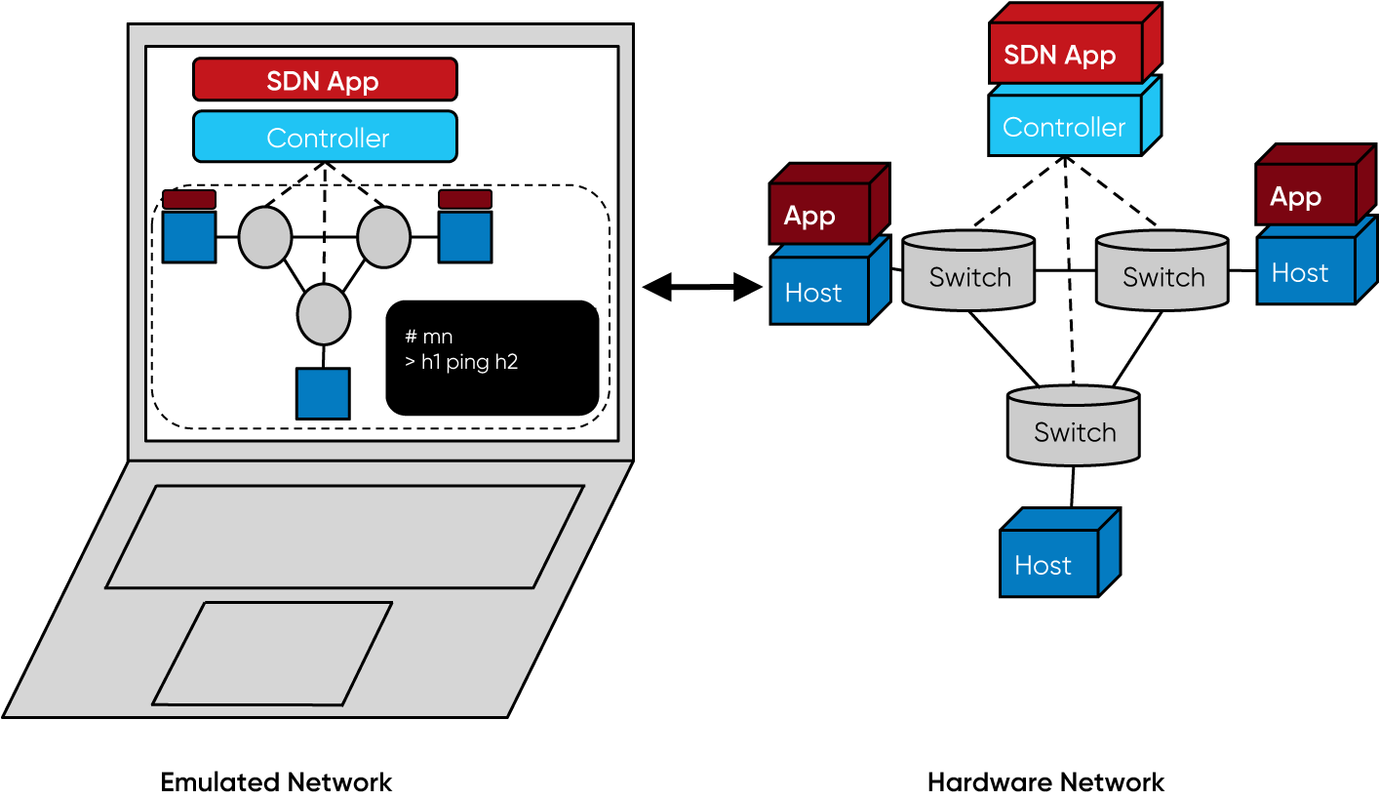
Mininet [Lantz, Heller, McKeown 2010]
Software-defined networking (SDN) based network emulator
Centralized, programmable control plane
Control and data plane disaggregated
Arbitrary topology network of virtual devices
Lightweight and hence scalable
Can have them run basic software
All these in on a single machine
Just edit the config file (Makefile)!
Image sources: https://opennetworking.org/mininet/

Slide 15
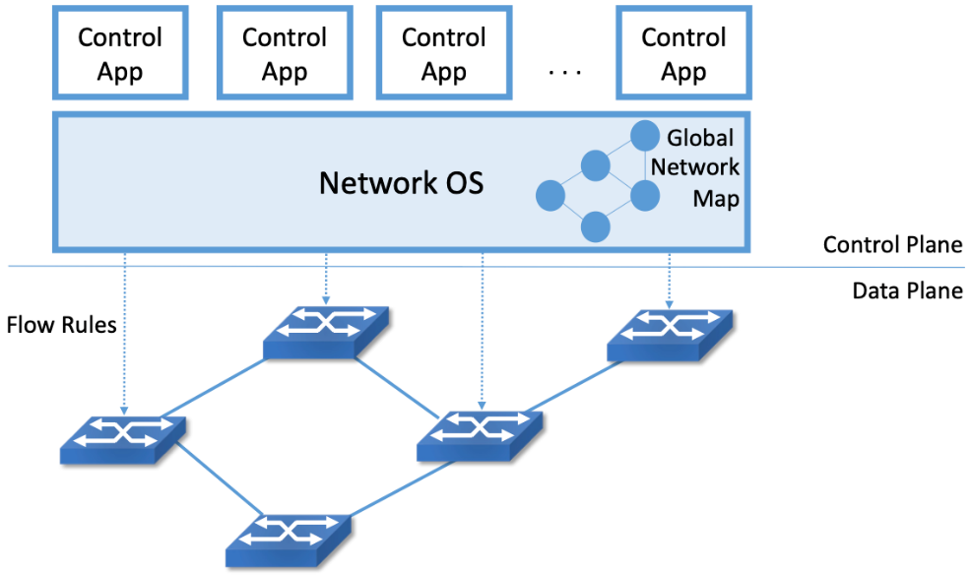
Open Network Operating System (ONOS) [Berde et. al 2014]
Open-source software providing the control plane for an SDN
OS for SDN controller
Allows centralized management and control
Scalable and easily extensible
Can run as a distributed systems across multiple servers
Customized routing
Just edit the config (netcfg) file!
Image sources: https://sdn.systemsapproach.org/arch.html

Slide 16
CLA: Disruption TCP (DTCP)
Sender’s knowledge
 |  | E |  |  | E | E |  |  |  | E |  |  |  |  |  |  | E
 |  | E |  |  | E | E |  |  |  | E |  |  |  |  |  |  | E
 |  |  | U |  |  |  |  |  |  |  |  |  | U | U
time
Receiver's knowledge
Other expected disruption implementation options:
Preset disruption frequencies (config file)
Randomly determined periodic disruption frequencies
Multiple (asymmetric) types of disruptions
Asymmetrical window sizes for expected and unexpected disruptions
Our goals: Simplicity and ease of analysis

Slide 17
Simulation

Slide 18
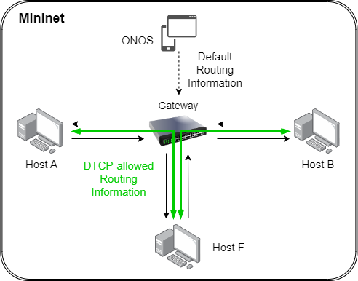
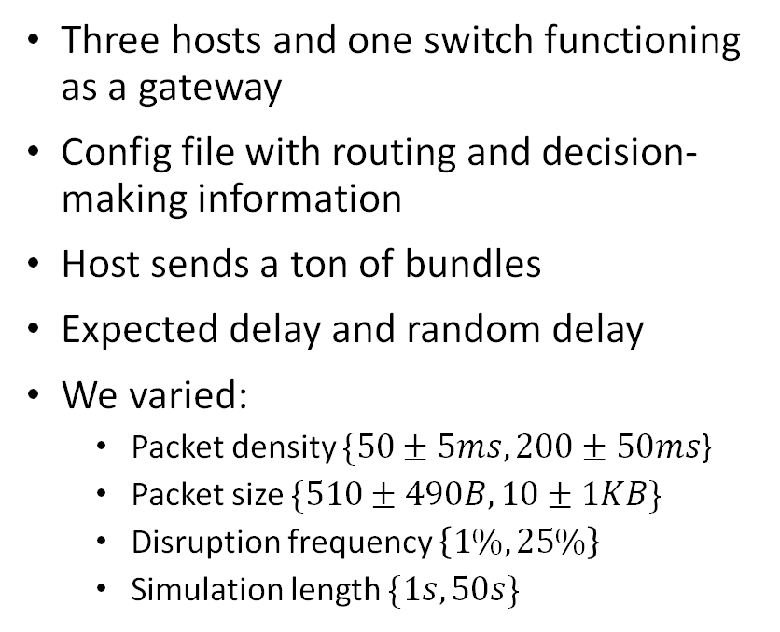
Simulation: Scenario
Three hosts and one switch functioning as a gateway
Config file with routing and decision-making information
Host sends a ton of bundles
Expected delay and random delay
We varied:
Packet density $\{50±5ms, 200±50ms$}
Packet size $\{510±490B, 10±1KB\}$
Disruption frequency $\left\{1\%,25\%\right\}$
Simulation length $\{1s, 50s\}$

Slide 19
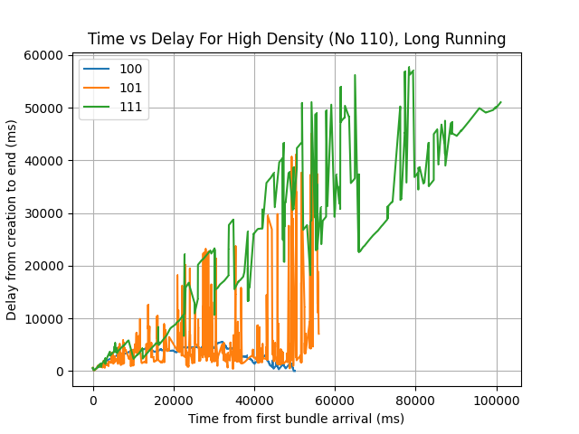
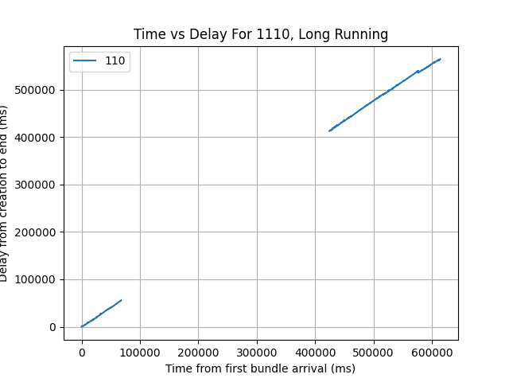
Simulation results
At 50s, the Application layer stopped sending information
BPA Thrashing

Slide 20
BPv7 (RFC 9171) Architectural Deficiencies

Slide 21
Violation of Single-Responsibility Principle (SRP)
Suppose that our bundle layer received a bundle that is an admin record
BPA receives the bundle from CLAs
BPA then extracts the payload/ADU (admin record) from the bundle
AE receives the admin record from BPA as an ADU
AE process the received admin record
What could go wrong?
Bundles
Image source: RFC 9171

Slide 22
Violation of Single-Responsibility Principle (SRP)
The purpose of the admin element is to deal with ACKs, status reports, and issues about bundles
No bundles here
Handling status report violates SRP!
For AE to accurately deal with status reports in an intelligent way, AE needs to know:
What a bundle is, removing abstraction of the BPA, in order to deal with it
What actions make sense given a particular bundle issue
The list of sent bundles (which is in BPA)
However, bundles fundamentally only exist in the BPA and below
Bundles
Image source: RFC 9171

Slide 23
High Coupling, Low Cohesion, and lack of an Information Expert
AE communicates with BPA by
processing admin records
Low Cohesion
AE does not communicate with
other elements in the same agent
AE primarily/solely functions as a secretary
for the BPA, i.e., belongs with the BPA
High Coupling
Future admin records may require
access to bundle-level metadata
Lack of an Information Expert
AA/AE then need to deserialize information from the ADUs, or BPA needs to parse it for AA/AE
Image source: RFC 9171

Slide 24
Missing Specifications
Unspecified Subject and Layer for Acknowledgement (ACK)
Suggestions
RFC 4838 (DTN): Optional delay-tolerant end-to-end ACK
Send ACKs in batches in a custom format to allow for a partial set of the ACKs to be received (if it is disrupted)
Unclear what it means by delay-tolerant (bundled or batched, etc.)
ACK for delivery is optional if TCP, but highly recommended for UDP, LTP, etc.
RFC 9171 (BPv7): Bundle-level metadata flag: “Acknowledgment by the user application is requested.”
Why is application layer responsible for ACKing? What are they ACKing?

Slide 25
Missing Specifications
Unspecified Notion and Subject of Hop-by-hop Reliable Delivery
Questions and Concerns
Hop-by-hop reliable transfer is required
DTN 4838: Custody transfer
It is unclear why:
Custody transfer is left as optional or removed in RFC 9171
Relies on other layers/protocols to handle reliability
Requirement removed in BPv7?
RFC 9171 does not define any notion of custody transfer
BPv7 by itself does not require DTNs to be reliable
Who conducts and responds to custody transfers?
BPA (based on BPv6)?
But how about admin element?

Slide 26
Future Works
Frameworks
More avenues of analysis
Expanded network configurations
Data corruption
Encoding
Metadata optimization
Architectural Flaws
Addressing identified architectural flaws and provide more suggestions
Is it necessary to remove custody transfer from the BP specifications?
In what cases it could be necessary?
Try redesigning BP architecture with AE inside BPA?
This would solve the violation of SRP for sure.

Slide 27






Acknowledgements
Co-authors
Aidan Casey
Sachit Kothari
Raushan Pandey
Wenbo Xie
Special Thanks
Alan Hylton
@ NASA GSFC
Anonymous reviewers
For productive convos
and helpful advice
For constructive feedback

Slide 28
Appendix

Slide 29

Why did we need to create a new implementation?
DTNs are being studied widely, and implementations of DTNs include BP.
Why did we implement BPv7 from scratch?
Too 'heavy' and intricate to use just for studying BP
Treats BP as a blackbox --- unclear where the 'disruption' tolerance comes from
Outdated
Implemented based on expired IETF drafts
Less popular languages (and less beginner-friendly)
Kotlin, C, etc.
Incorrect
E.g., BPA and AA communicating by sending bundles, not ADUs/admin records

Slide 30
Configurable Options
High-impact network options:
DTCP options
Down probabilities of E, U disruptions
Window size
Configurable options (Simulation Main controls):
Bundle lifetime
Sending delay range between bundles

Slide 31
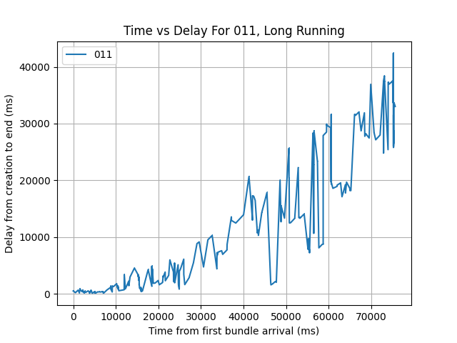
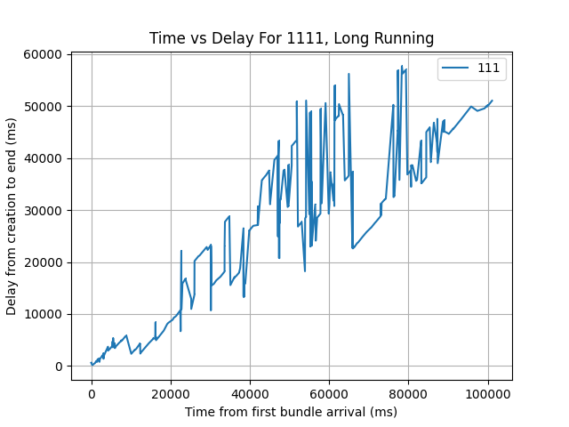
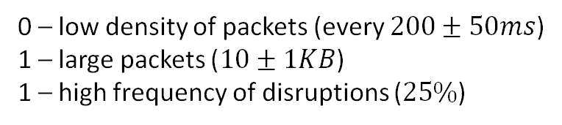
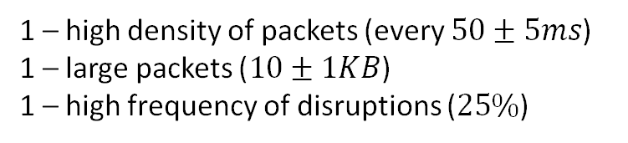
Simulation Results
At 50s, the Application layer stopped sending information
0 – low density of packets (every $200±50ms$)
1 – large packets ($10±1KB$)
1 – high frequency of disruptions ($25\%$)
1 – high density of packets (every $50±5ms$)
1 – large packets ($10±1KB$)
1 – high frequency of disruptions ($25\%$)

Slide 32
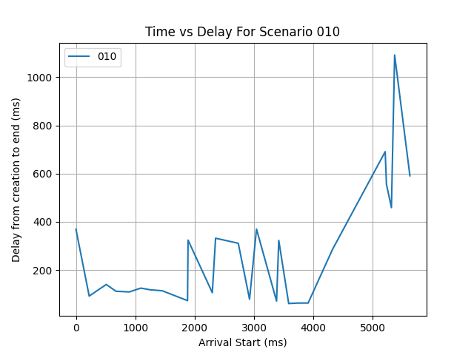
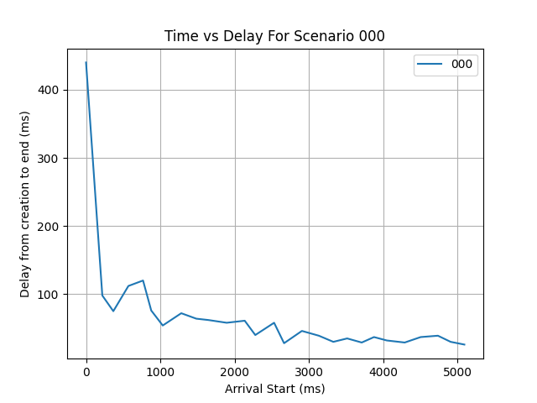
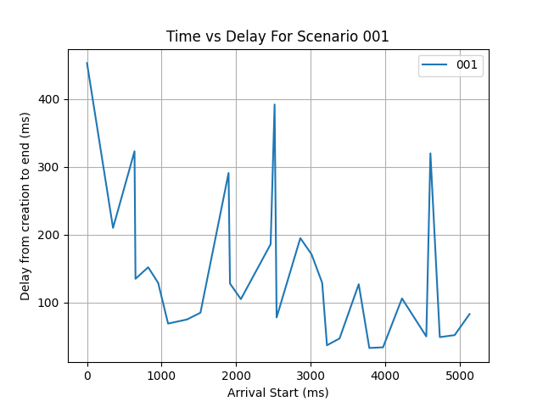
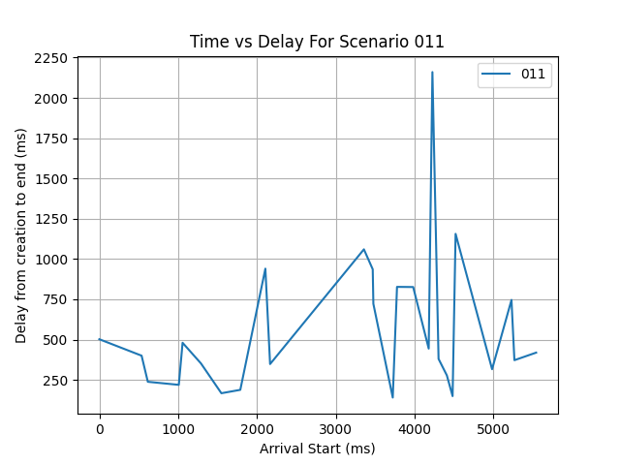
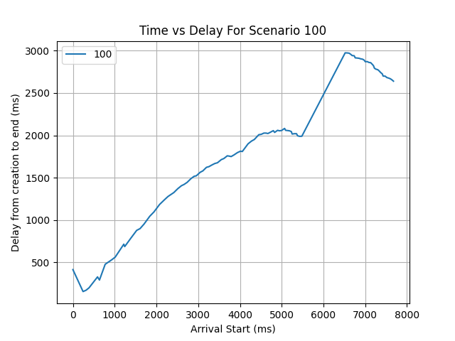
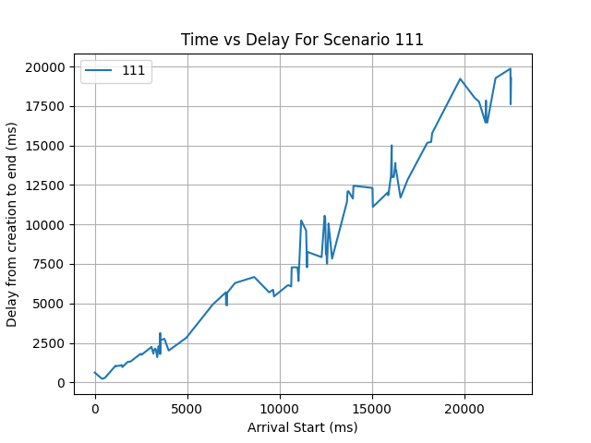
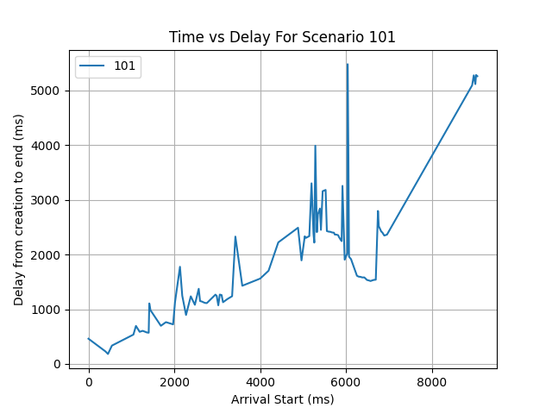
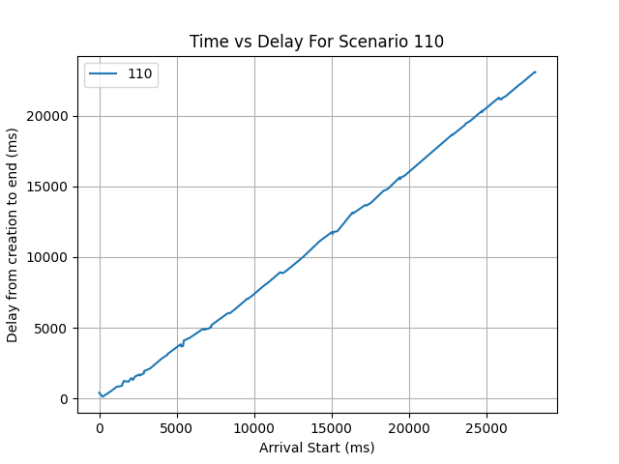
More Simulation Results

Slide 33
Missing Specifications
Unspecified Conv. Layer (CL)
Suggestions (request for answers)
CL/CLAs are left as implementation details
But DTN is an overlay architecture
How should the CL(A) receive packets? Should it hold onto partial packets?
CL provides congestion control in BPv7
Responsibility of the transport layer
What are the responsibilities of CLA (that are not for BPA and AA)? (E.g., routing.)
Should the CLA be responsible for knowing anything about and/or handling (un)expected network disruptions?

Slide 34
Missing Critical Features
Undefined method of clock accuracy
Scheduled contacts may require time-synchronization throughout the DTN
Bundles have timestamps and lifetime; need to be accurate for many purposes
Clock synchronization is not an easy/trivial problem
New notion of clock accuracy might be needed
Absence of identification of routing responsibilities
Only high-level mathematical intuition on routing in DTN was provided.
Unclear which layer/agent in BP is responsible for routing

