Slide 1


WELCOME
THE PONDICHERRY CO-OPERATIVE URBAN BANK LTD., P-14,

Slide 2

THE PONDICHERRY CO-OPERATIVE URBAN BANK LTD., P-14,
REGISTRATION
Registered as Primary Co-operative Urban Bank
Registration No - P-14
Date of Registration - 15th June, 1955
Date of Starting - 11th July, 1955
Area of Operation - Entire Region of Puducherry
and Karaikal.

Slide 3
THE PONDICHERRY CO-OPERATIVE URBAN BANK LTD., P-14,
H.O & BRANCHES
Head Office - 197, Jawaharlal Nehru Street, Puducherry – 605 001.
Branches - J.N. Street (1955)
- Muthialpet (1981)
- Mudaliarpet (1993)
- Nellithope (1993)
- Villianur (2001)
- Lawspet Branch (2010)

Slide 4
THE PONDICHERRY CO-OPERATIVE URBAN BANK LTD., P-14,
OBJECTIVES
To do Banking business by accepting deposits from public both
members and non-members.
To lend advances to members either upon security or otherwise.
To draw, make accept, buy, sell, collect and deal in bills, drafts,
investment scripts and other Government securities whether
transferable or negotiable.
To provide safe deposit vaults.
To open Branches or extension counters within the area of operation.

Slide 5
THE PONDICHERRY CO-OPERATIVE URBAN BANK LTD., P-14,
OBJECTIVES
To manage, to sell and to realize any property which may come into the
possession of the Bank in satisfaction.
To provide financial assistance to self-employed persons for setting up
their own business.
To do any form of business as specified in section 6 of the Banking
Regulation Act, 1949 (as applicable to Co-operative Societies).
To undertake any form of business which the State Government may
specify in which it is lawful for Banking business.

Slide 6
THE PONDICHERRY CO-OPERATIVE URBAN BANK LTD., P-14,
MANAGEMENT
Last election was conducted on 21.06.1992.
The Management of the Bank is now controlled by an Administrator
appointed by the Registrar of Co-operative Societies, w.e.f. 02.01.1995.
Managing Director - Deputy Registrar on deputation from Co-op. Dept.
Administrator - Deputy Registrar from Co-op. Dept.

Slide 7
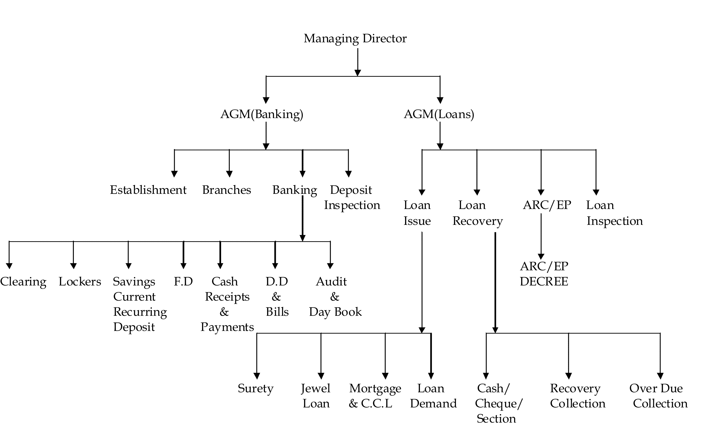
THE PONDICHERRY CO-OPERATIVE URBAN BANK LTD., P-14,
ORGANISATION CHART

Slide 8
THE PONDICHERRY CO-OPERATIVE URBAN BANK LTD., P-14,
MEMBERSHIP AND SHARE CAPITAL
(Rs. in Lakhs)
Classes | No. as on 31.12.2011. | Value as on 31.12.2011.
“A” Class - Individuals value Rs.100 | 23,927 | 524.20 Lakhs
“B” Class - State Govt. value Rs.100 | Nil | Nil
“C” Class - Firms/Companies Rs.100 | 91 | 0.10 lakhs
“D” Class - Nominal Member Rs. 5 | Nil | Nil

Slide 9
THE PONDICHERRY CO-OPERATIVE URBAN BANK LTD., P-14,
PROGRESS OF MEMBERSHIP
Year | No. of members
2007-08 | 23,125
2008-09 | 23,334
2009-10 | 23,374
2010-11 | 23,262
2011-12 | 23,927

Slide 10
THE PONDICHERRY CO-OPERATIVE URBAN BANK LTD., P-14,
A CLASS MEMBERSHIP GROWTH

Slide 11
THE PONDICHERRY CO-OPERATIVE URBAN BANK LTD., P-14,
DEPOSITS
(Rs. in Lakhs)
Types of Deposit | 31.03.2010 | 31.03.2011 | 31.03.2012
Fixed Deposits | 8614.15 | 9300.43 | 9657.55
Savings Deposits | 1840.09 | 2040.17 | 2096.50
Current Deposits | 63.35 | 59.00 | 68.18
Cash Certificate | 26.16 | 19.30 | 15.75
Matured Deposits | 375.39 | 503.12 | 477.16
Institutional Deposits | 85.85 | 230.06 | 290.02
Total | 11004.92 | 12152.08 | 12605.16

Slide 12
THE PONDICHERRY CO-OPERATIVE URBAN BANK LTD., P-14,
INTEREST ON DEPOSITS
Period | Rate of interest | Senior Citizen
15 days to 45 days | 3.50% | 3.50%
46 days to 90 days | 4.25% | 4.25%
91 days to 180 days | 5.25% | 5.25%
181 days to 364 days | 6.25% | 6.25%
1 year to less than 2 years | 10.00% | 10.50%
Above 2 years | 9.75% | 10.25%
Single Deposit of Rs. 15 Lakhs & above -0.50% extra Single Deposit of Rs. 50 Lakhs & above -1.00% extra

Slide 13
THE PONDICHERRY CO-OPERATIVE URBAN BANK LTD., P-14,
LOANS AND ADVANCES
(Rs. in Lakhs)
Sl. No: | Types of Loan | Outstanding as on 31.03.2012
1 | Jewel Loan | 5766.77
2 | Surety Loan (Private) | 11.04
3 | Cash Credit Loan | 32.04
4 | Mortgage Loan | 248.91
5 | Deposit Loan | 156.26
6 | Consumer Loan | 0.56
7 | Small Scale Industries Loan | 0.03
8 | Salary Recovery Loan (Govt.) | 3979.92
9 | Staff Loans and Advances | 220.91
 | Total | 10416.44

Slide 14
THE PONDICHERRY CO-OPERATIVE URBAN BANK LTD., P-14,
LOANS ISSUED

Slide 15
THE PONDICHERRY CO-OPERATIVE URBAN BANK LTD., P-14,
LOANS RECOVERED

Slide 16
THE PONDICHERRY CO-OPERATIVE URBAN BANK LTD., P-14,
INTEREST FOR LOANS
Sl. No: | Type of Loan | Rate of Interest
1 | Jewel Loan | 12.50% (Upto Rs. 1 Lakh S.I) 13.50% (Upto 1 lakh & above C.I)
2 | Mortgage Loan | 13.50%
3 | Cash Credit Loan | 13.50%
4 | Surety Loan | 14.00%

Slide 17
THE PONDICHERRY CO-OPERATIVE URBAN BANK LTD., P-14,
DEPOSITS – LOANS – OVER DUE

Slide 18
THE PONDICHERRY CO-OPERATIVE URBAN BANK LTD., P-14,
LOAN LIMITS – REPAYMENT SCHEDULES
Loan | Maximum loan amount prescribed in bylaws | Repayment Schedule | Interest Charged | Security | Bylaw provisions
Jewel Loan | Rs. 5,00,000/- | One year | 12.50% | Jewels | Loans Subsidiary regulations approved by RCS
Mortgage Loan | Rs. 2,00,000/- | 60 Months | 13.5% | House Property
Housing Loan | Rs. 3,00,000/- | 120 Months
Housing Repairs | Rs. 2,00,000/- | 60 Months
SRTO | Nil | Nil | Nil | Nil | Nil
Surety | Rs. 2,00,000/- | 60 Months | 14.0% | Surety and agreement with Pay disbursing Officer | Loans Subsidiary regulations approved by RCS
SSI | Nil | Nil | Nil | Nil | Nil
Self employment | Nil | Nil | Nil | Nil | Nil
Deposit | 85% of Deposit Amount |  | 2% above the Deposit Rate | Pledging of F.D. Receipt | Loans Subsidiary regulations approved by RCS
Cash Credit | Rs. 7,00,000/- | One year | 13.5% | House Property& Hypothecation of goods

Slide 19
THE PONDICHERRY CO-OPERATIVE URBAN BANK LTD., P-14,
INVESTMENT IN GOVT. SECURITIES
(Rs. in Lakhs)
Category | Amount
Held to Maturity (HTM) | 2239.26
Available for Sale (AFS) | 978.73
Held for Trading (HFT) | -
Total | 3217.99

Slide 20
THE PONDICHERRY CO-OPERATIVE URBAN BANK LTD., P-14,
GENERAL BODY MEETING
Last General Body Meeting was held on 09.01.2011 for the years
2007 - 2008, 2008 - 2009, 2009 -2010
Quorum required - 50
Number of members present - 74

Slide 21
THE PONDICHERRY CO-OPERATIVE URBAN BANK LTD., P-14,
AUDIT STATUS
Financial year ended | Audit Completed on | Audit classification | Compliance sent on
31.03.2010 | 28.09.2010 | “A” | 28.09.2010
31.03.2011 | 29.09.2011 | “A” | 29.09.2011
31.03.2012 | -- Audit in progress--
“A” Class Classification for the past 20 years given by RCS

Slide 22
THE PONDICHERRY CO-OPERATIVE URBAN BANK LTD., P-14,
WORKING OF THE BANK
(Rs. in Lakhs)
 | Particulars | 2007-08 | 2008-09 | 2009-10 | 2010-11 | 2011-12
1. | Deposits | 8924.33 | 10060.16 | 11004.92 | 12152.09 | 12605.16
2. | Loans & Advances | 7505.69 | 7915.75 | 9067.05 | 10061.78 | 10416.44
3. | Profit | 30.75 | 30.96 | 75.60 | 83.66 | 28.54
4. | Working Capital | 11324.07 | 12678.83 | 13834.43 | 15088.12 | 15602.53

Slide 23
THE PONDICHERRY CO-OPERATIVE URBAN BANK LTD., P-14,
WORKING CAPITAL

Slide 24
THE PONDICHERRY CO-OPERATIVE URBAN BANK LTD., P-14,
5 YEARS PERFORMANCE
 | 2006-07 | 2007-08 | 2008-09 | 2009-10 | 2010-11
1. Share Holders
a) Individuals | 23,041 | 23,125 | 23,334 | 23,374 | 23,262
b) Government | - | - | - | - | -
c) Companies | 84 | 83 | 83 | 91 | 91
d) Individual | - | - | - | - | -
2. Share Capital
a) Individuals | 518.06 | 530.06 | 533.94 | 525.92 | 507.25
b) Government | - | - | - | - | -
c) Companies | 0.10 | 0.10 | 0.10 | 0.10 | 0.10
d) Individual | - | - | - | - | -
3. Reserve Fund | 151.56 | 251.85 | 251.85 | 252.06 | 294.36
4. Bad Debts Reserve | 365.06 | 529.64 | 637.30 | 702.62 | 731.49
5. Reserve Funds & Other Reserves | 361.93 | 417.76 | 416.72 | 474.06 | 507.32
6. Deposits | 7931.07 | 8924.33 | 10060.16 | 11004.92 | 12152.09
7. Others | - | - | - | - | -
8. Working Capital | 10172.27 | 11324.07 | 12678.83 | 13834.43 | 14819.00
9. Loans & Advances Disbursement | 5675.82 | 6038.46 | 7314.77 | 9444.93 | 11573.99
10. Collection for Loans & Advances | 4957.01 | 5744.69 | 6904.71 | 8293.63 | 10579.26
11. Balance of Loans & Advances | 7211.92 | 7505.69 | 7915.75 | 9067.05 | 10061.78
12. Overdue Position | 473.75 | 502.81 | 531.50 | 509.49 | 522.87
13. Profit(+)/ Loss(-) | 29.22 | 30.75 | 30.96 | 75.60 | 83.66
14. Dividend | 3% | 4% | 4% | 9% | -

Slide 25
THE PONDICHERRY CO-OPERATIVE URBAN BANK LTD., P-14,
NON-PERFORMING ASSETS & CRAR
2009-2010 2010-2011 2011-2012
Gross NPAs 1025.05 1185.76 1303.65
Gross NPAs as % to Gross
advances 11.31% 11.79% 12.52%
Net NPAs 322.43 454.27 554.00
Net NPAs as % to Net advances 3.85% 4.87% 5.73%
Capital funds and Risk Assets Ratio
(CRAR) 15.79% 13.76% 13.71%
Net worth as per RBI Inspection Report 1287.64 1303.70 In progress

Slide 26
THE PONDICHERRY CO-OPERATIVE URBAN BANK LTD., P-14,
EMPLOYEES
 | Designation | Sanctioned Strength | Existing Strength
1. | Assistant General Manager | 2 | 2
2. | Manager | 8 | 7
3. | Deputy Manager | 15 | 16
4. | Assistant Manager | 12 | 11
5. | Chief Cashier | 3 | 3
6. | Assistant | 26 | 25
7. | Head Cashier | 5 | 1
8. | Junior Assistant | 27 | 18
9. | Steno | 1 | 0
10. | Assistant Cashier | 12 | 14
11. | Appraiser | 4 | 4
12. | Attender | 25 | 28
13. | Peon | 25 | 18
14. | Watchman Gr-I | 2 | 2
15. | Sweeper (Daily Rated) | 1 | 1
 | Total | 168 | 150

Slide 27
THE PONDICHERRY CO-OPERATIVE URBAN BANK LTD., P-14,
BENEFITS TO EMPLOYEES
 | (a) | Salary on par with other Banks with all allowances.
 | (b) | Loans |  | Maximum Amount
 |  | (i) | Term Loan | Rs. 1,00,000/-
 |  | (ii) | Consumer Loan | Rs. 30,000/-
 |  | (iii) | House Building Advance | Rs. 10,00,000/-
 |  | (iv) | Festival Advance | Rs. 5,000/-
 |  | (v) | Vehicle Loan (Moped) | Rs. 25,000/-
 |  |  | Vehicle Loan (Motorcycle or Scooter) | Rs. 40,000/-
 |  |  | Vehicle Loan (Car) | Rs. 2,50,000/-
 |  | (vi) | Marriage Advance | Rs. 20,000/-
 | (c) | Allowances
 |  | (i) | Coffee Allowance | Rs. 10/- per day
 |  | (ii) | Cashier Risk Allowance | Rs. 400/- per month
 |  | (iii) | Travelling Allowance | For Approval at RCS
 |  | (iv) | Special Allowance for Sterilization | One initial Increment

Slide 28
THE PONDICHERRY CO-OPERATIVE URBAN BANK LTD., P-14,
ACHIEVEMENTS & CREDITS
Reserve Bank of India licensed Bank w.e.f. August,1990.
RBI classified the Bank as Tier-II Bank since crossed 100 crores.
Profit making Bank from the inception.
Own a building in the heart of the town.
All branches are computerized and air-conditioned.
Safe deposit locker facilities at all Branches.
CCTV camera at Head Office and all Branches.
Burglary Alarm and Day/Night Watchmen security.

Slide 29
THE PONDICHERRY CO-OPERATIVE URBAN BANK LTD., P-14,
ACHIEVEMENTS & CREDITS
Memorandum of Understanding signed between the State
Government and Reserve Bank of India on 27th November 2008.
Deposits are guaranteed upto Rs. 1.00 lakh per depositor by
The Deposit Insurance and Credit Guarantee Corporation of
India, a subsidiary of RBI.
Audited by C.A. Auditors, EDP Auditor, Internal Inspection Officer
and Concurrent Auditor.
Extended business hours
Weekdays : 10:00AM to 02:00PM & 03:00PM to 04:00PM
Saturdays : 10:00AM to 01:00PM

Slide 30
THE PONDICHERRY CO-OPERATIVE URBAN BANK LTD., P-14,
CONTACT US
H.O. & J.N. Street Branch
197, Jawaharlal Nehru Street, Puducherry – 605 001. Ph : 2334289, 2285254.
232, M.G.Road, Muthialpet, Puducherry – 3. Ph : 2285255.
6, Jagathambal Thottam, Mudaliarpet, Puducherry – 4. Ph : 2285257.
270, Lenin Street, Nellithope, Puducherry – 13. Ph : 2285256.
4, Then Gopuram Street, Villianur, Puducherry – 110. Ph : 2285258.
146A, Lawspet Main Road, Lawspet, Puducherry – 8. Ph : 2285260.
Muthialpet Branch
Mudaliarpet, Branch
Nellithope, Branch
Villianur, Branch
Lawspet, Branch

Slide 31
THE PONDICHERRY CO-OPERATIVE URBAN BANK LTD., P-14,
FUTURE PLANS
1. Core Banking Solution
The bank has planned to implement a Core Banking Solution from Infrasoft Tech in partnership with IBM. In this model, the bank do not need a branch server and branch process can be accessed at a central remote location which significantly reduces the investment cost of setting up branch infrastructure and its maintenance. More importantly the bank will offer the services twice as fast as at half the cost compared to an on-premise licensed software model.
Deposits made will be reflected immediately on the bank’s servers and the customers can withdraw the deposited money from any of the bank’s branches throughout the city.

Slide 32
THE PONDICHERRY CO-OPERATIVE URBAN BANK LTD., P-14,
FUTURE PLANS
CBS will provide
Automated centralized front, middle and back-end banking processes.
Real-time transaction processing.
Flexible product and process definition
Multi delivery channel interfaces to enable ‘ Any time Any where’ banking
Built in security features to optimize safety of transactions and customer date.

Slide 33
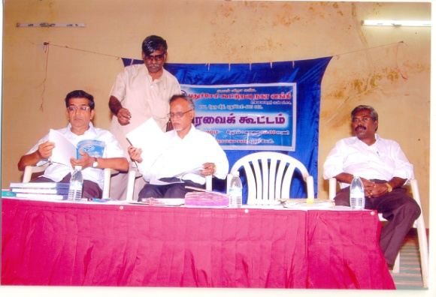
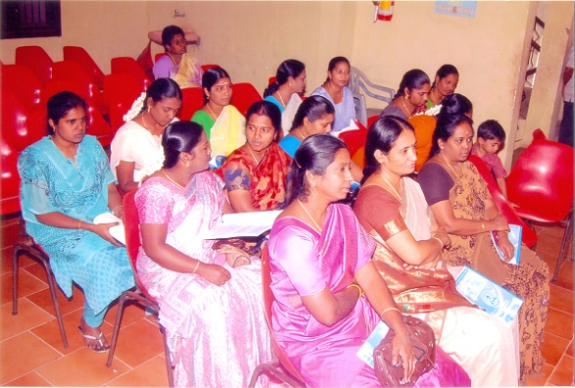
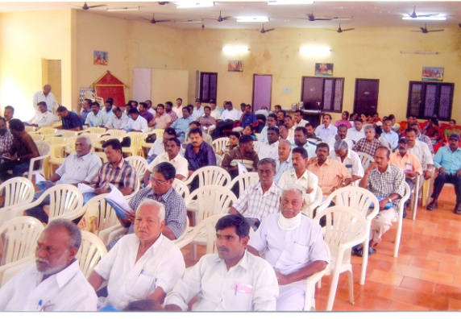
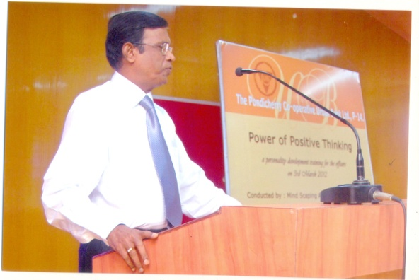
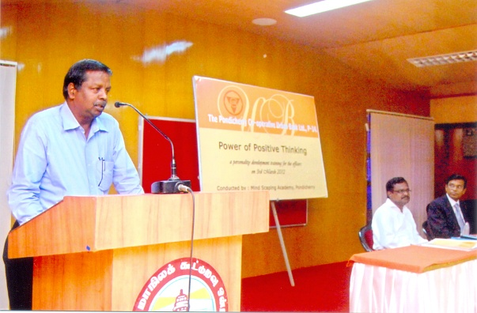
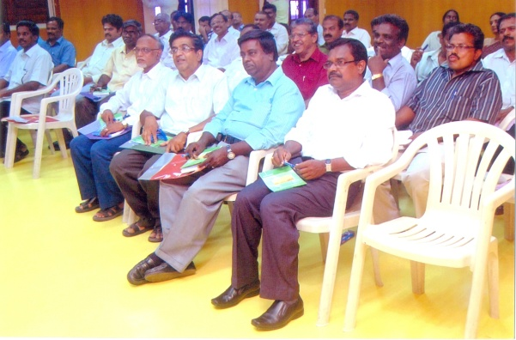
THE PONDICHERRY CO-OPERATIVE URBAN BANK LTD., P-14,
PHOTO GALLERY

Slide 34
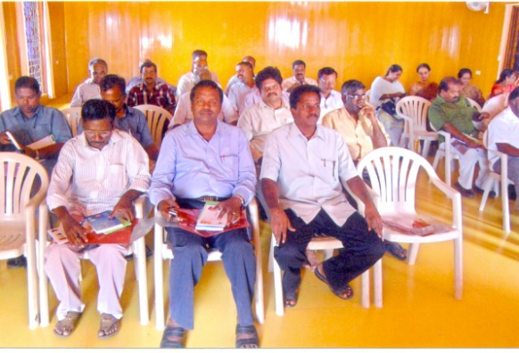
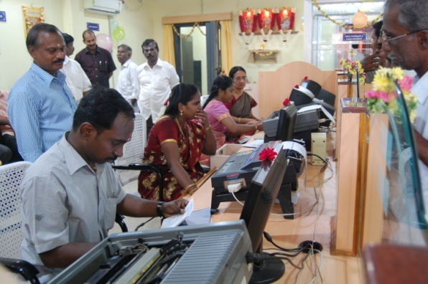
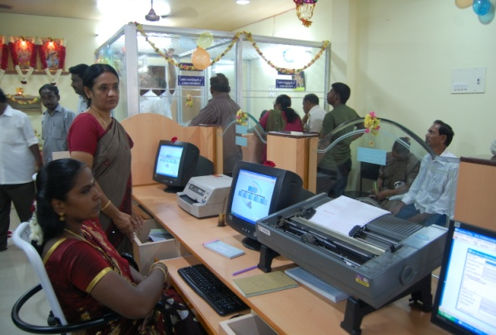
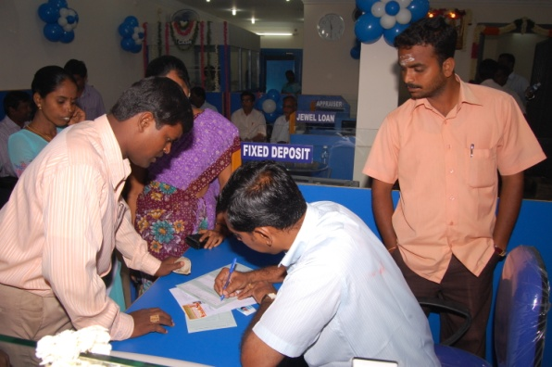
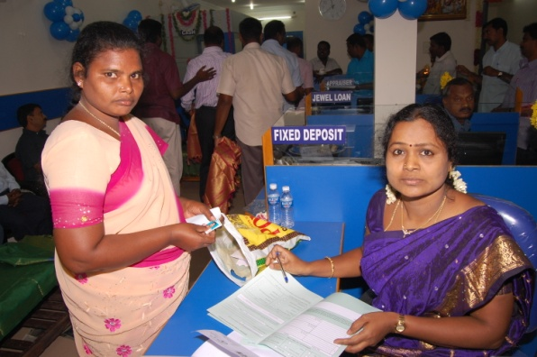
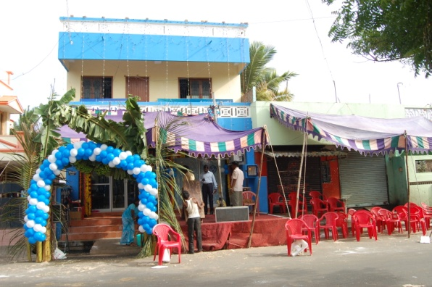
THE PONDICHERRY CO-OPERATIVE URBAN BANK LTD., P-14,
PHOTO GALLERY

Slide 35
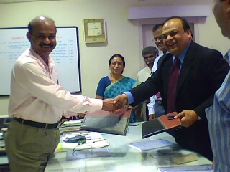
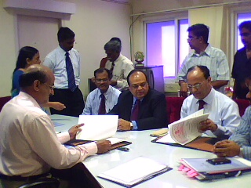
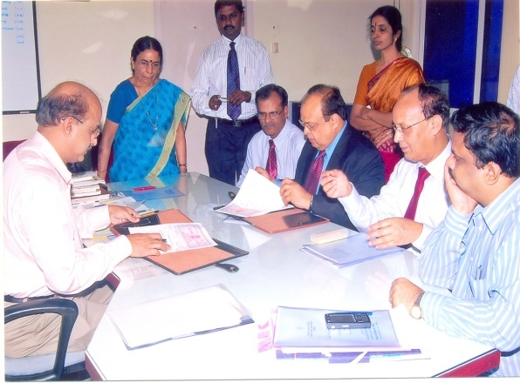
THE PONDICHERRY CO-OPERATIVE URBAN BANK LTD., P-14,
PHOTO GALLARY

Slide 36
THE PONDICHERRY CO-OPERATIVE URBAN BANK LTD., P-14,
PHOTO GALLERY

Slide 37
THE PONDICHERRY CO-OPERATIVE URBAN BANK LTD., P-14,
PHOTO GALLERY

Slide 38
THE PONDICHERRY CO-OPERATIVE URBAN BANK LTD., P-14,
PHOTO GALLERY

Slide 39
THE PONDICHERRY CO-OPERATIVE URBAN BANK LTD., P-14,
Thank you

