Slide 1

WELCOME TO
THE PONDICHERRY STATE CO-OP.
CONSUMERS’ FEDERATION

Slide 2
THE PONDICHERRY STATE CO-OPERATIVE CONSUMERS’ FEDERATION LIMITED, P. 429
BRIEF NOTE ON THE REVIEW MEETING TO BE HELD ON 16-05-2012
FROM 10.30 A.M. TO 11.30 A.M.

Slide 3
1. Date of Registration of the Society, date of starting and the area of operation:
The Pondicherry State Co-op. Consumers’ Federation Limited was registered as Coop. Society under the Pondicherry Co-op. Societies Act, 1972 on 10-03-1983 and started its function on 31-03-1983. The area of operation of the Federation is confined to the Union Territory of Pondicherry. The Registered Office of the Federation is at A-38 & A-39, Industrial Estate,Thattanchavady, Pondicherry - 605 009.

Slide 4
2. Objectives:
a) to make bulk procurement of consumer goods from within the state and other states mainly for sale and supply to the public through the affiliated member coop. Stores / Societies by door delivery and arrange for proper storage, packaging, grading and transporting of such goods,
b) to assist the management of the consumer coop. Institutions in planning and promotion of sales.
c) to arrange for training to the board of directors, members and staff of the various consumer coop. Institutions.
d) to deliver the petroleum products to the public.

Slide 5
3. Management, when last election was held:
The management of the Federation was vested with the committee of management comprising of 15 members nominated by the Registrar of Coop. Societies, Puducherry. The term of the committee expired on 30-06-1986. Since then, the Govt. appointed an Administrator in the place of committee of management. During the period from 27.09.02 to 10.11.02, an elected Board was functioning. Now, the management is running by the Administrator with effect from 11-11-2002.

Slide 6
4. Classification of Membership:
There are 4 classes of membership.
a) A Class Membership - Exclusively to the Govt. of Puducherry
b) B Class Membership - Open to all Coop. Institutions in the Union Territory of Puducherry
c) C Class Membership - Individuals
d) D Class Membership - F.D. holders
Membership of the Federation as on 31-03-2012 is 117.

Slide 7
5. Progress of membership in 5 years:
For the last five years, there is no progress of membership or decrease of membership.

Slide 8
6. Working of the Federation in 5 years:
Sl.No. | Particulars | 2007 - 08 | 2008 - 09 | 2009 - 10 | 2010 - 11 | 2011 - 12
1. | Opening Stock | 105.83 | 116.17 | 78.68 | 92.85 | 117.45
2. | Purchase | 4,819.14 | 5,266.25 | 5,616.40 | 6,235.70 | 7,012.53
3. | Trade Charges | 22.30 | 24.10 | 17.54 | 19.84 | 15.65
4. | Trade Discount | 0.63 | 0.42 | 0.48 | 0.53 | 0.55
5. | Sales Tax | 526.50 | 595.74 | 663.33 | 806.27 | 956.62
6. | Total (1 to 5) | 5,474.40 | 6,002.68 | 6,376.43 | 7,155.19 | 8,102.80
7. | Sales | 5,473.31 | 6,033.93 | 6,428.41 | 7,193.42 | 8,171.28
8. | Trade Income | 2.95 | 1.86 | 0.59 | 2.48 | 1.37
9. | Closing Stock | 116.17 | 78.68 | 92.85 | 117.45 | 109.87
10. | Total (7 to 9) | 5,592.43 | 6,114.47 | 6,521.85 | 7,313.35 | 8,282.50
11. | Gross Profit (10 - 6) | 118.03 | 111.79 | 145.42 | 158.16 | 179.70
12. | Miscellaneous Income | 4.02 | 29.92 | 56.26 | 14.60 | 9.61
13. | Total (11 + 12) | 122.05 | 141.71 | 203.68 | 172.96 | 189.51
14. | Salary | 146.73 | 173.90 | 209.57 | 250.47 | 258.07
15. | Interest | 7.81 | 10.40 | 11.22 | 15.11 | 16.23
16. | Rent | 1.60 | 3.32 | 4.48 | 6.53 | 6.81
17. | Postal, Phone, Xerox | 2.35 | 2.44 | 2.21 | 2.22 | 9.55
18. | Other Expenses | 31.69 | 52.85 | 30.35 | 66.14 | 29.83
19. | Total (14 to 18) | 190.18 | 242.91 | 257.83 | 340.47 | 320.49
20. | Net Loss (13 - 19) | (-) 68.13 | (-) 101.20 | (-) 54.15 | (-) 167.51 | (-) 130.98
21. | Accumulated Loss | (-) 375.38 | (-) 476.58 | (-) 530.73 | (-) 698.24 | (-) 829.22

Slide 9
7. Financial Results for 5 years:
Sl.No. | Liability | 2007 - 08 | 2008 - 09 | 2009 - 10 | 2010 - 11 | 2011 - 12
1. | Sources of Funds: Share Capital | 6,43,90,003.00 | 6,73,53,003.00 | 6,84,55,003.00 | 7,08,55,003.00 | 7,48,05,003.00
2. | Reserves & Surplus: Reserves | 66,87,241.85 | 69,82,022.70 | 76,21,850.87 | 98,94,640.85 | 1,00,55,053.05
3. | Previous Year Profit | 2,27,616.04 | 2,27,616.04 | 2,27,616.04 | 2,27,616.04 | 2,27,616.04
4. | Grants | 34,86,937.26 | 34,86,937.26 | 34,86,937.26 | 34,86,937.26 | 34,86,937.26
5. | Loan & Funds: a) Deposit b) Borrowings | 15,16,570.00 78,43,213.03 | 9,15,570.00 83,37,009.84 | 6,66,570.00 93,66,409.94 | 19,62,570.00 1,22,00,314.82 | 24,76,570.00 9,28,40,28.35
6. | Current Liability | 90,82,485.47 | 68,21,483.00 | 67,83,691.60 | 78,21,742.00 | 84,95,927.00
7. | Sundry Creditor | 58,99,294.75 | 39,58,568.03 | 66,13,425.93 | 1,52,96,670.97 | 2,03,12,747.50
8. | Capital Gain Reserves | 15,58,736.24 | 15,58,736.24 | 15,58,736.24 | 15,58,736.24 | 15,58,736.24
9. | Provision for Gratuity | 20,034.10 | 21,269.10 | 20,034.10 | 20,034.10 | 20,034.10
 | Total | 10,07,12,131.74 | 9,96,62,215.21 | 10,48,00,274.98 | 12,33,24,265.28 | 13,07,22,652.54

Slide 10
No. | Assets | 2007 - 08 | 2008 - 09 | 2009 - 10 | 2010 - 11 | 2011 - 12
1. | Application of Funds: Fixed Assets | 19410092.50 | 19571695.90 | 22894254.90 | 22949046.59 | 23061218.89
2. | Gross Block | 5385934.20 | 6036843.32 | 6636555.30 | 7137420.77 | 7680246.29
3. | Less: Depreciation | 14024158.30 | 13534852.58 | 16257699.80 | 15811625.82 | 15380972.60
4. | Total | 1206704.00 | 12456183.00 | 1283514.00 | 1325791.00 | 1340161.00
5. | Investments: Current Assets Loan & Advance | 12087329.64 | 8338152.49 | 9686801.05 | 12218077.71 | 11460431.32
6. | Inventories | 33945836.71 | 25415691.26 | 22356392.84 | 21759050.49 | 16939732.37
7. | Sundry Debtors | 1910040.60 | 3469486.02 | 2142016.09 | 2384830.83 | 2678526.31
8. | Cash & Bank | 63174069.25 | 52004365.35 | 51726423.58 | 53499375.85 | 47799823.60
9. | Profit & Loss Account | (-) 37538062.49 | (-) 47657849.86 | (-) 53073851.40 | (-) 698224889.43 | (-) 82922828.94
 | Total | 100712131.74 | 99662215.21 | 104800274.98 | 123324265.28 | 130722652.54

Slide 11
ORGANISATION CHART
ADMINISTRATOR
MANAGING DIRECTOR
INTERNAL AUDITOR
Administrative
Section
Accounts
Section
Audit
Section
Establishment Section
Godowns
Petrol Bunks
Karaikal Branch
Stenographer - 1
Junior Asst. - 1
Attendar - 2
Driver - 1
Sr.ASSt - 3
Jr.Asst - 1`
Sr.ASSt - 2
Sr.ASSt - 1
Groceries
Cosmetics
I) Kathirkamam
Business Manager - 1
Sr.ASSt - 1
Jr.ASSt - 1
Mach.Op - 1
Pack Wn - 9
Sr.Asst - 3
Helper - 1
Jr. Asst. - 3
Sr. Asst. - 1
D.S.M. - 19
Watchman - 1
Office
Sr.Asst- 2
Jr.Asst.- 2
PETROL BUNKS
I) Ammalchathiram
D.S.M. - 16
Attendar - 1
Watchman - 1
II) Thirunallar
Senior Asst. - 1
D.S.M. - 8
III) Vanjore
Junior Asst. - 1
D.S.M. - 4
IV) COST PRICE SHOP
D.S.M. - 3
Attendar - 1
Peon - 1
II) Karikalampakkam
Jr. Asst. - 1
D.S.M. -
III) Cost Price Shop
D.S.M. - 1
Pacck.Women - 2

Slide 12
9. Categories of employees:
Sl.No. | Name of the Post | Approved Strength | Existing Strength
1. | Business Manager | 2 | 1
2. | Consumer Education Officer | 1 | NIL
3. | Assistant Manager | 1 | NIL
4. | Stenographer | 1 | 1
5. | Senior Assistant | 23 | 17
6. | Junior Assistant | 15 | 9
7. | Machine Operator | 2 | 1
8. | Attender | 8 | 4
9. | Driver | 1 | 1
10. | DSM | 53 | 53
11. | Peon | 6 | 1
12. | Watchman | 3 | 2
13. | Packing/Cleaning Women | 11 | 11
14. | Helper/General Worker | 1 | 1
 | Total | 128 | 102

Slide 13
10. Benefits to employees:
For the benefits of employees, the management of the Pondicherry State Co-op. Consumers’ Federation is providing G.S.L.I.S. of Life Insurance Corporation of India Ltd., EPF, ESI, Bonus and Gratuity.

Slide 14
11. When last General Body Meeting was held:
Last General Body Meeting of the Pondicherry State Co-operative Consumers’ Federation Limited was held on 16-10-2006.

Slide 15
12. Audit Status for audit classification:
Audit Report was issued up-to the year 2007 - 2008. Audit Classification of the Audit Report issued for the year 2007 - 2008 is “C”.

Slide 16
13. List of Branches:
The Pondicherry State Co-op. Consumers’ Federation Limited is running two Cost Price Shops one at Pondicherry and another at Karaikal and five Petrol / Diesel Bunks, two at Pondicherry and three at Karaikal as detailed below:

Slide 17
Sl.No. | Address | Date of Commissioning
1. | PETROL / DIESEL BUNKS R.S. No. 236/10, Vazhudavour Road, Kathirkamam, Pondicherry - 9. Phone No. 2271502. | 15-12-2003
2. | R.S. No. 17/5, Madukarai Road, Karikalampakkam Revenue Village, Pondicherry - 7. Phone No. 2665012 | 06-01-2006
3. | R.S. No. 147/2, Keezhoduthurai Village, Ammalchathiram, Karaikal - 609 602. Phone No. 04368 - 222226. | 18-03-1992
4. | R.S. No. 249/5, Near Spic Henkal, Surakudi, Thirunallar, Karaikal - 609 607. Phone No. 04368 - 236640. | 12-07-2004
5. | R.S. No. 118A/118B/118/2A, Nagore Road, Vanjore, Karaikal - 611 002. Phone No. 04365 - 256591. | 03-12-2004
6. | COST PRICE SHOPS Karaikal Branch, Karaikal Milk Supply Society Complex, Karaikovilpathu, Thalatheru & Post, Karaikal - 609 605. | 15-11-2007
7. | 142, Lenin Street, Kosapalayam, Pondicherry - 605 013. Phone No. 2243300. | 20-08-2010

Slide 18
14. Branch-wise Profit / loss: (Net Loss)
Sl.No. | Places | 2007 - 08 | 2008 - 09 | 2009 - 10 | 2010 - 11 | 2011 - 12
1. | Pondicherry | 3,53,26,213.43 | 4,31,26,984.88 | 4,82,06,794.29 | 6,22,75,316.34 | 7,34,89,650.30
2. | Karaikal Branch | 22,11,849.06 | 45,30,864.98 | 48,67,057.11 | 75,49,573.09 | 94,33,178.64
 | Total | 3,75,38,062.49 | 4,76,57,849.86 | 5,30,73,851.40 | 6,98,24,889.43 | 8,29,22,828.94

Slide 19
15. Achievements and Credits:
M/s. Bharat Petroleum Corporation Limited has issued Certificates of Appreciation for the Highest Growth in HSD to Ammalchathiram Bunk, Karaikal, for Highest HSD Volume to Vanjore Bunk, Karaikal and Highest Growth in MS to Vanjore Bunk, Karaikal during the year 2008 - 09.
M/s. Bharat Petroleum Corporation Limited has issued award for the Highest Growth in MS to Ammalchathiram Bunk, Karaikal during the year 2009 - 10.
M/s. Bharat Petroleum Corporation Limited has issued award for the highest market share growth in MS to Karikalampakkam Bunk, Pondicherry during the year 2011 - 12.

Slide 20
16. Issues and Challenges:
The main issue is overheads that are in upward trends whereas Sales Turnover is in downward trend for want of funds.
In this competitive world, bringing the consumer Federation to the break ever point, i.e., NO LOSS NO PROFIT, is a big challenge.

Slide 21
17. Projects in pipeline:
CONFED is proposed to undertake the following developmental activities in the near future.
Strengthening of Storage facilities.
To become stockiest for cosmetics items.
Opening of Cost Price Shops exclusively for automobiles.
Installation of Gas Bunks in CONFED Petrol Bunks.
IMFL Whole sale business.

Slide 22
18. Photo gallery:
Photographs of award won for the highest growth of MS issued by M/s. Bharat Petroleum Corporation Limited to the Ammalchathiram Bunk for the year 2009 - 10 is enclosed.
Photograph of Cost Price Shop, Pondicherry inaugural function held on 20-08-2010 is enclosed.

Slide 23
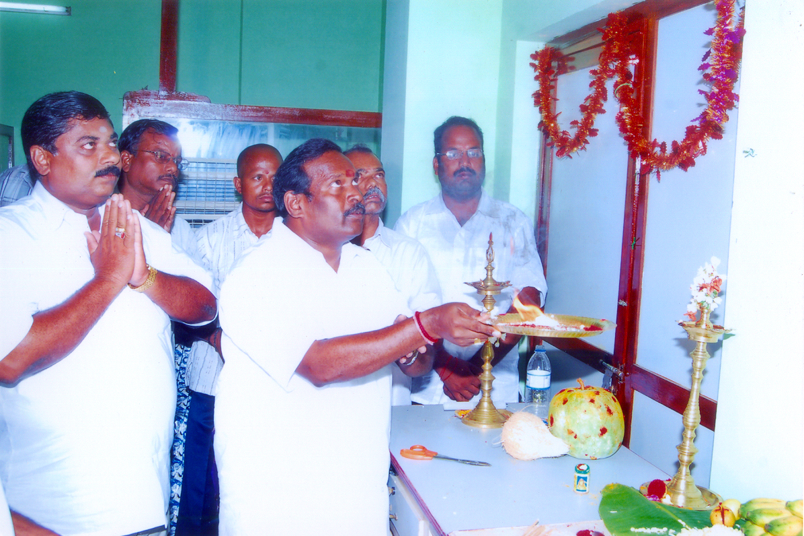

Slide 24
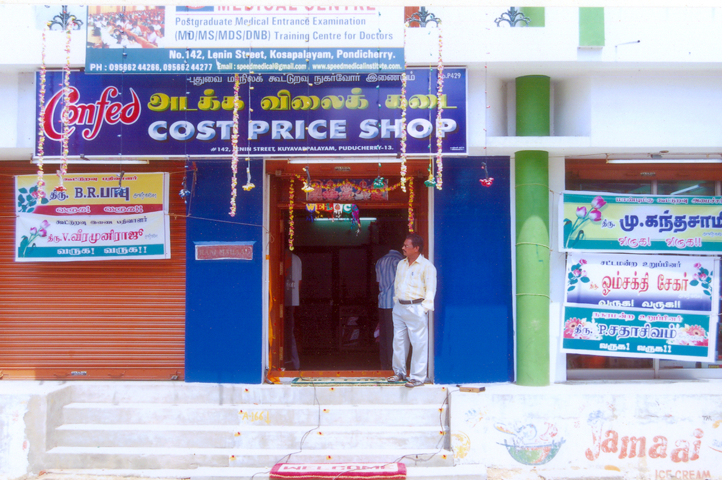

Slide 25
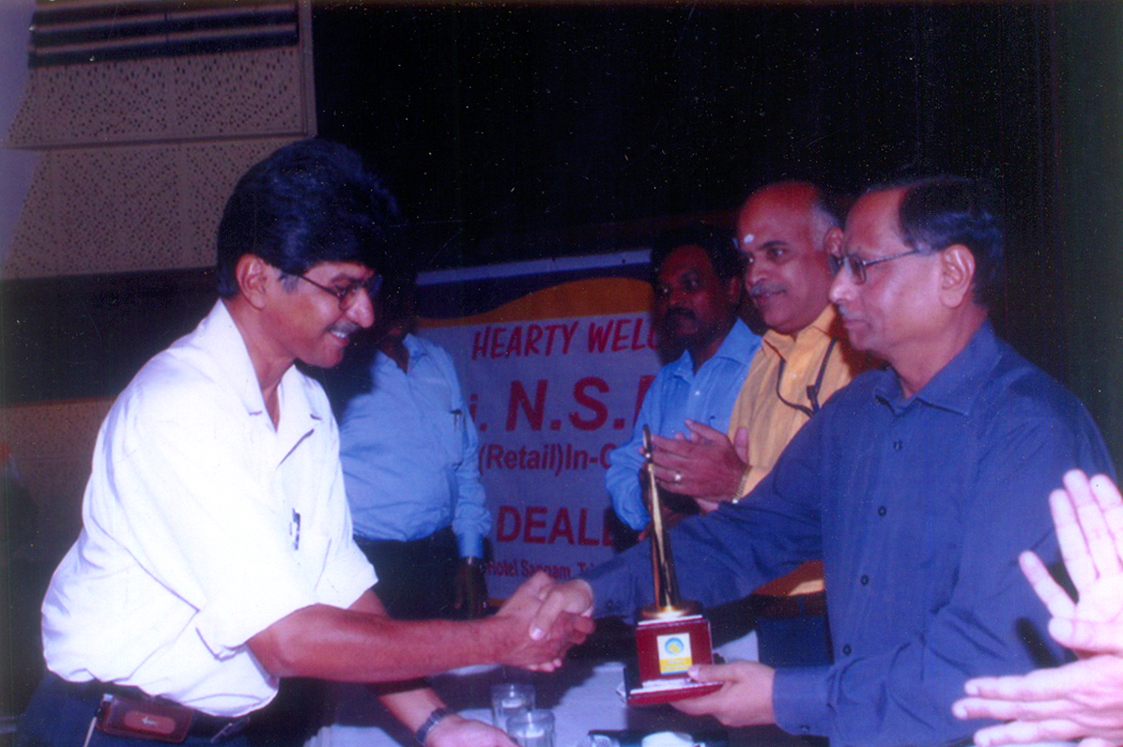

Slide 26
19. Mail id and Contact Address:
CONFED’s mail id Pondyconfed_1983@yahoo.in.
CONFED’s Address is
The Pondicherry State Co-op. Consumers’ Federation Ltd.,
A-38 & A-39, Industrial Estate,
Thattanchavady,
Pondicherry - 605 009.

Slide 27

For Your Patience

