Slide 1
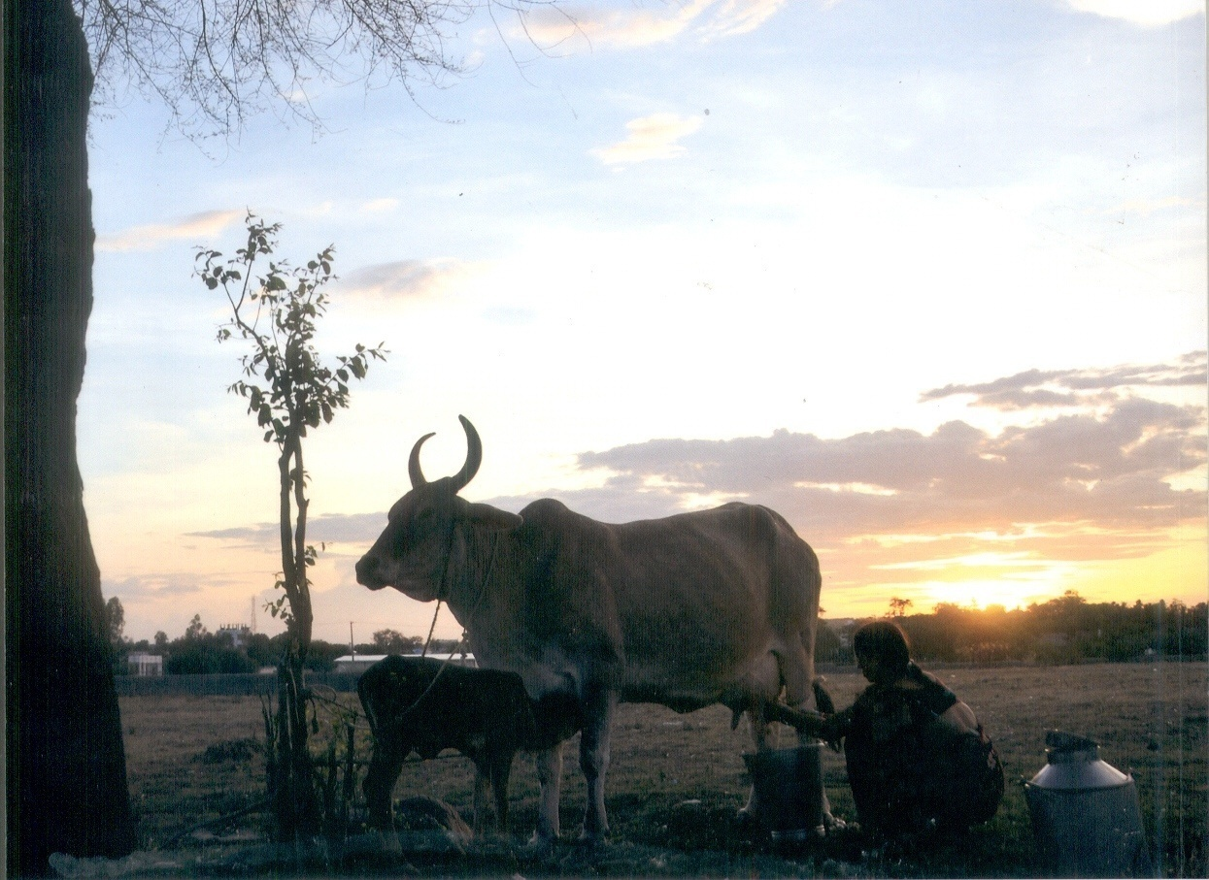

PONLAIT WELCOMES YOU
The pondicherry co-opetative milk producers’ union ltd., p.1.

Slide 2
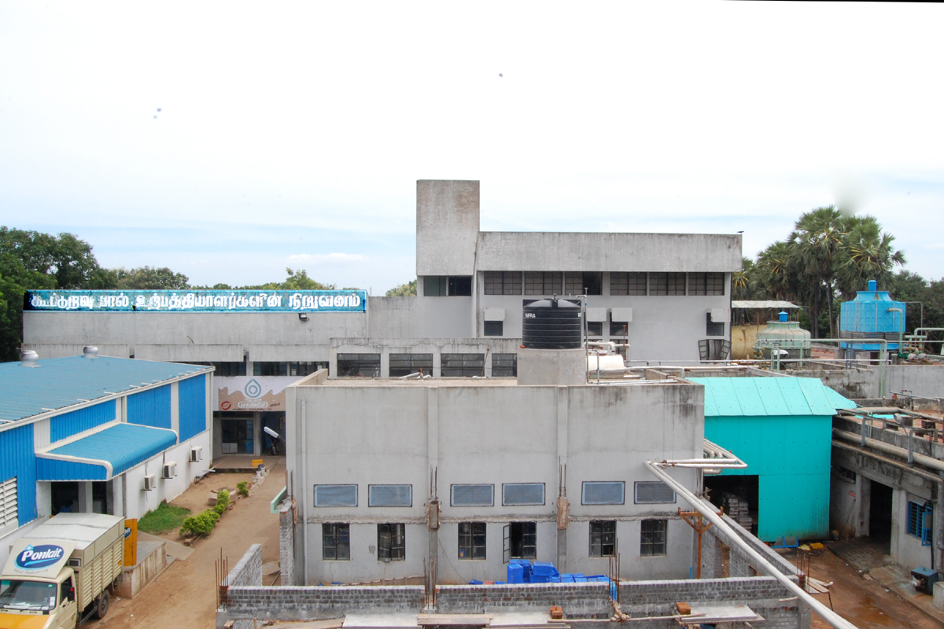

Slide 3
ORIGIN
The PCMPU has its origin in the year 1955 as the first registered cooperative society in Union Territory of Pondicherry in the name and style as, “THE PONDICHERRY COOPERATIVE MILK SUPPLY SOCIETY” which started functioning from 17.06.1955.
During the year 1973 the supply society was converted into co-operative milk producers’ Union as the No.1 registered union with the objective of shifting its focus on improving the Socio Economic consideration of Rural Milk Producers.

Slide 4
objectives
The objectives of the Union shall carry out activities conductive to the economic and socio-economic development of the milk producers by,
      Organizing effective milk production.
      Milk Processing and
      Marketing of commodities.
Area of operation
The name of this cooperative society shall be THE PONDICHERRY COOPERATIVE MILK PRODUCERS UNION LIMITED
The Registered address is Vazhudavoor Road, Kurumampet, Pondicherry – 605 009.
The area of operation of the Union shall be all the communes of Pondicherry region.

Slide 5
GROWTH
The Milk Union started procuring milk from the village producers on quality basis from 1970 onwards( 4.3 % FAT, 8.2 % SNF = 12.5% T.S Rs. 20.00 / Litre)
To keep pace with the milk production, the Milk Union has also set up a Dairy Plant with 10,000 Litres capacity for processing on 12.04.1971. subsequently it was improved to handle 50,000 Litre / Day.
The Nation’s Largest Dairy Development Programme, OPERATION FLOOD II & III was launched and implemented between 1982/1995 by the Pondicherry Milk Union in Pondicherry Region.
All the Primary Milk Producers Cooperative societies were transformed to ANAND Pattern societies, where ANAND pattern of Milk Procurement was adopted.
Presently, the Pondicherry Co-op. Dairy is handling about 1.25 Lakhs of Milk a day and sells 1.1 to 1.2 lakhs litres a day.

Slide 6
management
The Board of Management comprise of Directors as follows,
  Twelve members elected from amongst the Presidents of the affiliated societies of whom not less than one – third shall be women.
  Registrar of Co-operative Societies or his nominee, not below the rank of a Deputy Registrar.
  One nominee of the National Dairy Development Board.
  Director of Animal Husbandry or his nominee not below the rank of Joint Director.
  The Managing Director of the Union as ex-officio secretary.
  Election to the Board of Director was held last during the year 2002.
  From 06.09.2002 onwards , Administrator replaced the Board.
Membership
Any Registered Primary Milk Producers’ Cooperative Society in the area of Operation of the Union and supplying milk to Union can become a member.
The By-Laws of such society shall be in conformity with the model By-laws recommended by the Union.
98 Primary Co-op. Milk Producers Societies are the present members.

Slide 7
Working of the pcmpu
Milk procurement
Ponlait is operating in the Pondicherry Region with 98 affiliated functional Dairy Co-operative Societies.
There are 10,000 Cattle owners who become members in the Dairy Co-operative Societies at villages and supplying milk to Ponlait.
Milk Supplying members are paid fortnightly in cash with remunerative milk price @ Rs.20.00 per litre for (4.2% & 8.3% SNF) w.e.f 16.02.2012.
The primary responsibility of procurement and input section is to procure clean and quality milk from village cattle owners and carryout milk production enhancement services.
To achieve this objective, the Procurement & Input wing is conducting various programmes like Clean Milk Production and Quality milk Procurement at Dairy Co-operative Societies.
Besides the main activity of Milk procurement, the milk-supplying members’ milch animals are also provided with Cattle Feed, Green Fodder and Artificial Insemination at subsidized rate.

Slide 8
Price
Procurement Price |  | Sales Price |  | DTM | SM | PM | CM
Date | Procurement Price | Date | Rate/ Litre | Rate / Litre | Rate/ Litre
 | Litre(Fat4.5%+snf 8.5%) |  | Toned Milk (Rs)
01.01.1991 | 3.80 | 01.01.1991 | 5.00
16.03.1991 | 3.90
16.10.1991 | 4.03 | 01.02.1992 | 5.75
26.01.1992 | 4.75 | 16.05.1992 | 6.00
01.06.1993 | 5.59 | 01.06.1993 | 7.00
01.12.1994 | 5.98 | 16.12.1994 | 7.40
16.12.1995 | 6.43 | 16.12.1995 | 8.00
20.11.1996 | 7.67 | 20.11.1996 | 9.50
16.05.1998 | 9.17 | 16.05.1998 | 10.50
16.01.2002 | 10.17 | 16.01.2002 | 12.00 |  | 14.00 | 16.00
03.02.2007 | 11.17 | 20.05.2007 | 14.00 |  | 16.00 | 18.00
01.04.2007 | 12.17
21.03.2008 | 14.50 | 21.03.2008 | 17.50 |  | 22.50 | 24.00
 |  | 03.11.2008 | 18.00
16.09.2009 | 16.00 | 16.09.2009 | 20.50 |  | 22.50 | 28.00
27.09.2009 |  |  |  | 22.00
16.11.2009 | 16.50 | 16.11.2009 | 21.00
20.02.2011 | 19.00
04.07.2011 |  |  |  |  |  |  | 26.00
16.02.2012 | 20.00 | 16.02.2012 | 26.00 |  |  |  | 28.00
** Procurement Price total sold 12.5 (Fat 4.2 SNF 8.3 )

Slide 9
PRIMARY CO-OP. MILK PRODUCERS’ SOCIETIES
ORGANISED, FUNCTIONING

Slide 10
WOMENS Participation IN Primary cooperatives

Slide 11
MILK PROCUREMENT FROM PRIMARIES AND OUTSTATION
From 2004-05 onwards, PONLAIT started procuring Milk from Other Dairies (both Co-op.
and Private).
During 2011-12, the Average daily procurement from Private Dairies is around 73,400
ALPD against 29,500 ALPD from Primaries

Slide 12
MARKETING UNIT
(MILK)

Slide 13
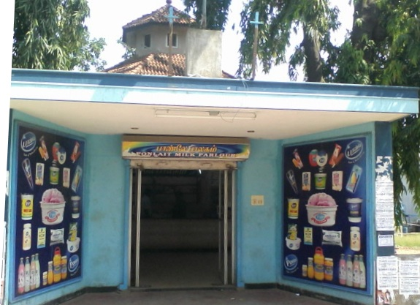
Ponlait parlour

Slide 14
PARLOUR DETAILS
Sl. No. | Parlour Name | Sl. No. | Parlour Name
1 | Anandha | 10 | Chinnakadai
2 | New Bus stand | 11 | Saram
3 | Muruga | 12 | Marketing office
4 | Kathirkammam Medical College | 13 | Registered Transport Office
5 | Balaji | 14 | Dairy
6 | Commercial Tax Office | 15 | Bahoor
7 | Amudhasurabhi | 16 | Kirumampakkam
8 | Maternity General Hospital | 17 | University - I
9 | Collector office | 18 | JIPMER

Slide 15
PARLOUR DETAILS
Sl. No. | Parlour Name | Sl. No. | Parlour Name
19 | Ariyankuppam | 28 | Embalam
20 | Railway station | 29 | Spinco
21 | Thavalakuppam | 30 | Nonankuppam
22 | Chief secretariat | 31 | Thiruknoor
23 | Uzhavarsandhai | 32 | Sedarapet
24 | Pondicherry Engg. College | 33 | CCL
25 | Madukarai | 34 | University – II
26 | Kariyamanikkam | 35 | Maternity Hospital
27 | Karikalampakkam

Slide 16
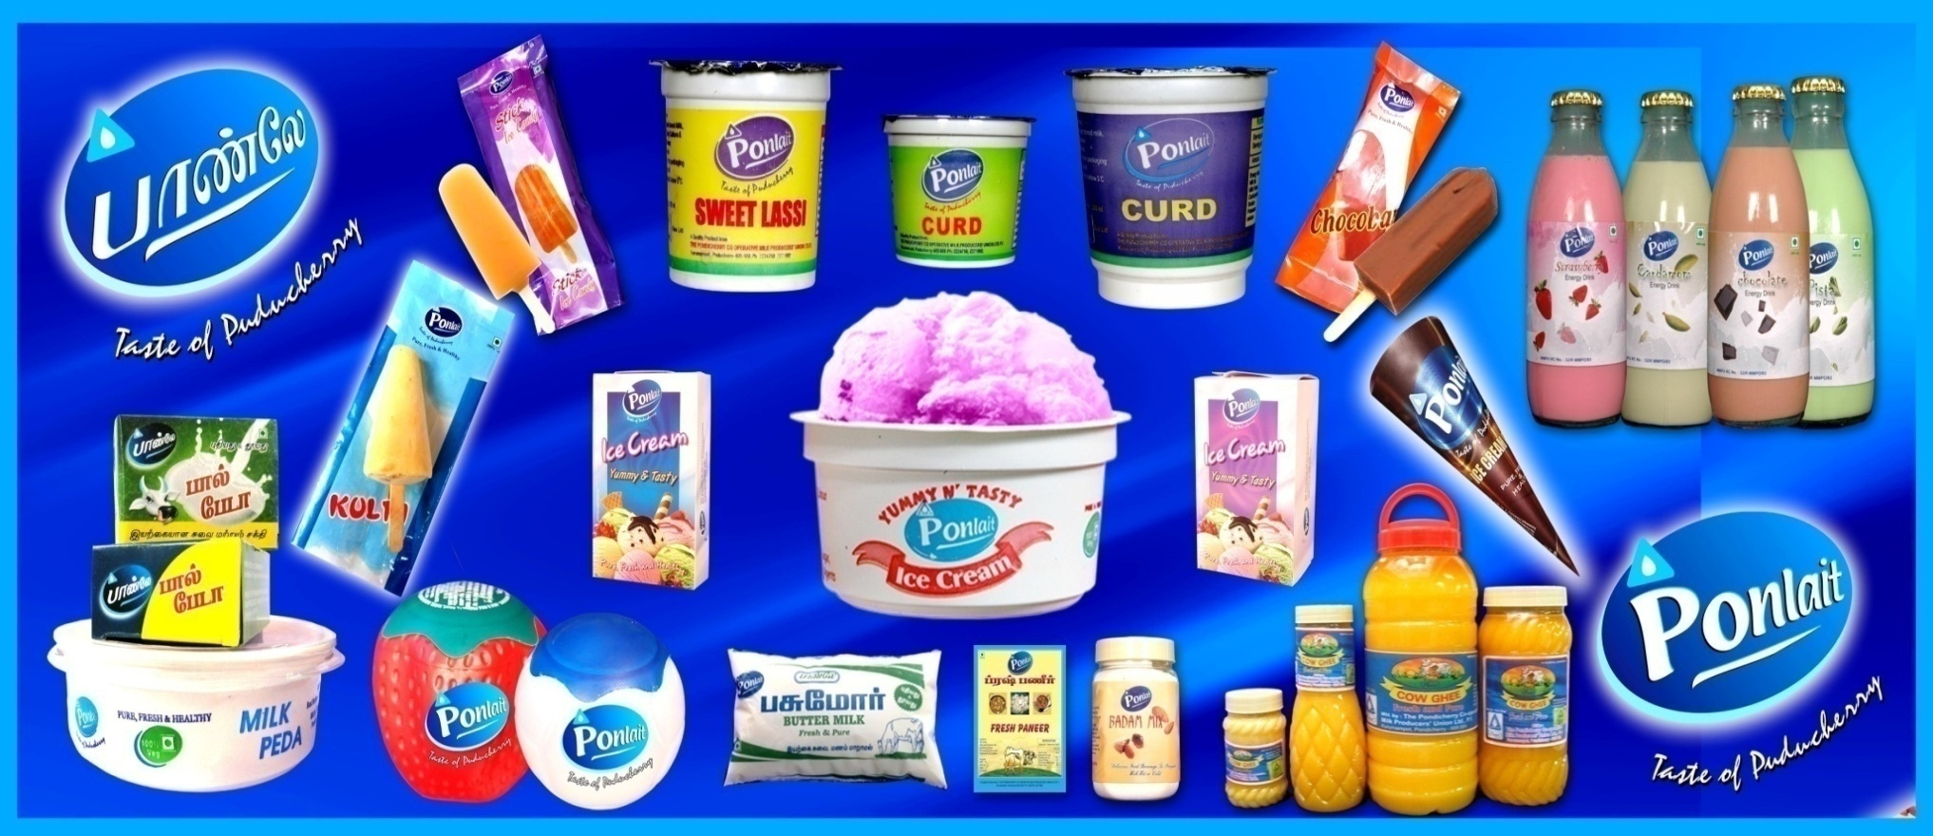
Ponlait MILK products
ICE CANDY SWEET LESSI CURD CHOCOBAR
FLAVOURED MILK MILK PEDA KULFI ICE CREAM
CONE ICE CREAM BALL ICE CREAM BUTTERMILK
PANEER BADAM MIX GHEE

Slide 17

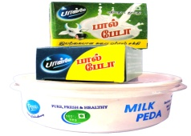

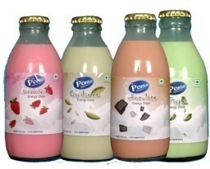
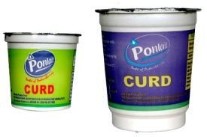
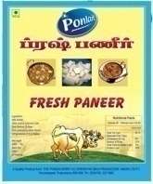
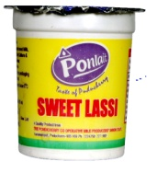
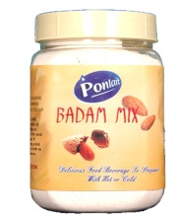
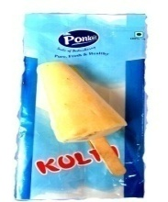
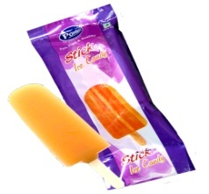
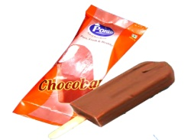
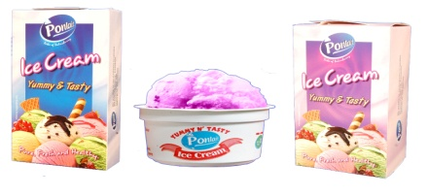
MILK products
Year | Khoa (MT) | Butter Milk (.000 lts.) | Flavoured Milk (.000 lts.) | Curd (.000 lts.) | Paneer (KG) | Sweet Curd (.000 lts)
06-07 | 23.9 | 30.7 | 46.8 | 18.2 | 693.0 | 0.0
07-08 | 27.0 | 43.2 | 54.5 | 27.5 | 800.0 | 0.0
08-09 | 37.0 | 50.0 | 53.0 | 52.0 | 2027.0 | 31.1
09-10 | 48.0 | 103.6 | 136.0 | 163.7 | 4114.0 | 47.7
10-11 | 60.2 | 126.7 | 216.3 | 268.4 | 5800.0 | 41.2
Year | Badam mix (KG) | Kulfi (.000 lts.) | Ice candy (.000 lts.) | Choco bar (.000 lts.) | Ice cream-Ponlait (.000 lts.) | Ice cream-Amul (.000 lts.)
10-11 | 12.3 | 53.1 | 11.5 | 6.7 | 1039.0 | 1039.0

Slide 18
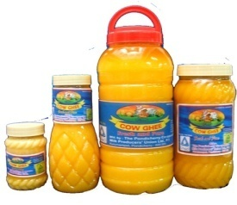
Ghee production and sales
(in Mts.)

Slide 19
Financial status
(cumulative profit / loss)

Slide 20
Business turn over

Slide 21
Organizational chart
MANAGING DIRECTOR
PA TO MD
(STENO. SUPDT.)
MANAGER
MANAGER
PRODUCT
DEPUTY MANAGER
DRIVER
ADMIN.
ASST. MANAGER
SUPDT.
SENIOR CLERK
JUNIOR CLERK
HELPER
DEPUTY MANAGER
ASST. MANAGER
SUPDT.
SENIOR CLERK
JUNIOR CLERK
DRIVER
HELPER
ACCOUNTS
DEPUTY MANAGER
ASST. MANAGER
SUPDT.
SENIOR CLERK
JUNIOR CLERK
DRIVER
HELPER
PROCUREMENT & INPUT
DEPUTY MANAGER
DEPUTY MANAGER
ASST. MANAGER
SUPDT.
SENIOR CLERK
JUNIOR CLERK
DRIVER
HELPER
MANAGER
DAIRY
MAINTENANCE
DEPUTY MANAGER
ASST. MANAGER
SUPDT.
SENIOR CLERK
JUNIOR CLERK
DRIVER
HELPER
TECH. SUPDT.
SENIOR CLERK
JUNIOR CLERK
DRIVER
HELPER
OPERATOR

Slide 22
Organizational chart
MANAGING DIRECTOR
PA TO MD
(STENO. SUPDT.)
MANAGER
MANAGER
MANAGER
MKTG. - MILK
MKTG - PRODUCT
SCHOOL MILK SUPPLY
QUAITY CONTROL
CATTLE FEED
ASST.
MANAGER
SUPDT.
SENIOR CLERK
JUNIOR CLERK
DRIVER
HELPER
ASST.
MANAGER
SUPDT.
SENIOR CLERK
JUNIOR CLERK
DRIVER
HELPER
ASST. MANAGER
JUNIOR CLERK
HELPER
QUALITY CONTROL
LAB TECHNICIAL
LAB HELPER
VET. OFFICER
JUNIOR CLERK
HELPER
DRIVER

Slide 23
Categories of employees
REGULAR EMPLOYEES
Sl. No. | Name of the Post | No. of Emp. | Sl. No. | Name of the Post | No. of Emp.
1 | Manager | 6 | 18 | A.I. Asst. Supervisor | 1
2 | Deputy Manager | 6 | 19 | A.I. Asst. Sl.Gr.II | 3
3 | Asst. Manager | 7 | 20 | A.I. Asst. | 2
4 | Tech. Supdt | 9 | 21 | Lab Technician | 1
5 | Vet. Officer | 3 | 22 | Sr. Lab Helper. | 1
6 | Superintendent | 3 | 23 | Lab. Helper | 2
7 | Sr. Steno. (Sudpt.) | 1 | 24 | Driver Sl.Gr.I | 1
8 | Sr. Asst. Gr.I | 4 | 25 | Driver Sl.Gr.II | 2
9 | Sr. Asst. | 22 | 26 | Driver Sl.Gr.III | 1
10 | Jr. Asst. | 20 | 27 | Sr. Driver | 1
11 | Foreman | 1 | 28 | Driver | 4
12 | Sr. Operator | 4 | 29 | Sr. Maistry | 2
13 | Operator Sel. Gr. | 1 | 30 | Maistry Gr.I | 1
14 | Operator Gr.I | 9 | 31 | Maistry Gr.II | 15
15 | Operator | 8 | 32 | Dairy Helper Sl. Gr. | 9
16 | Plant Operator | 11 | 33 | Dairy Helper Sl. Gr. I | 17
17 | Asst. Operator | 16 | 34 | Dairy Helper | 41

Slide 24
Categories of employees
TIME SCALE EMPLOYEES |  |  | CONSOLIDATED EMPLOYEES
Sl. No. | Name of the Post | No. of Emp. | Sl. No. | Name of the Post | No. of Emp.
1 | Tech. Supdt. | 1 | 1 | Jr. Asst. | 39
2 | Draught Man | 1 | 2 | Lab. Asst. | 1
3 | Operator | 10 | 3 | Driver | 4
4 | Jr. Asst. | 25 | 4 | Asst. Operator | 5
5 | Lab. Asst. | 2 | 5 | Dairy Helper | 117
6 | Lab Micro Biology. | 1 | REGULAR EMPLOYEES |  | 235
7 | Driver. | 5 | TIME SCALE EMPLOYEES |  | 112
8 | Dairy Helper. | 67 | CONSOLIDATED EMPLOYEES |  | 166
 |  |  | CASUAL EMPLOYEES |  | 275
 |  |  | TOTAL EMPLOYEES |  | 788

Slide 25
Benefits of employee
General Benefits:
Issue of Milk Card to the Employee @ 1 Litre / day.
Issue of Ghee @ ½ KG / Month.
Issue of Uniform to the Employee along with stitching charge @ 3 Sets every 2 Years.
Issue of Rain coats to the Employee @ 1 Set every 3 Years.
Issue of Chapel cost every year @Rs.350.

Slide 26
Cattle feed production

Slide 27
Problems in milk procurement
Milk production in Pondicherry region is not a profitable venture at the producers level i.e. Farmers.
Cattle holding capacity of members decreasing due to non availability of Labours, at the village level.
Cattle rearing interest of members diminishing due to urbanization of rural areas by industrialization and real estate of agricultural land.
Cattle rearing in Pondicherry region is becoming costlier due to non availability of graying land and insufficient availability of feed.
Competition from private dairies and Milk traders.
Milk consumption pattern in rural areas is also increasing because of changed life style, increased health awareness and increased purchase capacity, and thereby the supply of the Milk to societies has come down.
As a part of Milk production enhancement between 2009-2010 with the assistance of Government of Puducherry under 50% subsidy 7,358 Nos. of milch animals were supplied to producers. Though initially there was an increase in milk production it could not be maintained because the producers have sold out the cows, owned by them earlier.

Slide 28
Constraints in processing
Higher Maintenance Cost.
Insufficient working space for Milk - Product.
Higher interest burden.
Unstable price of Milk procured from Private Dairies because of Transportation Cost, and demand fluctuation.
The loss is mainly because of Price policy mentioned by The Government of Pondicherry, without considering the Reality.

Slide 29
Reason for loss from
(2007-08 to 2011-12)
Milk sourced from other states at higher price due to scarce availability of milk in Pondicherry region.
Higher Interest burden due to belated release of funds from Govt. for school milk supply, Cattle feed subsidy and Procurement supporting price.
Cattle Feed loss @ Rs.0.50 paise per Kg. Due to increase in raw material and packing cost.
Increase in Establishment & Contingencies.
However to that extent, the Milk Price could not be revised.

Slide 30
Future plans
Promotion of Green Fodder Cultivation among milk producers.
Imparting awareness Training Program to the Farmers in clean milk Production.
Increasing CF Production by Establishing a Cattle Feed Plant with 30 M.T per day.
Purchase of Insulated Tankers.
Construction of fully automated Dairy Plant.
Construction of a New Milk products Plant.
Introduction of New Ponlait Chocolate Products.
Establishment of 10 more parlours.
Taking up AMUL curd packing and sterilized Flavored Milk packing on Franchisee basis.
All these can be achieved only with the support of Government Assistance prevailing in other States.

Slide 31
Keep in touch
D. BALAKIROUCHENIN
MANAGING DIRECTOR
E-Mail ID : ponlait@dataone.in.
ponlaitmd@gmail.com
THE PONDICHERRY COOPERATIVE MILK PRODUCERS; UNION LTD.,
VAZHUDAVOOR ROAD,
KURUMAMPET
PONDICHERRY – 605 009.
Phone : 0413-2275331(M.D), 2271607(Office),2271992(Plant),
2224750(Marketing), 2249912(Cattle Feed Unit)
Fax : 0413 – 2271505.

Slide 32
Thank you

